Slide 1
Hedge Fund Disclosure and Operational Risk
第十九屆亞太財務經濟會計及管理會議
Stephen J. Brown
NYU Stern School of Business
The 19th Annual Conference on Pacific Basin Finance, Economics, Accounting, and Management

Slide 2
Overview
Hedge funds have favorable return attributes
Limited disclosure and significant operational risk
A simple and direct measure of operational risk
Operational risk leads to subsequent poor performance
Sophisticated investors understand this risk
Unsophisticated investors simply chase past high returns
Brown, S., Goetzmann, W., Liang, B., and C. Schwarz
“Trust and Delegation” JFE (2012) forthcoming

Slide 3
Despite favourable relative returns ...
Annualized Returns December 31 2007 – June 30 2009
Style Category | Value weighted after fee return on $US funds (survivorship corrected) | Credit Suisse/Tremont index
Convertible Arbitrage | 0.6% | -10.4%
Dedicated Short Bias | 23.1% | 1.6%
Emerging Markets | -23.7% | -14.7%
Equity Market Neutral | -19.3% | -28.6%
Event Driven | -11.5% | -8.4%
Fixed Income Arbitrage | -17.0% | -14.1%
Fund of Funds | -19.3%
Global Macro | -33.1% | -0.9%
Long/Short Equity Hedge | -15.1% | -9.0%
Managed Futures | 3.8% | 6.3%
S&P500 Index | -25.0%

Slide 4
... there has been a significant drawdown of AUM
Source: Lipper TASS

Slide 5
Hedge fund decline a leading indicator of the GFC
Source: Lipper TASS

Slide 6
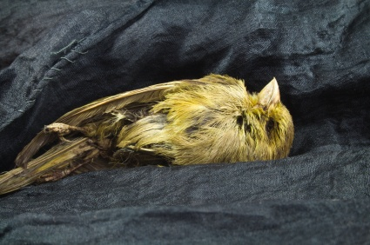
Role of Hedge Funds in the GFC
Bear Stearns

Slide 7
Financial Risk

Slide 8
Financial Risk

Slide 9
Hedge funds reduce financial risk
“In terms of investments in hedge funds, if we look at the pension market, we agree that pension funds should be investing in common equities. I think the reality is that common equities in most cases may be more risky than the overall hedge fund market”
George Hall
Managed Fund Association
Testimony before the U.S. House Committee on Financial Services
March 13, 2007

Slide 10
Hedge fund failures
January 2008-May 2009
Style Category | Number of non reporting funds | Percent of style category (Dec 2007)
Convertible Arbitrage | 57 | 31%
Dedicated Short Bias | 12 | 32%
Emerging Markets | 77 | 16%
Equity Market Neutral | 121 | 24%
Event Driven | 149 | 25%
Fixed Income Arbitrage | 102 | 28%
Fund of Funds | 700 | 22%
Global Macro | 81 | 19%
Long/Short Equity Hedge | 549 | 20%
Managed Futures | 69 | 10%
Multi-Strategy | 275 | 30%
Total | 2192 | 21%
Source: Lipper TASS

Slide 11
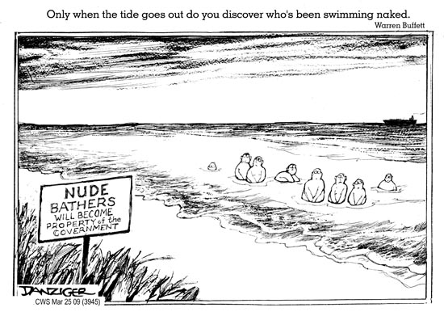
What went wrong?

Slide 12
Definition of operational risk
“the risk of direct or indirect loss resulting from inadequate or failed internal processes, people and systems or from external events” and is to be distinguished from market risk or reputation risk
Basel Committee on Banking Supervision 2001

Slide 13
Measuring Operational Risk
Multidimensional characteristic
Separating out operational and market risk
Absence of reliable data
importance of hedge fund application

Slide 14
Available Data
2006 mandatory disclosure by US hedge funds
    No information on strategies or positions
    Motivated to provide operational risk data
    Full census of funds with >$25M assets
    Limits to scope of and access to data
444 operational due diligence private reports
    Rich source of operational characteristics
    Limited sample of funds
    Need to control for sample selection issues

Slide 15
Measuring failed processes, people and systems
Incidence of legal and regulatory problems
  Documented in mandatory disclosures
Correlates of fund failure
  Documented in prior research findings
Out of sample validation
  Operational risk exposure diminished future returns

Slide 16
Analysis of 2006 Form ADV
Factors associated with operational risk
    External conflicts of interest
    Internal conflicts of interest

Slide 17
External conflicts are associated with legal and regulatory issues
 | Problem funds |  | Non problem funds
With: | N | % Yes | N | % Yes
Broker/Dealer | 359 | 73.1 | 1912 | 23.7
Investment Comp | 359 | 50.3 | 1912 | 15.8
Investment Advisor | 359 | 73.9 | 1912 | 41.6
Commodities Broker | 359 | 53.5 | 1912 | 20.3
Bank | 359 | 40.5 | 1912 | 9.8
Insurance | 359 | 39.8 | 1912 | 9.4
Sponsor of LLP | 359 | 56.8 | 1912 | 21.5
17
Notes:
17

Slide 18
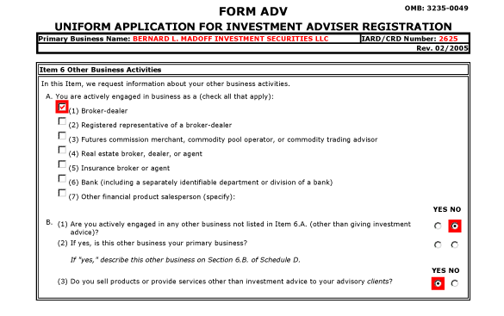
External conflicts: An example
Bernard L. Madoff Investment Securities

Slide 19
External Conflicts: Another example Fairfield Greenwich Group
Style Category | Number of non reporting funds | Percent of style category (Dec 2007)
Convertible Arbitrage | 57 | 31%
Dedicated Short Bias | 12 | 32%
Emerging Markets | 77 | 16%
Equity Market Neutral | 121 | 24%
Event Driven | 149 | 25%
Fixed Income Arbitrage | 102 | 28%
Fund of Funds | 700 | 22%
Global Macro | 81 | 19%
Long/Short Equity Hedge | 549 | 20%
Managed Futures | 69 | 10%
Multi-Strategy | 275 | 30%
Total | 2192 | 21%
Source: Lipper TASS

Slide 20
Problem funds have a more concentrated ownership structure ...
 | Problem Funds |  | Non-Problem funds
 | Mean | Median | Mean | Median
Direct Owners | 9.96 | 9.00 | 7.33 | 6.00
Controlling | 8.28 | 7.00 | 5.97 | 5.00
Percent 75% | 0.73 | 1.00 | 0.50 | 0.50
Personal Capital ($mm) | 1.26 | 0.00 | 2.62 | 0.00
Notes:
Problem funds have a higher number of direct and controlling owners.
problem firms are more likely to be structured as a venture or partnership with another institution.
percentage of owners that own 75% of the company, is larger for problem funds.

Slide 21
... and less access to leverage
All funds | Problem | Non problem | Diff
Leverage | 0.51 | 0.57 | -0.06**
Avg. Leverage | 52.20 | 85.31 | -33.11***
Max Leverage | 96.82 | 140.68 | -43.86***

Slide 22
Analysis of 2006 Form ADV
Factors associated with operational risk
    External conflicts of interest
    Internal conflicts of interest
Sophisticated investors already understand operational risk prior to 2006 disclosure
    Problem funds have concentrated ownership
    Problem funds have difficulty borrowing money
    But does not mediate the naive tendency to chase past returns
Operational risk
    Leads to lower returns
    Better predictor of failure than is financial risk

Slide 23
How do sophisticated investors become informed?
PWG (2007) on hedge fund issues:
    Fiduciaries have primary responsibility for due diligence
But hedge funds are non transparent
    Not registered with the SEC
    Ban on general solicitation
    Opaque trading strategies
“Trust me”
Important role of hedge fund consultants

Slide 24
A simple formula
Operational due diligence for Funds of Hedge Funds:
Brown, Stephen J., Gregoriou, Greg N. and Pascalau, Razvan C., Diversification in Funds of Hedge Funds: Is it Possible to Overdiversify? Review of Asset Pricing Studies 2011 (forthcoming)

Slide 25
How many FOFs pass the test?
Number of funds | N | Average | t-value
2 | 44 | 32% | -9.71
3 – 4 | 18 | 6% | -17.49
5 – 6 | 102 | 17% | -22.58
7 – 8 | 42 | 24% | -11.59
9 – 10 | 71 | 30% | -13
11 – 12 | 68 | 10% | -24.34
13 – 14 | 52 | 13% | -18.28
15 – 16 | 95 | 13% | -25.63
17 – 18 | 65 | 18% | -16.94
19 – 20 | 96 | 15% | -23.71
21 – 25 | 161 | 19% | -26.51
26 – 30 | 158 | 22% | -23.56
31 – 40 | 124 | 20% | -22.16
41 – 50 | 74 | 24% | -15.17
51 – 409 | 75 | 23% | -16

Slide 26
Significant nondiversifiable hedge fund tail risk for FOFs

Slide 27
Data
Data provided by HedgeFundDueDiligence.com
444 due diligence reports (100-200 pages)
    403 distinct advisors, 2003-2008
Data from
    Offering document and marketing materials
    On site interviews with the manager
    Questionnaire completed by the manager
    Verification of facts with administrator
    Check authenticity of audit with auditor
    Background check on management and key staff
Supplement data with TASS/CISDM

Slide 28
Operational characteristics
Pricing | Priced completely externally = 1, mixed or internal = 0
Signature: bank | # of signatures required to move money from bank
Signature: prime broker | # of signatures required to move money from prime broker
Signature: IQ | 1 if signature controls are institutional quality, zero otherwise
Big4Auditor | 1 if fund’s auditor is a big 4 auditor, zero otherwise
Money Restrictions | 1 if restrictions on where money can be sent from Bank/PB
Transparency | no position transparency=0, partial=1, full=2
NAV restate | 1 if fund has restated NAV in the past
Staff departure | # of persons that have departed the fund
% of board Ind. | % of board members that are independent

Slide 29
Verification problems
 | N | Mean | Std dev
Signature Disagreement | 443 | 16.03% | 36. 73%
Pricing Disagreement | 443 | 3.60% | 18.68%
Bad Recall | 443 | 20.99% | 40.77%
Assets Disagree | 443 | 10.38% | 30.54%
Performance Disagree | 442 | 4.52% | 20.81%
Switched Vendor | 443 | 11.51% | 31.95%
Refused DD question | 443 | 14.00% | 34.73%
Can't Verify Assets | 443 | 8.13% | 27.35%
Can't Verify Performance | 443 | 9.03% | 28.69%

Slide 30
Truth telling problems
 | N | Mean | Std dev
Strategic Misstatements | 443 | 6.32% | 24.36%
Misstatements | 443 | 9.26% | 29.01%
Truth teller | 443 | 23.48% | 42.43%
Regulatory Misstatement | 443 | 6.32% | 24.36%
Lawsuit Misstatement | 443 | 17.38% | 37.94%
Legal Misstatement | 443 | 2.26% | 14.87%
Background Misstatement | 443 | 5.87% | 23.53%

Slide 31
Differences between problem and non problem funds
 | Non-Problem Funds |  |  | Problem Funds
 | N | Mean |  | N | Mean
Fund Properties
Redemption period (days) | 260 | 64.41 |  | 181 | 83.51 | *
Lockup period (days) | 260 | 76.77 |  | 181 | 126.08 | *
AUM (Millions of $) | 260 | 282.12 |  | 181 | 522.11 | *
Operations
External Pricing | 260 | 0.72 |  | 183 | 0.54 | **
Big 4 Auditor | 260 | 0.70 |  | 183 | 0.52 | **
Background Issues
Misrepresentation | 260 | 0.10 |  | 183 | 0.38 | **
Noted Verification Problem | 260 | 0.34 |  | 183 | 0.54 | **
Switched Vendor | 260 | 0.07 |  | 183 | 0.18 | **
Independent Administrator | 259 | 0.93 |  | 183 | 0.83 | **
*Significant at 5% ** Significant at 1% | Only significant differences noted

Slide 32
Canonical Correlation Analysis
Correlates of failure
DD variates
Obtain consistent estimator of unconditional covariance matrix
  Multivariate extension of Heckman’s procedure
Find linear combination that maximizes correlation with failure
Construct univariate measure (ω-score) from DD variates

Slide 33
Canonical Correlation Analysis
TASS/CISDM Variables |  |  | DD Variables
Previous Returns | -0.02 |  | Misstatements | 0.56 | **
Previous Std. Dev. | -0.25 | ** | SignIQ | -0.15 | **
1st Order Autocorrel. | -0.70 | ** | Big4Auditor | -0.68 | **
Fund Age | -0.28 | ** | Pricing | -0.48 | **
Log of Assets | -0.24 | ** | Internal Accounting | 0.18 | **
Management Fee | -0.12 | ** | Misstatements*SignIQ | 0.32 | **
Incentive Fee | -0.05 |  | Misstatements*Big4Auditor | 0.22 | **
Leverage | -0.59 | ** | Misstatements*Pricing | 0.09
Lockup | 0.14 | ** | Misstatements*Internal Accounting | 0.75 | **
Advance Notice | 0.12 | *
Correlation Between
TASS and DD Panels | 0.47 | **

Slide 34
Operational risk predicts low market-adjusted returns
 |  | Model 1 |  |  | Model 2 |  |  | Model 3
 |  | coeff. | t-stat |  | coeff. | t-stat |  | coeff. | t-stat
 | Intercept | -1.761 | -3.57 | ** | -1.872 | -4.19 | ** | -0.803 | -2.47 | *
 | Omega | -0.256 | -2.68 | ** | -0.249 | -2.52 | * | -0.263 | -2.53 | *
 | Prior Std. Dev. | -0.444 | -3.65 | ** | -0.487 | -4.51 | ** | -0.486 | -4.51 | **
 | Omega* Std. Dev. | -0.064 | -2.66 | ** | -0.063 | -2.58 | * | -0.066 | -2.59 | **
 | Log(assets) |  |  |  |  |  |  | -0.061 | -2.97 | **
 | Fund age |  |  |  |  |  |  | -0.003 | -0.47
 | Lambda | 0.073 | 2.86 | ** | 0.074 | 2.84 | ** | 0.090 | 3.90 | **
 | Style controls | No |  |  | Yes |  |  | Yes
 | Adj. R-squared | 0.30 |  |  | 0.31 |  |  | 0.31
 | Num Obs. | 320 |  |  | 320 |  |  | 320

Slide 35
… and death of funds
 |  | Model 1 |  |  | Model 2
 |  | Coeff. | t-stat |  | Coeff. | t-stat
 | Intercept | -2.927 | -4.70 | ** | -3.268 | -4.88 | **
 | High Operational Risk | 2.261 | 2.47 | * | 2.385 | 2.56 | *
 | Std. Dev. | -0.434 | -2.60 | ** | -0.543 | -2.80 | **
 | High Op. Risk*Std. Dev | 0.711 | 2.83 | ** | 0.757 | 2.94 | **
 | Style controls | No |  |  | Yes
 | McFadden Pseudo R² | 0.018 |  |  | 0.032
 | Num Obs. | 631 |  |  | 631
 | Percent Dead | 18% |  |  | 18%

Slide 36
… but does not mediate flows
 |  | Model 1 |  |  | Model 2
 |  | Coeff | t-stat |  | Coeff | t-stat
 | Intercept | 3.998 | 1.96 | * | 4.122 | 1.93
 | Low Rank Prior Return | 4.055 | 0.95 |  | 4.255 | 1.39
 | Mid Rank Prior Return | -0.943 | -0.30 |  | -1.031 | -0.46
 | High Rank Prior Return | 3.477 | 2.71 | ** | 3.084 | 2.66 | **
 | Omega | -0.021 | -0.78 |  | 0.006 | 0.03
 | Log(assets) | -0.363 | -2.66 | ** | -0.368 | -2.79 | **
 | Prior Std. Dev. | -0.386 | -6.43 | ** | -0.378 | -5.77 | **
 | Low Rank*omega |  |  |  | -0.019 | -0.02
 | Mid Rank*omega |  |  |  | -0.002 | -0.01
 | High Rank*omega |  |  |  | -0.203 | -1.02
 | Lambda | 0.298 | 3.29 | ** | 0.298 | 3.68 | **
 | Adjusted R-squared | 0.13 |  |  | 0.12
 | Num Obs. | 250 |  |  | 250

Slide 37
Conclusion
Despite fundamental importance of integrity in delegated asset management business
  Incomplete disclosure is common among hedge funds
  Significant operational risk from conflicts and other factors
  Possible to derive a simple quantitative measure of this risk
  Operational due diligence is a source of alpha
  Sophisticated investors understand the importance of this risk
Unsophisticated investors simply chase past high returns!
Notes:
37

