Slide 1
Sharpe Ratio under Long-Range Dependent and Heavy-Tailed Log-Returns Obeying AR-GARCH Process: Theory and Empirical Evidence
Lie-Jane Kao
Heriot-Watt University Malaysia
Cheng-Few Lee
Rutgers University, NJ, USA
National Chiao-Tung University

Slide 2
Part I.
Limiting Distribution of Estimated Sharpe Ratio
when Log-returns are i.i.d. or Strictly-Stationary
with Finite 4th Moment

Slide 3
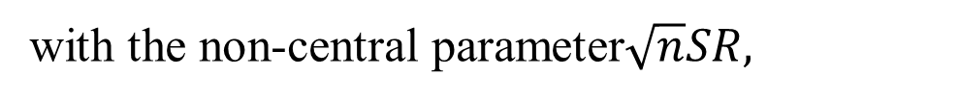
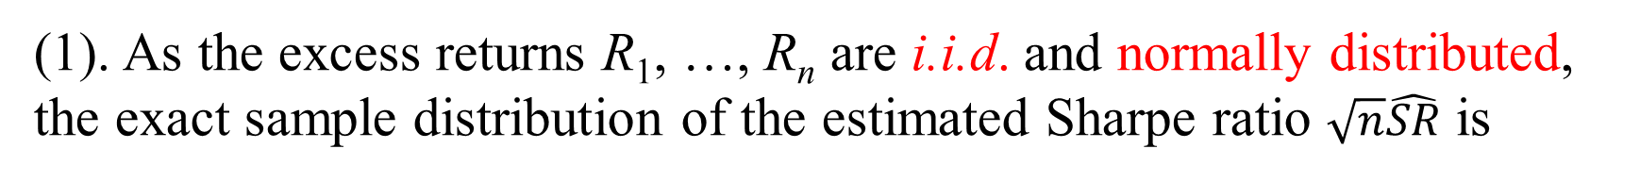
(1). As the excess returns R₁, …, R_{n} are i.i.d. and normally distributed,
the exact sample distribution of the estimated Sharpe ratio $\sqrt{n}\hat{SR}$ is
Non-central t-distributed with (n-1) d.f.
with the non-central parameter$\sqrt{n}SR,$
SR is the ex-ante Sharpe ratio.
Lee, C.F., and Chen, S.N. (1979). Sampling properties of composite performance measures and their implications, Faculty Working Papers 541, The University of Illinois at Urbana-Champaign.
Chen, S.N., and Lee, C.F. (1981). The sampling relationship between Sharpe’s performance measure and its risk proxy: sample size, investment horizon, and market condition, Management Science, 27, 6, 607-618.

Slide 4
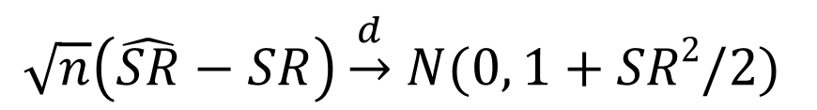
(2). As the excess returns R₁, …, R_{n} are i.i.d. and non-normally distributed,
the limiting distribution
$\sqrt{n}\left(\hat{SR}−SR\right)\underset{→}{d}$ $N(0, 1+SR2/2)$
Jobson, J.D. and Korkie, B.M. (1981) Performance hypothesis testing with Sharpe and Treynor measures, The Journal of Finance, 36, 4, 889-908.
Lo, A. W. (2002) The statistics of Sharpe ratios, Financial Analysts Journal, 36-47.

Slide 5
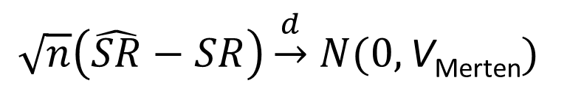
(3). As the excess returns R₁, …, R_{n} are i.i.d. and non-normally distributed,
the limiting distribution
$\sqrt{n}\left(\hat{SR}−SR\right)\underset{→}{d}$ $N(0,\text{V}\text{Merten})$
where
V_{Merten} =
γ₃ and γ₄ are the skewness and kurtosis of the excess return R_{t}, 1≤t≤n,
Merten, E. (2002). Comments on the correct variance of estimated Sharpe Ratios in Lo (2002, FAJ) when returns are iid. Research Note (www.elmarmertens.org).

Slide 6
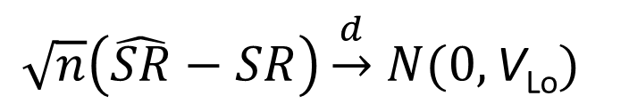
(4). As the excess returns R₁, …, R_{n} are strictly stationary and ergodic,
the limiting distribution
$\sqrt{n}\left(\hat{SR}−SR\right)\underset{→}{d}$ $N(0,\text{V}\text{Lo})$
where V_{Lo} is derived using the GMM technique.
Lo, A. W. (2002) The statistics of Sharpe ratios, Financial Analysts Journal, 36-47.

Slide 7
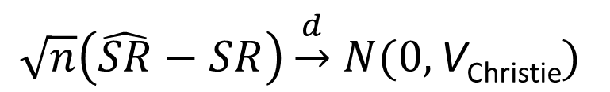
(5). As the excess returns R₁, …, R_{n} are strictly stationary and ergodic,
the limiting distribution
$\sqrt{n}\left(\hat{SR}−SR\right)\underset{→}{d}$ $N(0,\text{V}\text{Christie})$
where
V_{Christie} =
γ₃ and γ₄ are the skewness and kurtosis of the excess return R_{t}, 1≤t≤n,
Christie, S. (2005). Is the Sharpe ratio useful in asset allocation? MAFC Research Paper No. 31, Applied Finance Center, Macquarie University.
Opdyke, J.D. (2007). Comparing Sharpe ratio: So where are the p-values? Journal of Asset Management 8, 5, 208-336.

Slide 8
Part II.
Limiting Distribution of Estimated Sharpe Ratio when
Log-returns follow AR(1)-GARCH (1,1) Model

Slide 9
AR(1)-GARCH (1,1) Model
Let R_{t} be the log-return, 1≤t≤n, and r_{t}=R_{t}-μ be the centered log-return,
r_{t}=ρr_{t-1}+X_{t} (1)
the innovation term
X_{t}=
(2)
the conditional variance
h_{t}=α₀+h_{t-1}A_{t}
where
(3)
A_{t}=
+β₂

Slide 10
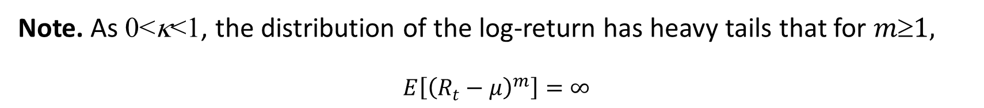
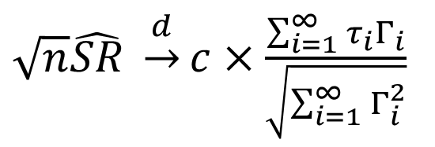
Lemma 1. For the AR(1)-GARCH (1,1) model (1)-(3), if Assumptions 1-3 are satisfied and the tail index 0<κ<1, the limiting distribution of the scaled estimated Sharpe ratio
$\sqrt{n}\hat{SR} \underset{→}{d}c×\frac{\sum_{i=1}^{∞}{{τ_{i}Γ}_{i}}}{\sqrt{\sum_{i=1}^{∞}{Γ_{i}^{2}}}}$
c is a positive constant depending on the local dependency of log-returns {r_{t}, t≥1}.
Note. As 0<κ<1, the distribution of the log-return has heavy tails that for $m1,$
$$E\left[{\left(R_{t}−μ\right)}^{m}\right]=∞$$

Slide 11
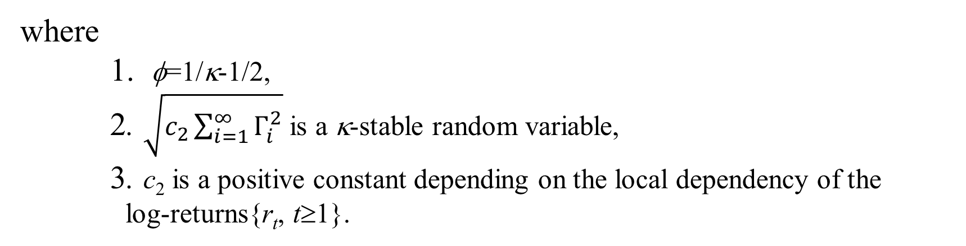
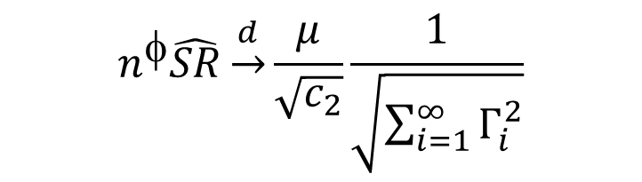
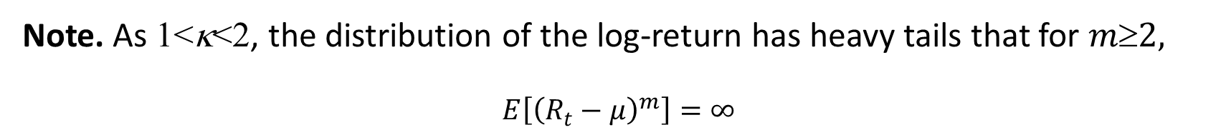
Lemma 2. Under the conditions of Lemma 1, if the tail index satisfies 1<κ<2, the limiting distribution of the scaled estimated Sharpe ratio
$$n^{φ}\hat{SR}\underset{→}{d}\frac{μ}{\sqrt{c_{2}}}\frac{1}{\sqrt{\sum_{i=1}^{∞}{Γ_{i}^{2}}}}$$
where
1. φ=1/κ-1/2,
2. $\sqrt{c_{2}\sum_{i=1}^{∞}{Γ_{i}^{2}}}$ is a κ-stable random variable,
3. c₂ is a positive constant depending on the local dependency of the
log-returns{r_{t}, t≥1}.
Note. As 1<κ<2, the distribution of the log-return has heavy tails that for $m2,$
$$E\left[{\left(R_{t}−μ\right)}^{m}\right]=∞$$

Slide 12
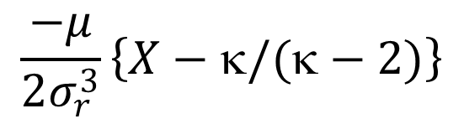
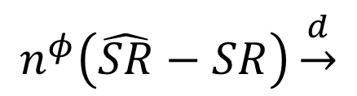
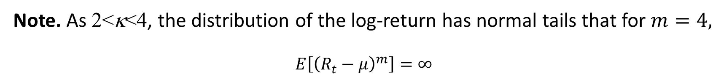
Lemma 3. Under the conditions of Lemma 1, if the tail index satisfies 2<κ<4, then the limiting distribution of the scaled estimated Sharpe ratio
$$n^{φ}\left(\hat{SR}−SR\right)\underset{→}{d}$$
$$\frac{−μ}{2σ_{r}^{3}}\left\{X−κ/(κ−2)\right\}$$
where φ=1-2/κ, $σ_{r}^{2}$=Var(r_{t}), and X is a κ/2-stable random variable.
Note. As 2<κ<4, the distribution of the log-return has normal tails that for $m=4,$
$$E\left[{\left(R_{t}−μ\right)}^{m}\right]=∞$$

Slide 13
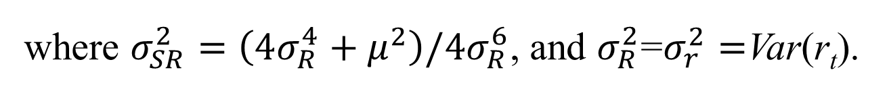
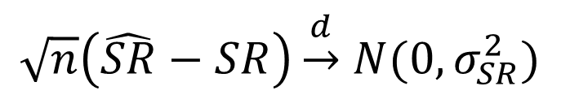
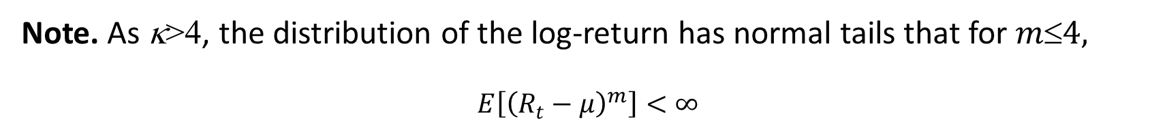
Lemma 4. Under the conditions of Lemma 1, if the tail index κ>4, then the limiting distribution of the scaled estimated Sharpe ratio
$\sqrt{n}\left(\hat{SR}−SR\right)\underset{→}{d}$ $N(0,σ_{SR}^{2})$
where $σ_{SR}^{2}=\left(4σ_{R}^{4}+μ^{2}\right)/4σ_{R}^{6}$, and $σ_{R}^{2}$=$σ_{r}^{2}=$Var(r_{t}).
Note. As κ>4, the distribution of the log-return has normal tails that for $m4,$
$$E\left[{\left(R_{t}−μ\right)}^{m}\right]<∞$$

Slide 14
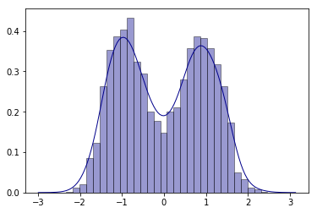
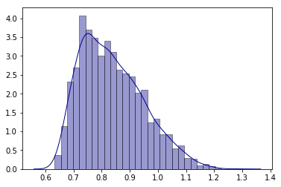
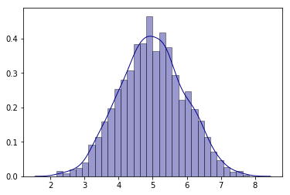


Limiting Distribution of Lemmas 1-4
Lemma 1. the tail index 0<κ<1, convergent rate $\sqrt{n}$
Lemma 2. the tail index 1<κ<2, convergent rate $n^{1/−0.5}$
Lemma 3. the tail index 2<κ<4, convergent rate $n^{1−2/}$
Lemma 4. the tail index 2<κ<4, convergent rate$\sqrt{n}$

Slide 15
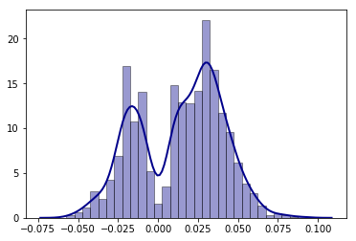
Empirical Study
Momentum portfolio from K.R. French’s database, constructed from six value-weight portfolios formed using independent sorts on size and prior return of NYSE, AMEX, and NASDAQ stocks.
Daily returns from Jan 03, 2000 to March 29, 2019 for a time horizon T= 4840
the tail index κ=1.257

Slide 16
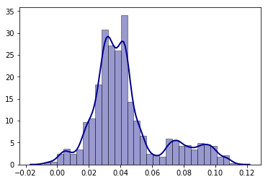
Empirical Study
Short-Reversal portfolio from K.R. French’s database, constructed from six value-weight portfolios formed using independent sorts on size and prior return of NYSE, AMEX, and NASDAQ stocks.
Daily returns from Jan 03, 2000 to March 29, 2019 for a time horizon T= 4840
the tail index κ=1.807

