Slide 1

Basel III - The new Capital Rules

Slide 2
Basel III: towards a safer financial system
- the BIS, at the 3rd Santander International Banking Conference, Madrid, 15 September 2010.
Basel III
a strengthening of global capital standards.
the introduction of global liquidity standards
a "macroprudential overlay" to better deal with systemic risk.
Notes:
巴塞爾三：邁向一個更安全的金融體系
卡魯阿納海梅先生致辭，國際清算銀行總經理，桑坦德舉行的第三屆國際銀行會議，馬德里，2010年9月15日。
摘要
巴塞爾是一個從根本上加強三 - 在某些情況下，大刀闊斧地改革 - 全球資本標準。 再加上引進的全球流動性標準，新的資本金標準兌現為核心的全球金融改革議程，將提交給 20國集團領導人峰會漢城十一月。
實施巴塞爾 III將大大增加銀行的質量資本及所要求的水平顯著提高其資本。 此外，它會提供一個“宏觀審慎覆蓋”，以更好地應對系統性風險。最後，新方案將允許有足夠的時間為順利過渡到新的制度

Slide 3
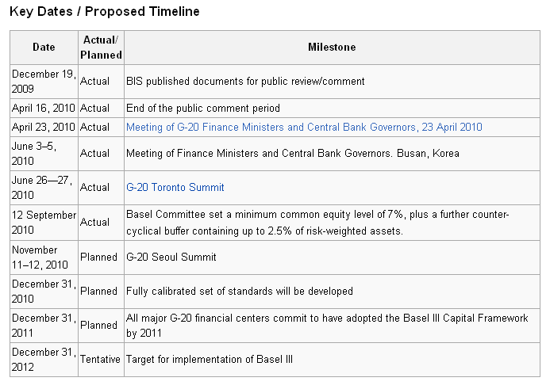
Notes:
重要日期/擬議的時間表
日期實際 /
計劃里程碑2009年12月19日實際國際清算銀行公佈的文件，供公眾查看/發表評論2010年4月16號實際結束公眾評議期2010年4月23日實際會議的20國集團財長和央行行長，2010年4月23日6月3-5日，2010實際會議的財政部長和中央銀行行長。 韓國釜山6月26-27日，2010實際20國集團首腦會議的多倫多2010年9月12號實際巴塞爾委員會規定的最低水平，普通股7％，另加反週期緩衝含有高達2.5％的風險加權資產。^{[11]}11月11-12日，2010計劃20國集團首腦會議漢城2010年12月31日計劃充分校準設置標準將制定2011年12月31日計劃所有主要的20國集團承諾的金融中心已通過了巴塞爾資本協議框架，到2011年第三2012年12月31日暫定目標，為實施巴塞爾三

Slide 4
5 Changes Proposed in Basel III
1. Strengthen the capital requirements for counterparty credit exposures arising from banks’ derivatives, repo and securities financing transactions
2. introduce a leverage ratio as a supplementary measure to the Basel II risk-based framework.
Notes:
其次，風險資本框架的覆蓋面將得到加強。加強資本要求交易對手 信貸風險產生的銀行衍生品，回購和 證券融資 交易
//
提高資本緩衝支持這些風險
減少 週期性 和
提供額外獎勵移動 場外衍生工具合約 向中央結算對手（可能 結算公司）
提供誘因，加強 風險管理 交易對手信貸風險

Slide 5
5 Changes Proposed in Basel III
3. introducing a series of measures to promote the build up of Capital Buffers in good times that can be drawn upon in periods of stress ("Reducing procyclicality and promoting countercyclical buffers").
Notes:
第四，委員會推出了一系列措施，促進建立良好的資本緩衝時間，可動用的時期應力（“減少週期性，促進反週期緩衝”）。該委員會提出了一系列措施，以解決週期性：
任何多餘的週期性浸濕的最低資本要求;
促進更前瞻性的規定;
保存資金，建立緩衝區在個別銀行和銀行界，可用於壓力;及

Slide 6
5 Changes Proposed in Basel III
4. introducing a global Minimum Liquidity Standard for internationally active banks that includes a 30-day liquidity coverage ratio (LCR) requirement underpinned by a longer-term structural liquidity ratio.
Notes:
第五，委員會將推出一個全球性的最低流動性標準對國際活躍銀行，其中包括一個 30天的流動資金需求支撐覆蓋率由一個較長期的結構性流動性比率。
//該委員會還正在審查是否需要額外的資金，流動性或其他監管措施，以減少 外部 創建的 具有系統重要性的 機構。

Slide 7
5 Changes Proposed in Basel III
5. the quality, consistency, and transparency of the capital base will be raised.
  Tier 1 capital: the predominant form of Tier 1 capital must be common shares and retained earnings
  Tier 2 capital instruments will be harmonised
  Tier 3 capital will be eliminated

Slide 8
Better capital quality
the definition of common equity – also called “core capital” – is now stricter. Under the present system, certain types of assets of questionable quality are already deducted from the capital base. Under Basel III, these deductions will be more stringent.
the new standards for common equity are significantly tougher than the old standards for Tier 1 capital in total.
Meanwhile, various dubious things which currently count as Tier 1 or Tier 2 capital but shouldn’t will be phased out even more slowly, over a period of 10 years beginning in 2013.
Notes:
普通股本-也叫的「核心資本」的定義-現在是更加嚴密的。 根據當前系統，可疑的質量財產的某些类型從资本基础已經被扣除。 在巴塞爾III之下，這些扣除將是更加嚴密的。
普通股本的新的標準比第1層資本的老標準显着堅韌总共。
同時，當前算作是第1層或第2層資本，但是的各種各樣的半信半疑的事不應該在10年中慢慢地將被逐步淘汰，在2013年的開始。

Slide 9
Some of the new rules:
BASEL II:
Tier 1 capital ratio = 4%
Core Tier 1 capital ratio = 2%
The difference between the total capital requirement of 8.0% and the Tier 1 requirement can be met with Tier 2 capital.
BASEL III:
Tier 1 Capital Ratio = 6%
Core Tier 1 Capital Ratio (Common Equity after deductions) = 4.5%
Core Tier 1 Capital Ratio (Common Equity after deductions) before 2013 = 2%, 1st January 2013 = 3.5%, 1st January 2014 = 4%, 1st January 2015 = 4.5%
The difference between the total capital requirement of 8.0% and the Tier 1 requirement can be met with Tier 2 capital.
Notes:
答：第一類資本
一覽表。 巴塞爾二：
第一級資本比率= 4％
核心第一級資本比率= 2％
總額之間的差額資本要求的8.0％和1級的要求可以得到滿足與第二類資本。
A2的。 巴塞爾三：
第一級資本比率= 6％
核心第一級資本比率（普通股權益扣減後）= 4.5％
核心第一級資本比率（普通股權益扣減後）= 2％在2013年之前，2013年1月1日= 3.5％，2014年1月1日= 4％，2015年1月1日= 4.5％
總額之間的差額資本要求的8.0％和1級的要求可以得到滿足與第二類資本。

Slide 11
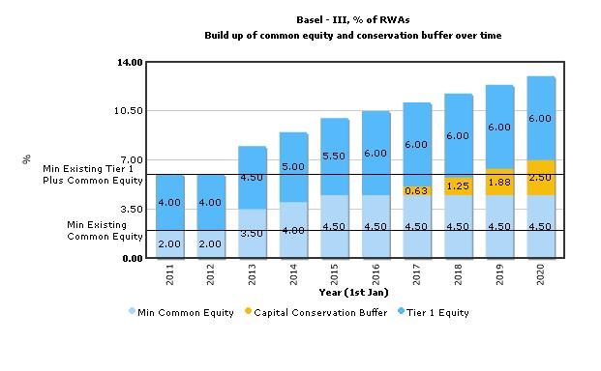

Slide 12
Macroprudential regulation
One important goal of Basel III is to provide a macroprudential regulation to tackle systemic risks.
The intention is to mitigate pro-cyclicality and credit constraints which result from regulatory capital requirements.
Remedies: 1. capital conservation buffer
2. capital counter-cyclicality buffer
3. capital systemic buffer for SIFIs
Notes:
This would, for instance, reduce the risk that available credit could be constrained by regulatory capital requirements. The intention is thus to mitigate procyclicality and attenuate the impact of the ups and downs of the financial cycle. Promptly releasing the buffer in times of stress can help to reduce the risk of the supply of credit being constrained by regulatory capital requirements.

Slide 13
Conservation buffer
Banks also be required to hold a capital conservation buffer of 2.5% of common equity (bringing the total common equity requirements to 7%) to withstand future periods of stress.
During periods of stress and banks are forced to write down lots of bad loans, they are allowed to use the buffer — but that will bring extra regulatory oversight (constraints on earnings distributions).

Slide 14
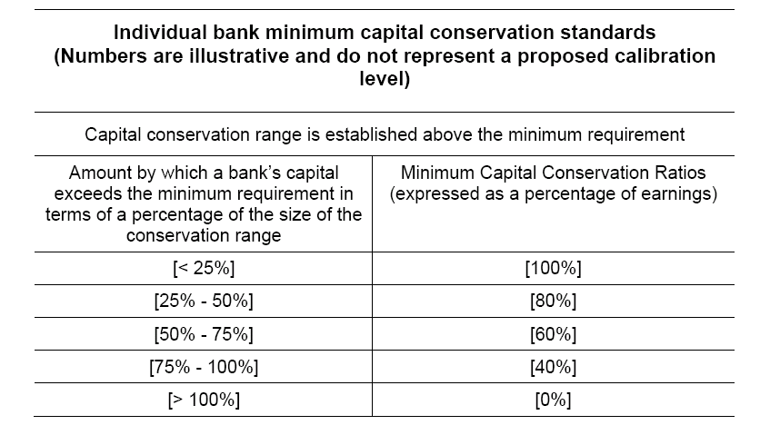
Conservation buffer
the capital conservation buffer operates using discrete bands:

Slide 15
Countercyclical buffer
The countercyclical capital buffer has been calibrated within a range of 0–2.5%.
That countercyclical buffer won’t be set by the BIS in Basel; it’ll be left up to national regulators.
During periods of rapid aggregate credit growth, the countercyclical buffer would build up, then in the downturn of the cycle , it could be released.
Notes:
This would, for instance, reduce the risk that available credit could be constrained by regulatory capital requirements. The intention is thus to mitigate procyclicality and attenuate the impact of the ups and downs of the financial cycle. Promptly releasing the buffer in times of stress can help to reduce the risk of the supply of credit being constrained by regulatory capital requirements.

Slide 16
Countercyclical buffer
The idea of countercyclical capital buffers is that : when credit is expanding faster than GDP, bank regulators slowly increase their capital requirements.
Therefore, the credit-to-GDP ratio was selected to be the indicator variable.
Notes:
Implementing the countercyclical capital buffer add-on
This means that the countercyclical capital buffer is presented as an add-on to the capital conservation buffer, effectively stretching the size of its range.
The higher capital requirements serve three main purposes: they help to slow down credit bubbles, they make an economy’s banks stronger, and they offer a way out of the paradox of capital.
credit/GDP guide should be considered as a useful starting reference point that authorities should take into account in formulating and explaining buffer decisions.

Slide 17
Step-by-step to calculate the jurisdiction specific buffer
Step 1: calculating the credit-to-GDP ratio
The credit-to-GDP ratio in period t for each country is calculated as:
RATIOt = CREDITt / GDPt Х 100%
Where GDPt is domestic GDP and CREDITt is a broad measure of credit to the private, non-financial sector in period t.

Slide 18
Step-by-step to calculate the jurisdiction specific buffer
Step 2: calculating the credit-to-GDP gap
The credit-to-GDP ratio is compared to its long term trend:
GAPt =RATIOt – TRENDt.
Where TREND is a approximation of sustainable average ratio of credit-to-GDP based on the historical experience.
If the credit-to-GDP ratio is significantly above its trend, then this indicated that credit may have grown to excessive levels relative to GDP.

Slide 19
Step-by-step to calculate the jurisdiction specific buffer
Step 3: transforming the credit-to-GDP gap into the buffer
As a example: Setting the lower thresholds L=2 and upper H=10, then when:
((CREDITt / GDPt ) Х 100% ) – (TRENDt) < 2%
→ counter-cyclicality buffer is zero
((CREDITt / GDPt ) Х 100% ) – (TRENDt) > 10%
→counter-cyclicality buffer is at its max (2.5%)
Notes:
When the credit-to-GDP ratio is 2 percentage points or less above its long term trend, the buffer add-on (VBt) will be 0%. When the credit-to-GDP ratio exceeds its long term trend by 10 percentage points or more, the buffer add-on will be 2% of risk weighted assets. When the credit-to-GDP ratio is between 2 and 10 percentage points of its trend, the buffer add-on will vary linearly between 0% and 2%.

Slide 20
Calculating bank specific buffer
For international bank, the buffer applied will reflect the geographic composition of the bank’s portfolio of credit exposures.
International bank calculate their countercyclical capital buffer as a weighted average of the buffer applied in jurisdictions.

Slide 21
Calculating bank specific buffer
Example : Assume that the published countercyclical buffer in the United Kingdom, Germany and Japan are 2%, 1% and 1.5% of risk weighted assets, respectively.
A bank with 60% of its credit exposures to UK counterparties, 25% to German and 15% to Japanese would be subject to an overall countercyclical capital buffer equal to 1.68% of risk weighted assets:

Slide 22
Countercyclical buffer
Buffer decisions would be pre-announced by 12 months to give banks time to meet the additional capital requirements before they take effect.
Reductions in the buffer would take effect immediately to help to reduce the risk of the supply of credit being constrained by regulatory capital requirements.
Notes:
The consequences of not meeting the countercyclical capital buffer will be the same as not meeting the capital conservation buffer (ie constraints on distributions of earnings).

Slide 23
Capital for Systemically Important Banks
Basel lll also consider the contribution each institution makes to the system as a whole, not just the riskiness on a standalone basis.
It has been agreed that these institutions should have loss-absorbing capacity beyond the common standards --- additional loss-absorbing capacity for systemically important financial institution (SIFIs) .
Work is still under way for addressing systemic risk.
Notes:
The new Basel III package encompasses specific macroprudential tools that national supervisory authorities can use to establish targeted capital requirements in order to deal with systemic risk both over time and across institutions. From this perspective, Basel III provides an anchor for the development of a fully fledged and strong macroprudential framework that takes account of these two dimensions of systemic risk.
Basel III will also allow for a better handling of the systemic risk due to the interlinkages and common exposures across individual institutions.. Under the Basel III framework,. Work is still under way to delineate the modalities for addressing systemic risk, but one possibility would be to allow national authorities to establish a systemic capital surcharge for SIFIs.

Slide 24
Total capital ratio required
Total Regulatory Capital Ratio
= [Tier 1 Capital Ratio]
+ [Capital Conservation Buffer]
+ [Countercyclical Capital Buffer]
+ [Capital for Systemically Important Banks]

Slide 25
Liquidity coverage ratio
Liquidity problem is serious in financial crisis.
The liquidity coverage ratio is used to promote banks’ short-term ability to potential liquidity disruptions.
It requires banks to hold a buffer of high-quality liquid assets sufficient to deal with the cash outflows encountered in an short-term stress.

Slide 26
Stable funding ratio
maturity mismatch is another important problem in financial crisis.
The minimum net stable funding ratio (NSFR) is intended to promote longer-term structural funding of banks’ balance sheets and to provide incentives for banks to use stable sources to fund their activities.
Notes:
As first announced in July 2010, the NSFR released as part of the December 2009 Basel III proposal is in the process of being revised, and a new NSFR proposal is expected by year-end 2010. The revised NSFR is not scheduled to take effect as a minimum standard until 2018.

Slide 27
Possible Effects—to Taiwan
Currently, Taiwan’s domestic banks have an average 8.9% of Tier 1 capital, so the 6% set by Basel is not a problem.
However, the common equity is about 3.8%-3.9%.
To meet the Basel’s new standard of 4.5%, the banks have to raise their capital by more than NT$200 billion or US$6.25 billion.
Notes:
the Financial Supervisory Commission (FSC) suggests it should start in 2012 to reach the Basel goal by 2015.

Slide 28
Contingent capital securities
Contingent capital securities are a financial innovation occurring in response to the financial crisis of 2008. The issuance of such securities was recommended by the Squam Lake Report (2010) and mandated under Basel III.
Under the Basel III all non-common equity capital instruments must incorporate a mandatory write-down or conversion feature if issued by an internationally active bank. The most common type of these contingent capital instruments securities are long-term subordinated debt which consists the main portion of Tier 2 capital.
These Basel III- compliant subordinated debt are long-term debt obligations converting automatically to equity in times of financial stress for the issuing entity. Such securities are seen as providing avenues for automatic recapitalization in times of need.

Slide 29
Also known as CoCos, or “contingent convertible bonds”.
In November 2009, Lloyds Banking Group was the first to issue such a security. The Lloyds issued £7bn in enhanced capital notes (ECNs), and will convert to ordinary equity if the group’s core tier 1 capital ratio falls below 5 per cent."
After that many transactions have been done.
For examples, in mid-2010, Rabobank issued a contingent core note.
In mid-February 2012, Credit Suisse issued contingent capital notes with a Basel III conversion trigger as well as a second contingency conversion trigger linked to the bank's core capital ratio. UBS issued USD 2 billion of subordinated loss-absorbing non-dilutive notes in February, 2012. The notes, which will qualify as tier 2 capital under Basel III standards and have a maturity of 10 years. The UBS 10-year contingent capital securities, will be written off if UBS's common equity ratio falls below 5 percent or the bank faces a bailout, exemplified the loss absorbency requirement and contingent capital feature of the Basel III.

Slide 30
09-12-2012 The Commonwealth Bank of Australia (CBA) has launched an offering for perpetual, exchangeable, resalable, listed, subordinated ("PERLS VI") unsecured notes that are Basel III-compliant, and the funding goal is $750 million

Slide 31
Subdebt has become an important funding source for banks, especially for large ones. According to Basel Committee on Banking Supervision (2003), subdebt issuance has been widespread in the largest European countries, Japan, and the U.S. over 1990-2002. The report shows that the subdebt of banks is on average about 3.6% of risk-weighted assets (RWA, hereafter).
When considering only the 50 largest issuers, the average share of subdebt is 5.3% of RWA. It also shows that the vast majority of issues have an initial term to maturity of between 5 and 15 years with an average of 11.4 years. Pennacchi (2010) states that for the 20 largest domestic bank holding companies in the United States, subordinated debt was equal to 2.2% of total assets in June 2007.
Flannery (2009) reports that for the 14 traditional bank holding companies in the Supervisory Capital Assessment Program, the ratio of subordinated debentures to total risky assets was 4.89% on average at the end of 2008. The subdebt capital instruments are expected to grow under the Basel guideline.

