Slide 1
Chapter 9
Capital Asset Pricing Model and Beta Forecasting
By
Cheng Few Lee
Joseph Finnerty
John Lee
Alice C Lee
Donald Wort

Slide 2
Chapter Outline
9.1 A GRAPHICAL APPROACH TO THE DERIVATION OF THE CAPM
9.1.1 The Lending, Borrowing, and Market Portfolios
9.1.2 The Capital Market Line
9.1.3 The Security Market Line — The Capital Asset Pricing Model
9.2 MATHEMATICAL APPROACH TO THE DERIVATION OF THE CAPM
9.3 THE MARKET MODEL AND RISK DECOMPOSITION
9.3.1 The Market Model
9.3.2 Risk Decomposition
9.3.3 Why Beta is Important for Security Analysis
9.3.4 Determination of Systematic Risk

Slide 3
9.4 GROWTH RATES, ACCOUNTING BETAS, AND VARIANCE IN EBIT
9.4.1 Sustainable Growth Rates
9.4.2 Accounting Beta
9.4.3 Variance in EBIT
9.4.4 Capital–Labor Ratio
9.4.5 Fixed Costs and Variable Costs
9.4.6 Beta Forecasting
9.4.7 Market-Based versus Accounting-Based Beta Forecasting
9.5 SOME APPLICATIONS AND IMPLICATIONS OF THE CAPM
9.6 SUMMARY
APPENDIX 9A: EMPIRICAL EVIDENCE FOR THE RISK-RETURN RELATIONSHIP
9A.1 Anomalies in the Semi-Strong Efficient-Market Hypothesis

Slide 4
9.1 A Graphical approach to the Derivation of the CAPM
Capital asset pricing model (CAPM) is one of the most important financial theories.
Following the risk-return tradeoff principle and the portfolio diversification process, Sharpe (1964), Lintner (1965), and Mossin (1966) have developed an asset pricing model that can determine both the market price of a portfolio and the price of an individual security.
They focus upon the pricing determination of those parts of security risk that can be eliminated through diversification as well as those that cannot.
Systematic risk (market risk) is that part of total risk that results from the common variability of stock prices and the subsequent tendency of stock prices to move together with the general market.
Unsystematic risk is the other part of total risk, which is the result of variables peculiar to the firm or industry — for example, a labor strike or resource shortage.
Beta (β) is universally accepted notion for the measure of a stock’s or a portfolio’s relative sensitivity to the market based upon its past record.

Slide 5
9.1.1 The Lending, Borrowing, and Market Portfolios
An investor’s portfolio can be composed of different combinations of riskless and risky assets.
Figure 9.1 is a graph of different sets of portfolio opportunities; it includes the risk-free asset with a return of .
Since the riskless asset has zero risk, it is represented by a point on the vertical axis.
Lending portfolios is basically investors lending money to the government at the risk-free rate, when they invest in the risk-free asset.
At point the investor wants only risky assets and has put his wealth into the risky-asset portfolio, which is called the market portfolio.
At investors receive a rate of return and undertake risk

Slide 6
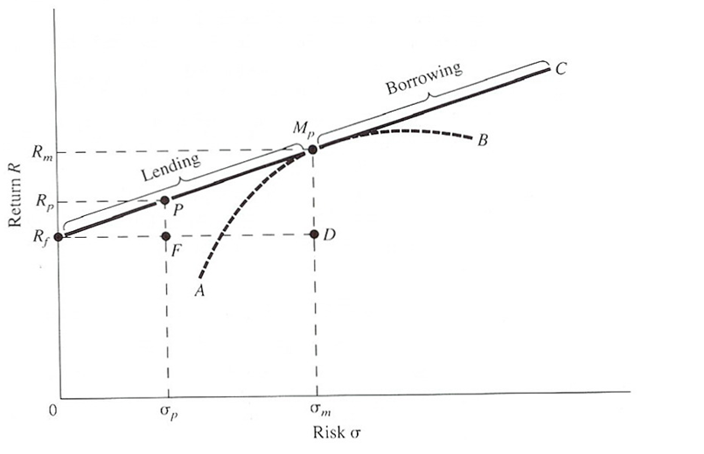
Mp: A portfolio of risky assets
Rf: the risk-free asset has zero risk, it is represented by a point on the vertical axis. Rf is proxied by a government security, such as the Treasury bill (T-bill).
→Total risk = Systematic risk + unsystematic risk

Slide 7
If it is assumed that the investor can borrow money at the risk-free rate and invest this money in the risky portfolio Mp, he will be able to derive portfolios with higher rates of return but with higher risks along the line extending beyond .
The portfolios along line are borrowing portfolios because they contain a negative amount of the risk-free asset.
The negative amount invested in the risk-free asset can be viewed as borrowing funds at the risk-free rate and investing in risky assets.
The borrowing for investment is called margin and is controlled by the government.
Therefore, the new efficient frontier becomes and is referred to as the capital market line (CML).
CML describes the relationship between expected return and total risk.

Slide 8
9.1.2 The Capital Market Line
The capital market line (CML) describes the relationship between expected return and total risk.
Where:
the risk-free rate;
return on market portfolio ;
return on the portfolio consisting of the risk-
free asset and portfolio ; and
the standard deviations of the portfolio and
the market, respectively.
Market risk premium is the difference between average return from market portfolio and riskless asset expected return times that difference.
(9.1)

Slide 9
At equilibrium all investors will want to hold a combination of the risk-free asset and the tangency portfolio, Mp.
Since the market is cleared at equilibrium－prices are such that the demand for all marketable assets equals their supply－the tangency portfolio Mp must represent the market portfolio.
An individual security’s proportional makeup (Xi) in the market portfolio will be the ratio of its market value (its equilibrium price times the total number of shares outstanding) to the total market value of all securities in the market, or:
The market portfolio is the only relevant portfolio of risky assets, the relevant risk measure of any individual security is its contribution to the risk of the market portfolio.
The beta coefficient relates the covariance between security and market to the market’s total variance, and it is the relevant market-risk measure.
Therefore, beta is

Slide 10
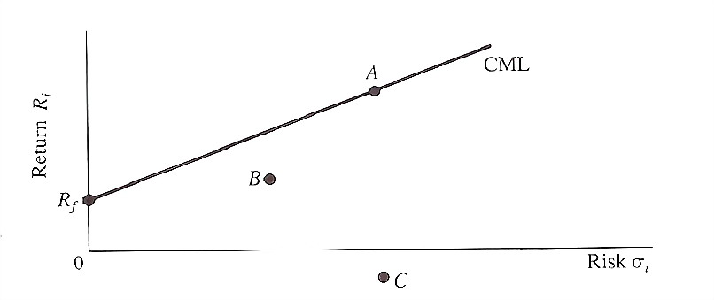
Sample Problem 9.1
Describe the kinds of assets that could characterize the risk/return tradeoffs depicted by A, B, and C in the figure.
Figure 9.2 The Capital Market Line

Slide 11
Solution
A is a correctly priced asset, perhaps a stock or a portfolio.
B is an overpriced asset, perhaps a bond selling at too large a premium.
C is an asset with expected negative return－for example, a lottery ticket.
The price of the lottery ticket is too high to be justified by the expected value of winning the jackpot.
Even though the jackpot may be large, the probability of winning it is very small, hence its expected value is small.
Therefore, the cost of the ticket is greater than the expected value of winning, which yields a negative return.

Slide 12
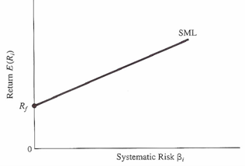
9.1.3 The Security Market Line (SML)- The Capital Asset Pricing Model (CAPM)
An asset’s systematic risk with the market, , is the only relevant risk measure of capital asset pricing for the individual asset and the portfolio.
Consequently, a derivation of the relationship between systematic risk and return can be made where the expected linear relationship between these two variables is referred to as the security market line (SML), illustrated by Figure 9.3.
Figure 9.3 The CAPM Showing the SML

Slide 13
Assumptions of SML
  Investors are risk averse
  The CAPM is a one-period model because it is assumed that investors maximize the utility of their end-of-period wealth.
  All investors have the same efficient frontier－that is, they have homogeneous expectations concerning asset returns and risk.
  Portfolios can be characterized by their means and variances.
  There exists a risk-free asset with a return , the rate at which all investors borrow or lend. The borrowing rate is equal to the lending rate.
  All assets are marketable and perfectly divisible, and their supplies are fixed.
  There are no transaction costs.
  Investors have all information available to them at no cost.
  There are no taxes or regulations associated with trading.

Slide 14
Given the SML, the return on a risky asset is equal to:
= the expected rate of return for asset;
= the expected risk-free rate;
= the measure of normalized systematic risk
(beta) of asset , and
= the expected return on the market portfolio.
The relationship between the CML and the SML can be seen by rearranging the definition of the beta coefficient:
where:
(9.3)
(Note: This security market line is also generally called the capital asset pricing model (CAPM)).
(9.4)

Slide 15
If , Equation (9.3) reduced to
If , this implies that this portfolio is an efficient portfolio.
If i is an individual security, it implies that the returns and risks associated with the asset are perfectly correlated with the market as a whole.
Equation (9.3) is a generalized case of Equation (9.3′).
The SML instead of the CML should be used to price an individual security or an inefficient portfolio.
The CML prices the risk premium in terms of total risk, and the SML prices the risk premium in terms of systematic risk.
(9.3’)

Slide 16
Sample Problem 9.2
Suppose the expected return on the market portfolio is 10% and that %.
Further, suppose that you were confronted with an investment opportunity to buy a security with return expected to be 12 % and with .
Should you undertake this investment?
Solution
for the market portfolio with we have
0.10 = a + (b × 1) = a + b
and for the risk-free rate with , we have
0.06 = a + (b × 0) = a
Solving these equations for a and b yields:
a = 0.06
b = 0.04
For the security with the expected return given the SML is
Ri = 0.06 + 0.04(1.2) = 0.108
Since 12% > 10.8%, the security is undervalued－it should be purchased since its return is above the equilibrium return of 10.8% for that level of the risk.

Slide 17
9.2 Mathematical Approach to the Derivation of the CAPM
How did Sharpe derive the capital asset pricing model (CAPM)?
  Sharpe (1964) used a general risky asset that did not lie along the CML and dubbed it i.
Risk and return for the possible combinations of security i with the market portfolio M are shown by Figure 9.4.
The average return and standard deviation for any I-M combination can be approached in the Markowitz fashion for a two-asset case:
(9.5)
Where represents excess demand for i or demand greater than its equilibrium weight in portfolio M.

Slide 18
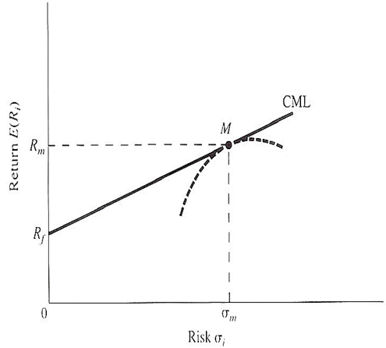
Figure9.4 The Opportunity Set Provided by Combination of Risky Asset and the Market Portfolio M.
When wi=0, the ith security is held in proportion to its total market value, and there is no excess demand for security i.
This is the key insight to Sharpe’s argument, for when wi=0, it is possible to equate the slope of the curve iMi’ with the capital market line, thus obtaining an expression for the return on any risky security i.

Slide 19
The changes in mean and standard deviation as the proportion changes are represented by:
(9.6)
At equilibrium when wi=0, the slope along the iMi’ curve will be equal to
The slope of the capital market line at point M is
(9.7)
(9.8)

Slide 20
Setting Equation (9.7) equal to Equation (9.8) and rearranging the terms to solve for E(Ri) gives the equation for the SML or CAPM:
(9.9)
This represents the return on any risky asset i.
At equilibrium, every risky asset will be priced so that it lies along the security market line.
It should be noted that the term represents the beta coefficient for the regression of Ri vs. Rm so that Equation (9.9) can be rewritten as
(9.10)

Slide 21
9.3 The Market Model and Risk Decomposition
To use the CAPM, the market model must be employed to estimate the beta (systematic risk).
In addition, the market model can be used to do risk decomposition.
Both the market model and risk decomposition are discussed in this section.

Slide 22
9.3.1 The Market Model
The equation that expresses these concepts states that the return on any asset at time t can be expressed as a linear function of the market return at time t plus a random error component.
Thus, the market model is expressed as
where
the return of the ith security in time t;
the intercept of the regression;
the slope;
the market return at time t; and
random error term.
(9.11)

Slide 23
9.3.2 Risk Decomposition
By using the market model, the total variance for security i ( ) can be represented by and decomposed into:
where is the systematic-risk component of total risk and is the unsystematic component.
The CAPM as developed here is expressed in terms of expected values.
Since expected values are not directly measured, we must transform the CAPM into an expression that uses observable variables.
Assuming that on average expected returns for a security equal realized returns, returns can be expressed as:
where is the random error term.
(9.12)
(9.13)

Slide 24
Assuming that the expected value of the error term is 0, that it is uncorrelated with the term and that the expression for can be substituted from the CAPM equation (9.10) into (9.13):
Simplifying this equation:
where is the intercept.
All variables of Equation (9.14) can be estimated from observed data.
Equation (9.14) is called the risk-premium version of the market model.
It is similar to the market model indicated in Equation (9.11), except that instead of using the total returns and , it uses the risk-premium portion of the returns, or and .
(9.14)

Slide 25
Sample Problem 9.3
To show how Equations (9.11) and (9.12) can be used, we will use monthly return data from Johnson & Johnson (J&J) and IBM.
The time period covers from March 2000 to April 2010
Their average return, beta coefficient, total variance, and residual variance are as indicated in Table 9.1 below.
We can see that IBM with 1.1964 is more sensitive to the fluctuations of the market than J&J with 0.3726.
 | Avg. Return | Beta | Residual Variance | Total Variance
Johnson & Johnson | 0.008 | 0.3726 | 0.0022 | 0.0025
IBM | 0.005 | 1.1964 | 0.0041 | 0.007
Table 9.1 Average Return, Beta Coefficient, Total Variance, and Residual Variance of J&J and IBM
Both the magnitude of total variance and beta of IBM were larger than for J&J, although the average rates of return for J&J were higher for IBM.
Hence J&J was a more desirable security, if that was the only choice the investor had.

Slide 26
9.3.3 Why Beta Is Important for Security Analysis
Implications and applications of beta coefficients in security analysis will be discussed in this section.
Beta is used as a measurement of risk: it gauges the sensitivity of a stock or portfolio relative to the market, as indicated in Equation (9.11).
Equation (9.11) is a fixed- coefficient market model; random- coefficient market model can be defined as Equation (9.15a) or Equation (19.5b):
in which represents the random fluctuation associated with the beta coefficient.
(9.15a)
(9.15b)

Slide 27
Using the random-coefficient market model, the total risk can be decomposed into three components, as defined in Equation (9.16):
in which represents an interaction risk between the market and the random fluctuation of the beta.
The relationship between total risk, market risk, and firm-specific risk can be shown as:
Since firm-specific risk can be eliminated by diversification:
Beta is important for the investment manager because it can be used
(1) to select individual stocks for investment;
(2) to construct portfolios of financial assets with desired levels of risk and return;
(3) to evaluate the performance of portfolio managers.
(9.16)

Slide 28
Sample Problem 9.4
Given the SML what should the expected return of a security be if it has a twice as great as a similar security returning 18 %?
Solution
Solving for yields
Therefore, the security’s is 2 × 1.5 = 3.0 and the required return is:
A 30% return is required.

Slide 29
9.3.4 Determination of Systematic Risk
There are two dimensions of risk that affect a firm’s systematic risk.
The first is financial risk, the additional risk placed on the firm and its stock holders due to the firm’s decision to be leveraged — that is, to take on additional debt.
The second, business risk, is the riskiness involved with a firm’s operations, if it takes on no debt.
Business risk can also be defined as the uncertainty inherent in projection of future operating income or earnings before interest and taxes (EBIT).
When a firm uses debt or financial leverage, business risk and financial risk are concentrated on the stockholders.
If, however, a firm is 50% levered the investors who put up the equity will then have to bear all business risk and some financial risk.
The effect of leverage upon return on assets (ROA) and return on equity (ROE) and its effect upon the stockholders are listed in text book page 329.

Slide 30
9.4 Growth Rates, Accounting Betas, and Variance in EBIT
9.4.1 sustainable Growth Rates
Growth rate can be measured in terms of the growth in total assets or the growth in sales.
It is determined by the percentage change between two periods.

Slide 31
Rapid growth can put considerable strain on a company’s resources, and unless management is aware of this effect and takes active steps to control it, rapid growth can lead to bankruptcy.
It becomes necessary, therefore, to define a company’s sustainable growth rate:
(9.17)

Slide 32
To derive Equation (9.17), assume that a company is not raising new equity, the cash to finance growth must come from retained profits and new borrowings:
And because the company wants to maintain a target debt-to-equity ratio equal to L, each dollar added to the owners’ equity enables it to increase its indebtedness by $L.
Since the owners’ equity will rise by an amount equal to retained profits:

Slide 33
The use of cash represented by the increase in assets must equal the two sources of cash (retained profits and new borrowings):
or g* = firm’s sustainable growth rate assuming no infusion of new equity
P = Profit margin
T = asset-to-sales ratio
D = payout ratio
L = leverage

Slide 34
If we divide both numerator and denominator of Equation (9.17) by T and make some arrangement, then we can show that the sustainable growth rate can be shown as
ROE = the rate of return on equity
Since sustainable growth rate does not allow company to use external equity, by allowing company to use both external debt and equity, Lee et al. (2011) have derived a generalized sustainable growth rate as

Slide 35
9.4.2 Accounting Beta
The accounting beta can be calculated from earnings-per-share data (EPS).
Using EPS as an example, beta can be computed as follows:
where:
= earnings per share of firm i at time t;
= earnings per share of market average at time t; and
= error term.
The estimate of is the EPS type of accounting beta.

Slide 36
9.4.3 Variance in EBIT
The variance in EBIT (X) can be defined as:
in which = earnings before interest and taxes in period t, and = average EBIT.
The total variance of EBIT can be used to measure the overall fluctuation of accounting earnings for a firm.

Slide 37
9.4.4 Capital- Labor Ratio
The capital–labor ratio has an impact upon the magnitude of the beta coefficient.
A production function is a function that can be seen as a function of labor and capital:
where K = capital and L = labor. K/L (the capital–labor ratio) is generally used to measure a firm’s degree of capital intensity.
If the capital–labor ratio is greater than one — that is, if K > L — a firm is capital intensive.
If the capital–labor ratio is less than one — that is, if K < L — then there is a reduction in capital intensity and a shift toward human-resource investment.
(9.18)

Slide 38
9.4.5 Fixed Costs and Variable Costs
Business risk is dependent upon the extent a firm builds fixed costs into its operations.
A firm with a large amount of fixed costs is said to have a large degree of operating leverage.
Variable costs have the opposite effect, because they are adjustable to the firm’s needs.
Should a drop in sales occur, variable costs can be lowered to meet the lowered output.
The extent to which firms can control their operating leverage is dependent upon their technological needs.
Companies that require large investments in fixed assets－such as steel mills, auto manufacturers, and airlines－will have large fixed costs and operating leverages.

Slide 39
9.4.6 Beta Forecasting
If the beta coefficient and standard deviation are stable, then using a beta derived from current and historical price data is fine, because the beta today is the same as the beta in the future.
However, if the beta coefficient and standard deviation are unstable or vary through time, the analyst or manager must forecast a beta’s future value before employing it.
The available evidence on the stability of beta indicates that the beta on an individual security is generally not stable, while portfolios have stable betas.
Hence we are faced with the problem of forecasting future betas in order to use the CAPM for individual securities.
Beta forecasting refers to using the historical beta estimates or other historical financial information to forecast future betas.

Slide 40
9.4.7 Market-Based versus Accounting-Based Beta Forecasting
Market-based beta forecasts are based upon market information alone.
Historical betas of firms are used as a proxy for their future betas.
This implies that the unadjusted sample beta, , is equal to the population value of future beta:
Alternatively, there may be a systematic relationship between the estimated betas for the first period and those of the second period, as shown:
in which and estimated beta for the ith firm in period t + 1 and t, respectively.
(9.19a)
(9.19b)

Slide 41
Sample Problem 9.5
If , then the future beta can be either
Note that Value Line uses Equation (9.19b) to estimate the future beta.
Accounting-based beta forecasts rely upon the relationships of accounting information such as the growth rate of the firm, EBIT, leverage, and the accounting beta as a basis for forecasting beta.
To use accounting information in beta forecasts, the historical beta estimates are first cross-sectionally related to accounting information such as growth rate, variance of EBIT, leverage, accounting beta, and so on:
where is the jth accounting variables for ith firm, and is the regression coefficient.
(9.20)

Slide 42
Ordinary least squares is a statistical procedure for finding the best fitting straight line for a set of points; it seems in many respects a formalization of the procedure employed when fitting a line by eye.
For instance, when visually fitting a line to a set of data, the ruler is moved until it appears that the deviations of the points from the prospective line have been minimized.
If the predicted value of (dependent variable) obtained from the fitted line is denoted as the prediction equation becomes:
where represent estimates of the true ; is an independent variable.

Slide 43
In order to find the best fit, it is necessary to minimize the deviations of the points.
A criterion of best fit that is often employed is known as the principle of least squares.
It may be stated as follows:
  Choose the best fitting line as the one that minimizes the sum of squares of the errors (SSE) of the observed values of Y from those predicted. Expressed mathematically
Further, the mean sum of squares of the error (MSSE) of the observed values of Y could be minimized from the predicted mean.
Expressed mathematically as

Slide 44
Mincer and Zarnowitz (1969) suggest a decomposition of the mean squared error term into three components representing bias, inefficiency, and random error. Mathematically, this is represented as
Where represent the mean, standard deviation, and correlation coefficient of y, respectively.
Using an ordinary least-squares estimate of and a Bayesian adjustment procedure of Vasicek (1973) as defined in Equation (9.21):
    = the least-squares estimate of a first-period individual beta;
    = variance estimate of ;
    = the cross-sectional mean value of estimated ;
    = the cross-sectional variance of estimated ;
    = the Bayesian adjusted beta.
(9.21)

Slide 45
Equation (9.21) indicates that the Vasicek type of Bayesian adjustment beta is a weighted average of .
The weights are
The authors first use first-period regressions projected forward to obtain forecasts of the second-period betas.
The summary of the stepwise regression for the first-period data is given in Table 9.2.
Table 9.3 summarizes the overall mean squared errors together with the mean squared error decomposition.

Slide 46
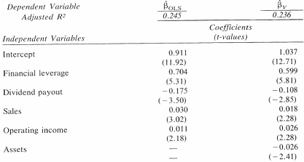
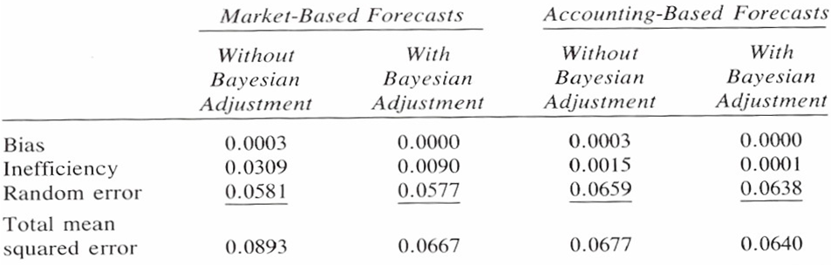
Table 9.2 Summary of Stepwise Regression Results for First-Period Data
Source: Lee et al. (1986, p. 59)
Table 9.3 Mean Squared Error Decompositions for Forecasts of Second- Period Betas.
Source: Lee et al. (1986, p. 600)

Slide 47
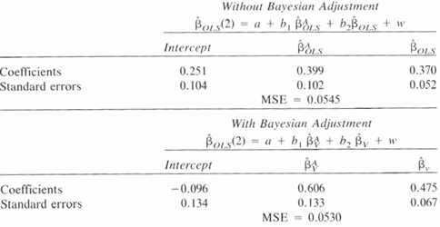
Table 9.4
Results for the Estimation of Market- and Accounting-Based Composite With and Without Bayesian Adjustment.
Source: Lee et al. (1986, p. 61)
Lee et al. (1986) tested a composite predictor for beta consisting of both a market beta and an accounting beta.
Table 9.4 shows the results of using this composite method to forecast beta for both the Bayesian-adjusted and nonadjusted model.
In Table 9.4, (2) represents the OLS-estimated beta in the second period; represent accounting-based beta without and with Bayesian adjustment, respectively.
From research it appears, then, that accounting-based and market-based forecasts can be combined to produce a superior composite forecast of beta.

Slide 48
9.5 Some applications and Implications of the CAPM
CAPM can be extended into all areas of corporate finance, investments, real-estate problem, valuation of the entire firm, test various financial theories, and many others.
Rubinstein (1973) demonstrated how the CAPM can also be used to value securities and to calculate their risk-adjusted equilibrium price.
First, the CAPM must be converted to using price variables instead of expected return.
It may be rewritten:
        = the expected returns for the ith firms;
        = the price of stock in time l; and
        = the price of stock in the previous period.

Slide 49
Thus, the CAPM is redefined:
or, rearranging Equation (9.22):
Thus the rate of return used to discount the expected end-of-period price contains a risk premium dependent upon the security’s systematic risk.
CAPM has also been applied in the analysis of mergers.
The merging of two firms with different product lines, called a conglomerate merger, creates diversification, considered of great benefit.
Suppose that one firm sells a product that is recession resistant, then a decrease in earnings of one division of the conglomerate will be offset by the steady earnings of another division.
The overall result will be a relatively stable income stream despite shifting trends in the economy.
(9.22)

Slide 50
9.6 Summary
This chapter has discussed the basic concepts of risk and diversification and how they pertain to the CAPM.
The procedures for deriving the CAPM itself were presented, and the CAPM was shown to be an extension of the CML theory.
The possible uses of the CAPM in financial management were also indicated.
The statistical method of least squares and its application were introduced, and beta forecasts based on the least-squares method were compared with those based on market information, accounting information, and a composite-predictor beta forecast composed of both accounting and market information.
The composite predictor appears to yield a better forecast than either the market-information or accounting-information forecasts separately.

