Slide 1
Appendix 11A:
Derivation of Equation (11.6a)
(11.1)

Slide 2
The objective function L as defined in Equation (18.3) can be rewritten:
Then, following the product and chain rule, we have:
(11A.1)

Slide 3
Multiplying Equation (11A.1) by , , and
rearranging yields:
(11A.2)
Defining

Slide 4
Yields
Therefore:

Slide 5
Define Hi=kWi, where the Wi are the fractions to invest in each security and the Hi are proportional to this fraction. Substituting Hi for Wi:
There is one equation like this for each value of i.
This is Equation (11.6a) in the text.

Slide 6
Appendix 11B:
Derivation of Equation 11.10
(11.2)

Slide 7
Following the optimization procedure for deriving Equation (18A.2) in Appendix 18A:
Let and, solving for any ,
(11B.1)

Slide 8
Multiplying both sides of the equation by :
（11B.2）
Adding together the n equation of this form yields:
（11B.3）
By substituting Equation (11B.3) into Equation (11B.1), Equation (11.10) is obtained.

Slide 9
Appendix 11C:
Derivation of Equation (11.15)
(11.3)

Slide 10
This appendix discusses the use of performance measure to examine the optimal portfolio with short sales not allowed. Therefore, Equation (11B.1) from Appendix 11B must be modified
(11C.1)
where and for all i.
The justification of this equation can be found in Elton et al. (1976). Assuming all stocks that would be in an optimal portfolio (called d) can be found, and then arranging these stocks as i=1, 2, ….. , d, for the subpopulation of stocks that make up the optimal portfolio:
(11C.2)

Slide 11
Multiplying both sides by , summing over all stocks in d, and rearranging yields:
(11C.3)
Notice since the set d contains all stocks with positive Hi:

Slide 12
And Let:
(11C.4)
Using (11C.4), the following equation for is obtained after substitution and rearranging from Equation (11C.1):
(11C.5)
Since , the inclusion of ; can only increase the value of Hi. Therefore, if Hi is positive with can never make it zero and the security should be included, If Hi<0 when , positive values of can increase Hi . However, because the product of and Hi must equal zero, as indicated in Equation (11C.1), positive values of imply Hi=0. Therefore, any security Hi<0 when must be rejected. Therefore, Equation (11.16) in the text can be used to estimate the optimal weight of a portfolio.

Slide 13
Appendix 11D:
Quadratic Programming and Kuhn-Tucker Conditions

Slide 14
The quadratic programming algorithm is based on a technique from advanced calculus called Kuhn–Tucker conditions.
This technique can solve the optimal portfolio with short sales not allowed.
The problem can be stated as
Subject to
where
To find the maximum value of F(W), there are two case of the optimal weights W=(W₁, W₂,…W_{n}) in Figure 11.D.1

Slide 15
F(W)
F(W)
P
P
P’
Wi
Wi
(a)
(b)
Figure 11.D.1 Value of the Function F(W) as W_{i} Changes
If F(W) is a function of W_{i} in Figure 11.D.1(a), then the maximum value of F(W) occurs at P, where at positive optimal weight (W_{i} > 0).
However, in Figure 11.D.1(b), the maximum feasible value of F(W) occurs at Pʹ instead of P because of short sell not allowed, then at optimal weight (W_{i} = 0).

Slide 16
Therefore, in general, we can obtain the optimal weights under conditions
We can rewrite the conditions as five Kuhn–Tucker conditions:
When maximum feasible value occurs on , A_{i} is positive and W_{i} is equal to zero.
If maximum feasible value occurs on , then A_{i} is equal to zero and W_{i} is positive.

Slide 17
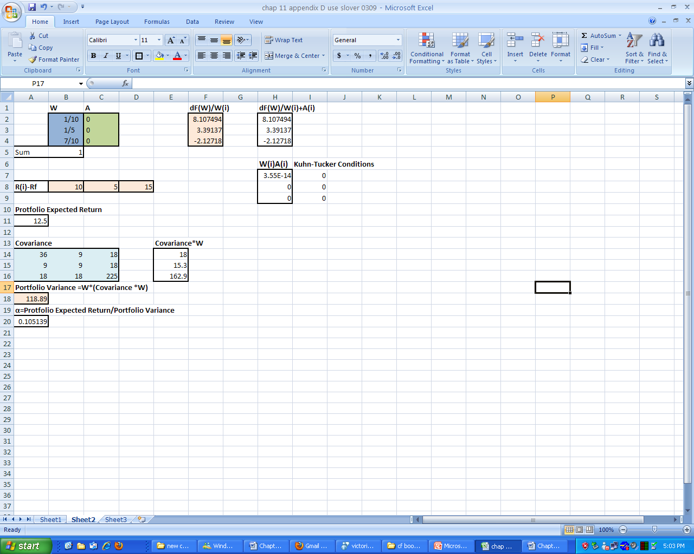
In the following part, we will solve the optimal weights under Kuhn–Tucker conditions by Excel.
Given an example in Figure 11.D.2: initial weights W = (0.1, 0.2, 0.7), can be calculated by the Equation (11A.2) in Appendix 11A and the value of the excess return and covariance matrix as below.
Figure 11.D.2 Solver Function in Excel

Slide 18
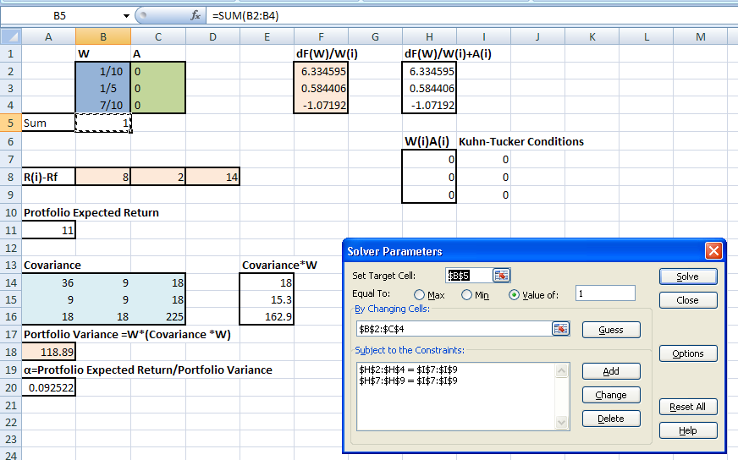
Then we use “Solver” function in Excel to find the optimal weights W.
Set target cell B5 equal to the value of 1 (the fifth Kuhn–Tucker condition), select the range from B2 to C4 as change cells, and select the first and second Kuhn–Tucker conditions as the constraints.
Figure 11.D.2 Solver Function in Excel (Continued)

Slide 19
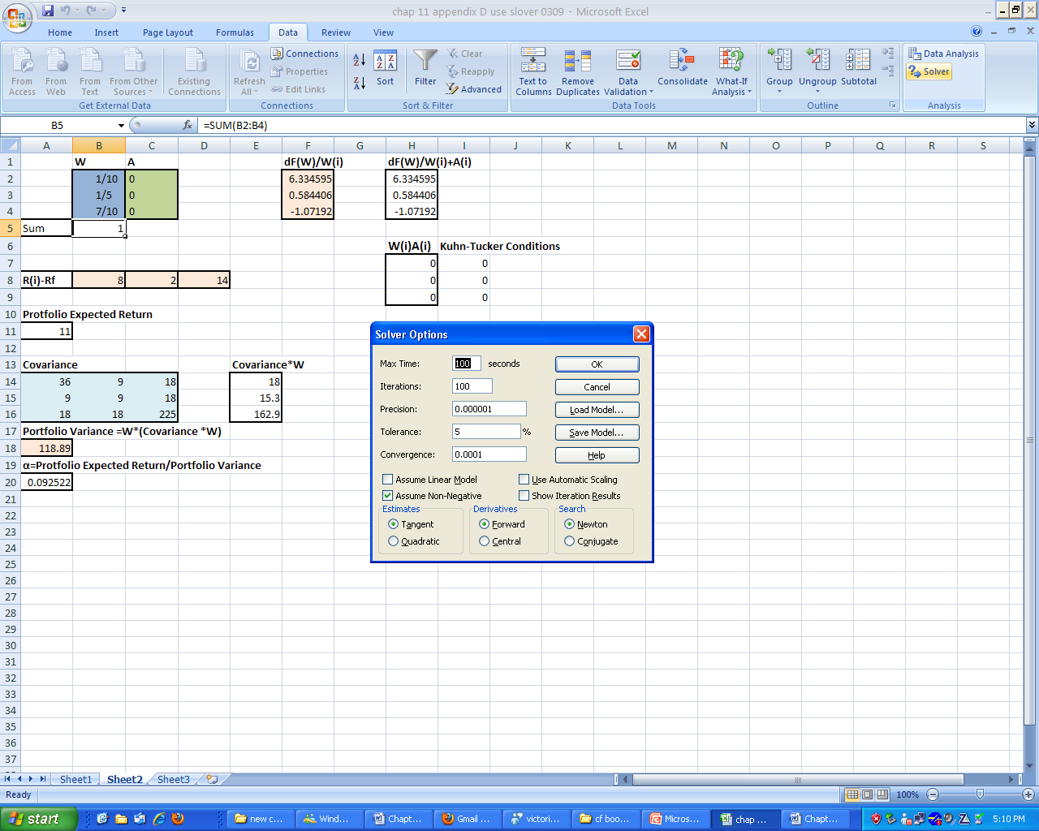
For the third and fourth Kuhn–Tucker conditions, press “Options” into Solver Options, select “Assume Non-Negative” and press “OK.”
Then go back to Solver Parameters and press “Solve.”.
Figure 11.D.2 Solver Function in Excel (Continued)

Slide 20
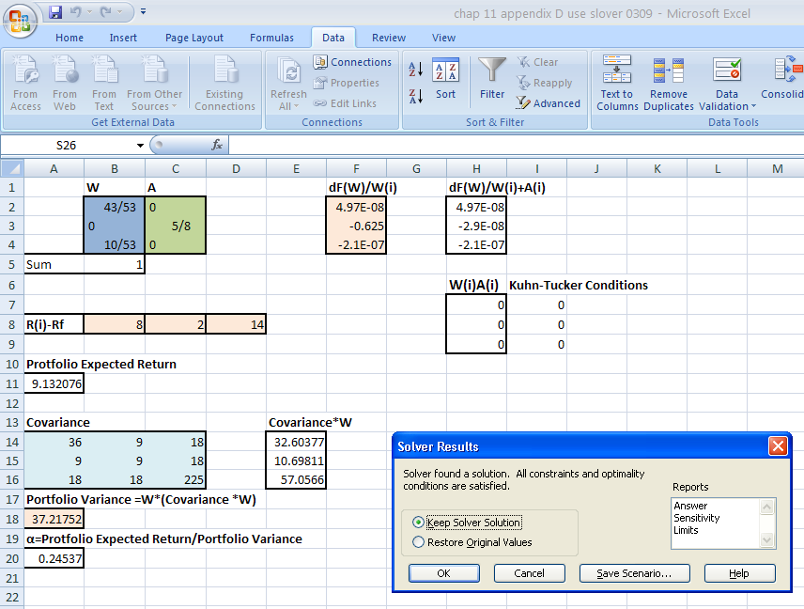
Figure 11.D.3 Optimal Weights by Solver Function
If first solve cannot find a solution, use “Solver” function again until the Solver find a solution as Figure11.D.3.
Figure 11.D.3 Optimal Weights by Solver Function

Slide 21
Appendix 11E:
Portfolio Optimization with Short-Selling Constraints

Slide 22
The traditional mean-variance efficient portfolios generate appealing characteristics.
However, it is frequently questioned by financial professionals due to the propensity of corner solutions in portfolio weights.
Therefore, adding portfolio weighting limits help portfolio managers to fashion realistic asset allocation strategies.

Slide 23
Suppose risky asset investments can be characterized as a vector of multivariate returns of N securities, R^{T}.
The expected risk premiums and variance-covariance of asset returns can be expressed as a vector μ and a positive definite matrix V, respectively.
Let Ω be the set of all real vectors w that define the weights of assets such that w^{T} 1=1, where 1 is an N-vector of ones.
The expected return of the portfolio is μp =w^{T} μ and the variance of the portfolio is σ_{p} = w^{T}Vw.
Considering all constraints given the objective to minimize the portfolio’s risk, the efficient frontier can be then expressed as a Lagrangian function:
As described in the previous section, the optimal portfolio weights are a function of means, variances, and covariances of asset returns.
(11E.1)

Slide 24
Consider a generalized case with N assets, let
  A=1^{T}V⁻¹R, B=R^{T}V⁻¹R, X=1^{T}V⁻¹1, and Δ=BX-A²,
the solution of the above quadratic function is (see Pennacchi (2008))
  w_{p}= [(X μp – A)(V⁻¹R) + (B – A μp )(V⁻¹1)]
The short-selling constraints are further considered in Markowitz model.
The inequalities that represent non-negative portfolio weights are
  w₁ ≥ 0, w₂ ≥ 0, ……, w_{N} ≥ 0 , where w=[w₁, w₂,……, w_{N}].
The solution of this constrained diversification is to incorporate Equation (11E.3) in Equation (11E.1).
(11E.2)
(11E.3)

Slide 25
A Numerical Example
Considering a three-asset case exemplified in the previous section, we have the following objective and constraint functions:
Replacing the variables in Equation (11E.4), we can rewrite Equation (11E.1) as
where i=1, 2, 3, are Lagrange multipliers (LMs).
(11E.4)
(11E.5)

Slide 26
The corresponding complementary slackness conditions are
The above complementary slackness conditions indicate that either inequality constraints should be active at a local optimum or the corresponding Lagarange variable should equal zero.
For differentiable nonlinear program, solutions W_{i}, i=1, 2, 3, satisfy the Kuhn–Tucker conditions if they fulfill complementary slackness conditions, primal constraints, and gradient equation
Any combination of W_{i}, i = 1, 2, 3, for which there exist a corresponding LMs satisfying these conditions is called a Kuhn–Tucker point.
(11E.6)
(11E.7)

Slide 27
Our portfolio model has the following objective function gradient
and those of the five linear constraints are
Therefore the gradient equation part of Kuhn–Tucker conditions is
(11E.8)
(11E.9)
(11E.10)

Slide 28
plus the primal constraints as part of the conditions
and complementary slackness conditions in Equation (11E.6).
(11E.11)

Slide 29
Notice that the weights are functions of five LMs and bounded by inequality constraints.
Since the functions of solutions of W_{i} are multidimensional, we cannot show their relation on a graph.
One may start from any feasible point and then search an improving feasible direction chased by implementations of feasible and small steps of LMs.
The stop of an improving feasible search not necessarily represents the current Kuhn–Tucker point is the global optimum but suggests it is a local optimum.
Since there is no close-form solution function for each weight, one may need to continue the search until no improvement can be found. In our case, if
there is an improvement in objective function.
(11E.12)

Slide 30
We use the same data set to construct the nonconstrained (NC) efficient frontier and short-selling constrained (SS) efficient frontier, which is shown in Figure 11E.1.
In Figure 11E.1, the SS optimal diversification is a subset of the NC portfolio.
Figure 11E.1 Efficient Frontiers

Slide 31
The global minimum variance (MV) for the two kinds of portfolio is identical in this case.
The information is listed in Table 11E.1.
The conclusion of the same MV under different constraints does not always happen when the coefficients of correlation among securities and the relative magnitudes of return among assets change.
Note that the optimal diversification strategies are sensitive to the variation in the first two moments of asset returns in the portfolio.
E(R)(%) | σ (%) | Portfolio Weight | w₁(%) | w₂(%) | w₃(%)
0.78 | 13.39 |  | 38.57 | 28.10 | 33.33
Table 11E.1 Minimum-Variance Portfolio

Slide 32
As the portfolios on efficient frontiers shown in Table 11E.2, assuming the long-term annual risk-free interest rate is 4%, the portfolios of corner solutions are less mean-variance efficient than the ones without negative and extremely positive weights.
E(R) (%) | σ (%) | Sharpe Ratio | Portfolio Weight | w₁ (%) | w₂ (%) | w₃ (%)
0.78 | 13.39 | 0.0333 |  | 38.57 | 28.10 | 33.33
1.04 | 16.87 | 0.0422 |  | 16.86 | 13.04 | 70.10
1.24 | 22.38 | 0.0406 |  | −25.82 | −16.90 | 142.72
2.63 | 72.96 | 0.0315 |  | −100.53 | −199.47 | 400.00
3.38 | 101.30 | 0.0300 |  | −366.73 | 66.73 | 400.00
Table 11E.2 Portfolios on Efficient Frontier

