Slide 1
Chapter 19
Normal,
Log-Normal Distribution,
and
Option Pricing Model
By
Cheng Few Lee
Joseph Finnerty
John Lee
Alice C Lee
Donald Wort

Slide 2
Outline
19.1 The Normal Distribution
19.2 The Log-Normal Distribution
19.3 The Log-Normal Distribution and It’s Relationship to the Normal Distribution
19.4 Multivariate Normal and Log-Normal Distributions
19.5 The Normal Distribution as an Application to the Binomial and Poisson Distributions
19.6 Applications of the Log-Normal Distribution in Option Pricing

Slide 3
Outline
19.7 The bivariate normal density function
19.8 american call options
19.8.1 Price American Call Options by the Bivariate Normal Distribution
19.8.2 Pricing an American Call Option: An Example
19.9 PRICING BOUNDS FOR OPTIONS
19.9.1 Options Written on Nondividend-Paying Stocks
19.9.2 Option Written on Dividend-Paying Stocks

Slide 4
19.1 The Normal Distribution
A random variable X is said to be normally distributed with mean and variance if it has the probability density function (PDF)
*Useful in approximation for binomial distribution and studying option pricing.
(19.1)

Slide 5
Standard PDF of is
This is the PDF of the standard normal and is independent of the parameters
and .
(19.2)

Slide 6
Cumulative distribution function (CDF) of Z
*In many cases, value
N(z) is provided by
software.
CDF of X
(19.3)
(19.4)

Slide 7
When X is normally distributed then the Moment generating function (MGF) of X is
*Useful in deriving the moment of X and moments of log-normal distribution.
(19.5)

Slide 8
19.2 The Log-Normal Distribution
Normally distributed log-normality with parameters of and
*X has to be a
positive random
variable.
*Useful in studying
the behavior of
stock prices.
(19.6)

Slide 9
PDF for log-normal distribution
*It is sometimes called the antilog-normal distribution, because it is the distribution of the random variable X.
*When applied to economic data, it is often called “Cobb-Douglas distribution”.
(19.7)

Slide 10
The r^{th} moment of X is
From equation 19.8 we have:
(19.8)
(19.9)
(19.10)

Slide 11
The CDF of X
The distribution of X is unimodal with the mode at
(19.11)
(19.12)

Slide 12
Log-normal distribution is NOT symmetric.
Let be the percentile for the log-normal distribution and be the corresponding percentile for the standard normal, then
so implying
Also that as .
Meaning that
(19.13)
(19.14)
(19.15)

Slide 13
19.3 The Log-Normal Distribution and Its Relationship to the Normal Distribution
Compare PDF of normal distribution and PDF of log-normal distribution to see that
Also from (19.6), we can see that
(19.16)
(19.17)

Slide 14
CDF for the log-normal distribution
Where
*N(d) is the CDF of standard normal distribution which can be found from Normal Table; it can also be obtained from S-plus/other software.
(19.18)
(19.19)

Slide 15
N(d) can alternatively be approximated by the following formula:
Where
In case we need Pr(X>a), then we have
(19.20)
(19.21)

Slide 16
Since for any h, , the hth moment of X, the following moment generating function of Y, which is normally distributed.
For example,
Hence
Fractional and negative movement of a log-normal distribution can be obtained from Equation (19.23)
(19.22)
(19.23)
(19.24)

Slide 17
Mean of a log-normal random variable can be defined as
If the lower bound a > 0; then the partial mean of x can be shown as
This implies that
partial mean of a log-normal
= (mean of x )( N(d))
(19.25)
Where
(19.26)

Slide 18
19.4 Multivariate Normal and Log-Normal Distributions
The normal distribution with the PDF given in Equation (19.1) can be extended to the p-dimensional case. Let be a p × 1 random vector. Then we say that , if it has the PDF
is the mean vector and is the covariance matrix which is symmetric and positive definite.
(19.27)

Slide 19
Moment generating function of X is
Where is a p x 1 vector of real values.
From Equation (19.28), it can be shown that
and
If C is a matrix of rank .
Then . Thus, linear transformation of a normal random vector is also a multivariate normal random vector.
(19.28)

Slide 20
Let , and , where and
are , , and =
The marginal distribution is also a multivariate normal with mean vector and covariance matrix that’s . The conditional distribution of with givens where
and
That is,
(19.29)
(19.30)

Slide 21
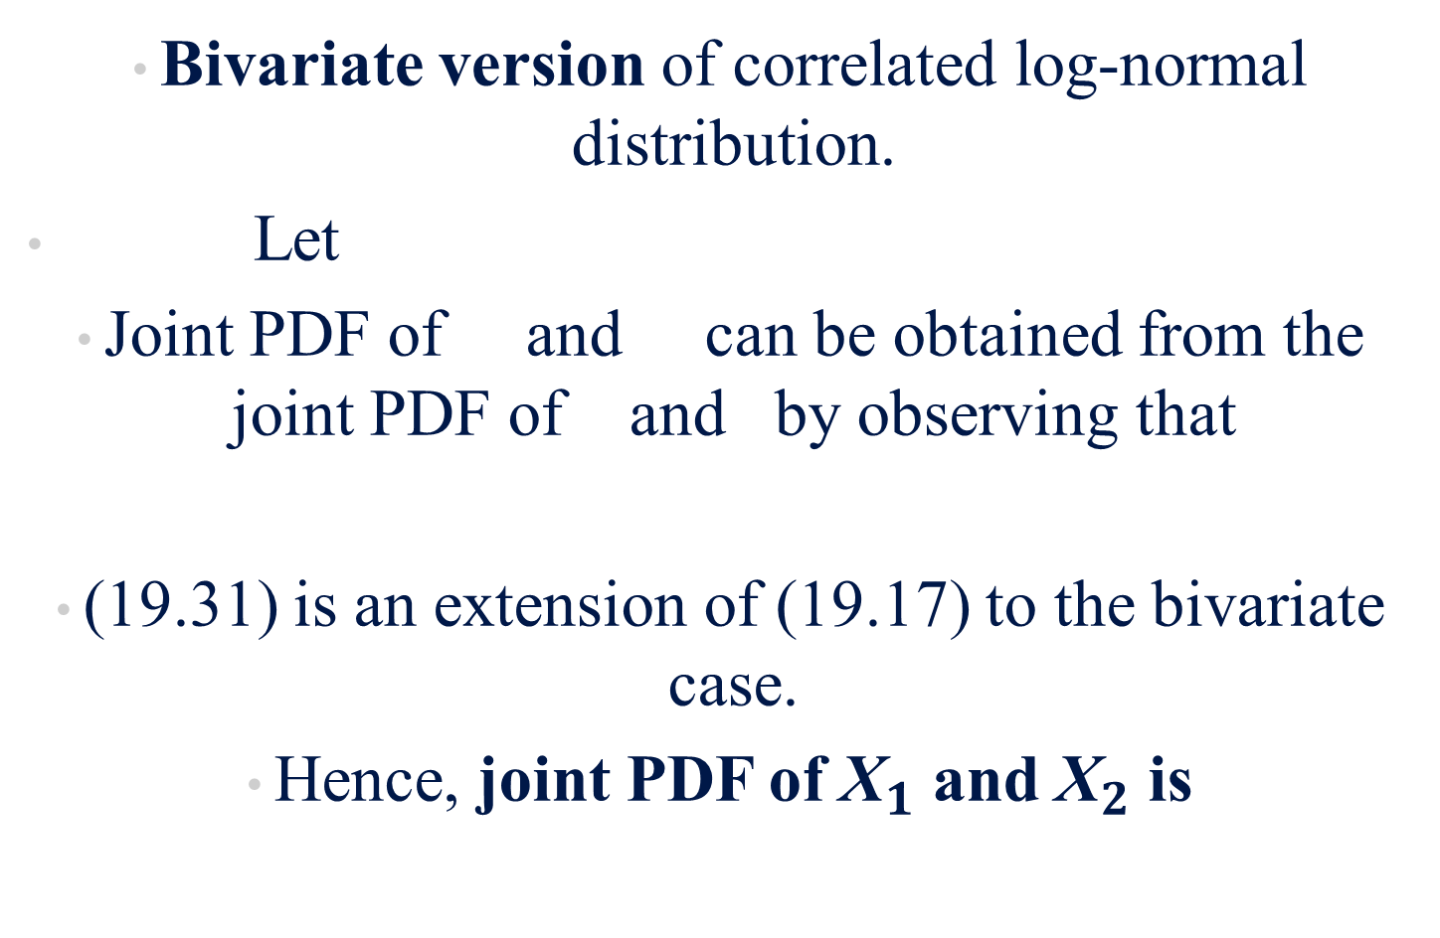
Bivariate version of correlated log-normal distribution.
Let
Joint PDF of and can be obtained from the joint PDF of and by observing that
(19.31) is an extension of (19.17) to the bivariate case.
Hence, joint PDF of ${\text{X}}_{1}$ and ${\text{X}}_{2}$ is
(19.31)
(19.32)

Slide 22

From the property of the multivariate normal distribution, we have
Hence, $X_{i}$ is log-normal with
(19.33)
(19.34)

Slide 23
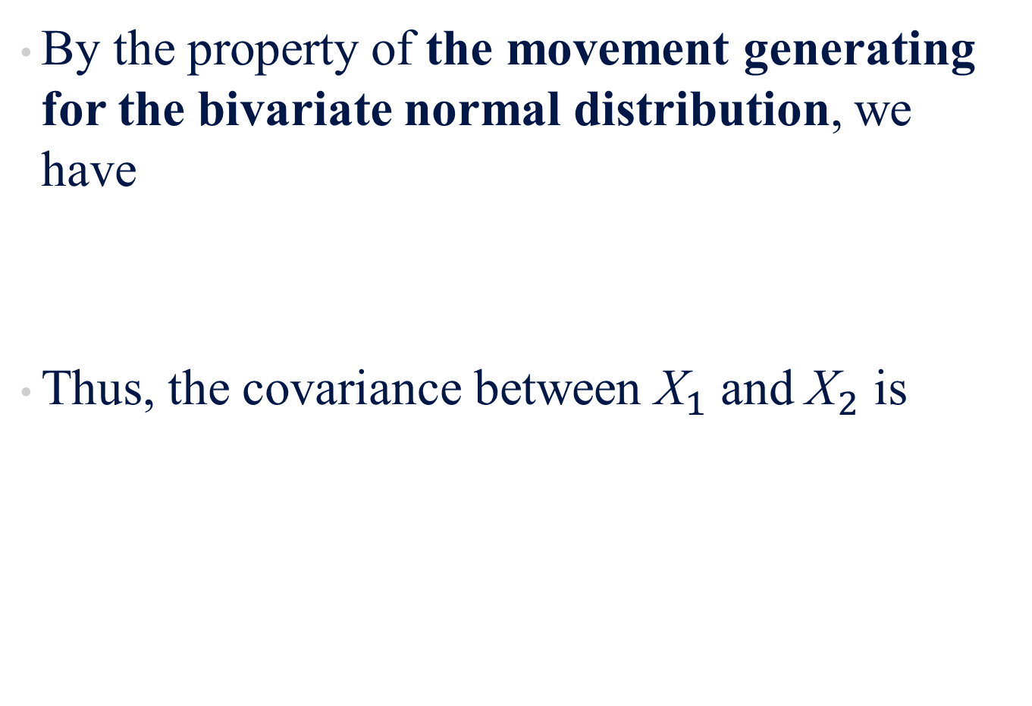
By the property of the movement generating for the bivariate normal distribution, we have
Thus, the covariance between ${\text{X}}_{1}$ and ${\text{X}}_{2}$ is
(19.35)
(19.36)

Slide 24
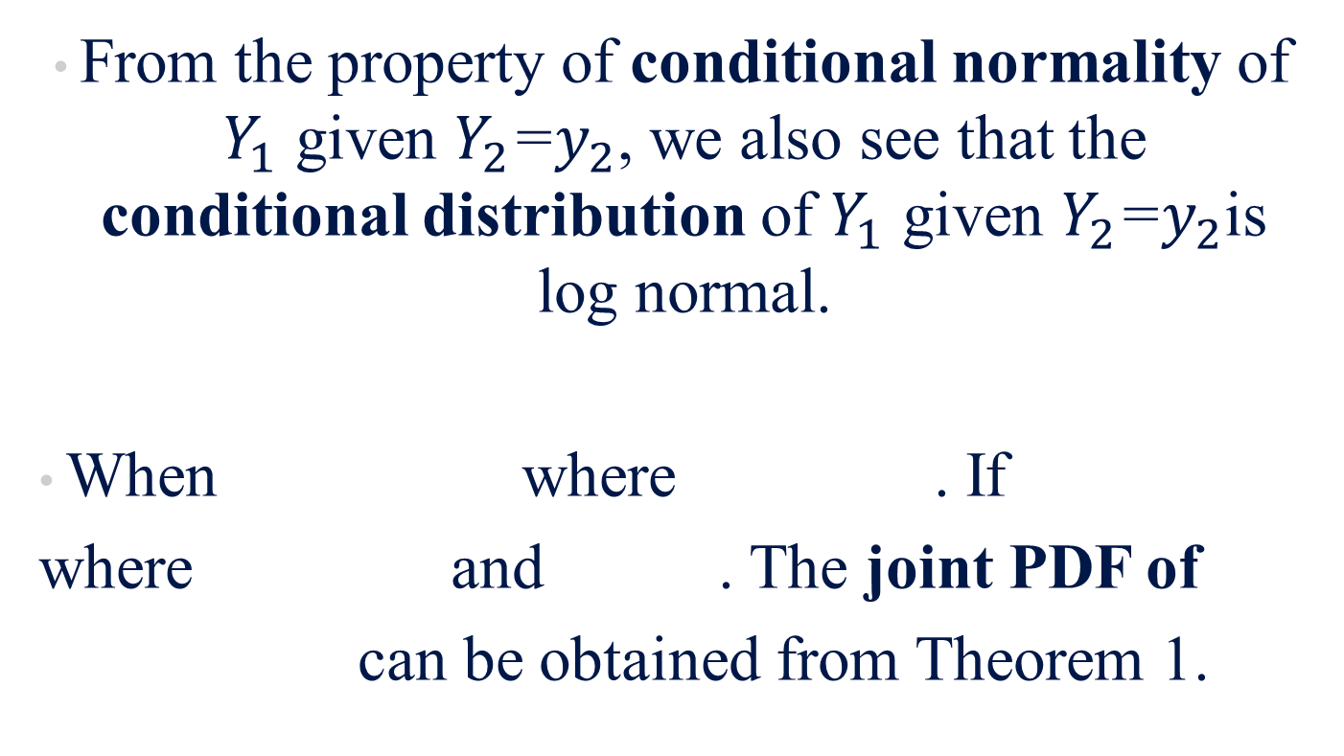
From the property of conditional normality of $Y_{1}$ given $Y_{2}$=$y_{2}$, we also see that the conditional distribution of $Y_{1}$ given $Y_{2}$=$y_{2}$is log normal.
When where . If
where and . The joint PDF of
can be obtained from Theorem 1.

Slide 25
Theorem 1
Let the PDF of be , consider the
p-valued functions
Assume transformation from the y-space to
x-space is one to one with
inverse transformation
(19.37)
(19.38)

Slide 26

If we let random variables be defined by
Then the PDF of is
Where J($x_{1}$,.., $x_{p})$ is Jacobian of transformations
“Mod” means modulus or absolute value
(19.39)
(19.40)
(19.41)

Slide 27
When applying theorem 1 with
being a p-variate normal and
We have joint PDF of
*when p=2, Equation (19.43) reduces to the bivariate case given in Equation (19.32)
(19.42)
(19.43)

Slide 28
The first two moments are
*Where is the correlation between and
(19.44)
(19.45)
(19.46)

Slide 29
19.5 The Normal Distribution as an Application to the Binomial and Poisson Distribution
Cumulative normal density function tells us the probability that a random variable Z will be less than x.

Slide 30
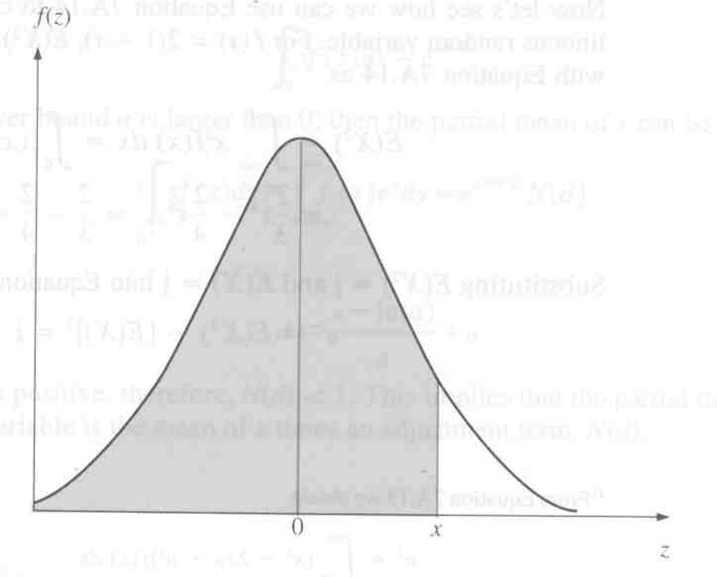
*P(Z<x) is the area under the normal curve from up to point x.
Figure 19-1

Slide 31
Applications of the cumulative normal distribution function is in valuing stock options.
A call option gives the option holder the right to purchase, at a specified price known as the exercise price, a specified number of shares of stock during a given time period.
A call option is a function of S, X, T, ,and r

Slide 32
The binomial option pricing model in Equation (19.22) can be written as
*C= 0 if m>T
(19.47)

Slide 33
S = Current price of the firm’s common stock
T = Term to maturity in years
m = minimum number of upward movements in stock price that is necessary for the option to terminate “in the money”
and
X = Exercise price (or strike price) of the option
R= 1+r = 1+ risk-free rate of return
u = 1 + percentage of price increase
d = 1 + percentage of price decrease

Slide 34
By a form of the central limit theorem, in Section 19.7 you will see , the option price C converges to C below
C = Price of the call option
N(d) is the value of the cumulative standard normal distribution
t is the fixed length of calendar time to expiration and h is the elapsed time between successive stock price changes and T=ht.
(19.48)

Slide 35
If future stock price is constant over time,
then
It can be shown that both and are equal to 1 and that that Equation (19.48) becomes
*Equation (19.48 and 19.49) can also be understood in terms of the following steps
(19.49)

Slide 36
Step 1: Future price of the stock is constant over time
Value of the call option:
  X= exercise price
  C= value of the option (current price of stock – present value of purchase price)
  *Equation 19.50 assumes discrete compounding of interest, whereas Equation 19.49 assumes continuous compounding of interest.
(19.50)

Slide 37
*We can adjust Equation 19.50 for continuous compounding by changing
to
And get
(19.51)

Slide 38
Step 2: Assume the price of the stock fluctuates over time ( )
Adjust Equation 19.49 for uncertainty associated with fluctuation by using the cumulative normal distribution function.
Assume from Equation 19.48 follows a log-normal distribution (discussed in section 19.3).

Slide 39
Adjustment factors and in Black-Scholes option valuation model are adjustments made to EQ 19.49 to account for uncertainty of the fluctuation of stock price.
Continuous option pricing model (EQ 19.48)
vs
binomial option price model (EQ19.47)
and are cumulative normal density functions
while and are complementary binomial distribution functions.

Slide 40
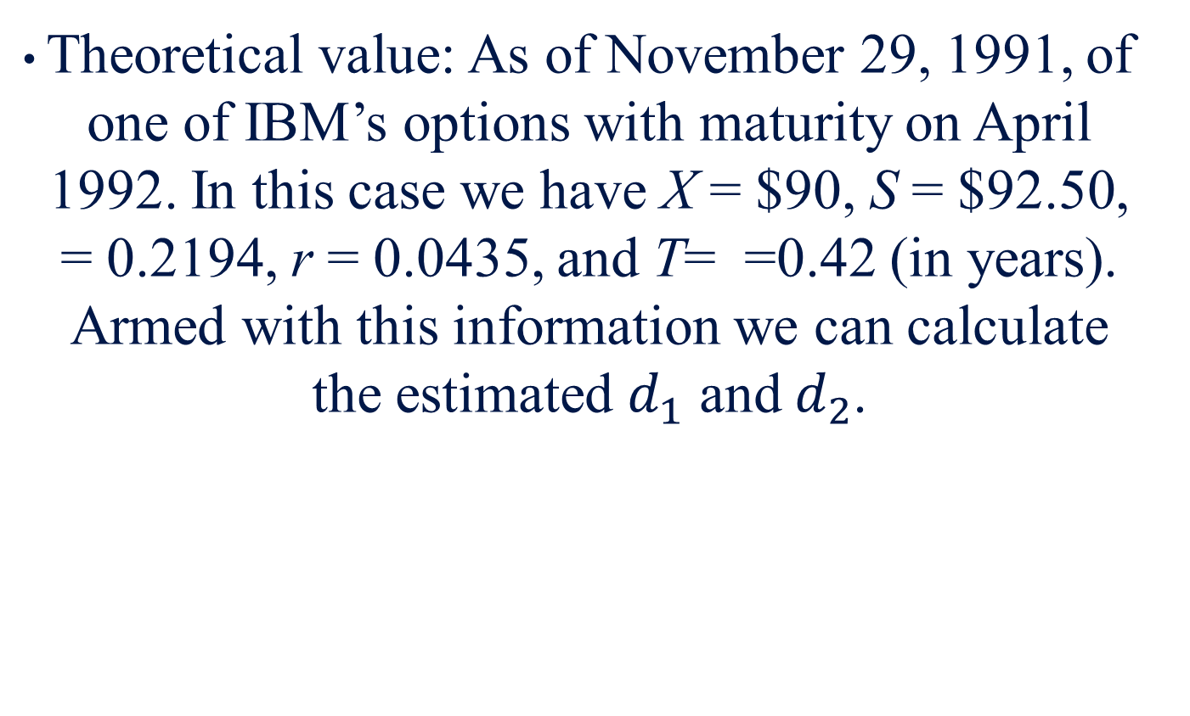
Application Eq. (19.48) Example
Theoretical value: As of November 29, 1991, of one of IBM’s options with maturity on April 1992. In this case we have X = $90, S = $92.50, = 0.2194, r = 0.0435, and T= =0.42 (in years). Armed with this information we can calculate the estimated $d_{1}$ and $d_{2}$.

Slide 41
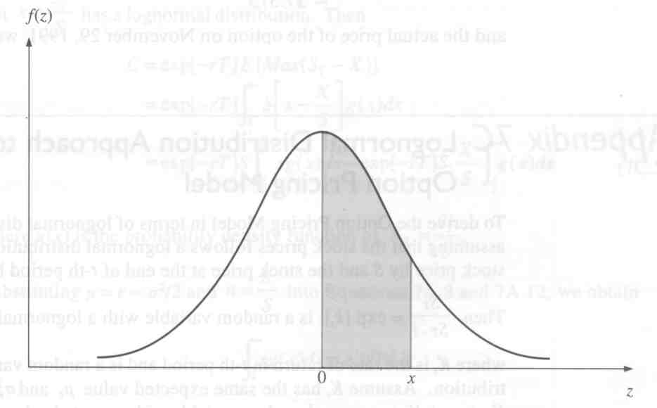
Probability of Variable Z between 0 and x
Figure 19-2
*In Equation 19.45, and are the probabilities that a random variable with a standard normal distribution takes on a value less than and a value less than , respectively. The values for the probabilities can be found by using the tables in the back of the book for the standard normal distribution.

Slide 42
To find the cumulative normal density function, we add the probability that Z is less than zero to the value given in the standard normal distribution table. Because the standard normal distribution is symmetric around zero, the probability that Z is less than zero is 0.5, so
= 0.5 + value from table

Slide 43
From
The theoretical value of the option is
The actual price of the option on November 29,1991, was $7.75.

Slide 44
19.6 Applications of the Log-Normal Distribution in Option Pricing
Assumptions of Black-Scholes formula :
No transaction costs
No margin requirements
No taxes
All shares are infinitely divisible
Continuous trading is possible
Economy risk is neutral
Stock price follows log-normal distribution

Slide 45
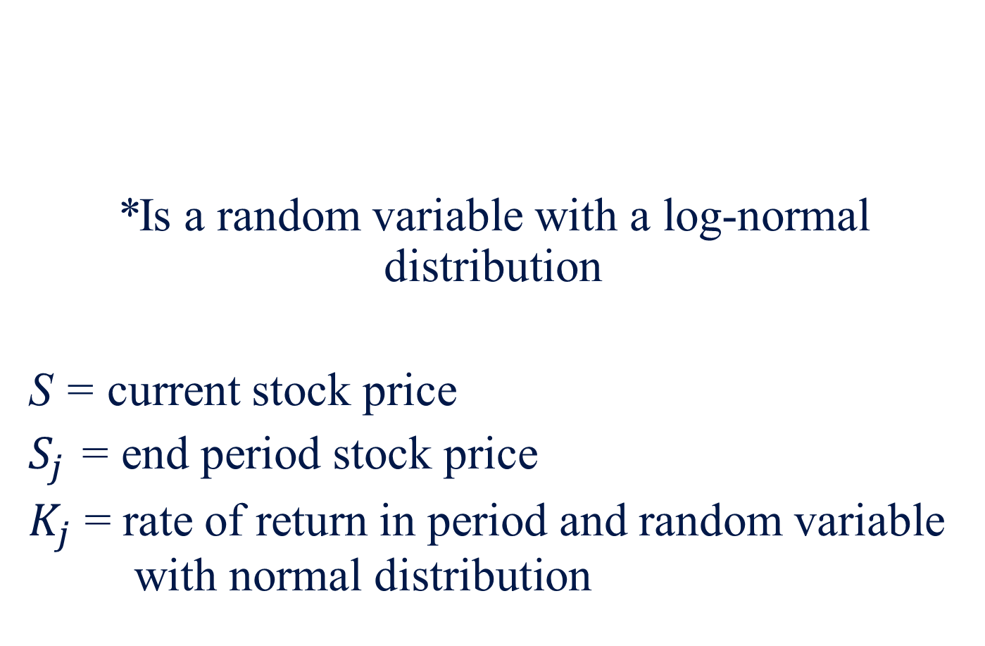
*Is a random variable with a log-normal distribution
S = current stock price
$S_{j}$ = end period stock price
$K_{j}$ = rate of return in period and random variable with normal distribution

Slide 46
Let K_{t} have the expected value and variance for each j. Then is a normal random variable with expected value and variance . Thus, we can define the expected value (mean) of as
Under the assumption of a risk-neutral investor, the expected return becomes ( where r is the riskless rate of interest). In other words,
(19.52)
(19.53)

Slide 47
In risk-neutral assumptions, call option price C can be determined by discounting the expected value of terminal option price by the riskless rate of interest:
T = time of expiration and X = striking price
(19.54)
(19.55)

Slide 48
Eq. (19.54) and (19.55) say that the value of the call option today will be either or 0, whichever is greater.
If the price of stock at time t is greater than the exercise price, the call option will expire in the money.
In other words, the investor will exercise the call option. The option will be exercised regardless of whether the option holder would like to take physical possession of the stock.

Slide 49
1.Own Stock
Obtain by exercising option
2. Sell Stock
Immediate profit of
Exercise option and sell immediately
Two Choices For Investor

Slide 50
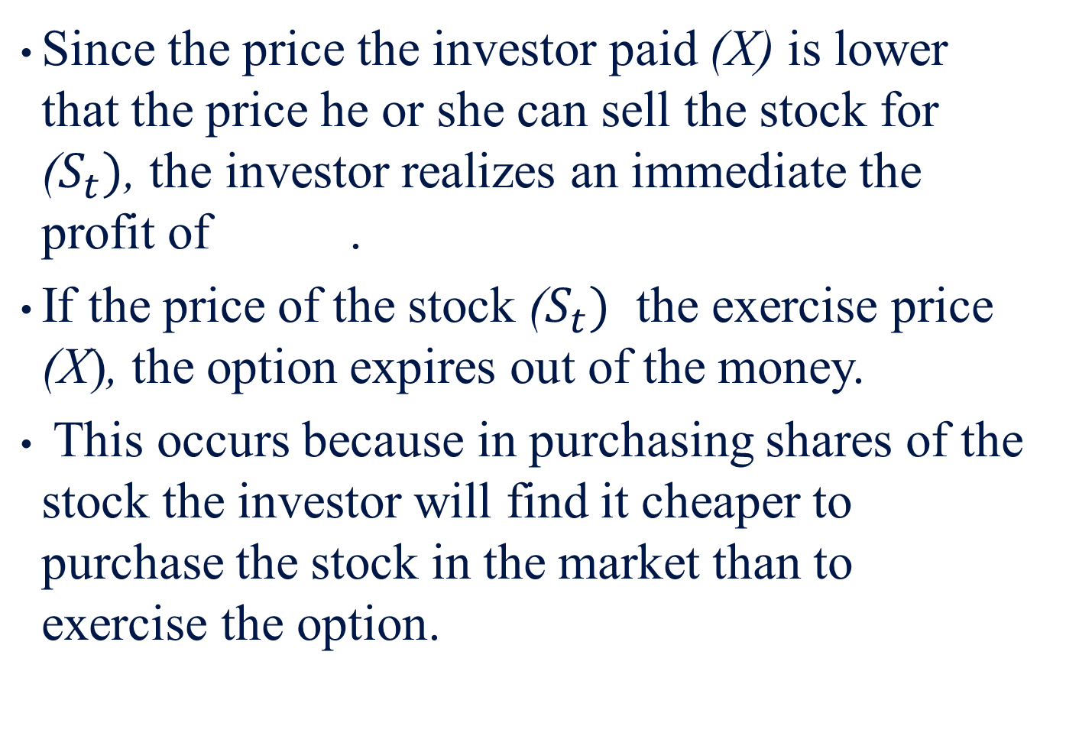
Since the price the investor paid (X) is lower that the price he or she can sell the stock for ($S_{t})$, the investor realizes an immediate the profit of .
If the price of the stock ($S_{t})$ the exercise price (X), the option expires out of the money.
This occurs because in purchasing shares of the stock the investor will find it cheaper to purchase the stock in the market than to exercise the option.

Slide 51
Let be log-normally distributed with parameters and . Then
Where g(x) is the probability density function of
(19.56)

Slide 52
By substituting and
Into eq. (19.18) and (19.26), we get
where
(19.57)
(19.58)
(19.59)
(19.60)

Slide 53
Substituting eq. (19.58) into eq. (19.56), we get
This is also Eq.(19.48) defined in Section 19.6
(19.61)

Slide 54
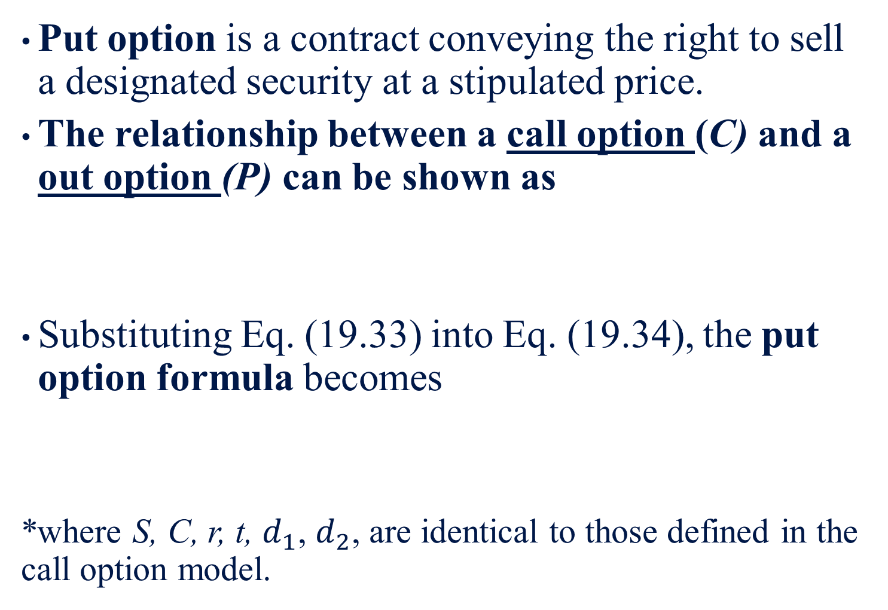
Put option is a contract conveying the right to sell a designated security at a stipulated price.
The relationship between a call option (C) and a out option (P) can be shown as
Substituting Eq. (19.33) into Eq. (19.34), the put option formula becomes
*where S, C, r, t, $d_{1}$, $d_{2}$, are identical to those defined in the call option model.
(19.62)
(19.63)

Slide 55
19.7 The Bivariate Normal Density Function
A joint distribution of two variables is when in correlation analysis, we assume a population where both X and Y vary jointly.
If both X and Y are normally distributed, then we call this known distribution a bivariate normal distribution.

Slide 56
The PDF of the normally distributed random variables X and Y can be
Where and are population means for X and Y, respectively; and are population standard deviations of X and Y, respectively; ;and exp represents the exponential function.
(19.64)
(19.65)

Slide 57
If represents the population correlation between X and Y, then the PDF of the bivariate normal distribution can be defined as
Where and
(19.66)
(19.67)

Slide 58
It can be shown that the conditional mean of Y, given X, is linear in X and given by
This equation can be regarded as describing the population linear regression line.
Accordingly, a linear regression in terms of the bivariate normal distribution variable is treated as though there were a two-way relationship instead of an existing causal relationship.
It should be noted that regression implies a causal relationship only under a “prediction” case.
(19.67)

Slide 59
It is also clear that given X, we can define the conditional variance of Y as
Eq. (19.66) represents a joint PDF for X and Y.
If , then Equation (19.66) becomes
This implies that the joint PDF of X and Y is equal to the PDF of X times the PDf of Y. We also know that both X and Y are normally distributed. Therefore, X is independent of Y.
(19.68)
(19.69)

Slide 60
Example 19.1
Using a Mathematics Aptitude Test to Predict Grade in Statistics
Let X and Y represent scores in a mathematics aptitude test and numerical grade in elementary statistics, respectively.
In addition, we assume that the parameters in Equation (19.66) are

Slide 61
Substituting this information into Equations (19.67) and (19.68), respectively, we obtain
(19.70)
(19.71)

Slide 62
If we know nothing about the aptitude test score of a particular student (say, john), we have to use the distribution of Y to predict his elementary statistics grade.
That is, we predict with 95% probability that John’s grade will fall between 87.84 and 72.16.

Slide 63
Alternatively, suppose we know that John’s mathematics aptitude score is 650. In this case, we can use Equations (19.70) and (19.71) to predict John’s grade in elementary statistics.
And

Slide 64
We can now base our interval on a normal probability distribution with a mean of 87 and a standard deviation of 2.86.
That is, we predict with 95% probability that John’s grade will fall between 92.61 and 81.39.

Slide 65
Two things have happened to this interval.
First, the center has shifted upward to take into account the fact that John’s mathematics aptitude score is above average.
Second, the width of the interval has been narrowed from 87.84−72.16 = 15.68 grade points to 92.61－81.39 = 11.22 grade points.
In this sense, the information about John’s mathematics aptitude score has made us less uncertain about his grade in statistics.

Slide 66
19.8 American Call Options
19.8.1 Price American Call Options by the Bivariate Normal Distribution
An option contract which can be exercised only on the expiration date is called European call.
If the contract of a call option can be exercised at any time of the option's contract period, then this kind of call option is called American call.

Slide 67
When a stock pays a dividend, the American call is more complex.
The valuation equation for American call option with one known dividend payment can be defined as
where
(19.72a)
(19.72b)
(19.72c)

Slide 68
(19.73)
represents the correct stock net price of the present value of the promised dividend per share (D);
t represents the time dividend to be paid.
is the exdividend stock price for which
S, X, r, , T have been defined previously in this chapter.
(19.74)

Slide 69
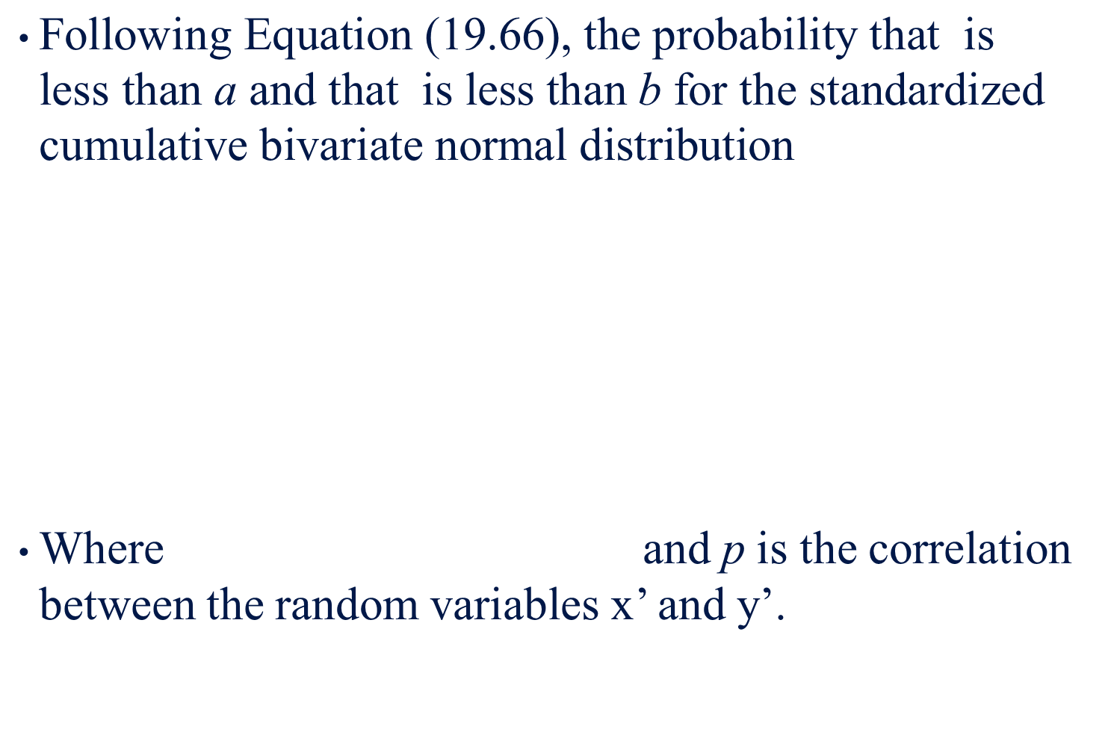
$\text{Following} \text{Equation}\text{ (19.66), }\text{the} \text{probability} \text{that} \text{is} \text{less} \text{than} \text{a} \text{and} \text{that} \text{is} \text{less} \text{than} \text{b} \text{for} \text{the} \text{standardized} \text{cumulative} \text{bivariate} \text{normal} \text{distribution}$
Where and p is the correlation between the random variables x’ and y’.

Slide 70
The first step in the approximation of the bivariate normal probability is as follows:
where
(19.75)

Slide 71
The pairs of weights, (w) and corresponding abscissa values ( ) are
i, j | w
1 | 0.24840615 | 0.10024215
2 | 0.39233107 | 0.48281397
3 | 0.21141819 | 1.0609498
4 | 0.033246660 | 1.7797294
5 | 0.00082485334 | 2.6697604

Slide 72
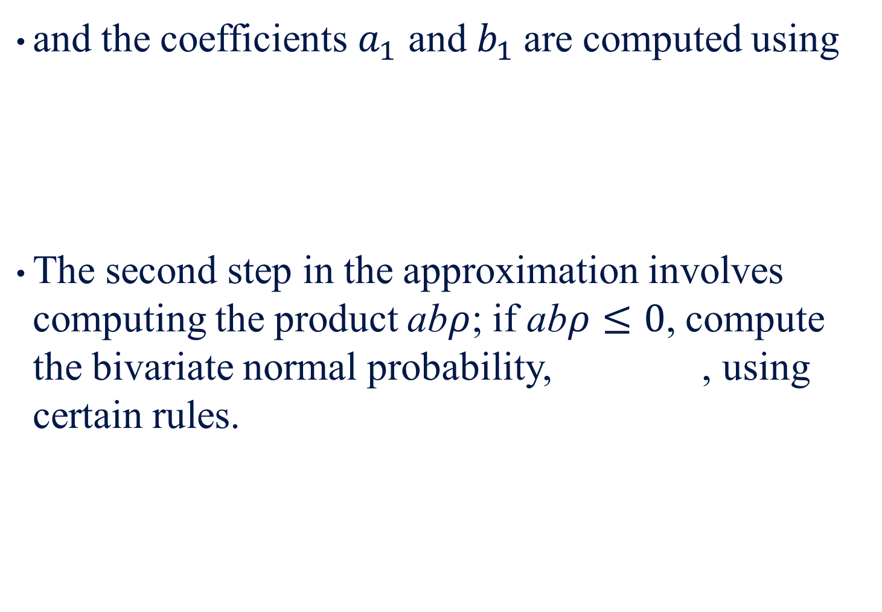
and the coefficients $a_{1}$ and $b_{1}$are computed using
The second step in the approximation involves computing the product ab$ρ$; if ab$ρ≤0$, compute the bivariate normal probability, , using certain rules.

Slide 73
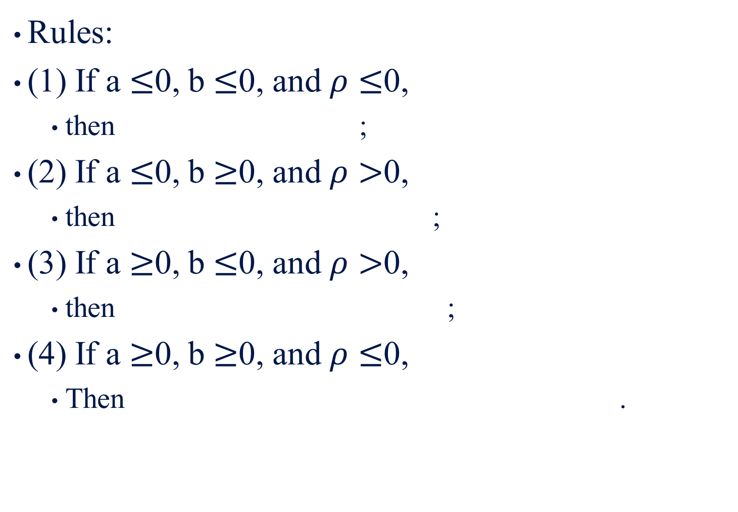
Rules:
(1) If a $≤$0, b $≤$0, and $ρ≤$0,
  then ;
(2) If a $≤$0, b $≥$0, and $ρ>$0,
  then ;
(3) If a $≥$0, b $≤$0, and $ρ>$0,
  then ;
(4) If a $≥$0, b $≥$0, and $ρ≤$0,
  Then .
(19.76)

Slide 74
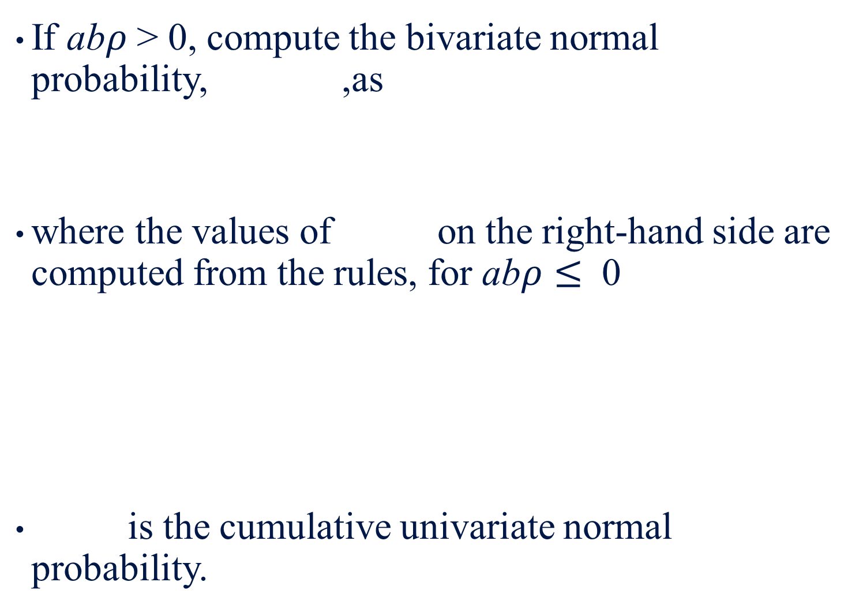
If ab$ρ$ > 0, compute the bivariate normal probability, ,as
where the values of on the right-hand side are computed from the rules, for ab$ρ≤$ 0
is the cumulative univariate normal probability.
(19.77)

Slide 75
19.8.2 Pricing an American Call Option
An American call option whose exercise price is $48 has an expiration time of 90 days. Assume the risk-free rate of interest is 8% annually, the underlying price is $50, the standard deviation of the rate of return of the stock is 20%, and the stock pays a dividend of $2 exactly for 50 days.
(a) What is the European call value?
(b) Can the early exercise price predicted?
(c) What is the value of the American call?

Slide 76
The current stock net price of the present value of the promised dividend is
The European call value can be calculated as
where

Slide 77
From standard normal table, we obtain
So the European call value is
C = (48.516)(0.599809) − 48(0.980)(0.561014) = 2.40123.

Slide 78
(b) The present value of the interest income that would be earned by deferring exercise until expiration is
Since d = 2> 0.432, therefore, the early exercise is not precluded.

Slide 79
= 46.9641. An Excel program used to calculate this value is presented in Table 19-1.
(c) The value of the American call is now calculated as
since both and depend on the critical exdividend stock price , which can be determined by
By using trial and error, we find that = 46.9641. An Excel program used to calculate this value is presented in Table 19-1.
(19.78)

Slide 80
Table 19-1 Calculation of S_{t}*
S_{t}* (Critical ex-dividend stock price)
S*(critical exdividend stock price) | 46 | 46.962 | 46.963 | 46.9641 | 46.9 | 47
X(exercise price of option) | 48 | 48 | 48 | 48 | 48 | 48
r(risk-free interest rate) | 0.08 | 0.08 | 0.08 | 0.08 | 0.08 | 0.08
volalitity of stock | 0.2 | 0.2 | 0.2 | 0.2 | 0.2 | 0.2
T-t(expiration date-exercise date) | 0.10959 | 0.10959 | 0.10959 | 0.10959 | 0.10959 | 0.10959
d₁ | −0.4773 | −0.1647 | −0.1644 | −0.164 | −0.1846 | −0.1525
d₂ | −0.5435 | −0.2309 | −0.2306 | −0.2302 | −0.2508 | −0.2187
D(divent) | 2 | 2 | 2 | 2 | 2 | 2
c(value of European call option to buy one share) | 0.60263 | 0.96319 | 0.96362 | 0.9641 | 0.93649 | 0.9798
p(value of European put option to sell one share) | 2.18365 | 1.58221 | 1.58164 | 1.58102 | 1.61751 | 1.56081
C(S_{t}*,T−t;X) −St*−D+X | 0.60263 | 0.00119 | 0.00062 | 2.3E−06 | 0.03649 | −0.0202

Slide 81
 | Caculation of S_{t}*(critical ex-dividend stock price)
1* |  | Column C*
2
3 | S*(critical ex-dividend stock price) | 46
4 | X(exercise price of option) | 48
5 | r(risk-free interest rate) | 0.08
6 | volatility of stock | 0.2
7 | T-t(expiration date-exercise date) | =(90-50)/365
8 | d₁ | =(LN(C3/C4)+(C5+C6^2/2)*(C7))/(C6*SQRT(C7))
9 | d₂ | =(LN(C3/C4)+(C5-C6^2/2)*(C7))/(C6*SQRT(C7))
10 | D(divent) | 2
11
12 | c(value of European call option to buy one share) | =C3*NORMSDIST(C8)-C4*EXP(-C5*C7)* NORMSDIST(C9)
13 | p(value of European put option to sell one share) | =C4*EXP(-C5*C7)*NORMSDIST(-C9)- C3*NORMSDIST(-C8)
14
15 | C(S_{t}*,T-t;X)-S_{t}*-D+X | =C12-C3-C10+C4

Slide 82
Substituting S^{x} = 48.208，X =＄48 and S_{t}* into Equations (19.72b) and (19.72c), we can calculate a₁, a₂, b₁, and b₂:
a₁ = d₁ =0.25285.
a₂ = d₂ =0.15354.
b₂ = 0.485931–0.074023 = 0.4119.

Slide 83
In addition, we also know
From the above information, we now calculate related normal probability as follows:
N₁（b₁）= N₁（0.4859）=0.6865
N₁（b₂）= N₁（0.7454）=0.6598

Slide 84
Following Equation (19.77), we now calculate the value of N₂（0.25285,−0.4859; −0.7454）and N₂（0.15354, −0.4119; −0.7454）as follows:
Since abρ > 0 for both cumulative bivariate normal density function, therefore, we can use Equation N₂（a, b;ρ）= N₂（a, 0;ρ_{ab}）+ N₂（b, 0;ρ_{ba}）-δ
to calculate the value of both N₂（a, b;ρ）as follows:

Slide 85
δ =（1−（1）（−1））/4 = ½
N₂（0.292,−0.4859; −0.7454）=N₂（0.292,0.0844）+N₂（−0.5377,0.0656）− 0.5 = N₁（0）+ N₁（−0.5377）−Φ（−0.292, 0; − 0.0844）−Φ（−0.5377,0; −0.0656）−0.5 = 0.07525

Slide 86
Using a Microsoft Excel programs presented in Appendix 19A, we obtain
N₂（0.1927, −0.4119; −0.7454）= 0.06862.
Then substituting the related information into the Equation (19.78), we obtain C=＄3.08238 and all related results are presented in Appendix 19B.

Slide 87
19.9 Price Bounds for Options
19.9.1 Options Written on Nondividend- Paying Stocks
To derive the lower price bounds and the put–call parity relations for options on nondividend-paying stocks, simply set
cost-of-carry rate (b) = risk-less rate of interest (r)
Note that, the only cost of carrying the stock is interest.

Slide 88
The lower price bounds for the European call and put options are
respectively, and the lower price bounds for the American call and put options are
respectively.
(19.79a)
(19.79b)
(19.80a)
(19.80b)

Slide 89
The put–call parity relation for nondividend-paying European stock options is
and the put–call parity relation for American options on nondividend-paying stocks is
For nondividend-paying stock options, the American call option will not rationally be exercised early, while the American put option may be done so.
(19.81a)
(19.81b)

Slide 90
19.9.2 Options Written on Dividend-Paying Stocks
If dividends are paid during the option's life, the above relations must reflect the stock's drop in value when the dividends are paid.
To manage this modification, we assume that the underlying stock pays a single dividend during the option’s life at a time that is known with certainty.
he dividend amount is D and the time to exdividend is t.

Slide 91
If the amount and the timing of the dividend payment are known, the lower price bound for the European call option on a stock is
In this relation, the current stock price is reduced by the present value of the promised dividend.
Because a European-style option cannot be exercised before maturity, the call option holder has no opportunity to exercise the option while the stock is selling cum dividend.
(19.82a)

Slide 92
In other words, to the call option holder, the current value of the underlying stock is its observed market price less the amount that the promised dividend contributes to the current stock value, that is, .
To prove this pricing relation, we use the same arbitrage transactions, except we use the reduced stock price in place of S. The lower price bound for the European put option on a stock is
(19.82b)

Slide 93
In the case of the American call option, for example, it may be optimal to exercise just prior to the dividend payment because the stock price falls by an amount D when the dividend is paid.
The lower price bound of an American call option expiring at the exdividend instant would be 0 or , whichever is greater.
On the other hand, it may be optimal to wait until the call option’s expiration to exercise.

Slide 94
The lower price bound for a call option expiring normally is (19.82a). Combining the two results, we get
The last two terms on the right-hand side of (19.83a) provide important guidance in deciding whether to exercise the American call option early, just prior to the exdividend instant.
The second term in the squared brackets is the present value of the early exercise proceeds of the call.
(19.83a)

Slide 95
If the amount is less than the lower price bound of the call that expires normally, that is, if
the American call option will not be exercised just prior to the exdividend instant.
To see why, simply rewrite (19.84) so it reads
In other words, the American call will not be exercised early if the dividend captured by exercising prior to the exdividend date is less than the interest implicitly earned by deferring exercise until expiration.
(19.84)
(19.85)

Slide 96
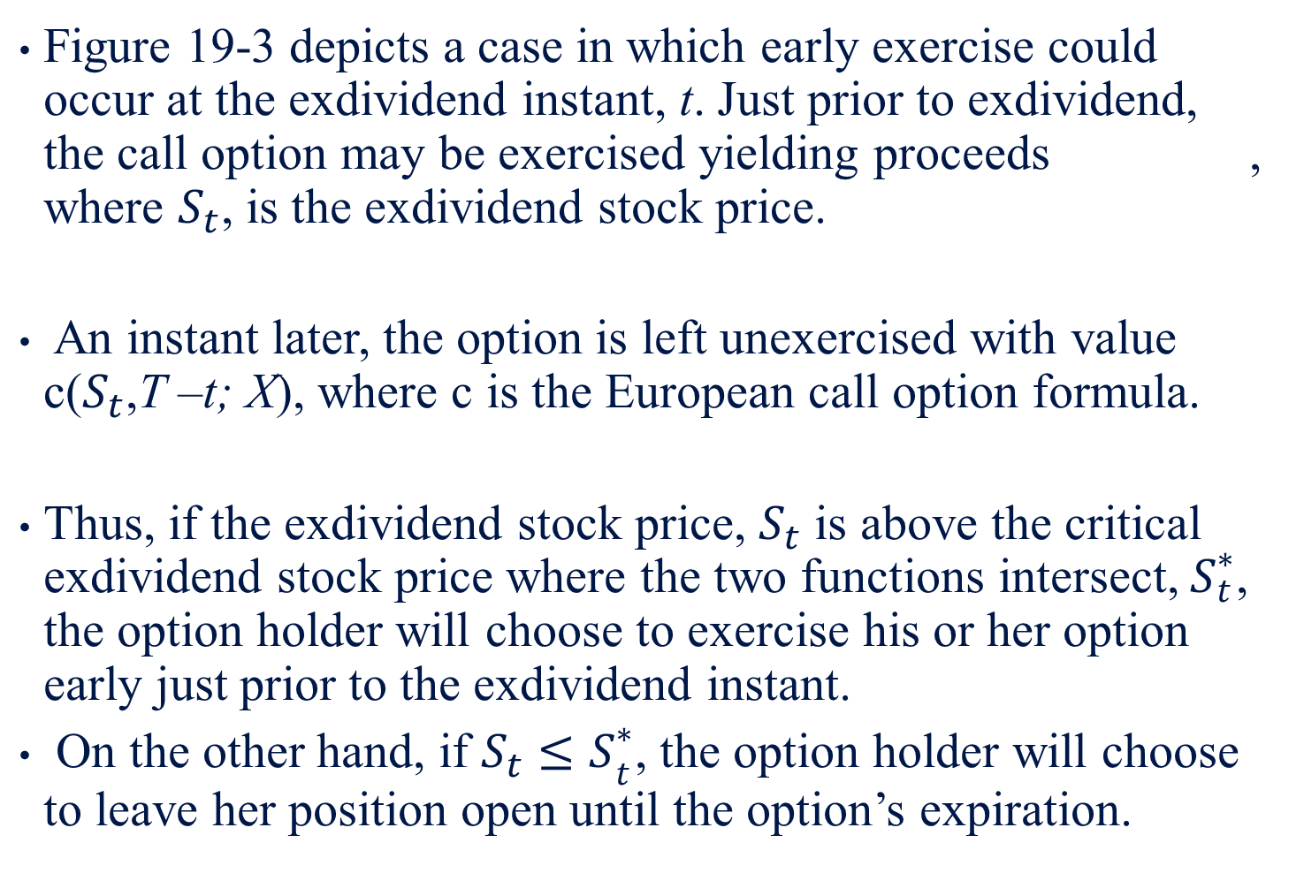
Figure 19-3 depicts a case in which early exercise could occur at the exdividend instant, t. Just prior to exdividend, the call option may be exercised yielding proceeds , where $S_{t}$, is the exdividend stock price.
An instant later, the option is left unexercised with value c($S_{t}$,T –t; X), where c is the European call option formula.
Thus, if the exdividend stock price, $S_{t}$ is above the critical exdividend stock price where the two functions intersect,${ S}_{t}^{∗}$, the option holder will choose to exercise his or her option early just prior to the exdividend instant.
On the other hand, if ${S_{t}≤S}_{t}^{∗}$, the option holder will choose to leave her position open until the option’s expiration.

Slide 97
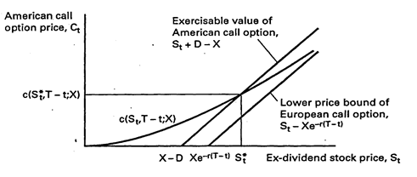
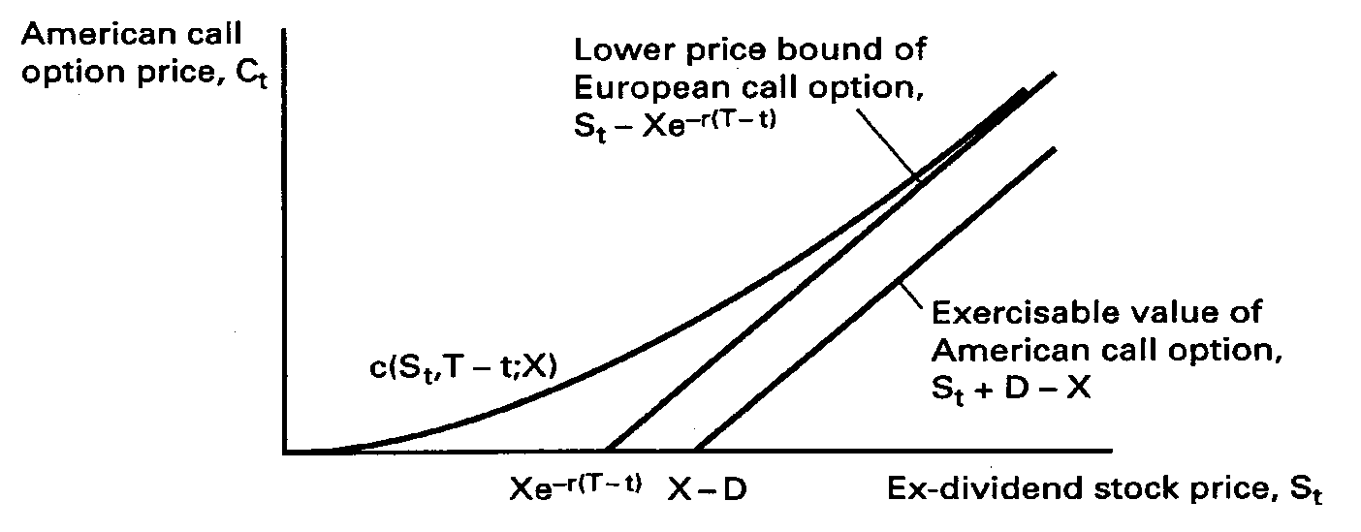
Figure 19-3 *Early exercise may be optimal.
Figure 19-4 *Early exercise will not be optimal.

Slide 98
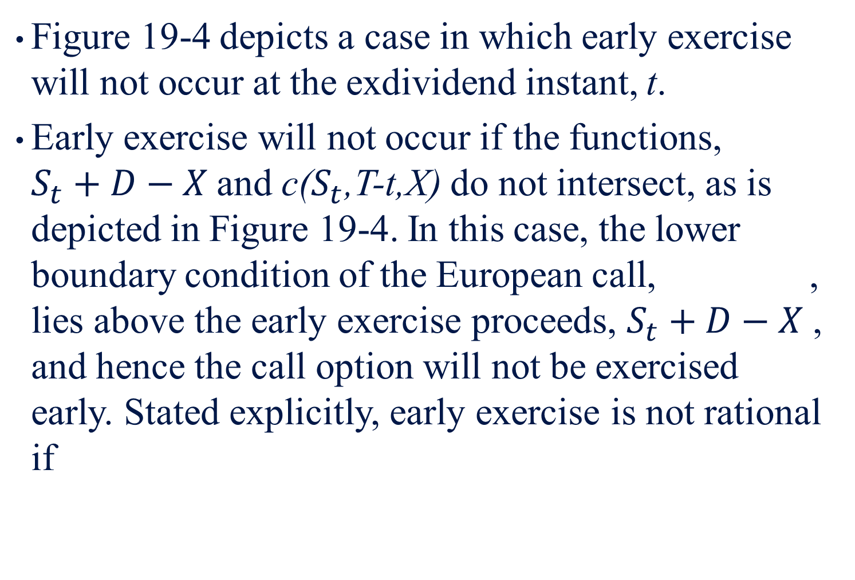
Figure 19-4 depicts a case in which early exercise will not occur at the exdividend instant, t.
Early exercise will not occur if the functions, $S_{t}+D−X$and c($S_{t}$,T-t,X) do not intersect, as is depicted in Figure 19-4. In this case, the lower boundary condition of the European call, , lies above the early exercise proceeds, $S_{t}+D−X$ , and hence the call option will not be exercised early. Stated explicitly, early exercise is not rational if

Slide 99
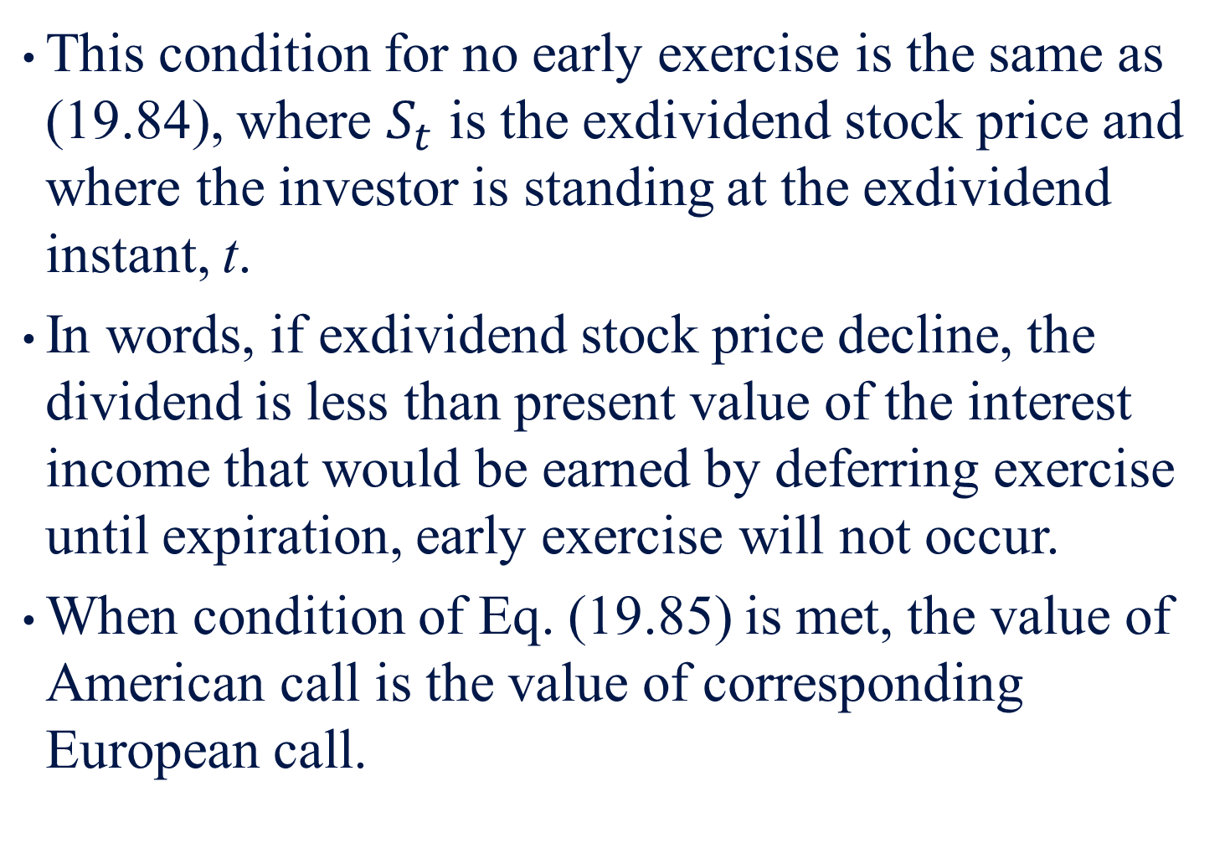
This condition for no early exercise is the same as (19.84), where $S_{t}$ is the exdividend stock price and where the investor is standing at the exdividend instant, t.
In words, if exdividend stock price decline, the dividend is less than present value of the interest income that would be earned by deferring exercise until expiration, early exercise will not occur.
When condition of Eq. (19.85) is met, the value of American call is the value of corresponding European call.

Slide 100
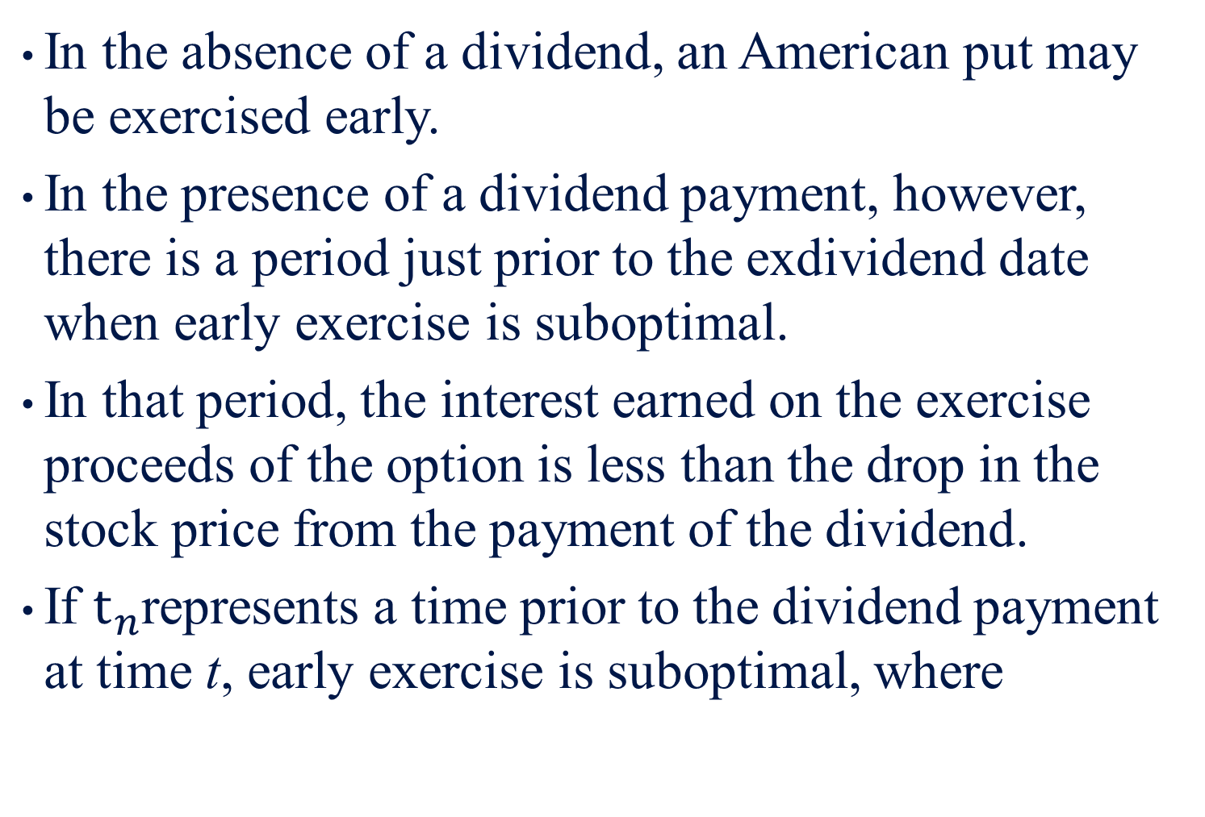
In the absence of a dividend, an American put may be exercised early.
In the presence of a dividend payment, however, there is a period just prior to the exdividend date when early exercise is suboptimal.
In that period, the interest earned on the exercise proceeds of the option is less than the drop in the stock price from the payment of the dividend.
If $t_{n}$represents a time prior to the dividend payment at time t, early exercise is suboptimal, where

Slide 101
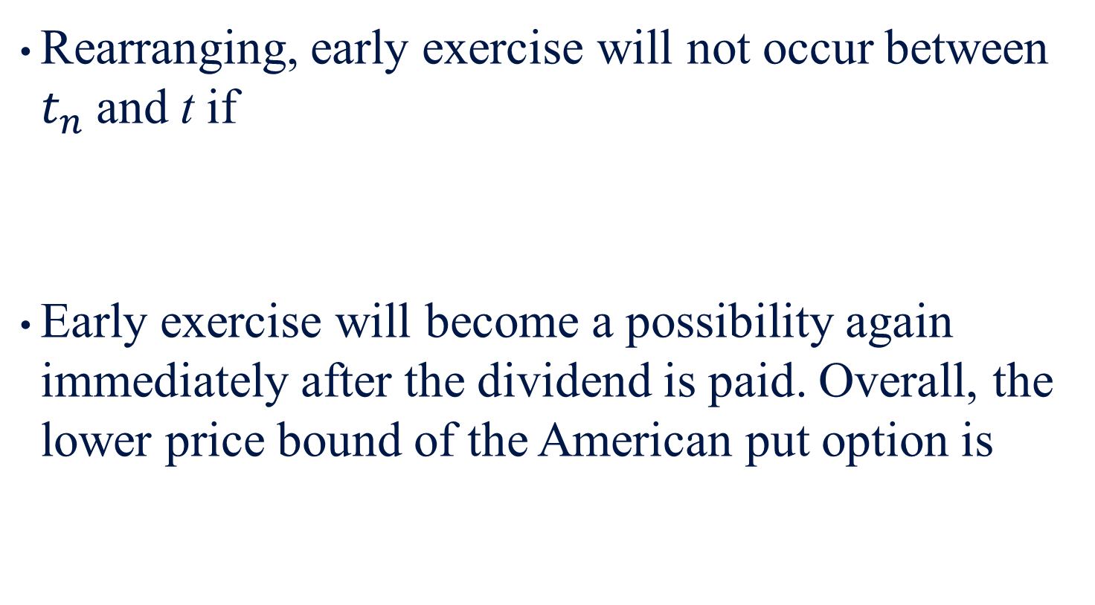
Rearranging, early exercise will not occur between $t_{n}$and t if
Early exercise will become a possibility again immediately after the dividend is paid. Overall, the lower price bound of the American put option is
(19.86)
(19.83b)

Slide 102
Put–call parity for European options on dividend-paying stocks also reflects the fact that the current stock price is deflated by the present value of the promised dividend, that is
That the presence of the dividend reduces the value of the call and increases the value of the put is again reflected here by the fact that the term on the right-hand side of (19.87) is smaller than it would be if the stock paid no dividend.
(19.87)

Slide 103
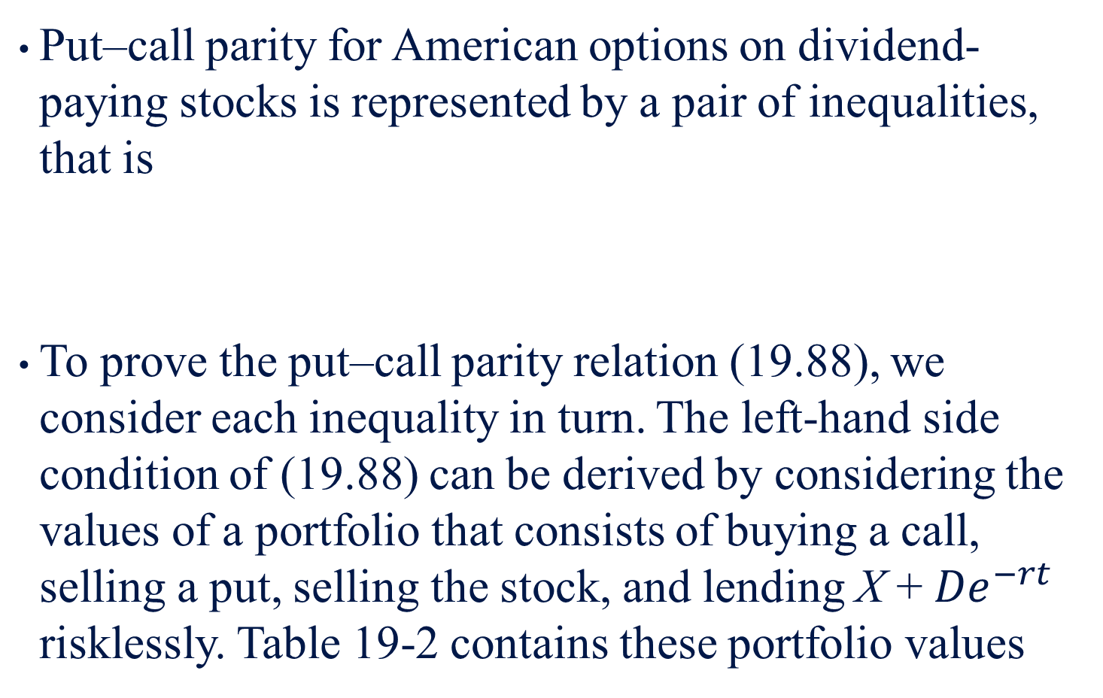
Put–call parity for American options on dividend-paying stocks is represented by a pair of inequalities, that is
To prove the put–call parity relation (19.88), we consider each inequality in turn. The left-hand side condition of (19.88) can be derived by considering the values of a portfolio that consists of buying a call, selling a put, selling the stock, and lending X + ${De}^{−rt}$ risklessly. Table 19-2 contains these portfolio values
(19.88)

Slide 104
In Table 19-2, if all of the security positions stay open until expiration, the terminal value of the portfolio will be positive, independent of whether the terminal stock price is above or below the exercise price of the options.
If the terminal stock price is above the exercise price, the call option is exercised, and the stock acquired at exercise price X is used to deliver, in part, against the short stock position.
If the terminal stock price is below the exercise price, the put is exercised. The stock received in the exercise of the put is used to cover the short stock position established at the outset.
In the event the put is exercised early at time T, the investment in the riskless bonds is more than sufficient to cover the payment of the exercise price to the put option holder, and the stock received from the exercise of the put is used to cover the stock sold when the portfolio was formed.
In addition, an open call option position that may still have value remains.

Slide 105
Table 19-2 Arbitrage Transactions for Establishing
Put–Call Parity for American Stock Options

Slide 106
In other words, by forming the portfolio of securities in the proportions noted above, we have formed a portfolio that will never have a negative future value.
If the future value is certain to be non-negative, the initial value must be nonpositive, or the left-hand inequality of (19.88) holds.

Slide 107
Summary
In this chapter, we first introduced univariate and multivariate normal distribution and log-normal distribution.
Then we showed how normal distribution can be used to approximate binomial distribution.
Finally, we used the concepts normal and log-normal distributions to derive Black–Scholes formula under the assumption that investors are risk neutral.
In this chapter, we first reviewed the basic concept of the Bivariate normal density function and present the Bivariate normal CDF.
The theory of American call stock option pricing model for one dividend payment is also presented.
The evaluations of stock option models without dividend payment and with dividend payment are discussed, respectively.
Finally, we provided an excel program for evaluating American option pricing model with one dividend payment.

