Slide 1
Chapter 26
Simultaneous Equation Models for Security Valuation
By
Cheng Few Lee
Joseph Finnerty
John Lee
Alice C Lee
Donald Wort

Slide 2
Outline
26.1 Warren and Shelton model
26.2 Johnson & JOhnson AS A CASE STUDY
26.2.1 Data Sources and Parameter Estimations
26.2.2 Procedure for Calculating WS model
26.3 Francis and Rowell model
26.3.1 The FR Model Specification
26.3.2 A Brief Discussion of FR’s Empirical Results
26.4 FELTHAM–OHLSON MODEL FOR DETERMINING EQUITY VALUE
26.5 Summary
Appendix 26A: PROCEDURE OF USING MICROSOFT EXCEL TO RUN FINPLAN PROGRAM
Appendix 26B: PROGRAM OF FINPLAN WITH AN EXAMPLE

Slide 3
26.1 Warren And Shelton Model
The Warren and Shelton (1971) (hereafter, WS) devised a simultaneous-equation model.
Table 26.1 shows that WS model has four distinct segments corresponding to the sales, investment, financing, and return-to-investment concepts in financial theory.
The entire model is a system of 20 equations of a semi-simultaneous nature.
The actual solution algorithm is recursive, between and within segments.
The 20-equation model appears in Table 26.1, and the parameters used as inputs to the model are demonstrated in the second part of Table 26.2.

Slide 4
Table 26.2 List of Unknowns and List of Parameters Provided by Management
Source: Warren, J. M. and J. P.Shelton. “A Simultaneous-Equation Approach to Financial Planning.” Journal of Finance (December 1971): Table 1. Reprinted by permission.
Unknowns
1. SALES_{t} Sales
2. CA_{t} Current Assets
3. FA_{t} Fixed Assets
4. A_{t} Total Assets
5. CL_{t} Current Payables
6. NF_{t} Needed Funds
7. EBIT_{t} Earnings before Interest and Taxes
8. NL_{t} New Debt
9. NS_{t} New Stock
10. L_{t} Total Debt
11. S_{t} Common Stock
12. R_{t} Retained Earnings
13. i_{t} Interest Rate on Debt
14.EAFCD_{I} Earnings Available for Common Dividends
15.CMDIV_{t} Common Dividends
16.NUMCS_{t} Number of Common Shares Outstanding
17.NEWCS_{t} New Common Shares Issued
18.P_{t} Price per Share
19.EPS_{t} Earnings per Share
20.DPS_{t} Dividends per Share

Slide 5
Table 26.2 List of Unknowns and List of Parameters Provided by Management
Source: Warren, J. M. and J. P.Shelton. “A Simultaneous-Equation Approach to Financial Planning.” Journal of Finance (December 1971): Table 1. Reprinted by permission.
II Provided by Management
21.SALES_{t−1} Sales in Previous Period
22.GSALS_{t} Growth in Sales
23.RCA_{t} Current Assets as a Percent of Sales
24.RFA_{t} Fixed Assets as a Percent of Sales
25.RCL_{t} Current Payables as a Percent of Sales
26.PFDSK_{t} Preferred Stock
27.PFDIV_{t} Preferred Dividends
28.L_{t−1} Debt in Previous Period
29.LR_{t} Debt Repayment
30.S_{t−1} Common Stock in Previous Period
31.R_{t−1} Retained Earnings in Previous Period
32.b_{t} Retention Rate
33.T_{t} Average Tax Rate
34.i_{t−1} Average Interest Rate in Previous Period
35.i^{e}_{t} Expected Interest Rate on New Debt
36.REBIT_{t} Operating Income as a Percent of Sales
37.U¹_{t} Underwriting Cost of Debt
38.U^{s}_{t} Underwriting Cost of Equity
39.K_{t} Ratio of Debt to Equity
40.NUMCS_{t−1} Number of Common Shares Outstanding in Previous Period
41.m_{t} Price-Earnings Ratio

Slide 6
26.2 Johnson & Johnson as a Case Study
Variable*
Number | Data** | Variable | Description
21 | 61897.0 | SALEt−1 | Net Sales at t−1 = 2009
22 | −0.2900 | GCALSt | Growth in Sales
23 | 0.6388 | RCAt−1 | Current Assets as a Percentage of Sales
24 | 0.8909 | RFAt−1 | Fixed Assets as a Percentage of Sales
25 | 0.3109 | RCLt−1 | Current Payables as a Percentage of Sales
26 | 0.0000 | PFDSKt−1 | Preferred Stock
27 | 0.0000 | PFDIVt−1 | Preferred Dividends
28 | 8223.0 | Lt−1 | Long-Term Debt in Previous Period
29 | 219.0 | LRt−1 | Long-Term Debt Repayment (Reduction)
30 | 3120.0 | St−1 | Common Stock in Previous Period
31 | 67248.0 | Rt−1 | Retained Earnings in Previous Period
32 | 0.5657 | bt−1 | Retention Rate
33 | 0.2215 | Tt−1 | Average Tax Rate (Income Taxes/Pretax Income)
34 | 0.0671 | it−1 | Average Interest Rate in Previous Period
35 | 0.0671 | i^{e}_{t}−₁ | Expected Interest Rate on New Debt
36 | 0.2710 | REBITt−1 | Operating Income as a Percentage of Sales
37 | 0.0671 | U^{L} | Underwriting Cost of Debt
38 | 0.1053 | U^{E} | Underwriting Cost of Equity
39 | 0.1625 | Kt | Ratio of Debt to Equity
40 | 2754.3 | NUMCSt−1 | Number of Common Shares Outstanding in Previous Period
41 | 14.5 | mt−1 | Price–Earnings Ratio
 | * Variable number as defined in Table 26-2. |  | ***Variables can be found in Balance Sheet, Income Statement, and Cash Flow
 | ** Data obtained from JNJ Balance Sheets and Income Statements.
Table 26.3 FINPLAN Input Format

Slide 7
26.2.1 Data Sources and Parameter Estimations
The base year of the planning is 2009 and the planning period is one year, that is, 2010.
Accounting and market data are required to estimate the parameters of WS financial-planning model.
The COMPUSTAT data file is the major sources of accounting and market information.
All dollar terms are in millions, and the number of shares outstanding is also millions.
Using these parameter estimates given in Table 26.3, the 20 unknown variables related to income statement and balance sheet can be solved for algebraically.

Slide 8
26.2.2 Procedure for Calculating WS Model
For detailed procedures for calculating WS Model please look in textbook page 1043 -1047.
About 18 out of 20 unknowns are listed in Table 26.4, the actual data is also listed to allow calculation of the forecast errors.
In the last column of Table 26.4, the relative absolute forecasting errors (|(A − F)/A|) are calculated to indicate the performance of the WS model in forecasting important financial variables.
It was found that the quality of the sales-growth rate estimate is the key to successfully using the WS model in financial planning and forecasting.

Slide 9
Table 26.4 The Comparison of Financial Forecast of JNJ: Hand Calculation and FINPLAN Forecasting
 | Manual | Financial Plan | Variance
Category | Calculation | Model | (|(A − F)/A|) (%)
INCOME STATEMENT
Sales | 43,946.87 | 43,946.87 | 0.0
Operating Income | 11,909.60 | 11,909.60 | 0.0
Interest Expense | 502.39 | 502.39 | 0.0
Income before taxes | 11,372.53 | 11,372.53 | 0.0
Taxes | 2,519.02 | 2,519.02 | 0.0
Net Income | 8,853.52 | 8,853.52 | 0.0
Common Dividends | 3,868.53 | 3,845.08 | 0.6
Debt Repayments | 219.00 | 219.00 | 0.0
BALANCE SHEET
Assets
Current Assets | 28,073.26 | 28,073.26 | 0.0
Fixed Assets | 39,152.27 | 39,152.27 | 0.0
Total Assets | 67,225.53 | 67,225.53 | 0.0
LIABILITIES AND NET WORTH
Current Payables | 13,663.08 | 13,663.24 | 0.0
Total Debt | 7,487.22 | 7,487.20 | 0.0
Common Stock | (26,211.7) | (26,211.89) | 0.0
Retained Earnings | 72,286.98 | 72,286.98 | 0.0
Total Liabilities and Net Worth | 67,225.53 | 67,225.53 | 0.0
PER SHARE DATA
Price per Share | 58.79 | 58.51 | 0.5
Earnings per Share (EPS) | 4.05 | 4.04 | 0.5
Dividends per Share (DPS) | 1.76 | 1.75 | 0.5

Slide 10
To do multiperiod forecasting and sensitivity analysis, the program of FINPLAN of Microsoft Excel, as listed in Appendix 26A, can be used.
The input parameters and the values used to produce the pro forma financial statements are listed in Table 26.5.
Table 26.5 FINPLAN Input 2009
FINPLAN input
 | Variable | Beginning | Last
Value of Data (2009) | Number* | Period | Period | Description
4 | 1 | 0 | 0 | The number of years to be simulated
61897.0000 | 21 | 0 | 0 | Net Sales at t−1=2009
−0.2900 | 22 | 1 | 4 | Growth in Sales
0.6388 | 23 | 1 | 4 | Current Assets as a Percentage of Sales
0.8909 | 24 | 1 | 4 | Fixed Assets as a Percentage of Sales
0.3109 | 25 | 1 | 4 | Current Payables as a Percentage of Sales
0.0000 | 26 | 1 | 4 | Preferred Stock
0.0000 | 27 | 1 | 4 | Preferred Dividends
8223.0000 | 28 | 0 | 0 | Long-Term Debt in Previous Period
219.0000 | 29 | 1 | 4 | Long-Term Debt Repayment (Reduction)
3120.0000 | 30 | 0 | 0 | Common Stock in Previous Period
67248.0000 | 31 | 0 | 0 | Retained Earnings in Previous Period
0.5657 | 32 | 1 | 4 | Retention Rate
0.2215 | 33 | 1 | 4 | Average Tax Rate (Income Taxes/Pretax Income)
0.0671 | 34 | 0 | 0 | Average Interest Rate in Previous Period
0.0671 | 35 | 1 | 4 | Expected Interest Rate on New Debt
0.2710 | 36 | 1 | 4 | Operating Income as a Percentage of Sales
0.0671 | 37 | 1 | 4 | Underwriting Cost of Debt
0.1053 | 38 | 1 | 4 | Underwriting Cost of Equity
0.1625 | 39 | 1 | 4 | Ratio of Debt to Equity
2,754.321 | 40 | 0 | 0 | Number of Common Shares Outstanding in Previous Period
14.4700 | 41 | 1 | 4 | Price–Earnings Ratio

Slide 11
Table 26.6
Pro forma Balance Sheet of JNJ: 2010- 2013
Table 26.7
Pro forma Income Statement of JNJ: 2010- 2013

Slide 12
Year |  |  | 2010 | 2011 | 2012 | 2013
GSALSt= | bt−1= | Kt=
−0.2900 | 0.5657 | 0.1625
EPS = |  |  | 4.04 | 3.43 | 2.95 | 2.54
DPS = |  |  | 1.75 | 1.49 | 1.28 | 1.10
PPS = |  |  | 58.42 | 49.59 | 42.68 | 36.74
GSALSt= | bt−1= | Kt=
−0.4 | 0.5657 | 0.1625
EPS = |  |  | 3.69 | 2.88 | 2.29 | 1.82
DPS = |  |  | 1.60 | 1.25 | 0.99 | 0.79
PPS = |  |  | 53.47 | 41.71 | 33.10 | 26.27
GSALSt= | bt−1= | Kt=
0.09 | 0.5657 | 0.1625
EPS = |  |  | 5.09 | 5.65 | 6.23 | 6.86
DPS = |  |  | 2.21 | 2.46 | 2.70 | 2.98
PPS = |  |  | 73.61 | 81.81 | 90.11 | 99.26
GSALSt= | bt−1= | Kt=
−0.2900 | 0.3 | 0.1625
EPS = |  |  | 3.97 | 3.31 | 2.80 | 2.37
DPS = |  |  | 2.78 | 2.32 | 1.96 | 1.66
PPS = |  |  | 57.46 | 47.92 | 40.52 | 34.27
GSALSt= | bt−1= | Kt=
−0.2900 | 0.7 | 0.1625
EPS = |  |  | 4.07 | 3.49 | 3.03 | 2.63
DPS = |  |  | 1.22 | 1.05 | 0.91 | 0.79
PPS = |  |  | 58.90 | 50.44 | 43.80 | 38.03
GSALSt= | bt−1= | Kt=
−0.2900 | 0.5657 | 0.1
EPS = |  |  | 3.97 | 3.46 | 2.99 | 2.58
DPS = |  |  | 1.72 | 1.50 | 1.30 | 1.12
PPS = |  |  | 57.42 | 50.02 | 43.23 | 37.37
GSALSt= | bt−1= | Kt=
−0.2900 | 0.5657 | 0.5
EPS = |  |  | 3.94 | 3.39 | 2.86 | 2.42
DPS = |  |  | 1.71 | 1.47 | 1.24 | 1.05
PPS = |  |  | 56.97 | 49.01 | 41.40 | 34.98
Table 26.8
Results of Sensitivity Analysis
Results of the sensitivity analysis related to EPS, DPS, and PPS are shown.
Table 26.8 indicates that the generated pro forma financial statements that describe the future financial condition of the firm for any assumed pattern of sales.

Slide 13
26.3 Francis and Rowell Model
The model presented below extends the simultaneous linear-equation model of the firm developed by WS in 1971.
The object of this model is to generate pro forma financial statements that describe the future financial condition of the firm for any assumed pattern of sales.
The FR model is composed of 10 sectors with a total of 36 equations.
The model incorporates an explicit treatment of risk by allowing for stochastic variability in industry sales forecasts.
The exogenous input of sales variance is transformed (through simplified linear relations in the model) to coefficients of variation for EBIT and net income after taxes (NIAT) (see Table 26.10 ).

Slide 14
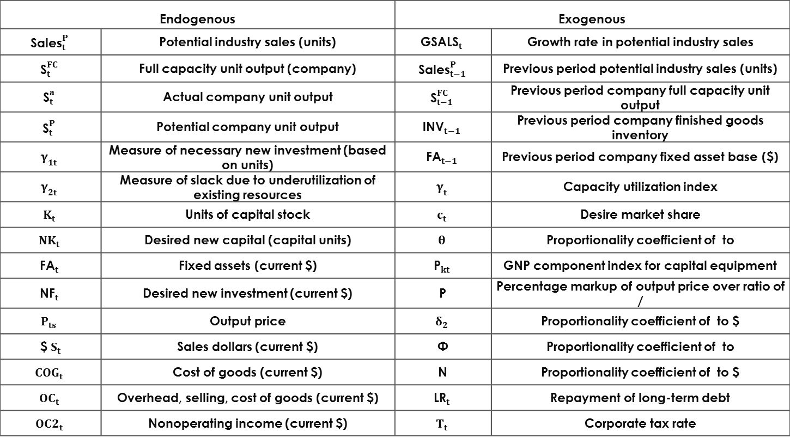
Table 26.9
List of Variables for FR Model
Endogenous |  | Exogenous
$${\text{Sales}}_{t}^{P}$$ | Potential industry sales (units) | $${\text{GSALS}}_{t}$$ | Growth rate in potential industry sales
$${\text{S}}_{t}^{FC}$$ | Full capacity unit output (company) | $${\text{Sales}}_{t−1}^{P}$$ | Previous period potential industry sales (units)
$${\text{S}}_{t}^{a}$$ | Actual company unit output | $${\text{S}}_{t−1}^{FC}$$ | Previous period company full capacity unit output
$${\text{S}}_{t}^{P}$$ | Potential company unit output | $${\text{INV}}_{t−1}$$ | Previous period company finished goods inventory
$$γ_{1t}$$ | Measure of necessary new investment (based on units) | $${\text{FA}}_{t−1}$$ | Previous period company fixed asset base ($)
$$γ_{2t}$$ | Measure of slack due to underutilization of existing resources | $$γ_{t}$$ | Capacity utilization index
$$K_{t}$$ | Units of capital stock | $$c_{t}$$ | Desire market share
$$NK_{t}$$ | Desired new capital (capital units) | $$θ$$ | Proportionality coefficient of to
$${\text{FA}}_{t}$$ | Fixed assets (current $) | $${\text{P}}_{kt}$$ | GNP component index for capital equipment
$${\text{NF}}_{t}$$ | Desired new investment (current $) | P | Percentage markup of output price over ratio of /
$$P_{ts}$$ | Output price | $$δ_{2}$$ | Proportionality coefficient of to $
$ $S_{t}$ | Sales dollars (current $) | Φ | Proportionality coefficient of to
$$COG_{t}$$ | Cost of goods (current $) | N | Proportionality coefficient of to $
$$OC_{t}$$ | Overhead, selling, cost of goods (current $) | $${\text{LR}}_{t}$$ | Repayment of long-term debt
$$OC2_{t}$$ | Nonoperating income (current $) | $$T_{t}$$ | Corporate tax rate

Slide 15
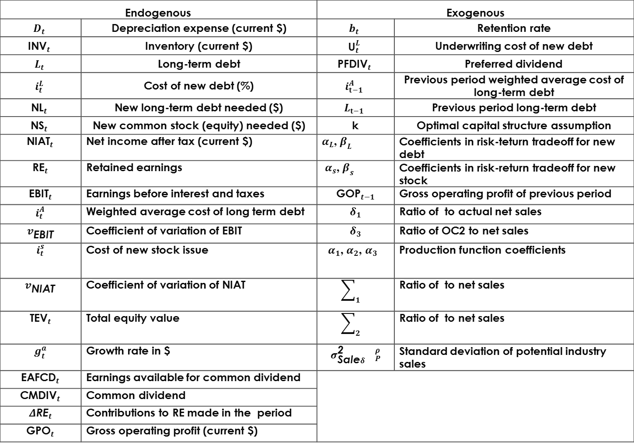
Endogenous |  | Exogenous
$$D_{t}$$ | Depreciation expense (current $) | $$b_{t}$$ | Retention rate
$${\text{INV}}_{t}$$ | Inventory (current $) | $${\text{U}}_{t}^{L}$$ | Underwriting cost of new debt
$$L_{t}$$ | Long-term debt | $${\text{PFDIV}}_{t}$$ | Preferred dividend
$$i_{t}^{L}$$ | Cost of new debt (%) | $$i_{t−1}^{A}$$ | Previous period weighted average cost of long-term debt
$${\text{NL}}_{t}$$ | New long-term debt needed ($) | $$L_{t−1}$$ | Previous period long-term debt
$${\text{NS}}_{t}$$ | New common stock (equity) needed ($) | k | Optimal capital structure assumption
$${\text{NIAT}}_{t}$$ | Net income after tax (current $) | $α_{L}$, $β_{L}$ | Coefficients in risk-teturn tradeoff for new debt
$${\text{RE}}_{t}$$ | Retained earnings | $α_{s}$, $β_{s}$ | Coefficients in risk-return tradeoff for new stock
$${\text{EBIT}}_{t}$$ | Earnings before interest and taxes | $${\text{GOP}}_{t−1}$$ | Gross operating profit of previous period
$$i_{t}^{A}$$ | Weighted average cost of long term debt | $$δ_{1}$$ | Ratio of to actual net sales
$$v_{\text{EBIT}}$$ | Coefficient of variation of EBIT | $$δ_{3}$$ | Ratio of OC2 to net sales
$$i_{t}^{s}$$ | Cost of new stock issue | $α_{1}$, $α_{2}$, $α_{3}$ | Production function coefficients
$$v_{\text{NIAT}}$$ | Coefficient of variation of NIAT | $$\sum_{1}{}$$ | Ratio of to net sales
$${\text{TEV}}_{t}$$ | Total equity value | $$\sum_{2}{}$$ | Ratio of to net sales
$$g_{t}^{a}$$ | Growth rate in $ | $$σ_{\text{Sale}δ}^{\text{2}}{}_{P}^{ρ}$$ | Standard deviation of potential industry sales
$${\text{EAFCD}}_{t}$$ | Earnings available for common dividend
$${\text{CMDIV}}_{t}$$ | Common dividend
$$Δ{\text{RE}}_{t}$$ | Contributions to RE made in the period
$${\text{GPO}}_{t}$$ | Gross operating profit (current $)
Table 26.9
List of Variables for FR Model
(Cont.)

Slide 16
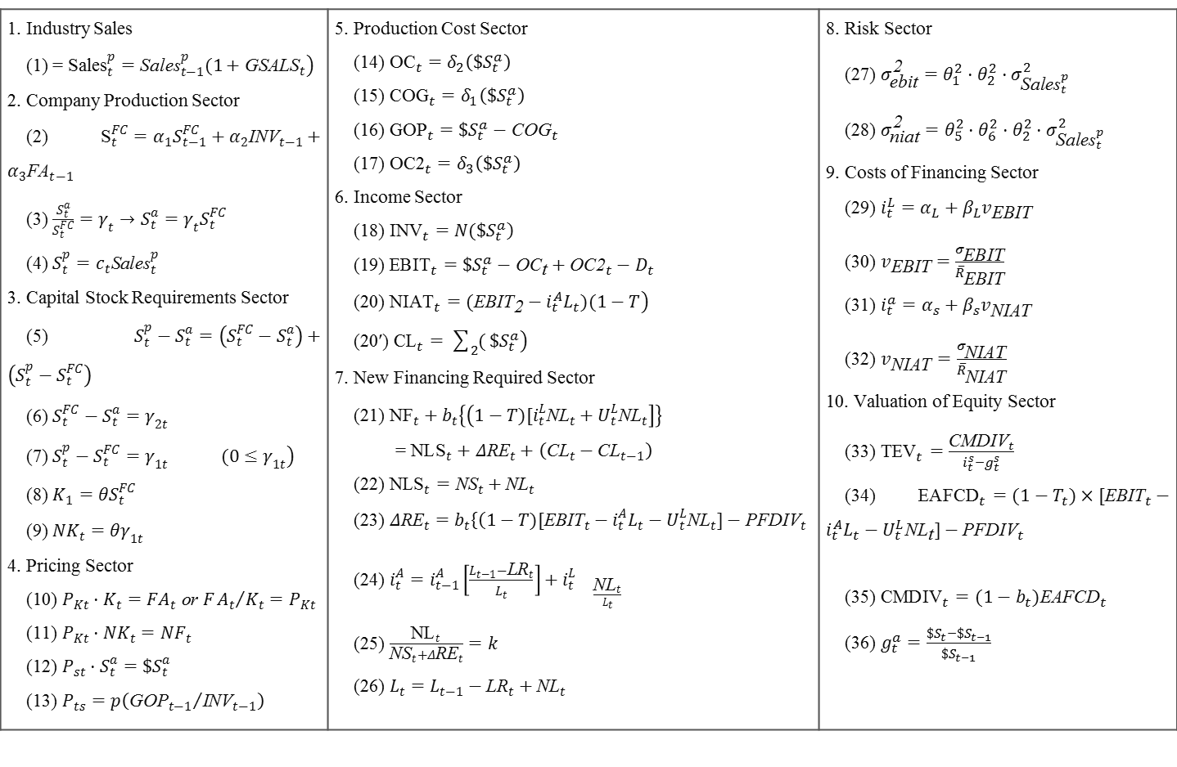
Table 26.10
List of Equations for FR Model
1. Industry Sales (1) = $\left.{\text{Sales}}_{t}^{p}={\text{Sales}}_{t−1}^{p}(1+{\text{GSALS}}_{t}\right)$ 2. Company Production Sector (2) ${\text{S}}_{t}^{FC}=α_{1}S_{t−1}^{FC}+α_{2}{\text{INV}}_{t−1}+α_{3}{\text{FA}}_{t−1}$ (3) $\frac{S_{t}^{a}}{S_{t}^{FC}}=γ_{t}→S_{t}^{a}=γ_{t}S_{t}^{FC}$ (4) $S_{t}^{p}=c_{t}{\text{Sales}}_{t}^{p}$ 3. Capital Stock Requirements Sector (5) $S_{t}^{p}−S_{t}^{a}=\left(S_{t}^{FC}−S_{t}^{a}\right)+\left(S_{t}^{p}−S_{t}^{FC}\right)$ (6) $S_{t}^{FC}−S_{t}^{a}=γ_{2t}$ (7) $\left.S_{t}^{p}−S_{t}^{FC}=γ_{1t} (0≤γ_{1t}\right)$ (8) $K_{1}=θS_{t}^{FC}$ (9) $NK_{t}=θγ_{1t}$ 4. Pricing Sector (10) $P_{Kt}·K_{t}=FA_{t} \text{or} F{A_{t}}/{K_{t}}=P_{Kt}$ (11) $P_{Kt}·NK_{t}=NF_{t}$ (12) $P_{st}·S_{t}^{a}=\$S_{t}^{a}$ (13) $P_{ts}=p\left({{\text{GOP}}_{t−1}}/{{\text{INV}}_{t−1}}\right)$ | 5. Production Cost Sector (14) ${\text{OC}}_{t}=δ_{2}\left(\$S_{t}^{a}\right)$ (15) ${\text{COG}}_{t}=δ_{1}\left(\$S_{t}^{a}\right)$ (16) ${\text{GOP}}_{t}=\$S_{t}^{a}−{\text{COG}}_{t}$ (17) ${\text{OC}\text{2}}_{t}=δ_{3}\left(\$S_{t}^{a}\right)$ 6. Income Sector (18) $\left.{\text{INV}}_{t}=N(\$S_{t}^{a}\right)$ (19) ${\text{EBIT}}_{t}=\$S_{t}^{a}−{\text{OC}}_{\text{t}}+{\text{OC}\text{2}}_{t}−D_{t}$ (20) $\left.{\text{NIAT}}_{t}=({\text{EBIT}}_{\text{2}}−i_{t}^{A}L_{t})(1−T\right)$ (20′) $\left.{\text{CL}}_{t}=\sum_{2}{(}\$S_{t}^{a}\right)$ 7. New Financing Required Sector (21) ${\text{NF}}_{t}+b_{t}\left\{\left(1−T)[i_{t}^{L}{\text{NL}}_{t}+U_{t}^{L}{\text{NL}}_{t}\right]\right\}$ = ${\text{NLS}}_{t}+Δ{\text{RE}}_{t}+\left({\text{CL}}_{t}−{\text{CL}}_{t−1}\right)$ (22) ${\text{NLS}}_{t}={\text{NS}}_{t}+{\text{NL}}_{t}$ (23) $Δ{\text{RE}}_{t}=b_{t}\left\{\left(1−T)[{\text{EBIT}}_{t}\right.\right.−i_{t}^{A}L_{t}−U_{t}^{L}{\text{NL}}_{t}]−{\text{PFDIV}}_{t}$ (24) $i_{t}^{A}=i_{t−1}^{A}\left[\frac{L_{t−1}−{\text{LR}}_{t}}{L_{t}}\right]+i_{t}^{L}{}_{\frac{{\text{NL}}_{t}}{L_{t}}}$ (25) $\frac{{\text{NL}}_{t}}{{\text{NS}}_{t}+Δ{\text{RE}}_{t}}=k$ (26) $L_{t}=L_{t−1}−{\text{LR}}_{t}+{\text{NL}}_{t}$ | 8. Risk Sector (27) $σ_{\text{ebit}}^{\text{2}}=θ_{1}^{2}·θ_{2}^{2}·σ_{{\text{Sales}}_{t}^{p}}^{2}$ (28) $σ_{\text{niat}}^{\text{2}}=θ_{5}^{2}·θ_{6}^{2}·θ_{2}^{2}·σ_{{\text{Sales}}_{t}^{p}}^{2}$ 9. Costs of Financing Sector (29) $i_{t}^{L}=α_{L}+β_{L}v_{\text{EBIT}}$ (30) $v_{\text{EBIT}}=\frac{σ_{\text{EBIT}}}{{\overline{R}}_{\text{EBIT}}}$ (31) $i_{t}^{a}=α_{s}+β_{s}v_{\text{NIAT}}$ (32) $v_{\text{NIAT}}=\frac{σ_{\text{NIAT}}}{{\overline{R}}_{\text{NIAT}}}$ 10. Valuation of Equity Sector (33) ${\text{TEV}}_{t}=\frac{{\text{CMDIV}}_{t}}{i_{t}^{s}−g_{t}^{s}}$ (34)${\text{EAFCD}}_{t}=(1−T_{t})×[{\text{EBIT}}_{t}−i_{t}^{A}L_{t}−U_{t}^{L}{\text{NL}}_{\text{t}}]−{\text{PFDIV}}_{t}$ (35) ${\text{CMDIV}}_{t}=(1−b_{t}){\text{EAFCD}}_{t}$ (36) $g_{t}^{a}=\frac{\$S_{t}−\$S_{t−1}}{\$S_{t−1}}$

Slide 17
26.3.1 FR Model Specification
The FR model is composed of 10 sectors:
  industry sales
  production sector
  fixed capital-stock requirements
  Pricing
  production costs
  Income
  new financing required
  Risk
  costs of financing
  common stock valuation.

Slide 18
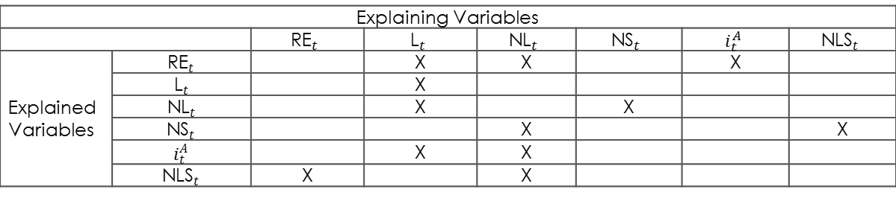
Table 26.11 summarized sectors one through ten in the interdependence table.
An "X" is placed in the table to represent the direction of an arrow (from explaining to explained) on the flow chart.
The simultaneity of the FR model is primarily within each sector's equations.
For example, this is illustrated for sector
seven in the variable interdependence
table shown below.
Table 26.11
Sector Interdependence
Table 26.12
Variable Interdependence within Sector Seven
Explaining Variables
 |  | $${\text{RE}}_{t}$$ | $${\text{L}}_{t}$$ | $${\text{NL}}_{t}$$ | $${\text{NS}}_{t}$$ | $$i_{t}^{A}$$ | $${\text{NLS}}_{t}$$
Explained Variables | $${\text{RE}}_{t}$$ |  | X | X |  | X
 | $${\text{L}}_{t}$$ |  | X
 | $${\text{NL}}_{t}$$ |  | X |  | X
 | $${\text{NS}}_{t}$$ |  |  | X |  |  | X
 | $$i_{t}^{A}$$ |  | X | X
 | $${\text{NLS}}_{t}$$ | X |  | X

Slide 19
Sector One: Industry Sales
The industry sales forecast sector influences directly the risk sector and production sector and, indirectly, every sector of the model.
The industry-sales equation shows that an industry-sales forecast must be made by some means over a predefined forecast period and given as an exogenous input to the FR model.
It’s the industry sales that drive the model, since it can be more accurately forecasted than company sales.
The mean and standard deviation are parameters emloyed from the industry sales forecast
The mean enters the model in the conventional way, whereas the standard deviation is mathematically transformed to obtain the standard deviation of its derivative quantities, the company's NIAT and EBIT.

Slide 20
Sector Two: Company Sales and Production
Potential company sales is obtained from forecasted industry sales through the market-share assumption.
The FR model distinguishes between potential and actual sales levels; this allows a realistic treatment of slack or idle capacity in the firm.
The production function allows explicit definition of the company's full-capacity production levels (see Equation (2) in Table 26-10 for the exact specification).
It serves the useful purpose of relaxing the unrealistic assumption (used in many models) that whatever is produced is sold.
Actual company production is derived from full-capacity production by a capacity-utilization index in Equation (3) of Table 26-10.

Slide 21
Sector Three: Fixed Capital-Stock Requirements
Necessary new investments is not linked directly to company sales in the FR model, but instead results from comparison between potential and actual company sales.
A capacity–utilization index for the simulated company and industry translates full-capacity output (from the production function) into actual company sales, just as a market-share assumption is used to translate potential industry sales into potential company sales.
Any positive difference between potential company sales and actual company sales is decomposed into the contribution due to idle capacity and the contribution due to company expansion possibility, as shown mathematically in Equation (5) of Table 26-10.

Slide 22
Sector Four: Pricing
The pricing sector of the model plays a key role by relating real or units sector to the nominal or dollar sectors.
The real sectors and the nominal sectors are connected by the pricing sector.
This sector separation allows explicit treatment of the product-pricing decision apart from the sales and production decisions.
Also, it maintains the important distinction between real and nominal quantities and thus permits an analysis of inflation's impact on the firm.
FR Equation (13) is a simple formula that generates product price by relating it, through a markup, to the ratio of previous-period gross operating profit to inventory. Real units of company sales are priced out in FR Equation (12).

Slide 23
Sector Five: Production Costs
The production cost sector is similar to previous models; production cost and inventory are related directly to actual company sales dollars.
Also, depreciation is linked directly to existing fixed investment.
Sector Six: Income
As in the production cost sector, the income-sector ties inventory, earnings before interest and taxes, and net income after taxes directly to actual company sales dollars.
This simplicity is preserved here to create a linear-determined income statement that produces EBIT as a function of actual company sales (given a few simplifying assumptions).
The NIAT is derived from EBIT after deduction of interest expense (also linearly related to actual sales levels and taxes).

Slide 24
Sector Seven: New Financing Required
The new-financing-required sector is composed primarily of accounting relationships that determine the dollar amount of external financing required from the new capital requirements (Sector Three) and internal financing capability (Sector Six).
The breakdown of new external financing into new equity and new debt occurs in FR Equation (25), where the notion of optimal capital structure is exploited.
The weighted-average cost of debt, FR Equation (24), consists of a weighted sum of new debt costs and the cost of existing debt.
The cost of the new debt is not exogenous in this model; it is estimated in a simplified risk–return tradeoff from Sector Nine.

Slide 25
Sector Eight: Risk
The linear derivation of both EBIT and NIAT in the income sector is used (with simplifying assumptions) in the risk sector to obtain the standard deviation of each income measure.
The derivation (presented in Table 26.13) demonstrates how management's judgment as to the variability (i.e., standard deviation) of forecasting industry sales affects the risk character (of both the business and financial risk) of the company.
This risk character influences the costs of financing new stock and debt in risk–return tradeoff equations of Sector Nine.
The debt-to-equity ratio (a financial leverage ratio) also positively influences the NIAT standard deviation.
Thus, the leverage structure of the firm endogenously influences the costs of financing in a realistic way.

Slide 26
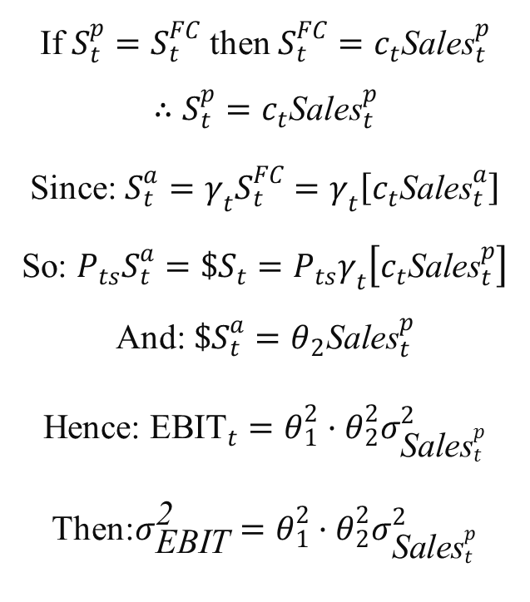
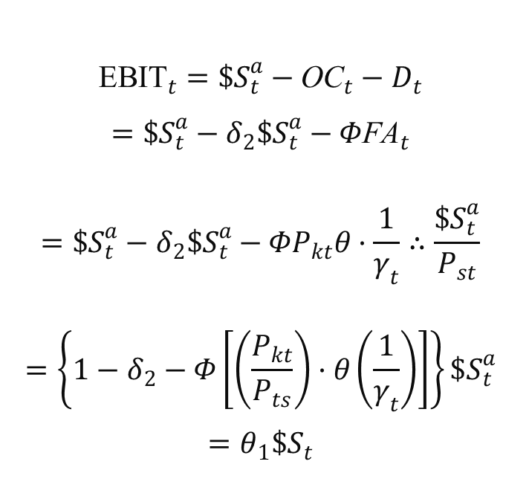
Table 26.13
Transformation of Industry Sales Moments to Company NIAT and EBIT Moments
EBIT
$${\text{EBIT}}_{t}=\$S_{t}^{a}−{\text{OC}}_{t}−D_{t}$$
$$=\$S_{t}^{a}−δ_{2}\$S_{t}^{a}−Φ{\text{FA}}_{t}$$
$$=\$S_{t}^{a}−δ_{2}\$S_{t}^{a}−ΦP_{kt}θ·\frac{1}{γ_{t}}∴\frac{\$S_{t}^{a}}{P_{st}}$$
$$=\left\{1−δ_{2}−Φ\left[\left(\frac{P_{kt}}{P_{ts}}\right)·θ\left(\frac{1}{γ_{t}}\right)\right]\right\}\$S_{t}^{a}$$
$$=θ_{1}\$S_{t}$$
If $S_{t}^{p}=S_{t}^{FC}$ then $S_{t}^{FC}=c_{t}{\text{Sales}}_{t}^{p}$
$$∴S_{t}^{p}=c_{t}{\text{Sales}}_{t}^{p}$$
Since: $S_{t}^{a}=γ_{t}S_{t}^{FC}=γ_{t}\left[c_{t}{\text{Sales}}_{t}^{a}\right]$
So: $P_{ts}S_{t}^{a}=\$S_{t}=P_{ts}γ_{t}\left[c_{t}{\text{Sales}}_{t}^{p}\right]$
And: $\$S_{t}^{a}=θ_{2}{\text{Sales}}_{t}^{p}$
Hence: ${\text{EBIT}}_{t}=θ_{1}^{2}·θ_{2}^{2}σ_{{\text{Sales}}_{t}^{p}}^{2}$
Then:$σ_{\text{EBIT}}^{\text{2}}=θ_{1}^{2}·θ_{2}^{2}σ_{{\text{Sales}}_{t}^{p}}^{2}$

Slide 27
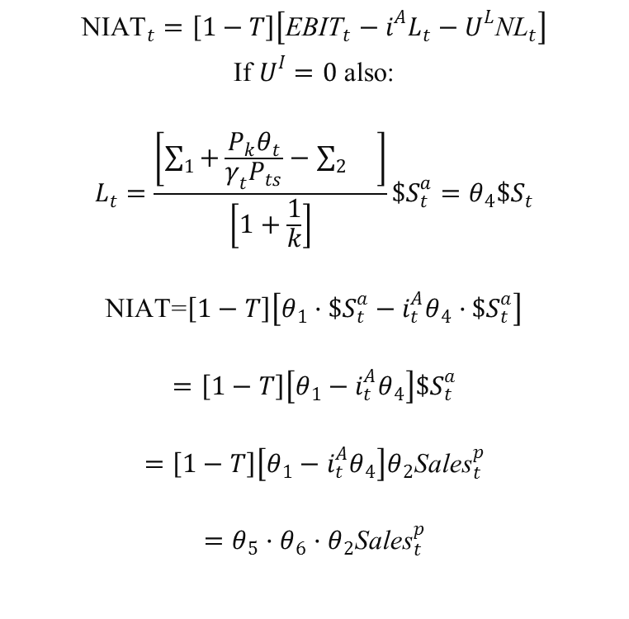
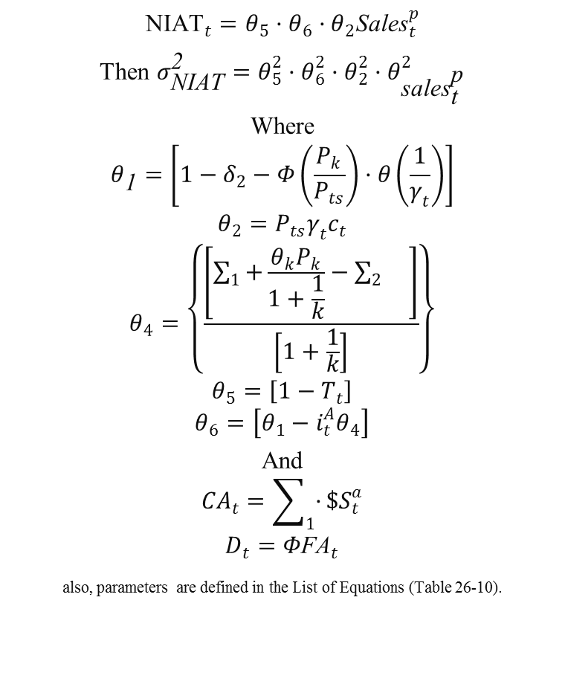
Table 26.13
Transformation of Industry Sales Moments to Company NIAT and EBIT Moments (Cont.)
NIAT
$${\text{NIAT}}_{t}=θ_{5}·θ_{6}·θ_{2}{\text{Sales}}_{t}^{p}$$
Then $σ_{\text{NIAT}}^{\text{2}}=θ_{5}^{2}·θ_{6}^{2}·θ_{2}^{2}·θ_{{\text{sales}}_{\text{t}}^{\text{p}}}^{2}$
Where
$$θ_{\text{1}}=\left[1−δ_{2}−Φ\left(\frac{P_{k}}{P_{ts}}\right)·θ\left(\frac{1}{γ_{t}}\right)\right]$$
$$θ_{2}=P_{ts}γ_{t}c_{t}$$
$$θ_{4}=\left\{\frac{\left[\sum_{1}{+}\frac{θ_{k}P_{k}}{1+\frac{1}{k}}−\sum_{2}{}\right]}{\left[1+\frac{1}{k}\right]}\right\}$$
$$θ_{5}=\left[1−T_{t}\right]$$
$$θ_{6}=\left[θ_{1}−i_{t}^{A}θ_{4}\right]$$
And
$$CA_{t}=\sum_{1}{·}\$S_{t}^{a}$$
$$D_{t}=Φ{\text{FA}}_{t}$$
also, parameters are defined in the List of Equations (Table 26-10).
$${\text{NIAT}}_{t}=\left[1−T\right]\left[{\text{EBIT}}_{t}−i^{A}L_{t}−U^{L}{\text{NL}}_{t}\right]$$
If $U^{I}=0$ also:
$$L_{t}=\frac{\left[\sum_{1}{+}\frac{P_{k}θ_{t}}{γ_{t}P_{ts}}−\sum_{2}{}\right]}{\left[1+\frac{1}{k}\right]}\$S_{t}^{a}=θ_{4}\$S_{t}$$
$$\text{NIAT}\text{=}\left[1−T\right]\left[θ_{1}·\$S_{t}^{a}−i_{t}^{A}θ_{4}·\$S_{t}^{a}\right]$$
$$=\left[1−T\right]\left[θ_{1}−i_{t}^{A}θ_{4}\right]\$S_{t}^{a}$$
$$=\left[1−T\right]\left[θ_{1}−i_{t}^{A}θ_{4}\right]θ_{2}{\text{Sales}}_{t}^{p}$$
$$=θ_{5}·θ_{6}·θ_{2}{\text{Sales}}_{t}^{p}$$

Slide 28
Sector Nine: Cost of Financing
Market factors enter into the determination of financing costs through the slope (b1 and b2) and intercept (a1 and a2) coefficients of the risk–return tradeoff functions — namely Equations (29) and (31) of Table 26.10.
At the present time, all four coefficients must be exogenously provided by management.
Historical coefficients can be estimated empirically using simple linear regression.
The regression coefficients would establish a plausible range of values that might be used by management to determine the present or future coefficient values.

Slide 29
Sector Ten: Common Stock Valuation
The valuation model used finds the present value of dividends, which are presumed to grow perpetually at a constant rate.
Algebraically reduced to its simplest form, the single-share valuation model is shown below:
Equation (33) of Table 26.10 differs slightly from the per-share valuation model above because it values the firm's total equity outstanding.
This change was accomplished merely by multiplying both sides of the valuation equation shown above by the number of shares outstanding.

Slide 30
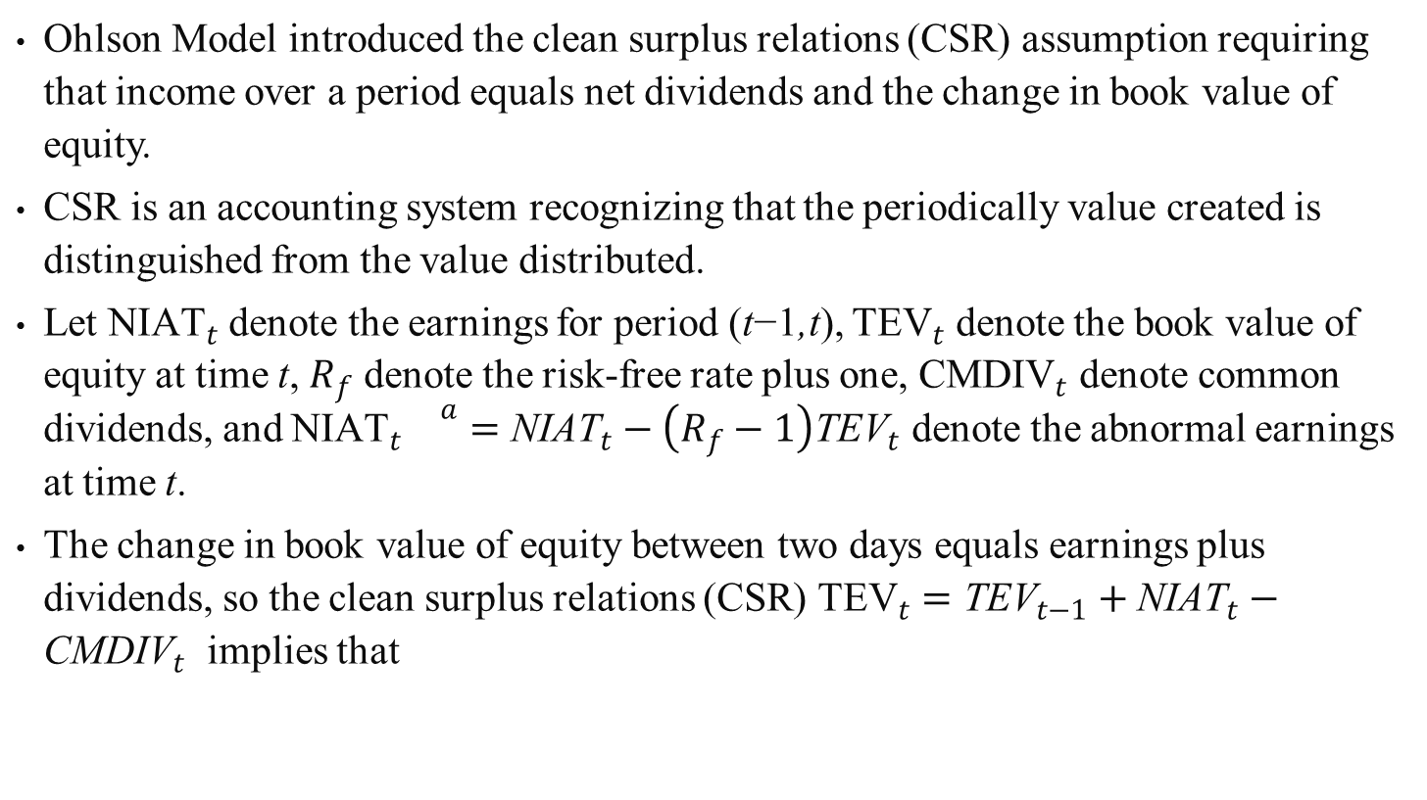
26.4 Feltham-Ohlson Model for Determining Equity Value
Ohlson Model introduced the clean surplus relations (CSR) assumption requiring that income over a period equals net dividends and the change in book value of equity.
CSR is an accounting system recognizing that the periodically value created is distinguished from the value distributed.
Let ${\text{NIAT}}_{t}$ denote the earnings for period (t−1,t), ${\text{TEV}}_{t}$ denote the book value of equity at time t, $R_{f}^{}$ denote the risk-free rate plus one, ${\text{CMDIV}}_{t}$ denote common dividends, and ${\text{NIAT}}_{t}{}_{}^{a}={\text{NIAT}}_{t}−\left(R_{f}−1\right){\text{TEV}}_{t}$ denote the abnormal earnings at time t.
The change in book value of equity between two days equals earnings plus dividends, so the clean surplus relations (CSR) ${\text{TEV}}_{t}={\text{TEV}}_{t−1}+{\text{NIAT}}_{t}−{\text{CMDIV}}_{t}$ implies that
(26.1)

Slide 31
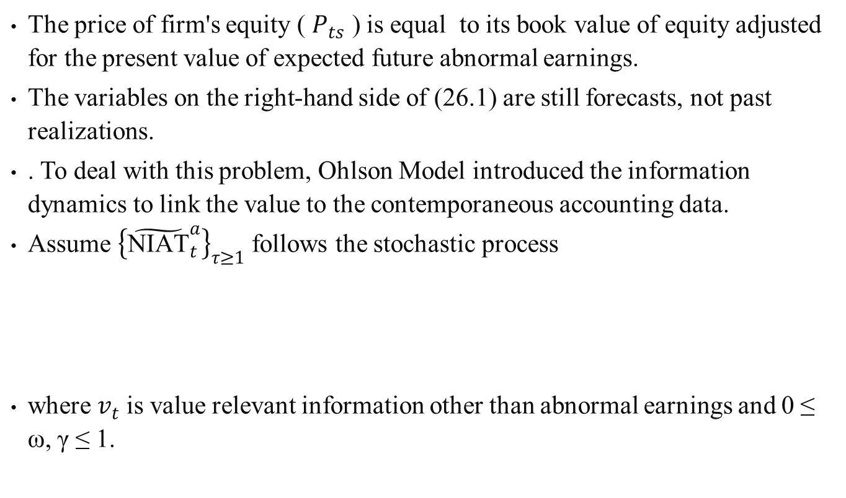
(26.1)
The price of firm's equity ( $P_{ts}$ ) is equal to its book value of equity adjusted for the present value of expected future abnormal earnings.
The variables on the right-hand side of (26.1) are still forecasts, not past realizations.
. To deal with this problem, Ohlson Model introduced the information dynamics to link the value to the contemporaneous accounting data.
Assume ${\left\{{\tilde{\text{NIAT}}}_{t}^{a}\right\}}_{τ≥1}$ follows the stochastic process
where $v_{t}$ is value relevant information other than abnormal earnings and 0 ≤ ω, γ ≤ 1.
(26.2)

Slide 32
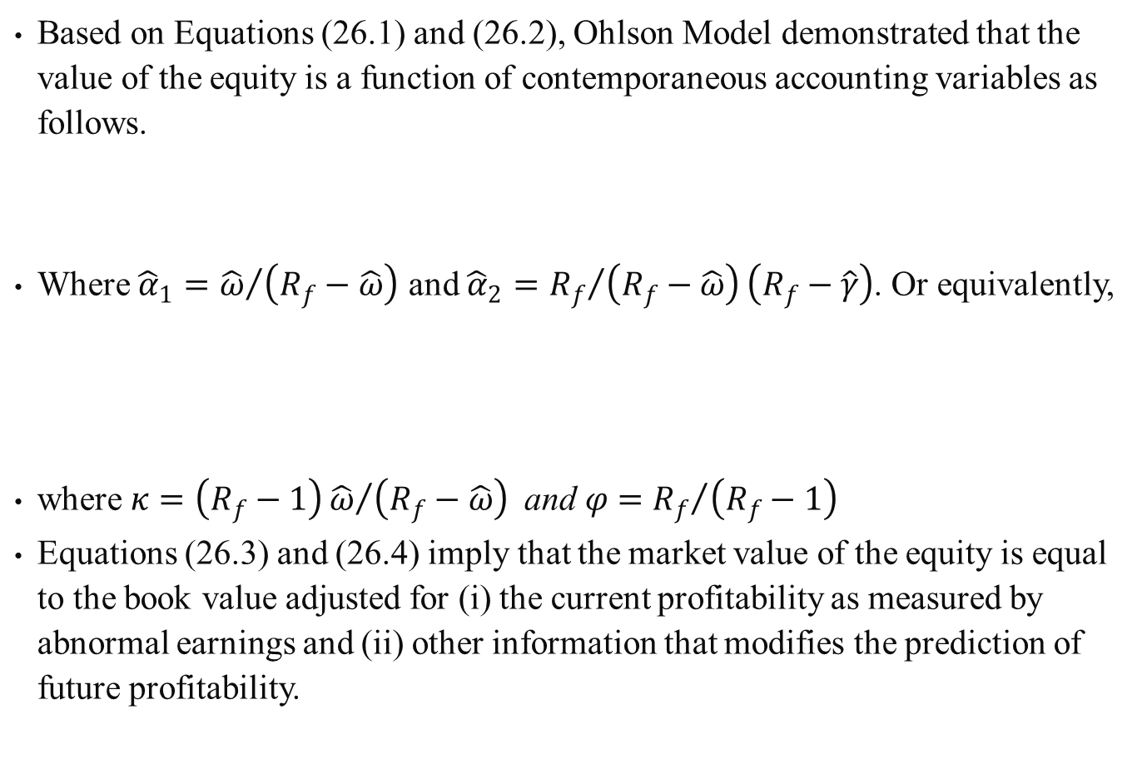
Based on Equations (26.1) and (26.2), Ohlson Model demonstrated that the value of the equity is a function of contemporaneous accounting variables as follows.
Where ${\hat{α}}_{1}={\hat{ω}}/{\left(R_{f}−\hat{ω}\right)}$ and ${\hat{α}}_{2}={R_{f}}/{\left(R_{f}−\hat{ω}\right)}\left(R_{f}−\hat{γ}\right)$. Or equivalently,
where $κ=\left(R_{f}−1\right){\hat{ω}}/{\left(R_{f}−\hat{ω}\right)} \text{and} φ={R_{f}}/{\left(R_{f}−1\right)}$
Equations (26.3) and (26.4) imply that the market value of the equity is equal to the book value adjusted for (i) the current profitability as measured by abnormal earnings and (ii) other information that modifies the prediction of future profitability.
(26.3)
(26.4)

Slide 33

One major limitation of the Ohlson Model is that it assumed unbiased accounting.
. Feltham and Ohlson (1995) (hereafter FO) introduce additional dynamics to deal with the issue of biased (conservative) accounting data.
The information dynamics in the FO Model is
where $ox_{t}^{a}$ is the abnormal operating earnings, $oa_{t}$ is the operating assets, $v_{1t}$ and $v_{2t}$ are the other value relevant information variables for firm at time t, respectively.
(26.5)

Slide 34
The derived implied pricing function is
Where
(26.6)
(26.7)

Slide 35
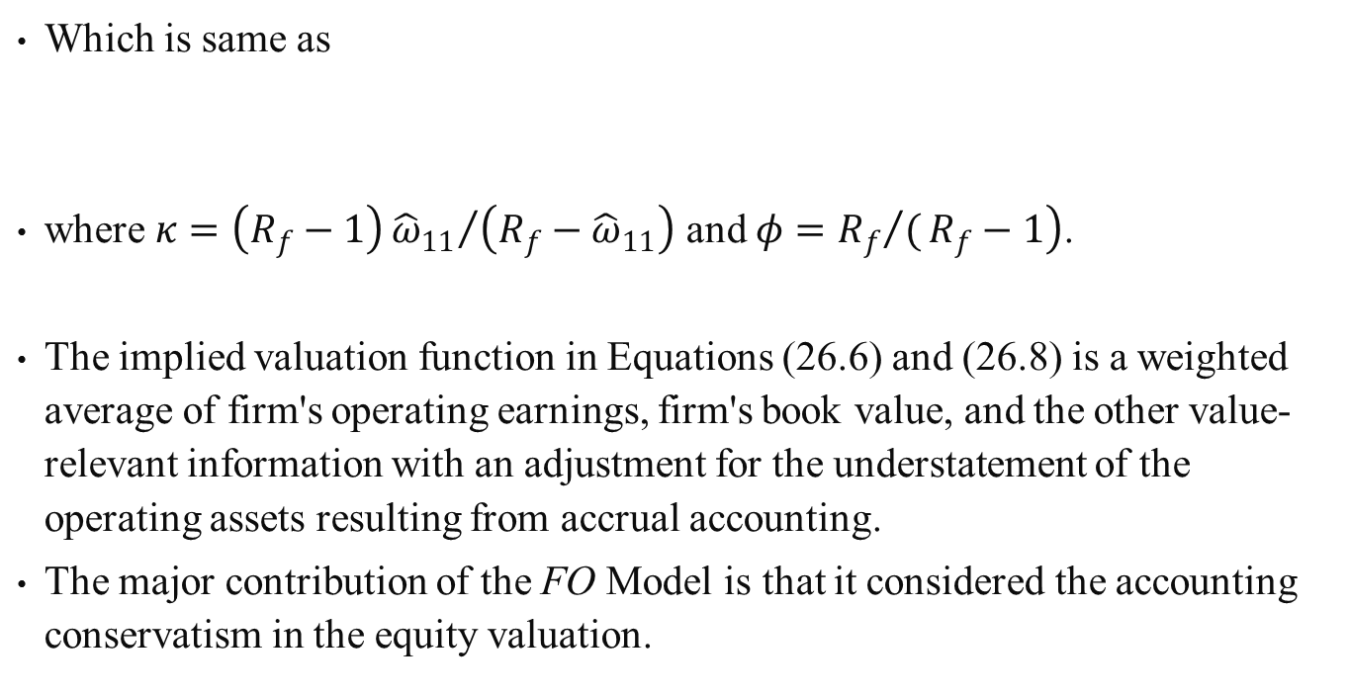
Which is same as
where $κ=\left(R_{f}−1\right){{\hat{ω}}_{11}}/{\left(R_{f}−{\hat{ω}}_{11}\right)}$ and $\left.φ={R_{f}}/(R_{f}−1\right)$.
The implied valuation function in Equations (26.6) and (26.8) is a weighted average of firm's operating earnings, firm's book value, and the other value-relevant information with an adjustment for the understatement of the operating assets resulting from accrual accounting.
The major contribution of the FO Model is that it considered the accounting conservatism in the equity valuation.
(26.8)

Slide 36
26.5 Combined Forecasting Method to Determine Equity Value
Lee et al. (2011) investigate the stock price forecast ability of Ohlson (1995) model FO (1995) model, and WS (1971) Model.
They use simultaneous equation estimation approach to estimate the information dynamics for Ohlson model and FO model and forecast future stock prices.
Empirical results show that the simultaneous equation estimation of the information dynamics improves the ability of the Ohlson Model and FO model in capturing the dynaic of the abnormal earnings process.
The evidence shows that combined forecast method can reduce the prediction errors.

Slide 37
26.6 Summary
Two simultaneous-equation financial planning models were discussed in detail in this chapter.
There are 20 equations and 20 unknowns in the WS model.
A computer program of the WS model is presented in Appendix 26B.
The FR model is a generalized WS financial-planning model.
There are 36 equation and 36 unknown in the FR model.
In this chapter, we have also briefly discussed Felthan-Ohlson model for determining equity value.
In addition, we have explored the usefulness of integrating WS model and Felthan-Ohlson model to improve the determination of equity value.

