Slide 1
Appendix 10 A:
A Linear-Programming Approach to Portfolio-Analysis Models
(Related to 10.1.2)
By
Cheng Few Lee
Joseph Finnerty
John Lee
Alice C Lee
Donald Wort

Slide 2
The linear programming (LP) that results from the use of market responsiveness as the risk measure and the imposition of an upper limit on investment in each security is
subject to:
where:
= the fraction of the portfolio invested in security i;
= the expected returns of security i;
= the beta coefficient of security i;
= the maximum fraction of the portfolio that may be held in any
one security; and
= a parameter reflecting the degree of risk aversion.
(10A.1)

Slide 3
Sharpe LP. Jacob’s model is to minimize
Subject to:
where:
= the investment in security i－all, or nothing;
= the expected return on security i equal to
K = the desired upper bound on the number of securities the investor
is willing to consider, usually in the range of 15 to 20;
= the measure of systematic risk;
= the measure of unsystematic risk; and
= the lowest acceptable rate of return the investor is willing to earn
on his or her portfolio.
(10A.2)

Slide 4
An additional simplification is to turn the objective function of Equation (10A.2) into a linear relationship.
Since the decision variables are binary valued, the unsystematic-risk term of the objective function is already linear.
Given that the portfolio beta is very close to unity, a reasonable linear approximation to the first term in the objective function is provided by
After division by K and rearrangement of terms, the objective function can be restated as
Letting , the problem can be cast as
subject to
in which is varied from zero to one.

Slide 5
Appendix 10 B:
Expected Return, Variance, and Covariance for a MIM
(Related to 10.2)
By
Cheng Few Lee
Joseph Finnerty
John Lee
Alice C Lee
Donald Wort

Slide 6
Using the orthogonalization technique discussed in the text, the MIM is transformed into
in which all are uncorrelated with each other.
The expected value of the model with the multiple indexes is
because a and the b are constants, and the expected value of the residuals is equal to zero
where is the expected value of index j.
(10B.1)
(10B.2)

Slide 7
The variance of the returns using multiple indexes is
Where is the expected value of the returns of security i.
Substituting from above:
Rearranging, and noticing that the cancel, yields:
Next the terms in the brackets are squared.
To proceed with this concentrate on the first index, arid the rest of the terms involving the other indexes follow directly.
The first index times itself and all other terms yields

Slide 8
Remembering that
the only nonzero term involving index one is expressed as
Because all terms involving are zero and :
The covariance of the returns between security i and j utilizing the MIM can be expressed as
(10B.3)

Slide 9
Again, substituting for :
Again, noting that cancels and combining the terms involving the same b’s:
Next multiply out terms, again concentrating on the terms involving :
Because the covariance between two indexes is zero, and the covariance between any residual and an index is zero:
To conclude, remember that the covariance of the residuals is equal to zero and therefore:
(10B.4)

Slide 10
Appendix 10 C:
Using Microsoft Excel to Calculate Optimal Weights of a Portfolio
(Related to Sample Problem 11.1)
By
Cheng Few Lee
Joseph Finnerty
John Lee
Alice C Lee
Donald Wort

Slide 11
Part I
This part illustrates how to solve a simultaneous equation system by matrix inversion method.
Given simultaneous equations as follows:
The simultaneous equations can be written as the matrix forms
Then we can obtain the elements of matrix X by multiplying the inverse matrix and the matrix .
In the following part, we will illustrate the calculation of the inverse matrix in Excel.

Slide 12

Part II
Here we use the monthly prices of Johnson &Johnson (JNJ), International Business Machines (IBM), Boeing Company (BA), and S&P 500 index (^GSPC) during March 1, 2000 to April 30, 2010 as the example.
The process includes data collection, the statistic analysis of samples, the results of the market model, and the calculation of the optimal weights of Markowitz model.
Data Collection
The collection of the monthly returns starts from the Yahoo Finance website: http://finance.yahoo.com/ and inputs the stock ticker “JNJ” to get quotes.

Slide 13

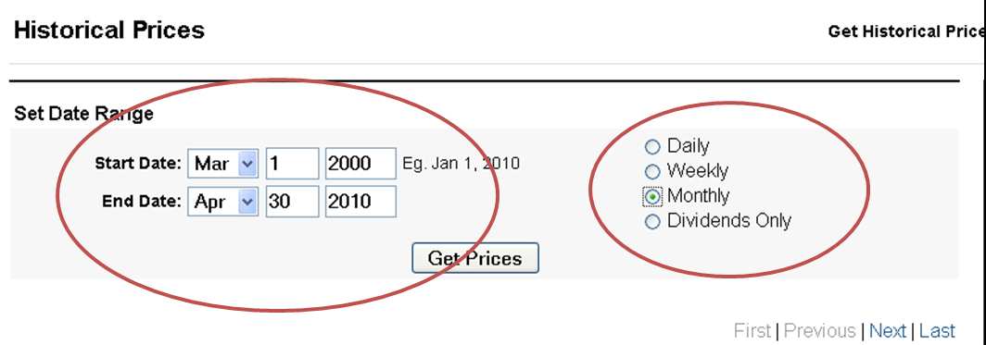
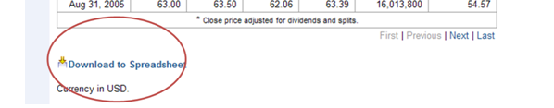
The second step is to get the stock prices: select “Historical Prices” on the left panel of the website, input the range of data from March 1, 2000 to April 30, 2010, select “Monthly” data and press “Get Prices.”
After the webpage shows the historical prices, scroll down to the bottom of the webpage and select “Download to Spreadsheet,” and then we can get the monthly prices of JNJ.
Here we only need the data of the adjusted prices and use “Sort” function on Excel to make price in ascending order.

Slide 14
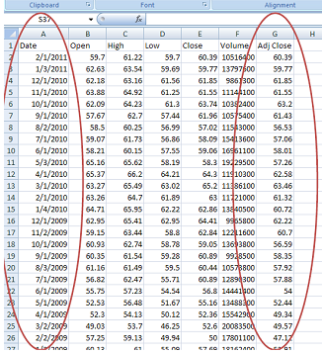
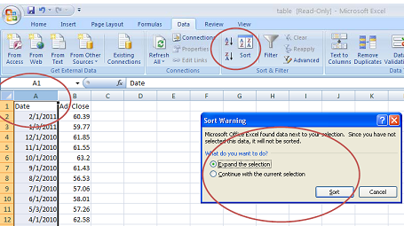

Slide 15
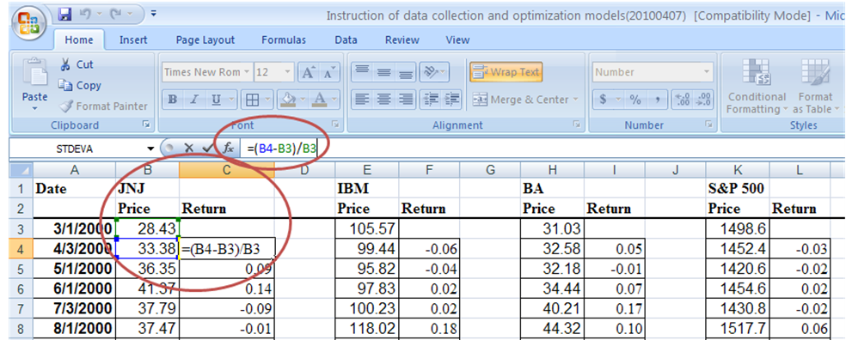
After repeat the second step to get the monthly prices of IBM, BA, and S&P 500 index, the final step is the calculation of the monthly returns.
The monthly returns at time t is the value of the price at time t minus the price at time t−1 divided by the price at time t.
In excel, use the formula “=(B4-B3)/B3” in cell C4 to get JNJ’s monthly return in April 2000, and then by the same way we can get the monthly returns of the individual securities and S&P 500 index.

Slide 16
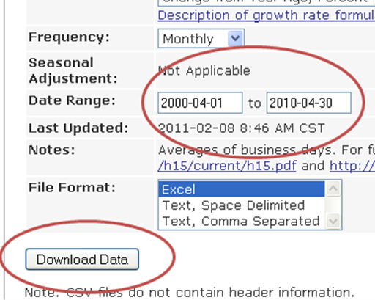
The Way to Collect the Monthly Risk-Free Rates
We use Three-Month Treasury Constant Maturity Rate from Federal Reserve Bank of St. Louis (http://research.stlouisfed.org/fred2/series/GS3M).
Press “Download Data” on the website, select the date range from April 1, 2000 to April 30, 2010 and press “Download Data” again.

Slide 17
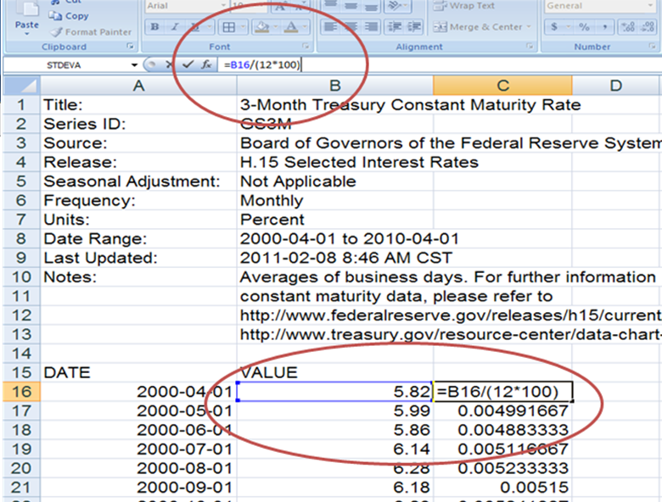
Here, the risk-free rate is in the form of percentage of annual rate, but the monthly returns of individual securities and S&P 500 index are in the form of decimal of monthly rate.
To adjust the risk-free rate to monthly risk-free rate, we should divide the risk-free rate by 12.
Further, to adjust the monthly risk-free rate to decimal, we should divide it by 100.

Slide 18
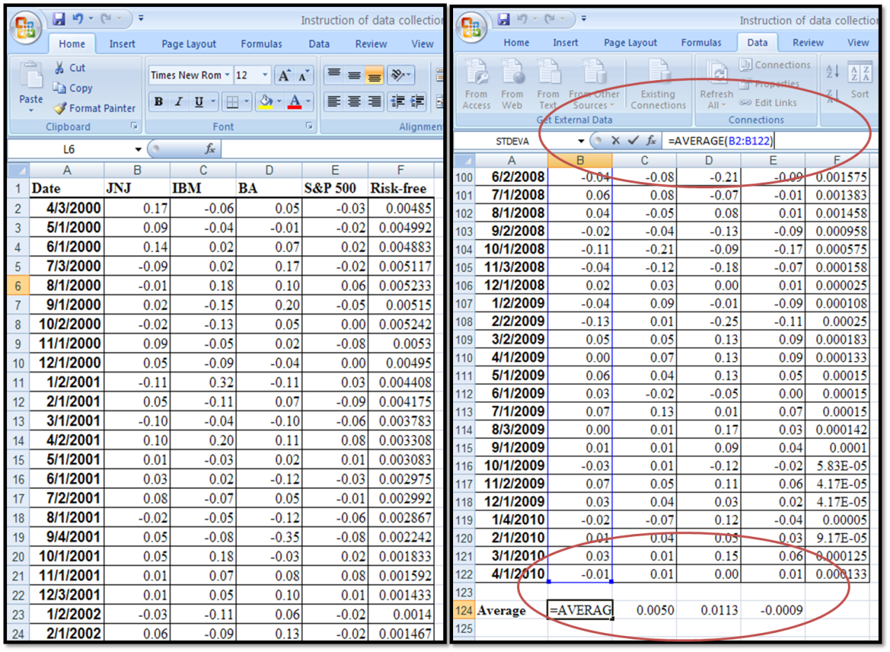
The Statistic Analysis of Samples
Copy the monthly returns of JNJ, IBM, BA, S&P 500 index, and the monthly risk-free rates into new sheet.
The values of average and variance are calculated by “AVERAGE” and “VARP” functions and the covariance matrix is calculated by “Covariance” in “Data Analysis.”

Slide 19
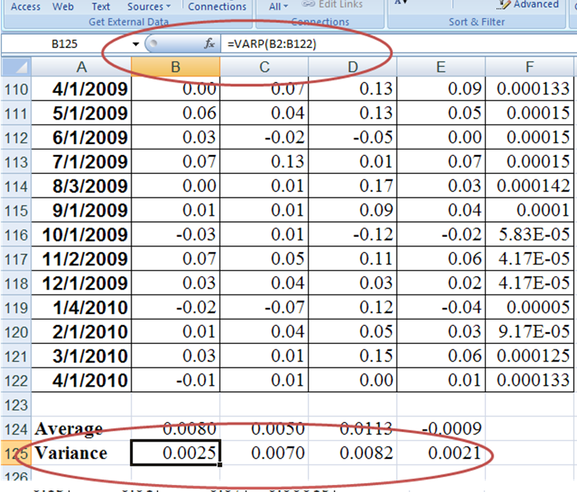
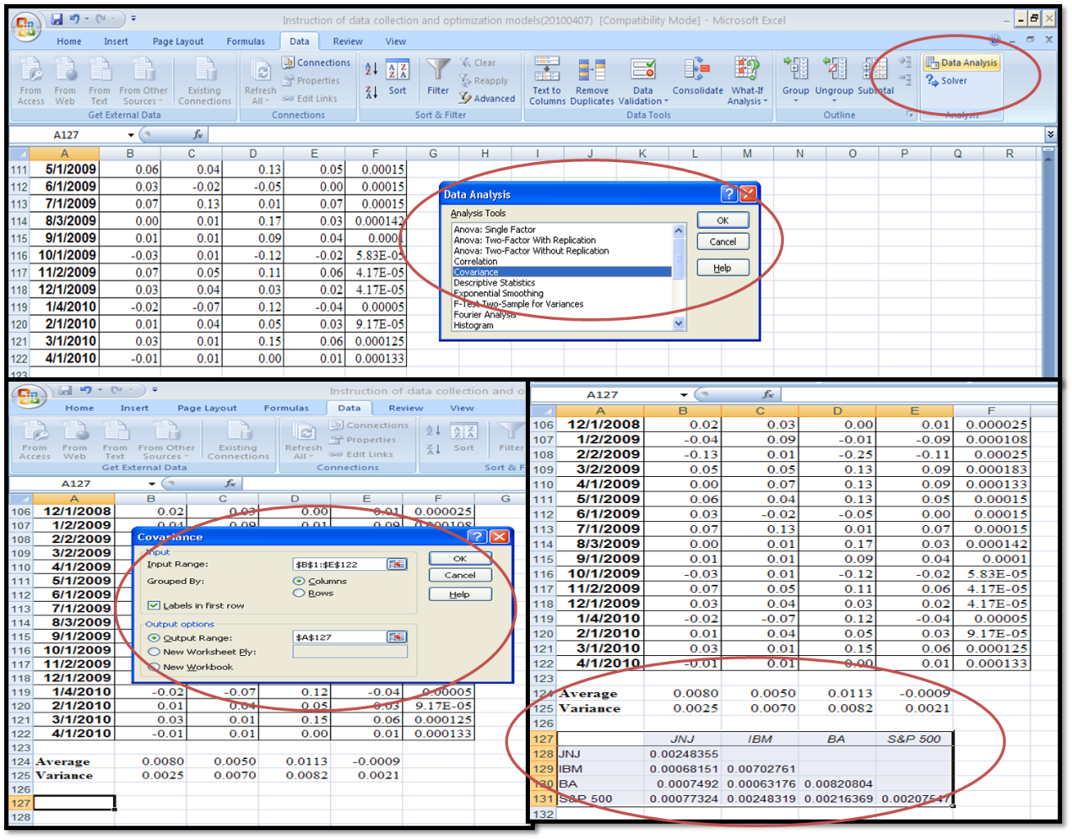

Slide 20
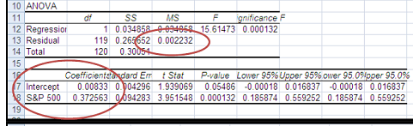
The Market Model
Use “Regression” function in “Data Analysis” to run the market model with respect to JNJ’s returns, select the monthly returns of JNJ in “Y range” and the monthly returns of S&P 500 index in “X range,” and press “OK.”
We then can get the regression results of market model with respect to JNJ in new sheet. The coefficients of intercept term and S&P 500 index are “Alpha” and “Beta” of market model with respect to JNJ’s return.
The MS of residual is the “Variance of residual” of the market model.
Repeat the “Regression” function, and then we can get the results of market model with respect to the monthly return of IBM and BA.

Slide 21
Markowitz Model
In Markowitz Model, we know
According to the statistic analysis of samples in the prior step, we can get the value of each element of Augmented matrix A.
From the matrix calculation of Markowitz Model, we can get the optimal weights from multiplying .

Slide 22
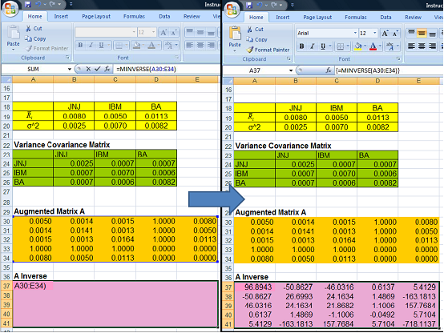
To calculate the inverse matrix of matrix A, select a range from A37 to E41 and type “=Minverse(A37:E41)” and press “Ctrl+Shift+Enter,” then we can get the inverse matrix of matrix A.

Slide 23
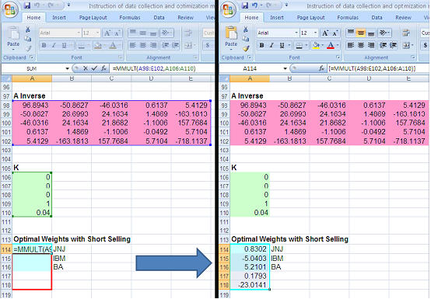
Input the value of each element of matrix K where E* is the required return of investor.
To multiply the matrixes , select a range from A114 to A118 and type “=MMULT(A98:E102,A106:A110).”
Press “Ctrl+Shift+Enter,” then we can get the optimal weight matrix W with short selling.

Slide 24
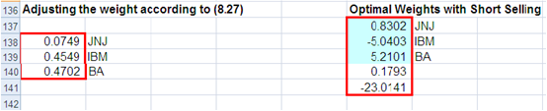
When short selling is constrained, the optimal weights can be rescaled by
The rescaled absolute weights are shown in the matrix below.

Slide 25
Part III
The data used in Index Model comes from the statistic analysis of samples and market model discussed in Part II.
Here we use the variance of S&P 500 index as the residual variance of the artificial security.
In Index Model, we know
Where are the residual variances of JNJ, IBM, BA, and artificial security.

Slide 26
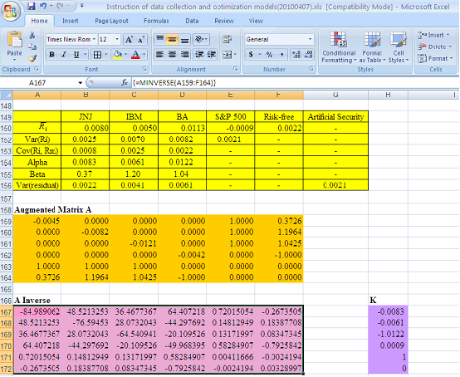
Input the value of each element of Augmented matrix A and calculate the inverse matrix of matrix A via select a range from A167 to F172, type “=Minverse(A159:F164)” and press “Ctrl+Shift+Enter.”
For the matrix K, the are the intercept terms of market model with respect with JNJ, IBM, and BA; is the average return of S&P 500 index; and is the indicator of risk aversion (here we assume equal to one).

Slide 27
From the matrix calculation of Index Model, we can get the optimal weights from multiplying .

Slide 28
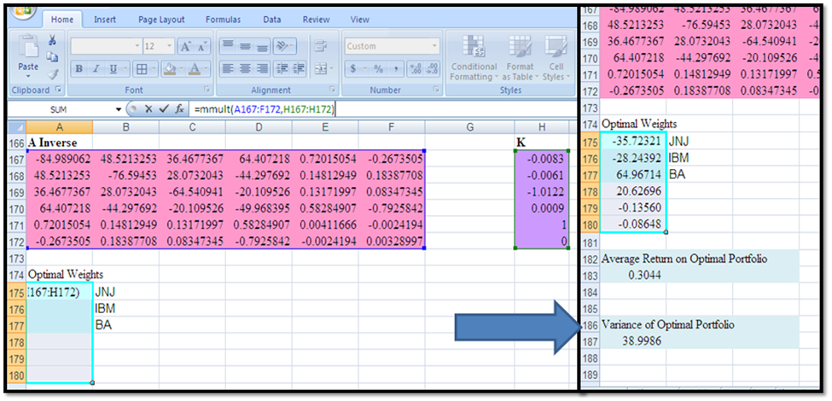
Select a range from A175 to A180, type “=MMULT(A167:F172,H167:H172)” and press “Ctrl+Shift+Enter,” then we can get the optimal weight matrix W.
The average return on optimal portfolio and the variance of optimal portfolio are calculated by the functions .

