Slide 1
Appendix 13A.
Alternative Specifications Of APT
By
Cheng Few Lee
Joseph Finnerty
John Lee
Alice C Lee
Donald Wort

Slide 2
Appendix 13A: Alternative Specifications Of APT
By using the relationship between premium (excess) return and the factor scores, Jobson (1982) has derived a multivariate linear-regression model for testing the APT:
(13A.1)
where
= excess return for company i at time t;
= intercept term;
= respective betas for excess return on company i and the excess returns on all other (N) companies;
= excess returns on all other (N) companies in the market at time t; and
= error term at time t.

Slide 3
Appendix 13A: Alternative Specifications Of APT
Even more significantly, Jobson has shown that his model can hold when the independent observations of are some subset k of the total set of returns, n. This testable form of the Jobson derivation can be defined:
(13A.2)
where i ≠ j and k < n.

Slide 4
Appendix 13A: Alternative Specifications Of APT
Jobson’s model is similar to that proposed by Lloyd and Lee (1976) and Lee and Lloyd (1978), who utilized an econometric model called a “block recursive system” to explain the covariability among company returns:
Where L = number of jointly determined (dependent) variables;
K = number of exogenous explanatory variables;
= coefficients on the jointly determined variables;
= coefficients on the exogenous variables;
= general economic or firm-related variables;
= returns on the Lth security in the model; and = error term.

Slide 5
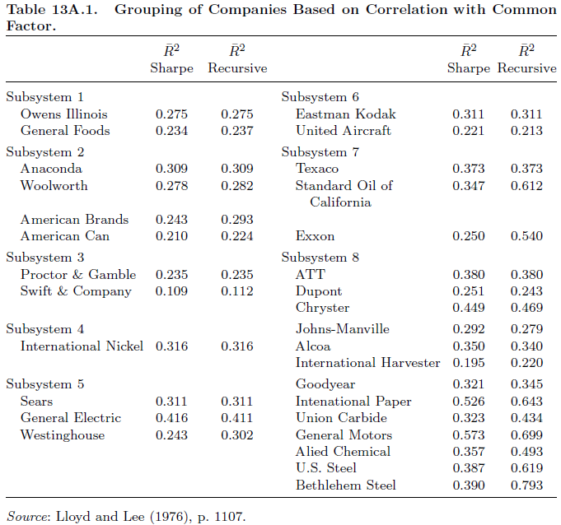
Appendix 13A: Alternative Specifications Of APT
As evidenced for the high explanatory potential of the bock recursive system, Table 13A.1 shows the eight stock clusters or subsystems, the ordering of securities within the subsystem, and a comparison of the percentage of variation in the individual security’s return explained by the Sharpe market model and the percentage explained by the block recursive model.
Table 13A.1
Grouping of Companies Based on Correlation with Common Factor

Slide 6
Appendix 13B.
Lee And Wei’s Empirical Results
By
Cheng Few Lee
Joseph Finnerty
John Lee
Alice C Lee
Donald Wort

Slide 7
Appendix 13B: Lee And Wei’s Empirical Results
Lee and Wei (2012) have proposed a multi-factor, multi-indicator approach to test the CAMP and the APT.
This approach is able to solve the measuring problem in the market portfolio in testing the CAPM; and it is also able to directly test the APT by linking the common factors to the macroeconomic indicators.
Table 13B.1 describes 11 economic-state variables which are used by Lee and Wei (2013) to identify common factors of the APT model.
Table 13B.2 describes the regression relationship between the factors and economic variables. Other detailed empirical results can be found in Lee and Wei
(2013).

Slide 8
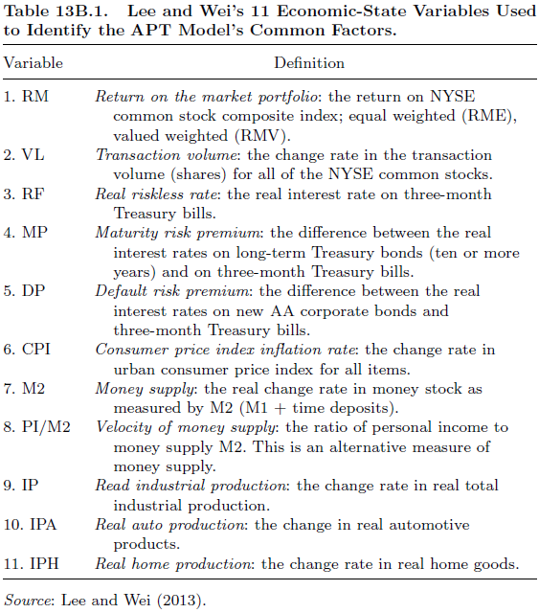
Appendix 13B: Lee And Wei’s Empirical Results

Slide 9
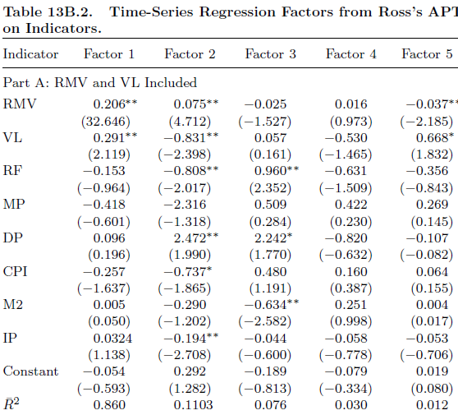
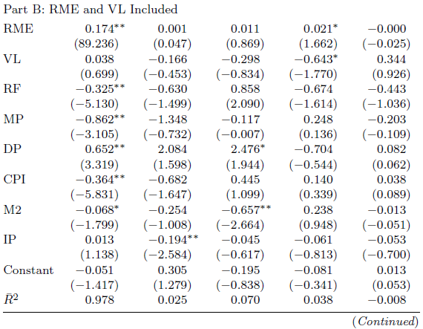
Appendix 13B: Lee And Wei’s Empirical Results

Slide 10
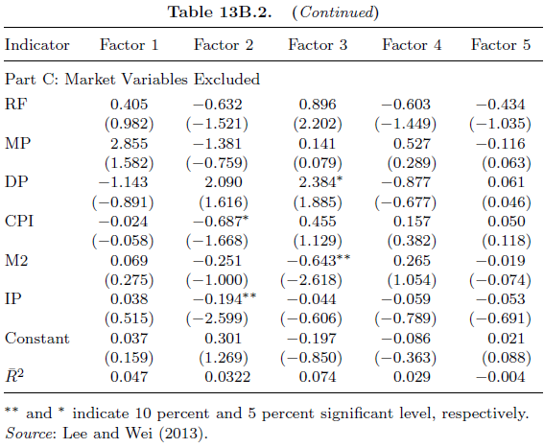
Appendix 13B: Lee And Wei’s Empirical Results

