Slide 1
Appendix 17A
Application of the Binomial Distribution to Evaluate Call Options

Slide 2
Appendix 17A: Applications of the Binomial Distribution to Evaluate Call Options
In this appendix, we show how the binomial distribution is combined with some basic finance concepts to generate a model for determining the price of stock options.
What is an option?
The simple binomial option pricing model
The Generalized Binomial Option Pricing Model

Slide 3
Appendix 17A: Applications of the Binomial Distribution to Evaluate Call Options
(17A.1)
(17A.2)
(17A.3)
(17A.4)

Slide 4
Appendix 17A: Applications of the Binomial Distribution to Evaluate Call Options
(17A.5)
(17A.6)
(17A.7)
(17A.8)

Slide 5
Appendix 17A: Applications of the Binomial Distribution to Evaluate Call Options
Table 17A.1 Possible Option Value at Maturity
Today
Stock (S) | Option (C) |  | Next Period (Maturity)
 |  | uS = $110 | C_{u} = | Max (0,uS – X)
 |  |  | = | Max (0,110 – 100)
 |  |  | = | Max (0,10)
 |  |  | = | $ 10
$100 | C
 |  | dS = $ 90 | C_{d} = | Max (0,dS – X)
 |  |  | = | Max (0,90 – 100)
 |  |  | = | Max (0, –10)
 |  |  | = | $0

Slide 6
Appendix 17A: Applications of the Binomial Distribution to Evaluate Call Options
Let
X = $100
S = $100
u = (1.10). so uS = $110
d = (.90), so dS = $90
R = 1 + r = 1 + 0.07 = 1.07
Next we calculate the value of p as indicated in Equation (17A.7):
Solving the binomial valuation equation as indicated in Equation (17A.8), we get
C = [.85(10) + .15(0)] / 1.07 = $7.94.

Slide 7
Appendix 17A: Applications of the Binomial Distribution to Evaluate Call Options
C_{T} = Max [0, S_{T} – X] (17A.9)
C_{u} = [pC_{uu} + (1 – p)C_{ud}] / R (17A.10)
C_{d}= [pC_{du} + (1 – p)C_{dd}] / R (17A.11)
(17A.12)
(17A.13)

Slide 8
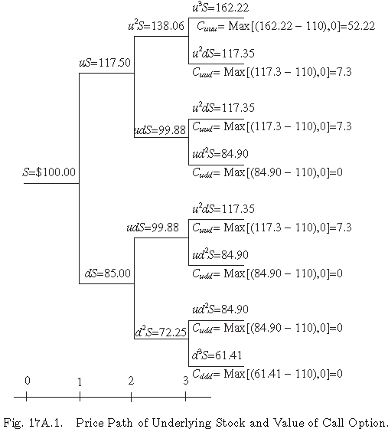
Example 17A.1
Figure 17A.1 Price Path of Underlying Stock and Value of Call Option
Source: R.J.Rendelman, Jr., and B.J.Bartter (1979), “Two-State Option Pricing,” Journal of Finance 34 (December), 1906.

Slide 9
Example 17A.1
In addition, we can Equation (17A.13) to determine the value of the call option.
The cumulative binomial density function can be defined as:
(17A.14)
where n is the number of periods,k is the number of successful trials,

Slide 10
Appendix 17A: Applications of the Binomial Distribution to Evaluate Call Options
(17A.15)
C₁ = Max [0, (1.1)³(.90)0(100) – 100] = 33.10
C₂ = Max [0, (1.1)²(.90) (100) – 100] = 8.90
C₃ = Max [0, (1.1) (.90)²(100) – 100] = 0
C₄ = Max [0, (1.1)⁰(.90)³(100) – 100] = 0

Slide 11
Appendix 17A: Applications of the Binomial Distribution to Evaluate Call Options

Slide 12
Appendix 17A: Applications of the Binomial Distribution to Evaluate Call Options
(17A.16)
(17A.17)

Slide 13
Appendix 17A: Applications of the Binomial Distribution to Evaluate Call Options

