Slide 1
Appendix 8A
Graphical Analysis in Markowitz Portfolio-Selection Model: Three-Security Empirical Solution
By
Cheng Few Lee
Joseph Finnerty
John Lee
Alice C Lee
Donald Wort

Slide 2
Appendix 8A Graphical Analysis in Markowitz Portfolio-Selection Model: Three-Security Empirical Solution
Graphical Analysis
Minimum-Risk Portfolio
The Iso-Expected Return Line
Iso-Variance Ellipses
The Critical Line and Efficient Frontier

Slide 3
Table 8A-1 Adjusted Prices for JNJ, IBM, and BA (April 2000–April 2010)
Date | JNJ | IBM | BA | CAT | Date | JNJ | IBM | BA | CAT
2000/3 | 27.19 | 103.26 | 30.12 | 14.72 | 2003/3 | 46.67 | 69.64 | 20.9 | 20.21
2000/4 | 31.93 | 97.26 | 31.62 | 14.84 | 2003/4 | 45.46 | 75.39 | 22.75 | 21.75
2000/5 | 34.76 | 93.72 | 31.23 | 14.39 | 2003/5 | 44.03 | 78.32 | 25.72 | 21.56
2000/6 | 39.56 | 95.69 | 33.43 | 12.75 | 2003/6 | 41.88 | 73.39 | 28.79 | 23.02
2000/7 | 36.14 | 98.04 | 39.02 | 12.94 | 2003/7 | 41.95 | 72.28 | 27.78 | 28.07
2000/8 | 35.83 | 115.43 | 43.01 | 13.97 | 2003/8 | 40.35 | 73.1 | 31.52 | 29.88
2000/9 | 36.61 | 98.47 | 51.72 | 11.78 | 2003/9 | 40.3 | 78.73 | 28.94 | 28.64
2000/10 | 35.9 | 86.12 | 54.37 | 13.47 | 2003/10 | 40.96 | 79.76 | 32.45 | 30.63
2000/11 | 39.1 | 81.86 | 55.49 | 15.1 | 2003/11 | 40.32 | 80.85 | 32.51 | 31.79
2000/12 | 41.08 | 74.41 | 53.03 | 18.18 | 2003/12 | 42.25 | 82.76 | 35.69 | 34.7

Slide 4
Table 8A-1 Adjusted Prices for JNJ, IBM, and BA (April 2000–April 2010) (Continued)
Date | JNJ | IBM | BA | CAT | Date | JNJ | IBM | BA | CAT
2001/1 | 36.41 | 98.05 | 47.01 | 17.12 | 2004/1 | 43.69 | 88.61 | 35.36 | 32.8
2001/2 | 38.18 | 87.56 | 50.13 | 16.1 | 2004/2 | 44.28 | 86.31 | 36.87 | 31.8
2001/3 | 34.32 | 84.3 | 44.9 | 17.18 | 2004/3 | 41.66 | 82.14 | 34.92 | 33.19
2001/4 | 37.85 | 100.92 | 49.81 | 19.57 | 2004/4 | 44.38 | 78.86 | 36.29 | 32.78
2001/5 | 38.17 | 98.11 | 50.82 | 21.11 | 2004/5 | 46 | 79.4 | 39.12 | 31.78
2001/6 | 39.34 | 99.6 | 44.93 | 19.51 | 2004/6 | 45.99 | 79 | 43.64 | 33.5
2001/7 | 42.6 | 92.32 | 47.3 | 21.62 | 2004/7 | 45.63 | 78.04 | 43.35 | 31.15
2001/8 | 41.64 | 87.82 | 41.5 | 19.62 | 2004/8 | 48.21 | 76.06 | 44.78 | 30.82
2001/9 | 43.77 | 80.59 | 27.15 | 17.58 | 2004/9 | 46.75 | 77.01 | 44.27 | 34.1
2001/10 | 45.75 | 94.96 | 26.42 | 17.68 | 2004/10 | 48.45 | 80.61 | 42.8 | 34.32
2001/11 | 46.16 | 101.69 | 28.6 | 18.75 | 2004/11 | 50.29 | 84.8 | 46.12 | 39.01
2001/12 | 46.83 | 106.42 | 31.59 | 20.66 | 2004/12 | 52.88 | 88.71 | 44.57 | 41.55

Slide 5
Table 8A-1 Adjusted Prices for JNJ, IBM, and BA (April 2000–April 2010) (Continued)
Date | JNJ | IBM | BA | CAT | Date | JNJ | IBM | BA | CAT
2002/1 | 45.57 | 94.92 | 33.36 | 20.02 | 2005/1 | 53.95 | 84.07 | 43.56 | 38.13
2002/2 | 48.41 | 86.44 | 37.6 | 22.11 | 2005/2 | 54.93 | 83.47 | 47.55 | 40.68
2002/3 | 51.63 | 91.62 | 39.47 | 22.64 | 2005/3 | 56.24 | 82.39 | 50.57 | 39.13
2002/4 | 50.76 | 73.79 | 36.49 | 21.89 | 2005/4 | 57.47 | 68.86 | 51.48 | 37.86
2002/5 | 48.93 | 71.01 | 35.02 | 20.95 | 2005/5 | 56.46 | 68.3 | 55.5 | 40.46
2002/6 | 41.68 | 63.55 | 36.95 | 19.62 | 2005/6 | 54.7 | 67.08 | 57.32 | 40.98
2002/7 | 41.95 | 62.14 | 34.09 | 18.06 | 2005/7 | 53.82 | 75.45 | 57.33 | 46.58
2002/8 | 43.48 | 66.68 | 30.58 | 17.63 | 2005/8 | 53.62 | 73.06 | 58.43 | 47.94
2002/9 | 43.29 | 51.58 | 28.15 | 15.04 | 2005/9 | 53.52 | 72.69 | 59.24 | 50.76
2002/10 | 47.03 | 69.83 | 24.54 | 16.66 | 2005/10 | 52.97 | 74.2 | 56.35 | 45.64
2002/11 | 45.8 | 77.03 | 28.24 | 20.35 | 2005/11 | 52.5 | 80.75 | 59.67 | 50.15
2002/12 | 43.14 | 68.68 | 27.36 | 18.64 | 2005/12 | 51.1 | 74.67 | 61.47 | 50.14
2003/1 | 43.06 | 69.3 | 26.2 | 18.07 | 2006/1 | 48.92 | 73.85 | 59.78 | 59.16
2003/2 | 42.3 | 69.22 | 22.98 | 19.31 | 2006/2 | 49.3 | 73.07 | 63.88 | 63.68

Slide 6
Table 8A-1 Adjusted Prices for JNJ, IBM, and BA (April 2000–April 2010) (Continued)
Date | JNJ | IBM | BA | CAT | Date | JNJ | IBM | BA | CAT
2006/3 | 50.64 | 75.1 | 68.48 | 62.57 | 2008/4 | 60.28 | 113.1 | 76.87 | 74.28
2006/4 | 50.12 | 74.98 | 73.33 | 66.21 | 2008/5 | 60.38 | 121.78 | 75.32 | 74.97
2006/5 | 51.81 | 73.02 | 73.41 | 63.77 | 2008/6 | 58.21 | 111.52 | 59.81 | 66.97
2006/6 | 51.55 | 70.21 | 72.23 | 65.1 | 2008/7 | 61.95 | 120.41 | 55.61 | 63.44
2006/7 | 53.82 | 70.75 | 68.27 | 62.22 | 2008/8 | 64.14 | 114.98 | 60.03 | 64.55
2006/8 | 55.96 | 74.29 | 66.3 | 58.25 | 2008/9 | 63.09 | 110.47 | 52.51 | 54.39
2006/9 | 56.2 | 75.18 | 69.8 | 57.77 | 2008/10 | 55.86 | 87.81 | 48 | 35.21
2006/10 | 58.33 | 84.72 | 70.69 | 53.53 | 2008/11 | 53.79 | 77.51 | 39.33 | 37.78
2006/11 | 57.36 | 84.62 | 78.64 | 54.69 | 2008/12 | 54.94 | 79.94 | 39.36 | 41.18
2006/12 | 57.46 | 89.43 | 78.92 | 54.08 | 2009/1 | 52.97 | 87.05 | 39.03 | 28.74
2007/1 | 58.13 | 91.27 | 79.56 | 56.78 | 2009/2 | 46.29 | 87.89 | 29.3 | 22.93
2007/2 | 55.09 | 85.81 | 77.82 | 57.1 | 2009/3 | 48.7 | 92.53 | 33.15 | 26.05
2007/3 | 52.75 | 87.03 | 79.29 | 59.4 | 2009/4 | 48.48 | 98.56 | 37.32 | 33.58

Slide 7
Table 8A-1 Adjusted Prices for JNJ, IBM, and BA (April 2000–April 2010) (Continued)
Date | JNJ | IBM | BA | CAT | Date | JNJ | IBM | BA | CAT
2007/4 | 56.21 | 94.37 | 82.93 | 64.63 | 2009/5 | 51.52 | 102.03 | 42.2 | 33.46
2007/5 | 55.75 | 98.81 | 90.04 | 69.94 | 2009/6 | 53.05 | 100.24 | 39.99 | 31.18
2007/6 | 54.29 | 97.56 | 86.07 | 69.69 | 2009/7 | 56.87 | 113.21 | 40.38 | 42.1
2007/7 | 53.3 | 102.56 | 92.58 | 70.43 | 2009/8 | 56.91 | 113.85 | 47.19 | 43.3
2007/8 | 54.81 | 108.54 | 86.85 | 67.72 | 2009/9 | 57.33 | 115.36 | 51.44 | 49.05
2007/9 | 58.28 | 109.58 | 94.3 | 70.1 | 2009/10 | 55.6 | 116.32 | 45.41 | 53
2007/10 | 57.81 | 108.01 | 88.55 | 67 | 2009/11 | 59.64 | 122.41 | 50.23 | 56.2
2007/11 | 60.46 | 98.18 | 83.41 | 64.56 | 2009/12 | 61.13 | 126.81 | 51.88 | 54.85
2007/12 | 59.53 | 100.91 | 78.83 | 65.16 | 2010/1 | 59.66 | 118.57 | 58.08 | 50.62
2008/1 | 56.35 | 99.99 | 74.98 | 64.1 | 2010/2 | 60.25 | 123.74 | 60.94 | 55.29
2008/2 | 55.67 | 106.69 | 74.99 | 65.31 | 2010/3 | 62.35 | 124.8 | 70.06 | 60.91
2008/3 | 58.28 | 107.89 | 67.36 | 70.7 | 2010/4 | 62.9 | 124.8 | 70.43 | 62.01

Slide 8
Appendix 8A Graphical Analysis in Markowitz Portfolio-Selection Model: Three-Security Empirical Solution
Graphical Analysis. To begin to develop the efficient frontier graphically, it is necessary to move from the three dimensions necessitated by the three-security portfolio to a two-dimensional problem by transforming the third security into an implicit solution from the other two. To do this it must be noted that since the summation of the weights of the three securities is equal to unity, then implicitly:
（8A.1）
Additionally, the above relation may be substituted into Equation (8A.1):
(8A.2)
Finally, inserting the values for the first and second securities yields in Table 8.3:

Slide 9
Appendix 8A Graphical Analysis in Markowitz Portfolio-Selection Model: Three-Security Empirical Solution
(8A.4)
The variance formula shown in Equation (8.2) is converted in a similar manner by substituting in Equation (8A.1) as follows:

Slide 10
Appendix 8A Graphical Analysis in Markowitz Portfolio-Selection Model: Three-Security Empirical Solution
Inserting the covariances and variances of the three securities from Table 8.3:
(8A.5)

Slide 11
Appendix 8A Graphical Analysis in Markowitz Portfolio-Selection Model: Three-Security Empirical Solution
Minimum-Risk Portfolio Part of the graphical solution is the determination of the minimum-risk portfolio. Standard partial derivatives are taken of Equation(8.18) with respect to the directly solved weight factors as follows:
(8A.6)

Slide 12
Appendix 8A Graphical Analysis in Markowitz Portfolio-Selection Model: Three-Security Empirical Solution
When these two partial derivatives are set equal to zero and the unknown weight factors are solved for, the minimum risk portfolio is derived. Using the numeric values from Table 8.3:
(8A.7)

Slide 13
Appendix 8A Graphical Analysis in Markowitz Portfolio-Selection Model: Three-Security Empirical Solution
By solving these two equations simultaneously the weights of the minimum-risk portfolio are derived. This variance represents the lowest possible portfolio-variance level achievable, given variance and covariance data for these stocks. This can be represented by the point V of Figure 8.8. This solution is an algebraic exercise that yields and and therefore, through Equation (8A.1), .

Slide 14
Appendix 8A Graphical Analysis in Markowitz Portfolio-Selection Model: Three-Security Empirical Solution
The iso-expected return line is a line that has the same expected return on every point of the line.
TABLE 8A.2 Iso-Return Lines
 | Target Return
 | 0.008 | 0.010 | 0.012
– 1.0 – 0.5 0.0 0.5 1.0 | 2.9091 1.9545 1.0000 0.0455 −0.9091 | 2.3030 1.3485 0.3939 −0.5606 −1.5152 | 1.6970 0.7424 −0.2121 −1.1667 −2.1212

Slide 15
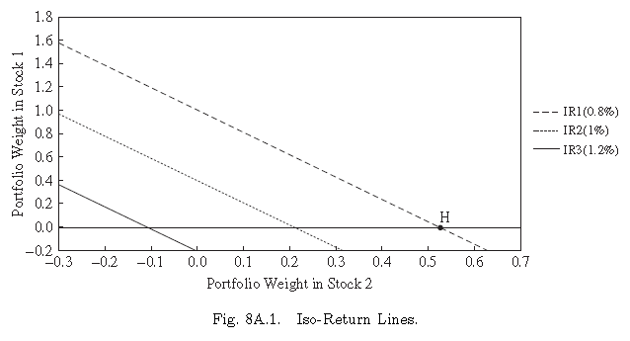
Appendix 8A Graphical Analysis in Markowitz Portfolio-Selection Model: Three-Security Empirical Solution
Each point on the iso-expected return line of Figure 8A.1 represents a different combination of weights placed in the three securities.

Slide 16
Appendix 8A Graphical Analysis in Markowitz Portfolio-Selection Model: Three-Security Empirical Solution
TABLE 8-6 Portfolio Variance along the Iso-Return Line
w2 | 0.0082 |  | 0.01008 |  | 0.01134
 | w1 | var | w1 | var | w1 | var
-1 | 1.5753 | 0.1806 | 1.3178 | 0.1618 | 1.1452 | 0.1564
-0.75 | 1.3322 | 0.1225 | 1.0747 | 0.1091 | 0.9021 | 0.1074
-0.5 | 1.0890 | 0.0771 | 0.8315 | 0.0693 | 0.6589 | 0.0713
-0.25 | 0.8459 | 0.0447 | 0.5884 | 0.0423 | 0.4158 | 0.0479
0 | 0.6027 | 0.0250 | 0.3452 | 0.0281 | 0.1726 | 0.0374
0.0795 | 0.5254 | 0.0214 | 0.2679 | 0.0263 | 0.0953 | 0.0368 *
0.151 | 0.4559 | 0.0194 | 0.1983 | 0.0258 * | 0.0257 | 0.0373
0.25 | 0.3596 | 0.0182 | 0.1021 | 0.0268 | -0.0705 | 0.0397
0.2577 | 0.3521 | 0.0182 * | 0.0946 | 0.0269 | -0.0780 | 0.0400
0.5 | 0.1164 | 0.0242 | -0.1411 | 0.0383 | -0.3137 | 0.0549
0.75 | -0.1267 | 0.0431 | -0.3842 | 0.0626 | -0.5568 | 0.0829
1 | -0.3699 | 0.0748 | -0.6274 | 0.0998 | -0.8000 | 0.1238
*Note: Underlined variances indicate minimum variance portfolios.

Slide 17
Appendix 8A Graphical Analysis in Markowitz Portfolio-Selection Model: Three-Security Empirical Solution

Slide 18
Appendix 8A Graphical Analysis in Markowitz Portfolio-Selection Model: Three-Security Empirical Solution
Note that the variance of the minimum-risk portfolio can be used as a base for graphing the iso-variance ellipses.
It can be completed by taking Equation (8A.3) and holding one of the weights, say W2 portfolio variance Var(Rp), constant. Then Equation (8A.3) can be solved using the quadratic formula:
(8A.8)
Where:

Slide 19
Appendix 8A Graphical Analysis in Markowitz Portfolio-Selection Model: Three-Security Empirical Solution
Substituting the numbers from the data of Table 8A.1 into Equation (8A.4) yields:
where:

Slide 20
Appendix 8A Graphical Analysis in Markowitz Portfolio-Selection Model: Three-Security Empirical Solution
When these expressions are plugged into the quadratic formula:
（8A.9）
where

Slide 21
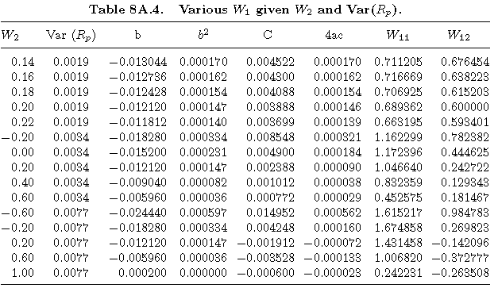
Appendix 8A Graphical Analysis in Markowitz Portfolio-Selection Model: Three-Security Empirical Solution
It should be noticed that all possible variances in Table 8A.4 are higher than the minimum-risk portfolio variance.
Data from Table 8A.4 are used to draw three iso-variance ellipses, as indicated in Figures 8A.2 and 8A.3.

Slide 22
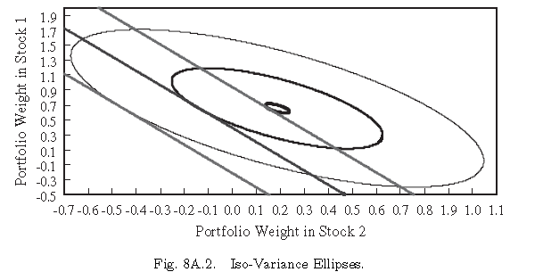
Appendix 8A Graphical Analysis in Markowitz Portfolio-Selection Model: Three-Security Empirical Solution

Slide 23
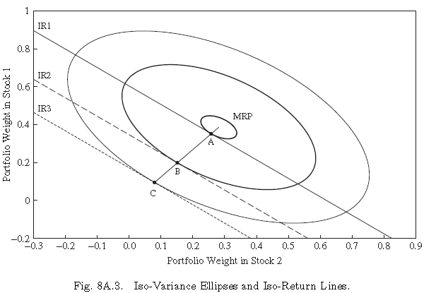
Appendix 8A Graphical Analysis in Markowitz Portfolio-Selection Model: Three-Security Empirical Solution

Slide 24
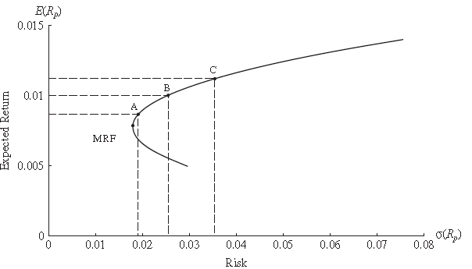
Appendix 8A Graphical Analysis in Markowitz Portfolio-Selection Model: Three-Security Empirical Solution
The Critical Line and Efficient Frontier. After the iso-expected return functions and iso-variance ellipses have been plotted, it is an easy task to delineate the efficient frontier.
MRFABC is denoted as the critical line; all portfolios that lie between points MRF and C are said to be efficient, and the weights of these portfolios may be read directly from the graph.

Slide 25
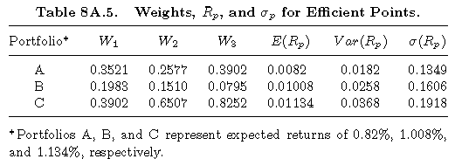
Appendix 8A Graphical Analysis in Markowitz Portfolio-Selection Model: Three-Security Empirical Solution
It is possible, given these various weights, to calculate the E(Rp) and the variances of these portfolios as indicated in Table 8A.5. The efficient frontier is then developed by plotting each risk-return combination, as shown in Figure 8A.4.

