Slide 1
Chapter 11
Performance-Measure Approaches for selecting Optimum Portfolios
By
Cheng Few Lee
Joseph Finnerty
John Lee
Alice C Lee
Donald Wort

Slide 2
Chapter Outline
11.1 SHARPE PERFORMANCE-MEASURE APPROACH WITH SHORT SALES ALLOWED
11.2 TREYNOR-MEASURE APPROACH WITH SHORT SALES ALLOWED
11.3 TREYNOR-MEASURE APPROACH WITH SHORT SALES NOT ALLOWED
11.4 IMPACT OF SHORT SALES ON OPTIMAL-WEIGHT DETERMINATION
11.5 ECONOMIC RATIONALE OF THE TREYNOR PERFORMANCE-MEASURE METHOD
11.6 SUMMARY

Slide 3
This chapter assumes the existence of a risk-free borrowing and lending rate and advances one step further to simplify the calculation of the optimal weights of a portfolio and the efficient frontier.
First discussed are Lintner’s (1965) and Elton et al.’s (1976) Sharpe performance-measure approaches for determining the efficient frontier with short sales allowed.
This is followed by a discussion of the Treynor performance-measure approach for determining the efficient frontier with short sales allowed.
The Treynor-measure approach is then analyzed for determining the efficient frontier with short sales not allowed.

Slide 4
11.1 Sharpe Performance-Measure Approach With Short Sales Allowed
Following previous chapters, the objective function for portfolio selection can be expressed:
where:
    = average rates of return for security i;
    = the optimal weight for ith (or jth) security;
    = the covariance between and ;
    = the standard deviation of a portfolio; and
    = Lagrangian multipliers.
Equation (11.1) maximizes the expected rates of return given targeted standard deviation.
(11.1)
4

Slide 5
If a constant risk-free borrowing and lending rate is subtracted from EQ(11.1) :
Equations (11.1) and (11.2a), both formulated as a constrained maximization problem, can be used to obtain optimum portfolio weights .
Since is a constant, the optimum weights obtained from Equation (11.1) will be equal to those obtained for Equation (11.2a).
(11.2a)
5

Slide 6
Previous chapters used the methodology of Lagrangian multipliers; it can be shown that Equation (11.2a) can be replaced by a nonconstrained maximization method as follows.
Incorporating the constant into the objective function by substituting
into Equation (11.2a):
A two-Lagrangian multiplier problem has been reduced to a one-Lagrangian problem as indicated in Equation (11.2b).
(11.2b)
6

Slide 7
By using a special property of the relationship between and the constrained optimization of Equation (18.2A) can be reduced to an uncon­strained optimization problem, as indicated in Equation (11.3).
Where .
Alternatively, the objective function of Equation (11.3) can be developed as follows.
This ratio L is equal to excess average rates of return for the ith portfolio divided by the standard deviation of the ith portfolio.
This is a Sharpe performance measure.
(11.3)
7

Slide 8
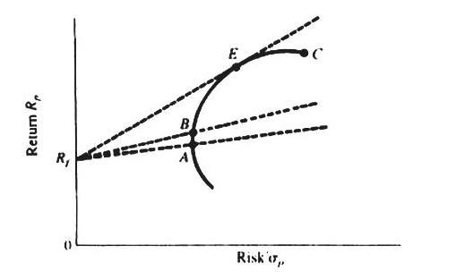
Figure 11.1 Linear Efficient Frontier
Following Sharpe (1964) and Lintner (1965), if there is a risk-free lending and borrowing rate and short sales are allowed, then the efficient frontier (efficient set) will be linear, as discussed in previous chapters.
In terms of return standard-deviation space, this linear efficient frontier is indicated as line in Figure 11.1.
AEC represents a feasible investment opportunity in terms of existing securities to be included in the portfolio when there is no risk-free lending and borrowing rate.
8

Slide 9
If there is a risk-free lending and borrowing rate, then the efficient frontier becomes .
An infinite number of linear lines represent the combination of a riskless asset and risky portfolio, such as .
It is obvious that line has the highest slope, as represented by
in which are defined as in Equation (11.2a).
Thus the efficient set is obtained by maximizing .
By imposing the constraint , Equation (11.4) is expressed:
(11.4)
(11.5a)
9

Slide 10
By using the procedure of deriving Equation (11.2b), Equation (11.5a) becomes
Following the maximization procedure discussed earlier in previous chapters, it is clear that there are n unknowns to be solved in either Equation (11.3) or Equation (11.5b).
Therefore, calculus must be employed to compute n first-order conditions to formulate a system of n simultaneous equations:
(11.5b)
10

Slide 11
From Appendix 11A, the n simultaneous equations used to solve are
where
The is proportional to the optimum portfolio weight by a constant factor K.
(11.6a)
11

Slide 12
To determine the optimum weight is first solved from the set of equations indicated in Equation (11.6).
Having d so the Hi must be called to calculate Wi, as indicated in Equation (11.7).
If there are only three securities, then Equation (11.6a) reduces to:
(11.7)
(11.6b)
12

Slide 13
Sample Problem 11.1
Let
Substituting this information into Equation (l1.6b):
Simplifying:
(11.6c)

Slide 14
Using Cramer’s rule, H₁, H₂, H₃ and can be solved for as follows:
14

Slide 15
Using Equation (11.7), W₁, W₂, W₃ are obtained:
15

Slide 16
Here can be calculated by employing these weights:
16

Slide 17
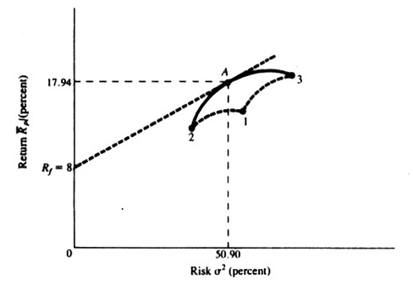
Figure 11.2 Efficient Frontier for Example 11.1
The efficient frontier for this example is shown in Figure 11.2.
Here A represents an efficient portfolio with .
17

Slide 18


In addition to Cramer’s rule method used in this example, we can also use the matrix inversion method to solve this question.
Equation (11.6b) can be written in the matrix form as following:
Then Equation (11.6c) can be written as following:
By using inverse matrix method in Appendix 10C of Chapter 10, we can obtain
18

Slide 19
11.2 Treynor-Measure Approach With Short Sales Allowed
Using single index market model discussed in Chapter 10, Elton et al (1976) define:
Substituting of this value of into Equation (11.3)
19

Slide 20
In order to find the set of that maximize L, take the partial derivatives of above equation with respect to each and some manipulation.
Then we can obtain
where
The procedure of deriving Equations (11.9) and (11.10) can be found in Appendix 11B.
The must be calculated for all the stocks in the portfolio.
By the Treynor measure approach, if is a positive value, this indicates the stock will be held long, whereas a negative value indicates that the stock should be sold short.
(11.9)
(11.10)
20

Slide 21
One method follows the standard definition of short sales, which presumes that a short sale of stock is a source of funds to the investor; it is called the standard method of short sales.
This standard scaling method is indicated in Equation (11.10). In Equation (11.10), can be positive or negative.
This scaling factor includes a definition of short sales and the constraint:
A second method (Lintner’s (1965) method of short sales) assumes that the proceeds of short sales are not available to the investor and that the investor must put up an amount of funds equal to the proceeds of the short sale.
21

Slide 22
The additional amount of funds serves as collateral to protect against adverse price movements.
Under these assumptions, the constraints on the can be expressed as
And the scaling factor is expressed as
(11.11)
22

Slide 23
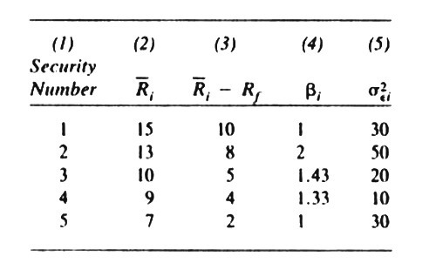
Sample Problem 11.2
The following example shows the differences in security weights in the optimal portfolio due to the differing short-sale assumptions.
Data associated with regressions of the single-index model are presented in the Table 11.1.
The mean return, , the excess return , the beta coefficient , and the variance of the error term are presented from columns 2 through 5.
Table 11.1 Data Associated with Regressions of the Single-Index Model
23

Slide 24
From the information in Table 11-1, using Equations (11.9) and (11.10).
can be calculated as
If this same example is scaled using the standard
definition of short sales , which provides
funds to the investor:

Slide 25
According to Lintner’s method:
Now to scale the values into an optimum portfolio,
apply Equation (11.11):
The difference between Lintner’s method and the standard method are due to the different definitions of short selling discussed earlier.
The standard method assumes that the investor has the proceeds of the short sale, while Lintner’s method assumes that the short seller does not receive the proceeds and must provide funds as collateral.

Slide 26
11.3 Treynor-Measure Approach With Short Sales Not Allowed
Equation (11.10) can be modified to
in which is the Treynor performance measure and C*can be
defined as
(11.12)
(11.13)
26

Slide 27
Elton et al. (1976) also derive a Treynor-measure approach with short sales not allowed.
From Appendix 11C, Equation (11.13) should be modified to
where
then
where d is a set which contains all stocks with positive
(11.14)
(11.15)
27

Slide 28
If all securities have positive , the following three step procedure from Elton et al. can be used to choose securities to be included in the optimum portfolio.
1) Use the Treynor performance measure to rank the securities in descending order.
2) Use equation (11.16) to calculate C* for first i^{th} securities.
3) Include i securities for which is larger than . Then C*is equal to .
4) Use Equation (11.5) to calculate optimum weights for i securities.

Slide 29
Sample Problem 18.3
The Center for Research in Security Prices tape was the source of five years of monthly return data, from January 2006 through December 2010, for the 30 stocks in the Dow-Jones Industrial Averages (DJIAs).
The value-weighted average of the S&P 500 index was used as the market while three-month Treasury-bill rates were used as the risk-free rate.
The single-index model was used with an ordinary least-squares regression procedure to determine each stock’s beta.
All data are listed in the worksheet, which lists the companies in descending order of Treynor performance measure.
29

Slide 30
To calculate the as defined in Equation (11.16)
.
are calculated and presented in the worksheet.
Substituting
into Equation (11.16) produces for every firm as listed in the last column in the worksheet.
30

Slide 31
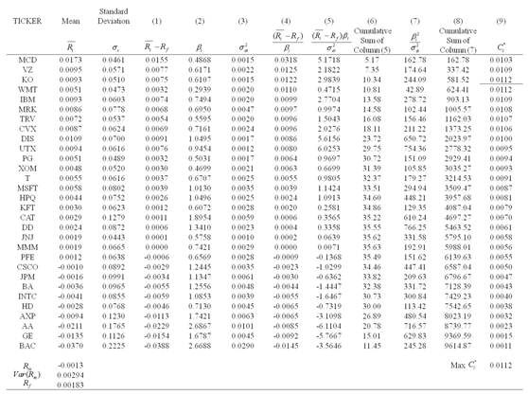
Worksheet for DJIAs (pg.413)

Slide 32
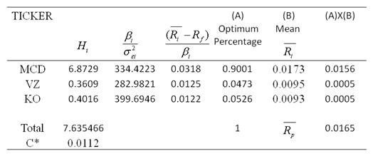
Table 11.2 Positive Optimum Weight for Three Securities
Using company VZ as an example:
From of the worksheet, it is clear that there are three securities that should be included in the portfolio.
The estimated of these three securities are listed in Table 11.2.
32

Slide 33
Substituting this information into Equation (11.15) produces for all three securities.
Using security MCD as an example:
Using Equation (11.12), the optimum weights can be estimated for all three securities, as indicated in Table 11.2.
In other words, 90.01% of our fund should be invested in security MCD, 4.73% in security VZ, 5.26% in security KO.
Based upon the optimal weights, the average rate for the portfolio is calculated as 1.65%, as presented in the last column of Table 11.2.
33

Slide 34
11.4 Impact of Short Sales on Optimal-Weight Determination
In both the Markowitz and Sharpe models, the analysis is facilitated by the presence of short selling.
This chapter discusses a method proposed by Elton and Gruber for the selection of optimal portfolios.
Their method involves ranking securities based on their excess return to beta ratio, and choosing all securities with a ratio greater than some particular cutoff level C*.
It is interesting to note that while the presence of short selling facilitated the selection of the optimum portfolio in both the Markowitz and Sharpe models, it complicates the analysis when we use the Elton and Gruber approach.
34

Slide 35
11.5 Economic Rationale of the Treynor Performance-Measure Method
Cheung and Kwan (1988) have derived an alternative simple rate of optimal portfolio selection in terms of the single-index model.
where:

Slide 36
Based upon the single-index model and the risk decomposition discussed in Chapter 7, the following relationships can be defined:
From Equation (11.17), Cheung and Kwan define in terms of .
in which is the nonsystematic risk for the ith portfolio.
They use both to select securities for an optimum portfolio, and they conclude that can be used to replace in selecting securities for an optimum portfolio.
But information is still needed to calculate the weights for each security.

Slide 37
11.6 SUMMARY
Following Elton et al. (1976) and Elton and Gruber (1987) we have discussed the performance-measure approaches to selecting optimal portfolios.
We have shown that the performance-measure approaches for optimal portfolio selection are complementary to the Markowitz full variance–covariance method and the Sharpe index-model method.
These performance-measure approaches are thus worthwhile for students of finance to study following an investigation of the Markowitz variance–covariance method and Sharpe’s index approach.

