Slide 1
Chapter 12
The Efficient-Market Hypothesis and Security Valuation
By
Cheng Few Lee
Joseph Finnerty
John Lee
Alice C Lee
Donald Wort

Slide 2
Chapter Outline
12.1 Market Value Versus Book Value
  12.1.1 Assets
  12.1.2 Liabilities and Owner’s Equity
  12.1.3 Ratios and Market Information
  12.1.4 Market-to-Book Ratio
12.2 Market Efficiency in a Market-Model and CAPM Context
  12.2.1 Market Model
  12.2.2 Sharpe-Linter CAPM Model
12.3 Tests for Market Efficiency
  12.3.1 Weak Form Efficiency
  12.3.2 Semi-Strong Form Efficiency
  12.3.3 Strong Form Efficiency
12.4 Other Methods of Testing the EMH
  12.4.1 Random Walk with Reflecting Barriers
  12.4.2 Variance-Bound Approach Test
  12.4.3 Hillmer and Yu’s Relative EMH Test
12.5 Random Walk Hypothesis vs. EMH Test
12.6 Market Anomalies
  12.6.1 The P/E Effect
  12.6.2 The Size Effect
  12.6.3 The January Effect

Slide 3
The Efficient-Market Hypothesis and Security Valuation
In an efficient capital market, security prices fully reflect all available information.
Efficient-Market Hypothesis (EMH)-hypothesis used to test whether the capital market is efficient
This chapter focuses on the EMH and its relationship to security valuation. Valuation concepts and financial theories and models discussed in previous chapters are utilized to show the degree of efficiency with which both market-based and accounting information is reflected in current stock prices. Four major areas are discussed:
The relationship between market value and book value
The three forms of efficiency
An analysis of the market model and the capital asset pricing model (CAPM) used for testing the EMH
Other recent issues related to the EMH.

Slide 4
12.1 Market Value Versus Book Value
One source of data used in security analysis is economic and market information. Another source — the primary source of information available to the security analyst — is accounting information from the financial statements of the firm, discussed earlier in Chapter 2. One of the key accounting items — assets — is the focus of the following section.

Slide 5
12.1 Market Value Versus Book Value
  12.1.1 Assets
In general, the financial statements of the firm value the physical assets at historical cost less accumulated depreciation. This is known as book value. On the other hand, market value is value in terms of market price.
Recording Value of Different Assets:
Land is not depreciated in the financial statements of the firm unless some “arm’s length” transaction has taken place to objectively verify the value.
Marketable equity securities is recorded at the lower of initial cost or market value.
Long-term bond investments are recorded at initial cost.
Stock held as an investment in another corporation can be accounted for under one of two methods: (1) the equity method or (2) the lower-of-cost or market-value method.
  Under the equity method, the investing firm exercises significant control over the other corporation and the investment is recorded at cost
  The lower of the cost or market value is used if no evidence of significant control exists. These securities are handled in the same way as marketable equity securities.

Slide 6
12.1 Market Value Versus Book Value
  12.1.2 Liabilities and Owner’s Equity
Liabilities
Current liabilities reflect their current values because they mature in less than one year.
Bond liabilities are recorded at the price at which they were sold when issued. If the bonds were not sold at par value, the discount or premium is amortized over the life of the issue.
  At the date of each interest payment, the amortization of a bond premium is deducted from the bonds-payable account
  Amortization of a discount is added to the bonds-payable account
  As a result, the balance-sheet account will steadily change (due to the amortization) toward the par value on the maturity date of the issue.

Slide 7
12.1 Market Value Versus Book Value
  12.1.2 Liabilities and Owner’s Equity
Owner/Stockholders’ Equity
The stockholders’ equity account of the firm consists of contributed and earned capital.
Contributed Capital includes capital stock and additional paid-in capital.
  When a firm issues common stock, the capital-stock account is increased by the par value of the issue. The par value is a nominal value per share. If stock is issued at a value greater than par value, a premium results. This increases the additional paid-in capital of the firm. Stock issued at less than par value results in a discount and decreases the additional paid-in-capital account.
Earned capital is better known as retained earnings.
The true market value of any firm is the sum of the market prices of all the firm’s outstanding debt and equity issues. This value is often substantially different than the accounting value or book value of the firm.

Slide 8
12.1 Market Value Versus Book Value
  12.1.3 Ratios and Market Information
Many ratios computed using accounting data can also be computed using market information (as discussed in Chapter 3). Ratios should be calculated using both kinds of information to determine whether there is a difference (relative to each other or to other firms in the industry) between the two methods.

Slide 9
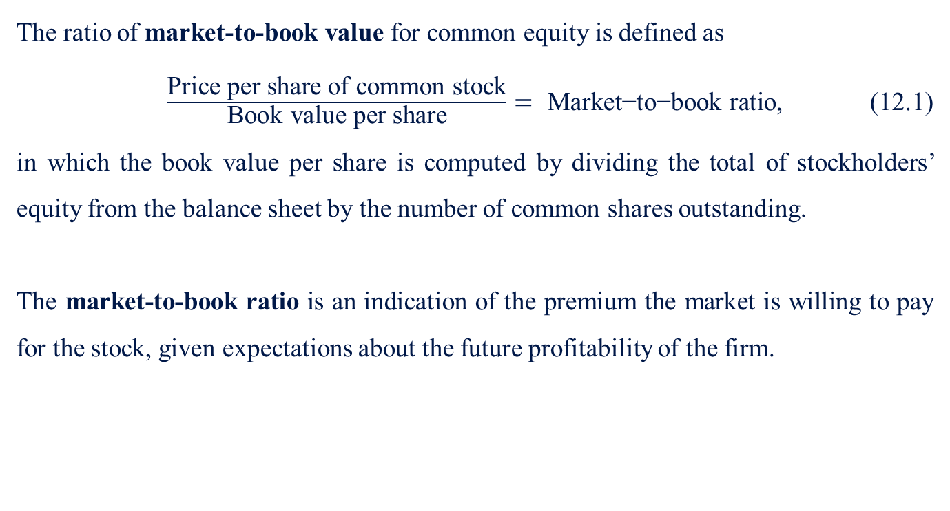
12.1 Market Value Versus Book Value
  12.1.4 Market-to-Book Ratio
The ratio of market-to-book value for common equity is defined as
$\frac{\text{Price} \text{per} \text{share} \text{of} \text{common} \text{stock}}{\text{Book} \text{value} \text{per} \text{share}}= \text{Market}\text{−}\text{to}\text{−}\text{book} \text{ratio}$, (12.1)
in which the book value per share is computed by dividing the total of stockholders’ equity from the balance sheet by the number of common shares outstanding.
The market-to-book ratio is an indication of the premium the market is willing to pay for the stock, given expectations about the future profitability of the firm.

Slide 10
12.1 Market Value Versus Book Value
  12.1.4 Market-to-Book Ratio
Sample Problem 12.1
The XYZ Company’s financial statements and certain market information are given in the Table12-1 below. Calculate the market-to-book ratio and indicate what it implies about XYZ. The stock sells for $20 per share.
Table 12-1 XYZ Company Year-End Balance Sheet (Dollars in million)
XYZ Company Year-End Balance Sheet ($ million)
Current assets | $ 10 |  | Current liabilities | $ 10
Fixed assets | 20 |  | Long-term debt | 25
Intangibles | 10 |  | Equity (in shares outstanding*) | 5
Total assets | $ 40 |  | Total liabilities and equity | $ 40
(*1 million shares are outstanding)

Slide 11
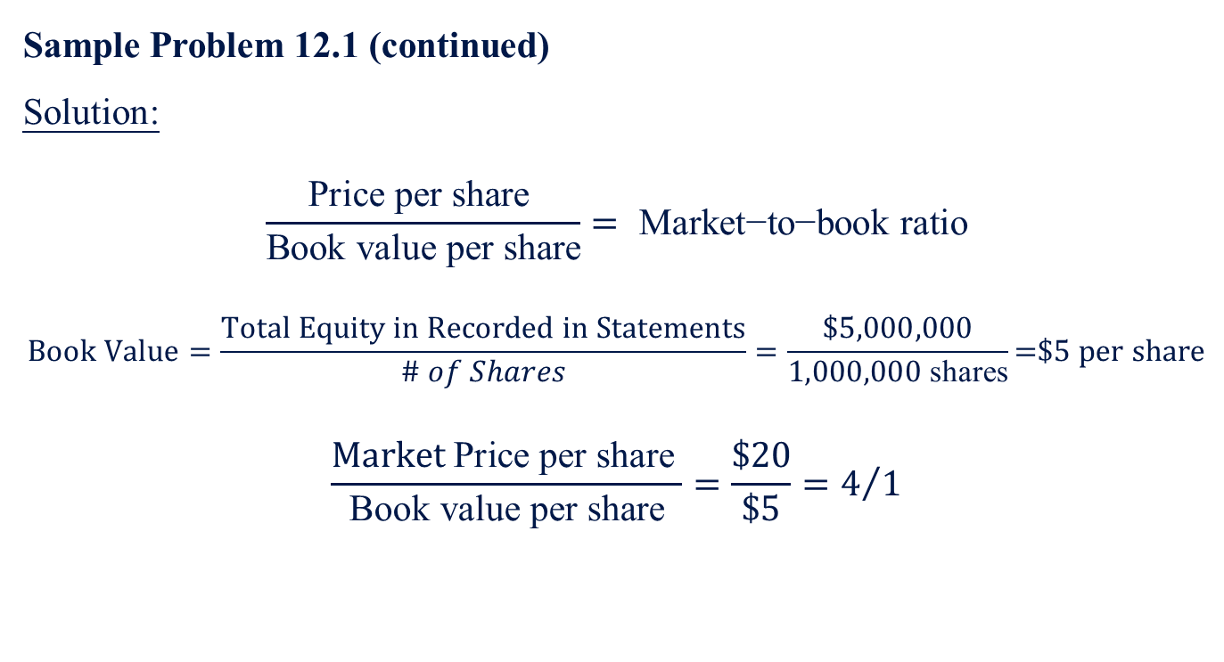
12.1 Market Value Versus Book Value
  12.1.4 Market-to-Book Ratio
Sample Problem 12.1 (continued)
Solution:
$$\frac{\text{Price} \text{per} \text{share} }{\text{Book} \text{value} \text{per} \text{share}}= \text{Market}\text{−}\text{to}\text{−}\text{book} \text{ratio}$$
$$Book Value=\frac{Total Equity in Recorded in Statements}{\# of Shares}=\frac{\$5,000,000}{1,000,000 \text{shares}}\text{=\$5 }\text{per} \text{share}$$
$$\frac{Market \text{Price} \text{per} \text{share} }{\text{Book} \text{value} \text{per} \text{share}}=\frac{\$20}{\$5}=4/1$$

Slide 12
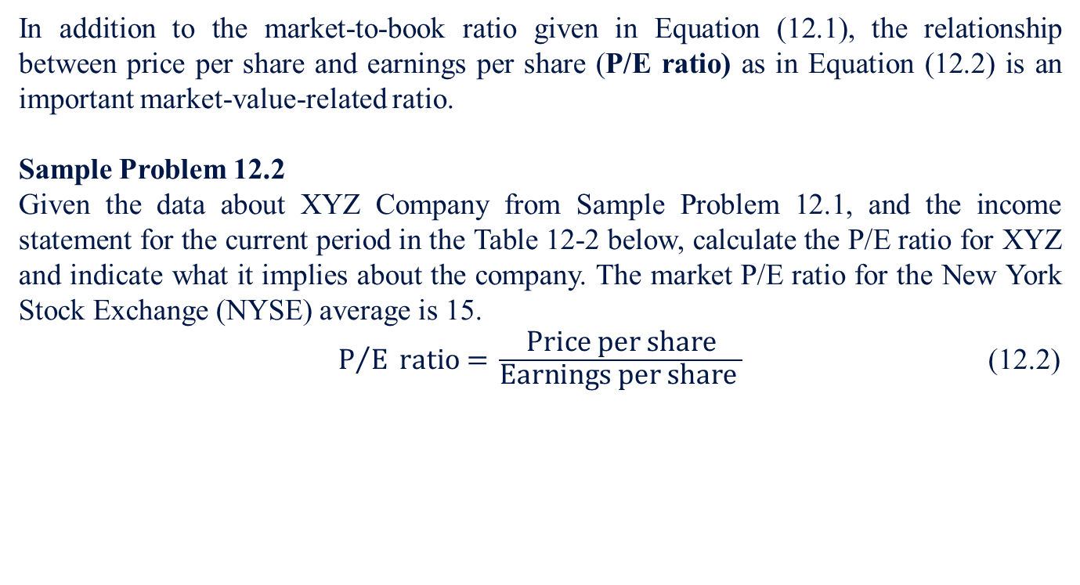
12.1 Market Value Versus Book Value
  12.1.4 P/E Ratio
In addition to the market-to-book ratio given in Equation (12.1), the relationship between price per share and earnings per share (P/E ratio) as in Equation (12.2) is an important market-value-related ratio.
Sample Problem 12.2
Given the data about XYZ Company from Sample Problem 12.1, and the income statement for the current period in the Table 12-2 below, calculate the P/E ratio for XYZ and indicate what it implies about the company. The market P/E ratio for the New York Stock Exchange (NYSE) average is 15.
${\text{P}}/{\text{E}} \text{ratio}\text{ = }\frac{\text{Price} \text{per} \text{share}}{\text{Earnings} \text{per} \text{share} }$ (12.2)
Table 12-2 XYZ Company Year-End Income Statement (in millions)
Revenues | $90
Expenses | -86
Operating income | $4
Interest | -2
Taxable income | $2
Tax | -0.67
Profit | $1.33

Slide 13
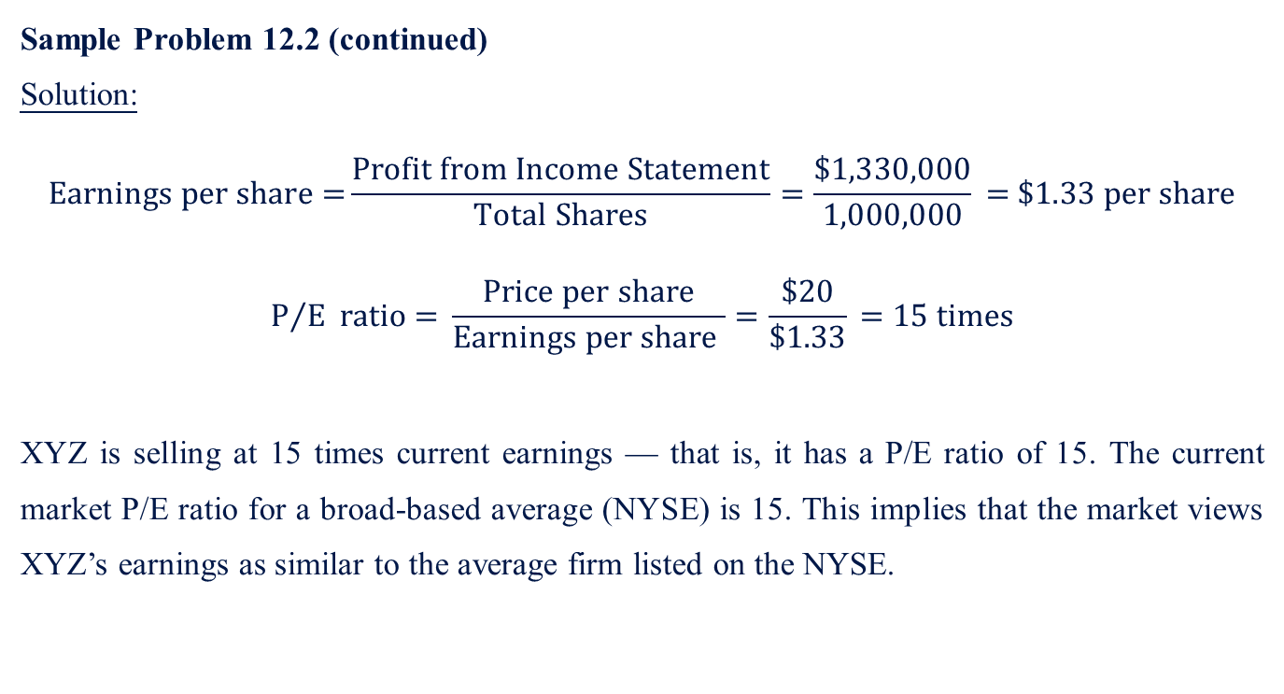
12.1 Market Value Versus Book Value
  12.1.5 P/E Ratio
Sample Problem 12.2 (continued)
Solution:
$$\text{Earnings} \text{per} \text{share}\text{ =}\frac{\text{Profit} \text{from} \text{Income} \text{Statement}}{\text{Total} \text{Shares}}=\frac{\text{\$1,330,000}}{\text{1,000,000}}\text{ = }\$1.33 per share$$
$${\text{P}}/{\text{E}} \text{ratio}\text{ = }\frac{\text{Price} \text{per} \text{share}}{\text{Earnings} \text{per} \text{share} }=\frac{\text{\$20}}{\text{\$1.33}}\text{ = 15 }\text{times}$$
XYZ is selling at 15 times current earnings — that is, it has a P/E ratio of 15. The current market P/E ratio for a broad-based average (NYSE) is 15. This implies that the market views XYZ’s earnings as similar to the average firm listed on the NYSE.

Slide 14
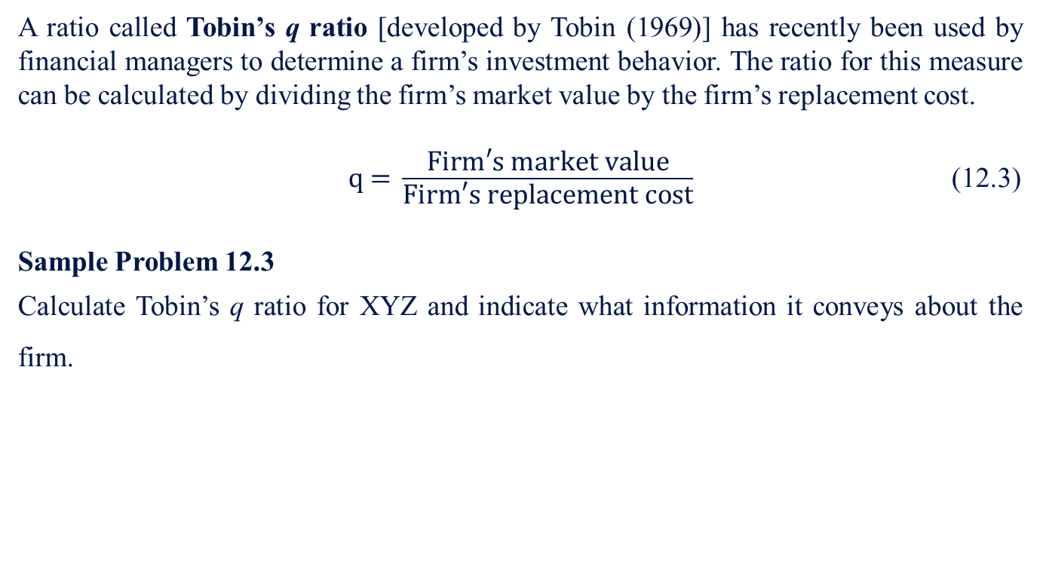
12.1 Market Value Versus Book Value
  12.1.6 Tobin’s q ratio
A ratio called Tobin’s q ratio [developed by Tobin (1969)] has recently been used by financial managers to determine a firm’s investment behavior. The ratio for this measure can be calculated by dividing the firm’s market value by the firm’s replacement cost.
$\text{q}\text{ = }\frac{\text{Firm}\text{′}\text{s} \text{market} \text{value}}{\text{Firm}\text{′}\text{s} \text{replacement} \text{cost}}$ (12.3)
Sample Problem 12.3
Calculate Tobin’s q ratio for XYZ and indicate what information it conveys about the firm.
Replacement cost of total assets | $50 million
Market value of XYZ’s debt | $30 million

Slide 15
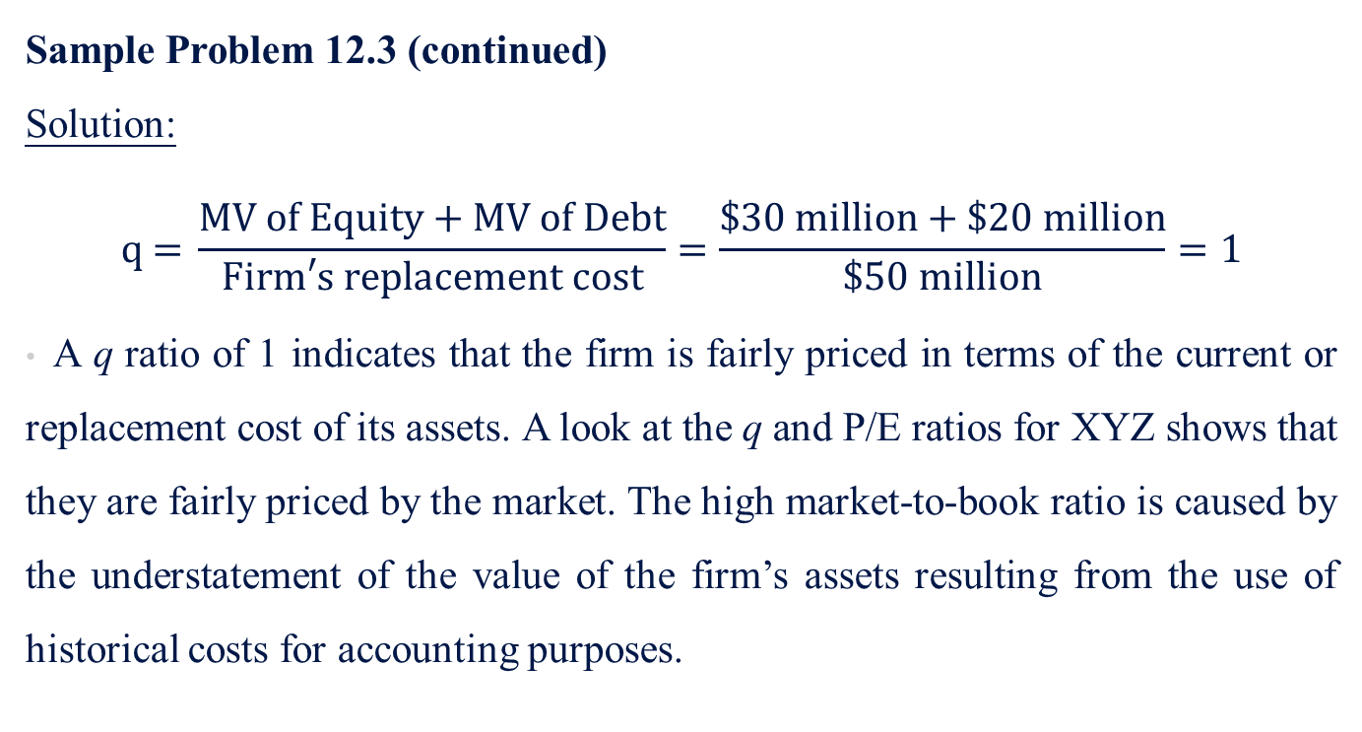
12.1 Market Value Versus Book Value
  12.1.6 Tobin’s q ratio
Sample Problem 12.3 (continued)
Solution:
$$\text{q}\text{ = }\frac{\text{MV} \text{of} \text{Equity}\text{ + }\text{MV} \text{of} \text{Debt}}{\text{Firm}\text{′}\text{s} \text{replacement} \text{cost}}=\frac{\$30 \text{million}\text{ + \$20 }\text{million}}{\text{\$50 }\text{million}}=1$$
A q ratio of 1 indicates that the firm is fairly priced in terms of the current or replacement cost of its assets. A look at the q and P/E ratios for XYZ shows that they are fairly priced by the market. The high market-to-book ratio is caused by the understatement of the value of the firm’s assets resulting from the use of historical costs for accounting purposes.

Slide 16
12.2 Market Efficiency in a Market-Model and CAPM Context
The quality of market valuation methods depends heavily on the concept of market efficiency. Efficient markets can be described as either perfect capital markets and efficient capital markets.

Slide 17
12.2 Market Efficiency in a Market-Model and CAPM Context
Perfect Capital Markets
A perfect market means an economy in continuous equilibrium — that is, a market which instantly and correctly responds to new information, providing signals for real economic decisions. The following are necessary conditions for perfect capital markets:
  Markets are frictionless (a financial market without transaction costs).
  Production and securities markets are perfectly competitive.
  Markets are informationally efficient.
  All individuals are rational expected-utility maximizers.
  Given these conditions, it follows that both product and securities markets will be both allocationally and operationally efficient. Markets are allocationally efficient when resources are directed to the best available opportunities, signaled correctly by relative prices; markets are operationally efficient when transaction costs are reduced to the minimum level possible.

Slide 18
12.2 Market Efficiency in a Market-Model and CAPM Context
Efficient Capital Markets
In an efficient capital market prices fully and instantaneously reflect all available information; thus, when assets are traded, prices are accurate signals for capital allocation. In this case, an efficient capital market only follows Rule 3 of a perfect capital market.
Fama (1970) defines three “types” of efficiency, each of which is based on a different notion of exactly what type of information is understood to be relevant. They are:
Weak form efficiency: No investor can earn excess returns by developing trading rules based on historical price or return information.
Semi-strong form efficiency: No investor can earn excess returns from trading rules based on publicly available information.
Strong form efficiency: No investor can earn excess returns using any information, whether or not publicly available.

Slide 19
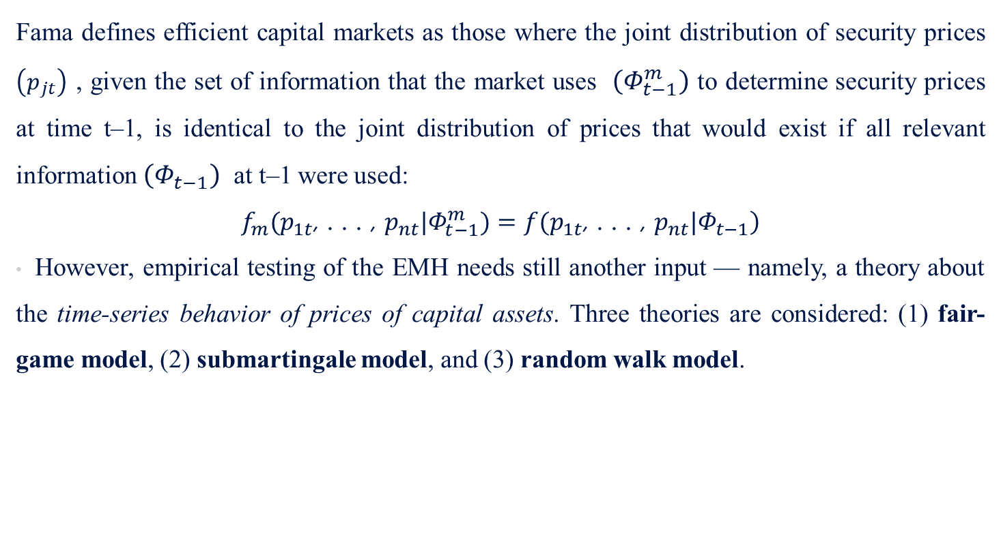
12.2 Market Efficiency in a Market-Model and CAPM Context
Efficient Capital Markets
Fama defines efficient capital markets as those where the joint distribution of security prices $\left(p_{jt}\right)$ , given the set of information that the market uses $\left(Φ_{t−1}^{m}\right)$ to determine security prices at time t–1, is identical to the joint distribution of prices that would exist if all relevant information $\left(Φ_{t−1}\right)$ at t–1 were used:
$$\left.f_{m}(p_{1t}\text{, . . . , }p_{nt}|Φ_{t−1}^{m})=f(p_{1t}\text{, . . . , }p_{nt}|Φ_{t−1}\right)$$
However, empirical testing of the EMH needs still another input — namely, a theory about the time-series behavior of prices of capital assets. Three theories are considered: (1) fair-game model, (2) submartingale model, and (3) random walk model.

Slide 20
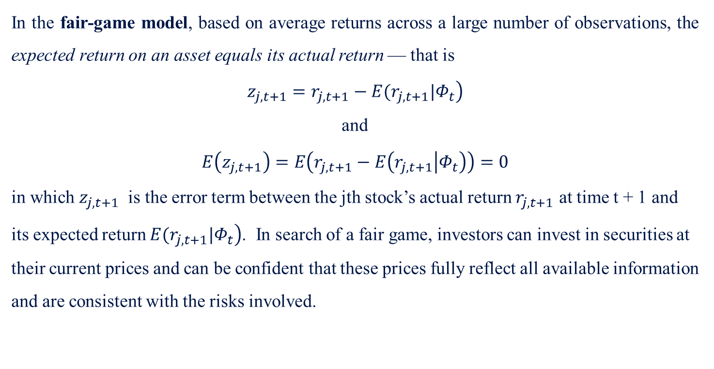
12.2 Market Efficiency in a Market-Model and CAPM Context
Efficient Capital Markets
Time-Series Behavior of Prices of Capital Assets-Fair Game Model
In the fair-game model, based on average returns across a large number of observations, the expected return on an asset equals its actual return — that is
$$\left.z_{j,t+1}=r_{j,t+1}−E(r_{j,t+1}|Φ_{t}\right)$$
and
$$E\left(z_{j,t+1}\right)=E\left(r_{j,t+1}−E\left(r_{j,t+1} | Φ_{t}\right)\right)=0$$
in which $z_{j,t+1}$ is the error term between the jth stock’s actual return $r_{j,t+1}$ at time t + 1 and its expected return $\left.E(r_{j,t+1}|Φ_{t}\right)$. In search of a fair game, investors can invest in securities at their current prices and can be confident that these prices fully reflect all available information and are consistent with the risks involved.

Slide 21
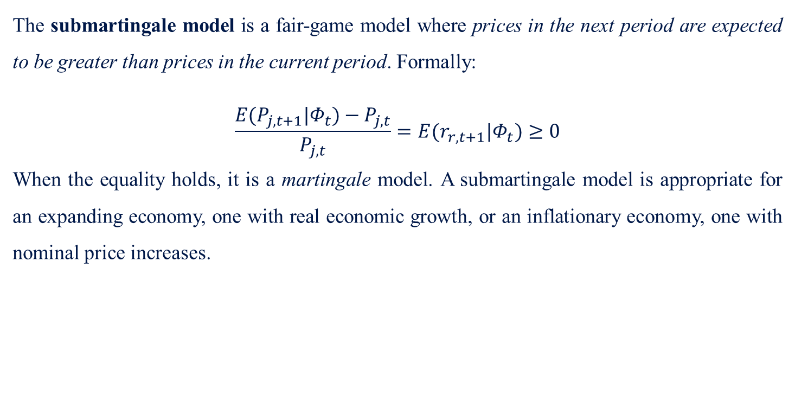
12.2 Market Efficiency in a Market-Model and CAPM Context
Efficient Capital Markets
Time-Series Behavior of Prices of Capital Assets-Submartingale Model
The submartingale model is a fair-game model where prices in the next period are expected to be greater than prices in the current period. Formally:
$$\frac{E(P_{j,t+1}|Φ_{t})−P_{j,t}}{P_{j,t}}=E(r_{r,t+1}|Φ_{t})≥0$$
When the equality holds, it is a martingale model. A submartingale model is appropriate for an expanding economy, one with real economic growth, or an inflationary economy, one with nominal price increases.

Slide 22
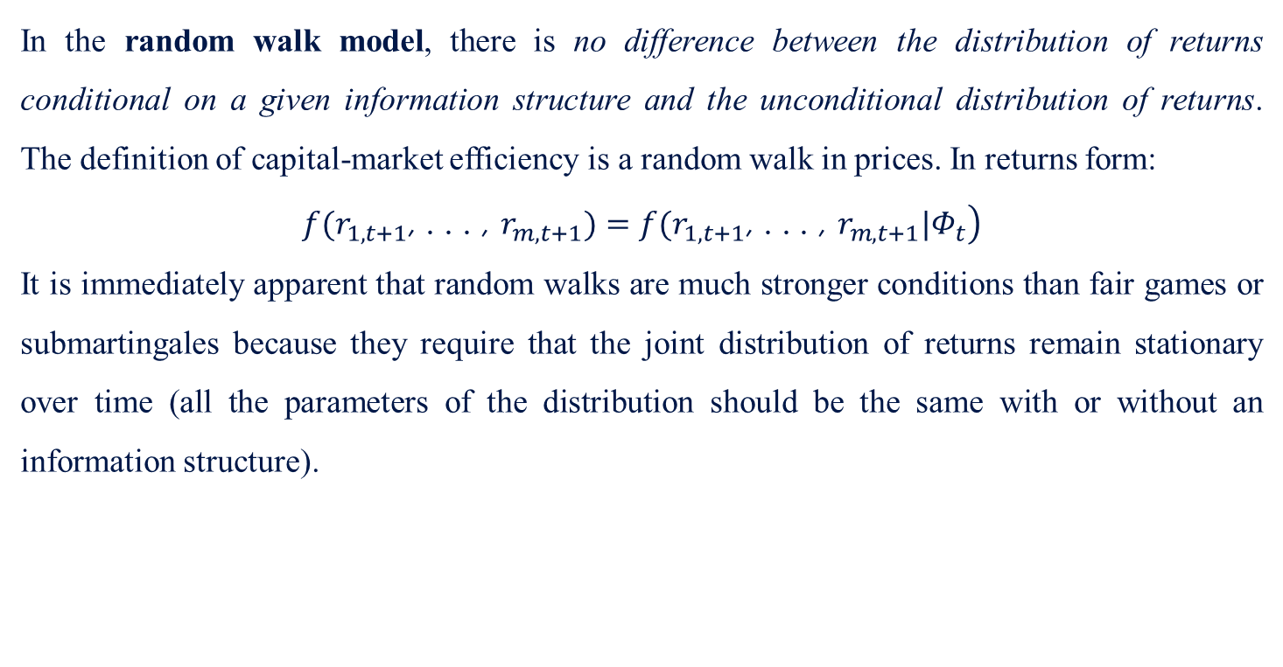
12.2 Market Efficiency in a Market-Model and CAPM Context
Efficient Capital Markets
Time-Series Behavior of Prices of Capital Assets-Random Walk Model
In the random walk model, there is no difference between the distribution of returns conditional on a given information structure and the unconditional distribution of returns. The definition of capital-market efficiency is a random walk in prices. In returns form:
$$\left.f(r_{1,t+1}\text{, . . . , }r_{m,t+1})=f(r_{1,t+1}\text{, . . . , }r_{m,t+1}|Φ_{t}\right)$$
It is immediately apparent that random walks are much stronger conditions than fair games or submartingales because they require that the joint distribution of returns remain stationary over time (all the parameters of the distribution should be the same with or without an information structure).

Slide 23
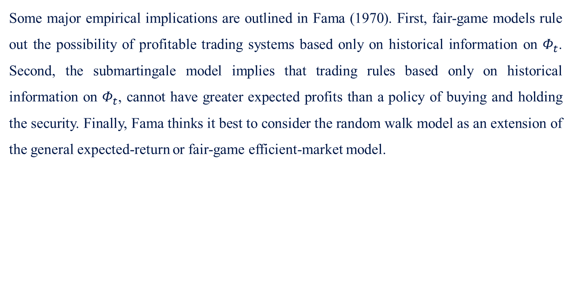
12.2 Market Efficiency in a Market-Model and CAPM Context
Efficient Capital Markets
Time-Series Behavior of Prices of Capital Assets
Some major empirical implications are outlined in Fama (1970). First, fair-game models rule out the possibility of profitable trading systems based only on historical information on $Φ_{t}$. Second, the submartingale model implies that trading rules based only on historical information on $Φ_{t}$, cannot have greater expected profits than a policy of buying and holding the security. Finally, Fama thinks it best to consider the random walk model as an extension of the general expected-return or fair-game efficient-market model.

Slide 24
12.2 Market Efficiency in a Market-Model and CAPM Context
With this as background, the discussion now turns to the empirical testing of the EMH. It is constructive, however, first to discuss the model used when this theory is tested, especially when testing the Semi-Strong Form of Efficiency.

Slide 25
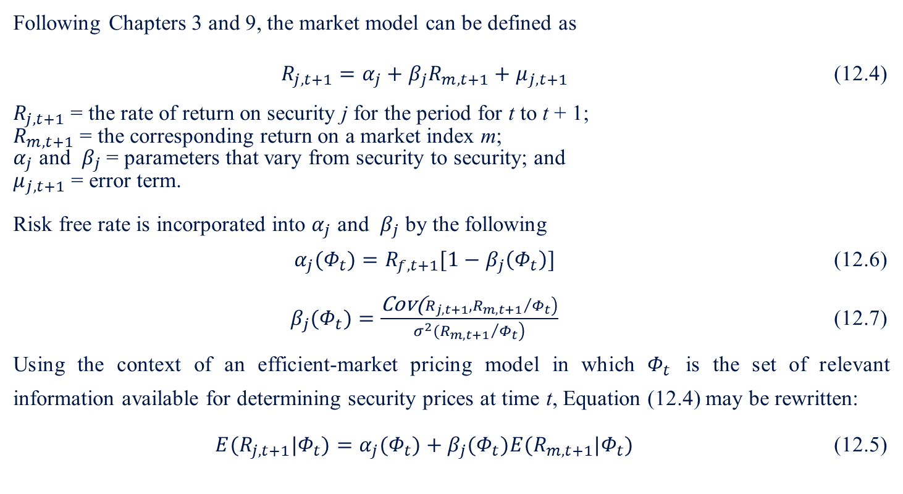
12.2 Market Efficiency in a Market-Model and CAPM Context
  12.2.1 Market Model
Following Chapters 3 and 9, the market model can be defined as
$R_{j,t+1}=α_{j}+β_{j}R_{m,t+1}+μ_{j,t+1}$ (12.4)
$R_{j,t+1}$ = the rate of return on security j for the period for t to t + 1;
$R_{m,t+1}$ = the corresponding return on a market index m;
$α_{j}$ and $β_{j}$ = parameters that vary from security to security; and
$μ_{j,t+1}$ = error term.
Risk free rate is incorporated into $α_{j}$ and $β_{j}$ by the following
$α_{j}(Φ_{t})=R_{f,t+1}[1−β_{j}\left(Φ_{t}\right)]$ (12.6)
$β_{j}(Φ_{t})=\frac{\left.\text{Cov}\text{(}R_{j,t+1},{R_{m,t+1}}/{Φ_{t}}\right)}{\left.σ^{2}({R_{m,t+1}}/{Φ_{t}}\right)}$ (12.7)
Using the context of an efficient-market pricing model in which $Φ_{t}$ is the set of relevant information available for determining security prices at time t, Equation (12.4) may be rewritten:
$E(R_{j,t+1}|Φ_{t})=α_{j}(Φ_{t})+β_{j}(Φ_{t})E(R_{m,t+1}|Φ_{t})$ (12.5)

Slide 26
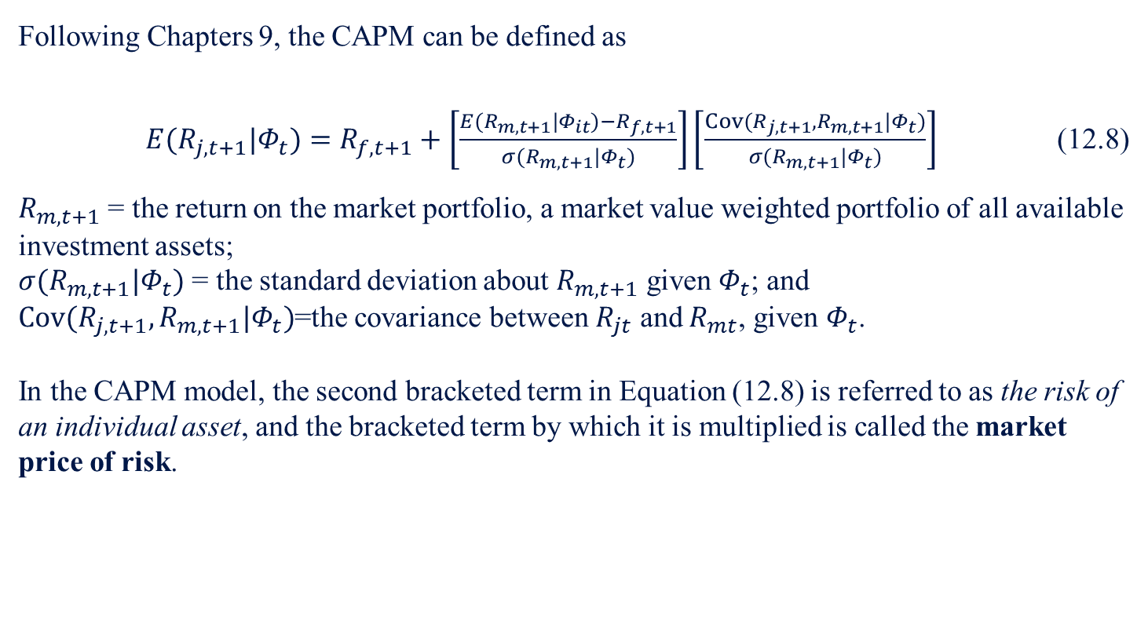
12.2 Market Efficiency in a Market-Model and CAPM Context
  12.2.2 Sharpe–Lintner CAPM Model
Following Chapters 9, the CAPM can be defined as
$E(R_{j,t+1}|Φ_{t})=R_{f,t+1}+\left[\frac{E(R_{m,t+1}|Φ_{it})−R_{f,t+1}}{σ(R_{m,t+1}|Φ_{t})}\right]\left[\frac{Cov(R_{j,t+1},R_{m,t+1}|Φ_{t})}{σ(R_{m,t+1}|Φ_{t})}\right]$ (12.8)
$R_{m,t+1}$ = the return on the market portfolio, a market value weighted portfolio of all available investment assets;
$σ(R_{m, t+1}|Φ_{t})$ = the standard deviation about $R_{m,t+1}$ given $Φ_{t}$; and
$Cov(R_{j,t+1},R_{m,t+1}|Φ_{t})$=the covariance between $R_{jt}$ and $R_{mt}$, given $Φ_{t}$.
In the CAPM model, the second bracketed term in Equation (12.8) is referred to as the risk of an individual asset, and the bracketed term by which it is multiplied is called the market price of risk.

Slide 27
12.3 Tests for Market Efficiency
12.3.1 Weak Form Efficiency
Two basic types of tests have been used to evaluate the weak form: (1) those that test for statistical independence in sequences of process and price changes, and (2) those that use technical trading rules to devise a profit beyond random selection.
Independence in Sequences of Process and Price Changes: Many authors, including Samuelson (1973) and Fama (1965), have demonstrated that the evidence is against any significant dependence in successive price changes.
  Niederhoffer and Osborne (1966) and Summers (1986) show studies of individual transaction-price data as they become immediately available on the stock exchanges.
  However, it is not likely that the significant serial correlation found in the sequence of individual transaction prices could be used to generate excess profits after transaction costs.

Slide 28
12.3 Tests for Market Efficiency
12.3.1 Weak Form Efficiency
The weak-form test of technical trading rules is characterized by the filter tests of Alexander (1961) and Fama and Blume (1966).
  A typical filter rule works as follows:
    Buy a stock if its daily closing price increase by at least z percent from a previous low and hold it until its price decreases by at least z percent from a previous high.
    Simultaneously sell and go short.
    When the stock price again increases by at least z percent above a previous low, close the short position and go long. Ignore price changes of less than z percent.
    Process is repeated continually over a fixed time period, at which time the results are compared with those from a buy-and-hold strategy over the same period.
  Conclusions from this study show that only small filters, not taking into account trading costs, can achieve above-average profits.

Slide 29
12.3 Tests for Market Efficiency
12.3.2 Semi-Strong Form Efficiency
The information for semi-strong form efficiency includes not only stock market data but all publicly available information. Current prices under this form already include any piece of information that might otherwise be expected to be useful in achieving above-average rates of return. Tests of this form include:
  Speed of adjustment of stock prices to new information
  Studies that consider whether investors can achieve above-average profits by trading on the basis of any publicly available information

Slide 30
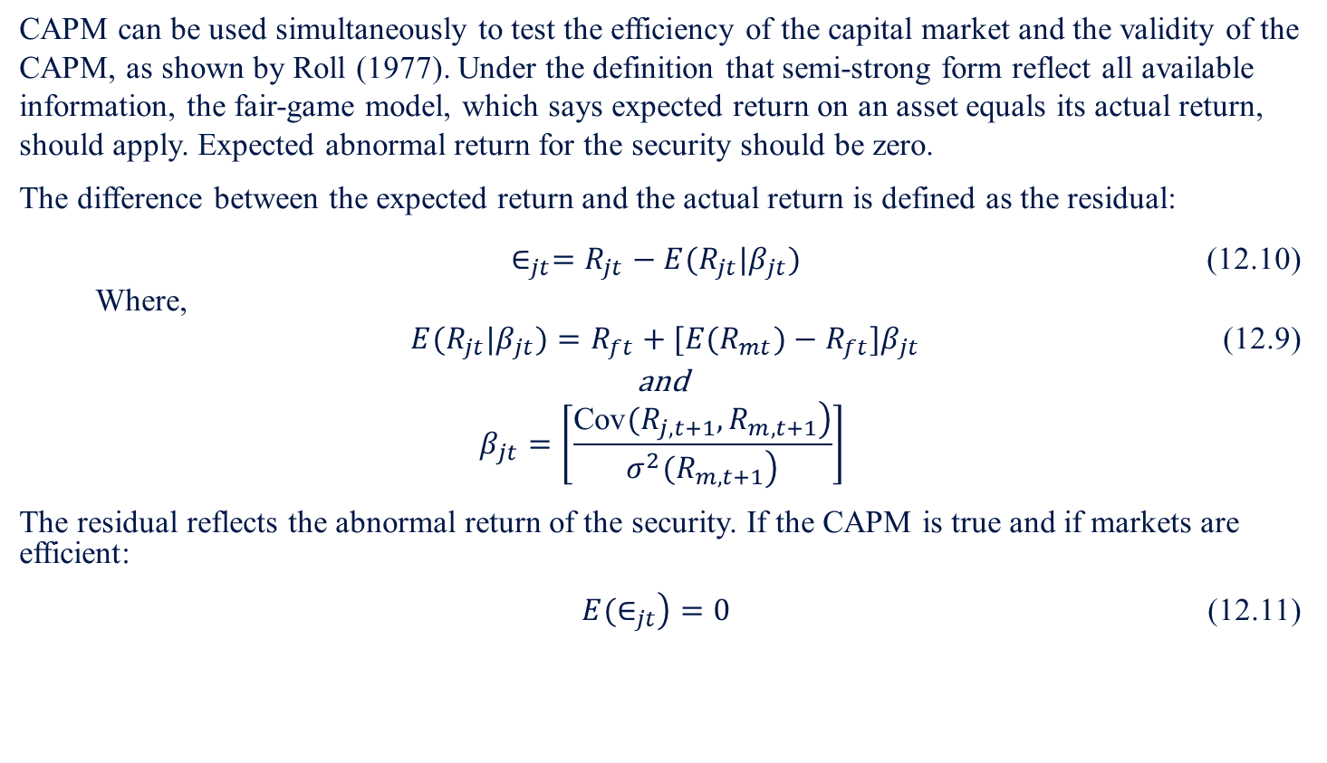
12.3 Tests for Market Efficiency
12.3.2 Semi-Strong Form Efficiency
Speed Of Adjustment
CAPM can be used simultaneously to test the efficiency of the capital market and the validity of the CAPM, as shown by Roll (1977). Under the definition that semi-strong form reflect all available information, the fair-game model, which says expected return on an asset equals its actual return, should apply. Expected abnormal return for the security should be zero.
The difference between the expected return and the actual return is defined as the residual:
$∈_{jt}=R_{jt}−E(R_{jt}|β_{jt})$ (12.10)
  Where,
$E(R_{jt}|β_{jt})=R_{ft}+[E(R_{mt})−R_{ft}]β_{jt}$ (12.9)
and
$$β_{jt}=\left[\frac{\left.\text{Cov}(R_{j,t+1},R_{m,t+1}\right)}{\left.σ^{2}(R_{m,t+1}\right)}\right]$$
The residual reflects the abnormal return of the security. If the CAPM is true and if markets are efficient:
$\left.E(∈_{jt}\right)=0$ (12.11)

Slide 31
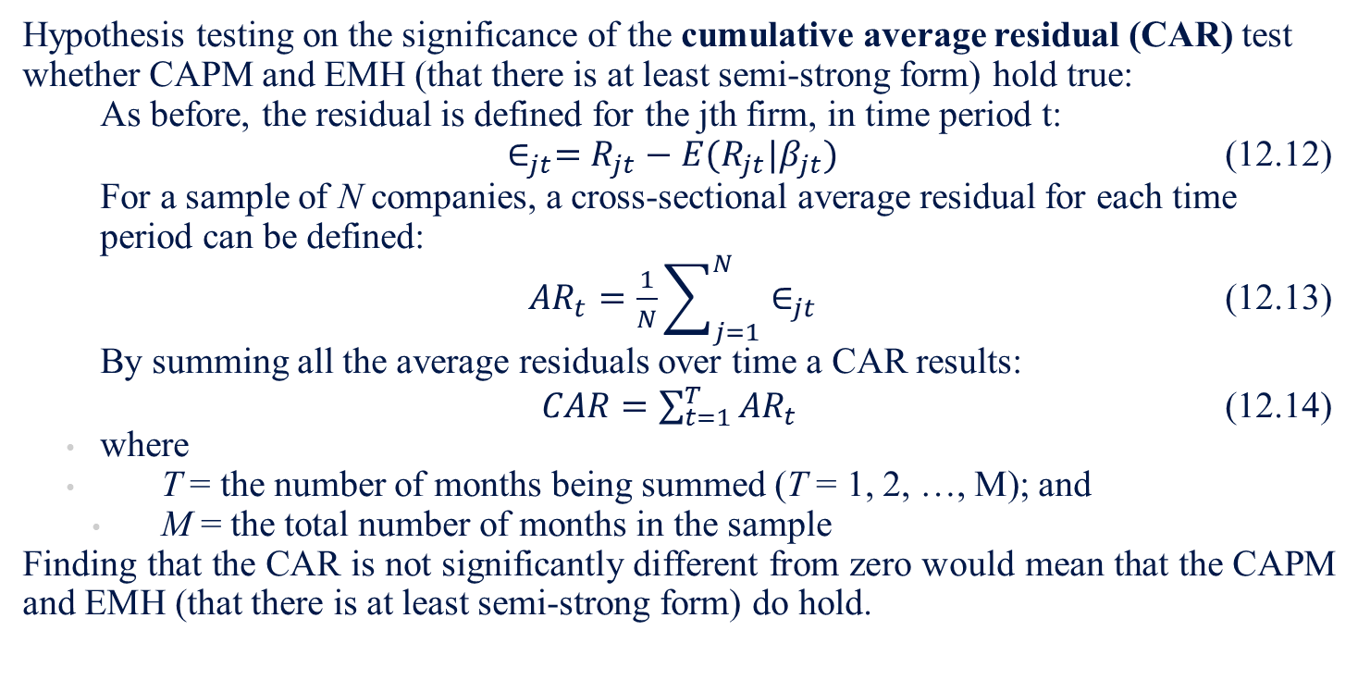
12.3 Tests for Market Efficiency
12.3.2 Semi-Strong Form Efficiency
Speed Of Adjustment
Hypothesis testing on the significance of the cumulative average residual (CAR) test whether CAPM and EMH (that there is at least semi-strong form) hold true:
  As before, the residual is defined for the jth firm, in time period t:
  $\left.∈_{jt}=R_{jt}−E(R_{jt}|β_{jt}\right.)$ (12.12)
  For a sample of N companies, a cross-sectional average residual for each time period can be defined:
  $AR_{t}=\frac{1}{N}\sum_{j=1}^{N}{∈_{jt}}$ (12.13)
  By summing all the average residuals over time a CAR results:
  $CAR=\sum_{t=1}^{T}{AR_{t}}$ (12.14)
  where
  T = the number of months being summed (T = 1, 2, …, M); and
  M = the total number of months in the sample
Finding that the CAR is not significantly different from zero would mean that the CAPM and EMH (that there is at least semi-strong form) do hold.

Slide 32
12.3 Tests for Market Efficiency
12.3.2 Semi-Strong Form Efficiency
Individual Studies:
Stock Splits
  Fama, Fisher, Jensen, and Roll (FFJR method):
    Hypothesized that any abnormal information to be derived from the split would show up in the residuals and would result in a permanently higher level of cash flows than would be expected by using only the CAPM
    Results indicate that those firms that also increased their cash dividend had slightly positive returns after the split, while those firms that did not increase their dividends had a negative return after the split
Earnings Announcement
  Ball & Brown (1968):
    Conclude that no more than about 10%–15% of the information in the annual earnings announcement had not been anticipated by the month of the announcement. This is viewed as further evidence consistent with the semi-strong theory of market efficiency.

Slide 33
12.3 Tests for Market Efficiency
12.3.2 Semi-Strong Form Efficiency
Individual Studies:
Weekend Effect
  Gibbons & Hess (1981), Keim & Stambaugh (1984):
    Stock prices tend to rise all week long to a peak price level on Friday. The stock prices then tend to trade on Mondays at reduced prices.
    Cornell (1985) found that a weekend effect does not exist in real returns on stock-index futures.
Announcement Effect
  Waud (1970):
    Examine the effects of discount-rate changes by the Federal Reserve Bank
    Found evidence of a statistically significant announcement effect on stock returns for the first trading day following an announcement
    Adjustment is small (0.5%)

Slide 34
12.3 Tests for Market Efficiency
12.3.2 Semi-Strong Form Efficiency
Individual Studies:
Federal Reserve Policy Changes
  Lynge (1981), Urich & Wachtel (1981), and Cornell (1979, 1983a, 1983b):
    Only unanticipated money-supply changes affected the market rates
    Implies that while the market is efficient, macroeconomic variables need to be analyzed by portfolio managers as well
Diversity of Accounting Methods
  Sunder (1973, 1975) and Kaplan & Roll (1972):
    Effect of inventory methods and accounting revisions that involve no changes in cash flow
    Excess returns could be made with inside information, thus violating strong form efficiency but not semi-strong form efficiency

Slide 35
12.3 Tests for Market Efficiency
12.3.2 Semi-Strong Form Efficiency
Factors that Alter Semi-Strong Form Efficiency:
Thin or Sporadic Trading
Investors of Differing Ability

Slide 36
12.3 Tests for Market Efficiency
12.3.3 Strong Form Efficiency
Strong form includes not only all publicly available information but also insider information
Information set is not available to all participants in the market but only to those relatively small groups that monopolize its source
Only a partial reflection of the information in the market price of the stock

Slide 37
12.3 Tests for Market Efficiency
12.3.3 Strong Form Efficiency
Insider Trading:
Niederhoffer and Osborne (1966)
  Pointed out that specialists on the NYSE use their monopolistic access to information concerning unfilled limit orders to generate monopoly profits
Jaffe’s (1974) and Finnerty’s (1976a)
  Excess returns could be obtained using insider-trading information
    Their results indicate that even after eight months excess returns still occurred

Slide 38
12.3 Tests for Market Efficiency
12.3.3 Strong Form Efficiency
Mutual Funds:
Studies generally find that mutual-fund managers have been unable to outperform the market average consistently
  Mutual funds performed worse than a naïve strategy of random selection or mixing the market with the riskless asset
  Jensen (1968):
    mutual funds seem not to earn enough extra returns to cover the portion of the management fee that represents analysis costs
    supports strong-form efficiency
  Merton (1981), Hendriksson and Merton (1981), and Hendriksson (1984)
    poor performance of mutual funds may result from the methodology used to estimate the performance of the fund.

Slide 39
12.4 Other Methods of Testing the EMH
While we’ve discussed EMH and its role in security valuation, this section discusses issues with EMH testing and alternative methods. These include:
  The random walk with reflecting barriers,
  The variance-bound approach,
  Hillmer and Yu’s relative EMH test, and
  Market anomalies.

Slide 40
12.4 Other Methods of Testing the EMH
  12.4.1 Random Walk with Reflecting Barriers
Cootner’s (1962)
  In the random walk model, there is no difference between the distribution of returns conditional on a given information structure and the unconditional distribution of returns.
  Random walk with reflecting barriers describes changes in stock prices over time
  Two types of investors
    Uninformed investors
      Very costly to perform research on their own to gain abnormal profit
        Tend to accept present prices
        Random walk exists for uninformed investors because information does not play a role in obtaining abnormal returns
    Informed investors
      Cannot profit unless the current price deviates enough from the expected price to cover their opportunity costs
      Random walk does not exist

Slide 41
12.4 Other Methods of Testing the EMH
  12.4.1 Random Walk with Reflecting Barriers
Technical Analysis (chartists)
  Stock prices tend to move in a deterministic, cyclical manner
  Perfectly predictable
  Largely refuted by efficient-market-hypothesis scholars
    Securities markets are efficient enough to make technical analysts unable to obtain unusual profit using only past security prices
    Treynor and Ferguson (1985)
      Shown that past prices, when combined with other valuable information, can indeed be helpful in achieving unusual profit
      Only nonprice information creates this opportunity
      Past prices serve only to permit its efficient exploitation

Slide 42
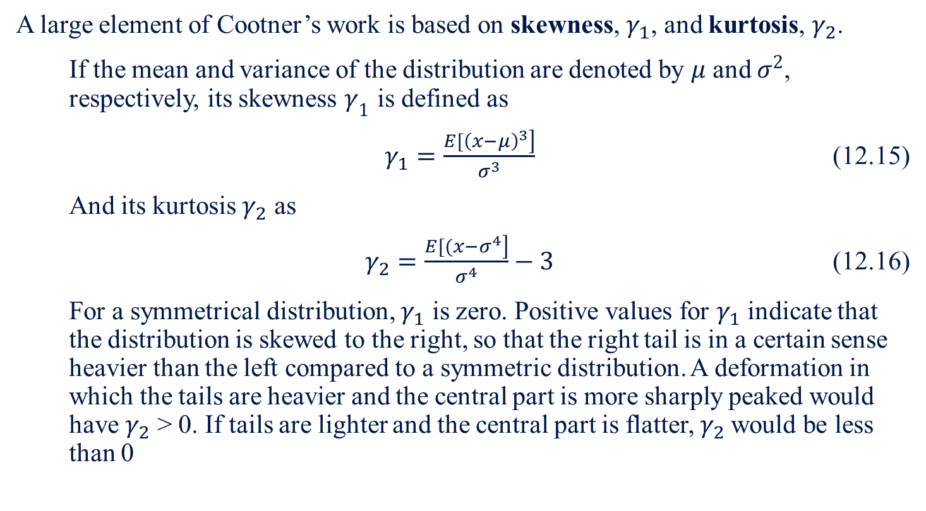
12.4 Other Methods of Testing the EMH
  12.4.1 Random Walk with Reflecting Barriers
A large element of Cootner’s work is based on skewness, $γ_{1}$, and kurtosis, $γ_{2}$.
  If the mean and variance of the distribution are denoted by $μ$ and $σ^{2}$, respectively, its skewness $γ_{1}$ is defined as
  $γ_{1}=\frac{\left.E[{\left(x−μ\right)}^{3}\right]}{σ^{3}}$ (12.15)
  And its kurtosis $γ_{2}$ as
  $γ_{2}=\frac{\left.E[(x−σ^{4}\right]}{σ^{4}}−3$ (12.16)
  For a symmetrical distribution, $γ_{1}$ is zero. Positive values for $γ_{1}$ indicate that the distribution is skewed to the right, so that the right tail is in a certain sense heavier than the left compared to a symmetric distribution. A deformation in which the tails are heavier and the central part is more sharply peaked would have $γ_{2}$ > 0. If tails are lighter and the central part is flatter, $γ_{2}$would be less than 0

Slide 43
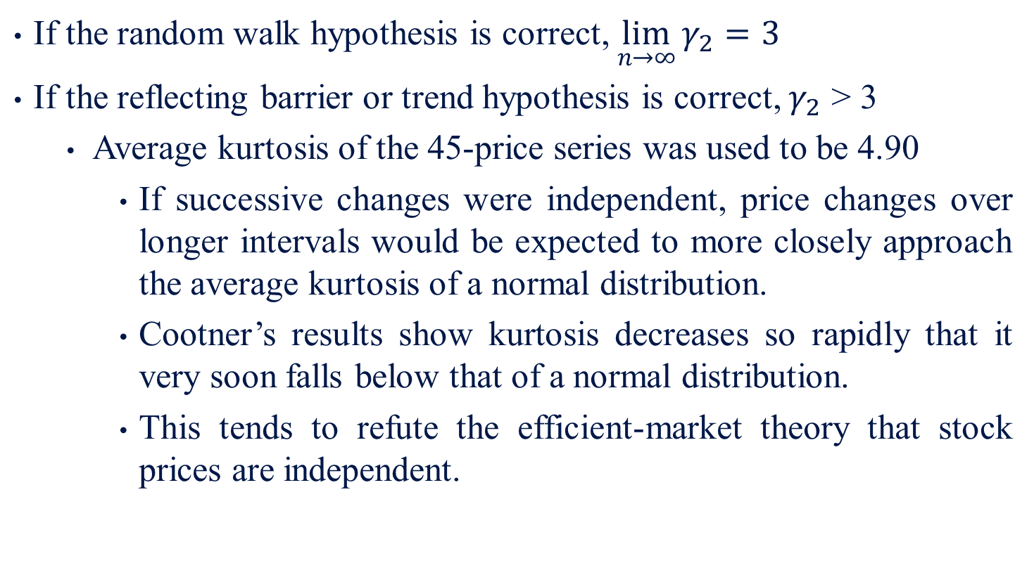
12.4 Other Methods of Testing the EMH
  12.4.1 Random Walk with Reflecting Barriers
If the random walk hypothesis is correct, $\lim_{n→∞}{γ_{2}=3}$
If the reflecting barrier or trend hypothesis is correct, $γ_{2}$ > 3
  Average kurtosis of the 45-price series was used to be 4.90
    If successive changes were independent, price changes over longer intervals would be expected to more closely approach the average kurtosis of a normal distribution.
    Cootner’s results show kurtosis decreases so rapidly that it very soon falls below that of a normal distribution.
    This tends to refute the efficient-market theory that stock prices are independent.

Slide 44
12.4 Other Methods of Testing the EMH
  12.4.1 Random Walk with Reflecting Barriers
Monthly data from the Dow Jones 30 during January 1, 1980–December 31, 1984, have been tested for any indication of skewness or kurtosis. Table 12-3 indicates evidence of both skewness and kurtosis in the price series. The average skewness and kurtosis are 0.5137 and 0.6137, respectively. As can be seen, the question of skewness and kurtosis for security analysis and portfolio management is a nontrivial issue — one that will be taken up in later chapter.

Slide 45
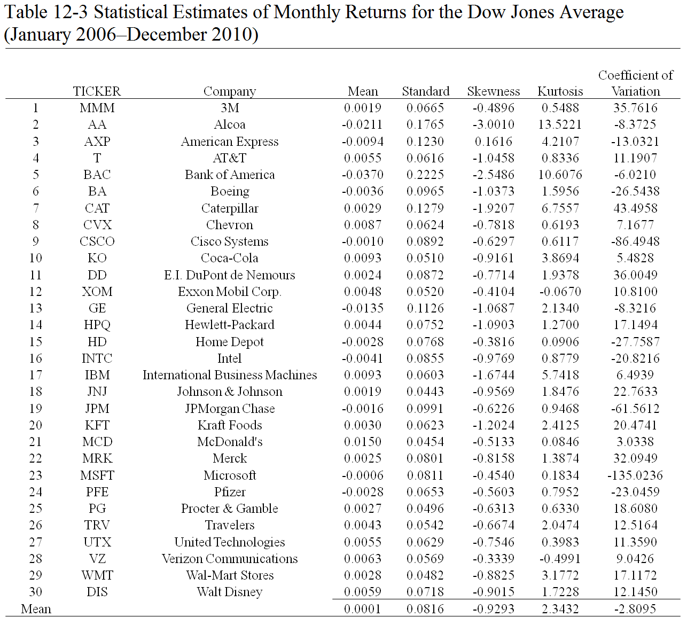
12.4 Other Methods of Testing the EMH
  12.4.1 Random Walk with Reflecting Barriers

Slide 46
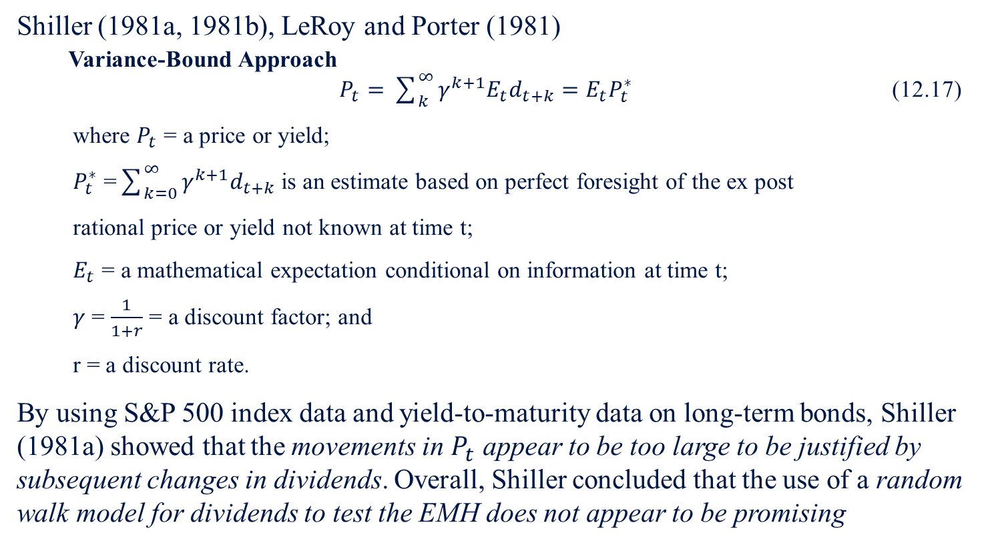
12.4 Other Methods of Testing the EMH
  12.4.2 Variance-Bound Approach Test
Shiller (1981a, 1981b), LeRoy and Porter (1981)
  Variance-Bound Approach
  $P_{t}=\sum_{k}^{∞}{γ^{k+1}E_{t}d_{t+k}}=E_{t}P_{t}^{∗}$ (12.17)
  where $P_{t}$ = a price or yield;
  $P_{t}^{∗}$ =$\sum_{k=0}^{∞}{γ^{k+1}d_{t+k}}$ is an estimate based on perfect foresight of the ex post
  rational price or yield not known at time t;
  $E_{t}$ = a mathematical expectation conditional on information at time t;
  $γ$ = $\frac{1}{1+r}$ = a discount factor; and
  r = a discount rate.
By using S&P 500 index data and yield-to-maturity data on long-term bonds, Shiller (1981a) showed that the movements in $P_{t}$ appear to be too large to be justified by subsequent changes in dividends. Overall, Shiller concluded that the use of a random walk model for dividends to test the EMH does not appear to be promising

Slide 47
12.4 Other Methods of Testing the EMH
  12.4.3 Hillmer and Yu’s Relative EMH Test
Hillmer and Yu (1979):
There are various degrees of efficiency based on the particular market variable and particular type of information
Studied how various types of information affect different types of stocks
  Relative EMH Test
  Patell and Wolfson (1984):
    Studied the intraday speed of adjustment of stock price to earnings and dividend announcements
    Found that the speed of adjustment is generally less than an hour

Slide 48
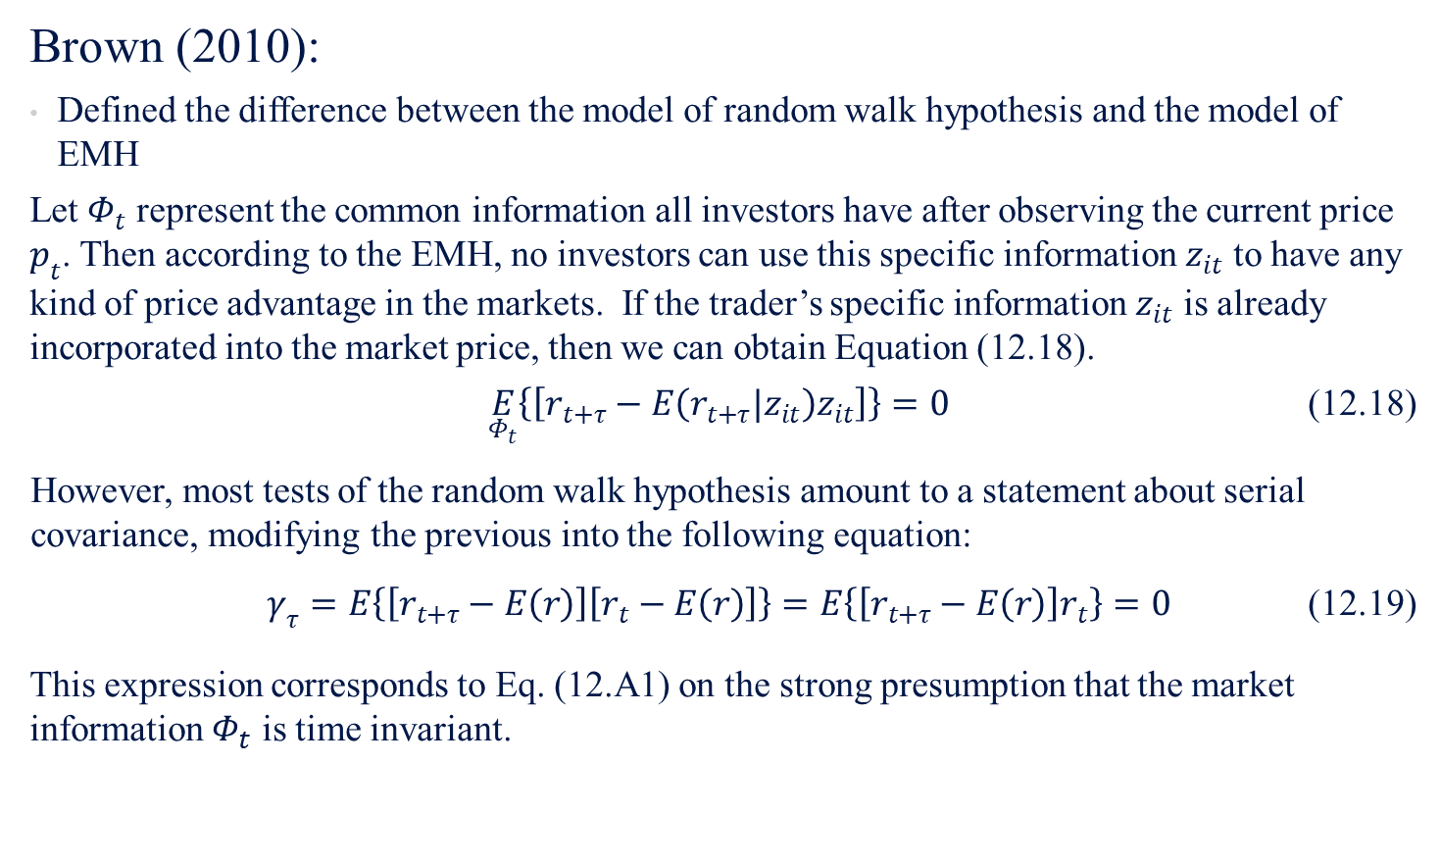
12.5 Random Walk Hypothesis vs. EMH Test
Brown (2010):
Defined the difference between the model of random walk hypothesis and the model of EMH
Let $Φ_{t}$ represent the common information all investors have after observing the current price $p_{t}$. Then according to the EMH, no investors can use this specific information $z_{it}$ to have any kind of price advantage in the markets. If the trader’s specific information $z_{it}$ is already incorporated into the market price, then we can obtain Equation (12.18).
  $\underset{Φ_{t}}{E}\left\{\left[r_{t+τ}−E\left(r_{t+τ}|z_{it}\right)z_{it}\right]\right\}=0$ (12.18)
  However, most tests of the random walk hypothesis amount to a statement about serial covariance, modifying the previous into the following equation:
  $γ_{τ}=E\left\{\left[r_{t+τ}−E\left(r\right)\right]\left[r_{t}−E\left(r\right)\right]\right\}=E\left\{\left[r_{t+τ}−E\left(r\right)\right]r_{t}\right\}=0$ (12.19)
This expression corresponds to Eq. (12.A1) on the strong presumption that the market information $Φ_{t}$ is time invariant.

Slide 49
12.6 Market Anomalies
If information is fully reflected in security prices, the market is efficient and it is not worthwhile to pay for information that is already impounded in security prices.
However, at times, there are irregularities in markets called market anomalies that cause disruption. Three of the most heavily researched anomalies are:
  P/E effect,
  size effect, and
  January effect

Slide 50
12.6 Market Anomalies
  12.6.1 The P/E Effect
Price-Earnings (P/E) Effect
Basu (1977):
  Compared the yearly risk-adjusted returns for portfolios composed of 150 stocks with the highest P/E, 150 stocks with the next highest P/E, down to the final portfolio of 150 stocks with the lowest P/E.
    Results showed that low P/E portfolios earned higher absolute and risk-adjusted rates of return than the high P/E securities
    P/E ratio information was not "fully reflected" in security prices in as rapid a manner as postulated by the semi-strong form of the efficient market hypothesis
Notes:
http://www.knopers.net/webspace/bjorn/artikelenvalueinvestingdeel2/basu.pdf
Page 680

Slide 51
12.6 Market Anomalies
  12.6.2 The Size Effect
Market may not be semi-strong form efficient due to not only lack of P/E information, but also size.
Banz (1981) and Reinganum (1981a)
  Rank all stocks on both the NYSE and the American Stock Exchange (ASE) by the total market value of the firm
  Divide their samples into five equal portfolios based on the market-value ranking
    Results indicate that the portfolios of the firm with the smallest market value experienced returns that were, both economically and statistically, significantly greater than the portfolios of the firms with large market value.
Arbel et al. (1983)
  Size effect may be related to the disproportionate amount of institutional interest in the larger firms

Slide 52
12.6 Market Anomalies
  12.6.3 January Effect/Year-End Effect
Branch (1977):
  Investors tend to sell stocks in which they have experienced capital losses at the end of the year in order to take advantage of the US tax laws, which decreases stock prices during December
  During January, the selling is reversed as investors return to the market and buying pressure is evident
  The returns calculated for the month of January are above average because the ending prices in December are lower than they should be and the ending prices in January are higher than they should be.

Slide 53
12.7 Summary
This chapter has examined the basic tenets and empirical support for the EMH and has outlined some of its implications for security valuation and portfolio management.
The relationship between market value and book value and its development into the concept of a q ratio was found to be very useful to security analysts in their estimates of the future value of a firm’s financial securities. The EMH was categorized into three forms: weak, semi-strong, and strong. The main distinguishing feature among these forms was pointed out to be the information set assumed to be impounded into the market price of a firm’s securities. For the weak form, the information set was shown to include historical prices, price changes, and related volume data; for the semi-strong form it was shown to include all publicly available information; and for the strong form it was shown to include all information, whether or not publicly available.

Slide 54
12.7 Summary
While empirical testing has provided good support for the weak and semi-strong forms of the EMH, the strong form has been upheld only in cases where, for example, mutual-fund managers have been unable to consistently outperform market averages. Tests involving corporate insiders and stock-exchange specialists have in general indicated that these groups do possess monopoly information and are able to use it to generate above-average returns.
Besides Fama’s (1970) EMH, the discussion briefly included the random walk with reflecting barriers, the variance-bound test of EMH, and the market anomalies that refute EMH. This implies that the security-analysis and portfolio-management theory and methods discussed are worthwhile tools for security analysts and portfolio managers. The next chapter discusses timing and selectivity of stocks and mutual funds.

