Slide 1
Chapter 13
Arbitrage Pricing Theory and Intertemporal Capital Asset Pricing Model
By
Cheng Few Lee
Joseph Finnerty
John Lee
Alice C Lee
Donald Wort

Slide 2
Chapter Outline
13.1 Multi-Index Models
13.2 Model Specification of APT
  13.2.1 Ross’s Arbitrage Model Specification
  13.2.2 Empirical Test Methodology
13.3 APT: Empirical Results and Implications
13.4 Identifying the Model Factors
13.5 APT Versus MPT and the CAPM
13.6 Intertemporal CAPM
13.7 Applications of APT
13.8 Summary

Slide 3
13.1 Multi-Index Models
Multi-Index models
where:
I_{h} = the actual level of some index h (h = 1, …, L); and
b_{ih} = a measure of the responsiveness of the return on stock i to changes in index h or its sensitivity, to index h.

Slide 4
13.1 Multi-Index
Systematic influence
1.Beta (the slope of the regression of excess return for the security against excess return on the S&P index)
2. Dividend yield
3. Size
4. Bond beta
5. Alpha
The significant sector influences includes eight factors
1. Basic industries
2. Capital goods
3. Construction
4. Consumer goods
5. Energy
6. Finance
7. Transportation
8. Utilities

Slide 5
13.1 Multi-Index
, (13.2)
principal-components analysis- a procedure that formulates homogeneous groups of firms (“pseudo-industries”) to form indexes as input to a multi-index model
Four pseudo-industries:
  1. Growth Stocks
  2. Cyclical stocks
  3. Stable stocks
  4. Oil stocks

Slide 6
13.2 Model Specification of APT
Suppose there are two riskless assets offering rates of return r and , respectively. Assuming no transaction costs, one of the strongest statements that can be made in positive economics is that:
r = r’ (13.6)
In terms of securities, the law of one price says that securities with identical risks must have the same expected return. Essentially, Equation (13.6) is an arbitrage condition that must be expected to hold in all but the most extreme circumstances

Slide 7
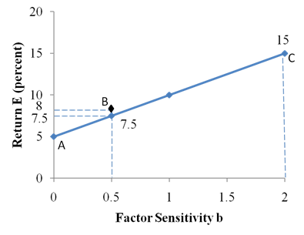
13.2 Model Specification of APT
Expected Returns and Factor Sensitivity example
Security | Expected Return (percent) | Factor Sensitivity
A | 5 | 0.0
B | 8 | 0.5
C | 15 | 2.0
Securities A and C are both correctly priced given the sensitivity they have to the factor. However, security B appears to be mispriced; it offers a return of 8% percent, which exceeds the expected return of 7.5% percent for securities with a sensitivity of 0.5.

Slide 8
13.2 Model Specification of APT
Example cont.
To take advantage of this mispricing, an investor can perform an arbitrage among the three securities. By buying $1 worth of security B and short selling $0.75 of security A and $0.25 of security C, the investor can generate a risk-free return of 0.5. The arbitrage allows the investor to earn a return of 0.5% with no risk and no investment.
 | Expected Return | Factor Sensitivity
Buy $1 of B. Sell $0.75 of A short. Sell $0.25 of C short. | (1 × 8%) = 8% －(0.75 × 5%) = －3.75% －(0.25 × 15%) = －3.75% | (1 × 5%) = 50% －(0.75 × 0) = 0% －(0.25 × 2) = －50%
Total investment = 0 | Total return = .5% | Total sensitivity = 0

Slide 9
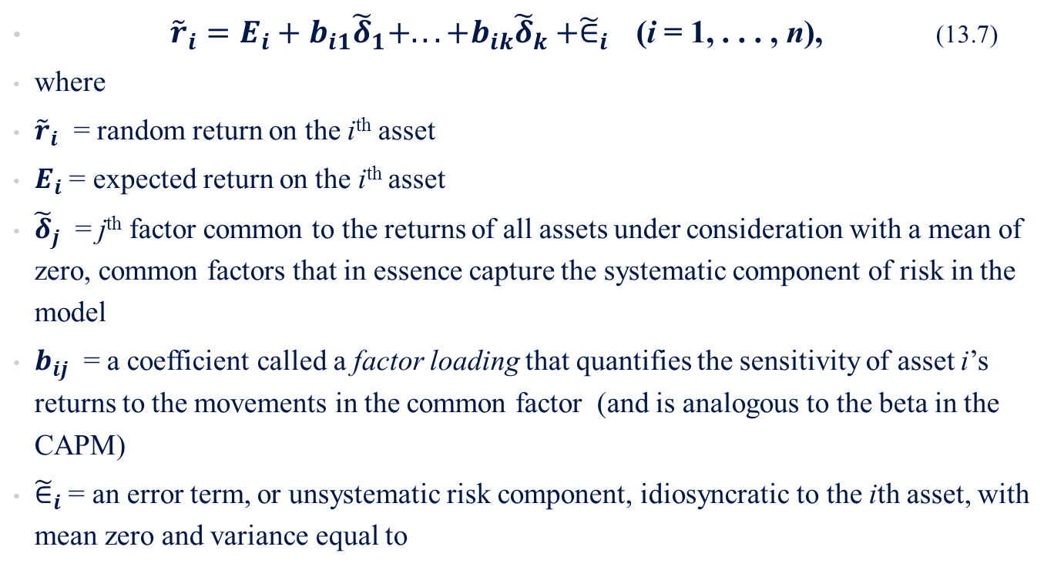
13.2.1 Ross’s Arbitrage Model Specification
K-factor generating model
${\tilde{r}}_{i}=E_{i}+b_{i1}{\tilde{δ}}_{1}+...+b_{ik}{\tilde{δ}}_{k}+{\tilde{∈}}_{i}$ (i = 1, . . . , n), (13.7)
where
${\tilde{r}}_{i}$ = random return on the i^{th} asset
$E_{i}$ = expected return on the i^{th} asset
${\tilde{δ}}_{j}$ = j^{th} factor common to the returns of all assets under consideration with a mean of zero, common factors that in essence capture the systematic component of risk in the model
$b_{ij}$ = a coefficient called a factor loading that quantifies the sensitivity of asset i’s returns to the movements in the common factor (and is analogous to the beta in the CAPM)
${\tilde{∈}}_{i}$ = an error term, or unsystematic risk component, idiosyncratic to the ith asset, with mean zero and variance equal to

Slide 10
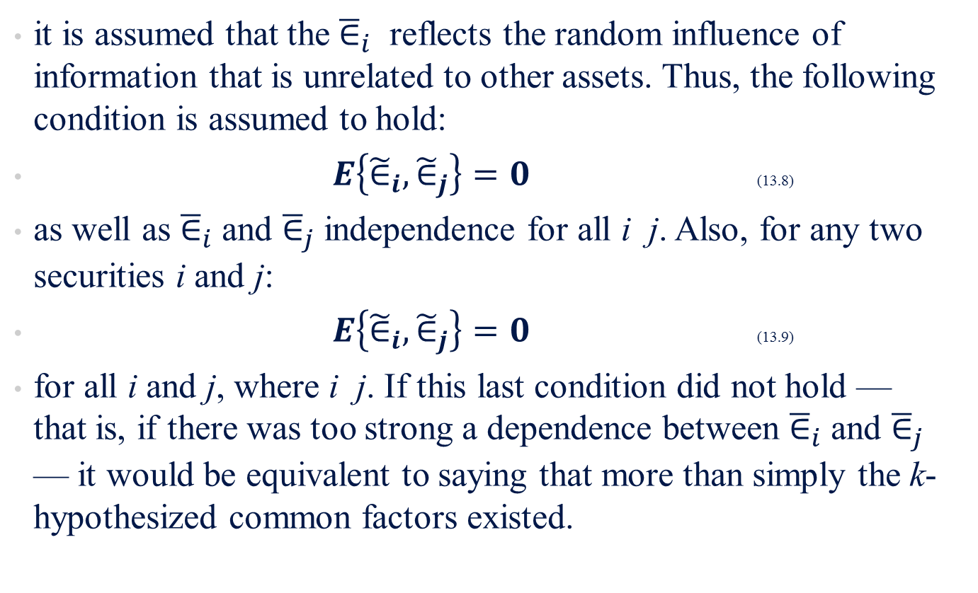
13.2.1 Ross’s Arbitrage Model Specification
it is assumed that the ${\overline{∈}}_{i}$ reflects the random influence of information that is unrelated to other assets. Thus, the following condition is assumed to hold:
$E\left\{{\tilde{∈}}_{i},{\tilde{∈}}_{j}\right\}=0$ (13.8)
as well as ${\overline{∈}}_{i}$ and ${\overline{∈}}_{j}$ independence for all i j. Also, for any two securities i and j:
$E\left\{{\tilde{∈}}_{i},{\tilde{∈}}_{j}\right\}=0$ (13.9)
for all i and j, where i j. If this last condition did not hold — that is, if there was too strong a dependence between ${\overline{∈}}_{i}$ and ${\overline{∈}}_{j}$ — it would be equivalent to saying that more than simply the k-hypothesized common factors existed.

Slide 11

13.2.1 Ross’s Arbitrage Model Specification
The investor’s portfolio investment is constrained to hold to the following condition:
$\sum_{i=1}^{n}{x_{i}}=0$ (13.10)
Additional purchases of assets must be financed by sales of others.

Slide 12
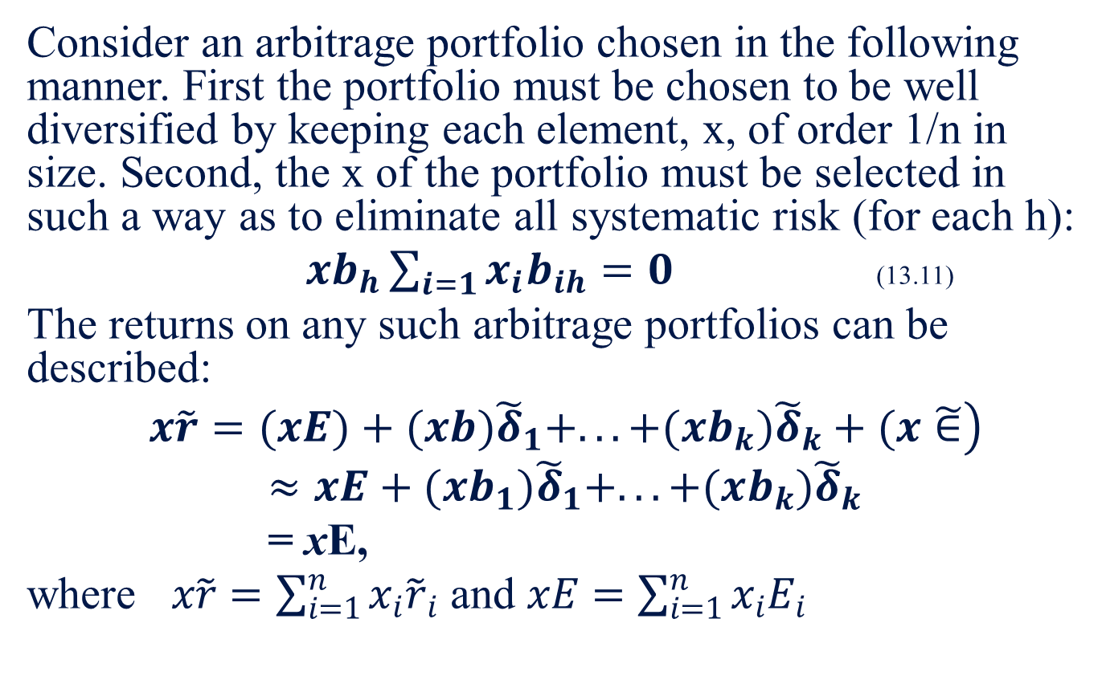
13.2.1 Ross’s Arbitrage Model Specification example
Consider an arbitrage portfolio chosen in the following manner. First the portfolio must be chosen to be well diversified by keeping each element, x, of order 1/n in size. Second, the x of the portfolio must be selected in such a way as to eliminate all systematic risk (for each h):
$xb_{h}\sum_{i=1}{x_{i}b_{ih}}=0$ (13.11)
The returns on any such arbitrage portfolios can be described:
$\left. x\tilde{r}=(xE)+(xb){\tilde{δ}}_{1}+...+(xb_{k}){\tilde{δ}}_{k}+(x\tilde{∈}\right)$
$≈xE+(xb_{1}){\tilde{δ}}_{1}+...+(xb_{k}){\tilde{δ}}_{k}$
= xE,
where $x\tilde{r}=\sum_{i=1}^{n}{x_{i}{\tilde{r}}_{i}}$ and $xE=\sum_{i=1}^{n}{x_{i}E_{i}}$

Slide 13
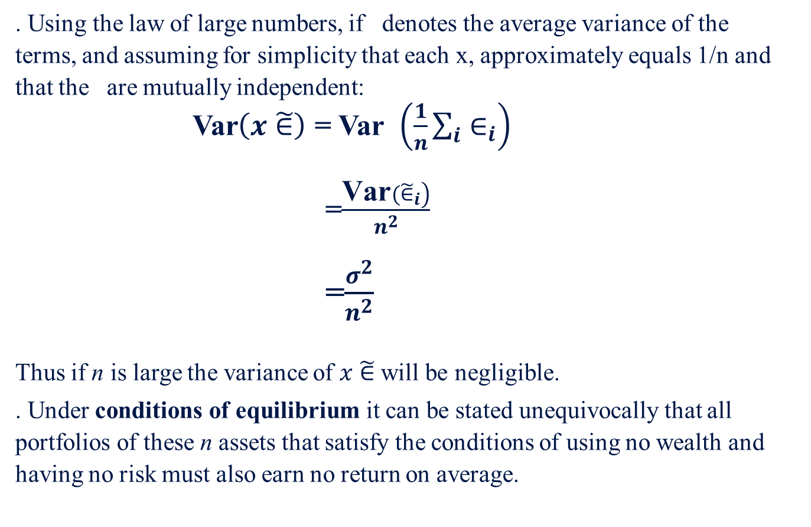
13.2.1 Ross’s Arbitrage Model Specification example cont.
. Using the law of large numbers, if denotes the average variance of the terms, and assuming for simplicity that each x, approximately equals 1/n and that the are mutually independent:
Var$\left(x\tilde{∈}\right)$ = Var $\left(\frac{1}{n}\sum_{i}{∈_{i}}\right)$
=$\frac{\left.\text{Var}({\tilde{∈}}_{i}\right)}{n^{2}}$
=$\frac{σ^{2}}{n^{2}}$
Thus if n is large the variance of $x\tilde{∈}$ will be negligible.
. Under conditions of equilibrium it can be stated unequivocally that all portfolios of these n assets that satisfy the conditions of using no wealth and having no risk must also earn no return on average.

Slide 14
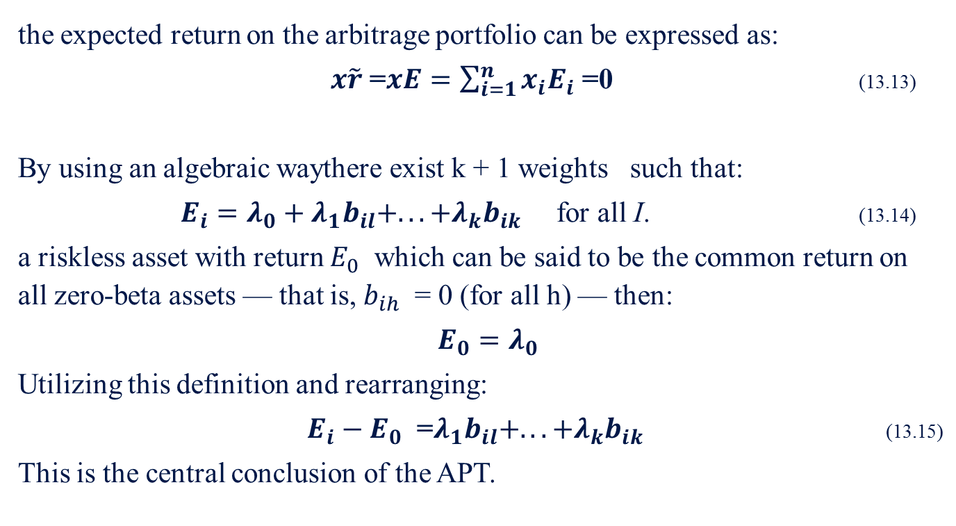
13.2.1 Ross’s Arbitrage Model Specification example cont.
the expected return on the arbitrage portfolio can be expressed as:
$x\tilde{r}$ =$xE=\sum_{i=1}^{n}{x_{i}E_{i}}$ =0 (13.13)
By using an algebraic waythere exist k + 1 weights such that:
$E_{i}=λ_{0}+λ_{1}b_{il}+...+λ_{k}b_{ik}$ for all I. (13.14)
a riskless asset with return $E_{0}$ which can be said to be the common return on all zero-beta assets — that is, $b_{ih}$ = 0 (for all h) — then:
$E_{0}=λ_{0}$
Utilizing this definition and rearranging:
$E_{i}−E_{0}$ =$λ_{1}b_{il}+...+λ_{k}b_{ik}$ (13.15)
This is the central conclusion of the APT.

Slide 15
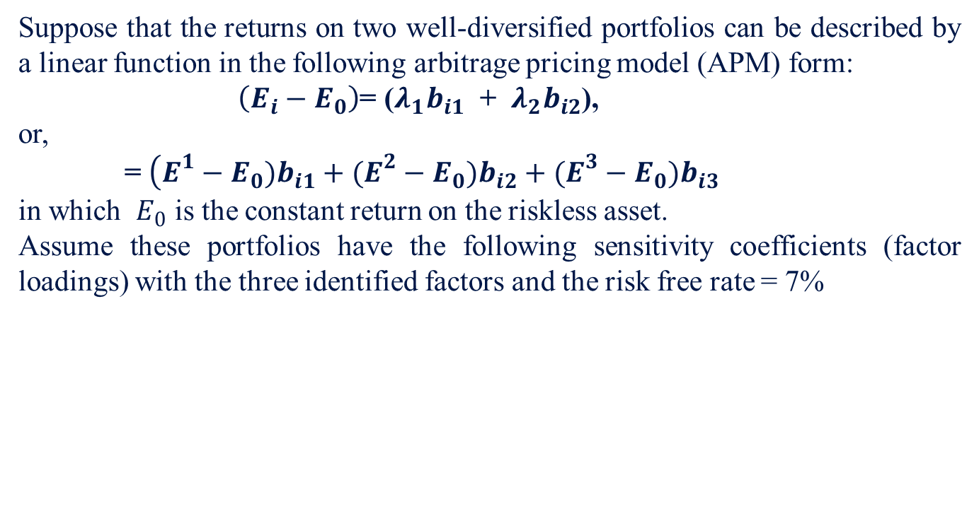
Sample Problem 13.1
Suppose that the returns on two well-diversified portfolios can be described by a linear function in the following arbitrage pricing model (APM) form:
$\left(E_{i}−E_{0}\right)$= ($λ_{1}b_{i1}$ + $λ_{2}b_{i2}$),
or,
= $\left(E^{1}−E_{0})b_{i1}+(E^{2}−E_{0})b_{i2}+(E^{3}−E_{0})b_{i3}\right.$
in which $E_{0}$ is the constant return on the riskless asset.
Assume these portfolios have the following sensitivity coefficients (factor loadings) with the three identified factors and the risk free rate = 7%
Portfolio
1 | 0.6 | 1.0 | 0.8
2 | 0.3 | 0.7 | 0.5

Slide 16
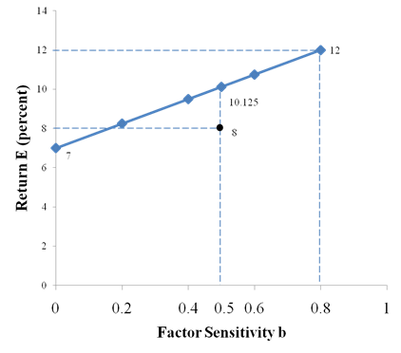
Sample Problem 13.1 cont.
Expected Return and Factor Sensitivity
Portfolio | (%)
1 | 12 | 6.25
2 | 8 | 2.00
The second portfolio is overpriced

Slide 17

13.1 Sample Problem cont.
3.2.2 Geometric Mean
10.125% is calculated as follows$:$
    $$\begin{matrix}\frac{x−7}{0.5}=\frac{12−7}{0.8} \\ x=10.125\end{matrix}$$
X= the theoretical expected return to the factor sensitivity of the second portfolio.
 | Investment | Systematic Risk ( b_{ih} ) | Expected Return (%)
For portfolio 2, sell short | ＄1,000,000 | －0.5 | －8.0
For portfolio 1, buy | (＄625,000) | (0.625 × 0.8)＝0.5 | (0.625 × 12.0)＝7.5
Invest remainder in bills | (＄375,000) | (0.375 × 0)＝0 | (0.375 × 7.0)＝2.625
Net investment: | ＄0
Net risk: |  | 0.0
Total excess return earned: |  |  | 2.125％

Slide 18
13.1 Sample Problem cont.
APT Assumptions
(1) Investors are return maximizers.
(2) Borrowing and lending is done at the riskless rate.
(3) There are no market restrictions such as transaction costs, taxes, or restrictions on short selling.
(4) Investors agree on the number and identity of the factors that are priced.
(5) Riskless profitable opportunities above the risk-free rate are immediately arbitraged away.

Slide 19
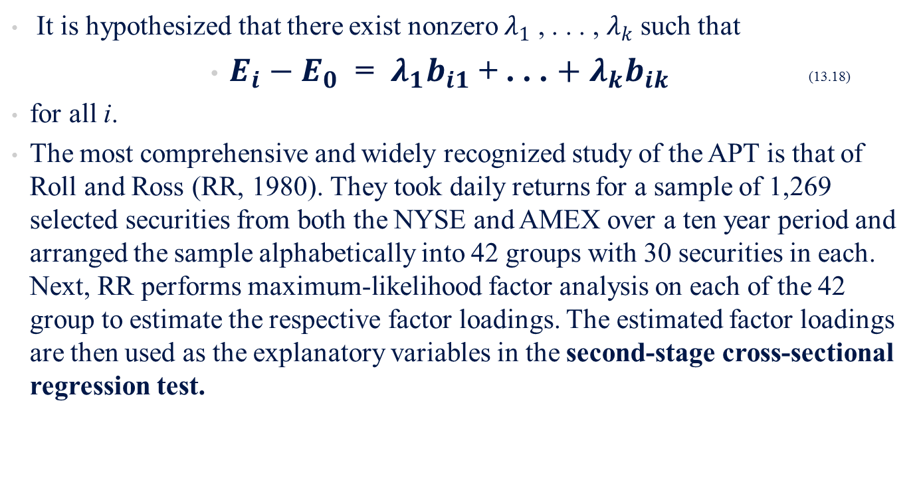
13.2.2 Empirical Test Methodology
It is hypothesized that there exist nonzero $λ_{1}$ , . . . , $λ_{k}$ such that
        $E_{i}−E_{0}$ = $λ_{1}b_{i1}$ + . . . $+ λ_{k}b_{ik}$ (13.18)
for all i.
The most comprehensive and widely recognized study of the APT is that of Roll and Ross (RR, 1980). They took daily returns for a sample of 1,269 selected securities from both the NYSE and AMEX over a ten year period and arranged the sample alphabetically into 42 groups with 30 securities in each. Next, RR performs maximum-likelihood factor analysis on each of the 42 group to estimate the respective factor loadings. The estimated factor loadings are then used as the explanatory variables in the second-stage cross-sectional regression test.

Slide 20
13.2.2 Empirical Test Methodology
Other Approaches in APT testing:
small-ample approach- assets are divided into several groups as before but only a single group (as opposed to every group) is factor analysis applied and corresponding factor loadings estimated.
The estimates of factor loadings for in the remaining groups are inferred from the covariance of their returns with the loading coefficients of the factor analyzed group.
portfolio approach- assets are grouped into portfolios, and factor analysis is performed on the covariance matrix among these portfolio returns. The problem with this methodology is that as the number of assets in a portfolio increases, the portfolio returns tend to reflect a single-factor model even when a multi-factor model is true.

Slide 21
13.3 EMPIRICAL RESULTS AND IMPLICATIONS
Following the empirical tests of the APT, it is important to examine some of the findings in relation to the following questions.
(1) How many factors have been identified? How many should there be?
(2) Has empirical research been able to verify APT?
(3) If the theory is correct and significant factors have been identified, what do these factors represent?

Slide 22
13.4 IDENTIFYING THE MODEL FACTORS
The relevant affecting economic factors include:
(1) Unanticipated inflation
(2) Expected inflation
(3) Unanticipated change in the term structure of interest rates
(4) Monthly and yearly growth rates in industrial production
(5) Unexpected changes in the yearly growth in industrial production
(6) Change in the expected rate of yearly growth in industrial production
(7) Unanticipated changes in the risk premiums embedded in interest rates
(8) Percentage changes in real consumption
(9) Growth rate in oil prices
(10) Return on the equal-weighted NYSE index
(11) Return on the value-weighted NYSE index
(12) Treasury-bill (T-bill) rates

Slide 23
13.4 Growth-Rate Estimation and its Application
Lee and Wei (1984) attempted to uncover the pricing influences of a similar set of macroeconomic-state variables on the returns of securities.
Five categories of state variables:
(1) Money supply (MS)
(2) Real production
(3) Inflation
(4) Interest rate
(5) Market return
In addition to the market index, only the risk-free rate, expected inflation, and industrial production significantly influence stock-market returns.

Slide 24
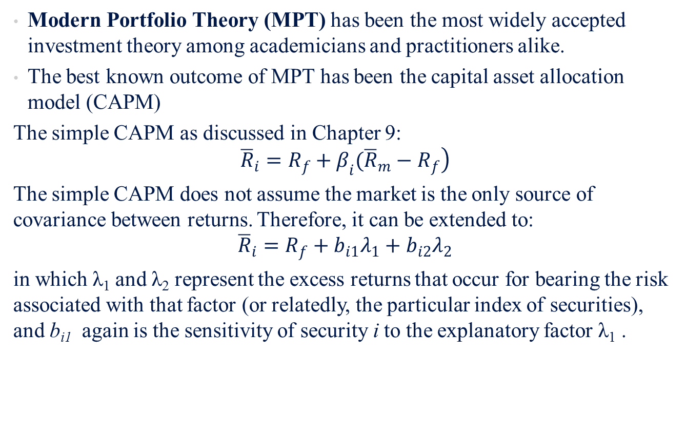
13.5 APT VERSUS MPT AND THE CAPM
Modern Portfolio Theory (MPT) has been the most widely accepted investment theory among academicians and practitioners alike.
The best known outcome of MPT has been the capital asset allocation model (CAPM)
The simple CAPM as discussed in Chapter 9:
$$\left.{\overline{R}}_{i}=R_{f}+β_{i}({\overline{R}}_{m}−R_{f}\right)$$
The simple CAPM does not assume the market is the only source of covariance between returns. Therefore, it can be extended to:
$${\overline{R}}_{i}=R_{f}+b_{i1}λ_{1}+b_{i2}λ_{2}$$
in which λ₁ and λ₂ represent the excess returns that occur for bearing the risk associated with that factor (or relatedly, the particular index of securities), and b_{i1} again is the sensitivity of security i to the explanatory factor λ₁ .

Slide 25
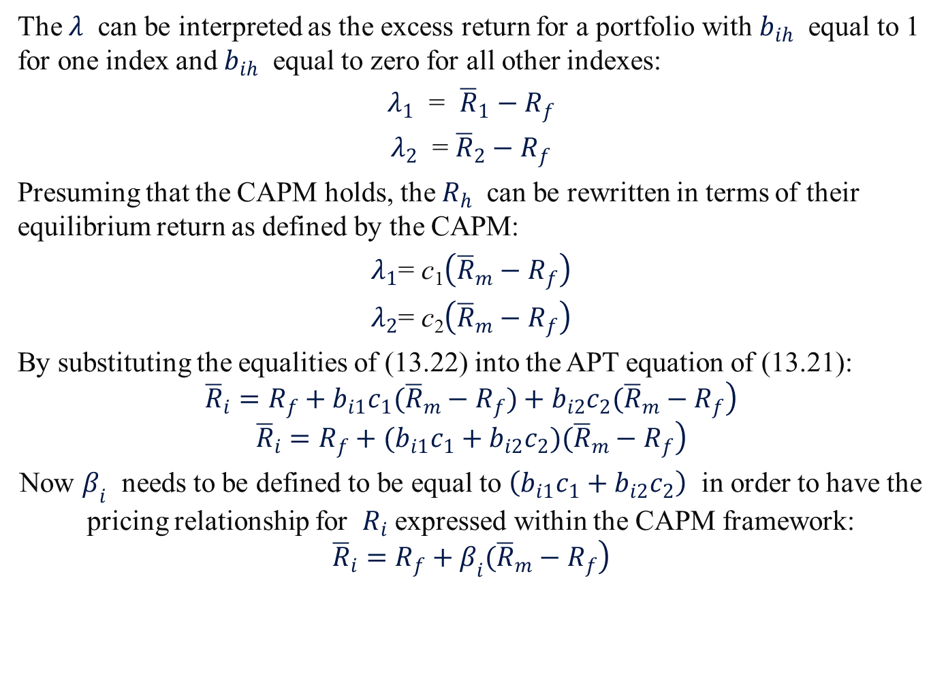
13.5 APT VERSUS MPT AND THE CAPM
The $λ$ can be interpreted as the excess return for a portfolio with $b_{ih}$ equal to 1 for one index and $b_{ih}$ equal to zero for all other indexes:
$λ_{1}$ = ${\overline{R}}_{1}−R_{f}$
$λ_{2}$ = ${\overline{R}}_{2}−R_{f}$
Presuming that the CAPM holds, the $R_{h}$ can be rewritten in terms of their equilibrium return as defined by the CAPM:
$λ_{1}$= c₁$\left({\overline{R}}_{m}−R_{f}\right)$
$λ_{2}$= c₂$\left({\overline{R}}_{m}−R_{f}\right)$
By substituting the equalities of (13.22) into the APT equation of (13.21):
$$\left.{\overline{R}}_{i}=R_{f}+b_{i1}c_{1}({\overline{R}}_{m}−R_{f})+b_{i2}c_{2}({\overline{R}}_{m}−R_{f}\right)$$
$$\left.{\overline{R}}_{i}=R_{f}+(b_{i1}c_{1}+b_{i2}c_{2})({\overline{R}}_{m}−R_{f}\right)$$
Now $β_{i}$ needs to be defined to be equal to $\left(b_{i1}c_{1}+b_{i2}c_{2}\right)$ in order to have the pricing relationship for $R_{i}$ expressed within the CAPM framework:
$$\left.{\overline{R}}_{i}=R_{f}+β_{i}({\overline{R}}_{m}−R_{f}\right)$$

Slide 26
13.5 APT VERSUS MPT AND THE CAPM
The following assumptions are required for the CAPM but not the APT.
(1) The CAPM is restricted to a single-period planning horizon.
(2) The CAPM is restricted to rates of price change that conform to a normal (or log normal) empirical probability distribution of returns.
(3) The CAPM depends on rather strong assumptions about investors’ utility functions in order to generate a two-parameter model.
(4) The CAPM requires the existence of a market portfolio that is a uniquely desirable investment medium.

Slide 27
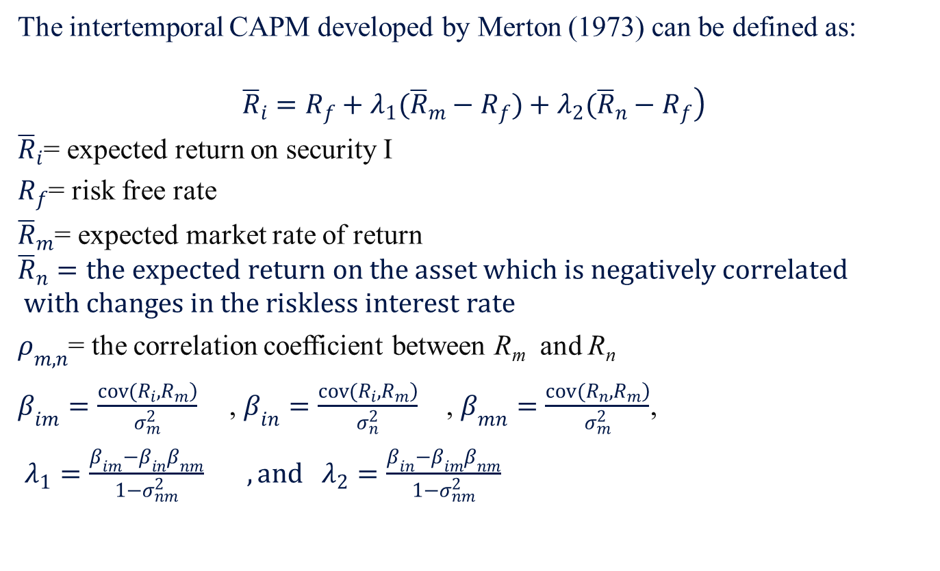
13.6 INTERTEMPORAL CAPM
The intertemporal CAPM developed by Merton (1973) can be defined as:
$$\left.{\overline{R}}_{i}=R_{f}+λ_{1}({\overline{R}}_{m}−R_{f})+λ_{2}({\overline{R}}_{n}−R_{f}\right)$$
${\overline{R}}_{i}$= expected return on security I
$R_{f}$= risk free rate
${\overline{R}}_{m}$= expected market rate of return
$${\overline{R}}_{n}=the expected return on the asset which is negatively correlated$$
$$with changes in the riskless interest rate$$
$ρ_{m,n}$= the correlation coefficient between R_{m} and R_{n}
$β_{im}=\frac{\left.cov(R_{i},R_{m}\right)}{σ_{m}^{2}}$ , $β_{in}=\frac{\left.cov(R_{i},R_{m}\right)}{σ_{n}^{2}}$ , $β_{mn}=\frac{\left.cov(R_{n},R_{m}\right)}{σ_{m}^{2}}$,
$λ_{1}=\frac{β_{im}−β_{in}β_{nm}}{1−σ_{nm}^{2}} , and λ_{2}=\frac{β_{in}−β_{im}β_{nm}}{1−σ_{nm}^{2}}$

Slide 28
13.7 APPLICATIONS OF APT
Potential applications of the APT are similar to those of the CAPM. These include:
(1) Security analysis
(2) Portfolio management
(3) Performance measurement
(4) Capital budgeting
(5) Cost of equity capital for public utilities and other types of companies
The central application of APT is in estimating required rates of return, or equivalently the cost of equity capital.

Slide 29
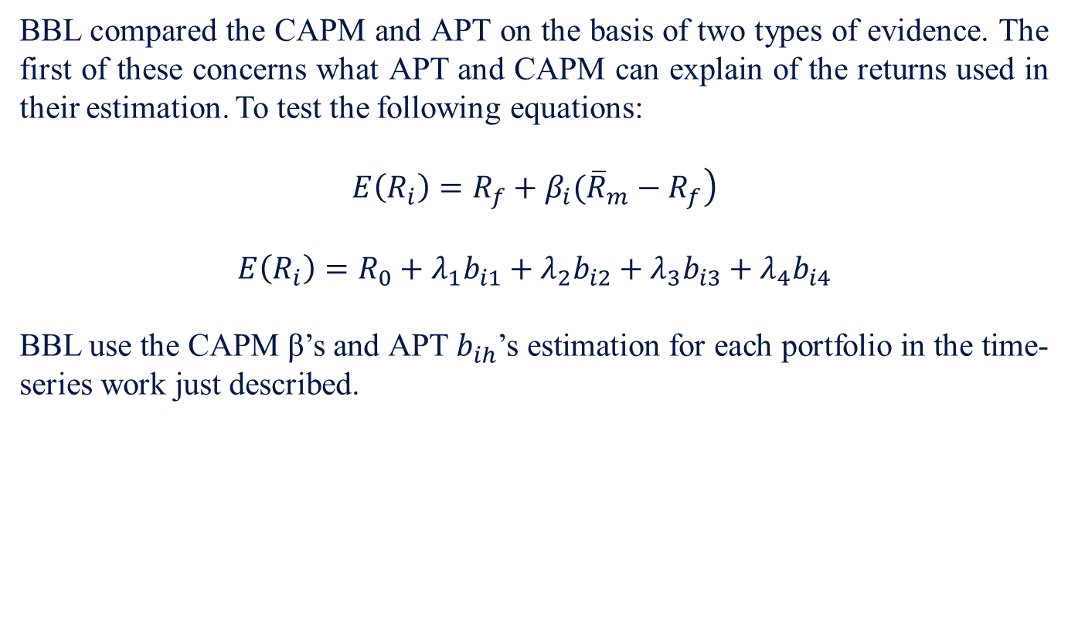
13.7 APPLICATIONS OF APT
BBL compared the CAPM and APT on the basis of two types of evidence. The first of these concerns what APT and CAPM can explain of the returns used in their estimation. To test the following equations:
$$\left.E\left(R_{i}\right)=R_{f}+β_{i}({\overline{R}}_{m}−R_{f}\right)$$
$$E\left(R_{i}\right)=R_{0}+λ_{1}b_{i1}+λ_{2}b_{i2}+λ_{3}b_{i3}+λ_{4}b_{i4}$$
BBL use the CAPM β’s and APT $b_{ih}$’s estimation for each portfolio in the time-series work just described.

Slide 30
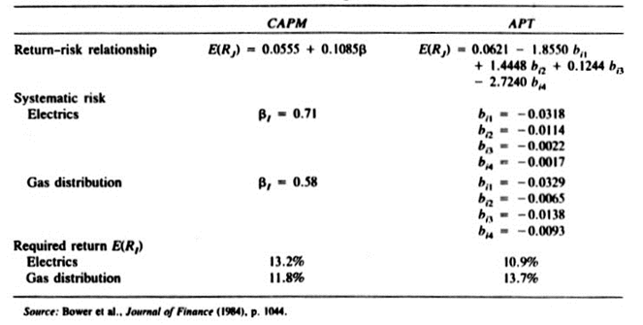
13.7 APPLICATIONS OF APT
Market-Model Formulation Results Using CAPM and APT
By forming a holdout group of 127 utilities not included in the original coefficient estimation for CAPM and APT, these authors forecast expected monthly returns for each utility over the 108 months from 1971-–1979.

Slide 31
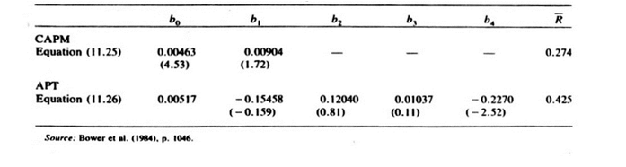
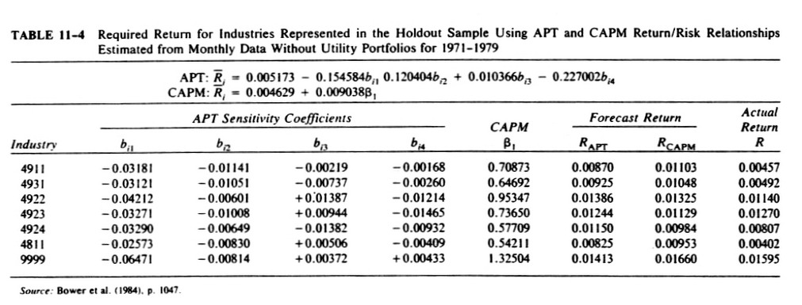
13.7 APPLICATIONS OF APT
Risk Premiums, t-Values, and Average R2 for CAPM and APT
Required Return for Industries Represented in the Holdout Sample Using APT and CAPM Return/Risk Relationships Estimated from Monthly Data without Utility Portfolios for 1971–1979

Slide 32
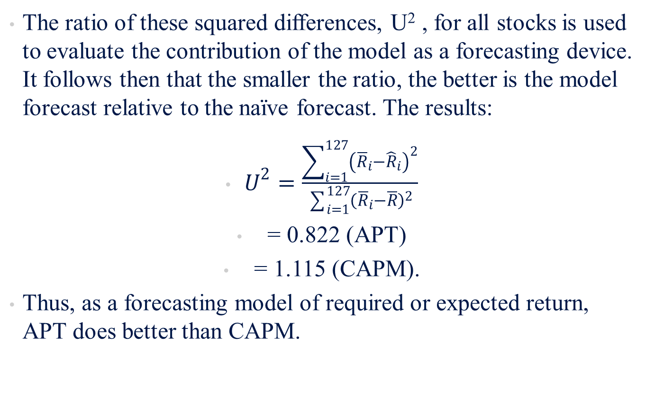
13.7 APPLICATIONS OF APT
The ratio of these squared differences, U² , for all stocks is used to evaluate the contribution of the model as a forecasting device. It follows then that the smaller the ratio, the better is the model forecast relative to the naïve forecast. The results:
$U^{2}=\frac{\sum_{i=1}^{127}{{\left({\overline{R}}_{i}−{\hat{R}}_{i}\right)}^{2}}}{\sum_{i=1}^{127}{{\left({\overline{R}}_{i}−\overline{R}\right)}^{2}}}$
= 0.822 (APT)
= 1.115 (CAPM).
Thus, as a forecasting model of required or expected return, APT does better than CAPM.

Slide 33
13.8 SUMMARY
This chapter has discussed extended versions of CAPM derived by Sharpe (1964), Lintner (1965), and Mossin (1966), APT and intertemperal CAPM. Arbitrage pricing theory (APT) embodies a good deal of the more robust efforts of academicians to formulate less restrictive and more applicable models for asset pricing. Much research on APT and associated testing methodologies lies ahead; nevertheless, its alluring intuitive arguments and generalized construction make APT a formidable competitor to the CAPM
The APT has not been developed to the stage of being usable by security analysts in predicting security returns. Studies at this point indicate that the APT describes the long-term expected return on a security and therefore would not be as beneficial to those concerned with short-term deviations in equilibrium conditions.

