Slide 1
Chapter 14
Futures Valuation and Hedging
By
Cheng Few Lee
Joseph Finnerty
John Lee
Alice C Lee
Donald Wort

Slide 2
Outline
14.1 FUTURES VERSUS FORWARD MARKETS
14.2 FUTURES MARKETS: OVERVIEW
14.3 COMPONENTS AND MECHANICS OF FUTURES MARKETS
14.4 THE VALUATION OF FUTURES CONTRACTS
14.5 HEDGING CONCEPTS AND STRATEGIES
14.6 SUMMARY

Slide 3
14.1 FUTURES VERSUS FORWARD MARKETS
futures markets allow for the transfer of risk from hedgers (risk-averse individuals) to speculators (risk-seeking individuals)
A future contract is a standardized legal agreement between a buyer and a seller, who promise to exchange a specified amount of money for goods or services at a future time.
To guarantee fulfillment of this obligation, a “good-faith” deposit, also called margin, may be required from the buyer (and the seller, if he or she does not already own the product).

Slide 4
14.1 FUTURES VERSUS FORWARD MARKETS
Some of the major users of forward contracts include:
(1) Public utilities: Public utilities sometimes engage in fairly long-term perpetual forward contracts for the delivery of coal or natural gas.
(2) Savings-and-loan associations: A typical thrift institution might contract to deliver a pool of mortgages to another thrift in 90 days.
(3) Apparel or toy manufacturers: Stores often contract for the delivery of the “new fall line” in early spring.
(4) Import-–export businesses: A U.S. exporter may contract for the delivery of a foreign currency in sixty60 days, after it receives payment in the foreign currency for goods sold overseas.

Slide 5
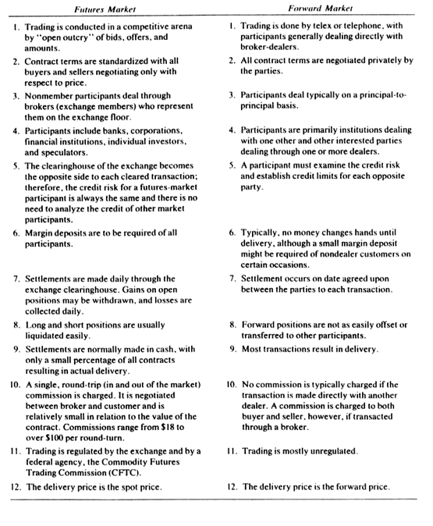
14.1 FUTURES VERSUS FORWARD MARKETS

Slide 6
14.2 FUTURES MARKETS: OVERVIEW
Accordingly, futures contracts can be classified into three main types.
(1) Commodity futures
(2) Financial futures
(3) Index futures
commodity futures for purposes of clarity and classification its meaning here is restricted to a limited segment of the total futures markets.
Financial futures are a trading medium initiated with the introduction of contracts on foreign currencies at the International Monetary Market (IMM) in 1972.
An index-futures contract is one for which the underlying asset is actually a portfolio of assets

Slide 7
14.2 FUTURES MARKETS: OVERVIEW
Futures-market participants are divided into two broad classes: hedgers and speculators.
Hedging refers to a futures-market transaction made as a temporary substitute for a cash-market transaction to be made at a later date.
Futures market speculation involves taking a short or long futures position solely to profit from price changes.

Slide 8
Sample Problem 14.1
An investor has a portfolio of T-bills with a face value of $1 million, currently worth $950,000 in the cash market. A futures contract with a face value of $1 million,000,000 worth of T-bills is currently selling for per $100. Interest rates rise and the value of the T-bills falls to $946.875, where the value of the T-bill futures contract falls to per $. If the investor were to hedge the T-bill position with T-bill futures, what would be the net result of this interest-rate change on the value of the hedged position? If the investor were to speculate that interest rates would fall, what is the next effect of the portfolio value?

Slide 9
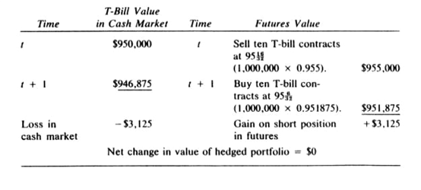
14.1 Solution

Slide 10
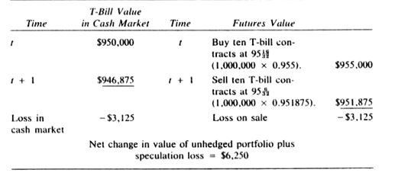
14.1 Solution continued

Slide 11
14.3 COMPONENTS AND MECHANICS OF FUTURES MARKETS
This chapter discusses:
Exchanges
Clearinghouse
Margin
Order execution
T-bill futures transactions

Slide 12
14.3.1 The Exchanges
A futures exchange, just like a stock exchange, is the arena for the actual daily trade. Members include individual traders, brokerage firms, and other types of institutions. The exchange’s governing rules and procedures are determined by its members, who serve on various policy committees and elect the officers of the exchanging of futures contracts.

Slide 13
14.3.2 The Clearinghouse
Central to the operation of organized futures markets is the clearinghouse or clearing corporation for the exchange. Whenever someone enters a position in a futures contract on the long or short side, the clearinghouse always takes the opposite side of the contract.
The advantages of having a central organization providing this role are threefold.
(1) The clearinghouse eliminates concern over the creditworthiness of the party on the other side of the transaction.
(2) It frees the original trading partners from the obligation of delivery or offset with each other.
(3) It provides greater flexibility in opening or closing a position.

Slide 14
14.3.3 Margin
Whenever someone enters into a contract position in the futures market, a security deposit, commonly called a margin requirement, must be paid.
marking to market –adjustments where every futures-trading account is incremented or reduced by the corresponding increase or decrease in the value of all open futures positions at the end of each trading day.
maintenance margin- the additional sum that a clearing member firm will usually require to be deposited at the initiation of any futures position

Slide 15
14.3.4 Order Execution
Each order to buy and sell futures contracts comes to the exchange floor either by telephone or by a computerized order-entry system. The person receiving the order is called a phone clerk. The phone clerk then hands the order to a runner, who relays it to the appropriate trading area or pit, to the floor broker.
When the order is executed, the floor broker endorses its time, price, and size while a specially trained employee of the exchange, the pit observer, records the price for immediate entry into the exchange’s computerized price-reporting system.

Slide 16
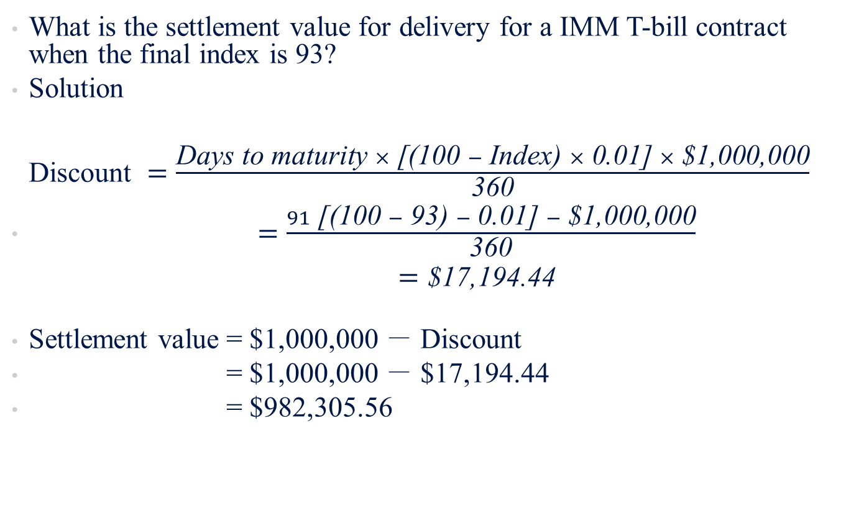
Sample Problem 14.2
What is the settlement value for delivery for a IMM T-bill contract when the final index is 93?
Solution
$\begin{matrix}\text{Discount} =\frac{\text{Days} \text{to} \text{maturity} ×\text{ [(100 }− \text{Index}\text{) }×\text{ 0.01] }×\text{ \$1,000,000}}{\text{360}} \\ =\frac{91\text{ [(100 }−\text{ 93) }−\text{ 0.01] }−\text{ \$1,000,000}}{\text{360}} \\ \begin{aligned} =\text{\$17,194.44} \\ \end{aligned}\end{matrix}$
Settlement value = $1,000,000 － Discount
= $1,000,000 － $17,194.44
= $982,305.56

Slide 17
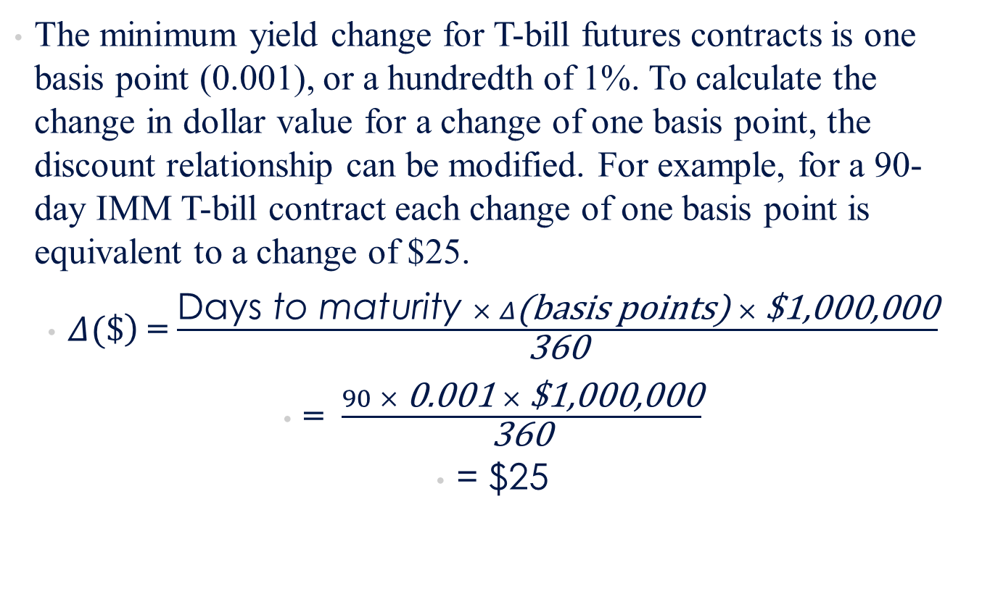
Sample Problem 14.2 continued
The minimum yield change for T-bill futures contracts is one basis point (0.001), or a hundredth of 1%. To calculate the change in dollar value for a change of one basis point, the discount relationship can be modified. For example, for a 90-day IMM T-bill contract each change of one basis point is equivalent to a change of $25.
$\left.Δ(\$\right)$ = $\frac{\text{Days} \text{to} \text{maturity} × Δ\text{(}\text{basis} \text{points}\text{) }×\text{ \$1,000,000}}{\text{360}}$
= $\frac{90 ×\text{ 0.001 }×\text{ \$1,000,000}}{\text{360}}$
= $25

Slide 18
14.4 THE VALUATION OF FUTURES CONTRACTS
The discussions of each of the three classifications of futures contracts have pointed out pricing idiosyncrasies and have examined specific pricing models for particular types of contracts. Nevertheless, the underlying tenets of any particular pricing model have their roots in a more general theoretical framework of valuation.

Slide 19
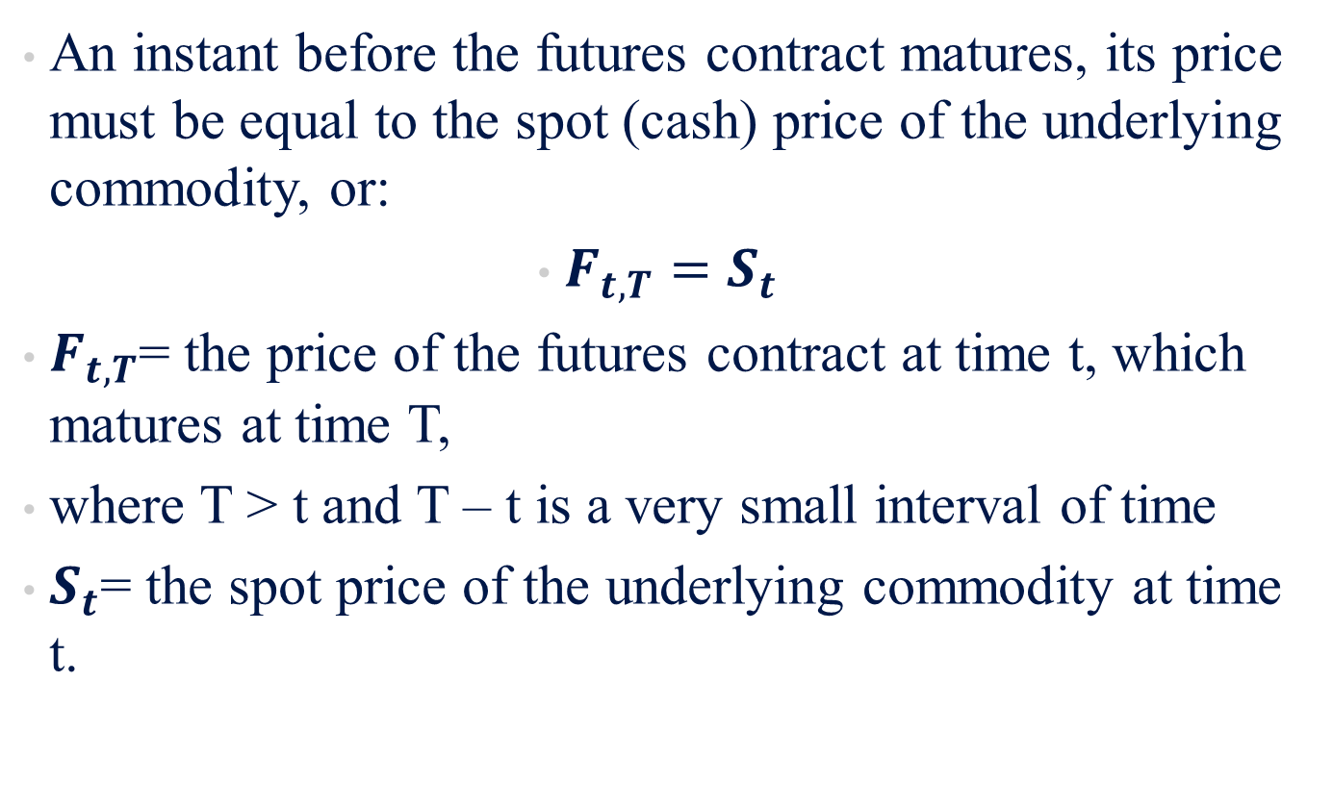
14.4.1 The Arbitrage Argument
An instant before the futures contract matures, its price must be equal to the spot (cash) price of the underlying commodity, or:
$F_{t,T}=S_{t}$
$F_{t,T}$= the price of the futures contract at time t, which matures at time T,
where T > t and T – t is a very small interval of time
$S_{t}$= the spot price of the underlying commodity at time t.

Slide 20
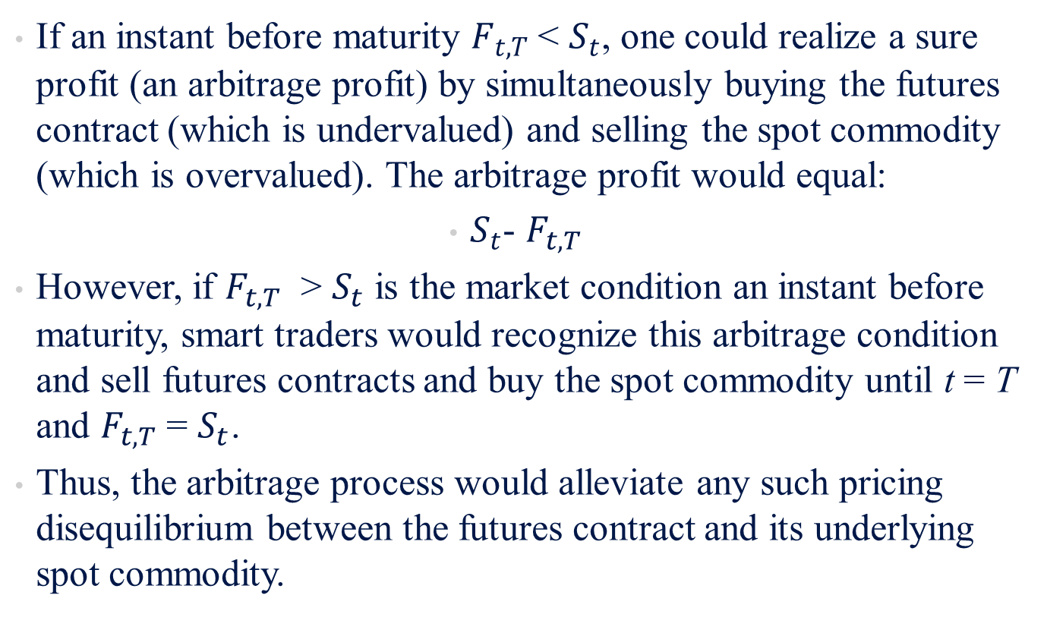
14.4.1 The Arbitrage Argument
If an instant before maturity $F_{t,T}$ < $S_{t}$, one could realize a sure profit (an arbitrage profit) by simultaneously buying the futures contract (which is undervalued) and selling the spot commodity (which is overvalued). The arbitrage profit would equal:
$S_{t}$- $F_{t,T}$
However, if $F_{t,T}$ > $S_{t}$ is the market condition an instant before maturity, smart traders would recognize this arbitrage condition and sell futures contracts and buy the spot commodity until t = T and $F_{t,T}$ = $S_{t}$.
Thus, the arbitrage process would alleviate any such pricing disequilibrium between the futures contract and its underlying spot commodity.

Slide 21
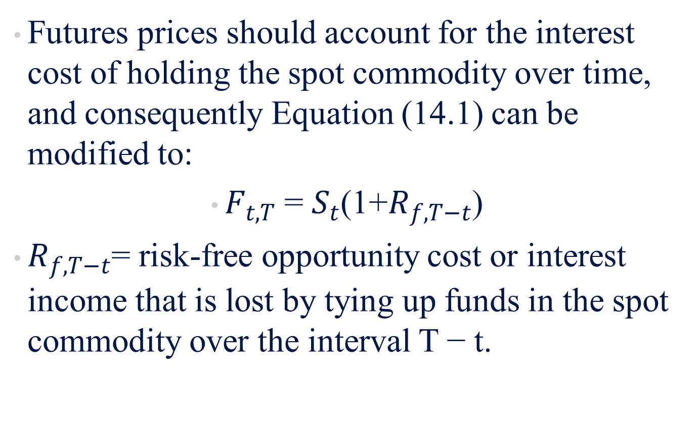
14.4.2 Interest Costs
Futures prices should account for the interest cost of holding the spot commodity over time, and consequently Equation (14.1) can be modified to:
$F_{t,T}$ = $S_{t}$(1+$R_{f,T−t}$)
$R_{f,T−t}$= risk-free opportunity cost or interest income that is lost by tying up funds in the spot commodity over the interval T − t.

Slide 22
Sample Problem 14.3
On September 1, the spot price of a commodity is $100. The current risk-free rate is 12% . What is the value on September 1 of a futures contract that matures on October 1 with a price of $100?

Slide 23
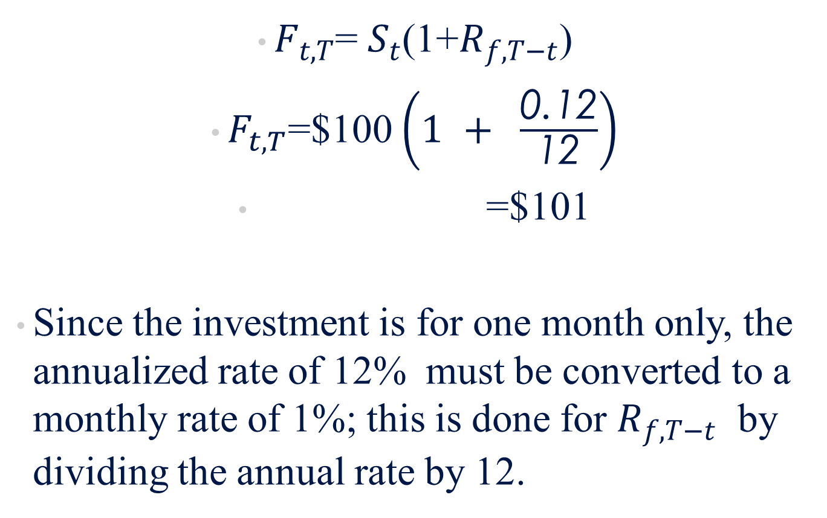
Sample Problem 14.3 Solution
$F_{t,T}$= $S_{t}$(1+$R_{f,T−t}$)
$F_{t,T}$=$100 $\left(1 + \frac{\text{0.12}}{\text{12}}\right)$
=$101
Since the investment is for one month only, the annualized rate of 12% must be converted to a monthly rate of 1%; this is done for $R_{f,T−t}$ by dividing the annual rate by 12.

Slide 24
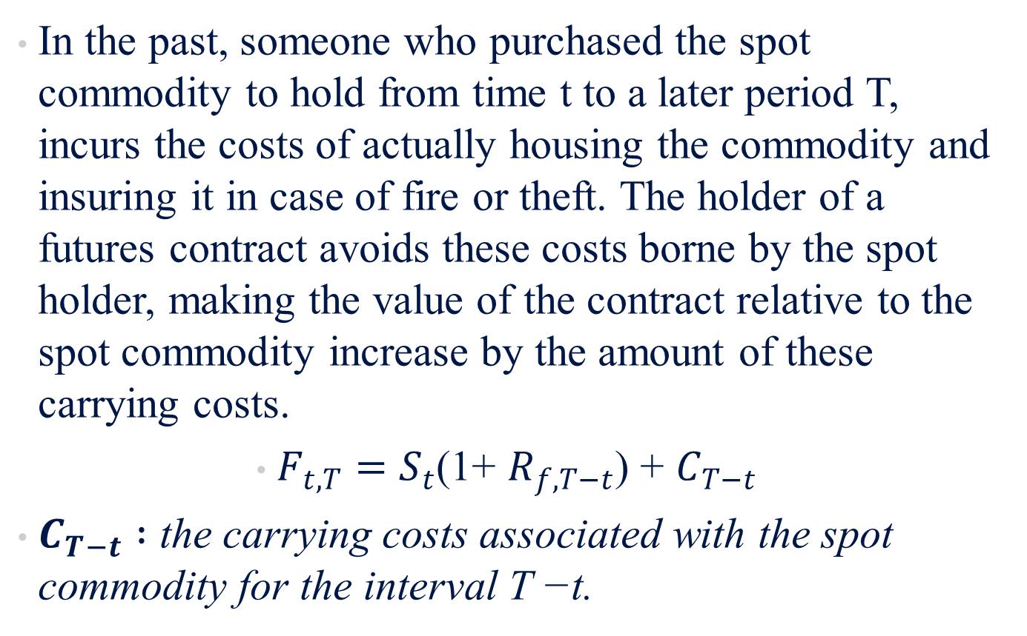
14.4.3 Carrying Costs
In the past, someone who purchased the spot commodity to hold from time t to a later period T, incurs the costs of actually housing the commodity and insuring it in case of fire or theft. The holder of a futures contract avoids these costs borne by the spot holder, making the value of the contract relative to the spot commodity increase by the amount of these carrying costs.
$F_{t,T}=S_{t}$(1+ $R_{f,T−t}$) + $C_{T−t}$
$C_{T−t} :$ the carrying costs associated with the spot commodity for the interval T −t.

Slide 25
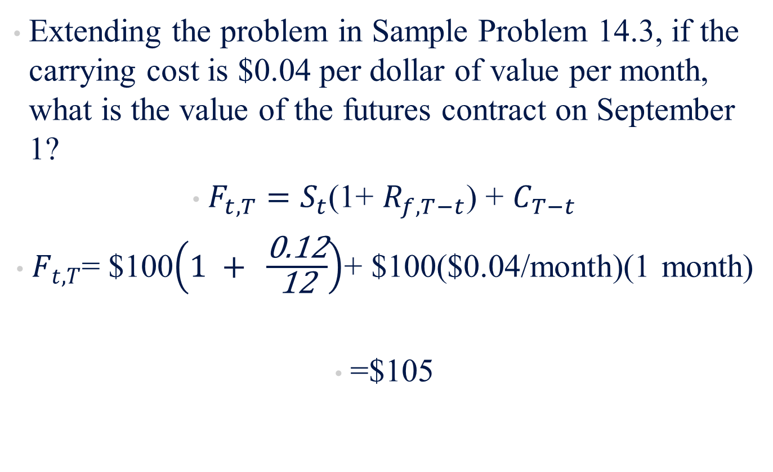
Sample Problem 14.4
Extending the problem in Sample Problem 14.3, if the carrying cost is $0.04 per dollar of value per month, what is the value of the futures contract on September 1?
$F_{t,T}=S_{t}$(1+ $R_{f,T−t}$) + $C_{T−t}$
$F_{t,T}$= $100$\left(1 + \frac{\text{0.12}}{\text{12}}\right)$+ $100($0.04/month)(1 month)
=$105

Slide 26
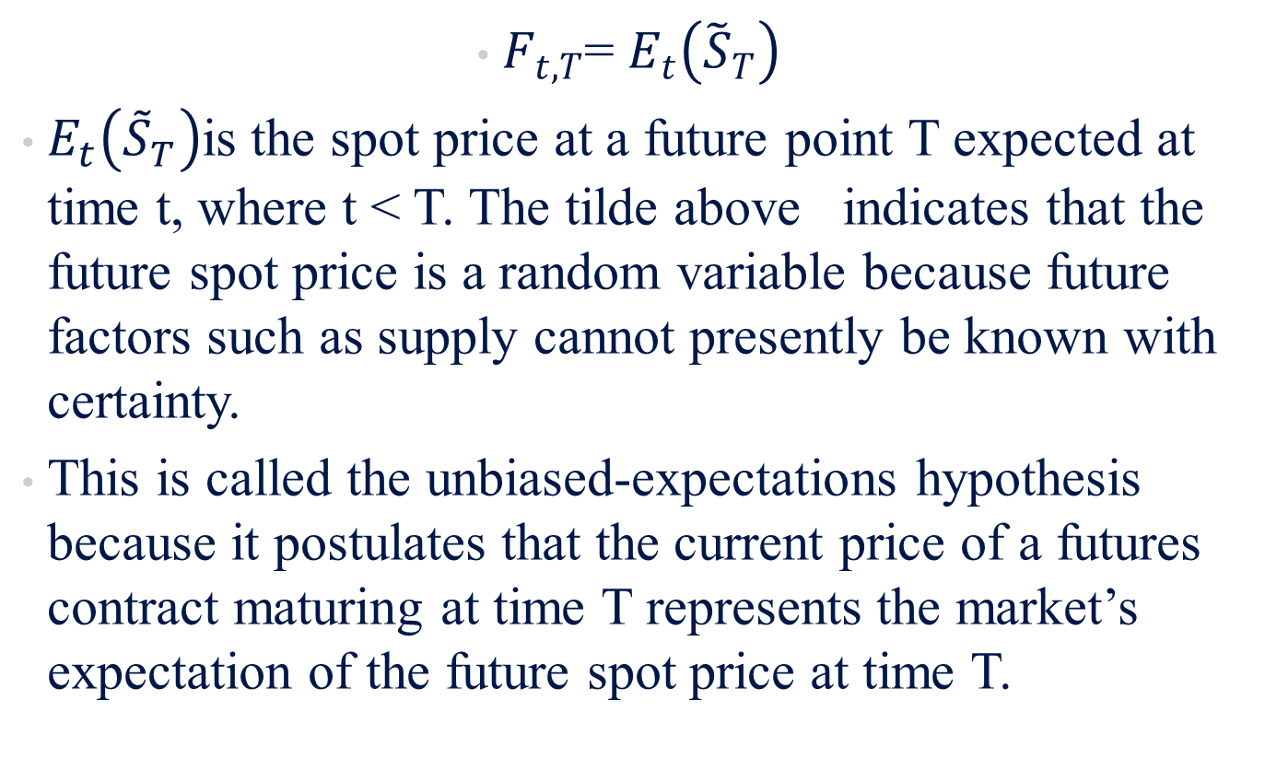
14.4.4 Supply and Demand Effects
$F_{t,T}$= $E_{t}\left({\tilde{S}}_{T}\right)$
$E_{t}\left({\tilde{S}}_{T}\right)$is the spot price at a future point T expected at time t, where t < T. The tilde above indicates that the future spot price is a random variable because future factors such as supply cannot presently be known with certainty.
This is called the unbiased-expectations hypothesis because it postulates that the current price of a futures contract maturing at time T represents the market’s expectation of the future spot price at time T.

Slide 27

14.4.4 Supply and Demand Effects
the market price of the futures contract will take on the minimum value of either of these two pricing relationship, or:
$F_{t,T}$=Min [$E_{t}\left({\tilde{S}}_{T}\right)$, $S_{t}($1+$R_{f,T−t}$) +$C_{T−t}$]

Slide 28
Sample Problem 14.5
Continuing Sample Problems 14.3 and 14.4, suppose that the consensus expectation is that the price of the commodity at time T will be $103. What is the price that anyone would pay for a futures contract on September 1?

Slide 29

Sample Problem 14.5 Solution
$F_{t,T}$=Min [$E_{t}\left({\tilde{S}}_{T}\right)$, $S_{t}($1+$R_{f,T−t}$) +$C_{T−t}$]
$F_{t,T}$= Min($103, $105)
= $103

Slide 30
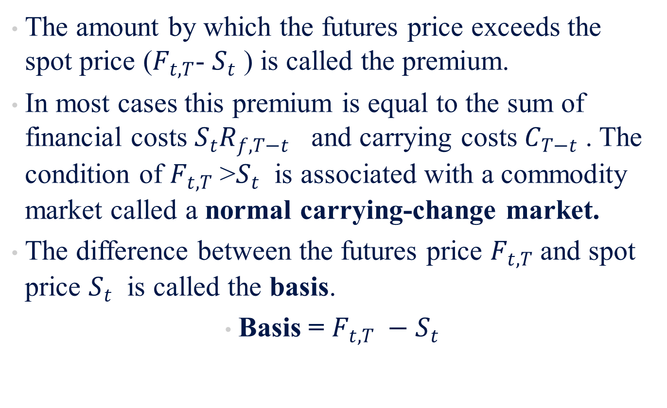
Sample Problem 14.5 continued
The amount by which the futures price exceeds the spot price ($F_{t,T}$- $S_{t}$ ) is called the premium.
In most cases this premium is equal to the sum of financial costs $S_{t}R_{f,T−t}$ and carrying costs $C_{T−t}$ . The condition of $F_{t,T}$ >$S_{t}$ is associated with a commodity market called a normal carrying-change market.
The difference between the futures price $F_{t,T}$ and spot price $S_{t}$ is called the basis.
Basis = $F_{t,T} −S_{t}$

Slide 31
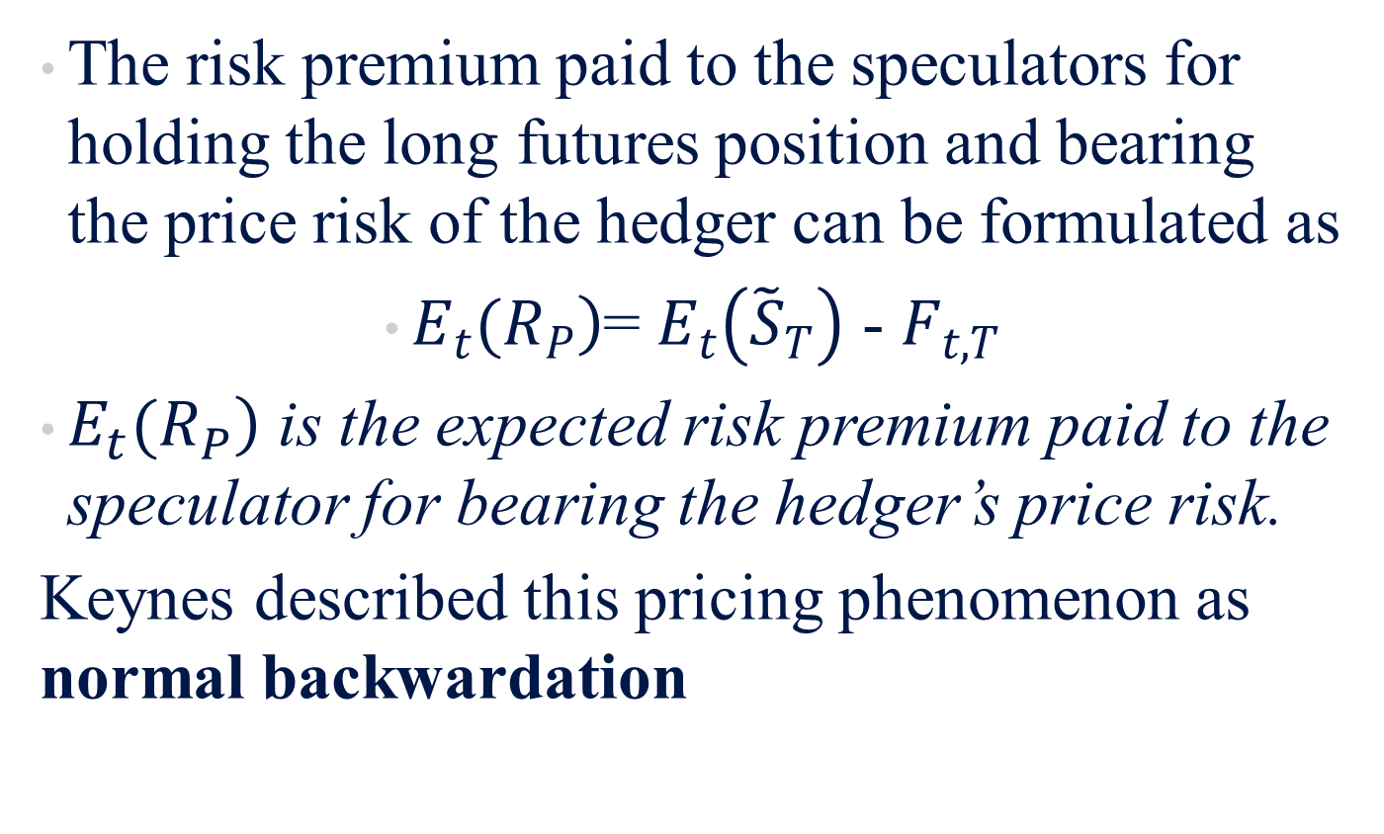
14.4.5 The Effect of Hedging Demand
The risk premium paid to the speculators for holding the long futures position and bearing the price risk of the hedger can be formulated as
$\left.E_{t}(R_{P}\right)$= $E_{t}\left({\tilde{S}}_{T}\right)$ - $F_{t,T}$
$\left.E_{t}(R_{P}\right)$ is the expected risk premium paid to the speculator for bearing the hedger’s price risk.
Keynes described this pricing phenomenon as normal backwardation

Slide 32
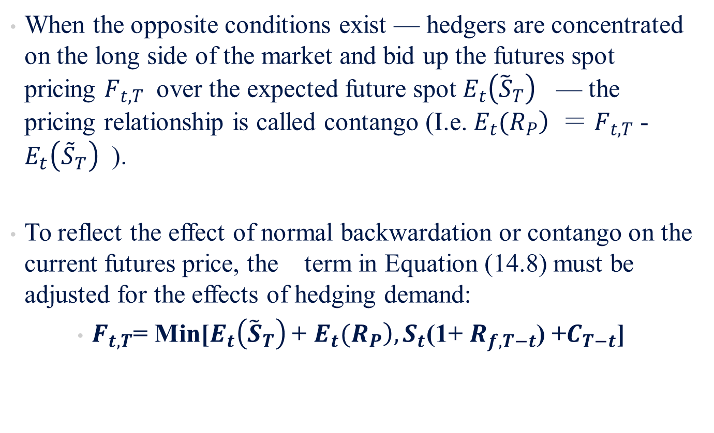
14.4.5 The Effect of Hedging Demand
When the opposite conditions exist — hedgers are concentrated on the long side of the market and bid up the futures spot pricing $F_{t,T}$ over the expected future spot $E_{t}\left({\tilde{S}}_{T}\right)$ — the pricing relationship is called contango (I.e. $\left.E_{t}(R_{P}\right)$ ＝ $F_{t,T}$ - $E_{t}\left({\tilde{S}}_{T}\right)$ ).
To reflect the effect of normal backwardation or contango on the current futures price, the term in Equation (14.8) must be adjusted for the effects of hedging demand:
$F_{t,T}$= Min[$E_{t}\left({\tilde{S}}_{T}\right)$ + $\left.E_{t}(R_{P}\right),S_{t}$(1+ $R_{f,T−t}$) +$C_{T−t}$]

Slide 33
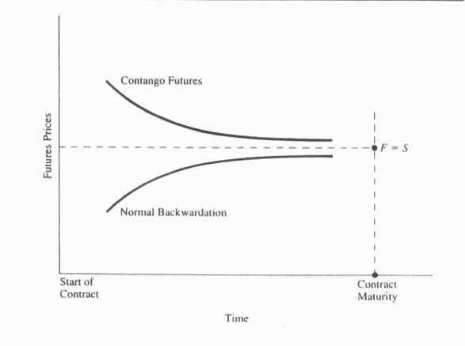
14.4.5 The Effect of Hedging Demand
Figure 14-4 Bounds for Futures Prices

Slide 34
14.5 HEDGING CONCEPTS AND STRATEGIES
The underlying motivation for the development of futures markets is to aid the holders of the spot commodity in hedging their price risk; consequently, the discussion now focuses on such an application of futures market.

Slide 35
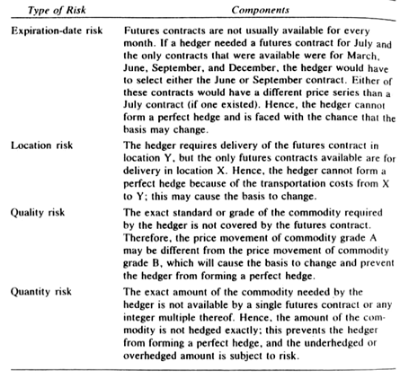
14.5.1 Hedging Risks and Costs
This nonsynchronicity of spot and futures prices is related to the basis and is called the basis risk

Slide 36
14.5.1 Hedging Risks and Costs
Cross-hedging refers to hedging with a futures contract written on a nonidentical commodity (relative to the spot commodity).
  is frequently the best that can be done with financial and index futures.
  Changes in the basis risk induced by the cross-hedge are caused by less than perfect correlation of price movements between the spot and futures prices — even at maturity.

Slide 37
Sample Problem 14.6
Basis risk is illustrated in Table 14-35. The spot price is $100 and the futures price is $105 on day t. The top half of the exhibit shows what can happen if the spot price falls at day t + 1, and the bottom half shows what happens if the spot price rises. It is assumed that the hedger is trying to create a fully hedged position in each of the cases presented.
If the basis is unchanged, the hedged position will neither gain nor lose. As can be seen in Table 14-53, the gain or loss on the hedged position is related to the change in the basis. Hence, the asset position’s exposure to price risk is zero and the only risk the hedger faces is a change in the basis.

Slide 38
14.5.2 The Classic Hedge Strategy
To apply the classic hedge strategy to the hedging problem, an opposite and equal position is taken in the futures market for the underlying commodity.
Classic strategy implies that the objective of the classic hedge is risk minimization or elimination.

Slide 39
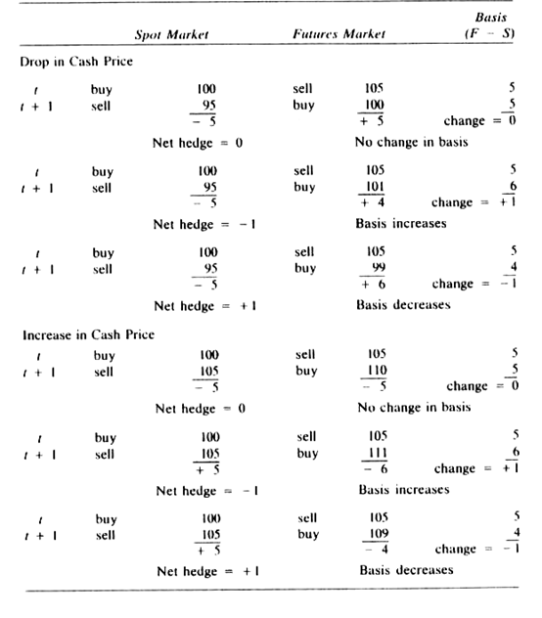
14.5.2 The Classic Hedge Strategy

Slide 40
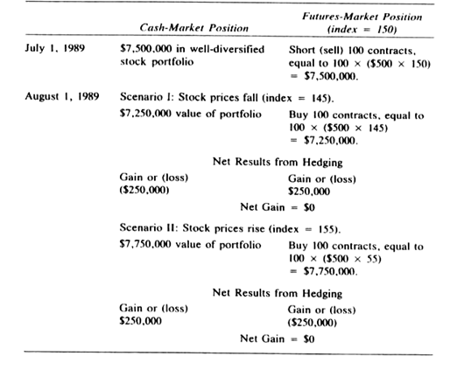
Sample Problem 14.7
It is assumed that (1) there are no associated costs for entering or liquidating a futures position (e.g. commission costs or margin costs) and (2) a perfect correlation exists between the spot and futures price movements (no basis risk)

Slide 41
14.5.3 The Working Hedge Strategy
The Working hedge strategy makes explicit the speculative aspect of hedging. That is, in any hedged position the basis will not be constant over time. Therefore, the hedger in a certain sense is speculating on the future course of the basis.
This speculative aspect to hedging is exploited in Working’s model by simultaneously determining positions in the spot and futures markets in order to capture increased return arising from relative movements in spot and futures prices.

Slide 42
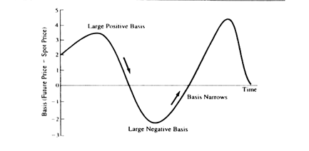
Figure 14-3 graphs a hypothetical basis relationship over time and designates the points considered indicative of large positive or negative basis.

Slide 43
Sample Problem 14.8
Assume that the manager of the well-diversified portfolio of stocks worth $7.5 million sees a difference between the stock-index futures price for the S&P 500 near-term contract and the spot price of 2.85 (152.85 – 150.00) on July 1. Her portfolio is highly correlated with the S&P 500 index, and she sells 98 contracts to achieve an approximately equally valued position in the futures. Table 14-75 summarizes the results of this hedge strategy one month later.

Slide 44
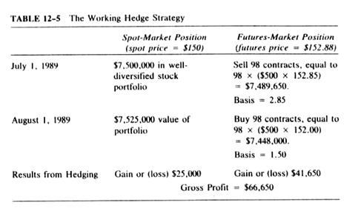
Sample Problem 14.8 continued

Slide 45
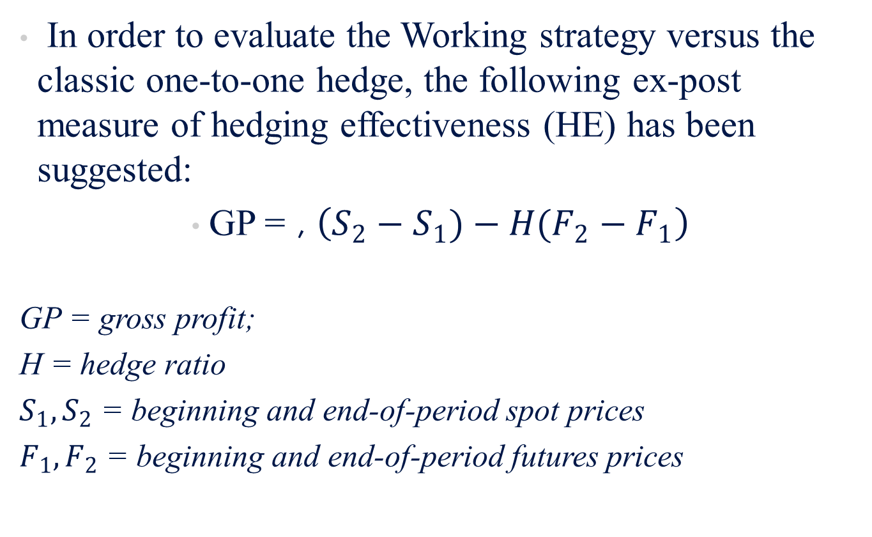
Sample Problem 14.8 continued
In order to evaluate the Working strategy versus the classic one-to-one hedge, the following ex-post measure of hedging effectiveness (HE) has been suggested:
GP = , $\left(S_{2}−S_{1})−H(F_{2}−F_{1}\right)$
GP = gross profit;
H = hedge ratio
$S_{1},S_{2}$ = beginning and end-of-period spot prices
$F_{1},F_{2}$ = beginning and end-of-period futures prices

Slide 46
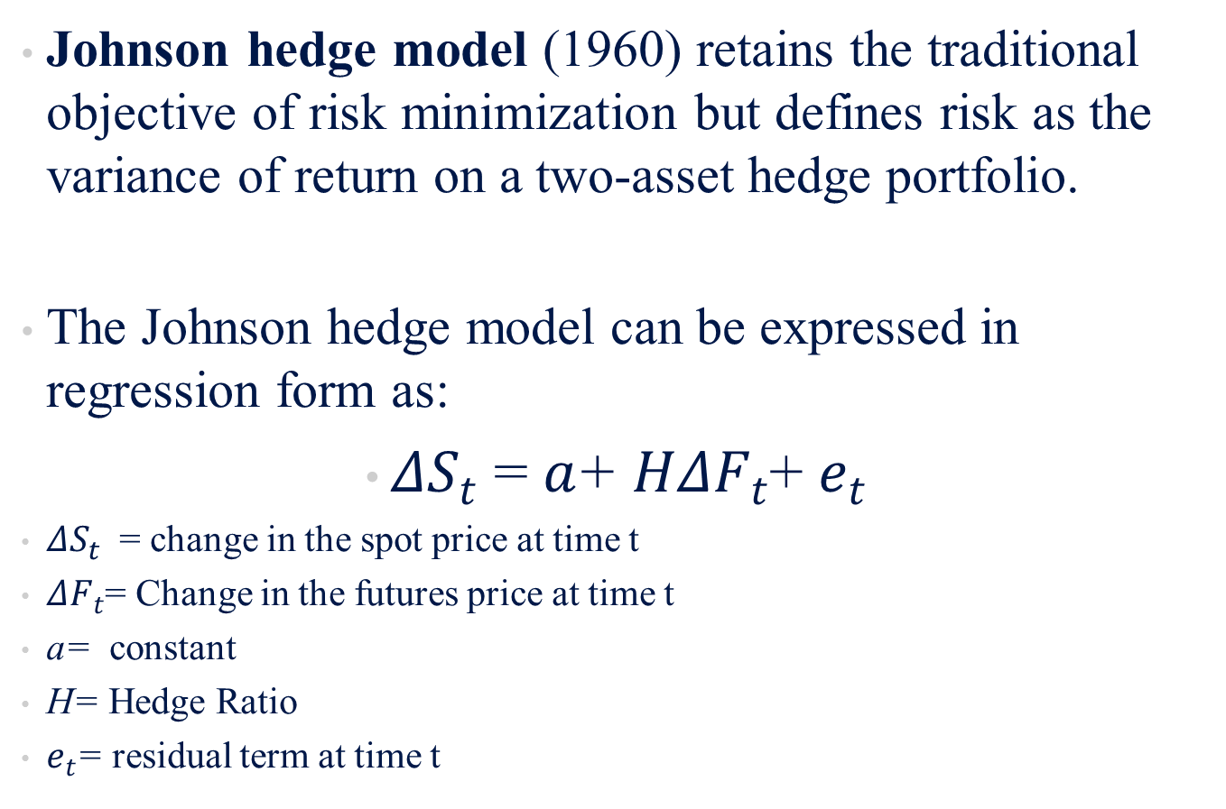
14.5.4 The Johnson Minimum-Variance Hedge Strategy
Johnson hedge model (1960) retains the traditional objective of risk minimization but defines risk as the variance of return on a two-asset hedge portfolio.
The Johnson hedge model can be expressed in regression form as:
$ΔS_{t}$ = $a$+ $HΔF_{t}$+ $e_{t}$
$ΔS_{t}$ = change in the spot price at time t
$ΔF_{t}$= Change in the futures price at time t
a= constant
H= Hedge Ratio
$e_{t}$= residual term at time t

Slide 47
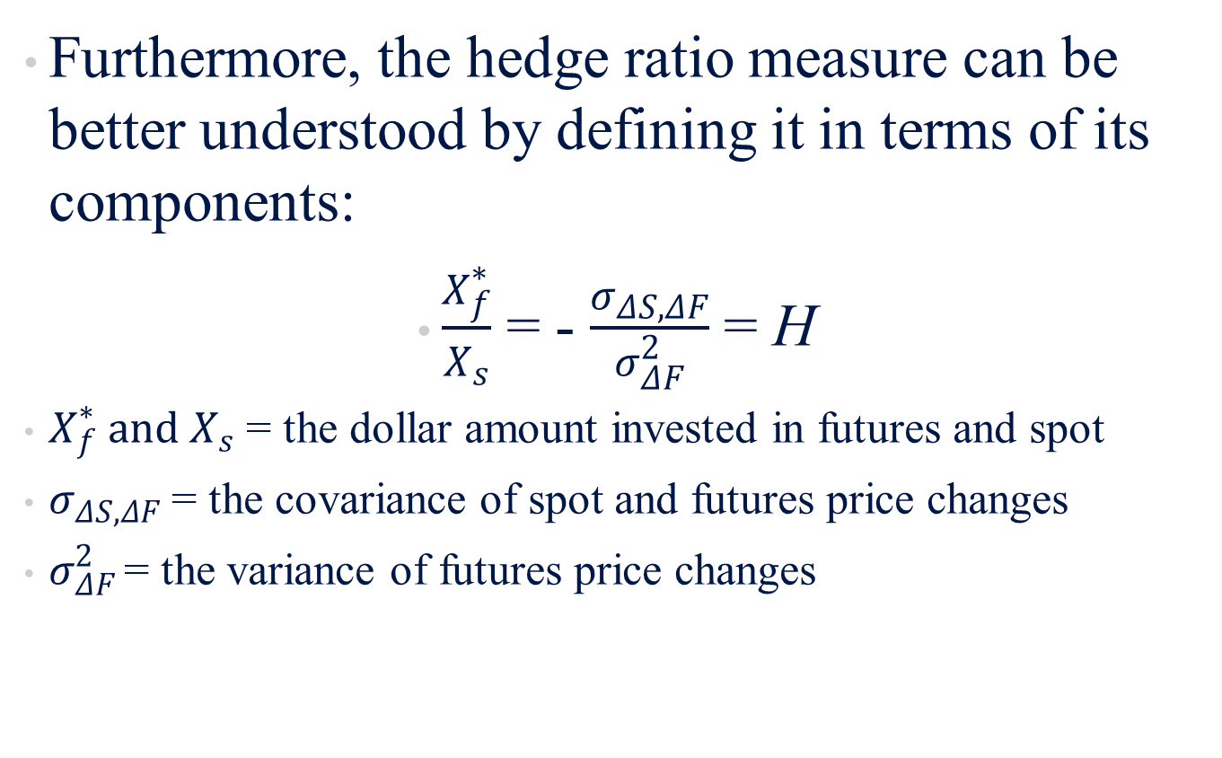
14.5.4 The Johnson Minimum-Variance Hedge Strategy
Furthermore, the hedge ratio measure can be better understood by defining it in terms of its components:
$\frac{X_{f}^{∗}}{X_{s}}$ = - $\frac{σ_{ΔS,ΔF}}{σ_{ΔF}^{2}}$ = H
$X_{f}^{∗} and X_{s}$ = the dollar amount invested in futures and spot
$σ_{ΔS,ΔF}$ = the covariance of spot and futures price changes
$σ_{ΔF }^{2}$= the variance of futures price changes

Slide 48
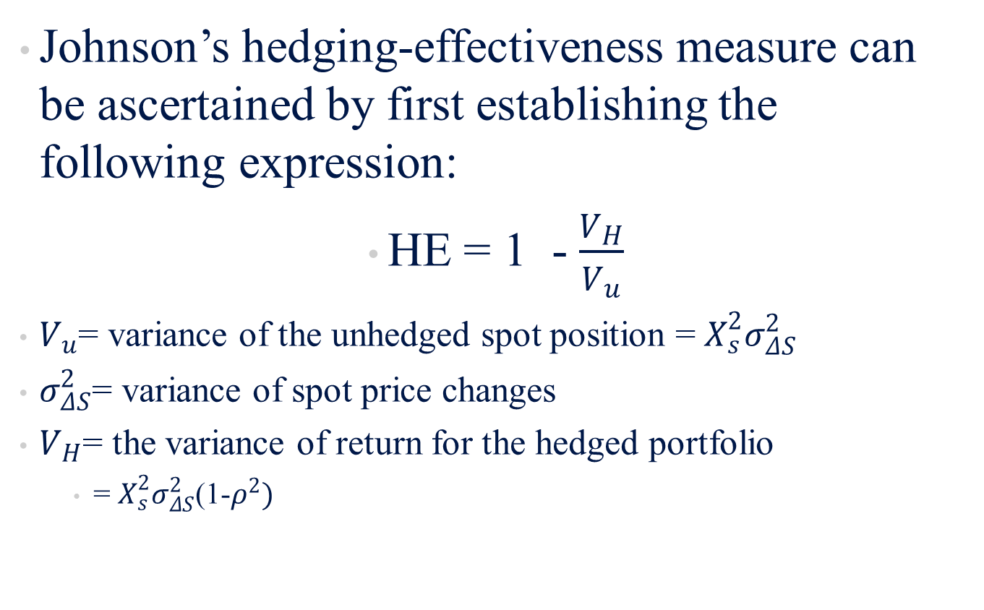
14.5.4 The Johnson Minimum-Variance Hedge Strategy
Johnson’s hedging-effectiveness measure can be ascertained by first establishing the following expression:
HE = 1 - $\frac{V_{H}}{V_{u}}$
$V_{u}$= variance of the unhedged spot position = $X_{s}^{2}σ_{ΔS}^{2}$
$σ_{ΔS}^{2}$= variance of spot price changes
$V_{H}$= the variance of return for the hedged portfolio
  = $X_{s}^{2}σ_{ΔS}^{2}$(1-$ρ^{2})$

Slide 49
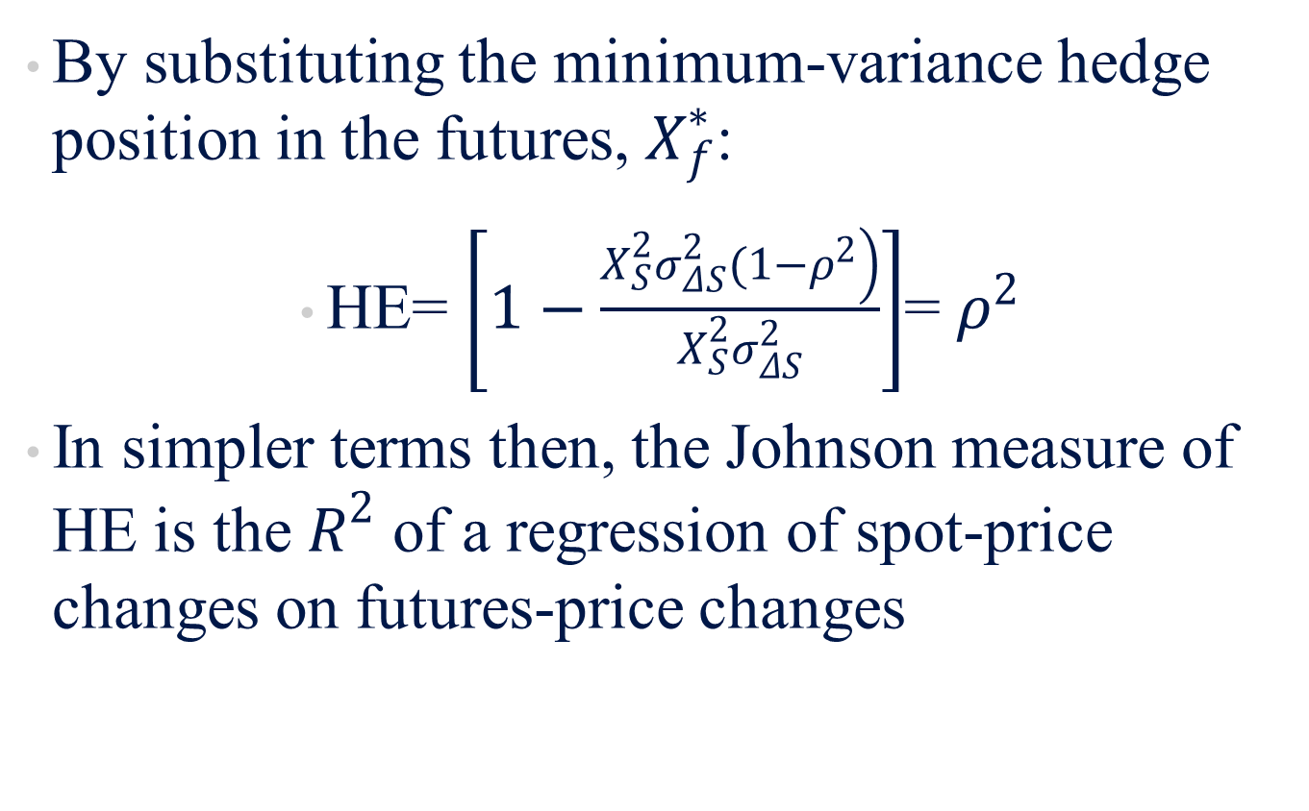
14.5.4 The Johnson Minimum-Variance Hedge Strategy
By substituting the minimum-variance hedge position in the futures, $X_{f}^{∗}$:
HE= $\left[1−\frac{\left.X_{S}^{2}σ_{ΔS}^{2}(1−ρ^{2}\right)}{X_{S}^{2}σ_{ΔS}^{2}}\right]$= $ρ^{2}$
In simpler terms then, the Johnson measure of HE is the $R^{2}$ of a regression of spot-price changes on futures-price changes

Slide 50
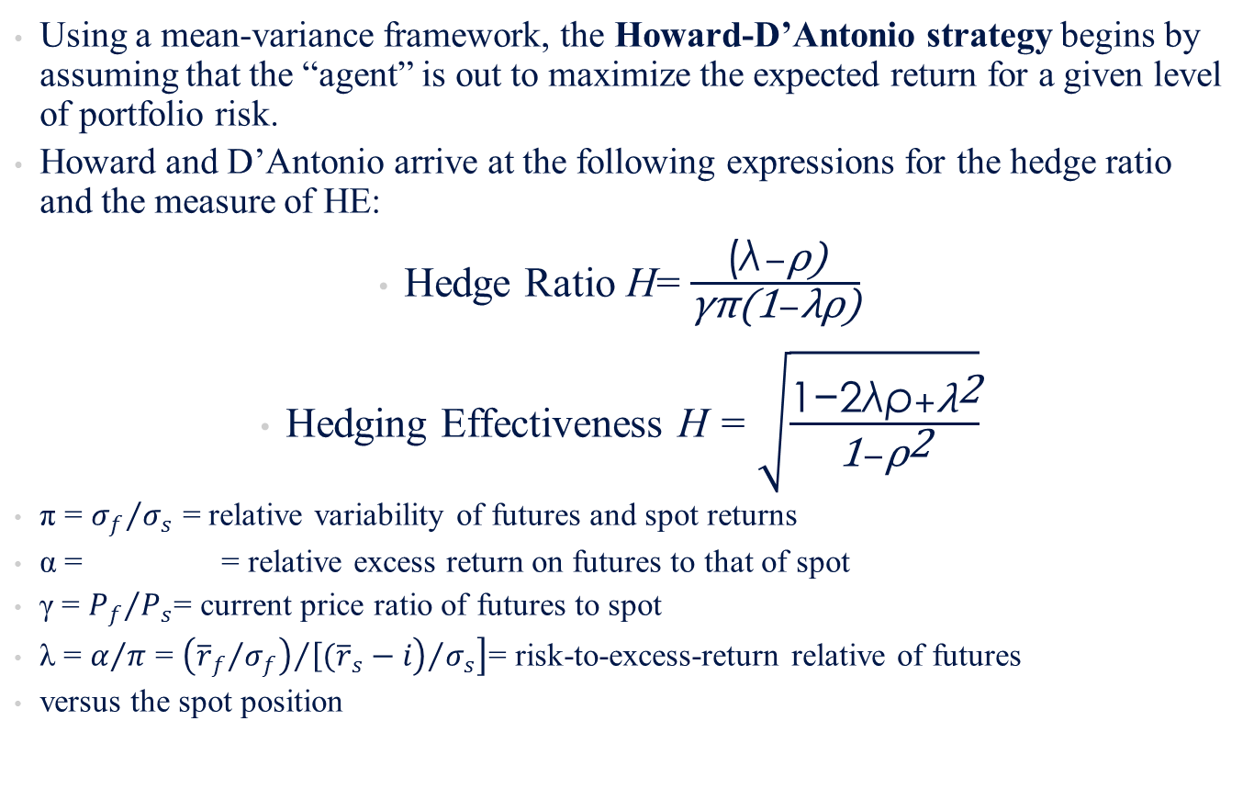
14.5.5 The Howard-D’Antonio Optimal Risk-Return Hedge Strategy
Using a mean-variance framework, the Howard-D’Antonio strategy begins by assuming that the “agent” is out to maximize the expected return for a given level of portfolio risk.
Howard and D’Antonio arrive at the following expressions for the hedge ratio and the measure of HE:
Hedge Ratio H= $\frac{\text{(}\text{λ}−\text{ρ}\text{)}}{\text{γπ}\text{(1}−\text{λρ}\text{)}}$
Hedging Effectiveness H = $\sqrt{\frac{\text{1−2}\text{λρ}+{\text{λ}}^{\text{2}}}{\text{1}−{\text{ρ}}^{\text{2}}}}$
π = ${σ_{f}}/{σ_{s}}$ = relative variability of futures and spot returns
α = = relative excess return on futures to that of spot
γ = ${P_{f}}/{P_{s}}$= current price ratio of futures to spot
λ = $α/π$ = $\left.{\left.{\left({{\overline{r}}_{f}}/{σ_{f}}\right)}/{\left[({\overline{r}}_{s}\right.}−i\right)}/{σ_{s}}\right]$= risk-to-excess-return relative of futures
versus the spot position

Slide 51
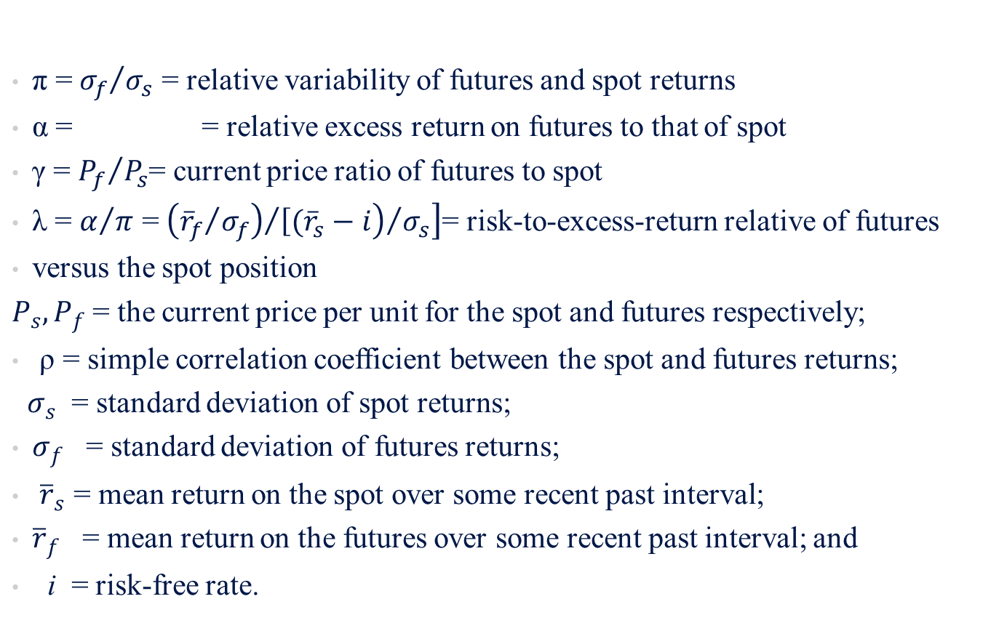
14.5.5 The Howard-D’Antonio Optimal Risk-Return Hedge Strategy
π = ${σ_{f}}/{σ_{s}}$ = relative variability of futures and spot returns
α = = relative excess return on futures to that of spot
γ = ${P_{f}}/{P_{s}}$= current price ratio of futures to spot
λ = $α/π$ = $\left.{\left.{\left({{\overline{r}}_{f}}/{σ_{f}}\right)}/{\left[({\overline{r}}_{s}\right.}−i\right)}/{σ_{s}}\right]$= risk-to-excess-return relative of futures
versus the spot position
$P_{s},P_{f}$ = the current price per unit for the spot and futures respectively;
ρ = simple correlation coefficient between the spot and futures returns;
$σ_{s}$ = standard deviation of spot returns;
$σ_{f}$ = standard deviation of futures returns;
${\overline{r}}_{s}$ = mean return on the spot over some recent past interval;
${\overline{r}}_{f}$ = mean return on the futures over some recent past interval; and
i = risk-free rate.

Slide 52
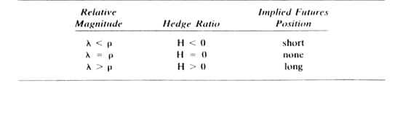
The Hedging Implications of Different Relative Magnitudes of λ and ρ

Slide 53
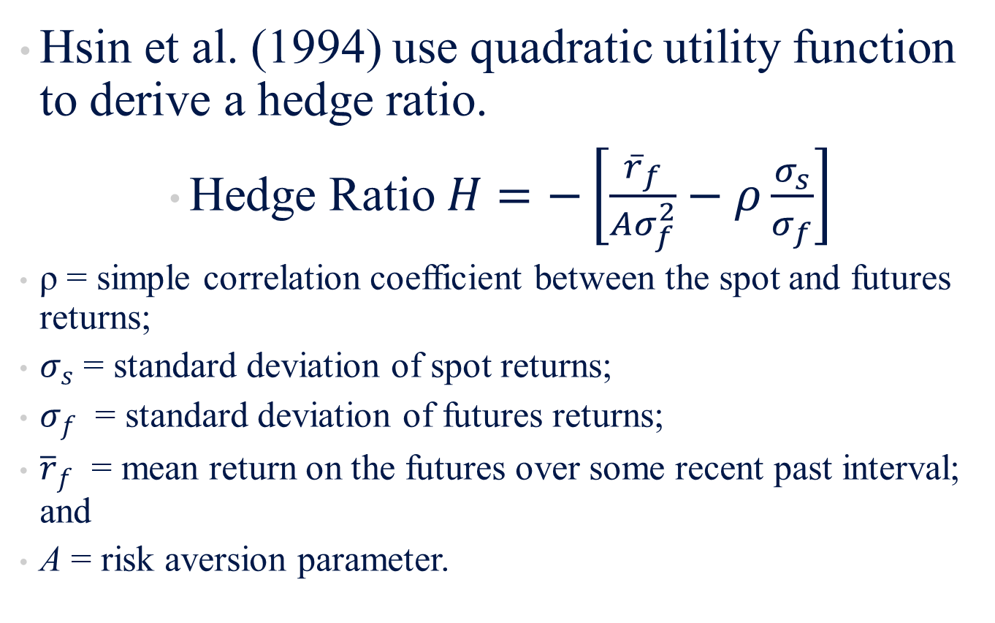
14.5.5.1 Other Hedge Ratios
Hsin et al. (1994) use quadratic utility function to derive a hedge ratio.
Hedge Ratio $H=−\left[\frac{{\overline{r}}_{f}}{Aσ_{f}^{2}}−ρ\frac{σ_{s}}{σ_{f}}\right]$
ρ = simple correlation coefficient between the spot and futures returns;
$σ_{s}$ = standard deviation of spot returns;
$σ_{f}$ = standard deviation of futures returns;
${\overline{r}}_{f}$ = mean return on the futures over some recent past interval; and
A = risk aversion parameter.

Slide 54
14.6 SUMMARY
This chapter has focused on the basic concepts of futures markets. Important terms were defined and basic models to evaluate futures contracts were discussed. The differences between futures and forward markets also received treatment. Finally hedging concepts and strategies were analyzed and alternative hedging ratios were investigated in detail. These concepts and valuation models can be used in security analysis and portfolio management related to futures and forward contracts. The next chapter investigates in depth commodity futures, financial futures, and index futures.

