Slide 1
Chapter 15
Commodity Futures, Financial Futures, and Stock-Index Futures
By
Cheng Few Lee
Joseph Finnerty
John Lee
Alice C Lee
Donald Wort

Slide 2
Outline
15.1 COMMODITY FUTURES
15.2 FUTURES QUOTATIONS
15.3 FINANCIAL FUTURES
15.3.1 Currency Futures
15.3.1.1Evolution
15.3.1.2 Advantages
15.3.1.3 Pricing Currency Futures
15.3.2 The Traditional Theory of International Parity
15.3.2.1 Interest-Rate Parity
15.3.2.2 Purchasing-Power Parity
15.3.2.3 Fisherian Relation
15.3.2.4 Forward Parity

Slide 3
15.3.3 Interest-Rate Futures
15.3.4 US Treasury Debt Futures
15.3.4.1 Characteristics of T-Bill Futures
15.3.4.2 Pricing T-Bill Futures Contracts
15.3.4.3 Characteristics of T-Note and T-Bond Futures
15.3.5 The Eurodollar Futures Market
15.3.5.1 Evolution
15.3.5.2 Eurodollar Futures
15.4 STOCK-INDEX FUTURES
15.4.1 Pricing Stock-Index Futures Contracts
15.4.2 Stock-Index Futures: Does the Tail Wag the Dog?
15.5 SUMMARY

Slide 4
15.1 Commodity Futures
Commodity futures contracts were forward agreements for future trade.
The agricultural industry was first because the perishable goods have price risks.
A person can also “lock in” on contracted future price by arranging the expiration date of the contract to be the same as the day it hits the market.

Slide 5
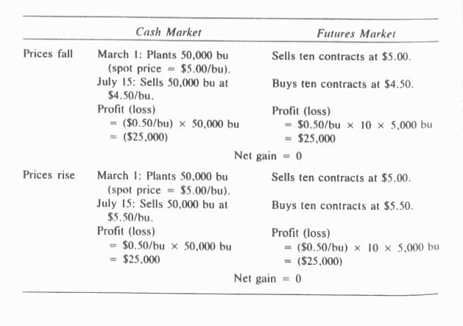
Sample Problem 15.1
Farmer Smith decided to hedge his price risk by going into the futures market and effectively selling his crop ahead of time.
Assuming there’s no basis risk, the outcomes of this transaction for falling and risking prices over the interim period are shown below.
Table 15-1 Hedging the Price Risk by Futures Market

Slide 6
Speculators buy the futures contracts from the farmer on the chance that prices would actually rise and now fall as expected.
Speculators contributes to the functioning of futures markets in two invaluable ways:
  Risk transference
  Liquidity

Slide 7
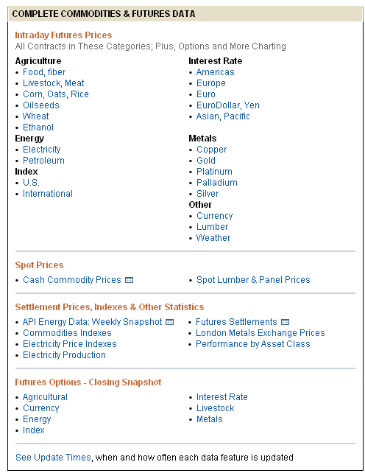
15.2
Futures Quotations
To find certain future contract, for example corn future, click the item “Core, Oats, Rice” under agriculture here
Figure 15.1 Futures Prices Data

Slide 8
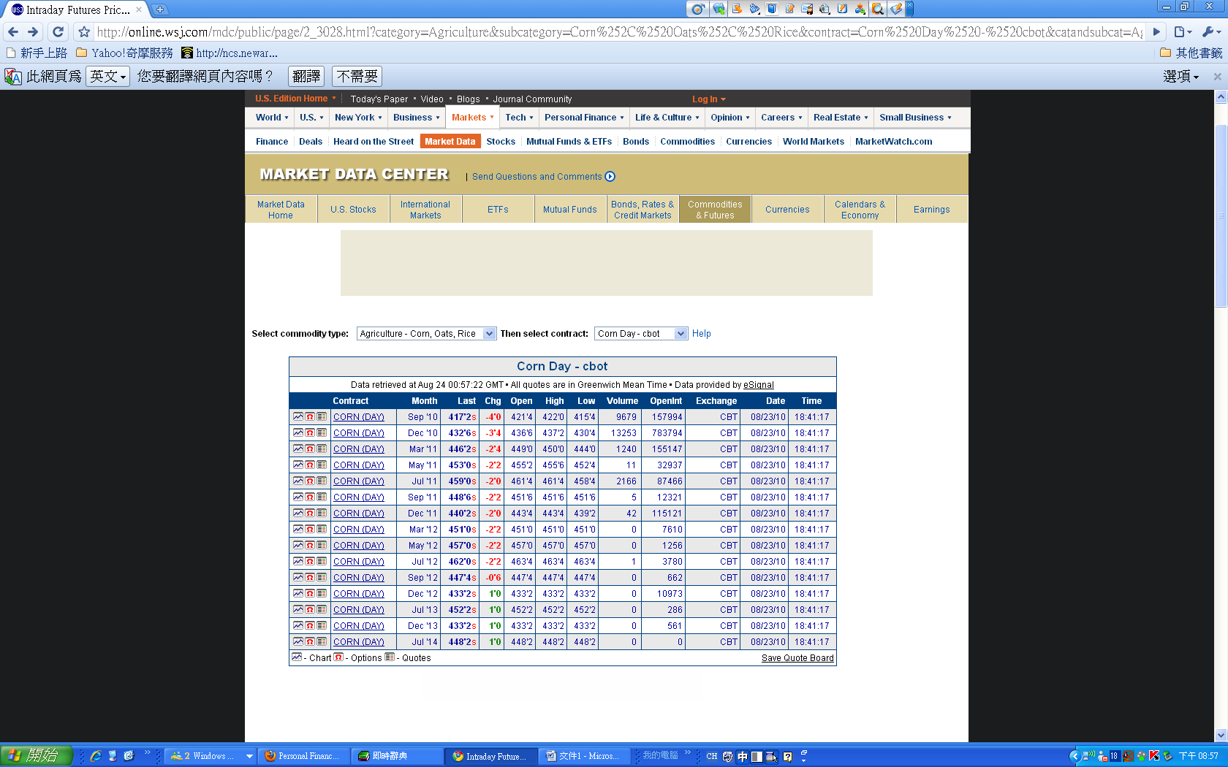
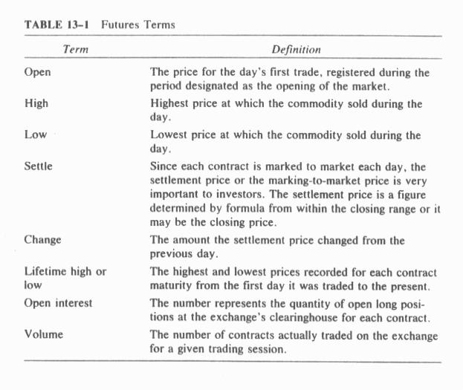
Figure 15.2 Corn Future Prices
Then obtain the corn future price in the figure above.
Table 15.2 shows useful definitions for future contracts.
Commodity trade is corn
Exchange refers to the place where the futures contracts are traded
Contract size refers to the amount of spot commodity that the contract represent
The price is the manner in which the prices are quoted
Table 15.2 Future Terms

Slide 9
15.3 Financial Futures
Financial futures are standardized futures contracts whose market prices are established through open outcry and hand signals in regulated commodity exchange.
15.3.1 Currency Futures
Currency futures contracts promises future delivery of a standard amount of a foreign currency at a specified time, place, and price.
It can be used to hedge foreign-exchange risk for investors and firms involved in the import and export business.

Slide 10
15.3.1.1 Evolution
The concept of financial futures on currencies emerged as an anticipatory reaction to the end of the Bretton Woods Agreement, which called for elimination of fixed parities between major currencies.
On May 16, 1972, the International Monetary Market (IMM) and Mercantile Exchange (CME) opened and offered the first organized trading of standardized futures contracts on foreign currencies.
The change in U.S. monetary policy in October1979, which went from essentially “pegging” interest rates to letting them float in accordance with market forces, resulted in a significant increase in the volatility of market interest rates.
As interest rates change in one country, so does the value of its currency relative to those of other counties.

Slide 11
15.3.1.2 Advantages
The establishment of currency futures has provided a means by which Interbank dealers can hedge their positions in spot or forward markets.
The funds of participants are protected by daily settlement of the change in position values; they are also safeguarded by the exchange’s clearing house, whose members together guarantee all trades.
Futures markets allow dealers to trade anonymously and provide price insurance and arbitrage opportunities in the spot and forward markets.
The IMM (International Monetary Market) is today one of three divisions of the CME, the largest futures exchange in the United States.
Presently, the foreign currencies for which futures contracts are traded include U.K. pound (ticker code GBP); Canadian dollars (CAD); Euro (EUR); Swiss franc (CHF); Japanese yen (JPY); Russian Ruble (RUB); and Australian dollar (AUD).

Slide 12
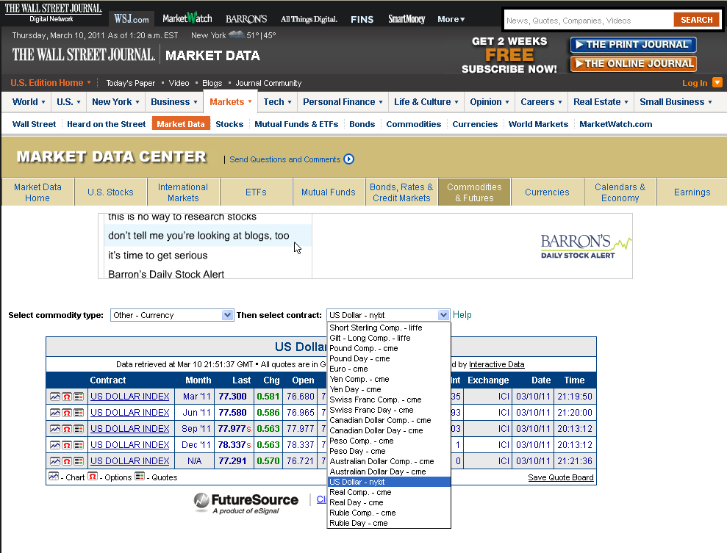
When dealing with foreign exchange, it is important to realize that the price of a currency is in terms of a second currency.
Both the numerator and denominator of the price ratio are in terms of money.
Figure 15.3 Currency Futures Data

Slide 13
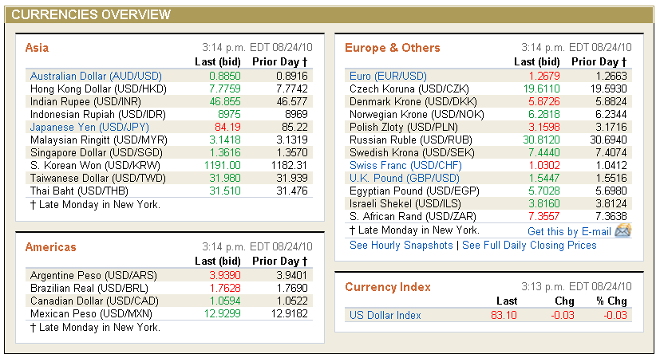
For example, in Figure 15-4 the euro is worth $1.2663 (0.7897 dollar per euro) and the yen is worth $0.0117 (85.22 Yen per dollar).
All foreign-exchange rates are related as reciprocals.
For other currencies (usually the currencies of the major trading nations), not only are the spot rates quoted but also the forward rates.
Figure 15.4 Currency Rates

Slide 14
The futures market is different from the forward market. In the futures market, the maturity date of a given contract is fixed by the rules of the exchange.
In the forward market, 30-, 60-, and 90-day contracts (or any other number of days) are available.
In the forward market, the contract size is determined between the buyer and seller.
In the futures market, only contracts of standardized amounts are traded.

Slide 15
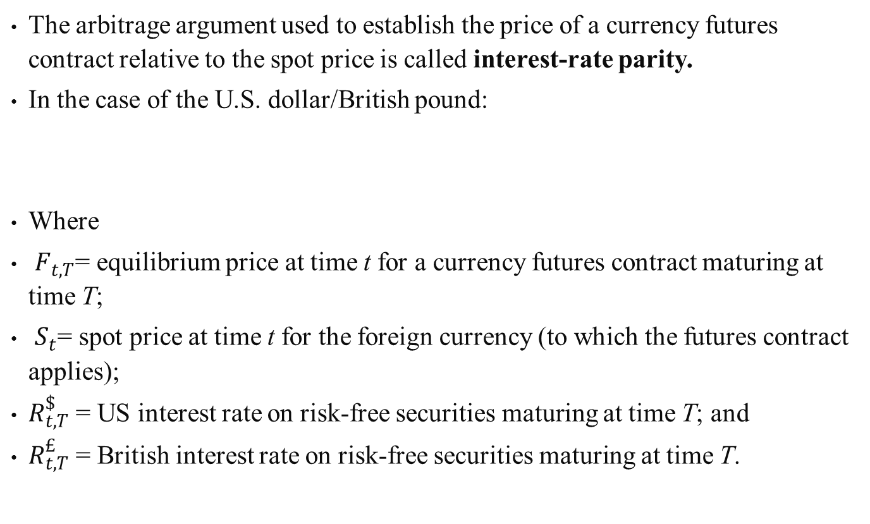
15.3.1.3 Pricing Currency Futures
The arbitrage argument used to establish the price of a currency futures contract relative to the spot price is called interest-rate parity.
In the case of the U.S. dollar/British pound:
Where
$F_{t,T}$= equilibrium price at time t for a currency futures contract maturing at time T;
$S_{t}$= spot price at time t for the foreign currency (to which the futures contract applies);
$R_{t,T}^{\$}$ = US interest rate on risk-free securities maturing at time T; and
$R_{t,T}^{£}$ = British interest rate on risk-free securities maturing at time T.
(15.1)

Slide 16
Sample Problem 15.2
As an example, suppose the US dollar is currently quoted in the spot currency market for the British pound at $1.80/￡.
Interest rates in the United States and Britain for three months are 3% and 4%, respectively.
What is the price of a three-month deposit futures contract for pounds?
Solution:
Substituting all information into Equation (15.1):
Empirical tests have shown that the pricing relationship described by interest-rate parity holds very closely in the currency markets.

Slide 17
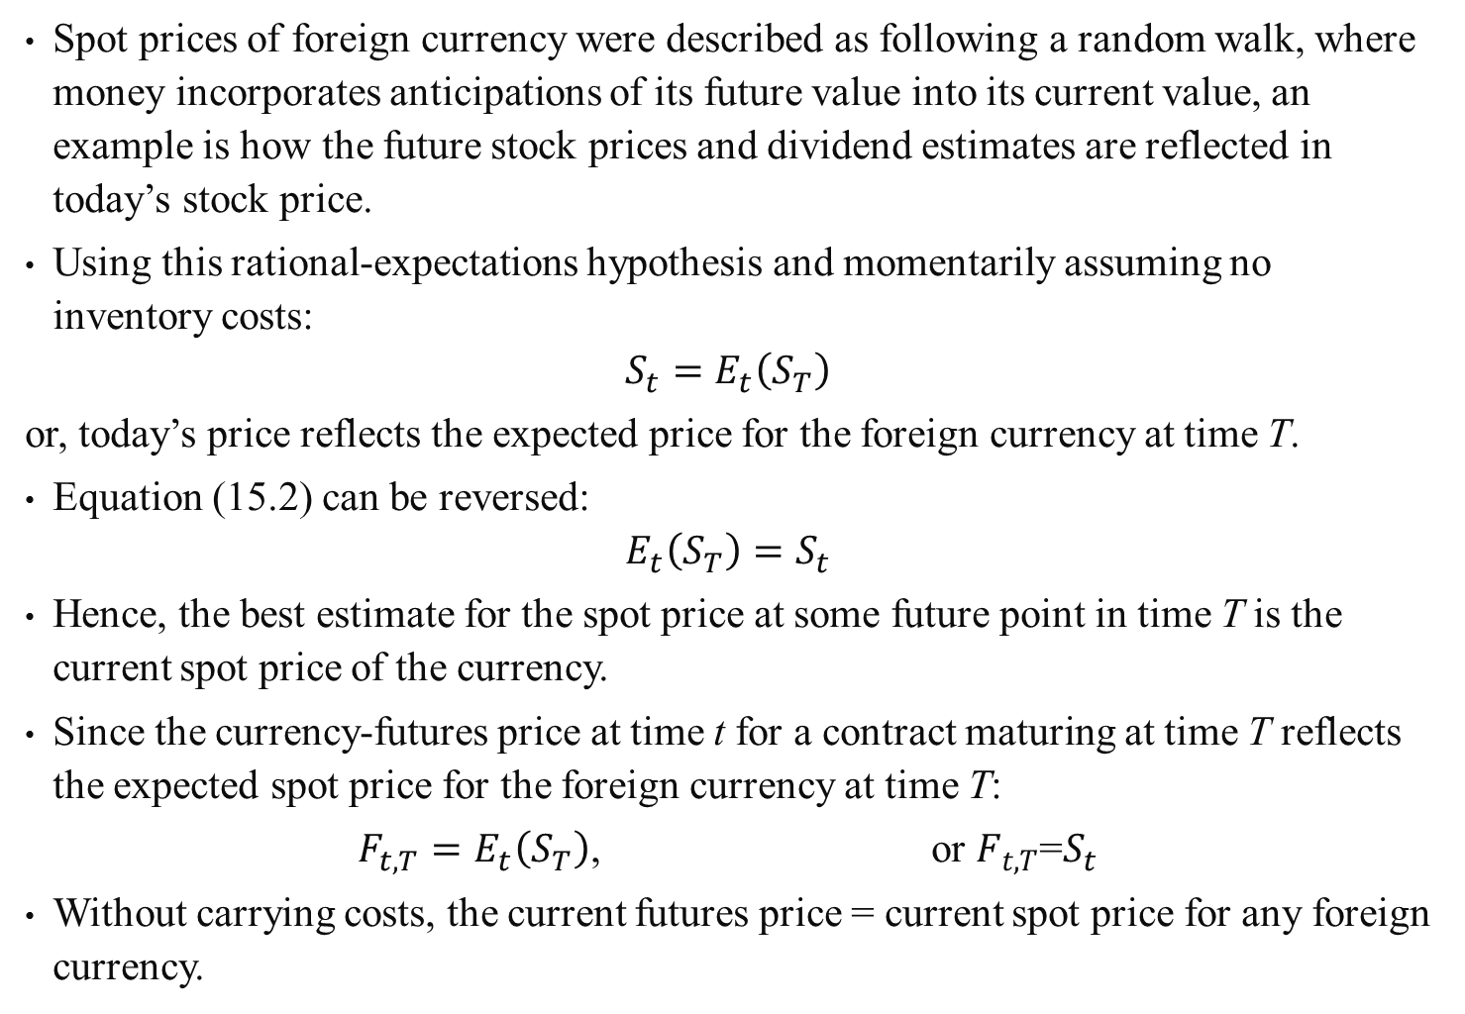
Spot prices of foreign currency were described as following a random walk, where money incorporates anticipations of its future value into its current value, an example is how the future stock prices and dividend estimates are reflected in today’s stock price.
Using this rational-expectations hypothesis and momentarily assuming no inventory costs:
$$S_{t}=E_{t}\left(S_{T}\right)$$
or, today’s price reflects the expected price for the foreign currency at time T.
Equation (15.2) can be reversed:
$$E_{t}\left(S_{T}\right)=S_{t}$$
Hence, the best estimate for the spot price at some future point in time T is the current spot price of the currency.
Since the currency-futures price at time t for a contract maturing at time T reflects the expected spot price for the foreign currency at time T:
$F_{t,T}=E_{t}\left(S_{T}\right)$, or $F_{t,T}$=$S_{t}$
Without carrying costs, the current futures price = current spot price for any foreign currency.
(15.2)
(15.3)
(15.4)

Slide 18
Sample Problem 15.3
Transactions and closing position value:
January 1, 1989
Buy $1.3 million worth of pounds.
Invest proceeds at 10-% British rate.
Sell ￡1 million worth of futures at $1.33.
January 1, 1990
Proceeds from earned interest $150,000
Deliver ￡1 million against short futures
Position at $1.33/￡1.00 $1,330,000
Gross revenue $1,460,000
Less initial investment $1,300,000
Net profit $160,000
Annual return 12.3%

Slide 19
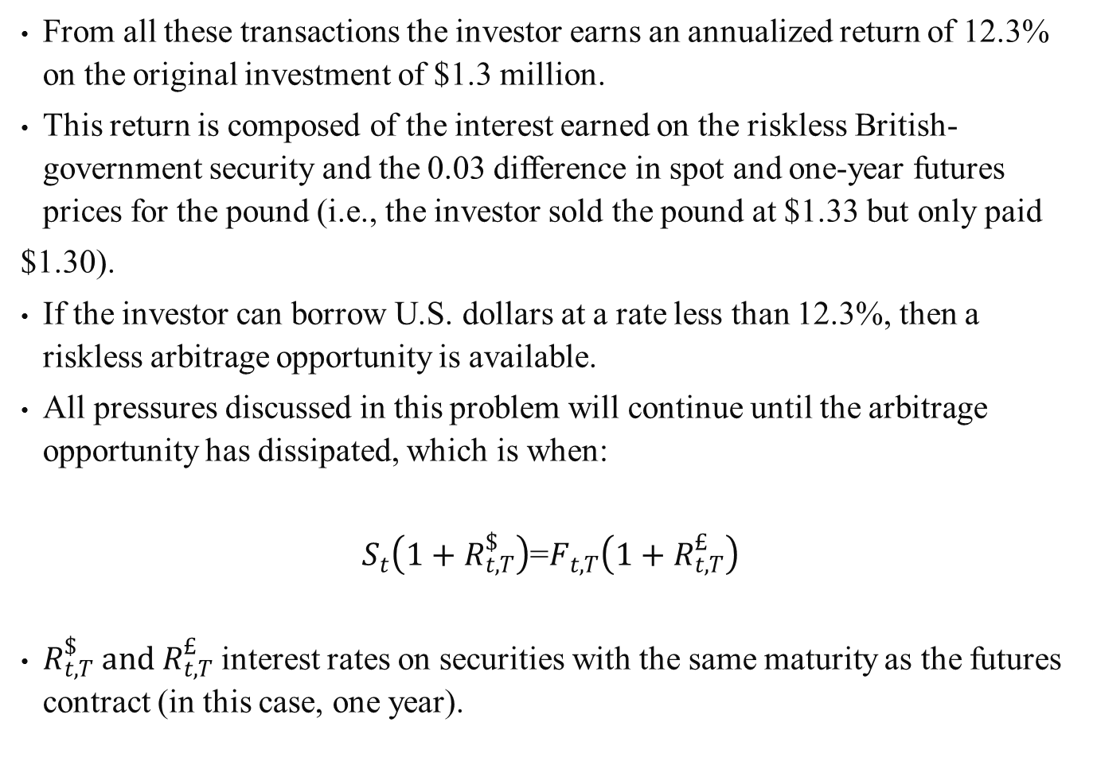
From all these transactions the investor earns an annualized return of 12.3% on the original investment of $1.3 million.
This return is composed of the interest earned on the riskless British-government security and the 0.03 difference in spot and one-year futures prices for the pound (i.e., the investor sold the pound at $1.33 but only paid
$1.30).
If the investor can borrow U.S. dollars at a rate less than 12.3%, then a riskless arbitrage opportunity is available.
All pressures discussed in this problem will continue until the arbitrage opportunity has dissipated, which is when:
$S_{t}\left(1+R_{t,T}^{\$}\right)$=$F_{t,T}\left(1+R_{t,T}^{£}\right)$
$R_{t,T}^{\$} and{ R}_{t,T}^{£}$ interest rates on securities with the same maturity as the futures contract (in this case, one year).
(15.6)

Slide 20
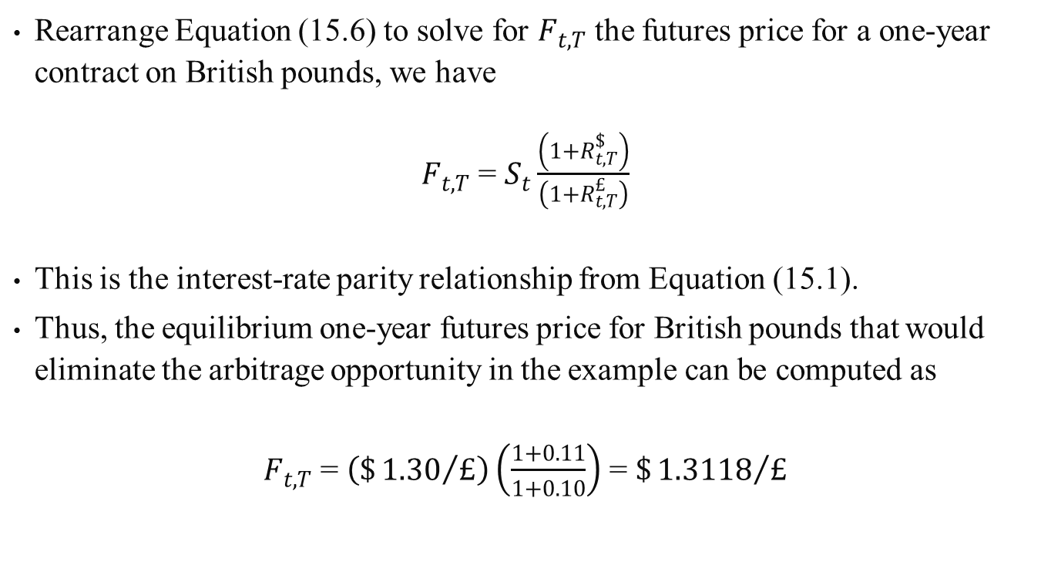
Rearrange Equation (15.6) to solve for $F_{t,T}$ the futures price for a one-year contract on British pounds, we have
$F_{t,T}$ = $S_{t}\frac{\left(1+R_{t,T}^{\$}\right)}{\left(1+R_{t,T}^{£}\right)}$
This is the interest-rate parity relationship from Equation (15.1).
Thus, the equilibrium one-year futures price for British pounds that would eliminate the arbitrage opportunity in the example can be computed as
$F_{t,T}$ = $\left(\${1.30}/£\right)\left(\frac{1+0.11}{1+0.10}\right)$ = $\${1.3118}/£$
(15.7)

Slide 21
15.3.2 The Traditional Theory of International Party
The writings of Keynes, Cassel, and Irving Fisher implicitly require four conditions for international currency parity.
Financial markets are perfect. There are no controls, transaction costs, taxes, and so on.
Goods markets are perfect. Shipment of goods anywhere in the world is costless.
There is a single consumption good common to everyone.
The future is known with certainty.

Slide 22
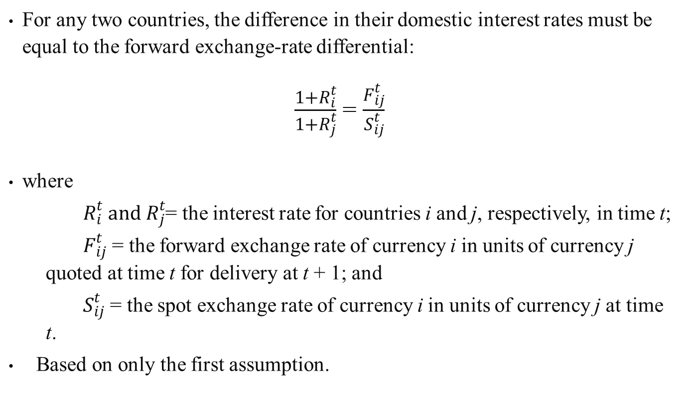
15.3.2.1 Interest-Rate Parity
For any two countries, the difference in their domestic interest rates must be equal to the forward exchange-rate differential:
$\frac{1+R_{i}^{t}}{1+R_{j}^{t}}$ = $\frac{F_{ij}^{t}}{S_{ij}^{t}}$
where
$R_{i}^{t} and R_{j}^{t}$= the interest rate for countries i and j, respectively, in time t;
  $F_{ij}^{t}$ = the forward exchange rate of currency i in units of currency j quoted at time t for delivery at t + 1; and
  $S_{ij}^{t}$ = the spot exchange rate of currency i in units of currency j at time t.
Based on only the first assumption.

Slide 23
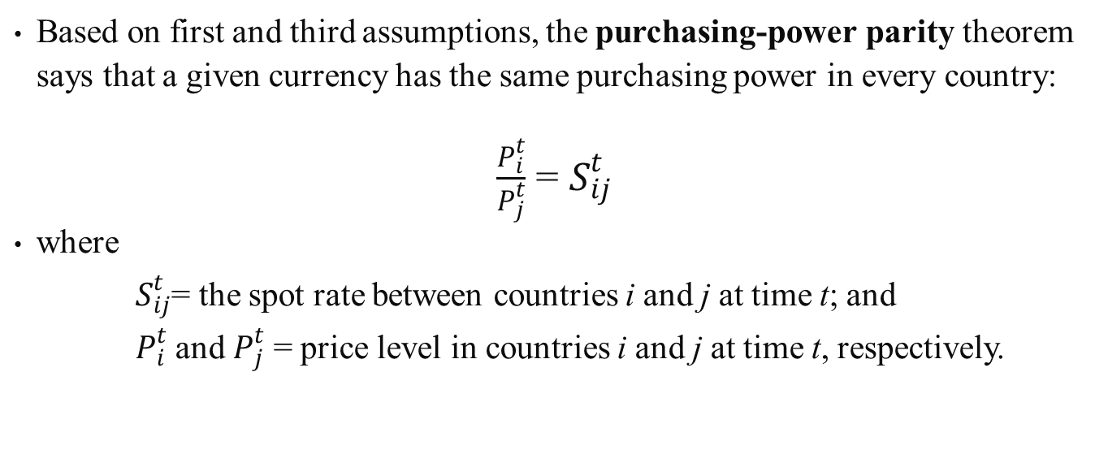
15.3.2.2 Purchasing-Power Parity
Based on first and third assumptions, the purchasing-power parity theorem says that a given currency has the same purchasing power in every country:
$\frac{P_{i}^{t}}{P_{j}^{t}}$ = $S_{ij}^{t}$
where
  $S_{ij}^{t}$= the spot rate between countries i and j at time t; and
  $P_{i}^{t}$ and $P_{j}^{t}$ = price level in countries i and j at time t, respectively.

Slide 24
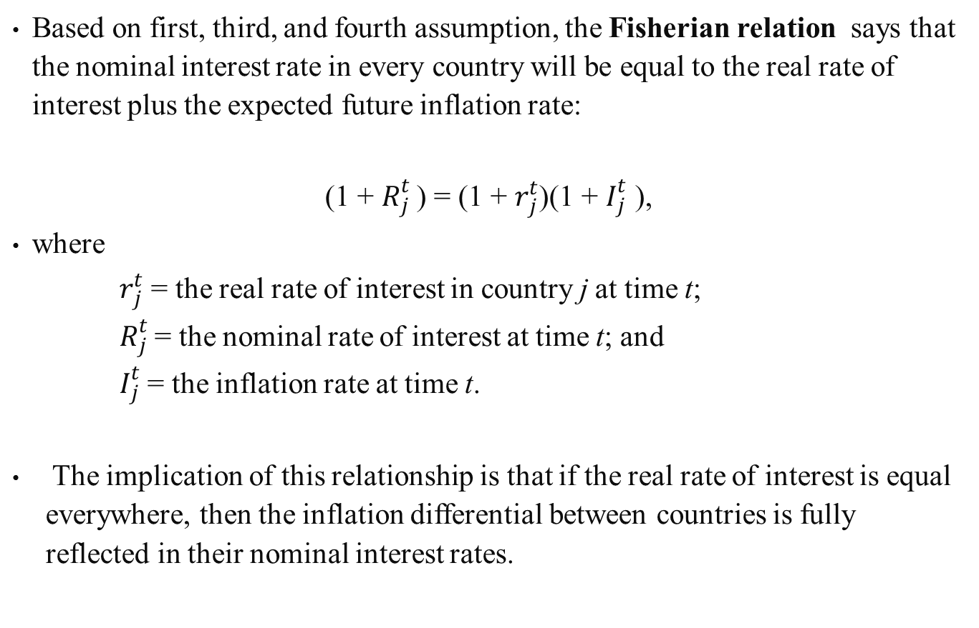
15.3.2.3 Fisherian Relation
Based on first, third, and fourth assumption, the Fisherian relation says that the nominal interest rate in every country will be equal to the real rate of interest plus the expected future inflation rate:
(1 +$R_{j}^{t}$ ) = (1 + $r_{j}^{t}$)(1 + $I_{j}^{t}$ ),
where
  $r_{j}^{t}$ = the real rate of interest in country j at time t;
  $R_{j}^{t}$= the nominal rate of interest at time t; and
  $I_{j}^{t}$= the inflation rate at time t.
The implication of this relationship is that if the real rate of interest is equal everywhere, then the inflation differential between countries is fully reflected in their nominal interest rates.

Slide 25
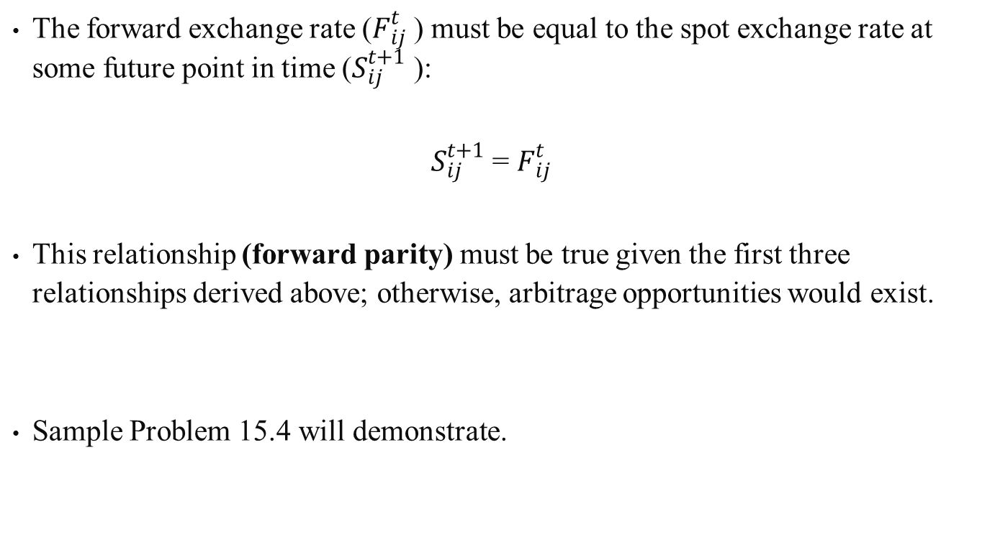
15.3.2.4 Forward Parity
The forward exchange rate ($F_{ij}^{t}$ ) must be equal to the spot exchange rate at some future point in time ($S_{ij}^{t+1}$ ):
$S_{ij}^{t+1}$ = $F_{ij}^{t}$
This relationship (forward parity) must be true given the first three relationships derived above; otherwise, arbitrage opportunities would exist.
Sample Problem 15.4 will demonstrate.

Slide 26
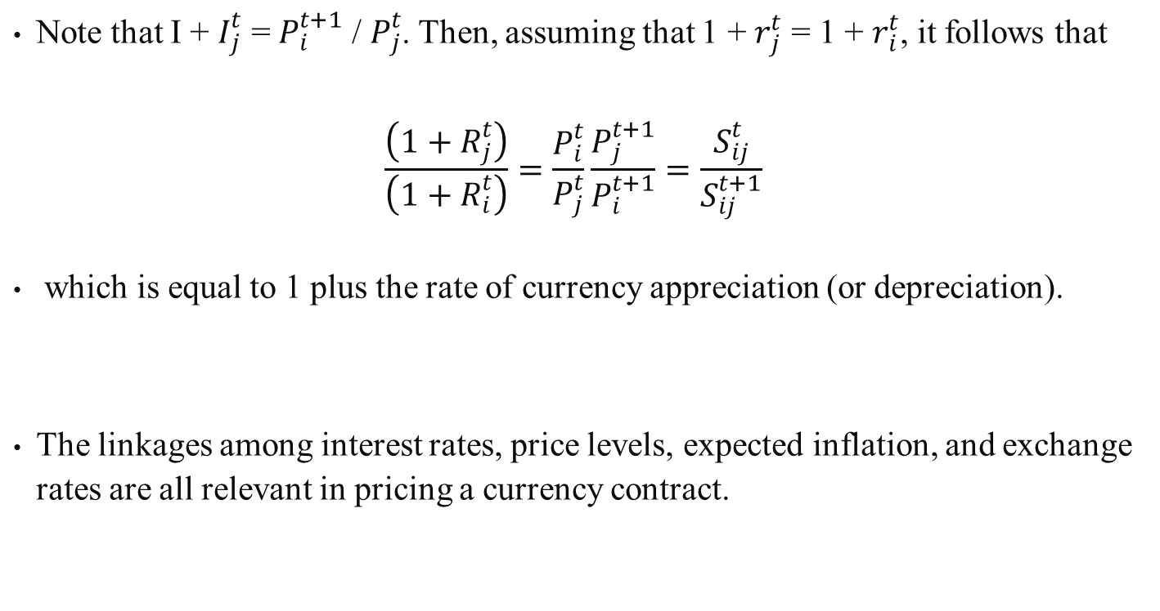
Sample Problem 15.4
Note that I + $I_{j}^{t}$ = $P_{i}^{t+1}$ / $P_{j}^{t}$. Then, assuming that 1 + $r_{j}^{t}$ = 1 + $r_{i}^{t}$, it follows that
$$\frac{\left(1+R_{j}^{t}\right)}{\left(1+R_{i}^{t}\right)}=\frac{P_{i}^{t}}{P_{j}^{t}}\frac{P_{j}^{t+1}}{P_{i}^{t+1}}=\frac{S_{ij}^{t}}{S_{ij}^{t+1}}$$
which is equal to 1 plus the rate of currency appreciation (or depreciation).
The linkages among interest rates, price levels, expected inflation, and exchange rates are all relevant in pricing a currency contract.

Slide 27
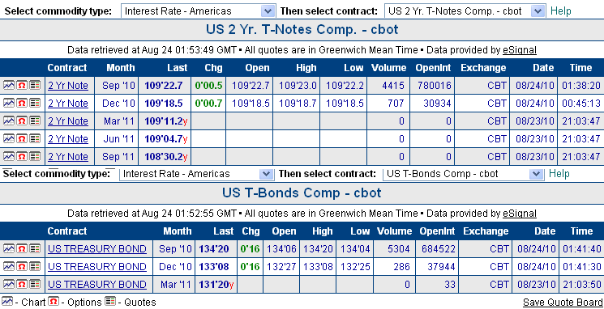
15.3.3 Interest-Rate Futures
Financial futures-related, interest-rate-sensitive instruments such as US Treasury debt futures are the focus of this section.
Sample daily price quotations for interest-rate futures are shown in Figure 15.5.
Figure 15.5 Interest Rate Futures Data Source: The Wall Street Journal, August 24, 2010

Slide 28
15.3.4 U.S. Treasury Debt Futures
The US Treasury issues debt securities, which are backed by the government and are considered to be free of default risk, to finance government operations and the federal deficit.
The debt can be classified into 3 types based on its time to maturity:
  US Treasury bills (T-bills), with a time to maturity of one year
  US Treasury notes (T-notes), with a time to maturity of between one year and 10 years
  US Treasury bonds (T-bonds), with a time to maturity of more than 10 years
One of the attractive features of US Treasury securities is that they can easily be resold, because a strong secondary market exists for them.
T-bill futures are traded at the IMM, while T-notes futures and T-bond futures are offered by the CBT.

Slide 29
15.3.4.1 Characteristics of T-Bill Futures
T-bills (as well as T-notes and T-bonds) are traditionally quoted in terms of their yield to maturity.
Since interest rates (or yields) and prices of debt securities move inversely, the common perception that a long position makes money as the quoted values increase does not apply to such instruments.
The IMM quote system for its interest-rate securities is essentially an index based on the difference between the actual T-bill price and 100.00.
When the IMM T-bill futures contract reaches the maturity date, the seller of the contract may have to make delivery of the underlying T-bill.

Slide 30
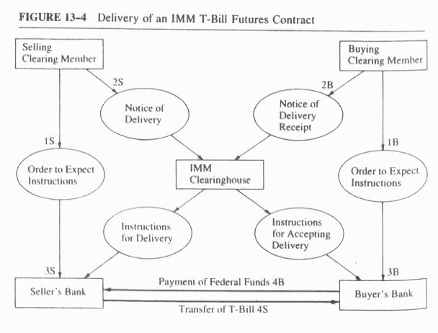
Figure 15.6 Delivery of an IMM T-Bill Futures Contract
Figure 15.6 illustrates the delivery process.
The major function of the clearinghouse is to see that the transfer and payment (4B and 4S in Figure 15-6) take place in a timely fashion.
Should either party default in any way, the clearinghouse will complete the transaction and then seek to recover from the defaulting party.

Slide 31
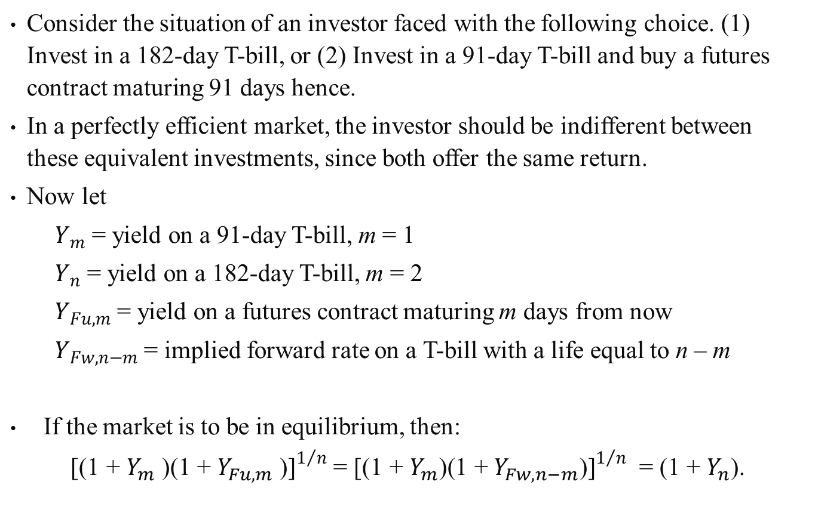
15.3.4.2 Pricing T-Bill Futures Contracts
Consider the situation of an investor faced with the following choice. (1) Invest in a 182-day T-bill, or (2) Invest in a 91-day T-bill and buy a futures contract maturing 91 days hence.
In a perfectly efficient market, the investor should be indifferent between these equivalent investments, since both offer the same return.
Now let
  $Y_{m}$ = yield on a 91-day T-bill, m = 1
  $Y_{n}$ = yield on a 182-day T-bill, m = 2
  $Y_{Fu,m}$ = yield on a futures contract maturing m days from now
  $Y_{Fw,n−m}$ = implied forward rate on a T-bill with a life equal to n – m
If the market is to be in equilibrium, then:
${\text{[(1 + }Y_{m}\text{ )(1 + }Y_{Fu,m}\text{ )]}}^{1/n}$ = ${\text{[(1 + }Y_{m}\text{)(1 + }Y_{Fw,n−m}\text{)]}}^{1/n}$ = (1 + $Y_{n}$).
(15.8)

Slide 32
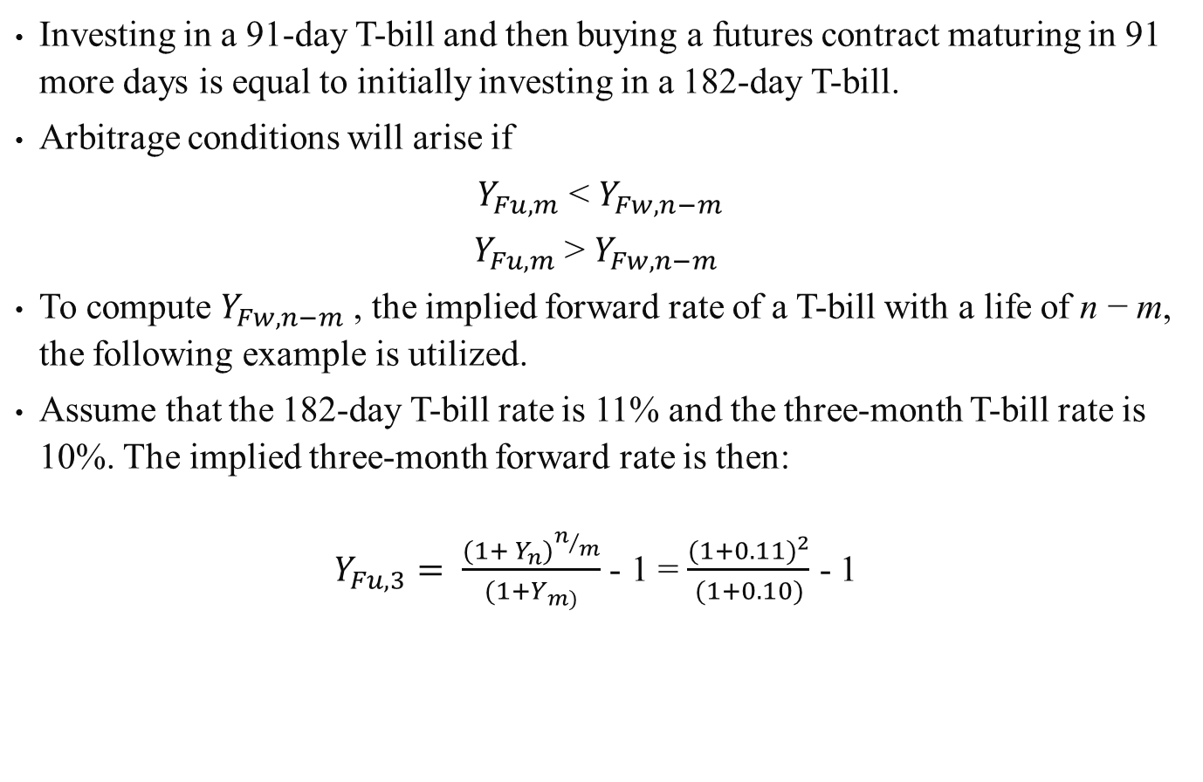
Investing in a 91-day T-bill and then buying a futures contract maturing in 91 more days is equal to initially investing in a 182-day T-bill.
Arbitrage conditions will arise if
$Y_{Fu,m}$ < $Y_{Fw,n−m}$
$Y_{Fu,m}$ > $Y_{Fw,n−m}$
To compute $Y_{Fw,n−m}$ , the implied forward rate of a T-bill with a life of n − m, the following example is utilized.
Assume that the 182-day T-bill rate is 11% and the three-month T-bill rate is 10%. The implied three-month forward rate is then:
$Y_{Fu,3}= \frac{{(1+ Y_{n})}^{n/m}}{(1+Y_{m)}}$ - 1 = $\frac{{(1+0.11)}^{2}}{(1+0.10)}$ - 1
(15.9)

Slide 33
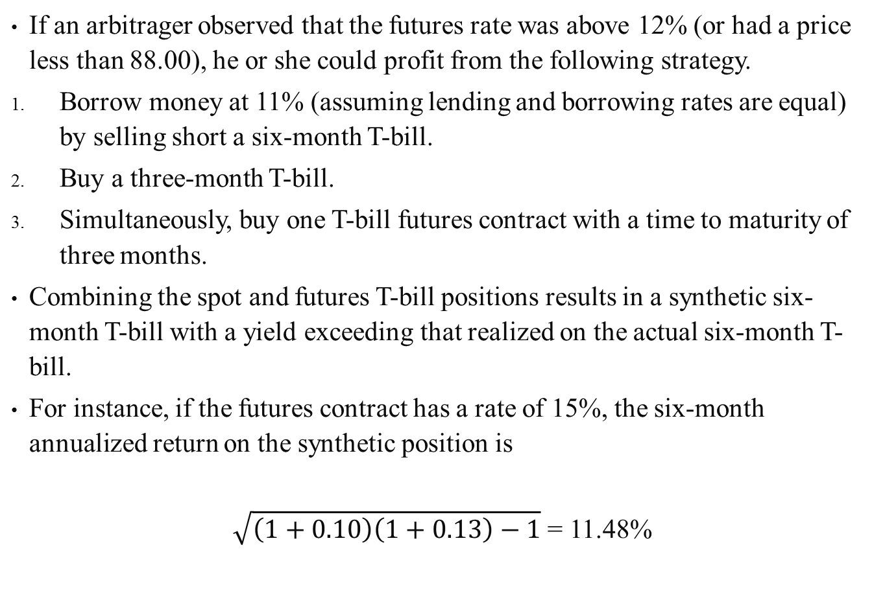
If an arbitrager observed that the futures rate was above 12% (or had a price less than 88.00), he or she could profit from the following strategy.
Borrow money at 11% (assuming lending and borrowing rates are equal) by selling short a six-month T-bill.
Buy a three-month T-bill.
Simultaneously, buy one T-bill futures contract with a time to maturity of three months.
Combining the spot and futures T-bill positions results in a synthetic six-month T-bill with a yield exceeding that realized on the actual six-month T-bill.
For instance, if the futures contract has a rate of 15%, the six-month annualized return on the synthetic position is
$\sqrt{\left(1+0.10\right)\left(1+0.13\right)−1}$ = 11.48%

Slide 34
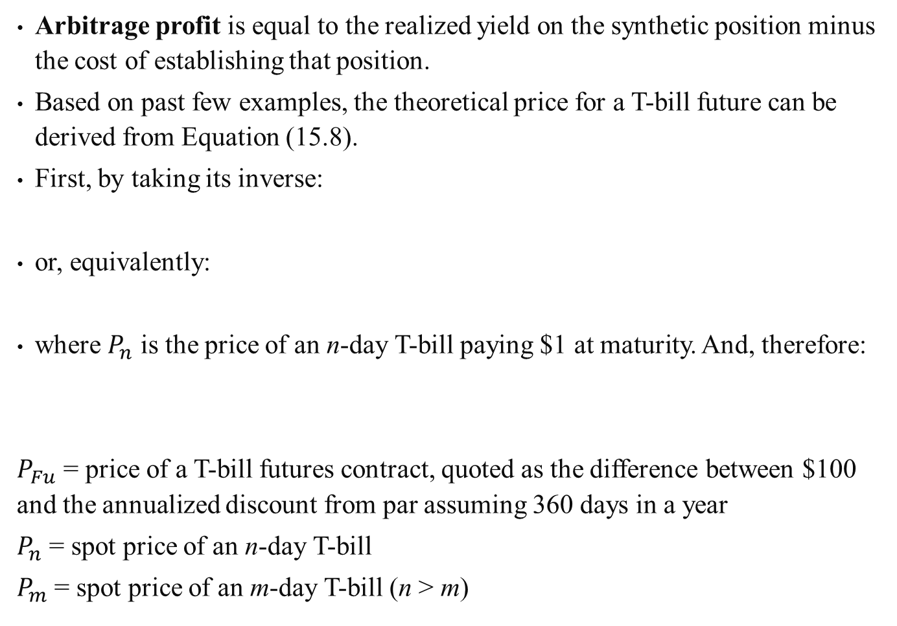
Arbitrage profit is equal to the realized yield on the synthetic position minus the cost of establishing that position.
Based on past few examples, the theoretical price for a T-bill future can be derived from Equation (15.8).
First, by taking its inverse:
or, equivalently:
where $P_{n}$ is the price of an n-day T-bill paying $1 at maturity. And, therefore:
$P_{Fu}$ = price of a T-bill futures contract, quoted as the difference between $100 and the annualized discount from par assuming 360 days in a year
$P_{n}$ = spot price of an n-day T-bill
$P_{m}$ = spot price of an m-day T-bill (n > m)
(15.11)
(15.12)
(15.13)

Slide 35
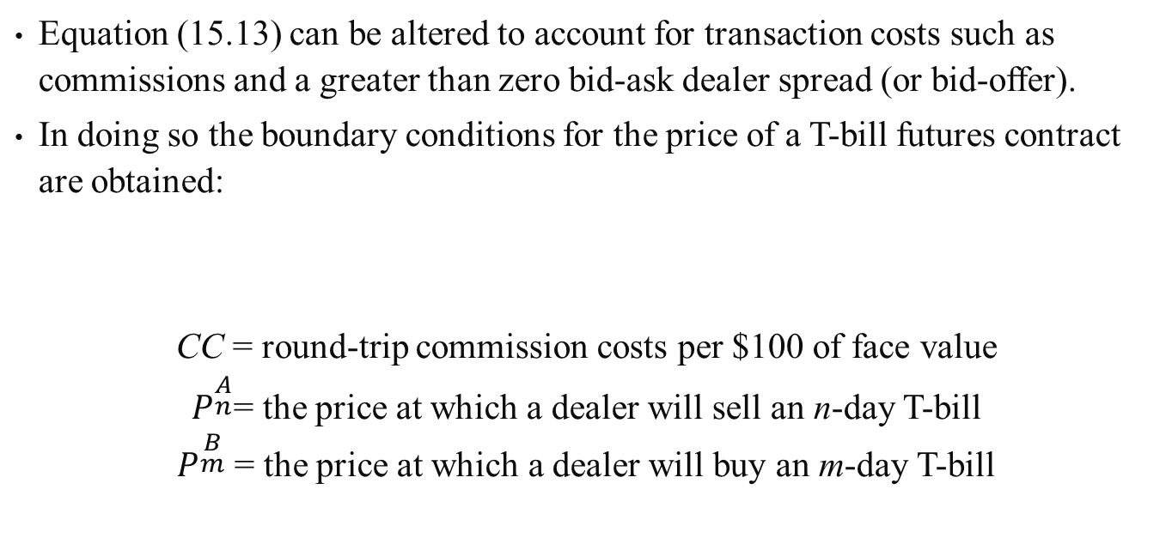
Equation (15.13) can be altered to account for transaction costs such as commissions and a greater than zero bid-ask dealer spread (or bid-offer).
In doing so the boundary conditions for the price of a T-bill futures contract are obtained:
CC = round-trip commission costs per $100 of face value
$P^{\begin{aligned}A \\ n\end{aligned}}$= the price at which a dealer will sell an n-day T-bill
$P^{\begin{aligned}B \\ m\end{aligned}}$ = the price at which a dealer will buy an m-day T-bill

Slide 36
Sample Problem 15.5
Using Equation (15.13), compute the theoretical futures price for the IMM December 1989 contract as of June 7, 1988.
Assume that the deliverable bill (in period) against the futures contract is the T-bill maturing March 21, 1989, with a bid price of 10.67 and ask price of 10.59.
Also assume $0.004 per $100 of face value as the round-trip commission cost.

Slide 37
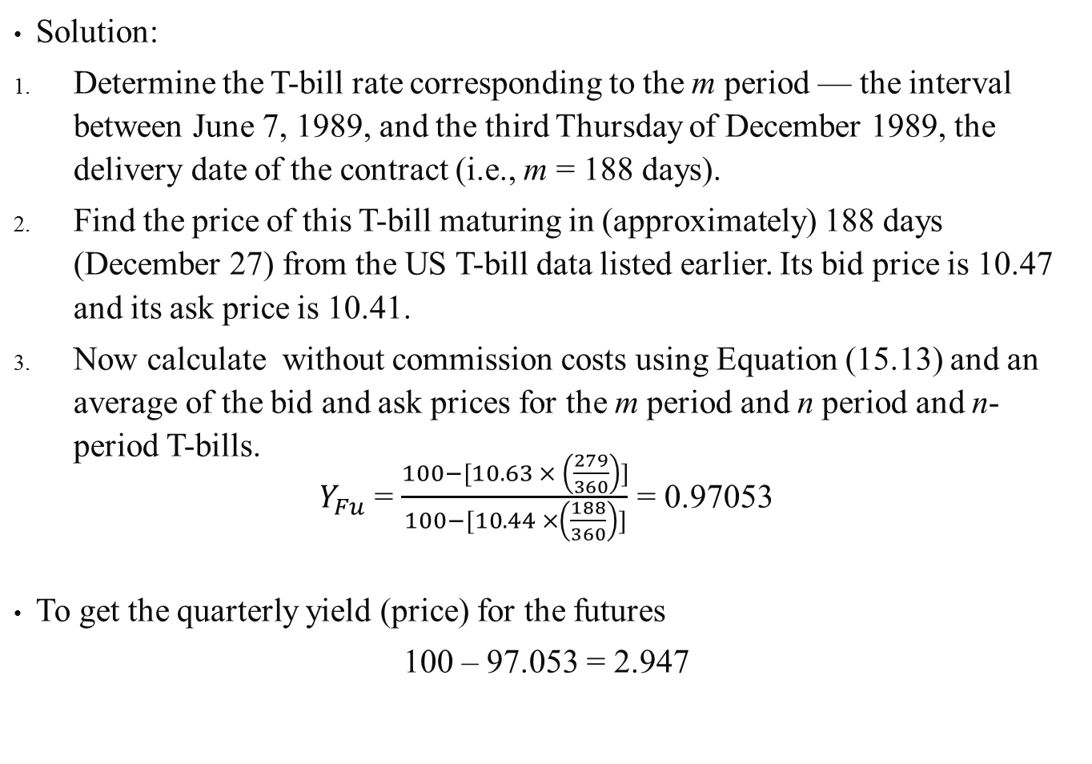
Solution:
Determine the T-bill rate corresponding to the m period — the interval between June 7, 1989, and the third Thursday of December 1989, the delivery date of the contract (i.e., m = 188 days).
Find the price of this T-bill maturing in (approximately) 188 days (December 27) from the US T-bill data listed earlier. Its bid price is 10.47 and its ask price is 10.41.
Now calculate without commission costs using Equation (15.13) and an average of the bid and ask prices for the m period and n period and n-period T-bills.
$Y_{Fu}$ = $\frac{100−[10.63 × \left(\frac{279}{360}\right)]}{100−[10.44 ×\left(\frac{188}{360}\right)]}$ = 0.97053
To get the quarterly yield (price) for the futures
100 – 97.053 = 2.947

Slide 38
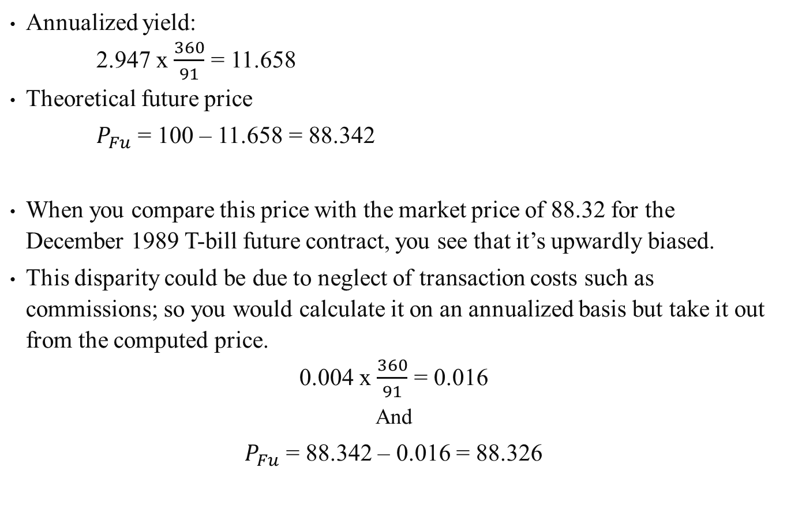
Annualized yield:
2.947 x $\frac{360}{91}$ = 11.658
Theoretical future price
$P_{Fu}$ = 100 – 11.658 = 88.342
When you compare this price with the market price of 88.32 for the December 1989 T-bill future contract, you see that it’s upwardly biased.
This disparity could be due to neglect of transaction costs such as commissions; so you would calculate it on an annualized basis but take it out from the computed price.
0.004 x $\frac{360}{91}$ = 0.016
And
$P_{Fu}$ = 88.342 – 0.016 = 88.326

Slide 39
15.4.3 Characteristics of T-Note and T-Bond Futures
T-bond futures as on the CBT require the delivery of a US T-bond with a face value of $100,000 and maturing at least 15 years from maturity.
Prices are quoted as a percentage of par in the same way as GNMA futures prices are quoted.
The depth of trading in this contract is revealed by the existence of outstanding T-bond contracts with maturities nearly three years into the future.
T-note futures is growing in popularity and also offered by CBT.
One of the underlying stimuli for its success is the growing proportion of total Treasury debt, which is represented by T-note securities.
The T-note futures contract specifies the delivery of a US Treasury note with a face value of $100,000 and a maturity of no less than 6.5 years and no more than 10 years form the date of delivery.

Slide 40
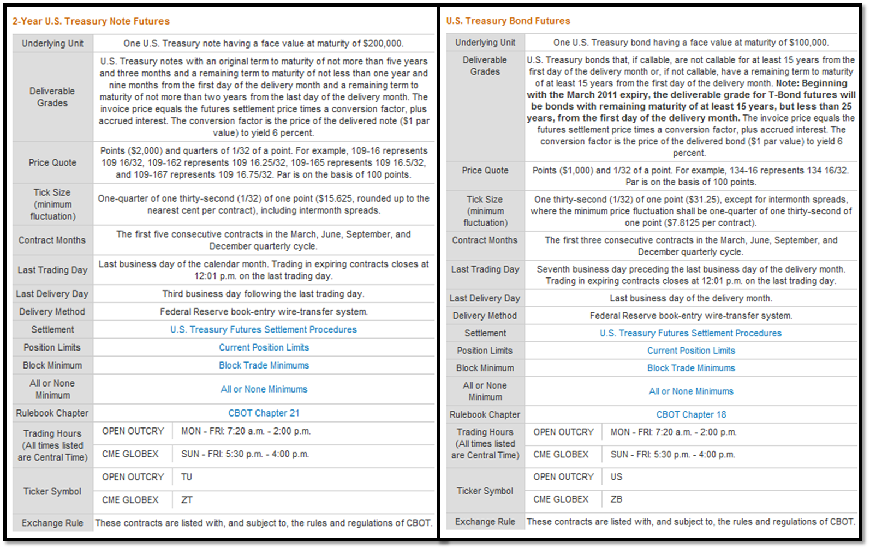
Figure 15.7 Contract Specification of T-Bonds and T-Notes Futures
Source: CME Group, U.S. Treasury Bond Futures and 2-Year U.S. Treasury Note Futures

Slide 41
15.3.5 The Eurodollar Futures Market
A Eurodollar is any dollar on deposit outside the United States.
An important aspect of these deposits is that, because of their location outside of the United States they do not fall under US jurisdiction.
Therefore, Eurodollars are not governed by the same regulations that apply to domestic deposits, set by the Federal Reserve.
15.3.5.1 Evolution
The Eurodollar market evolved in the 1950s in response to Federal Reserve restrictions on the maximum allowable interest rate to be paid on a deposit.
Because Foreign merchants didn’t have this restriction, they were earning more money, so US banks eventually allowed their London branches to enter that market and take in dollar deposits.

Slide 42
As the Eurodollar markets developed and matured, formal lines of credit and sovereign risk limitations were formalized by participants.
A bank lending funds in the Eurodollar market is exposed to essentially three risks:
The interest-rate risk involved with a Eurodollar loan is the same as before
Credit risk is a larger concern in the Eurodollar market because of the difficulties that can arise when trying to analyze a foreign borrower’s financial position
Sovereign risk is unique to the arena of international lending; it refers to the unfavorable consequences that can have impact on a bank’s investment if a foreign government is overthrown, becomes economically unstable, or passes detrimental regulations affecting the movement of funds
Most banks will have sovereign-risk limitations restricting the total amount placed on deposit with (or loaned to) institutions in any one country.

Slide 43
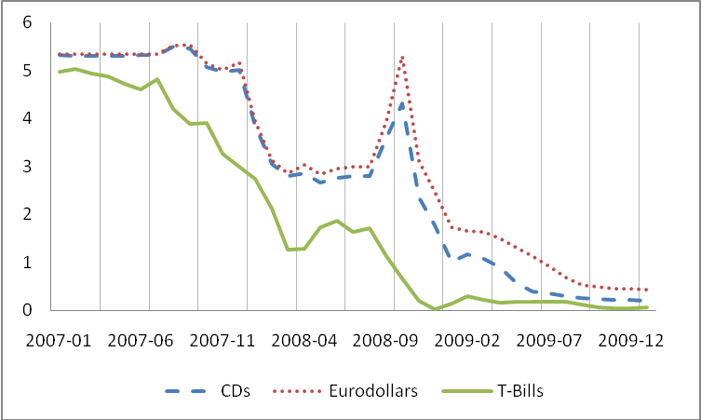
The relationship between three-month rates offered on Eurodollar deposits (as measured by the London Interbank Offered Rate (LIBOR) rate), US CDs, and US T-bills can be visualized for a two-year period in Figure 15.8.
Few things on the relationships can be noted from the chart.
  Eurodollar rates are higher than CD rates, which are higher than T-bill rates — a ranking consistent with the level of risk inherent in these securities.
  The variation in the spread between Eurodollar rates and CD rates are affected by a variety of unpredictable market forces and decisions of US and foreign government.
  Unlike the behavior of the spread between Eurodollar and CD rates, the Eurodollar rates and Treasury rates have a less predictable tendency to rise together as rates rise.
Figure 15.8
Three-Month Rates on U.S. CDs, U.S. T-Bills, and Eurodollar deposits,
Jan 2007 – Jan 2010 (monthly data)
Source: Board of Governors of the Federal Reserve System
https://www.federalreserve.gov/default.htm

Slide 44
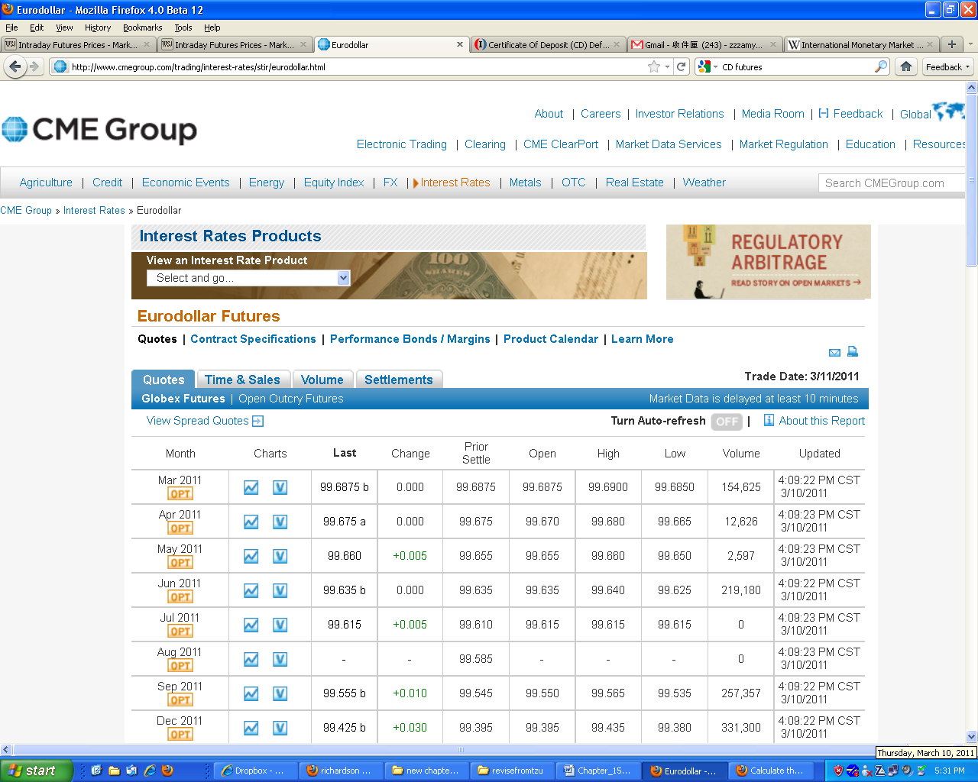
15.3.5.2 Eurodollar Futures
Eurodollar futures are traded on the Chicago Mercantile Exchange (CME) (Figure 15-9) and the London International Financial Exchange (LIFFE).
The primary use of Eurodollar futures as a hedging vehicle is similar to that of other hedging vehicles; they are capable of protecting against detrimental changes in interest rates.
Figure 15.9 Eurodollar Futures Quotes
Source: CME Group, March 10, 2011, http://www.cmegroup.com/

Slide 45
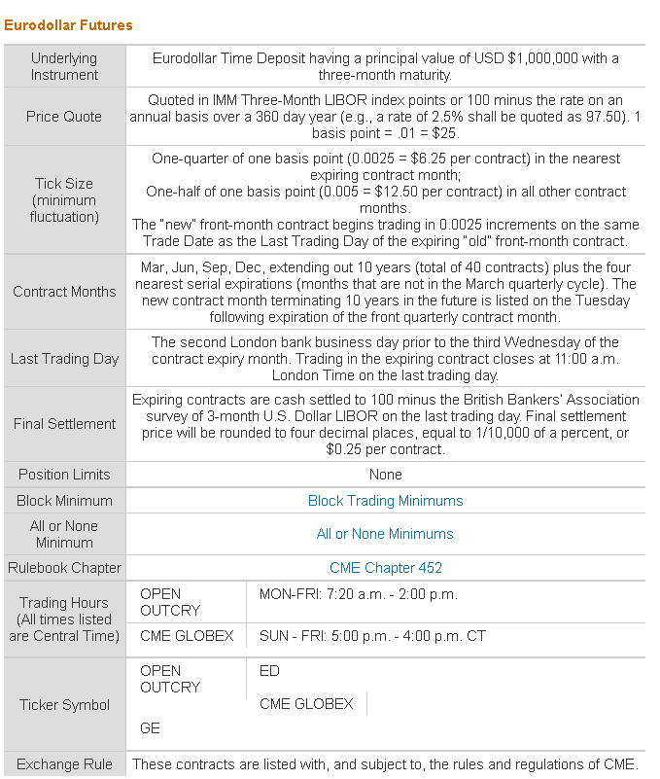
The Eurodollar futures contract has as its underlying instrument a three-month Eurodollar time deposit in the amount of $1 million as shown in Figure 15.10.
Figure 15.10 Eurodollar Futures Contract
Source: CME Group
http://www.cmegroup.com/

Slide 46
Sample Problem 15.7
Suppose that the London branch of a US bank anticipates a decline in rates from September 16 to December 16.
Furthermore, on June 12, the bank makes a three-month loan in the Eurodollar market and finances the loan with the funds from a six-month Eurodollar CD.
The process in which the bank loans and borrow money makes it prone to reinvestment-rate risk.
To alleviate the problem, the bank chooses to fix the reinvestment rate for the latter three-month investment horizon through a long position in Eurodollar Futures.
On June 12, the Eurodollar contract for September delivery was priced at an index of 86.53 (100% − 13.47%), the six-month Eurodollar CD rate was 13%, and the initial three-month loan was made at the LIBOR rate of 14%.
Table 15.3 summarizes the transactions results.

Slide 47
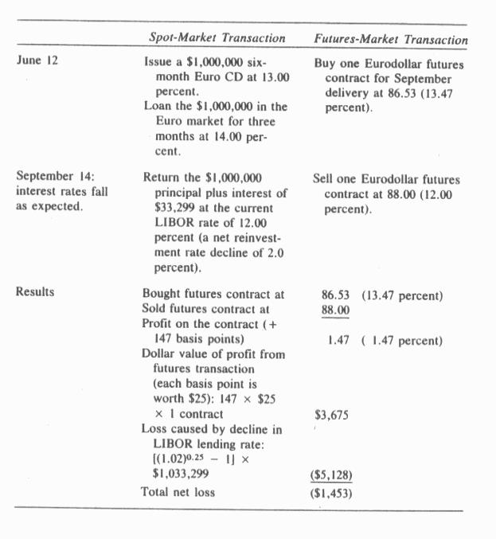
As Table 15.3 indicates, the use of the futures position to hedge the interest-rate risk allows the bank to reduce its reinvestment rate loss by 71%.
Table 15.3 Hedging Interest Rate Risk by Future Market

Slide 48
15.4 Stock-Index Futures
Stock-index futures offer the investor a medium for expressing an opinion on the general course of the market, and these contracts can be used by portfolio managers in a variety of ways to alter the risk-return distribution of their stock portfolios.
The calculation of the market value for a stock-index futures contract on any given day is simply a matter of multiplying the current index price for the contract by the appropriate dollar amount.
Each of the US stock-index futures is listed in order of market popularity.
Each contract bought and sold on a particular day is included in the calculation of daily trading volume.
Open interest represent the number of open contract positions on a given day with only one side counted — that is, when the buyer and seller make their transaction, only one position is counted as being open, not two.

Slide 49
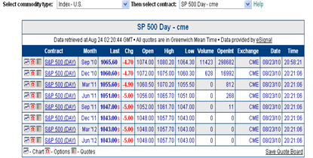
Figure 15.11 shows prices, volume, and open interest for S&P 500 indexes future.
Figure 15.11 S&P 500 Future Quotes
Source: The Wall Street Journal, August 23, 2010

Slide 50
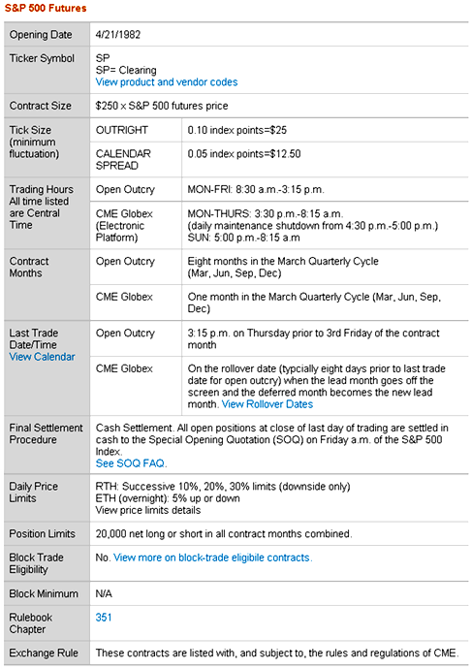
Figure 15.12 S&P 500 Future Contract
Source: GME Group, http://www.cmegroup.com/

Slide 51
The importance of trading-volume data is that is represents the relative liquidity of the various index-futures contracts.
This is important information for users (particularly hedgers) trying to decide which would best suit their purposes.
The higher a contract’s liquidity, the easier to enter and exit positions and to trade in larger lots of contracts without overly impacting price.
All index-futures contracts call for cash settlement or delivery.
This means that on the expiration date of the contract, no security or portfolio of securities is delivered; instead, the difference in the value of the contract between buying and selling is delivered in cash.

Slide 52
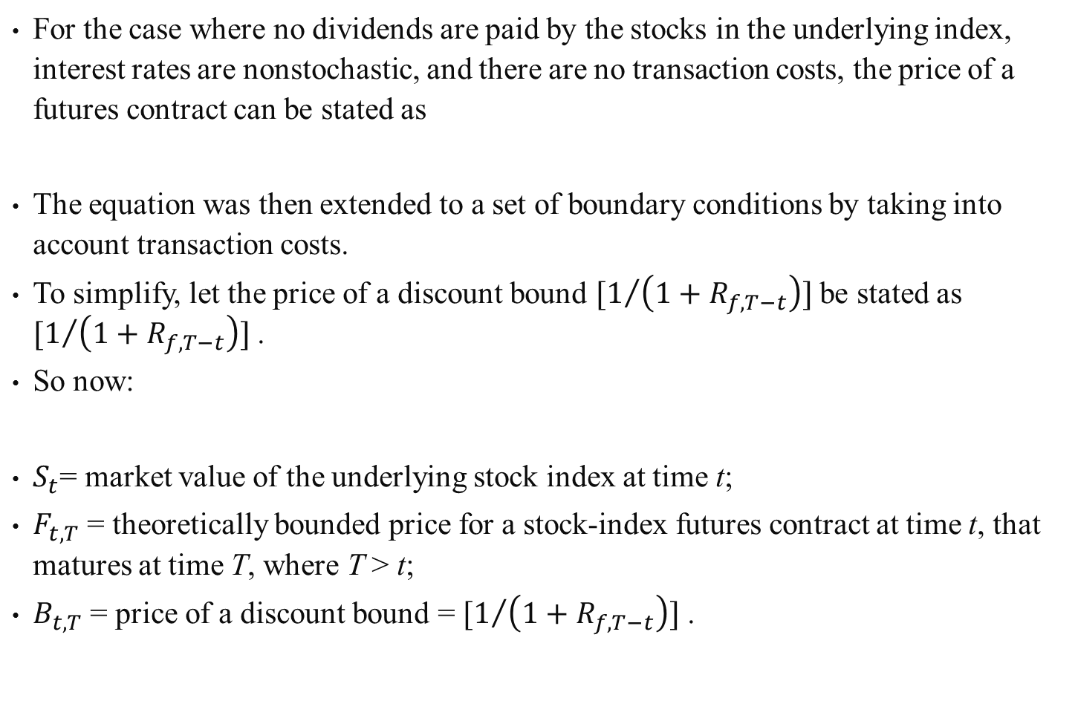
15.4.1 Pricing Stock-Index Futures Contracts
For the case where no dividends are paid by the stocks in the underlying index, interest rates are nonstochastic, and there are no transaction costs, the price of a futures contract can be stated as
The equation was then extended to a set of boundary conditions by taking into account transaction costs.
To simplify, let the price of a discount bound $[1/{\left(1+R_{f,T−t}\right)}]$ be stated as $[1/{\left(1+R_{f,T−t}\right)}]$ .
So now:
$S_{t}$= market value of the underlying stock index at time t;
$F_{t,T}$ = theoretically bounded price for a stock-index futures contract at time t, that matures at time T, where T > t;
$B_{t,T}$ = price of a discount bound = $[1/{\left(1+R_{f,T−t}\right)}]$ .
(15.14)
(15.15)

Slide 53
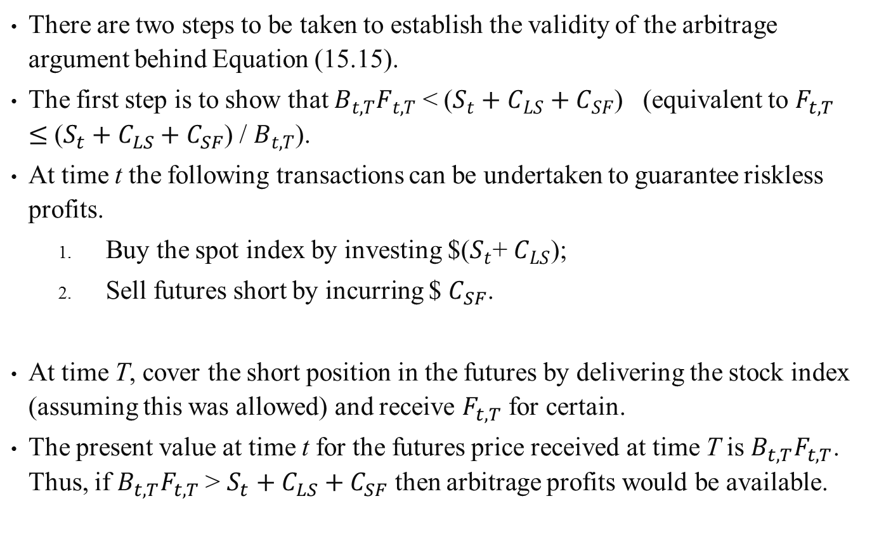
There are two steps to be taken to establish the validity of the arbitrage argument behind Equation (15.15).
The first step is to show that $B_{t,T}F_{t,T}$ < ($S_{t}+C_{LS}+C_{SF}$) (equivalent to $F_{t,T}$ $≤$ ($S_{t}+C_{LS}+C_{SF}$) / $B_{t,T}$).
At time t the following transactions can be undertaken to guarantee riskless profits.
  Buy the spot index by investing $($S_{t}$+ $C_{LS}$);
  Sell futures short by incurring $ $C_{SF}$.
At time T, cover the short position in the futures by delivering the stock index (assuming this was allowed) and receive $F_{t,T}$ for certain.
The present value at time t for the futures price received at time T is $B_{t,T}F_{t,T}$. Thus, if $B_{t,T}F_{t,T}$> $S_{t}+C_{LS}+C_{SF}$ then arbitrage profits would be available.

Slide 54
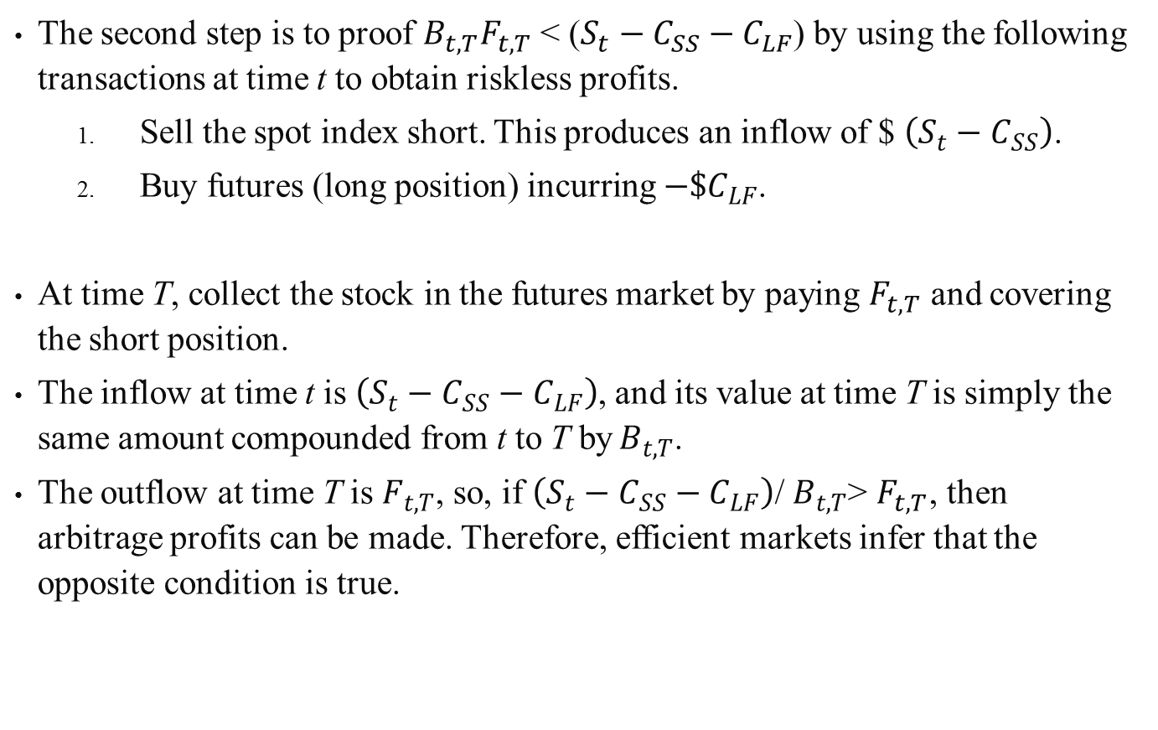
The second step is to proof $B_{t,T}F_{t,T}$ < ($S_{t}−C_{SS}−C_{LF}$) by using the following transactions at time t to obtain riskless profits.
  Sell the spot index short. This produces an inflow of $ $\left(S_{t}−C_{SS}\right)$.
  Buy futures (long position) incurring $−\$C_{LF}$.
At time T, collect the stock in the futures market by paying $F_{t,T}$ and covering the short position.
The inflow at time t is $\left(S_{t}−C_{SS}−C_{LF}\right)$, and its value at time T is simply the same amount compounded from t to T by$B_{t,T}$.
The outflow at time T is $F_{t,T}$, so, if $\left(S_{t}−C_{SS}−C_{LF}\right)$/ $B_{t,T}$> $F_{t,T}$, then arbitrage profits can be made. Therefore, efficient markets infer that the opposite condition is true.

Slide 55
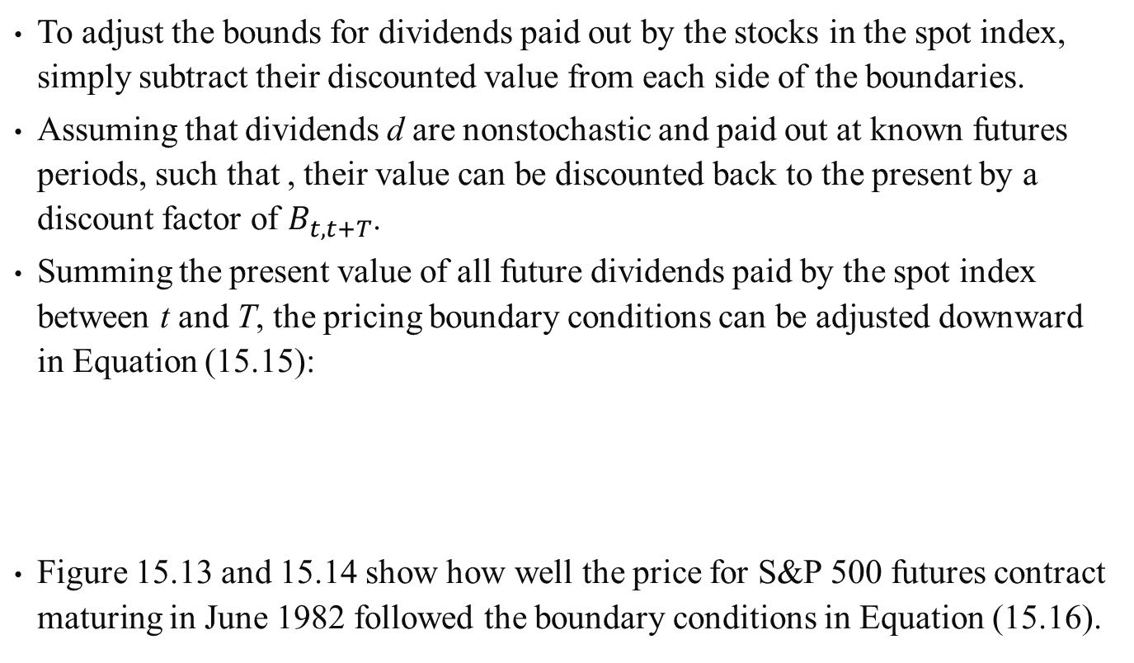
To adjust the bounds for dividends paid out by the stocks in the spot index, simply subtract their discounted value from each side of the boundaries.
Assuming that dividends d are nonstochastic and paid out at known futures periods, such that , their value can be discounted back to the present by a discount factor of $B_{t,t+T}$.
Summing the present value of all future dividends paid by the spot index between t and T, the pricing boundary conditions can be adjusted downward in Equation (15.15):
Figure 15.13 and 15.14 show how well the price for S&P 500 futures contract maturing in June 1982 followed the boundary conditions in Equation (15.16).
(15.16)

Slide 56
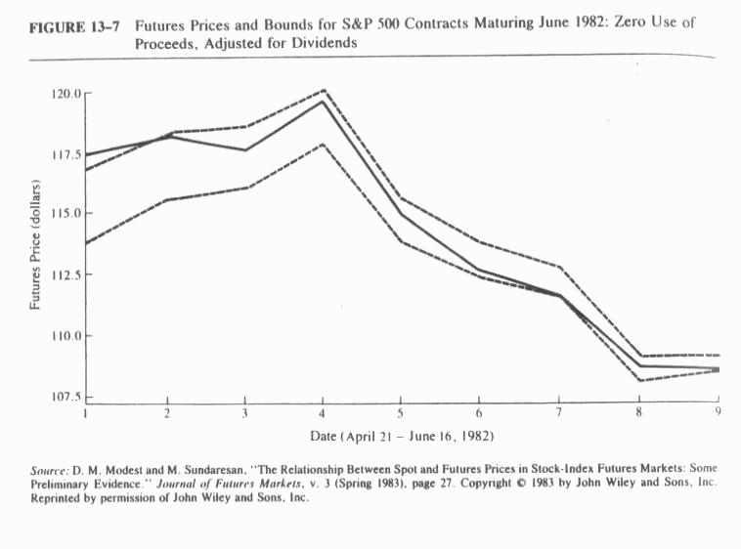
Figure 15.13 Futures Prices and Bounds for S&P 500 Contracts Maturing June 1982: Zero Use of Proceeds, Adjustments for Dividends.
Figure 15.13 assumes that zero percent of any proceeds from a short sale of the spot index was available for use.

Slide 57
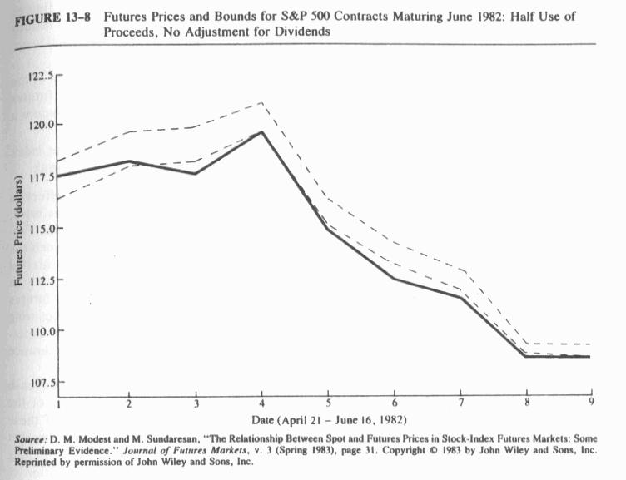
Figure 15.14 Futures Prices and Bounds for S&P 500 Contracts Maturing June 1982: Half Use of Proceeds, No Adjustments of Dividends
Figure 15.14 assumes that 50% of such proceeds should be used by the investor for reinvestment.

Slide 58
An analysis of the components in Equation (15.16) can help discern how the futures price should be affected by a change in any one of the variables.
As the price of a discount bond increases or equivalently, interest rate falls, the futures price will increase.
As the underlying spot price increases so will the futures price.
As future dividend payments are expected to increase the futures price declines.
As relevant transaction costs rise, the futures price will fall. (15.17d)
If more than one of the denominator variables changes at the same time, the expression cannot be generalized for the resulting effect on the futures price.
(15.17a)
(15.17b)
(15.17c)
(15.17d)

Slide 59
Sample Problem 15.8
In this example an institutional investor is going to use S&P 500 stock-index futures contracts to hedge an expected market decline over the coming month. Assume the following:
    (1) the S&P 500 stock index is an exact proxy of the composition of the investor’s stock portfolio,
    (2) no transaction costs are involved in entering or exiting either market, and
    (3) that the investor uses the Howard–D’Antonio hedge ratio equation [Chapter 14, Equation (14.15)] to determine how many futures contracts to sell.
The figures used to compute the hedge ratio are from daily data over a two-month period.

Slide 60
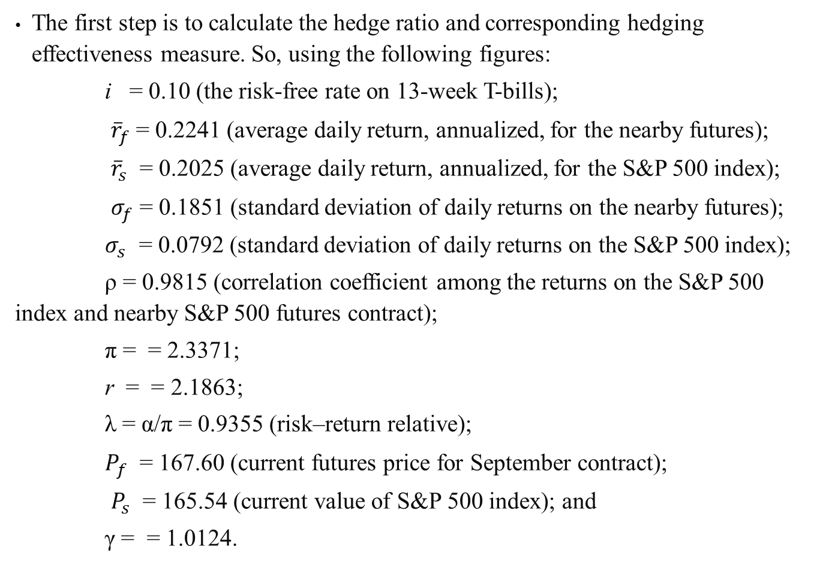
The first step is to calculate the hedge ratio and corresponding hedging effectiveness measure. So, using the following figures:
i = 0.10 (the risk-free rate on 13-week T-bills);
${\overline{r}}_{f}$ = 0.2241 (average daily return, annualized, for the nearby futures);
${\overline{r}}_{s}$ = 0.2025 (average daily return, annualized, for the S&P 500 index);
$σ_{f}$ = 0.1851 (standard deviation of daily returns on the nearby futures);
$σ_{s}$ = 0.0792 (standard deviation of daily returns on the S&P 500 index);
ρ = 0.9815 (correlation coefficient among the returns on the S&P 500 index and nearby S&P 500 futures contract);
π = = 2.3371;
r = = 2.1863;
λ = α/π = 0.9355 (risk–return relative);
$P_{f}$ = 167.60 (current futures price for September contract);
$P_{s}$ = 165.54 (current value of S&P 500 index); and
γ = = 1.0124.

Slide 61
Hedge ratio is
= 1.0284
Assuming the investor’s stock portfolio is 100 the value of the S&P 500 index, the investor should sell 24 futures contracts to hedge the portfolio.
Based on the past risk–return relationship between the futures and the spot markets, the institutional investor can expect to enhance the excess return to risk on his or her portfolio by 2.8% over the hedging period [(1.0284 − 1) 100%].
Utilizing the Howard and D’Antonio hedging strategy, the loss on the spot position was reduced by 38%.

Slide 62
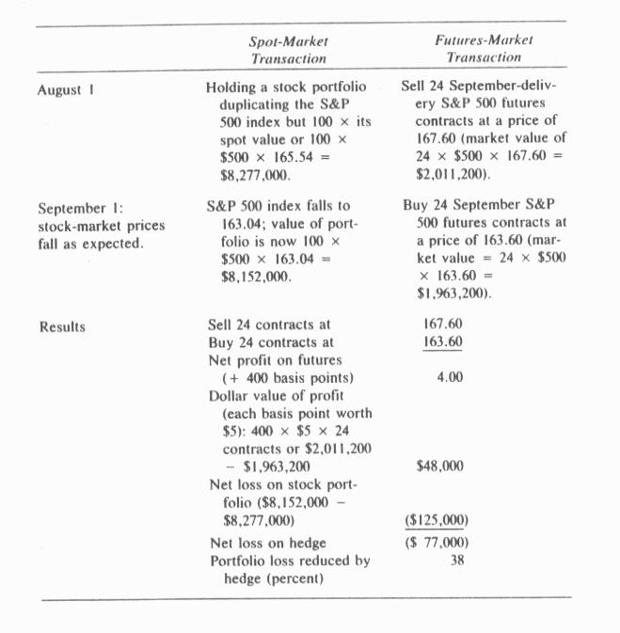
Table 15.4 Summarizes the transactions and hedging results
Table 15.4 Transactions and Results

Slide 63
15.4.2 Stock-Index Futures: Does the Tail Wag the Dog?
The rise in program trading based on a comparatively narrow blue-chip stock-market barometer, the Major Market Index (MMI), is said to be fueling the volatile price swings in the stock market, a case of the tail wagging the dog.
The MMI is a price-weighted index of 20 very actively traded stocks, 16 of which are included in the Dow Jones 30 Industrials.
Basically, program trading is taking a position (long or short) in a portfolio of stocks comprising the index and simultaneously taking an opposite position in the index-futures contracts.
The objective of the program trade is to create a risk-free position that earns a return in excess of the currently available risk-free return.

Slide 64
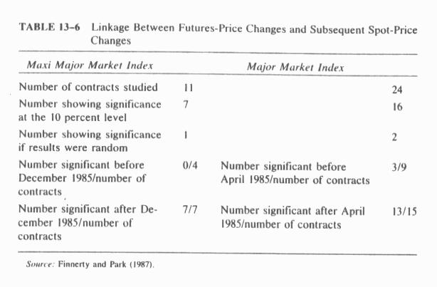
Table 15.5 Linkage between Futures-Price Changes and Subsequent Spot-Price Changes.
Using intraday spot and futures prices of the CBT’s MMI over the period August 1984 to August 1986, Finnerty and Park (19871 provide the following and subsequent spot-price changes (Table 15.5).
A majority of the contracts studied showed a significant relationship between the change in the futures price and the subsequent change in the index.
This supports the notion that the tail is wagging the dog.
This result was present for both the Maxi and the regular MMI contracts.

Slide 65
15.5 Summary
In one sense, uncertainty and risk are equivalent; thus the more uncertain something is, the more risky it is.
The futures markets evolved to alleviate one particular kind of risk that associated with unexpected price changes.
The purpose of this chapter has been to help explain what futures contracts are, how markets for them operate, and most important, how they can be applied to the hedging of price risk for securities.
The general methodology for using futures to reduce price risk (or equivalently, interest-rate risk) should seem quite straightforward.
We can long the spot commodity or instrument, and sell or short the related futures contract to lock in a price (or rate).
Nevertheless, exactly how to determine the appropriate hedge ratio and evaluate the effectiveness of the hedge has no all-conclusive answer.

