Slide 1
Chapter 17
Option Pricing Theory and Firm Valuation

Slide 2
Outline
17.1 Basic Concepts of Options
17.2 Factors Affecting Option Value
17.3 Determining the Value of Options
  17.3.1 Expected Value Estimation
  17.3.2 The Black-Scholes Option Pricing Model
  17.3.3 Taxation of Options
  17.3.4 American Options
17.4 Option Pricing Theory and Capital Structure
  17.4.1 Proportion of Debt in Capital Structure
  17.4.2 Riskiness of Business Operations
  17.4.3 Option Pricing Approach to Determine the Optimal Capital Structure
17.5 Warrants
17.6 Summary

Slide 3
17.1 Basic concepts of Options
In general, there are three types of equity options: (1) warrants, (2) executive stock options, and (3) publicly traded options.
A warrant is a financial instrument issued by a corporation that gives the purchaser the right to buy a fixed number of shares at a set price for a specific period.
The publicly traded option is an agreement between two individuals who have no relationship with the corporation whose shares are being optioned.
Executive stock options are a means of compensation for corporate employees.

Slide 4
17.1 Basic concepts of Options
The list of terms used in options:
Call: An option to purchase a fixed number of shares of common stock.
Put: An option to sell a fixed number of shares of common stock.
Exercise price contract : Trading price set for the transaction as specified
in an option.
Expiration date: Time by which the option transaction must be carried out.
Exercise option: Carrying out the transaction specified in an option.
American option: An option in which the transaction can only be carried
out at any time up to the expiration date.
European option: An option in which the transaction can only be carried
out in the expiration date.
Call option “in the money” If the stock price is above the exercise price.
Put option “in the money” If the stock price is below the exercise price.
Call option “out of the money” If the stock price is below the exercise price.
Put option “out of the money” If the stock price is above the exercise price.

Slide 5
17.1 Basic concepts of Options
The first three months (September, October, and January) are for a call option contract on JNJ for 100 shares of stock at an exercise price of 65.12 represents the closing price of JNJ shares.
The numbers in the September column represents the price of one call option with a September expiration date.
Table 17.1 Listed Options Quotations
Close Price | Strike Price | Calls |  |  | Puts
 |  | Sep | Oct | Jan | Sep | Oct | Jan
JNJ
65.12 | 45.00 | 20.40 | N/A | N/A | N/A | N/A | N/A
65.12 | 50.00 | N/A | N/A | N/A | N/A | N/A | N/A
65.12 | 55.00 | 10.30 | 10.40 | 11.10 | N/A | 0.02 | 0.30
65.12 | 60.00 | 5.30 | N/A | 6.40 | N/A | N/A | 0.70
65.12 | 65.00 | 0.10 | 1.15 | 2.60 | 0.05 | 0.85 | 1.95
65.12 | 70.00 | N/A | 0.05 | 0.55 | 4.80 | 4.50 | 5.00

Slide 6
17.1 Basic concepts of Options
The value of a call option on the maturity date is
The value of a put option on the maturity date is
Where E= exercise price, P = stock price at maturity date.

Slide 7
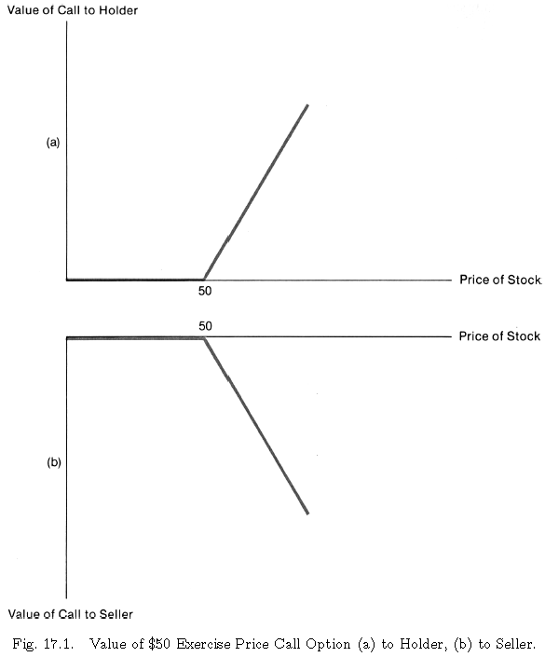
17.1 Basic concepts of Options
Figure 17.1
Value of $50 Exercise Price Call Option (a) to Holder, (b) to Seller
The figure shows the option value as a function of stock price to the option holder.
The holder of the option has the possibility of obtaining gains but cannot incur losses.
Correspondingly, the writer of the option may incur losses but cannot achieve any gains after receiving the premium.

Slide 8
17.2 Factors affecting option value
There are five factors that influence the value of a call option:
Market price of the stock
The exercise price
The risk-free interest rule
The volatility of the stock price
Time remaining to expiration date
The mathematical derivations of the sensitivity between the factors and the option value are discussed in Chapter 20.

Slide 9
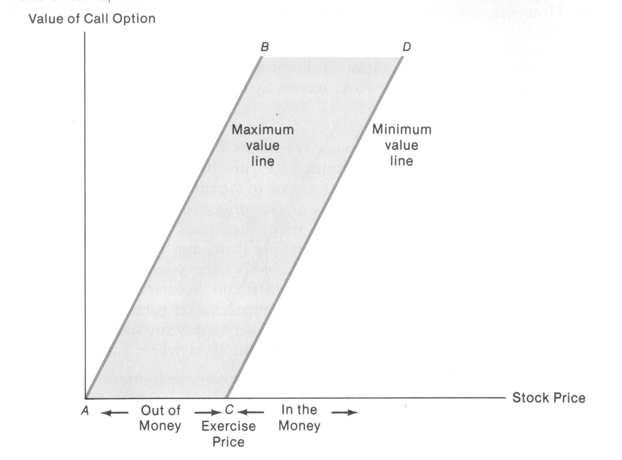
17.2 Factors affecting option value
Lower bound: The value of a call cannot be less than the payoff that would accrue if it were exercised immediately.
Upper bound: The value of a call cannot be more than the market price of the stock.
Figure 17.2 Value of Call Option

Slide 10
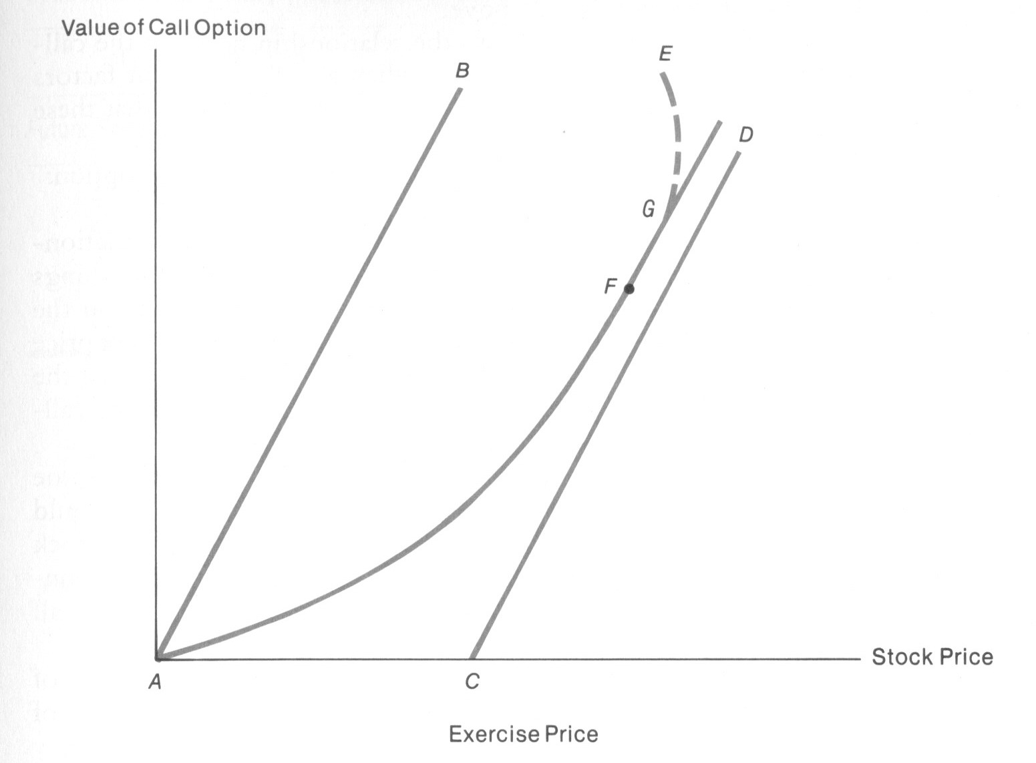
17.2 Factors affecting option value
Figure 17.3 Call Option Value as a Function of Stock Price

Slide 11
17.2 Factors affecting option value
The following considerations should help in forming the appropriate picture of Figure 17.3:
If the market price of the stock 0, the call value will also be 0, as indicated by point A.
All other things equal, as the stock price increases, so does the call value (see lines AB and CD).
If the price of the stock is high in relation to the exercise price, each dollar increase in price induces an increase of very nearly the same amount in the call value (shown by the slope of the line at point F).
The call value rises at an increasing rate as the value of the stock price rises, as shown by curvature AFG.

Slide 12
17.2 Factors affecting option value
Table 17.2 illustrate the impact of the stock price’s volatility on option value.
TABLE 17.2 Probabilities for Future Prices of Two Stocks
Less Volatile Stock |  | More Volatile Stock
Future Price($) | Probability | Future Price ($) | Probability
42 47 52 57 62 | .10 .20 .40 .20 .10 | 32 42 52 62 72 | .15 .20 .30 .20 .15
Expected payoff from call option on less volatile stock = (0)(0.10) + (0)(0.20) + (2)(0.40) + (7)(0.20) + (12)(0.10) = $3.40
Expected payoff from call option on more volatile stock = (0)(0.15) + (0)(0.20) + (2)(0.30) + (12)(0.20) + (22)(0.15) = $6.30

Slide 13
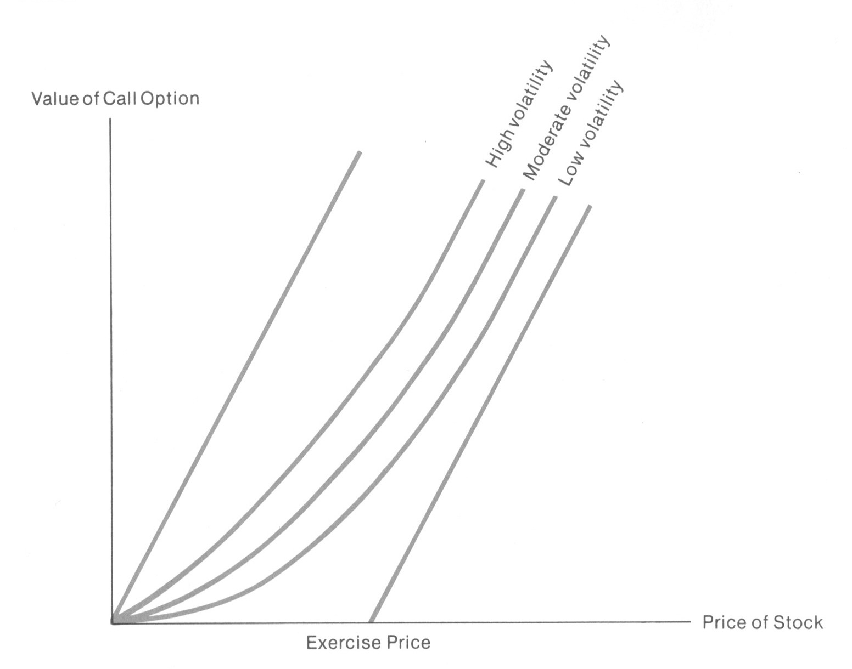
17.2 Factors affecting option value
Figure 17.4 Call-Option Value as Function of Stock Price for High-, Moderate-, and Low-Volatility Stocks

Slide 14
17.2 Factors affecting option value
TABLE 17.3 Data for a Hedging Example
In Table 17.4, we list the consequences to the investor for the two expiration-date stock prices. Within this framework, consider the factors in Table 17.3.
TABLE 17.4 Possible Expiration-Date Outcomes for Hedging Example
Current price per share: $100 Future price per share: $125 with probability .6 $85 with probability .4 Exercise price of call option: $100
Expiration-Date Stock Price | Value per Share of Stock Holdings | Value per Share of Options Written
$125 $85 | $125 $85 | －$25 $0

Slide 15
17.2 Factors affecting option value
Suppose that the investor wants to form a hedged portfolio by both purchasing stock and writing call options, so as to guarantee as large a total value of holdings per dollar invested as possible, whatever the stock price on the expiration date. The hedge is constructed to be riskless, since any profit (or loss) from the stock is exactly offset with a loss (or profit) from the call option.
A riskless hedge can be accomplished by purchasing H shares stock for each option written.
This ratio is known as the hedge ratio of stocks to options. More generally, the hedge ratio is given by:
where PU = upper share price; PL = lower share price; E = exercise price of option; and E is assumed to be between PU and PL.

Slide 16
17.2 Factors affecting option value
Let V_{c} denote the price per share of a call option. Then, the purchase of five shares costs $500, but $8V_{c} is received from writing call options on eight shares, so that the net outlay will be $500-$8V_{c}. For this outlay, a value one year hence of $425 is assured.
(5)(125)－(8)(25) = $425
(5) (85)＋(8) (0) = $425
An investment could be made in government securities at the risk-free interest rate. Suppose that this rate is 8% per annual. On the expiration date, an initial investment of $500-$8V_{c} will be worth 1.08($500-$8V_{c}). If this is to be equal to the value of the hedge portfolio, then

Slide 17
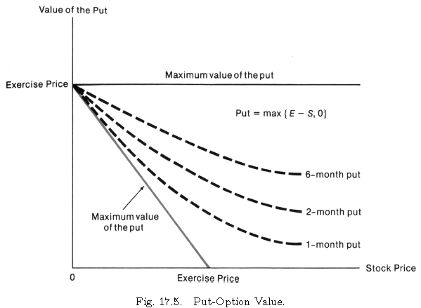
17.3 Determining the value of options
Figure 17.5 shows the relationship between put-option value and stock price.
The value of a put option is:
Where Vp is put option value, E is exercise price, and P is value of underlying stock.

Slide 18
17.3 Determining the value of options
Black-Scholes Option pricing Model
(17.1)

Slide 19
17.3.2 The Black-Scholes Option Pricing Model
Assumptions of Black-Scholes Model
Only European options are considered
Options and stocks can be traded in any quantities in a perfectly competitive market. (no transaction costs, and all information is freely available to market participants.)
Short-selling of stocks and options in a perfectly competitive market is possible.
The risk-free interest rate is known and is constant up to the expiration date.
Market participants are able to borrow or lend at risk-free rate.
No dividends are paid on the stock.
The stock price follows a random path in continuous time such that the variance of the rate of return is constant over time and known to market participants. The logarithm of future stock prices follows a normal distribution.

Slide 20
17.3 Determining the value of options
Black-Scholes Option pricing Model
(17.1)
(17.2A)
(17.2B)

Slide 21
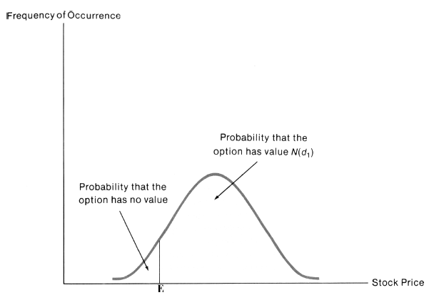
17.3 Determining the value of options
FIGURE 17.6 Probability Distribution of Stock Prices

Slide 22
17.3 Determining the value of options
Example 17.1
Suppose that the current market price of a share of stock is $90 with a standard deviation 0.6. An option is written to purchase the stock for $100 in 6 months. The current risk-free rate of interest is 8%.

Slide 23
17.3 Determining the value of options
Example 17.1

Slide 24
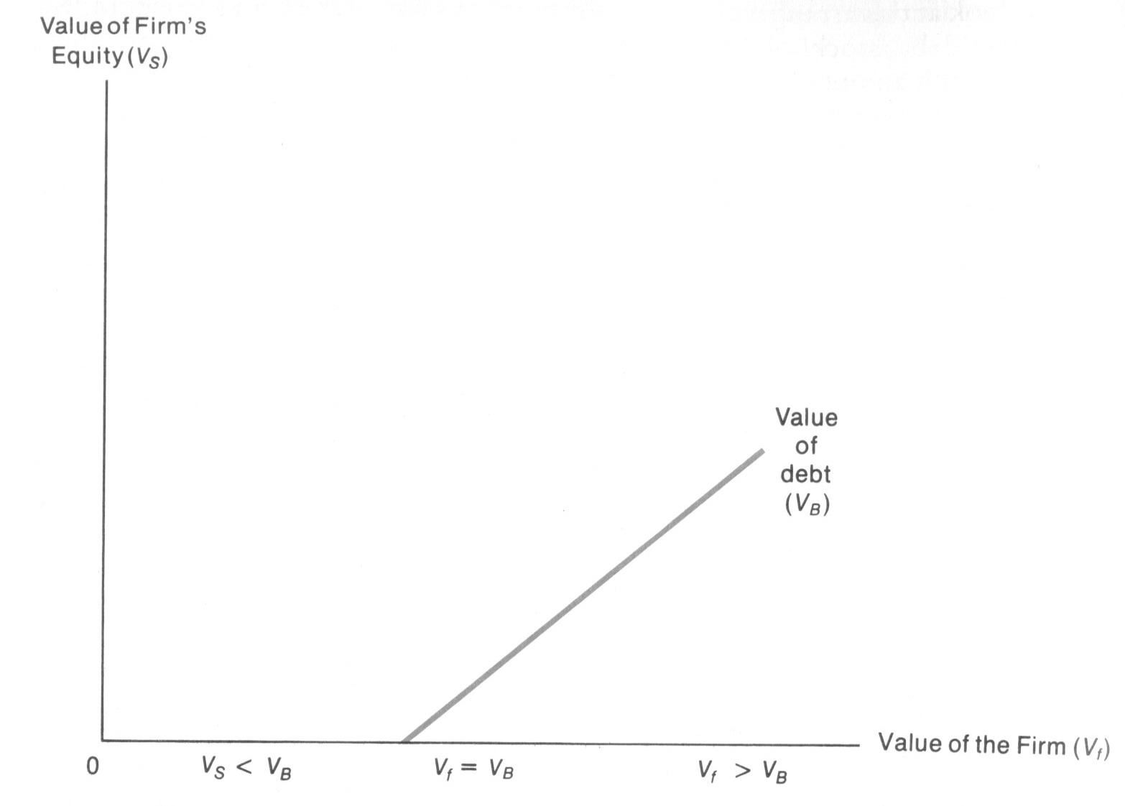
17.4 Option pricing theory and capital structure
（17.3）
FIGURE 17.7 Option Approach to Capital Structure

Slide 25
17.4 Option pricing theory and capital structure
Proportion of debt in capital structure
Example 17.2
An unlevered corporation is valued at $14 million. The corporation issues debt, payable in 6 years, with a face value of $10 million. The standard deviation of the continuously compounded rate of return on the total value of this corporation is 0.2. Assume that the risk-free rate of interest is 8% per annum.

Slide 26
17.4 Option pricing theory and capital structure
Example 17.2

Slide 27
17.4 Option pricing theory and capital structure
Following Example 17.2, only $5miilion face value of debt is to be issued.
value of debt = 14－10.91 = $3.09 million

Slide 28
17.4 Option pricing theory and capital structure
In Table 17.5, we compare, from the point of view of bondholders, the cases where the face values of issued debt are $5 million and $10 million.
We see from the table that increasing the proportion of debt in the capital structure decreases the value of each dollar of face value of debt.
Table 17.5
Effect of Different Levels of Debt on Debt Value
Face Value of Debt ($ millions) | Actual Value of Debt ($ millions) | Actual Value per Dollar Debt Face Value of Debt
5 10 | 3.09 6.10 | $.618 $.610

Slide 29
17.4 Option pricing theory and capital structure
Riskiness of Business Operations
Following Example 17.2, which is about to issue debt with face value of $10 million. Leaving the other variables unchanged, suppose that the standard deviation of the continuously compounded rate of return on the corporation’s total value is 0.4 rather than 0.2.
value of debt = 14－8.77 = $5.23 million

Slide 30
17.4 Option pricing theory and capital structure
Table 17.6 summarizes the comparison between these results and those of Example 17.2. We see that this increase in business risk, with its associated increase in the probability of default on the bonds, leads to a reduction from $6.10 million to $5.23 million in the market value of the $10 million face value of debt.
The greater the degree of risk, the higher the interest rate that must be offered to sell a particular amount of debt.
Table 17.6 Effect of Different Levels of Business Risk on the Value of $10 Million Face Value of Debt
Variance of Rate of Return | Value of Equity ($ millions) | Value of Debt ($ millions)
.2 .4 | 7.90 8.77 | 6.10 5.23

Slide 31
17.5 Warrants
A warrant is an option issued by a corporation to individual investors to purchase, at a stated price, a specified number of the shares of common stock of that corporation.
where Vw = value of warrant; N = number of shares that can be purchased; P = market price per share of stock; and E = exercise price for the purchase of N shares of stock.
Since using warrants, a corporation can extract more favorable terms from bondholders, it follows that the company must have transferred something of value it bondholders. This transfer can be visualized as giving the bondholders a stake in the corporation’s equity. Thus, we should regard equity comprising both stockholdings and warrant value. We will refer to this total equity, prior to the exercise of the options, as old equity so that
old equity = stockholders’ equity + warrants
If the warrants are exercised, the corporation then receives additional money from the purchase of new shares, so that total equity is
new equity = old equity + exercise money

Slide 32
17.5 Warrants
We denote by N the number of shares outstanding and by N_{w} the number of shares that warrantholders can purchase. If the options are exercised, there will be a total of N+N_{w} shares, a fraction N_{w}/(N+N_{w}) of which is owned by former warrantholders. These holders then own this fration of the new equity,
H(new equity) = H (old equity) + H (exercise money)

Slide 33
17.5 Warrants
Thus, a fraction, N_{w}/(N+N_{w}), of the exercise money is effectively returned to the former warrantholders. Therefore, in valuing the warrants, the Black-Scholes formula must be modified. We need to make appropriate substitutions in Eq. (10.1) for the current stock price, P, and the exercise price of the option, E.
It also follows that the appropriate measure of volatility is the variance of rate of return on the total old equity (including the value of warrants), not simply on stockholders’ equity.

Slide 34
17.6 Summary
In this chapter, we have discussed the basic concepts of call and put options and have examined the factors that determine the value of an option. One procedure used in option valuation is the Black-Scholes model, which allows us to estimate option value as a function of stock price, option-exercise price, time-to-expiration date, and risk-free interest rate. The option pricing approach to investigating capital structure is also discussed, as is the value of warrants.

