Slide 1
Chapter 18
Decision Tree and
Microsoft Excel Approach for Option Pricing Model
By
Cheng Few Lee
Joseph Finnerty
John Lee
Alice C Lee
Donald Wort

Slide 2
Outline
18.1 CALL AND PUT OPTIONS
18.2 ONE-PERIOD OPTION PRICING MODEL
18.3 TWO-PERIOD OPTION PRICING MODEL
18.4 USING MICROSOFT EXCEL TO CREATE THE BINOMIAL OPTION TREES
18.5 BLACK–SCHOLES OPTION PRICING MODEL
18.6 RELATIONSHIP BETWEEN THE BINOMIAL OPTION PRICING MODEL AND THE BLACK–SCHOLES OPTION PRICING MODEL
18.7 DECISION TREE BLACK–SCHOLES CALCULATION

Slide 3
18.1 Call and Put Options
A call option gives the owner the right but not the obligation to buy the underlying security at a specified price
The exercise price is the price in which the owner can buy the underlying price
Call option becomes valuable when:
exercise price < current price of underlying stock price

Slide 4
Example
A call option on a GE stock with an exercise price of $20 when the stock price of an GE stock is $25 is worth $5.
The reason it is worth $5 is because a holder of the call option can buy the GE stock at $20 and then sell the GE stock at the prevailing price of $25 for a profit of $5.
Also, a call option on an GE stock with an exercise price of $30 when the stock price of an GE stock is $15 is worth $0.

Slide 5
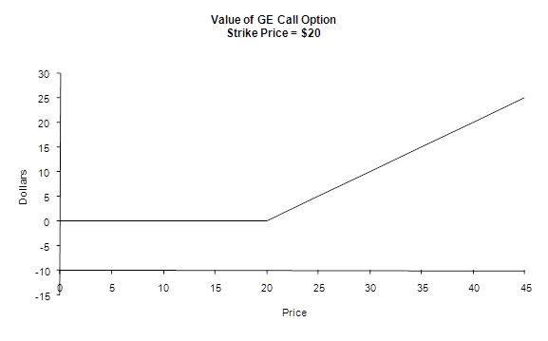
Figure 18-1 Value of GE Call Option

Slide 6
Put option gives the owner the right but not the obligation to sell the underlying security at a specified price.
Put option becomes valuable when:
exercise price > current price of underlying stock price

Slide 7
Example
A put option on an GE stock with an exercise price of $20 when the stock price of a GE stock is $15 is worth $5.
The reason it is worth $5 is because a holder of the put option can buy the GE stock at the prevailing price of $15 and then sell the GE stock at the put price of $20 for a profit of $5.
Also, a put option on a GE stock with an exercise price of $20 when the stock price of the GE stock is $25 is worth $0.

Slide 8
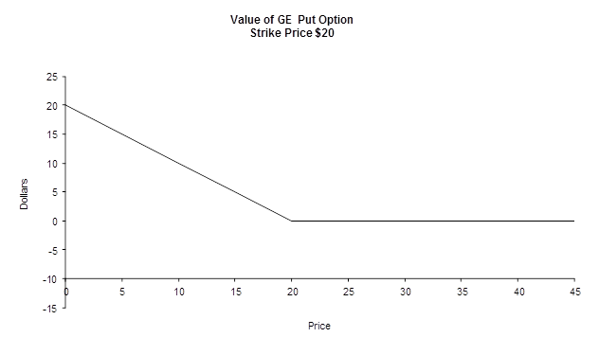
Figure 18-2 Value of GE Put Option

Slide 9
18.2 One- Period Option Pricing Model
Let us look at a case
  where only the value of options for one period matters
  where we know for certain certain that a GE stock with a price of $20 will either go up 5% or go down 5% in the next period and the exercise after one period is $20.
Figure 18-3
GE Stock Price
Figure 18-4
GE Call Option Price
Figure 18-5
GE Put Option Price

Slide 10
We have just discussed the possible ending value of a GE call option in period 1.
What we are really interested in is what the value is now of the GE call option knowing the two resulting value of the GE call option.
To help determine the value of a one-period GE call option, it is useful to know that it is possible to replicate the resulting two state of the value of the GE call option by buying a combination of stocks, S, and bonds, B.
Below is the formula to replicate the situation where the price increases to $21.
We will assume that the interest rate for the bond is 3%.
21S + 1.03B = 1
19S + 1.03B = 0

Slide 11
We can use simple algebra to solve for both shares of stocks and bonds, S and B.
The first thing that we need to do is to rearrange the second equation as follows:
1.03B = −19S
With the above equation, we can rewrite the first equation as
21S + (–19S) = 1
2S = 1
S = 0.5
We can solve for the shares of bonds, B, by substituting the value 0.5 for the shares of stocks, S, in the first equation.
21(0.5) + 1.03B = 1
10.5 + 1.03B = 1
1.03B = –9.5
B = –9.223
Therefore, we should at period 0 buy 0.5 shares of GE stock and borrow 9.223 at 3% to replicate the payoff of the GE call option.
This means the value of a GE call option should be 0.5 × 20 − 9.223 = 0.777.

Slide 12
Example
If this was not the case, there would then be arbitrage profits.
If the call option were sold for $3, there would be a profit of 2.223. This would result in the increase in the selling of the GE call option.
The increase in the supply of GE call options would push the price down for the call options. If the call option were sold for $0.50, there would be a saving of 0.277.
This saving would result in the increase demand for the GE call option. This increase demand would result in the price of the call option to increase. The equilibrium point would be $0.777.

Slide 13
Using the abovementioned concept and procedure, a one-period call option model was derived as
If we let i = r, R = (1 + r), p = (R – d)/(u – d), 1 – p = (u – R)/(u – d),
C_{u} =Max[uS –X, 0] and C_{d} =Max[dS –X, 0], then we have
C = [ pC_{u} + (1 – p)C_{d}]/R
where, C_{u} = call option price after increase
C_{d} = call option price after decrease.
(18.1)
(18.2)

Slide 14
Below calculates the value of the ne-period call option where the strike price, X, is $20 and the risk-free interest rate is 3%. We will assume that that the price of a stock for any given period will either increase or decrease by 5%.
X = $20
S = $20
u = 1.05
d = 0.95
R = 1 + r = 1 + 0.03
p = (1.03 – 0.95)/(1.05 – 0.95)
C = [0.8(1) + 0.2(0)]/1.03 = $0.777
Therefore from the above calculations, the value of the call option is $7.94. Figure 18-6 shows the resulting Decision Tree for the above call option.
Figure 18-6
Call Option Price

Slide 15
Like the call option, it is possible to replicate the resulting two state of the value of the put option by buying a combination of stocks, S, and bonds, B.
Below is the formula to replicate the situation where the price decreases to $19.
21S + 1.03B = 0
19S + 1.03B = 1
We will use simple algebra to solve for both shares of stocks and bonds, S and B. The first thing we will do is to rewrite the second equation as follows:
1.03B = 1.5 – 19S
The next thing to do is to substitute the above equation to the first put option equation. Doing this would result in the following:
21S + 1.5 – 19S = 0
The following solves for the shares of stocks, S,
2S = −1.5
S = −0.5

Slide 16
Now let us solve for the shares of bonds, B by putting the value of S into the first equation.
21(–0.5) + 1.03B = 0
1.03B = 10.5
B = 10.194
From the above simple algebra exercise, we have S = –0.5 and B = 10.194.
This tell us that we should in period 0 lend $10.194 at 3% and sell 0.5 shares of stock to replicate the put option payoff for period 1.
And, the value of the GE put option should be 20(−0.5) + 10.194 = 0.194.
Using the same arbitrage argument that we used in the discussion of the call option, 0.194 has to be the equilibrium price of the put option.

Slide 17
As with the call option, a one-period put option model was derived as
If we let i = r, R = (1 + r), p = (R – d)/(u – d), 1 – p = (u – R)/(u – d), , P_{u} = Max[X – u S, 0] and P_{d} = Max[X – dS, 0], then we have
P = [ pP_{u} + (1 – p)P_{d}]/R
where, P_{u} = put option price after increase
P_{d} = put option price after decrease.
(18.3)
(18.4)

Slide 18
Below calculates the value of the above one-period put option where the strike price, X, is $30 and the risk-free interest rate is 3%.
P = [0.8(0) + 0.2(1)]/1.03 = $0.194.
From the above calculation, the put option pricing Decision Tree would look like the following.
Figure 18-7 shows the resulting Decision Tree for the above put option.
Figure 18-7
GE Put Option Price

Slide 19
There is a relationship between the price of a put option and the price of all call option. This relationship is called the put-call parity.
P = C + X/R – S
where
C = call price
X = strike price
R = 1 + interest rate
S = stock price
The following uses the put-call parity to calculate the price of the GE put option.
P = $0.777 + $20/(1.03) – $20
= 0.777 + 19.417 – 20
= 0.194.
(18.5)

Slide 20
18.3 Two-Period Option Pricing Model
We now will look at pricing options for two periods.
This Decision Tree was created based on the assumption that a stock price will either increase by 5% or decrease by 5%.
Figure 18-8
GE Stock Price

Slide 21
The highest possible value for our stock based on our assumption is $22.05.
We get this value first by multiplying the stock price at period 0 by 105% to get the resulting value of $21 of period 1.
We then again multiply the stock price in period 1 by 105% to get the resulting value of $22.05.
In period 2, the value of a call option when a stock price is $22.05 is the stock price minus the exercise price, $22.05 – $20, or $2.05.
In period 2, the value of a put option when a stock price $22.05 is the exercise price minus the stock price, $20 – $22.05, or –$2.05.
A negative value has no value to an investor so the value of the put option would be $0.

Slide 22
The lowest possible value for our stock based on our assumptions is $18.05.
We get this value first by multiplying the stock price at period 0 by 95% (decreasing the value of the stock by 5%) to get the resulting value of $19.0 of period 1.
We then again multiply the stock price in period 1 by 95% to get the resulting value of $18.05.
In period 2, the value of a call option when a stock price is $18.05 is the stock price minus the exercise price, $18.05 – $20, or –$1.95. A negative value has no value to an investor so the value of a call option would be $0.
In period 2, the value of a put option when a stock price is $18.05 is the exercise price minus the stock price, $20 − $18.05, or $1.95.
We can derive the call and put option value for the other possible value of the stock in period 2 in the same fashion.

Slide 23
Figure 18-9: GE Call Option
Figure 18-10: GE Put Option
We cannot calculate the value of the call and put option in period 1 the same way we did in period 2 because it is not the ending value of the stock.
In period 1, there are two possible call values.
  One value is when the stock price increased
  one value is when the stock price decreased
  The call option Decision Tree shown in Figure 18.9 shows two possible values for a call option in period 1

Slide 24
  If we just focus on the value of a call option when the stock price increases from period 1, we will notice that it is like the Decision Tree for a call option for one period.
Figure 18-11: GE Call Option

Slide 25
Using the same method for pricing a call option for one period, the price of a call option when stock price increase from period 0 will be $1.5922.
Figure 18-12: GE Call Option

Slide 26
In the same fashion we can price the value of a call option when a stock price decreases. The price of a call option when a stock price decreases from period 0 is $0.
Figure 18-13: GE Call Option

Slide 27
In the same fashion we can price the value of a call option in period 0.
We can calculate the value of a put option in the same manner as we did in calculating the value of a call option.
Figure 18-14: GE Call Option
Figure 18-15: GE Put Option

Slide 28
18.4 Using Microsoft Excel To Create the Binomial Option Trees
Table 18-1
In the previous section, we priced the value of a call and put option by pricing backward, from the last period to the first period.
This method of pricing call and put options will work for any n-period.
To price the value of a call options for two periods required seven sets of calculations. The number of calculations increases dramatically as n increases.
Table 18-1 lists the number of calculations for specific number of periods.

Slide 29
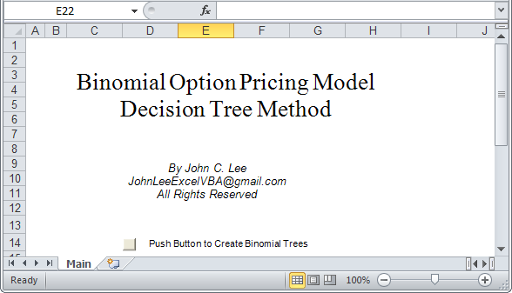
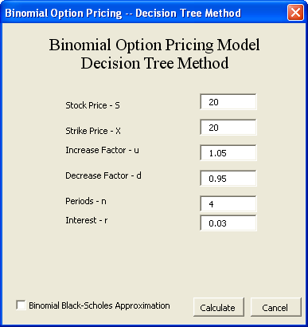
After two periods it becomes very cumbersome to calculate and create the Decision Trees for a call and put option.
In the previous section, we saw that calculations were very repetitive and mechanical.
To solve this problem, this chapter will use Microsoft Excel to do the calculations and create the Decision Trees for the call and put options. We will also use Microsoft Excel to calculate and draw the related Decision Trees for the underlying stock and bond.
Figure 18-17 is using Microsoft Excel to solve the Binomial OPM
Figure 18-17
Dialog Box Showing Parameters for the Binomial OPM
Figure 18-16 Excel File BinomialBS_OPM.xls

Slide 30
Pushing calculate button in Figure 18.17 will produce
Figure 18.19 Call Option Pricing.

Slide 31
Benninga (2000, p. 260) has defined the price of a call option in a Binomial OPM with n periods as
and the price of a put option in a Binomial OPM with n- periods as
Lee et al. (2000, p. 237) has defined the pricing of a call option in a Binomial OPM with n- period as
The definition of the pricing of a put option in a Binomial OPM with n period would then be defined as
(18.6)
(18.7)
(18.8)
(18.9)

Slide 32
18.5 Black-Sholes Option Pricing Model
The Black–Scholes model prices European call and put options.
The Black–Scholes model for a European call option is
C = SN(d1) – Xe^{-rT}N(d2)
Where
C = Call price; S = Stock price; r = risk free interest rate; T = time to maturity of option in years; N(∙) = standard normal distribution; and σ = stock volatility.
Let us manually calculate the price of an European call option in term of Equation (18.10) with the following parameter values, S = 20, X =20, r = 3%, T = 4, σ = 20%
(18.10)

Slide 33
Solution
N(d1) = 0.69146, N(d2)= 0.5398, e^{-rT}=0.8869
C = (20) * (0.69146) – (20) *(0.8869)* 0.5398
= 13.8292 – 9.5749724 = 4.2542276
The Black–Scholes put–call parity equation is
The put option value for the stock would be
P = 4.25 – 20 + 20(0.8869)
= 4.25 – 20 + 17.738
= 1.988.

Slide 34
18.6 Relationship Between the Binomial Option Pricing Model and the Black-Scholes Option Pricing Model
We can use either the Binomial model or Black–Scholes to price an option. They both should result in similar numbers.
If we look at the parameters in both models, we will notice that the Binomial model has an Increase Factor (U), a Decrease Factor (D), and n-period parameters that the Black–Scholes model does not have.
We also notice that the Black–Scholes model has the σ and T parameters that the Binomial model does not have.
Benninga (2008) suggest the following translation between the Binomial and Black–Scholes parameters.

Slide 35
In the Excel program, shown in Appendix 18A, we use Benniga’s (2008) Increase Factor and Decrease Factor definitions.
They are defined as follows:
where
u = 1 + percentage of price increase;
d = 1 – percentage of price increase; and
R = 1 + interest rate.

Slide 36
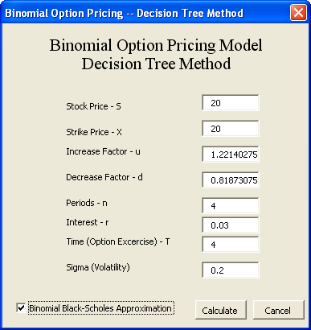
18.7 Decision Tree
Black-Scholes Calculations
.Notice that in Figure 18-22 the Binomial Black-Scholes Approximation check-box is checked.
Checking this box will cause T and σ parameters to appear and will adjust the Increase Factor — u and Decrease Factor — d parameters.
Figure 18-22
Dialog Box Showing Parameters
for the Binomial OPM

Slide 37
Figure 18-23 Decision Tree Approximation of Black-Scholes Call Pricing
Notice in Figures 18-23 Binomial OPM value does not agree with the Black–Scholes OPM.
The Binomial OPM value will get very close to the Black–Scholes OPM value once the Binomial parameter n gets very large.
This demonstrated that the Binomial value will be close to the Black–Scholes when the Binomial n parameter gets larger than 500.

Slide 38
Summary
This chapter demonstrated, with the aid of Microsoft Excel and Decision Trees, the Binomial Option model in a less mathematical fashion.
This chapter allowed the reader to focus more on the concepts by studying the associated Decision Trees, which were created by Microsoft Excel.
This chapter also demonstrated that using Microsoft Excel releases the reader from the computation burden of the Binomial Option Model.
This chapter also used Decision trees to demonstrate the relationship between the Binomial OPM and the Black–Scholes OPM.

