Slide 1
Chapter 2
Accounting Information, Regression Analysis
By
Cheng Few Lee
Joseph Finnerty
John Lee
Alice C Lee
Donald Wort

Slide 2
Chapter Outline
2.1 Introduction
2.2 Financial Statement: A Brief Review
2.2.1 Balance Sheet
2.2.2 Statement of Earnings
2.2.3 Statement of Equity
2.2.4 Statement of Cash Flows
2.2.5 Interrelationship Among Four Financial Statements
2.2.6 Annual vs. Quarterly Financial Data
2.3 Critique of Accounting Information
2.3.1 Criticism
2.3.2 Methods for Improvement
2.4 Static ratio analysis and its extension
2.4.1 Static Determination of Financial Ratios
2.4.2 Dynamic Analysis of Financial Ratios
2.4.3 Statistical Distribution of Financial Ratios
2.5 Cost-Volume-Profit Analysis and its Applications
2.5.1 Deterministic Analysis
2.5.2 Stochastic Analysis
2.6 Accounting Income vs. Economic Income

Slide 3
2.2 Financial statement: A brief review
Balance sheet
Income statement
Cash flow statement
Equity statement
Annual vs. quarterly financial data

Slide 4
2.2.1 Balance Sheet
Table 2-1 Consolidated Balance Sheets of Johnson & Johnson Inc & Consolidated Subsidiaries (2004–2009)
(Dollars in Millions)
Assets | 2004 | 2005 | 2006 | 2007 | 2008 | 2009
Current Assets
Cash and Cash Equivalent ($) | 9,203 | 16,055 | 4,083 | 7,770 | 10,768 | 15,810
Marketable Securities | 3,681 | 83 | 1 | 1,545 | 2,041 | 3,615
Account Receivable | 6,831 | 7,010 | 8,712 | 9,444 | 9,719 | 9,646
Inventory | 3,744 | 3,959 | 4,889 | 5,110 | 5,052 | 5,180
Deferred Taxes on Income | 1,737 | 1,845 | 2,094 | 2,609 | 3,430 | 2,793
Prepaid Expenses and Other Receivable | 2,124 | 2,442 | 3,196 | 3,467 | 3,367 | 2,497
Total Current Assets | 27,320 | 31,394 | 22,975 | 29,945 | 34,377 | 39,541
Marketable Securities — Non-current | 46 | 20 | 16 | 2 | - | -
Property, Plant and Equipment, Net | 10,436 | 10,830 | 13,044 | 14,185 | 14,365 | 14,759
Intangible Assets, Net | 11,842 | 12,175 | 28,688 | 28,763 | 27,695 | 31,185
Deferred Taxes on Income | 551 | 385 | 3,210 | 4,889 | 5,841 | 5,507
Other Assets | 3,122 | 3,221 | 2,623 | 3,170 | 2,634 | 3,690
Total Assets | 53,317 | 58,025 | 70,556 | 80,954 | 84,912 | 94,682
Liabilities and Shareholder’s Equity
Current Liabilities
Loans and Notes Payable | 280 | 668 | 4,579 | 2,463 | 3,732 | 6,318
Account Payable | 5,227 | 4,315 | 5,691 | 6,909 | 7,503 | 5,541
Accrued Liabilities | 3,523 | 3,529 | 4,587 | 6,412 | 5,531 | 5,796
Accrued Rebates, Returns, and Promotion | 2,297 | 2,017 | 2,189 | 2,318 | 2,237 | 2,028
Accrued Salaries, Wages, and Commissions | 1,094 | 1,166 | 1,391 | 1,512 | 1,432 | 1,606
Taxes on Income | 1,506 | 940 | 724 | 223 | 417 | 442
Total Current Liabilities | 13,927 | 12,635 | 19,161 | 19,837 | 20,852 | 21,731
Long-term Debt | 2,565 | 2,017 | 2,014 | 7,074 | 8,120 | 8,223
Deferred Tax liability | 403 | 211 | 1,319 | 1,493 | 1,432 | 1,424
Employee Related Obligations | 2,631 | 3,065 | 5,584 | 5,402 | 7,791 | 6,769
Other Liabilities | 1,978 | 2,226 | 3,160 | 3,829 | 4,206 | 5,947

Slide 5
2.2.1 Balance Sheet
Table 2-1 Consolidated Balance Sheets of Johnson & Johnson Inc & Consolidated Subsidiaries (2004–2009)
(continued)
Shareowners’ Equity
Preferred Stock-without Par Value | — | — | — | — | — | —
Common Stock-Par Value $1.00 | 3,120 | 3,120 | 3,120 | 3,120 | 3,120 | 3,120
Net Receivable from Employee Stock Plan | −11 | — | — | — | — | —
Accumulated Other Comprehensive Income | −515 | −755 | −2,118 | −693 | −4,955 | −3,058
Retained Earnings | 35,223 | 41,471 | 49,290 | 55,280 | 63,379 | 70,306
Less: Common Stock Held in Treasury | 6,004 | 5,965 | 10,974 | 14,388 | 19,033 | 19,780
Total Shareowners’ Equity | 31,813 | 37,871 | 39,318 | 43,319 | 42,511 | 50,588
Total Liabilities and Shareholders’ Equity | 53,317 | 58,025 | 70556 | 80954 | 84912 | 94682

Slide 6
2.2.2 Income Statement
Table 2-2 Consolidated Statements of Earnings of JNJ Inc. & Subsidiaries (2004-09)
(dollars in millions)
(Dollars in Millions Except Per Share Figures) | 2004 | 2005 | 2006 | 2007 | 2008 | 2009
Sales to Customers ($) | 47,348 | 50,514 | 53,324 | 61,095 | 63,747 | 61,897
Cost of Products Sold | 13,422 | 13,954 | 15,057 | 17,751 | 18,511 | 18,447
Gross Profit | 33,926 | 36,560 | 38,267 | 43,344 | 45,236 | 43,450
Selling, Marketing and administrative expenses | 15,860 | 16,877 | 17,433 | 20,451 | 21,490 | 19,801
Research Expense | 5,203 | 6,312 | 7,125 | 7,680 | 7,577 | 6,986
Purchased in-process research and development | 18 | 362 | 559 | 807 | 181 | —
Interest Income | −195 | −487 | −829 | −452 | −361 | 90
Interest Expense, net of portion capitalized | 187 | 54 | 63 | 296 | 435 | 451
Other (income) expense, Net | 15 | −214 | −671 | 1,279 | −1,015 | 547
 | 21,088 | 22,904 | 23,680 | 30,061 | 26,307 | 27,695
Earnings before Provision for Taxes on Income | 12,838 | 13,656 | 14,587 | 13,283 | 16,929 | 15,755
Provision for Taxes on Income | 4,329 | 3,245 | 3,534 | 2,707 | 3,980 | 3,489
Net Earnings | 8,509 | 10,411 | 11,053 | 10,576 | 12,949 | 12,266
Basic Net Earnings per Share ($) | 2.87 | 3.5 | 3.76 | 3.67 | 4.62 | 4.45
Diluted Net Earnings per Share ($) | 2.84 | 3.46 | 3.73 | 3.63 | 4.57 | 4.4

Slide 7
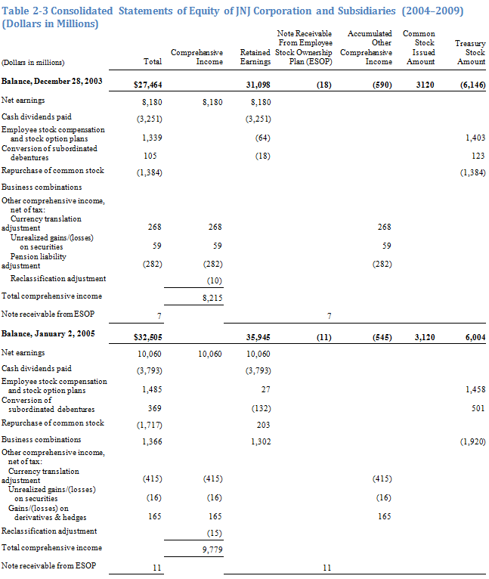
2.2.3 Statement of Equity

Slide 8
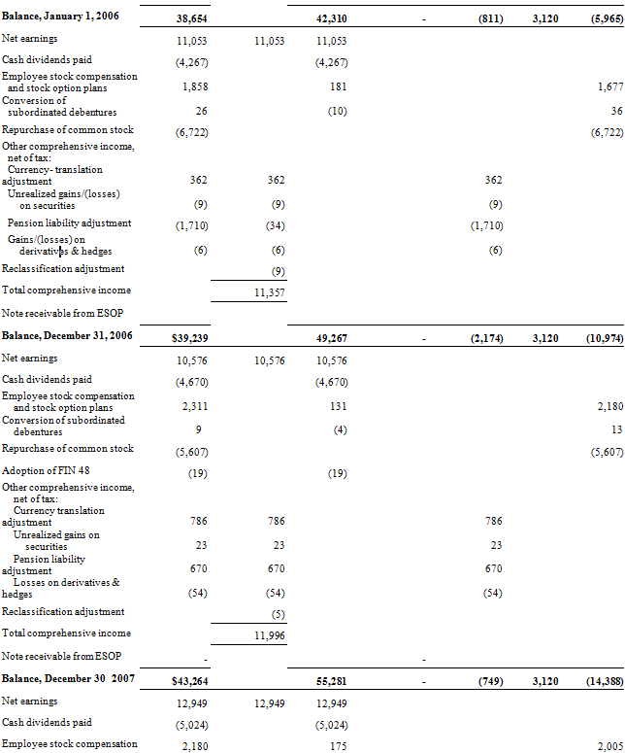
2.2.3 Statement of Equity

Slide 9
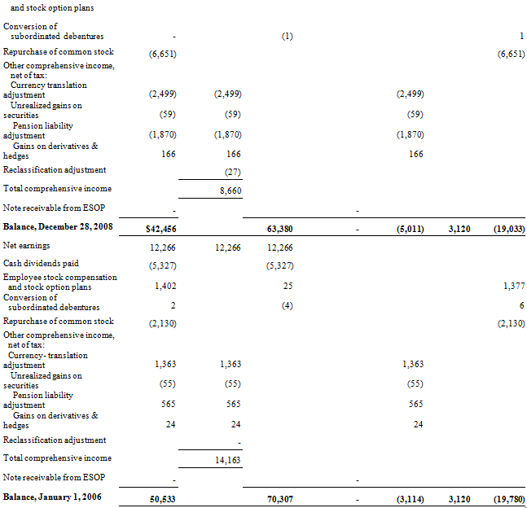
2.2.3 Statement of Equity

Slide 10
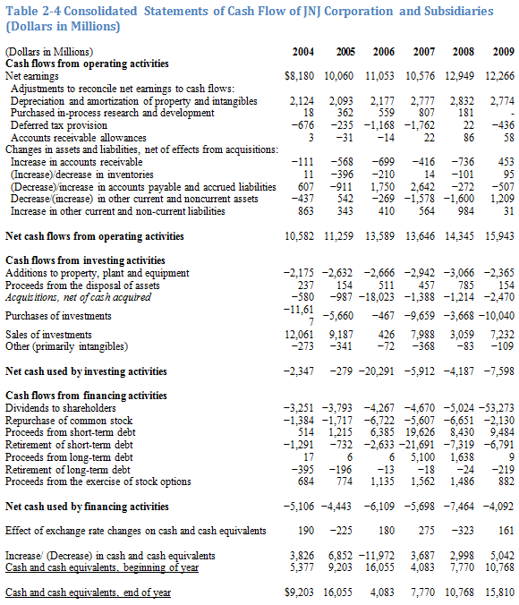
2.2.4 Statement of Cash Flows

Slide 11
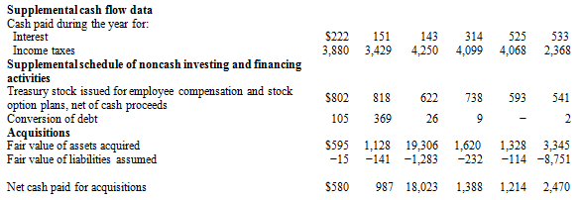
2.2.4 Statement of Cash Flows

Slide 12
2.3 Critique of accounting information
Criticism
Methods for improvement
a) Use of Alternative Information
b) Statistical Adjustments
c) Application of Finance and Economic Theories

Slide 13
2.4 Static ratio analysis and its extension
Static determination of financial ratios
Dynamic analysis of financial ratios
Statistical distribution of financial ratios

Slide 14
Static determination of financial ratios
Table 2.5: Company ratios period 2003-2004
Ratio Classification | Formula | J&J |  | Industry
 |  | 2008 | 2009 | 2008 | 2009
Liquidity Ratio
Current Ratio |  | 1.65 | 1.82 | 2.18 | 2.06
Quick Ratio |  | 0.61 | 0.89 | 1.61 | 1.51
Leverage Ratio
Debt-to-Asset |  | 0.48 | 0.45 | 0.48 | 0.49
Debt-to-Equity |  | 0.96 | 0.84 | 1.02 | 1.04
Equity Multiplier |  | 2.00 | 1.87 | 2.10 | 2.12
Times Interest Paid |  | 27.78 | 30.39 | 26.49 | 27.16

Slide 15
Static determination of financial ratios
Table 2.5: Company ratios period 2003-2004 (Continued)
Ratio Classification | Formula | J&J |  | Industry
 |  | 2008 | 2009 | 2008 | 2009
Activity Ratios
Average collection period |  | 54.11 | 56.32 | 72.73 | 73.14
Accounts receivable Turnover |  | 6.65 | 6.39 | 5.81 | 5.88
Inventory Turnover |  | 3.09 | 3.04 | 2.40 | 2.38
Fixed Asset Turnover |  | 1.26 | 1.12 | 3.82 | 3.82
Total Asset Turnover |  | 0.75 | 0.65 | 0.67 | 0.71
Profitability Ratios
Profit margin |  | 20.30% | 19.80% | 19.47% | 19.43%
Return on assets |  | 15.25% | 12.95% | 12.41% | 12.38%
Return on equity |  | 30.20% | 26.40% | 25.07% | 24.51%
Market value
Price/earnings |  | 12.95 | 14.47 | 17.32 | 20.99
Price-to-book-value |  | 3.90 | 3.51 | 3.63 | 4.27

Slide 16
Dynamic Analysis of Financial Ratios
Basic Model
Y_{j,t}=Y_{j,t}-1+δ_{j}(Y_{j,t}*-Y_{j,t-1}) (2.1)
where 0≤δ_{j}≤1, and
δ_{j} = A partial adjustment coefficient;
Y_{j,t} = Firm’s jth financial ratio period t;
Y_{j,t-1} = Firm’s jth financial ratio period t-1; and
Y*_{j,t} = Firm’s jth financial ratio target in period t,

Slide 17
Dynamic Analysis of Financial Ratios
Basic Model
Y*_{j,t} = CX_{j,t-1} + τ_{j,t}, (2.2)
Y_{j,t} -Y_{j,t-1} =δ_{j}[X_{j,t-1}-Y_{j,t-1}] (2.3)
Z_{j,t} =A_{j}+B_{j}W_{j,t-1}+ε_{j,t} (2.4)
where
Z_{j,t} = Y_{j,t} - Y_{j,t-1};
W_{j,t-1} = X_{j,t-1} - Y_{j,t-1};
A_{j} and B_{j} = Regression parameters, and
ε_{jj,t} = The error term.

Slide 18
Dynamic Analysis of Financial Ratios
Extensions of Basic Model
Z′_{j,t} = A′_{j} + B′_{j}W′_{j,t-1} + ε_{j}′_{j,t}, (2.5)
where
Z′_{j,t} = log (Y_{j,t}) - log (Y_{j,t-1});
W′_{j,t-1} = log (X_{j,t-1}) - log (Y_{j,t-1}); and
ε_{j}′_{j,t} = The Error term.

Slide 19
Dynamic Analysis of Financial Ratios
Extension of Basic Model

Slide 20
Dynamic Analysis of Financial Ratios
Empirical Data
Table 2.6: Dynamic adjustment ratio regression results
Variable | Current Ratio | Leverage Ratio
Mean Z | 0.0075 | -0.03083
Mean W | -0.14583 | 0.361666667
Var(Z) | 0.013039 | 0.006099
Cov(Z,W) | 0.074 | 0.009
B_{j}` | 0.810* | 0.259
t-Statistics | [3.53] | [1.06]
A_{j}` | 0.032 | -0.042
* Partial adjustment coefficient significant at 95% level

Slide 21
Dynamic Analysis of Financial Ratios
Empirical Data
Table 2.7: Ratio correlation coefficient matrix
 | CR | AT | GPM | LR
CR | 1.0
AT | -0.443841 | 1.0
GPM | 0.363273 | 0.381393 | 1.0
LR | -0.51175 | 0.21961 | -0.05028 | 1.0

Slide 22
Dynamic Analysis of Financial Ratios
Empirical Data
Z_{1,t} = A₀ +A₁Z_{2,t} + A₂W₁ + ε_{j1,t}, (2.9a)
Z_{2,t} = B₀ + B₁Z_{1,t} + B₂W₂ + ε_{j2,t}. (2.9b)
where
A_{i}, B_{i} (i = 0, 1, 2) are coefficients, ε_{j1} and ε_{j2} are error terms,
and
Z_{1,t} = Individual firm’s current ratio in period t - individual firm’s current ratio in period t-1;
Z_{2,t} = Individual firm’s leverage ratio in period t - individual firm’s leverage ratio period t-1;
W_{1,t} = Industry average current ratio in period t-1 - individual firm’s current ratio period t-1;
W_{2,t} = Industry average leverage ratio in period t-1 - individual firm’s leverage ratio in period t-1.

Slide 23
Dynamic Analysis of Financial Ratios
Empirical Data
Table 2.8: Johnson & Johnson empirical results for the simultaneous equation system
 | A₀(B₀) | A₁(B₁) | A₂(B₂)
(2.9a) | -0.071 [-1.80] | -0.378 [-5.52] | 0.080 [1.20]
(2.9b) | -0.0577 [-1.59] | -0.842 [-6.07] | 0.074 [0.91]

Slide 24
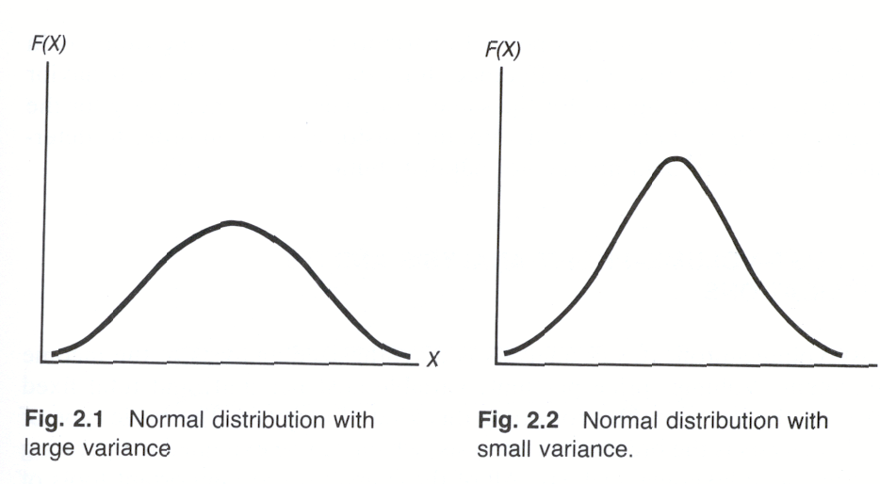
Statistical Distribution of Financial Ratios
where μ and σ² are the population mean and variance, respectively, and e and π are given constants; that is, π= 3.14159 and e = 2.71828.

Slide 25
Statistical Distribution of Financial Ratios
There is a direct relationship between the normal distribution and the log-normal distribution. If Y is log-normally distributed, then X = log Y is normally distributed. Following this definition, the mean and the variance of Y can be defined as:
where exp represents an exponential with base e.

Slide 26
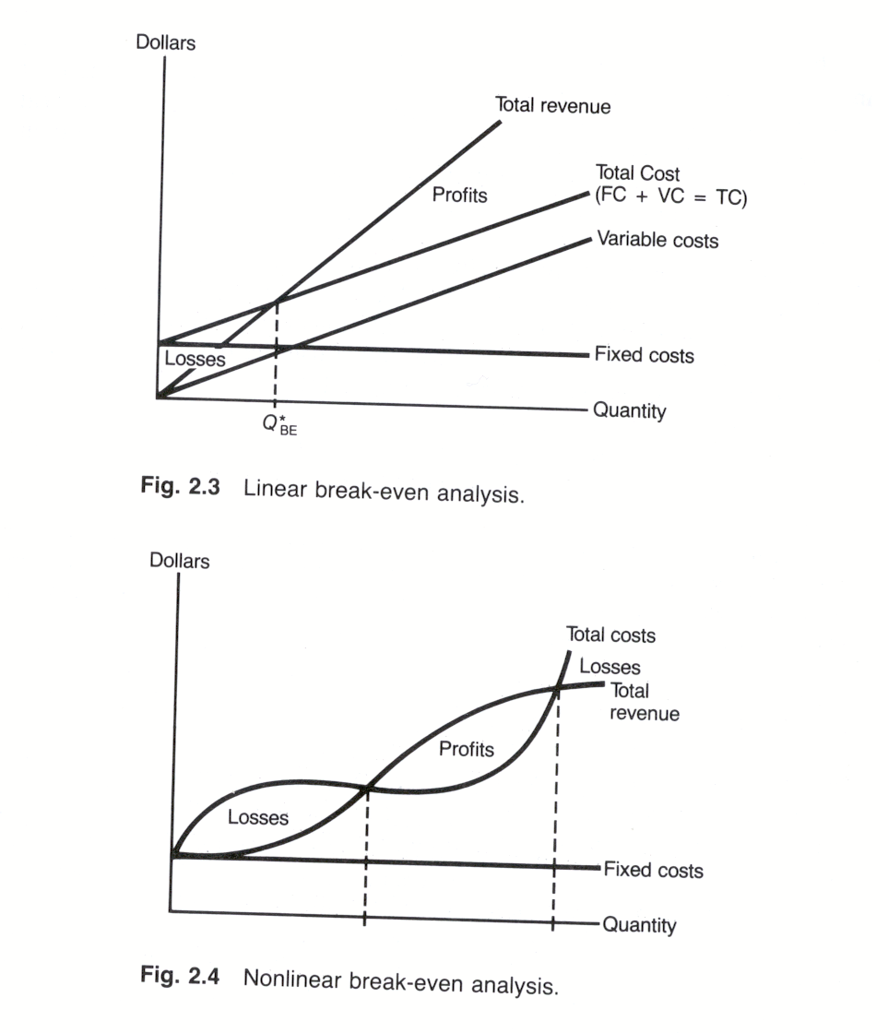
Deterministic Analysis

Slide 27
2.5 COST-VOLUME-PROFIT ANALYSIS AND ITS APPLICATIONS
Deterministic analysis
Stochastic analysis

Slide 28
Deterministic Analysis
Operating Profit = EBIT = Q(P－V)－F, (2.12)
where
Q = Quantity of goods sold;
P = Price per unit sold;
V = Variable cost per unit sold;
F = Total amount of fixed costs; and
P - V = Contribution margin.

Slide 29
Deterministic Analysis
Operating profit = EBIT = Q^{π}(P^{π} － V^{π}) －F. (2.16)

Slide 30
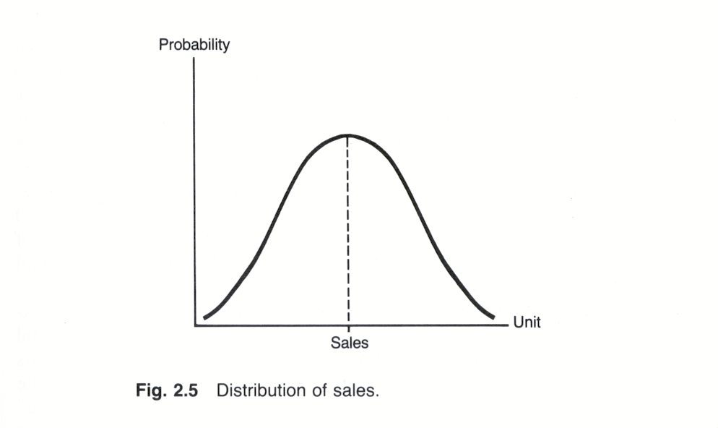
Deterministic Analysis

Slide 31
2.6 ACCOUNTING INCOME VS. ECONOMIC INCOME
E_{t} = A_{t} + P_{t}, (2.17)
where
E_{t} = Economic income,
A_{t} = Accounting earnings,
and
P_{t} = Proxy errors.

Slide 32
2.7 SUMMARY
In this chapter, the usefulness of accounting information in financial analysis is conceptually and analytically evaluated. Both statistical methods and regression analysis techniques are used to show how accounting information can be used to perform active financial analysis for the pharmaceutical industry.
In these analyses, static ratio analysis is generalized to dynamic ratio analysis. The necessity of using simultaneous-equation technique in conducting dynamic financial ratio analysis is also demonstrated in detail. In addition, both deterministic and stochastic CVP analyses are examined. The potential applications of CVP analysis in financial analysis and planning are discussed in some detail. Overall, this chapter gives readers a good understanding of basic accounting information and econometric methods, which are needed for financial analysis and planning.

