Slide 1
Chapter 21
Security Analysis and Mutual Fund Performance
By
Cheng Few Lee
Joseph Finnerty
John Lee
Alice C Lee
Donald Wort

Slide 2
Outline
21.1 FUNDAMENTAL VERSUS TECHNICAL ANALYSIS
21.1.1 Fundamental Analysis
21.1.2 Technical Analysis
21.1.3 Dow Theory
21.1.4 The Odd-Lot Theory
21.1.5 The Confidence Index
21.1.6 Trading Volume
21.1.7 Moving Average
21.2 ANOMALIES AND THEIR IMPLICATIONS
21.2.1 Basu’s Findings

Slide 3
21.2.2 Reinganum’s Findings
21.2.3 Banz’s Findings
21.2.4 Keim’s Findings
21.2.5 Additional Findings
21.3 SECURITY RATE-OF-RETURN FORECASTING
21.3.1 Regression Approach
21.3.1.1 Fixed-Coefficient Market Model
21.3.1.2 Time-Varying-Coefficient Market Model
21.3.2 Time-Series Approach
21.3.2.1Component Analysis

Slide 4
21.3.2.2 ARIMA Models
21.3.3 Composite Forecasting
21.4 VALUE LINE RANKING
21.4.1 Criteria of Ranking
21.4.2 Performance Evaluation
21.5 MUTUAL FUNDS
21.5.1 Mutual-Fund Classification
21.5.2 Mutual-Fund Manager’s Timing and Selectivity
21.6 SUMMARY

Slide 5
21.1 Fundamental Versus Technical Analysis
This section explores the relationship between two components of security analysis and portfolio management: fundamental analysis and technical analysis.

Slide 6
21.1.1 Fundamental Analysis
. If a security’s estimated value is above its market price, the security analyst will recommend buying the stock; if the value is below the market price, the security should be sold before its price drops.
Underpriced stocks are purchased until their price is bid up to equal their value; overpriced stocks are sold, driving their price down until it equals their value.
. Fundamental analysis (the fundamentalist school) studies the basic facts affecting a stock’s value.
It deals with companies’ earnings, their management, earnings forecasts, the firm’s competition, market conditions, and many other business and economic factors.
Technical analysis concentrates almost totally on charts of security-market prices and related summary statistics of security trading; in other words, the behavior of security prices overtime.

Slide 7
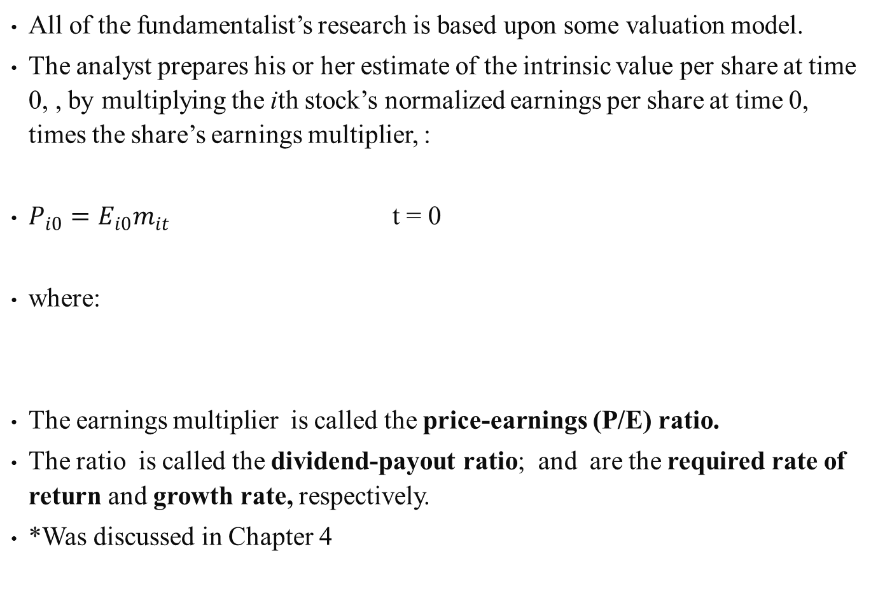
All of the fundamentalist’s research is based upon some valuation model.
The analyst prepares his or her estimate of the intrinsic value per share at time 0, , by multiplying the ith stock’s normalized earnings per share at time 0, times the share’s earnings multiplier, :
$P_{i0}=E_{i0}m_{it}$ t = 0
where:
The earnings multiplier is called the price-earnings (P/E) ratio.
The ratio is called the dividend-payout ratio; and are the required rate of return and growth rate, respectively.
*Was discussed in Chapter 4
(21.1)

Slide 8
A 2 step approach to fundamental analyst’s work which involves using micro to estimate future values for the stock market:
  estimating the expected earnings for some market-indicator series (Dow-Jones Industrial Average or Standard & Poor’s Industrial Index) or some stock
  estimating the expected earnings multiplier for the market series or stock
Main factors that must be considered in determining the correct multiplier are:
  the risk of the security
  the growth rate of the dividend stream
  the duration of any expected growth
  the dividend-payout ratio

Slide 9
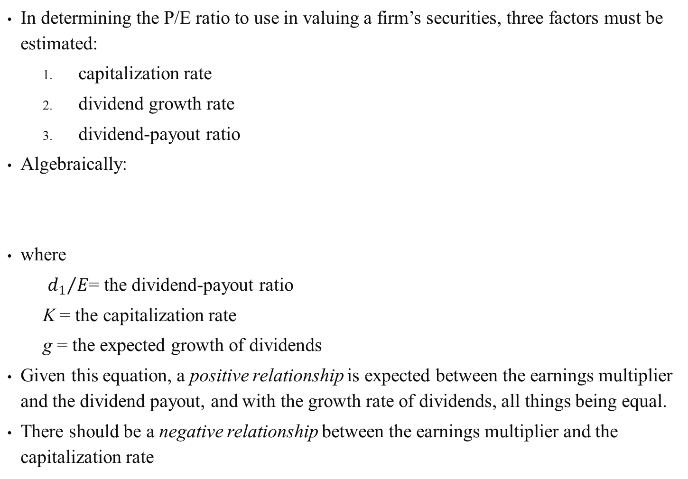
In determining the P/E ratio to use in valuing a firm’s securities, three factors must be estimated:
  capitalization rate
  dividend growth rate
  dividend-payout ratio
Algebraically:
where
  ${d_{1}}/E$= the dividend-payout ratio
  K = the capitalization rate
  g = the expected growth of dividends
Given this equation, a positive relationship is expected between the earnings multiplier and the dividend payout, and with the growth rate of dividends, all things being equal.
There should be a negative relationship between the earnings multiplier and the capitalization rate
(21.2)

Slide 10
Sample Problem 21.1
The stock of XYZ Corporation is currently paying a dividend of $1.00 per share.
The firm’s dividend growth rate is expected to be 10%.
For firms in the same risk class as XYZ, market analysts agree that the capitalization rate is approximately 15%.
Current earnings for XYZ are $2.00 per share and they are expected to grow at 10%.
What are the P/E ratio and the price of XYZ shares given this information?

Slide 11
Solution

Slide 12
Sample Problem 21.2
XYZ in Sample Problem 21.1 is expected to experience an increase in growth rate from 10% to 12%.
What is the impact on XYZ’s P/E ratio and price?
Solution

Slide 13
As can be seen from comparing Sample Problems 21.1 and 21.2, a 20% increase in growth has led to a 67% increase in P/E ratio and a 69% increase in price.
It is clear, therefore, that the accuracy of the analyst’s growth estimate is very important.

Slide 14
The capitalization rate varies with a firm’s risk class and the prevailing market conditions (that’s why we use the macro approach).
Since future expectations are influenced by past experience, one way to estimate a firm’s risk class is to examine historical data .
The capitalization rate is determined by
  the economy’s risk-free rate
  the expected rate of price increases (annual rate of inflation)
  a risk premium for common stocks that reflects investor uncertainty regarding future returns
In theory, using CAPM discussed in chapter 9 should be the beta for common relative to the market portfolio for all risky assets.
Since a portfolio of all risky assets does not exist, an alternative is to examine the relationship between the systematic risk (beta) for a security and various proxies for business risk and financial risk using fundamental factors.
A generally accepted measure of a firm’s business risk is the coefficient of variation of the firm’s operating income.

Slide 15
Financial risk is determined by the financing decisions of the firm, or, more specifically, by the extent of financial leverage employed.
The most common measures of financial risk are the debt/equity ratio and the fixed-charge coverage ratio.
Studies of securities listed on the New York Stock Exchange (NYSE) have shown that their historical average-earnings capitalization rate varied directly with the security’s volatility coefficient.
The fundamental analyst can measure the risk of the company in recent periods, adjust these historical risk statistics for any expected changes, and then use these forecasted risk statistics to obtain capitalization rates.
Reilly et al. (1983) found that the fundamental factors such as the payout ratio, growth, risk-free rate, earnings variability, the debt/equity ratio, and the failure rate of firms going bankrupt combine to form the determinants of the aggregate stock0market earnings multipler
Using these fundamental factors as independent variables in an ordinary least-squares (OLS) regression and multiple discriminate analysis, predictions are made for the multiplier.

Slide 16
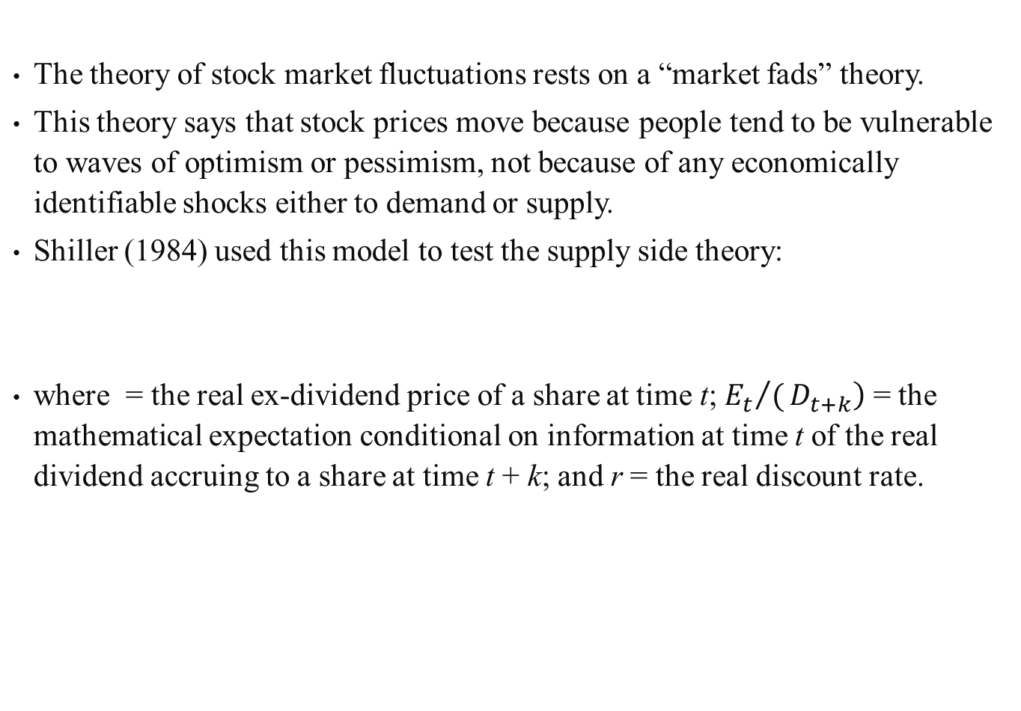
The theory of stock market fluctuations rests on a “market fads” theory.
This theory says that stock prices move because people tend to be vulnerable to waves of optimism or pessimism, not because of any economically identifiable shocks either to demand or supply.
Shiller (1984) used this model to test the supply side theory:
where = the real ex-dividend price of a share at time t; $\left.{E_{t}}/(D_{t+k}\right)$ = the mathematical expectation conditional on information at time t of the real dividend accruing to a share at time t + k; and r = the real discount rate.
(21.3)

Slide 17
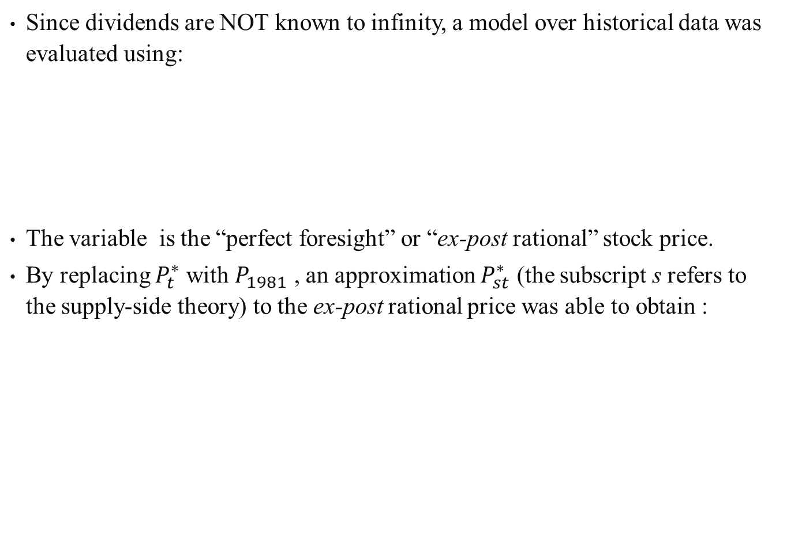
Since dividends are NOT known to infinity, a model over historical data was evaluated using:
The variable is the “perfect foresight” or “ex-post rational” stock price.
By replacing $P_{t}^{∗}$ with $P_{1981}$ , an approximation $P_{st}^{∗}$ (the subscript s refers to the supply-side theory) to the ex-post rational price was able to obtain :
(21.4a)
(21.4b)
(21.5)

Slide 18
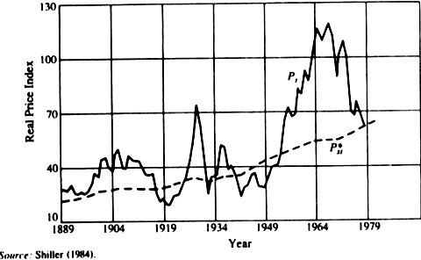

By plotting $P_{st}^{∗}$ along with the real Standard & Poor’s price index $P_{t}$, the two series are quite divergent.
It appears that $P_{st}^{∗}$ behaves like a simple growth trend, while $P_{t}$ oscillates wildly around it; $P_{st}^{∗}$ is smooth increasing because it is a weighted moving average of dividends, and moving averages serve to smooth the series averaged.
Moreover, real dividends are a fairly stable and upward trending series.
Figure 21-1 Real Stock-Price Index and Ex-Post Rational Counterpart Based on Real Dividends, 1889–1981

Slide 19
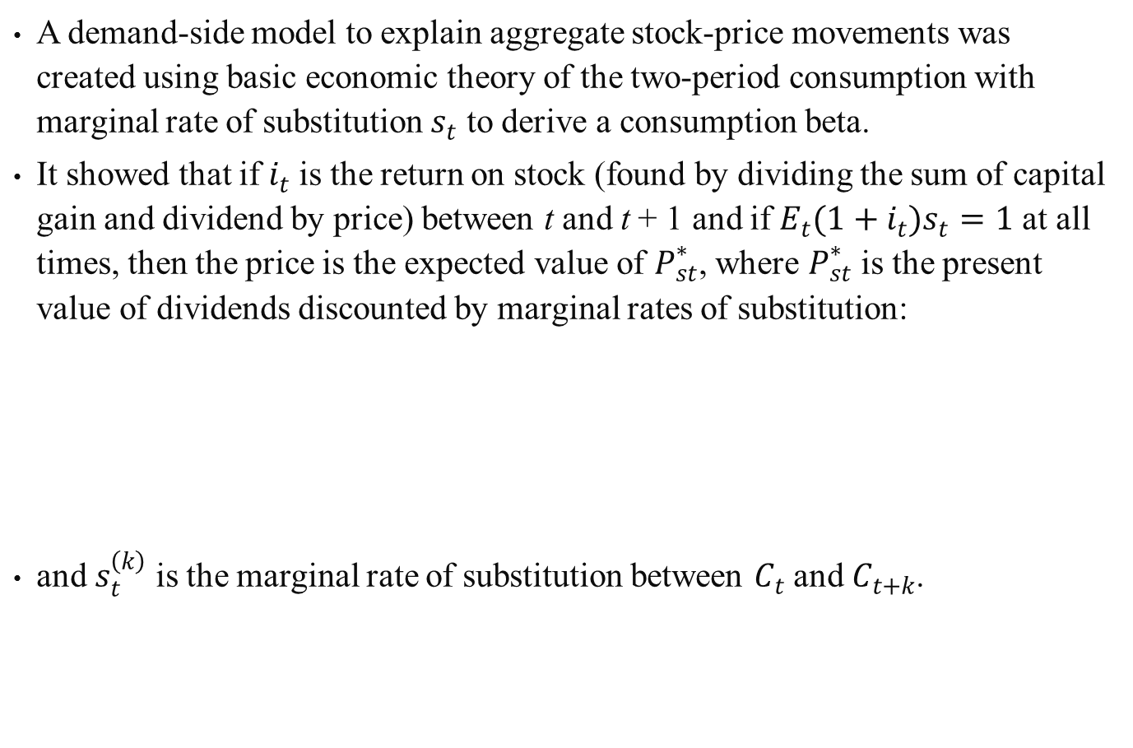
A demand-side model to explain aggregate stock-price movements was created using basic economic theory of the two-period consumption with marginal rate of substitution $s_{t}$ to derive a consumption beta.
It showed that if $i_{t}$ is the return on stock (found by dividing the sum of capital gain and dividend by price) between t and t + 1 and if $E_{t}(1+i_{t})s_{t}=1$ at all times, then the price is the expected value of $P_{st}^{∗}$, where $P_{st}^{∗}$ is the present value of dividends discounted by marginal rates of substitution:
and $s_{t}^{\left(k\right)}$ is the marginal rate of substitution between $C_{t}$ and $C_{t+k}$.
(21.4a)
(21.6)

Slide 20
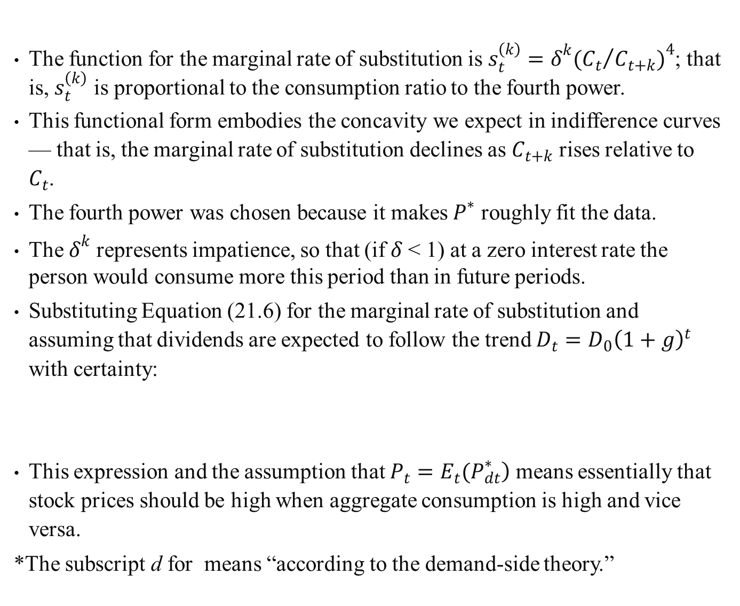
The function for the marginal rate of substitution is $s_{t}^{\left(k\right)}=δ^{k}({C_{t}}/{C_{t+k})^{4}}$; that is, $s_{t}^{\left(k\right)}$ is proportional to the consumption ratio to the fourth power.
This functional form embodies the concavity we expect in indifference curves — that is, the marginal rate of substitution declines as $C_{t+k}$ rises relative to $C_{t}$.
The fourth power was chosen because it makes $P^{∗}$ roughly fit the data.
The $δ^{k}$ represents impatience, so that (if $δ$ < 1) at a zero interest rate the person would consume more this period than in future periods.
Substituting Equation (21.6) for the marginal rate of substitution and assuming that dividends are expected to follow the trend $D_{t}=D_{0}{\left(1+g\right)}^{t}$ with certainty:
This expression and the assumption that $\left.P_{t}=E_{t}(P_{dt}^{∗}\right)$ means essentially that stock prices should be high when aggregate consumption is high and vice versa.
*The subscript d for means “according to the demand-side theory.”
(21.7)

Slide 21
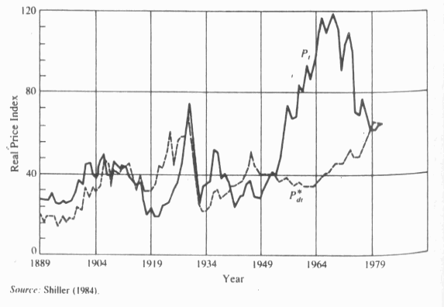

By plotting $P_{dt}^{∗}$ along with real price per share $P_{t}$ (Figure 21-2), it shows that $P_{dt}^{∗}$ moves a great deal more than $P_{st}^{∗}$ ; $P_{dt}^{∗}$ and $P_{t}$ resemble each other much more than $P_{st}^{∗}$ and $P_{t}$ .
The figure shows a break of the demand-side theory in 1950.
But overall, demand-side theory seems more capable than supply-side theory.
Figure 21-2 Real Stock-Price Index P_{t} and Ex-Post Rational $P_{dt}^{∗}$ Counterpart Based on Real Consumption, 1889–1981

Slide 22
21.1.2 Technical Analysis
.Technical analysis is based on the widely accepted premise that security prices are determined by the supply of and the demand for securities.
Typically technical analysts record historical financial data on charts, study these charts in an effort to find meaningful patterns, and use these patterns to predict future prices.
Technical analysts believe that past patterns of market action will recur in the future and that past patterns can be used for predictive purposes.
Rather than try to evaluate the intrinsic value of a security, the technical analysts seek to estimate security prices, or forecast short-run shifts in supply and demand that will affect the market price of one or more securities.
Some of the tools used by chartists to measure supply and demand and to forecast security prices are the Dow theory chart, odd-lot theory, confidence index, breadth-of-market indicators, relative-strength analysis, and trading-volume data.

Slide 23
21.1.3 Dow Theory
The Dow theory is used to indicate reversals and trends in the market as a whole or in individual securities.
According to the theory, there are three movements going on in the markets at all times:
  daily fluctuations (the narrow movement from day-to-day)
  secondary movements (short-run movements over two weeks to a month or more)
  primary trends, major movements covering at least four years in duration
The theory asserts that daily fluctuations are meaningless but daily asset prices or market average must be plotted in order to outline the primary and secondary trends, which is used for searching price patterns indicating market tops and bottoms.

Slide 24
Technical analysts use three basic types of charts:
  Line charts: used to connect successive day’s prices which is then used to search for patterns indicating market tops or bottoms
  Bar charts: have vertical bars representing each day’s price movement. Each bar spans the distance from the day’s highest price to the lowest with a small cross on the bar marking the closing price.
  Point-and-figure charts: draw the percentage change directly; used to detect reversals in a trend and also employed to set actual price forecasts
Only significant changes are posted to a point-and-figure chart.
As a result there are one-point, two-point, three-point, and five-point, point-and-figure charts.

Slide 25
Point-and-figure chartists begin to set the price target (forecasted stock price), by finding a congestion area.
A congestion area is a horizontal band created by a series of reversals around a given price level.
Congestion areas are supposed to result when supply and demand are equal.
A breakout is said to have occurred when a column of price increase rises above the top of a congestion area.
Breakout refers to a price rise or fall in which the price rises above or falls below the horizontal band which contained the congestion area.
A penetration of the top of a congestion area is a signal for continued price rise.
Penetration of the bottom of a congestion area by a column of price declines is a bearish signal.

Slide 26
21.1.4 The Odd-Lot Theory
The Odd-Lot Theory assumes that the common man is usually wrong, and it is therefore advantageous to pursue strategies opposite to his thinking.
In order to find out what the common man is doing, statistics on odd-lot trading are gathered.
Most odd-lot purchases are made by amateur investors with limited resources — that is, by the common man, who is a small, unsophisticated investor.
The odd-lot statistics are broken down into the number of shares purchased, sold, and sold short.
The index of odd-lot purchases less odd-lot sales is typically plotted concurrently with some market index.
The odd-lotter’s net purchases are used by chartists as a leading indicator of market prices.
That is, positive net purchases are presumed to forecast falls in market prices, and net selling by odd-lotters is presumed to occur at the end of a bear market.

Slide 27
21.1.5 The Confidence Index
The confidence index is designed to measure how willing investors are to take a chance in the market.
It is the ratio of high-grade bond yields to low-grade bond yields which starts below one.
When bond investors grow more confident about the economy the ratio shifts closer to one because they shift their holdings from high-grade to lower-grade bonds, lowering their yield relative to high-grade bonds and increasing the confidence index.
Confidence-index technicians believe that the confidence index leads the stock market by two to eleven months.
An increase in the confidence index is supposed to foretell the rising optimism and prices in the stock market, while a decrease represents that low-grade bond yields are rising faster or falling more slowly than high-grade yields.

Slide 28
21.1.6 Trading Volume
Many technical analysts believe that it is possible to detect whether the market in general and/or certain security issues are bullish or bearish by studying the volume of trading.
Volume is supposed to be a measure of the intensity of investors’ emotions.
If high volume occurs on days when prices move up, the overall nature of the market is considered to be bullish.
If the high volume occurs on days when prices are falling, this is a bearish sign.

Slide 29
21.1.7 Moving Average
Moving-average (or rate-of-change) technicians focus on prices and/or moving averages of prices.
The moving average is used to provide a smoothed stable reference point against which the daily fluctuations can be gauged.
Moving-average analysts recommend buying a stock when:
  the 200-day moving average flattens out and the stock’s price rises through the moving average
  the price of a stock falls below a moving-average line that is rising
  the price of a stock that is above the moving-average line falls but turns around and begins to rise again before it ever reaches the moving-average line

Slide 30
Moving-average chartists recommend selling a stock when:
  the moving-average line flattens out and the stock’s price drops downward through the moving-average line
  a stock’s price rises above a moving-average line that is declining
  a stock’s price falls downward through the moving-average line and turns around to rise but then falls again before getting above the moving-average line
All the technical-analysis tools have one thing in common — they attempt to measure the supply and demand for some group of investors.
When changes in prices are used to predict further price change because these shifts are expected to gradually continue as the price gradually reacts to news or other factors, and not instantaneous.

Slide 31
The DONCH system is part of a family of technical systems known as price channels.
The system generates a buy signal any time the daily high price is outside (greater than) the highest price in the specified time interval.
A sell signal is generated any time the daily high breaks outside (lower than) the lowest price in the same interval.
The system always generates a signal for the trader to take a position, long or short, in the futures market.
The MAPB system belongs to a technical family derived from moving averages.
Moving averages come in many forms — that is, simple moving averages, exponentially weighted, linearly weighted, and so on.
The MAPB system employs a simple moving average with a band based on a percentage of price centered around it, the band creates a neutral zone in which the trader is neither long nor short.
A signal to exit a position occurs when the price recrosses the moving average.

Slide 32
The DMAC system employs logic similar to the MAPB system by seeking to find when the short-run trend rises above or below the long-term trend.
The MAPB represents the short-term trend by the daily price and the long-term trend by the moving average.
The DMAC uses a short-term moving average and long-term moving average to represent the short- and long-term trend.
A change in the price trend is signaled when these two moving averages cross.
Specifically, a buy signal is generated when the shorter moving average is greater than (above) the longer moving average, and a sell signal when the shorter moving average is less than (below) the longer moving average.

Slide 33
The DI system is from a technical family known as momentum oscillators.
Whereas the previous systems outlined deal with the futures-price level, oscillators deal with price changes.
The logic employed by the directional-indicator system is that any trending period can be characterized as having a significant excess of either positive or negative price movements.
DI estimates the relative price change of periods when prices are quickly moving upward will have more upward price change than downward price change, and vice versa.
Technical analysis seems to have some merit when the market involved is not efficient.

Slide 34
21.2 Anomalies and Their Implications
21.2.1 Basu’s Findings
Basu tried to determine empirically whether the investment performance of common stocks is related to their P/E ratios.
For any given year under consideration, three criteria are used in selecting sample firms:
  the fiscal year ends on December 31
  the firm actually traded on the NYSE as of the beginning of the portfolio-holding period and is included in the merged tape
  the relevant investment–return and financial-statement data are not missing
From 1956, the P/E ratio of every sample security is computed with numerator of the ratio defined as market value of common stock and denominator as reported annual earnings available for common stockholders.

Slide 35
The procedure, is then repeated annually for 14 years.
Then using that information with the performance evaluation measures, the conclusion was that there are above-normal returns.
The results are consistent with the view that P/E-ratio information is not fully reflected in security prices in as rapid a manner as postulated by the semi-strong form of the efficient-market hypothesis (EMH).
To the extent that low-P/E portfolios did earn superior returns on a risk-adjusted basis, the proposition of the price-ratio hypothesis (on the relationship between investment performance of equity securities and their P/E ratios) seems to be valid.
There appear to be lags and frictions in the process of adjusting security prices to publicly available information.
Therefore, publicly available P/E ratios may possess information content and may warrant an investor’s attention at the time of portfolio formation or revision.

Slide 36
21.2.2 Reinganum’s Findings
Reinganum’s (1981) study documents an empirical anomaly that suggests that either the simple one-period CAPM is misspecified or that capital markets are inefficient.
He collected data mainly from The Wall Street Journal and divided into portfolios based upon standardized unexpected earnings (SUE).
The results indicated that abnormal returns cannot be earned over the period studied by constructing portfolios on the basis of a firm’s SUE.
Reinganum uses the same data source computed earnings/price (E/P) ratios for the firms in his sample.
The E/P ratios are computed as the quarterly net income divided by the value of the common stock.
The value of the common stock is calculated with both pre-earnings and post-earnings announcement prices.

Slide 37
Results indicate that during 1976 and 1977, an abnormal return of about 0.1% per day on the average can be earned by forming portfolios based on E/P ratios.
The evidence in this study suggests that the simple one-period CAPM is misspecified.
The set of factors omitted from the equilibrium pricing mechanism seems to be more closely related to firm size than E/P ratios.
According to Reinganum, the misspecification does not appear to be a market inefficiency in the sense that abnormal returns arise because of transaction costs or informational lags.
Rather, the source of the misspecification seems to be risk factors that are omitted from the CAPM as is evidenced by the persistence of abnormal returns for at least two years.

Slide 38
21.2.3 Banz’s Findings
Banz (1981) examines the empirical relationship between the return and the total market value of NYSE common stocks.
His samples includes all common stocks quoted on the NYSE for at least five years between 1926 and 1975.
. Five years of data are used for the estimation of the security beta; the next five year’s data are used for the re-estimation of the portfolio betas.
Stock price and number of shares outstanding at the end of the five-year periods are used for the calculation of the market proportions.
The results indicate that shares of firms with large market values have had smaller risk-adjusted returns, on average, than similar small firms over a 40-year period.
To summarize, the size effect exists, but it is not clear why it exists.
Although it has been conjectured that the effect may be due to restricted distribution of information about small firms, it has not been established that size is not just a proxy for yet another effect.

Slide 39
21.2.4 Keim’s Findings
Keim (1983) examines, month by month, the empirical relation between abnormal returns and the market value of NYSE and AMEX common stocks.
Evidence is provided that daily abnormal return distributions in January have large means relative to the remaining 11 months, and that the relation between abnormal returns and size is always negative and more pronounced in January than in any other months.
The data for this study are drawn from the CRSP daily stock files for a 17-year period, 1963–1979.
The sample consists of firms listed on the NYSE and AMEX that had returns on the CRSP files during the entire calendar year under consideration.

Slide 40
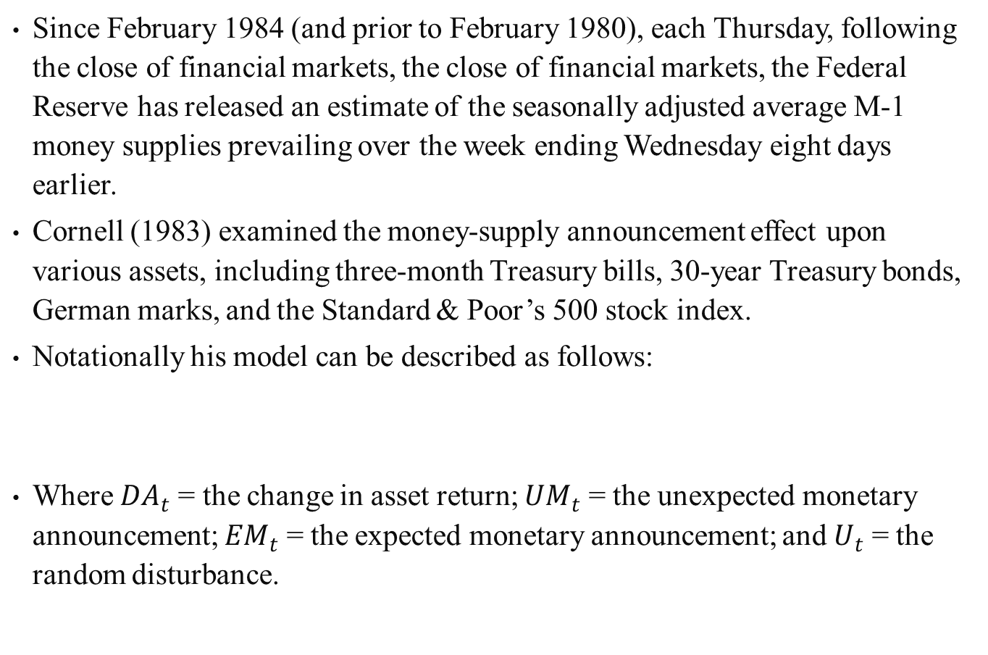
21.2.5 Additional Findings
Since February 1984 (and prior to February 1980), each Thursday, following the close of financial markets, the close of financial markets, the Federal Reserve has released an estimate of the seasonally adjusted average M-1 money supplies prevailing over the week ending Wednesday eight days earlier.
Cornell (1983) examined the money-supply announcement effect upon various assets, including three-month Treasury bills, 30-year Treasury bonds, German marks, and the Standard & Poor’s 500 stock index.
Notationally his model can be described as follows:
Where $DA_{t}$ = the change in asset return; $UM_{t}$ = the unexpected monetary announcement; $EM_{t}$ = the expected monetary announcement; and $U_{t}$ = the random disturbance.
(21.8)

Slide 41
Cornell summarized four major hypotheses that explain why money-supply announcements affect asset prices.
  First, the expected-inflation hypothesis states that the announcements alter analysts’ inflation forecasts.
  Second, the Keynesian hypothesis predicts that in response to an announced innovation in the money stock, analysts expect the Fed to take offsetting action.
  Third, the real-activity hypothesis alleges that money-supply announcements provide the market with information about future output, and thereby future money demand.
  Finally, the risk-premium hypothesis states that money-supply announcements alter the required real return on financial assets by providing the market with information about aggregate risk preferences and beliefs.
None of the hypotheses explained the reaction of all four assets.
Therefore, at best, the market is responding to money-supply announcements in an eclectic manner.

Slide 42
Cornell, Urich, and Wachtel have found other evidence to support the anomalies.
Due to the existence of anomalies tends to indicate that the market is not perfectly efficient, technical analysts have hope for some success in capturing excess profits.
Treynor and Ferguson (1985) further defended the use of technical analysis by using a Bayesian probability estimate to assess whether, in using past price data, the market has already incorporated some firm-specific information available to the investor.
If the market has not discovered this information and past price data confirms this, the informed investor may be able to realize excess returns.
Their results showed that past prices, combined with other valuable information, can be used to achieve excess returns.
However, they noted that it is the firm-specific information that creates the opportunity while past prices serve to permit its exploitation.

Slide 43
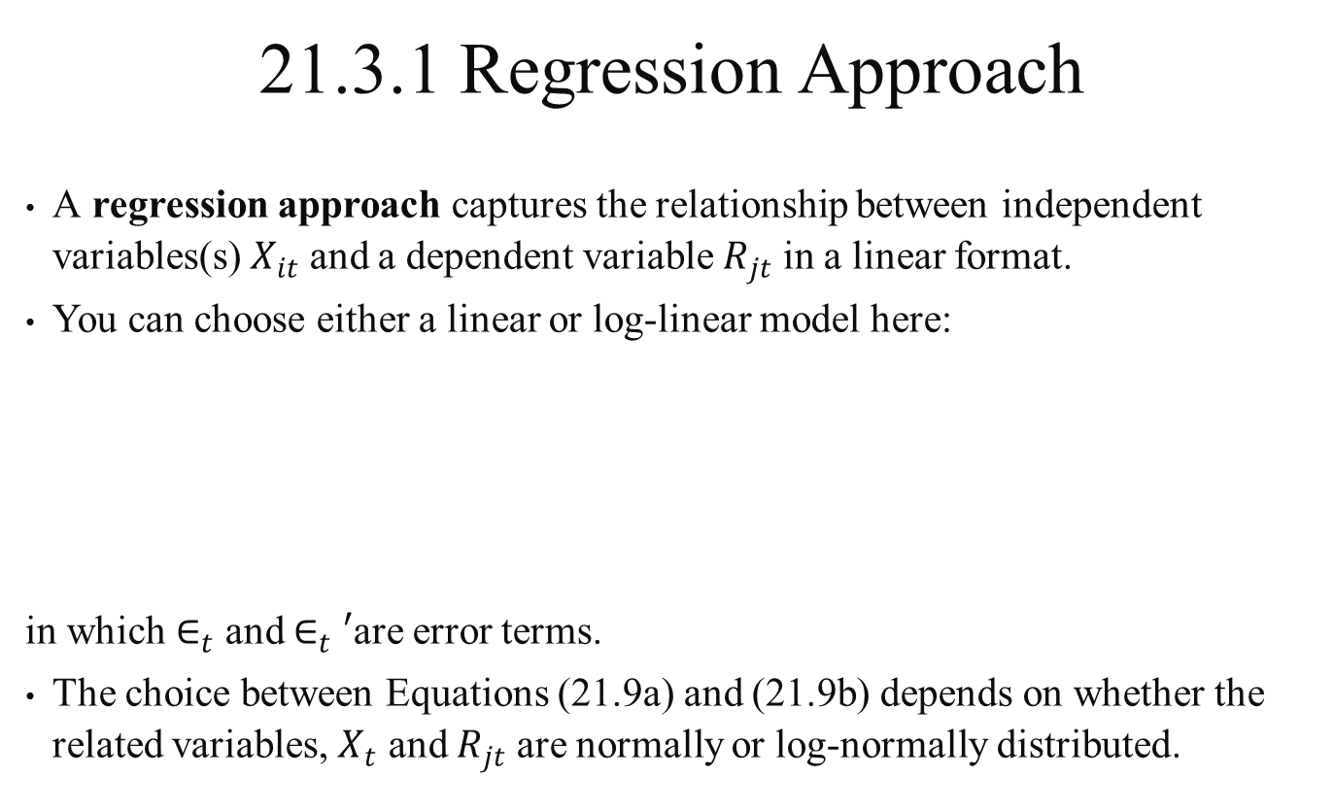
21.3 Security Rate-of-Return Forecasting
21.3.1 Regression Approach
A regression approach captures the relationship between independent variables(s) $X_{it}$ and a dependent variable $R_{jt}$ in a linear format.
You can choose either a linear or log-linear model here:
in which $∈_{t}$ and $∈_{t}′$are error terms.
The choice between Equations (21.9a) and (21.9b) depends on whether the related variables, $X_{t}$ and $R_{jt}$ are normally or log-normally distributed.
(21.9a)
(21.9b)

Slide 44
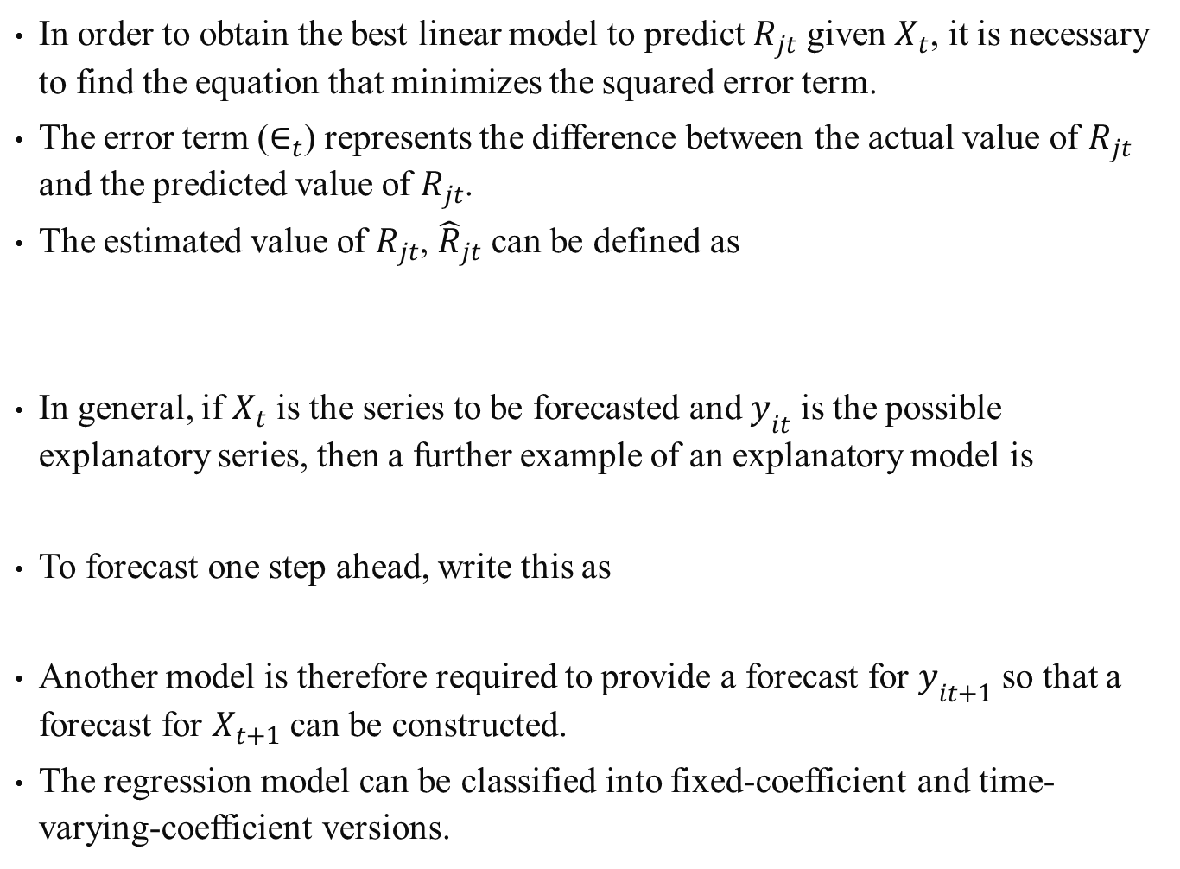
In order to obtain the best linear model to predict $R_{jt}$ given $X_{t}$, it is necessary to find the equation that minimizes the squared error term.
The error term ($∈_{t}$) represents the difference between the actual value of $R_{jt}$ and the predicted value of $R_{jt}$.
The estimated value of $R_{jt}$, ${\hat{R}}_{jt}$ can be defined as
In general, if $X_{t}$ is the series to be forecasted and $y_{it}$ is the possible explanatory series, then a further example of an explanatory model is
To forecast one step ahead, write this as
Another model is therefore required to provide a forecast for $y_{it+1}$ so that a forecast for $X_{t+1}$ can be constructed.
The regression model can be classified into fixed-coefficient and time-varying-coefficient versions.

Slide 45
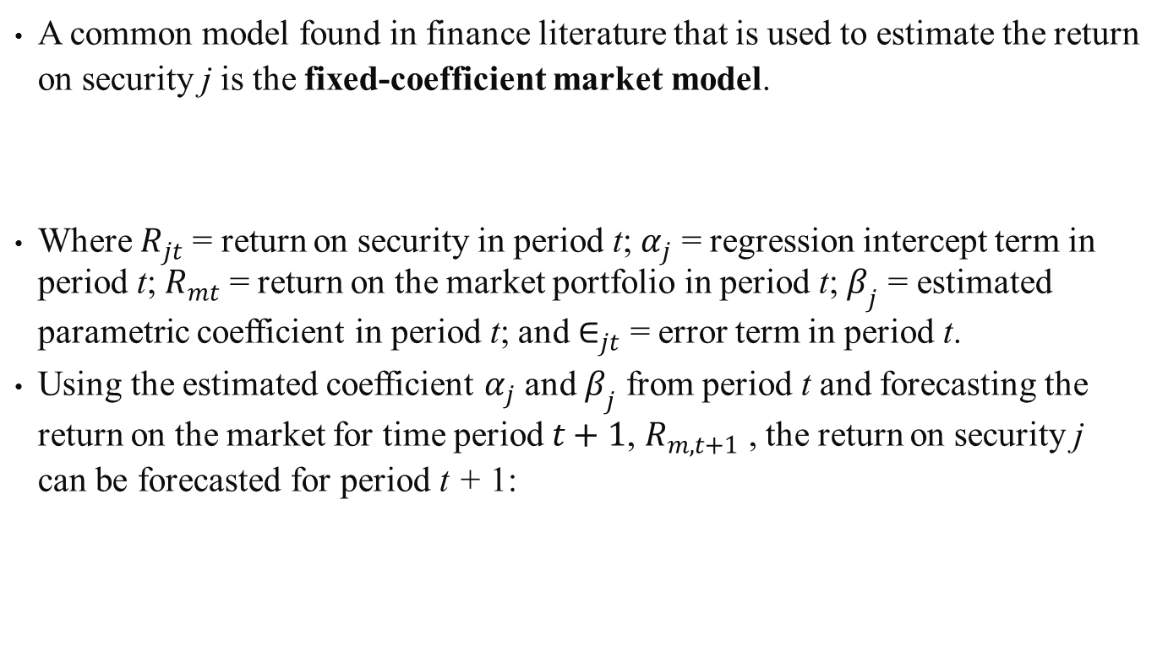
21.3.1.1 Fixed- Coefficient Market Model
A common model found in finance literature that is used to estimate the return on security j is the fixed-coefficient market model.
Where $R_{jt}$ = return on security in period t; $α_{j}$ = regression intercept term in period t; $R_{mt}$ = return on the market portfolio in period t; $β_{j}$ = estimated parametric coefficient in period t; and $∈_{jt}$ = error term in period t.
Using the estimated coefficient $α_{j}$ and $β_{j}$ from period t and forecasting the return on the market for time period $t+1$, $R_{m,t+1}$ , the return on security j can be forecasted for period t + 1:
(21.10)
(21.11)

Slide 46
21.3.1.2 Time- Varying- Coefficient Market Model
A variation of the fixed-coefficient market model, the time-varying-coefficient market model allows the coefficient to vary with time.
Algebraically:
Substituting Equation (21.12b) into Equation (21.12a) leads to a multiple-regression format where
In order to use this format to forecast , not only must be forecasted but also , which indicates that a forecast of variable must be available.
As one can see this is a much more complex situation than forecasting using a constant beta.
(21.12a)
(21.12b)
(21.13)

Slide 47
21.3.2 Time-Series Approach
A time series is a set of observations generated sequentially in time.
If the set is continuous, the time series is said to be continuous.
If the set is discrete, the time series is said to be discrete.
The use at time t of available observations from a time series to forecast its value at some future time t + 1 can provide a base for economic and business planning, production planning, inventory and production control, and optimization of industrial processes.
To calculate the best forecasts, it is also necessary to specify their accuracy, so that the risks associated with decisions based upon the forecasts may be calculated.

Slide 48
Two major approaches to time-series analysis are
  Component analysis regards the time series as being composed of several influences or components that are generally taken to be trend-cycle, seasonal, and random movements.
    In component analysis the seasonal and trend movements are modeled in a deterministic manner.
    The trend might be fitted by a polynomial of a given degree and the seasonal component by a Fourier series (a trigonometric function with a given period and amplitude).
  Sample-function analysis regards a time series as an observed sample function representing a realization of an underlying stochastic process.
    Complicated parametric statistical-estimation procedures are used to determine the properties of time-series data.
    Since empirical results obtained from component analysis are easier to understand and interpret, henceforth this chapter concerns only component analysis.

Slide 49
21.3.2.1 Component Analysis
Component analysis is based on the premise that seasonal fluctuations can be measured in an original series of economic data and separated from trend, cyclical, trading-day, and random fluctuation.
The seasonal component reflects a long-term pattern of variation which is repeated constantly or in an evolving fashion from year to year.
The trend-cycle component includes the long-term trend and the business cycle.
The trading-day component consists of variations which are attributed to the composition of the calendar.
The random component is composed of residual variations that reflect the effect of random or unexplained events in the time series.

Slide 50
Decomposing past time series and discovering the relative percentage contribution of the trend, seasonal, and random components to changes in the series provide insight to financial analysts.
The trend-cycle component reflects permanent information in both a short- and long-run economic time series.
The seasonal component is considered to represent a permanent pattern underlying the short-run time series.
The random component contains the randomness that exists in the time series for both short- and long-run analysis.
The higher the relative percentage contribution of the random component in a time series, the greater the uncertainty and thus the greater the probability of forecasting errors.
An industry index of the percentage contribution of the random components for each income statement variable would provide a useful benchmark to measure the reliability of an analyst’s forecast.

Slide 51
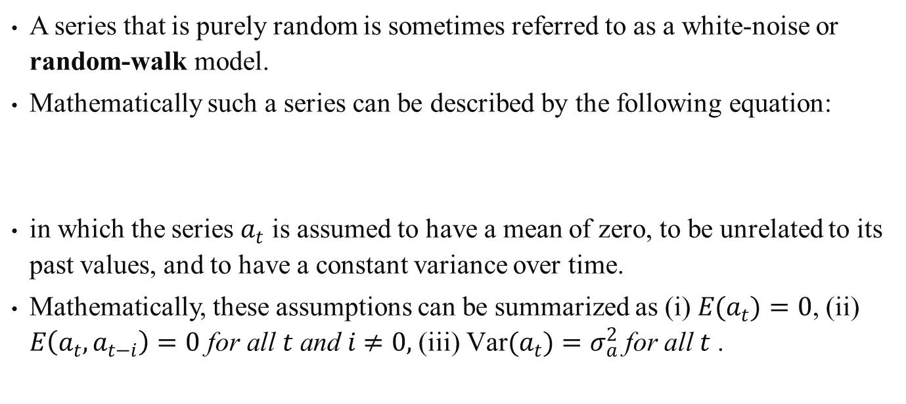
21.3.2.2 ARIMA Models
A series that is purely random is sometimes referred to as a white-noise or random-walk model.
Mathematically such a series can be described by the following equation:
in which the series $a_{t}$ is assumed to have a mean of zero, to be unrelated to its past values, and to have a constant variance over time.
Mathematically, these assumptions can be summarized as (i) $E(a_{t})=0$, (ii) $E\left(a_{t},a_{t−i}\right)=0 \text{for} \text{all} t \text{and} i≠0,$ (iii) $\text{Var}(a_{t})=σ_{a}^{2} \text{for} \text{all} t$ .
(21.14)

Slide 52
Modifying Equation (21.14) to allow the series to be concentrated around a nonzero mean , the series could now be described:
Equation (21.15) is a model that can be used to represent many different time series in economics and finance.
For example, in an efficient market a series of stock prices might be expected to randomly fluctuate around a constant mean.
So the actual stock price observed in time period t would be equal to its average price plus some random shock in time period t.
(21.15)

Slide 53
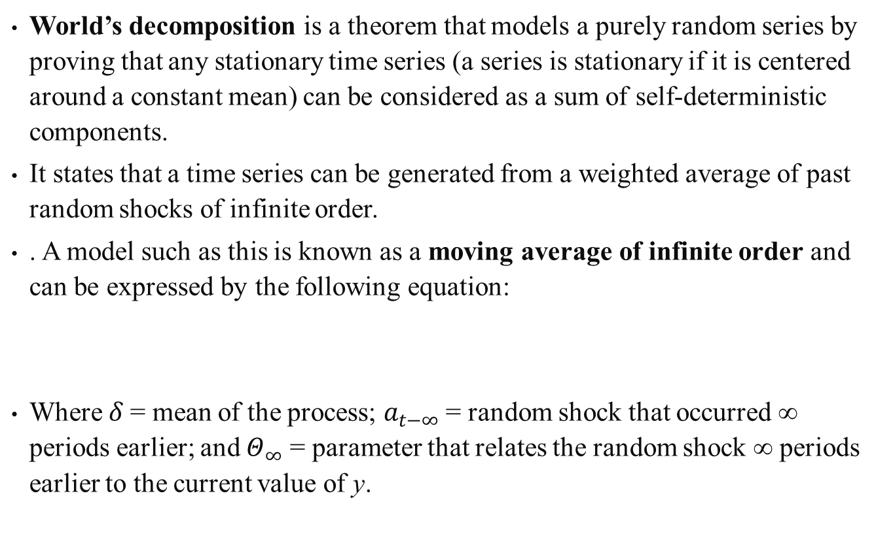
World’s decomposition is a theorem that models a purely random series by proving that any stationary time series (a series is stationary if it is centered around a constant mean) can be considered as a sum of self-deterministic components.
It states that a time series can be generated from a weighted average of past random shocks of infinite order.
. A model such as this is known as a moving average of infinite order and can be expressed by the following equation:
Where $δ$ = mean of the process; $a_{t−∞}$ = random shock that occurred ∞ periods earlier; and $Θ_{∞}$ = parameter that relates the random shock ∞ periods earlier to the current value of y.
(21.16)

Slide 54
The moving-average model just discussed should not be confused with the moving-average concept previously discussed in this chapter.
Previously, the term moving average was used to refer to an arithmetic average of stock prices over a specified number of days.
The term moving average was used because the average was continually updated to include the most recent series of data.
In time-series analysis, a moving-average process refers to a series generated by a weighted average of past random shocks.
Because it would be impossible to estimate a model of infinite order, in practice it is best to specify a model of finite order.
A moving-average process of order q with zero mean would be expressed:
(21.17)

Slide 55
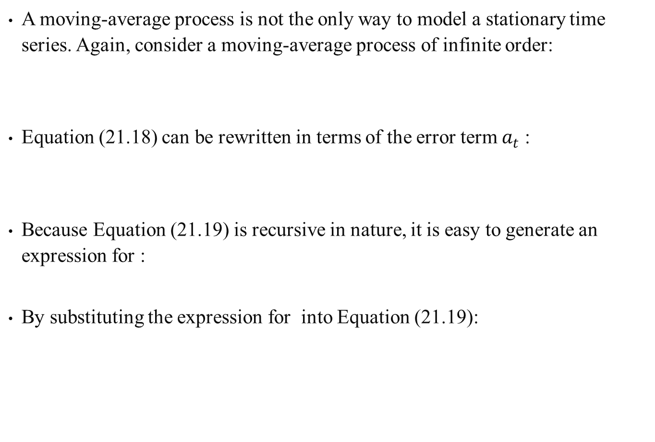
A moving-average process is not the only way to model a stationary time series. Again, consider a moving-average process of infinite order:
Equation (21.18) can be rewritten in terms of the error term $a_{t}$ :
Because Equation (21.19) is recursive in nature, it is easy to generate an expression for :
By substituting the expression for into Equation (21.19):
(21.18)
(21.19)
(21.20)
(21.21)

Slide 56
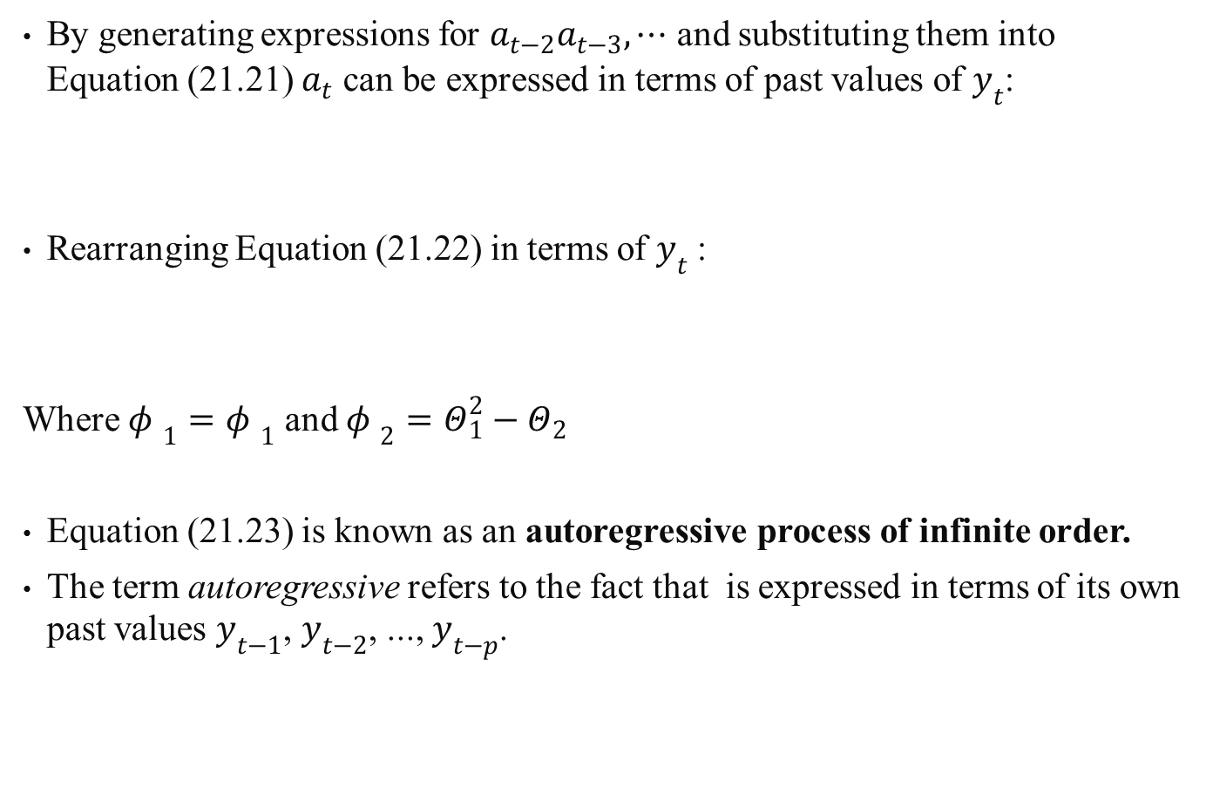
By generating expressions for $a_{t−2}a_{t−3},⋯$ and substituting them into Equation (21.21) $a_{t}$ can be expressed in terms of past values of $y_{t}$:
Rearranging Equation (21.22) in terms of $y_{t}$ :
Where $φ_{ 1}=φ_{ 1}$ and $φ_{ 2}=Θ_{1}^{2}−Θ_{2}$
Equation (21.23) is known as an autoregressive process of infinite order.
The term autoregressive refers to the fact that is expressed in terms of its own past values $y_{t−1}$, $y_{t−2}$, ..., $y_{t−p}$.
(21.22)
(21.23)

Slide 57
Again, because it is impossible to estimate a model of infinite order, an approximate model of finite order is specified.
An autoregressive process of order p can be expressed:
Thus a stationary time series can be expressed in two ways:
  as a moving-average process in which the series can be represented as a weighted average of past random shocks
  as an autoregressive process in which the series can be represented as a weighted average of its past values.
  a series may involve some combination of the two processes.
This process is referred to as a mixed autoregressive moving-average (ARMA) process.
(21.24)

Slide 58
An ARMA process of infinite order can be expressed:
Again, an ARMA process of finite order must be specified in order to make estimation possible. An ARMA (p, q) process can be expressed:
So far the discussion has focused on the estimation of stationary time series.
A nonstationary series can usually be made stationary by transforming the data in an appropriate manner.
The most popular method of transforming a nonstationary series to a stationary one is by differencing the series
(21.25)
(21.26)

Slide 59
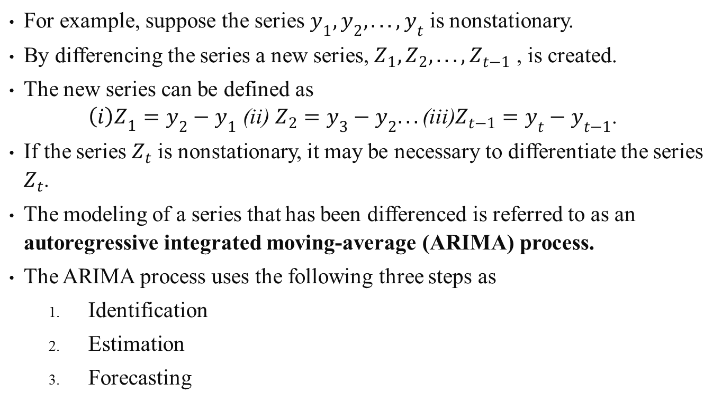
For example, suppose the series $y_{1},y_{2},...,y_{t}$ is nonstationary.
By differencing the series a new series, $Z_{1},Z_{2},...,Z_{t−1}$ , is created.
The new series can be defined as ${\left(i\right)Z}_{1}=y_{2}−y_{1}\text{ (}\text{ii}\text{) }Z_{2}=y_{3}−y_{2}...\text{(}\text{iii}\text{)}Z_{t−1}=y_{t}−y_{t−1}$.
If the series $Z_{t}$ is nonstationary, it may be necessary to differentiate the series $Z_{t}$.
The modeling of a series that has been differenced is referred to as an autoregressive integrated moving-average (ARIMA) process.
The ARIMA process uses the following three steps as
  Identification
  Estimation
  Forecasting

Slide 60
The first step is to identify the appropriate model.
Identification involves determining the degree of differencing necessary to make the series stationary and to determine the form (ARMA or ARIMA) and order of the process.
After a suitable model is identified, the parameters , need to be estimated.
The final step in the ARIMA process is to use the model for forecasting.
Oftentimes the adequacy of the model is checked by using the model to forecast within the sample.
This allows a comparison of the forecasted values to the actual values.
If the model is determined to be adequate, the model can be used to forecast future values of the series.

Slide 61
21.3.3 Composite Forecasting
Bessler and Brandt (1979) have examine three alternative procedure for forecasting time-dependent prices:
  Econometric models
  Time series (ARIMA)
  Expert opinion
The results suggests that no method consistently outperformed each other.
Composite forecasts based on the forecasts of the individual methods are formed by:
  Minimum variance
  Adaptive weighting
  Simple average composites

Slide 62
The econometric model is essentially based on representations of the underlying economic behavioral system for a particular commodity.
These representations attempt to identify and model the relevant supply-and-demand factors that together determine market price and quantity.
As an alternative to statistical models for forecasting, forecasts based upon expert opinions are available.
The forecasts of experts are like those of econometric- or ARIMA-model forecasting in that they incorporate much of the same information from the same data sources, however, expert can change the weights assigned to different bits of information, or can select with relative ease the sources from which to draw the data.
In addition, these expert forecasts are able to incorporate information that cannot, perhaps, be included in a more quantitative model in the form of data.

Slide 63
Bessler and Brandt (1979) use various test or measure of performance to evaluate the price forecasts of the 4 alternatives.
They used the mean-squared error, the mean forecast error, and the mean absolute forecast error.
Mean-squared error is a nonparametric statistic that provides a measure of the size of individual forecast errors from the actual values
Bessler and Brandt’s study didn’t find any specific forecasting method to be universally superior in terms of performance measures, though in most commodities, ARIMA model performed the best.
The results of the performance evaluation suggest that forecasters should seriously consider using composite forecasting techniques

Slide 64
21.4 Value Line Ranking
Value Line Investment Survey is an independent weekly investment-advisory service registered with the US Securities and Exchange Commission
There are 3 sections:
  Rating and Reports
  Summary and Indexes
  Selection and Opinion

Slide 65
21.4.1 Criteria of Ranking
Value line is ranked by timeliness and safety
Timeliness run on scale from 1 (highest) down to 5 (lowest)
Safety rank is a measure of risk avoidance; 1 (safest) to 5 (riskiest)
Evaluation of a single stock involves:
  Choosing stocks that are acceptable in terms of timeliness rankings;
  Among the stocks chosen for timeliness, picking those that are in industries also shown to be timely;
  Among the most timely stocks in the most timely industries, picking those that conform to the investor’s safety constraints;
  Among those stocks that meet the investor’s timeliness and safety constraints, choosing those that meet the investor’s current yield requirement.

Slide 66
21.4.2 Performance Evaluation
Fischer Black (1972), advocate of the buy-and-hold strategy, using monthly data over a given year commencing with April 1965, tested for the investment performance of the Value Line rankings.
He used Jensen’s time-series test of consistency of performance, calculating the return on the market at frequent intervals.
The results of Black’s tests show that the success of the rankings are very consistent over time, and thus very significant in a statistical sense.
In sum, the use of Jensen’s CAPM time-series test tends to indicate that rankings clearly provide a profitable portfolio strategy for investors who can execute orders at low transaction costs.
Even in reducing the turnover activity involved, significant excess returns were achieved.

Slide 67
Holloway (1981) and Copeland and Mayer (1982) and Chen (1987) all performed similar studies.
Stickel (1985) used an event-study methodology to examine evidence on
  the differential impact of the various types of rank change
  the speed of adjustment of individual security prices to new information
The results indicated that although Value Line rank changes have information content, the effect varies by the type of rank change.

Slide 68
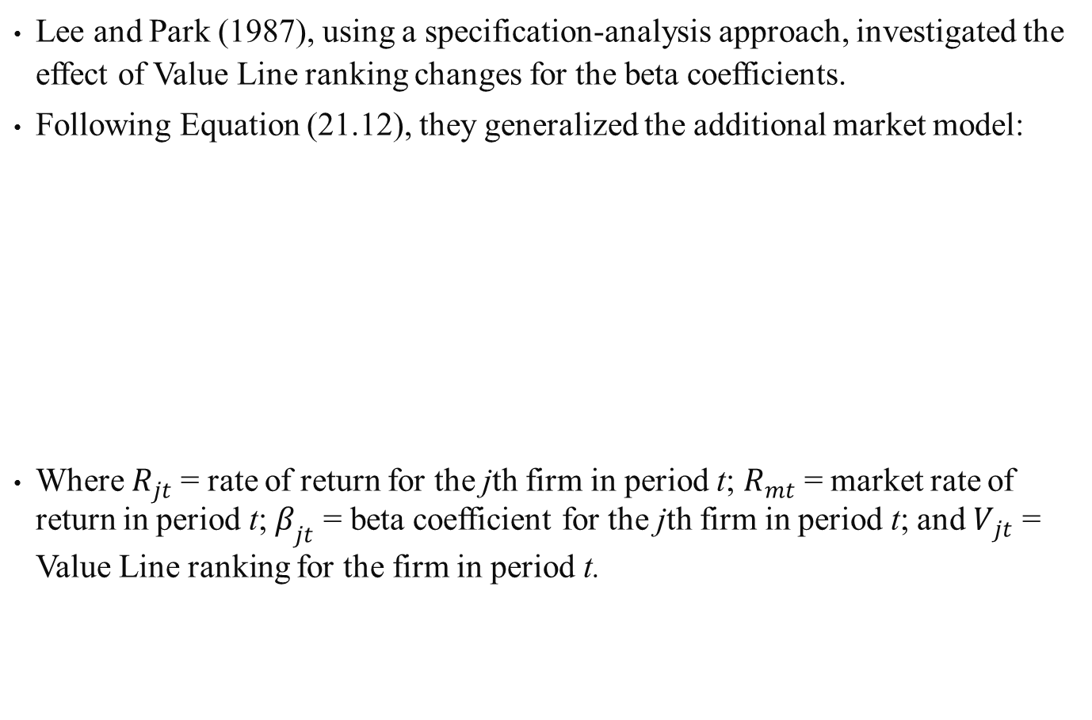
Lee and Park (1987), using a specification-analysis approach, investigated the effect of Value Line ranking changes for the beta coefficients.
Following Equation (21.12), they generalized the additional market model:
Where $R_{jt}$ = rate of return for the jth firm in period t; $R_{mt}$ = market rate of return in period t; $β_{jt}$ = beta coefficient for the jth firm in period t; and $V_{jt}$ = Value Line ranking for the firm in period t.
(21.27a)
(21.27b)

Slide 69
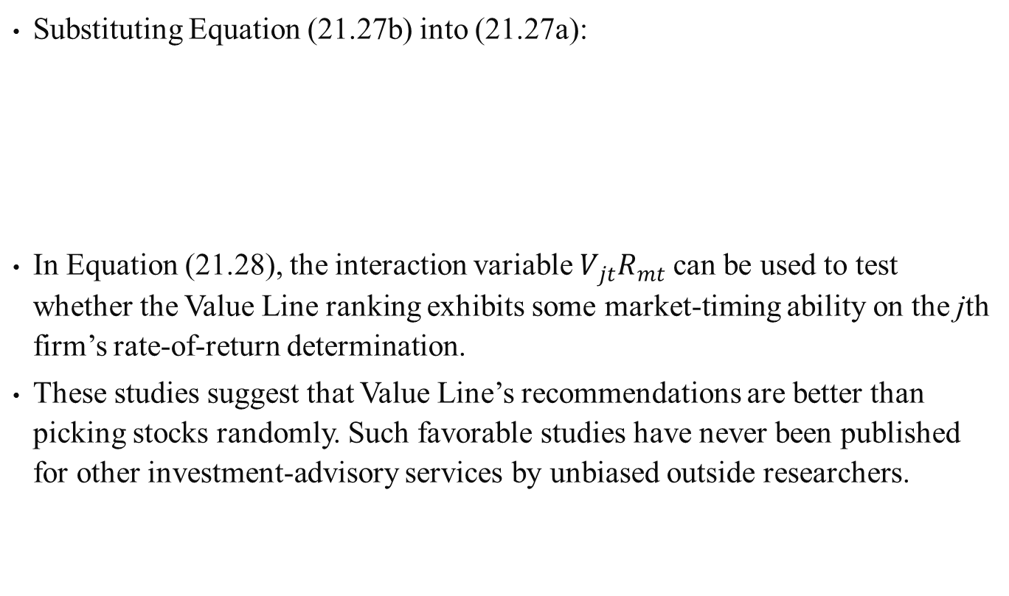
Substituting Equation (21.27b) into (21.27a):
In Equation (21.28), the interaction variable $V_{jt}R_{mt}$ can be used to test whether the Value Line ranking exhibits some market-timing ability on the jth firm’s rate-of-return determination.
These studies suggest that Value Line’s recommendations are better than picking stocks randomly. Such favorable studies have never been published for other investment-advisory services by unbiased outside researchers.
(21.28)

Slide 70
21.5 Mutual Funds
21.5.1 Mutual-Fund Classification
Investment company Act 1940 said that mutual funds must publish a written statement of their investment objectives and make it available to their shareholders.
The investment objectives of mutual funds can be classified into four categories
  Growth
  Income and growth
  Income
  Income, growth, and stability (balanced fund)
These objectives are listed in descending order of the aggressiveness with which the fund’s management implies it will seek a high average rate of return and assume the corresponding risks.

Slide 71
Balanced funds offer a complete investment program to their clients, so far as marketable securities are concerned
Growth funds are structured to include a well-diversified combination of common stocks
Why are growth funds more popular than balanced funds?
  Empirical studies of common stocks have almost invariably shown their long-term total returns to exceed those on bonds
  Stock is generally conceded to be a better hedge against inflation risk than bonds
  Many small investors may prefer to hold obligations of financial institutions as their major fixed-income securities because of their convenience and safety resulting from government insurance programs
Income funds are composed of well-diversified selection of bonds.
Income-and-growth funds are composed of a combination of common stock and bonds
Emphasis on either income or growth determines on what percentage of bonds or common stock is in the portfolio

Slide 72
21.5.2 Mutual-Fund Manager’s Timing and Selectivity
When faced with the problem of deriving a performance measure, there are two considerations:
  the collective performance of the security portfolio
  the relative performance of the security portfolio
Performance evaluations originally employed a one-parameter risk–return benchmark like that developed by Jensen (1968, 1969) and refined by Black et al. (1972), and Blume and Friend (1973).
Fama (1972) and Jensen (1972) pointed out the empirical measurement problems involved in evaluating properly the constituents of investment performance when portfolio risk levels are nonstationary as indicated by Chang and Lewellen (1984).

Slide 73
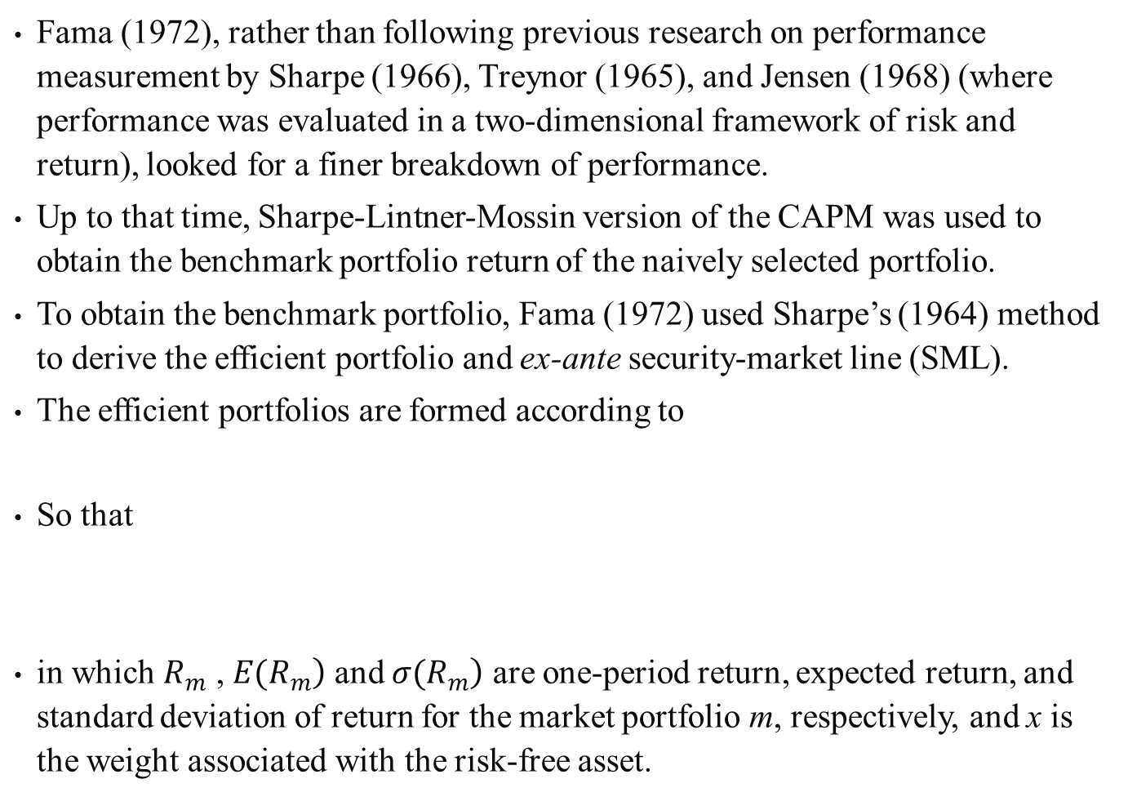
Fama (1972), rather than following previous research on performance measurement by Sharpe (1966), Treynor (1965), and Jensen (1968) (where performance was evaluated in a two-dimensional framework of risk and return), looked for a finer breakdown of performance.
Up to that time, Sharpe-Lintner-Mossin version of the CAPM was used to obtain the benchmark portfolio return of the naively selected portfolio.
To obtain the benchmark portfolio, Fama (1972) used Sharpe’s (1964) method to derive the efficient portfolio and ex-ante security-market line (SML).
The efficient portfolios are formed according to
So that
in which $R_{m}$ , $\left.E(R_{m}\right)$ and $\left.σ(R_{m}\right)$ are one-period return, expected return, and standard deviation of return for the market portfolio m, respectively, and x is the weight associated with the risk-free asset.
(21.29)
(21.30)
(21.31)

Slide 74
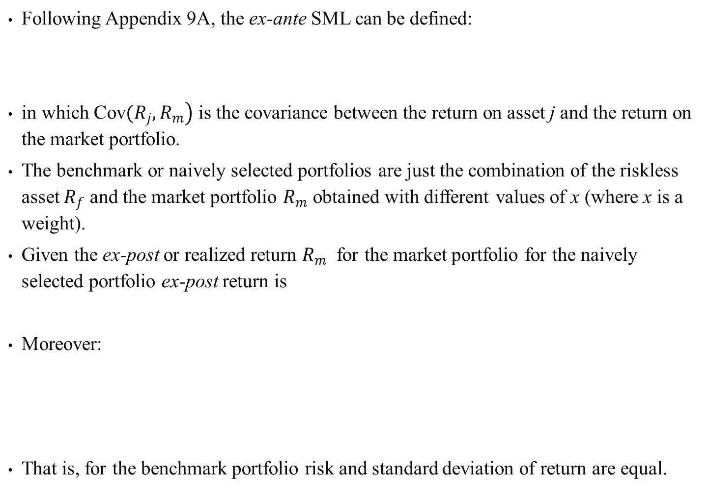
Following Appendix 9A, the ex-ante SML can be defined:
in which $\left.\text{Cov}(R_{j},R_{m}\right)$ is the covariance between the return on asset j and the return on the market portfolio.
The benchmark or naively selected portfolios are just the combination of the riskless asset $R_{f}$ and the market portfolio $R_{m}$ obtained with different values of x (where x is a weight).
Given the ex-post or realized return $R_{m}$ for the market portfolio for the naively selected portfolio ex-post return is
Moreover:
That is, for the benchmark portfolio risk and standard deviation of return are equal.
(21.32)
(21.33)
(21.34)

Slide 75
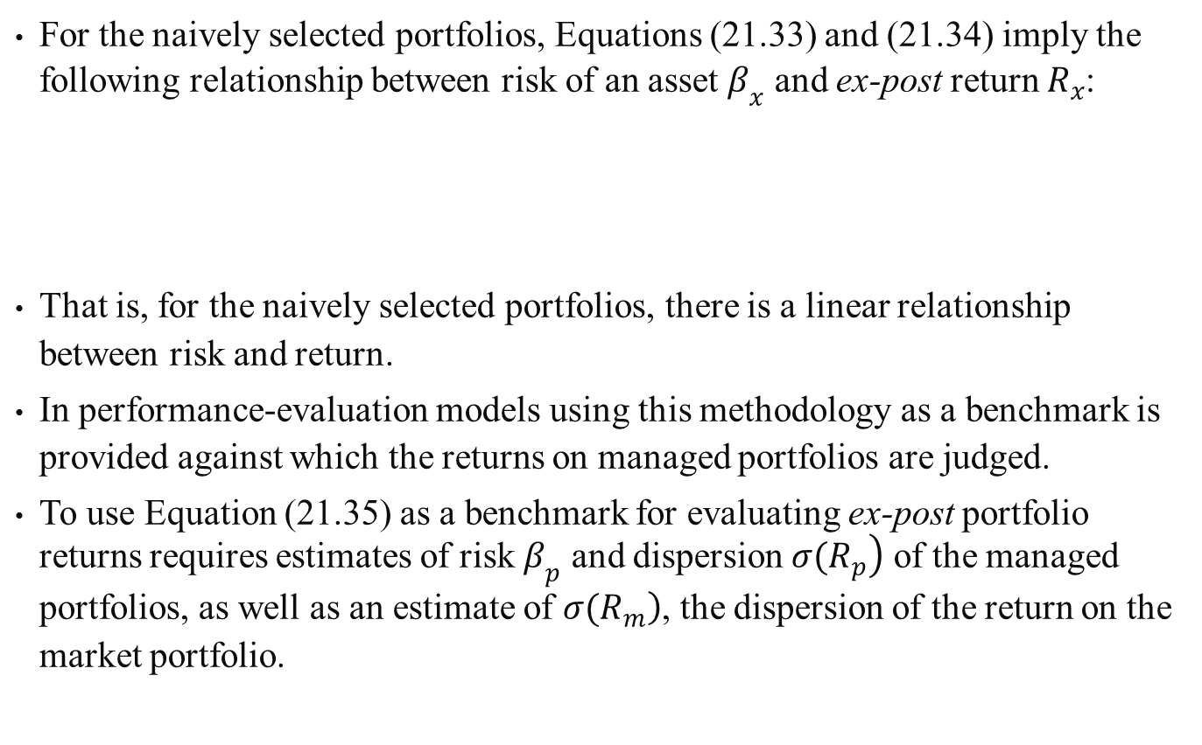
For the naively selected portfolios, Equations (21.33) and (21.34) imply the following relationship between risk of an asset $β_{x}$ and ex-post return $R_{x}$:
That is, for the naively selected portfolios, there is a linear relationship between risk and return.
In performance-evaluation models using this methodology as a benchmark is provided against which the returns on managed portfolios are judged.
To use Equation (21.35) as a benchmark for evaluating ex-post portfolio returns requires estimates of risk $β_{p}$ and dispersion $\left.σ(R_{p}\right)$ of the managed portfolios, as well as an estimate of $\left.σ(R_{m}\right)$, the dispersion of the return on the market portfolio.
(21.35)

Slide 76
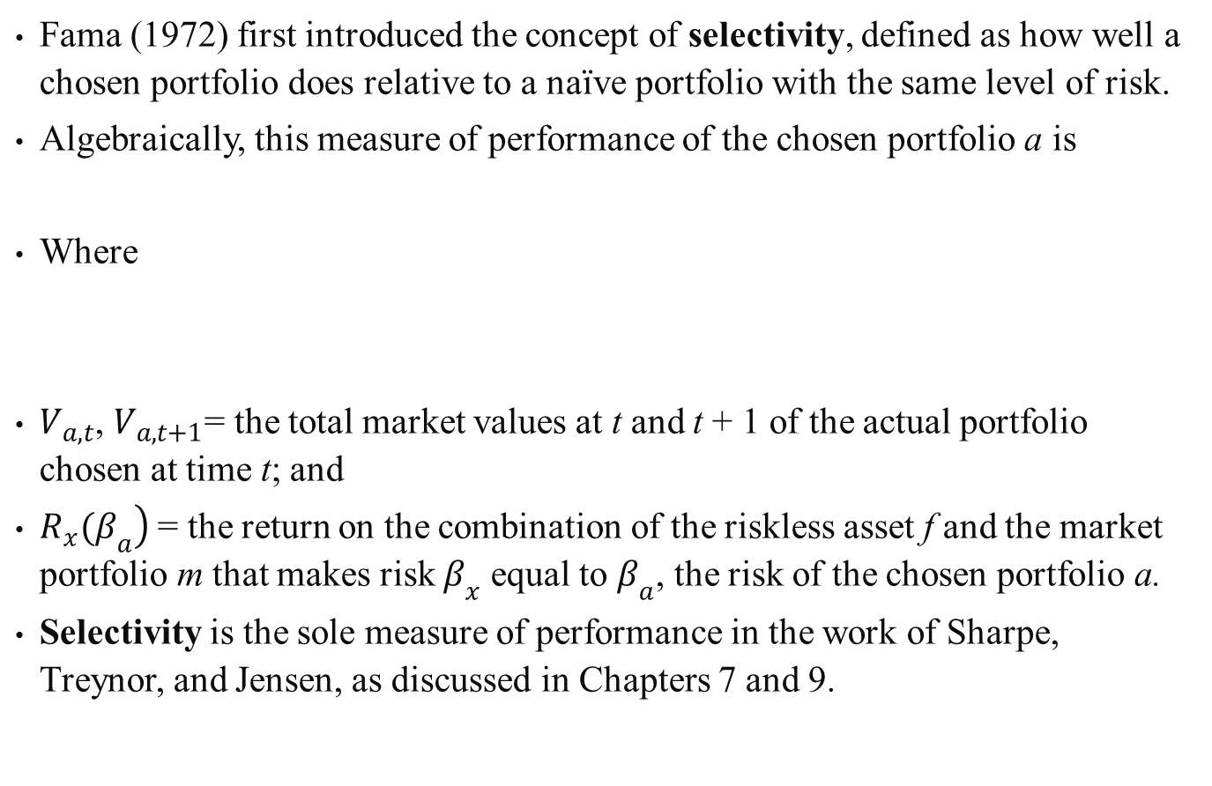
Fama (1972) first introduced the concept of selectivity, defined as how well a chosen portfolio does relative to a naïve portfolio with the same level of risk.
Algebraically, this measure of performance of the chosen portfolio a is
Where
$V_{a,t}$, $V_{a,t+1}$= the total market values at t and t + 1 of the actual portfolio chosen at time t; and
$\left.R_{x}(β_{a}\right)$ = the return on the combination of the riskless asset f and the market portfolio m that makes risk $β_{x}$ equal to $β_{a}$, the risk of the chosen portfolio a.
Selectivity is the sole measure of performance in the work of Sharpe, Treynor, and Jensen, as discussed in Chapters 7 and 9.
(21.36)

Slide 77
Fama introduced the concept of overall performance, which is the difference between the return on the chosen portfolio and the return on the riskless asset.
Overall performance is in turn split into two parts:
  Selectivity
  Risk
Algebraically:

Slide 78

This figure graphically presents the components related to mutual-fund performance of Equation (21.37).
Fama referred to the distance to Jensen’s measure of performance (A’A) as the return due to selectivity.
It also indicates overall performance $R_{a}−R_{f}$ and risk $R_{x}(β_{a})−R_{f}$.
Figure 21-3 Overall Components of Mutual- Fund Performance

Slide 79
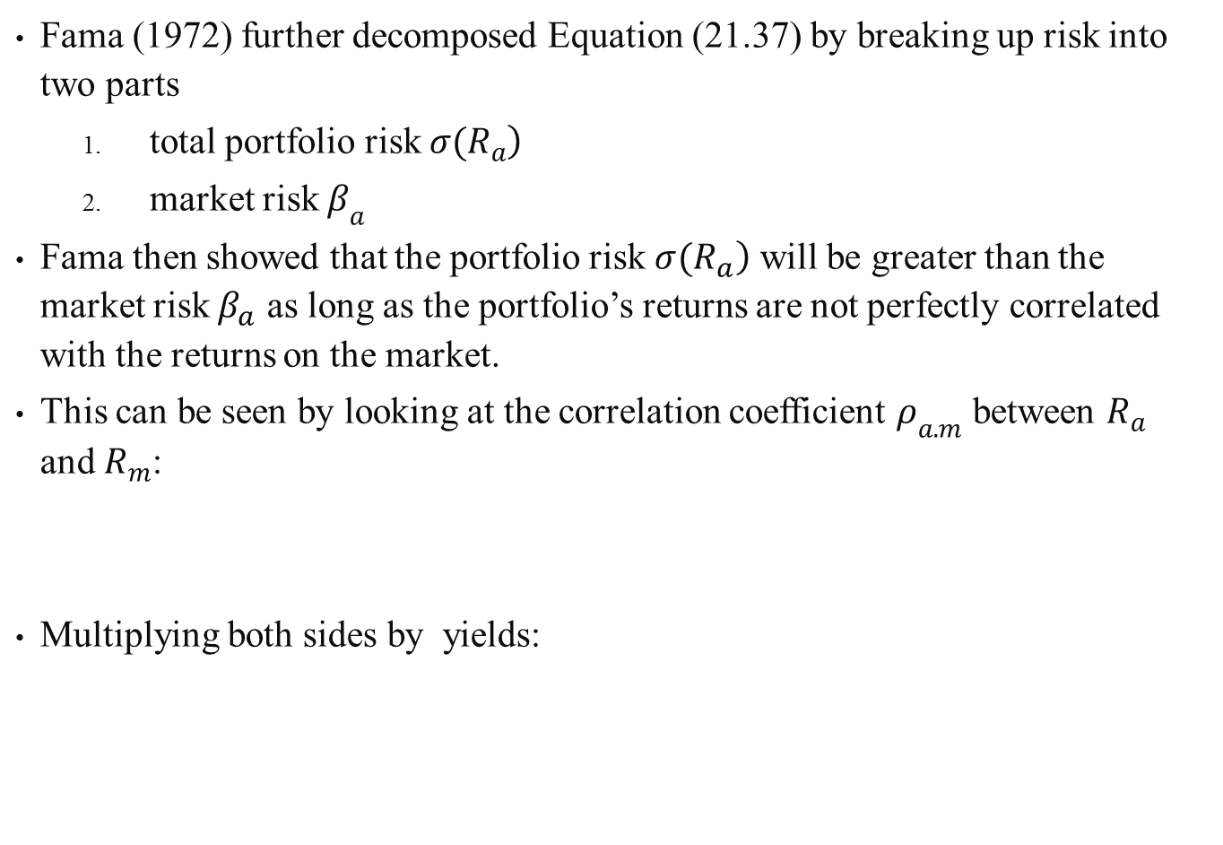
Fama (1972) further decomposed Equation (21.37) by breaking up risk into two parts
  total portfolio risk $\left.σ(R_{a}\right)$
  market risk $β_{a}$
Fama then showed that the portfolio risk $\left.σ(R_{a}\right)$ will be greater than the market risk $β_{a}$ as long as the portfolio’s returns are not perfectly correlated with the returns on the market.
This can be seen by looking at the correlation coefficient $ρ_{a.m}$ between $R_{a}$ and $R_{m}$:
Multiplying both sides by yields:

Slide 80
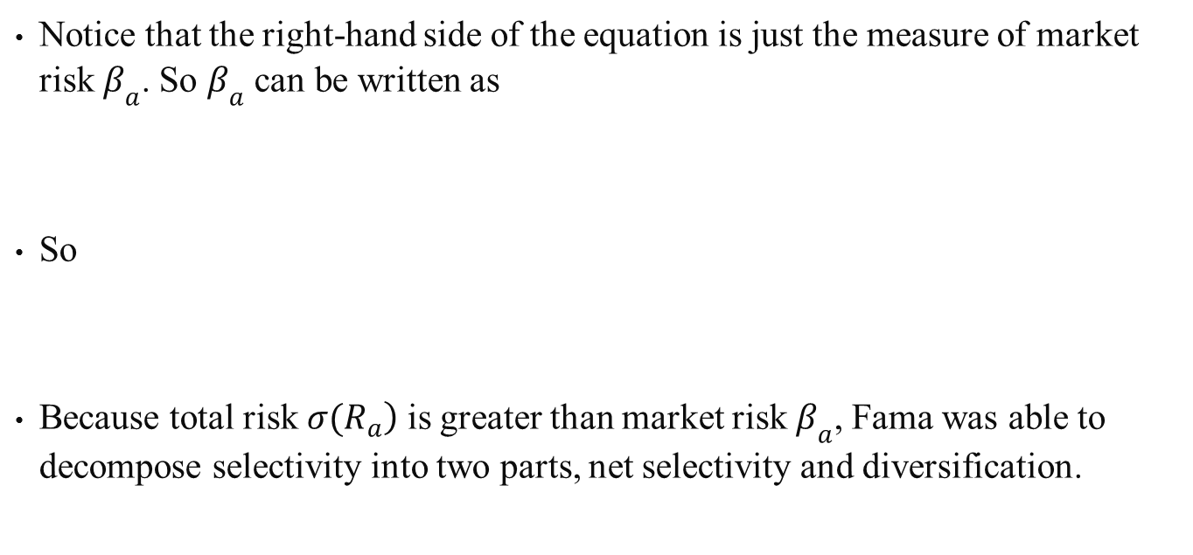
Notice that the right-hand side of the equation is just the measure of market risk $β_{a}$. So $β_{a}$ can be written as
So
Because total risk $\left.σ(R_{a}\right)$ is greater than market risk $β_{a}$, Fama was able to decompose selectivity into two parts, net selectivity and diversification.

Slide 81
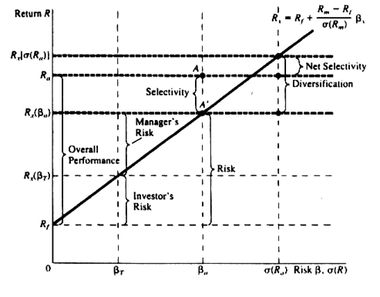
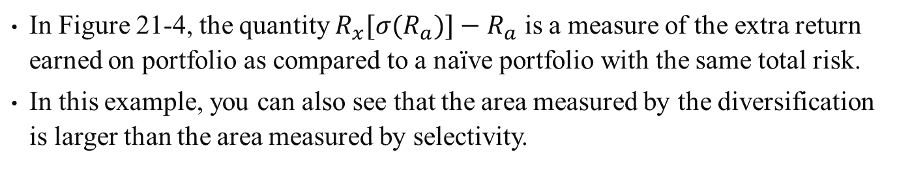
Figure 21-4 Detailed Components of Mutual-Fund Performance
In Figure 21-4, the quantity $R_{x}[σ(R_{a})]−R_{a}$ is a measure of the extra return earned on portfolio as compared to a naïve portfolio with the same total risk.
In this example, you can also see that the area measured by the diversification is larger than the area measured by selectivity.

Slide 82
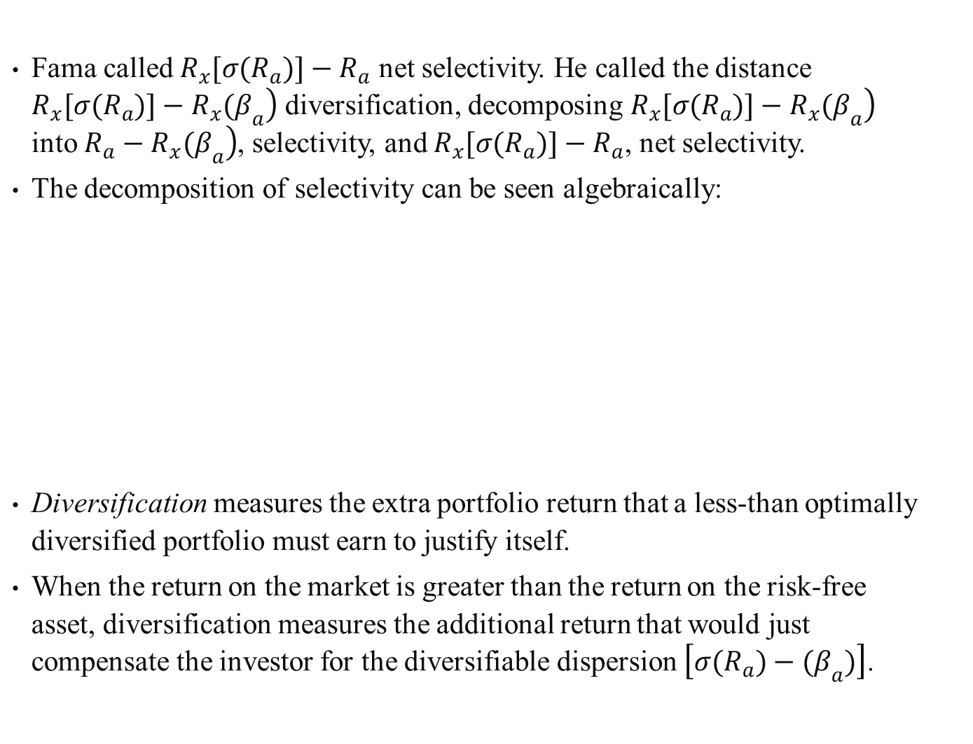
Fama called $R_{x}[σ(R_{a})]−R_{a}$ net selectivity. He called the distance $\left.R_{x}[σ(R_{a})]−R_{x}(β_{a}\right)$ diversification, decomposing $\left.R_{x}[σ(R_{a})]−R_{x}(β_{a}\right)$ into $\left.R_{a}−R_{x}(β_{a}\right)$, selectivity, and $R_{x}[σ(R_{a})]−R_{a}$, net selectivity.
The decomposition of selectivity can be seen algebraically:
Diversification measures the extra portfolio return that a less-than optimally diversified portfolio must earn to justify itself.
When the return on the market is greater than the return on the risk-free asset, diversification measures the additional return that would just compensate the investor for the diversifiable dispersion $\left[σ(R_{a})−(β_{a})\right]$.

Slide 83
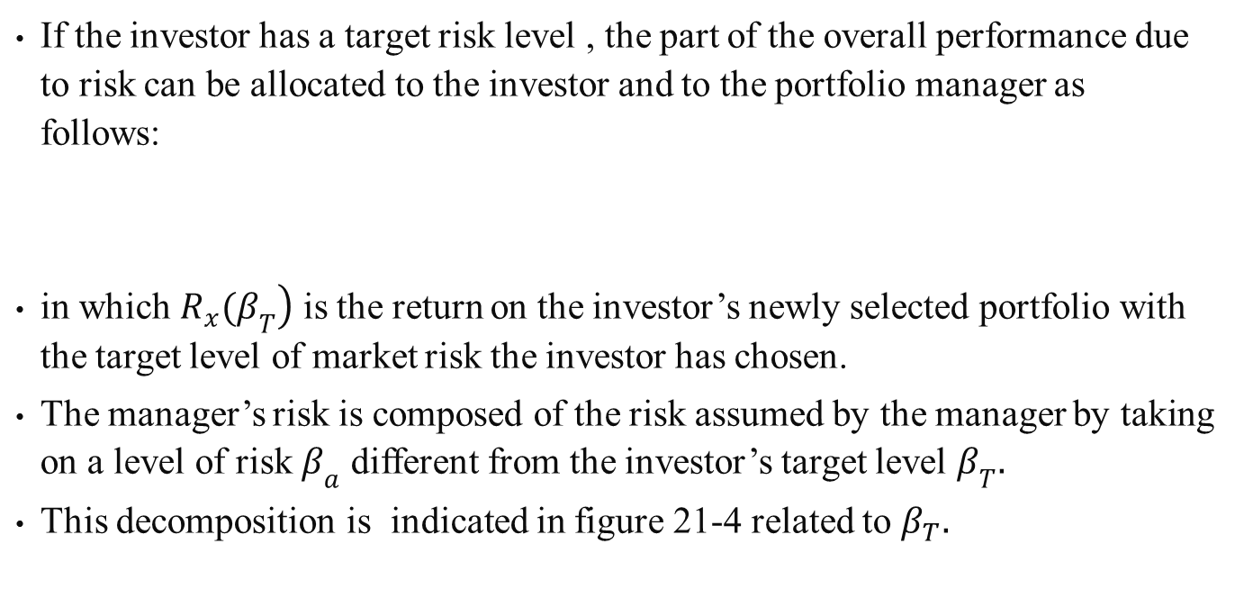
If the investor has a target risk level , the part of the overall performance due to risk can be allocated to the investor and to the portfolio manager as follows:
in which $\left.R_{x}(β_{T}\right)$ is the return on the investor’s newly selected portfolio with the target level of market risk the investor has chosen.
The manager’s risk is composed of the risk assumed by the manager by taking on a level of risk $β_{a}$ different from the investor’s target level $β_{T}.$
This decomposition is indicated in figure 21-4 related to $β_{T}.$

Slide 84
Manager’s risk might in part result from a timing decision.
Using an ex-ante CAPM market line, risk can be subdivided as follows:
The manager’s expected risk is the incremental expected return from the manager’s decision to take on a nontarget level of risk.
The expression for market conditions measures how much the market deviated from expectations at the target level of risk.
Total timing is the difference between the ex-post return on the naively selected portfolio with risk and the ex-ante expected return.
Manager’s timing is the difference between total timing and market conditions.
(21.40)

Slide 85
At times, a target level of risk may not be relevant; if this is the case, the market portfolio may be treated as the target portfolio.
Fama was one of the first to suggest that the return on a portfolio could be subdivided into two parts:
  the return from security selection
  the return from the bearing of risk in attempting to predict general market-price movements
Although the observed return–risk relationships seem to be linear, the trade-off of risk for return is in general less than predicted by the standard CAPM.
(21.41)

Slide 86
One of the principal applications of modern capital-market theory has been to propose a structural specification within which to measure investment performance and thereby to identify superior performers if they exist.
. In this structure, it is usually assumed that forecasting skills can be partitioned into two distinct components:
  forecasts of price movements of selected individual stocks (microforecasting)
  forecasts of price movements of the general stock market as a whole (macroforecasting)
The microforecaster, in essence, forecasts the nonsystematic or nonmarket-explained component of the return on individual stocks.

Slide 87
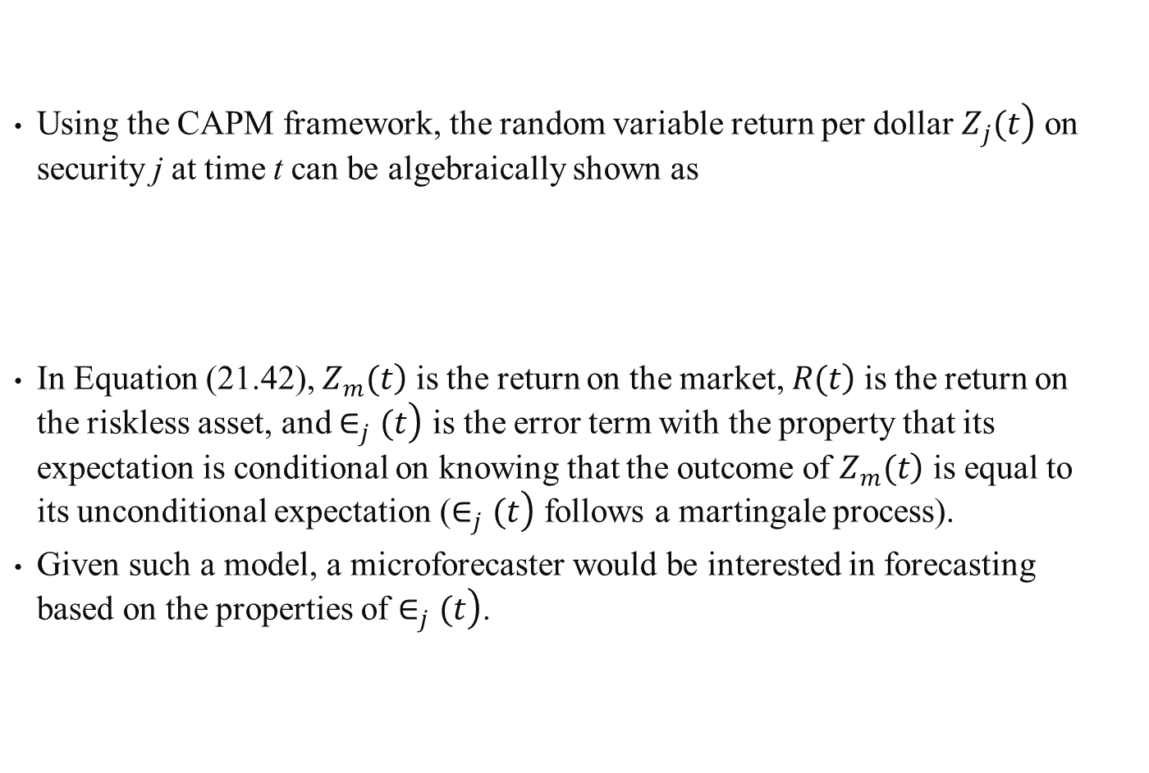
Using the CAPM framework, the random variable return per dollar $\left.Z_{j}(t\right)$ on security j at time t can be algebraically shown as
In Equation (21.42), $\left.Z_{m}(t\right)$ is the return on the market, $\left.R(t\right)$ is the return on the riskless asset, and $\left.∈_{j}(t\right)$ is the error term with the property that its expectation is conditional on knowing that the outcome of $\left.Z_{m}(t\right)$ is equal to its unconditional expectation ($\left.∈_{j}(t\right)$ follows a martingale process).
Given such a model, a microforecaster would be interested in forecasting based on the properties of $\left.∈_{j}(t\right)$.
(21.42)

Slide 88
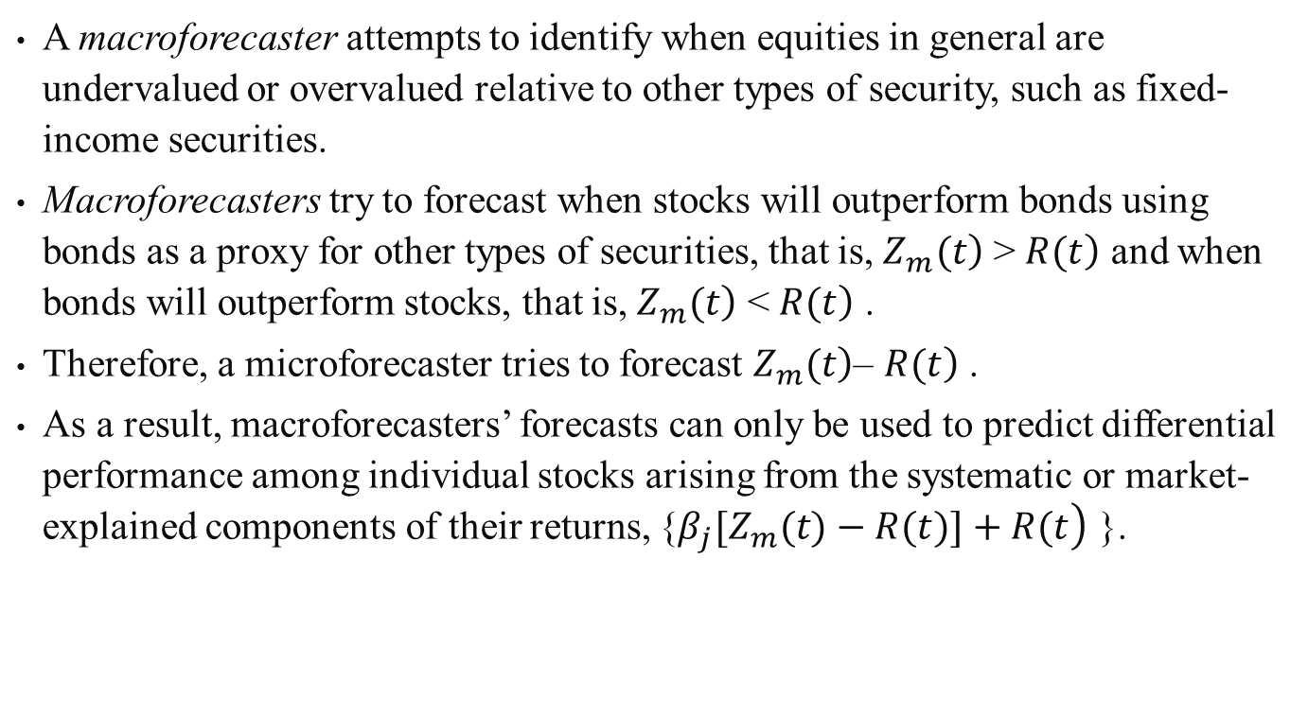
A macroforecaster attempts to identify when equities in general are undervalued or overvalued relative to other types of security, such as fixed-income securities.
Macroforecasters try to forecast when stocks will outperform bonds using bonds as a proxy for other types of securities, that is, $\left.Z_{m}(t\right)$ > $\left.R(t\right)$ and when bonds will outperform stocks, that is, $\left.Z_{m}(t\right)$ < $\left.R(t\right)$ .
Therefore, a microforecaster tries to forecast $\left.Z_{m}(t\right)$– $\left.R(t\right)$ .
As a result, macroforecasters’ forecasts can only be used to predict differential performance among individual stocks arising from the systematic or market-explained components of their returns, {$\left.β_{j}[Z_{m}(t)−R(t)]+R(t\right)$ }.

Slide 89
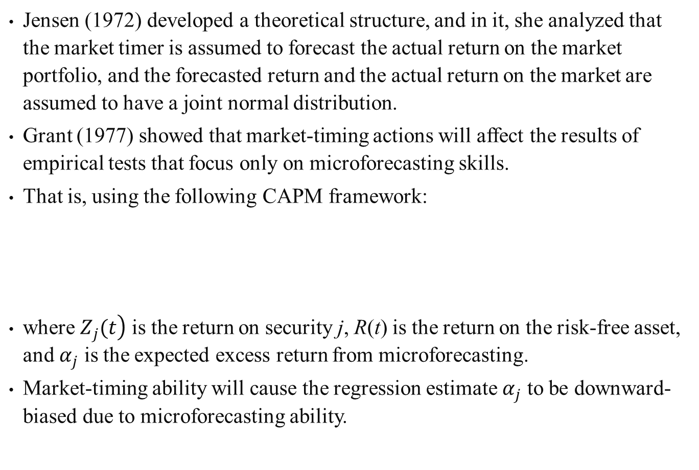
Jensen (1972) developed a theoretical structure, and in it, she analyzed that the market timer is assumed to forecast the actual return on the market portfolio, and the forecasted return and the actual return on the market are assumed to have a joint normal distribution.
Grant (1977) showed that market-timing actions will affect the results of empirical tests that focus only on microforecasting skills.
That is, using the following CAPM framework:
where $\left.Z_{j}(t\right)$ is the return on security j, R(t) is the return on the risk-free asset, and $α_{j}$ is the expected excess return from microforecasting.
Market-timing ability will cause the regression estimate $α_{j}$ to be downward-biased due to microforecasting ability.
(21.43)

Slide 90
Treynor and Mazuy (1966) added a quadratic term to the previous CAPM framework to test for market-timing ability.
Kon and Jen (1979) used the Quandt (1972) switching regression technique in a CAPM framework to examine the possibility of changing levels of market-related risk over time for mutual-fund portfolios.
Merton (1981) developed a model that is not based on the CAPM framework; from it he was able to analyze market timing through the theoretical structure of the pattern of future returns based upon a posterior distribution of returns.

Slide 91
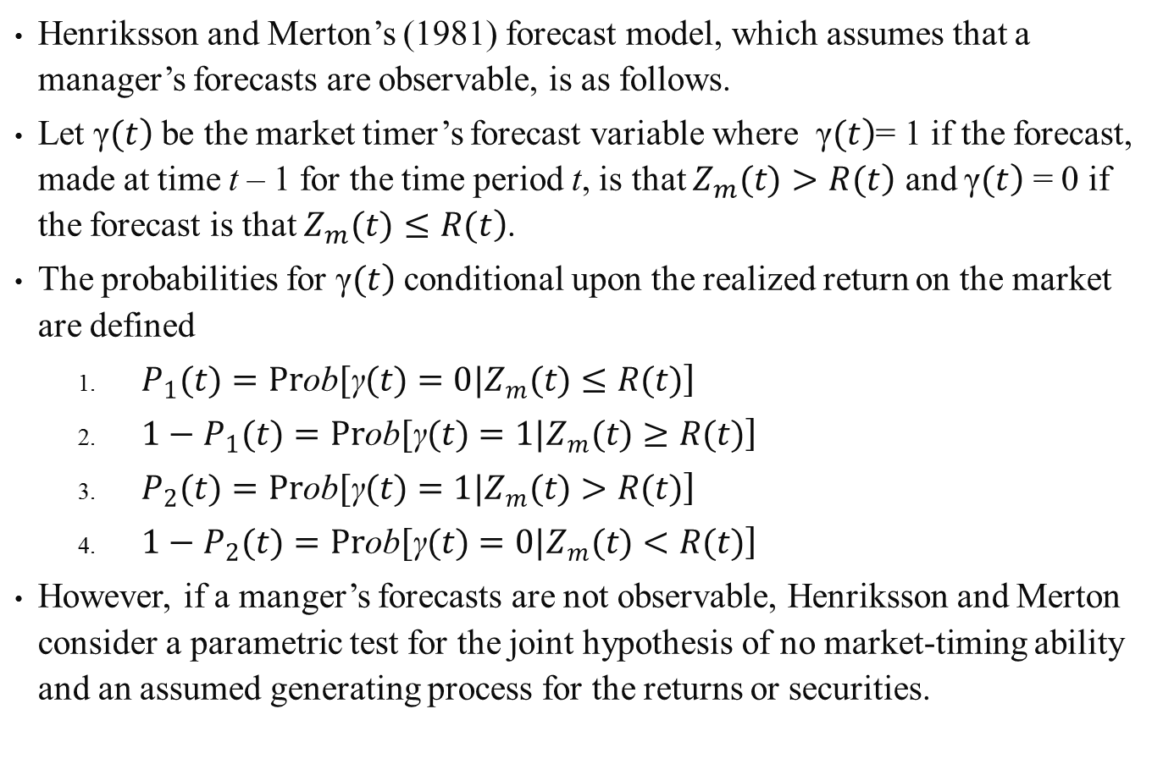
Henriksson and Merton’s (1981) forecast model, which assumes that a manager’s forecasts are observable, is as follows.
Let $\left.\text{γ}(t\right)$ be the market timer’s forecast variable where $\left.\text{γ}(t\right)$= 1 if the forecast, made at time t – 1 for the time period t, is that $\left.Z_{m}(t)>R(t\right)$ and $\left.\text{γ}(t\right)$ = 0 if the forecast is that $\left.Z_{m}(t)≤R(t\right)$.
The probabilities for $\left.\text{γ}(t\right)$ conditional upon the realized return on the market are defined
  $\left.P_{1}(t)=Pr\text{ob}[\text{γ}(t)=0|Z_{m}(t)≤R(t)\right]$
  $\left.1−P_{1}(t)=Pr\text{ob}[\text{γ}(t)=1|Z_{m}(t)≥R(t)\right]$
  $\left.P_{2}(t)=Pr\text{ob}[\text{γ}(t)=1|Z_{m}(t)>R(t)\right]$
  $\left.1−P_{2}(t)=Pr\text{ob}[\text{γ}(t)=0|Z_{m}(t)<R(t)\right]$
However, if a manger’s forecasts are not observable, Henriksson and Merton consider a parametric test for the joint hypothesis of no market-timing ability and an assumed generating process for the returns or securities.

Slide 92
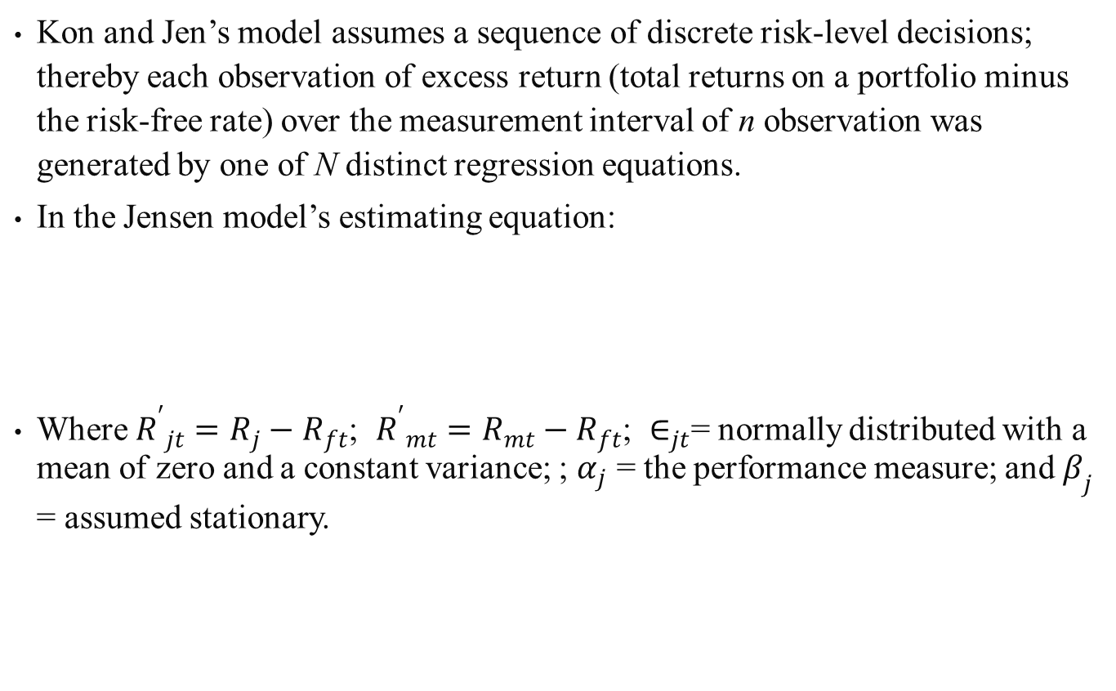
Kon and Jen’s model assumes a sequence of discrete risk-level decisions; thereby each observation of excess return (total returns on a portfolio minus the risk-free rate) over the measurement interval of n observation was generated by one of N distinct regression equations.
In the Jensen model’s estimating equation:
Where ${R^{′}}_{jt}=R_{j}−R_{ft}$; ${R^{′}}_{mt}=R_{mt}−R_{ft}$; $∈_{jt}$= normally distributed with a mean of zero and a constant variance; ; $α_{j}$ = the performance measure; and $β_{j}$ = assumed stationary.

Slide 93
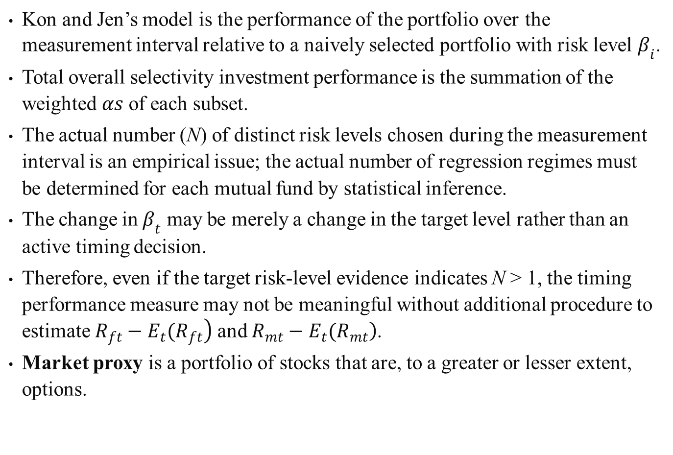
Kon and Jen’s model is the performance of the portfolio over the measurement interval relative to a naively selected portfolio with risk level $β_{i}$.
Total overall selectivity investment performance is the summation of the weighted $αs$ of each subset.
The actual number (N) of distinct risk levels chosen during the measurement interval is an empirical issue; the actual number of regression regimes must be determined for each mutual fund by statistical inference.
The change in $β_{t}$ may be merely a change in the target level rather than an active timing decision.
Therefore, even if the target risk-level evidence indicates N > 1, the timing performance measure may not be meaningful without additional procedure to estimate $\left.R_{ft}−E_{t}(R_{ft}\right)$ and $\left.R_{mt}−E_{t}(R_{mt}\right)$.
Market proxy is a portfolio of stocks that are, to a greater or lesser extent, options.

Slide 94
21.6 Summary
This chapter has employed the concepts and theory of technical and fundamental analysis to show that security analysts and portfolio managers might utilize theory, methodology, and data information to outperform the market.
Both Value Line ranking performance and mutual-fund managers’ performance are used to support this conclusion.
Overall, this chapter has culled information discussed in previous chapters to explore how security analysis and portfolio management can more effectively be executed.

