Slide 1
Chapter 22
International Diversification and Asset Pricing
By
Cheng Few Lee
Joseph Finnerty
John Lee
Alice C Lee
Donald Wort

Slide 2
Outline
22.1 Exchange-Rate Risk
22.2 Theoretical Effects Of International Diversification
  22.2.1 Segmented Versus Integrated World Markets
  22.2.2 The CAPM and the APT Applied Internationally
  22.2.3 Inflation and Exchange-Rate Risks
  22.2.4 Are World Markets Efficient?
  22.2.5 Empirical Evidence Supporting International Diversification
22.3 Applied International Diversification
  22.3.1 Direct Foreign Investment
  22.3.2 Indirect Foreign Investment
  22.3.3 Return, Risk, and Sharpe Performance Measure for International Indexes
22.4 Currency Option and Index Option
  22.4.1 Currency Option
  22.4.2 Index Option
22.5 Summary

Slide 3
22.1 Exchange-Rate Risk
Securities denominated in a currency other than the currency used by the purchaser have an additional element of risk, exchange-rate (or currency) risk.
Thus, total return an investor receives is:
(22.1)
Equation (22.1) can be rewritten in a modified security-return format:
(22.2)

Slide 4
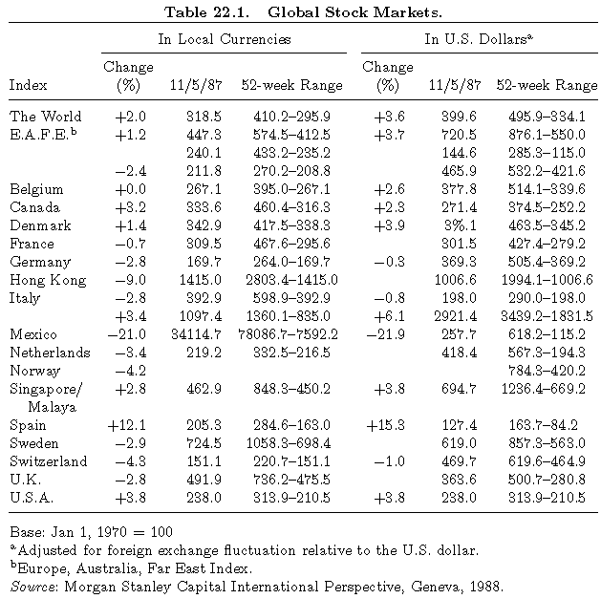
22.1 Exchange-Rate Risk
Table 22.1 illustrates this principle of Eq. (22.2), from the U.S. perspective, for the period from November 1986 through November 1987 for nineteen 19 stock markets.

Slide 5
22.1 Exchange-Rate Risk
Results of Table 22.2 show that: (1) Some reduction in currency risk can be obtained through diversification into several countries’ securities. (2)A substantial portion of the risk will remain for U.S. investors because of the tendency of the foreign currencies’ movements to be correlated positively with each other. (3) If the domestic currency were not the U.S. dollar, diversification benefits could be greater due to the negative correlation with the dollar.
TABLE 22.2 Correlations of Returns from Local Bond Markets and Currency (1971-1985)
Source: From Carl Beidelman, ed., Handbook of International Investing (1987), page 622.
Reprinted by permission of Probus Publishing Company. Data from J.P. Morgan Investment, 1986.
U.S. | 1
Japan | 0.20 | 1
Germany | 0.37 | 0.37 | 1
U.K. | 0.23 | 0.19 | 0.21 | 1
Yen | 0.13 | 0.34 | 0.15 | 0.14 | 1
DM | 0.11 | 0.23 | 0.25 | 0.01 | 0.54 | 1
Sterling | 0.16 | 0.14 | 0.20 | 0.25 | 0.46 | 0.54 | 1

Slide 6
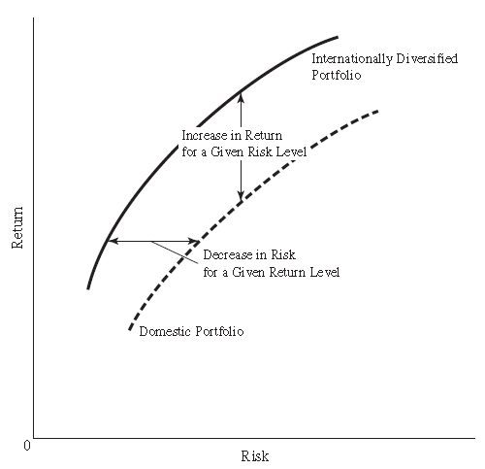
22.1 Exchange-Rate Risk
By purchasing futures contracts for an amount equal to the expected net proceeds of the future dividends and sales price, Equation (22.2) becomes:
(22.3)
Efficient-frontier portfolios: given any particular group of assets, various optimal weightings of those assets exist that create portfolios with the maximum possible return for a given level of risk.
(Fig. 22.1 International versus Domestic Efficient Frontiers)

Slide 7
22.2 Theoretical Effects of International Diversification
22.2.1 Segmented versus Integrated World Markets
22.2.2 The CAPM and the APT Applied Internationally
22.2.3 Inflation and Exchange-Rate Risks
22.2.4 Are World Markets Efficient?
22.2.5 Empirical Evidence Supporting International Diversification

Slide 8
22.2.1 Segmented versus Integrated World Markets
The CAPM can be extended to account for the correlation between national securities markets in determination of securities on a given international market:
(22.4)
where:
This national factor is in turn dependent on a single common world factor, (return for the world market portfolio), defined:
(22.5)
Where is the international systematic risk of country j.

Slide 9
22.2.1 Segmented versus Integrated World Markets
Solnik (1974, 1977), using his international asset pricing model (IAPM) to test whether assets are best regarded as being traded in segmented (national) or integrated (international) markets, found some evidence that markets are integrated.
The integrated-market theory stipulates that all securities in the world are priced in terms of their global systematic risk as:
(22.6)
where

Slide 10
22.2.1 Segmented versus Integrated World Markets
Solnik (1974c) shows that the relationship between , , and can be defined:
(22.7)
Equation (22.7) indicates that the international systematic risk of a security i in country j ( ) is equal to the product of the national systematic risk of that security ( ) and the international systematic risk ( ).

Slide 11
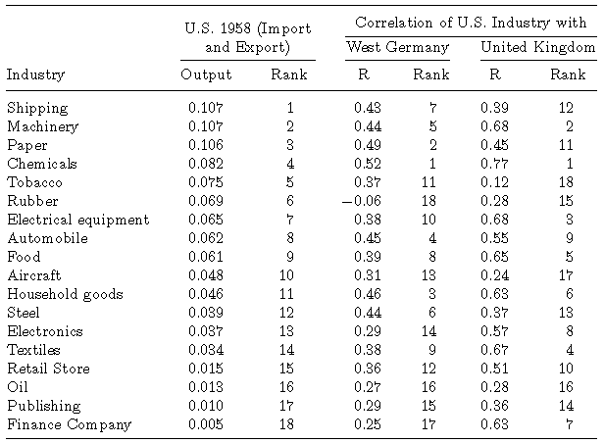
22.2 Theoretical Effects Of International Diversification
Grubel and Fadner (1971) measured the strength of relationship between the US portfolio and foreign portfolios.
Table 22.3 shows that the correlation is greater the larger the ratio of an industry’s exports plus imports over output, which means that international diversification pays off.
Table 22-3
Industries’ Foreign Trade and Levels of Correlation Quarterly Holding

Slide 12
22.2.2 The CAPM and the APT Applied Internationally
The APT assumes that the rate of return on any security is a linear function of k factors, or:
(22.8)
where:
Solnik (1974) extended the APT to the international capital markets, leading to the international arbitrage pricing theory (IAPT).
  IAPT overcomes the problem of aggregation when asset demands are summed in the universe of investors who use different numeration to measure returns.

Slide 13
22.2.3 Inflation and Exchange-Rate Risks
Inflation differential risk is the second added dimension of international diversification.
There are two types of exchange-rate risk to consider: the risk of inflation and relative price risk.
The Fisher effect, used to take into account inflation, can be expanded internationally:
(22.9)
(22.10)
Where Rreal is the real rate of interest, Rm is the nominal interest rate, and I is the inflation rate. The superscripts, d and f ,indicate domestic and foreign rates, respectively.

Slide 14
Sample Problem 22.1
Equations (22.9) and (22.10) can be combined to solve for the relative nominal rates:
(22.11)
As a first-order approximation, the nominal interest-rate differential between two countries can be shown to be:
(22.11A)
The real rate of interest in the United States and Germany is 4%, the inflation rate in the United States is expected to be 5%, and the inflation rate in Germany is expected to be 1%. What is the difference in the nominal rates between the two countries?

Slide 15
Sample Problem 22.2
The inflation rate in each country will have an impact on the value of the currency in that particular country.
The amount of the impact can be determined relatively precisely since the parity between currencies must be observed by the law of price equilibrium, which can be expressed as:
Where is the expected future exchange rate between the foreign and the domestic currency and is the current spot exchange rate.
The current spot exchange rate between the US dollar and the British pound is $2.00/￡, the expected inflation in the United States is 5%, and the expected inflation in England is 10%. What is the expected future spot rate (＄/￡)?
(22.12)
£
£
£
£
£
£
£

Slide 16
22.3 Applied International Diversification
22.3.1 Direct Foreign Investment
22.3.1.1Canada
22.3.1.2 West Germany
22.3.1.3 Japan
22.3.1.4 Other Pacific-Basin Countries
22.3.1.5 United Kingdom
22.3.2 Indirect Foreign Investment
22.3.2.1 American Depository Receipts (ADRs)
22.3.2.2 Foreign Bonds and Eurobonds
22.3.2.3 International Mutual Funds
  22.3.3 Return, Risk, and Sharpe Performance Measure for International Indexes

Slide 17
22.3.1 Direct Foreign Investment
The manager of a large portfolio would probably consider the direct foreign investment option first.
The costs of gathering information and the additional currency-transaction cost would be a much smaller proportion of the total portfolio return and therefore a worthwhile tradeoff to achieve a higher degree of choice in the selection of securities and countries, as well as greater flexibility in the timing of transactions.

Slide 18
22.3.2 Indirect Foreign Investment
The purchase of US securities with large foreign operations can be a lower-cost, lower-risk way to diversify internationally.
Foreign-exchange risks are not incurred directly, information is more easily available, and the markets and regulations are the ones that are familiar to the investor.
A foreign bond issue is one offered by a foreign borrower to the investors in a national
capital market and denominated in that nation’s currency.
A Eurobond issue is one denominated in a particular currency but sold to investors in national capital markets other than the country that
issued the denominating currency.

Slide 19
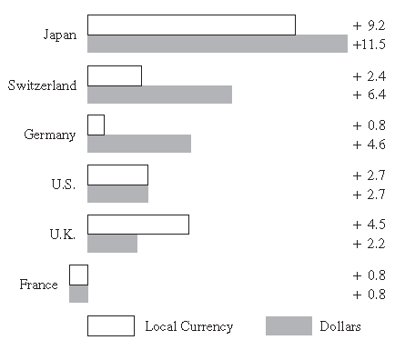
22.3.2.3 International Mutual Funds
Fig. 22.2. Historical Compound Annual Rates of Return (Price Only — 20-Year,1959–1978, percentage).
Source: Morgan Guaranty Trust Company. Investing Internationally, 1978.
Figure 22.2 shows the rates of return for the U.S. and five major foreign stock markets.
The average annual compounded rate of return is calculated in two ways, with the assets valued in the local currency and with the assets valued in U.S. dollars.

Slide 20
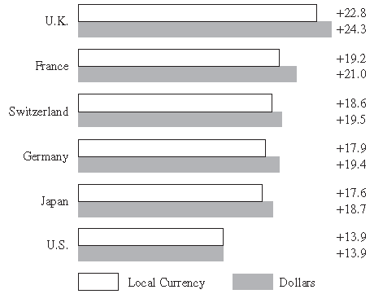
22.3.2.3 International Mutual Funds
Figure 22.3 Historical Standard Deviations of Return (Price Only — 20-Year, 1959-1978, percentage)
Unlike rates of return, which can be substantially different when measured in dollars rather than in local currency units, the variability of return is not significantly different whether measured in local currencies or in dollars.

Slide 21
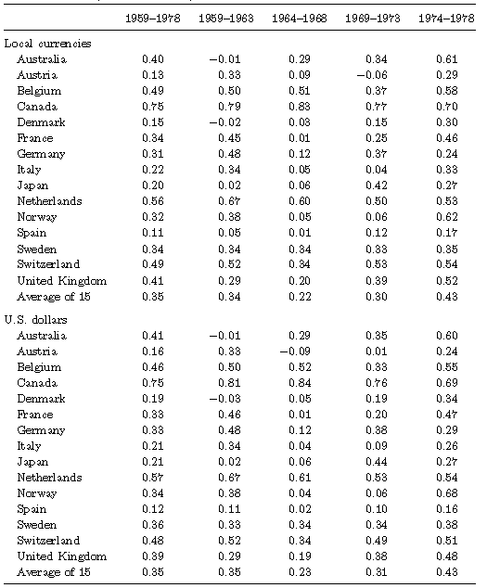
22.3.2.3 International Mutual Funds
Table 22.4. Correlation Coefficient of Foreign Equity Markets with the United States (Monthly Data).

Slide 22
22.3.2.3 International Mutual Funds
The basic conclusions to be drawn from the correlation coefficients shown in Table 22.4 are as follows:
(1) The correlations of returns have not been constant but have tended to increase somewhat as world markets have become more integrated.
(2) Very substantial variations exist in the degree to which other equity markets tend to move with the U.S. market.
(3) The size of the correlations tends to be low, which indicates that there can be substantial risk reductions through international diversification.

Slide 23
  22.3.3 Return, Risk, and Sharpe Performance Measure for International Indexes
First, following Eun and Resnick (1987) , summary statistics of monthly returns for 15 major stock markets (1973–1982) are presented in Table 22.5.
Second, in Table 22.6, we updated the data used by Chiou et al. (2010) calculate return, standard deviation, beta coefficient, and Sharpe performance measure for 34 countries during the period from January 1988 to January 2011.
In addition, Table 22.7 also indicates that the correlation coefficients among different countries are relatively low. Therefore, if we formulate a portfolio to invest in these countries, the uncorrelated mature allows for diversification in the portfolio.
Finally, Table 22.8 also implies that if we formulate a portfolio by investing in these 21 countries, we will enjoy a large diversification effect because of low correlation coefficients among these countries.

Slide 24
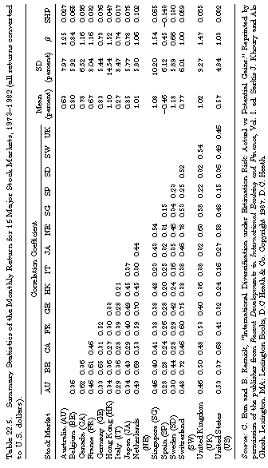
22.3.3 Return, Risk, and Sharpe Performance Measure for International Indexes (Table 22.5)

Slide 25
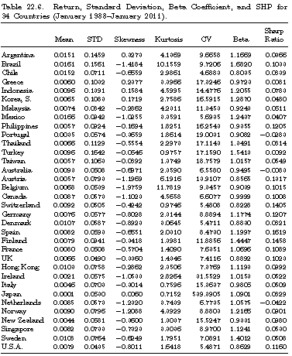
22.3.3 Return, Risk, and Sharpe Performance Measure for International Indexes (Table 22.6)

Slide 26
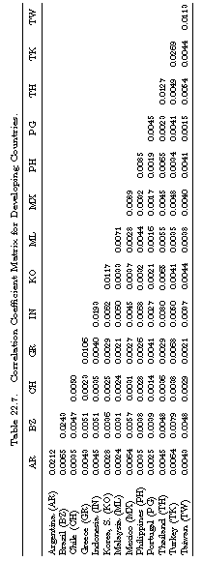
22.3.3 Return, Risk, and Sharpe Performance Measure for International Indexes (Table 22.7)

Slide 27
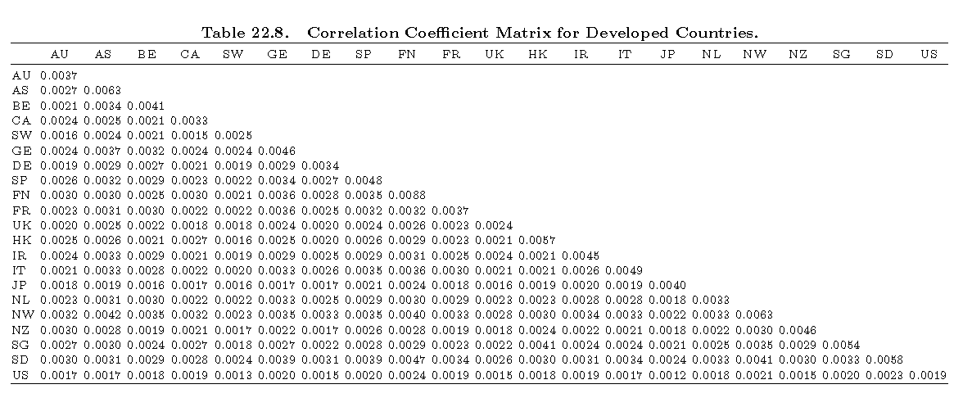
22.3.3 Return, Risk, and Sharpe Performance Measure for International Indexes (Table 22.8)

Slide 28
22.4 Currency Option and Index Option
Currency option is option on spot exchange rate instead of either individual stock or stock index.
The valuation model for the European type of currency call option can be defined as
(22.13)
Where S= spot exchange rate, r= domestic risk-free rate, rf = foreign risk free rate, X= exercise price, σ= standard deviation of spot exchange rate, t = time to expiration.

Slide 29
Example: Valuation of Currency Option
Consider a four-month European call option on the Japanese yen. Suppose that the current exchange rate is 130, the exercise price is 125, the risk-free rate in the United States is 6% per annum, the risk-free rate in Japan is 2% per annum. The volatility of foreign exchange rate is 15%.
From Equation (22.13),
From standard normal distribution table, we obtain:
N(.65) = .7422 N(.56) = 0.7123
Substituting all related information into Equation (22.13), we obtain:

Slide 30
22.4 Currency Option and Index Option
Index option is the option on stock index instead of individual stocks.
The European style of index call options can be evaluated in terms of the European style of stock call option formula defined as:
(22.14)
Where S= index price, q= dividend yield, r= risk-free rate, X= exercise price, σ= standard deviation of market rate of return, t = time to expiration.

Slide 31
Example: Index Option Valuation
Consider a European call option on the S&P 500 that is two months from maturity. The current value of the index is 950, the exercise price is 900, the risk-free interest rate is 6% per annum, and the volatility of the index is 15 per annum. Dividend yields of 0.2% and 0.3% are expected in the first and the second month, respectively. In this case, S = 950, X = 900, r = 0.06, σ = 15% and T = 2/12. The total dividend yield during the option’s life is 0.2 + 0.3 = 0.5%. This is 3% per annum. Hence, q = 0.03 and
From standard normal distribution table, we obtain:
N(d1) = 0.8413 N(d2) = 0.8238
so that the call price, C, is given by Equation (22.14)

Slide 32
22.5 SUMMARY
This chapter has explored international diversification from both theoretical and empirical viewpoints. It was demonstrated that the exchange risk and inflation risk will affect the return of international investment, and, therefore, should be a major factor for analyzing international diversification.
Theoretically, the question of whether the world market is segmented or integrated has been shown to be important in investigating the effectiveness of international diversification. Both international CAPM and APT were used to discuss these related issues.
Both direct and indirect investment in foreign securities were used to show the benefit of international diversification. Finally, international mutual funds were employed to illustrate the usefulness of international diversification.

