Slide 1
Chapter 23
Bond Portfolios: Management and Strategy
By
Cheng Few Lee
Joseph Finnerty
John Lee
Alice C Lee
Donald Wort

Slide 2
Outline
23.1 Bond Strategies
  23.1.1 Riding The Yield Curve
  23.1.2 Maturity-structure Strategies
  23.1.3 Swapping
23.2 Duration
  23.2.1 Weighted-average Term To Maturity
  23.2.2 WATM Versus Duration Measure
  23.2.3 Yield To Maturity
  23.2.4 The Macaulay Model
23.3 Convexity
23.4 Contingent Immunization
23.5 Bond Portfolios: A Case Study
23.6 Summary

Slide 3
23.1 Bond Strategies
23.1.1 Riding the Yield Curve
23.1.2 Maturity-Structure strategies
23.1.3 Swapping
  23.1.3.1 Substitution Swap
  23.1.3.2 Intermarket-Spread Swap
  23.1.3.3 Interest-Rate Application Swap
  23.1.3.4 Pure-Yield Pickup Swap

Slide 4
23.1.1 Riding the Yield Curve
Riding the yield curve is an investment strategy designed to take advantage of yield-curve shapes that are expected to be maintained for a period of time.
Given the yield-curve shape, an investor then decides whether to purchase a debt security that matures at the end of his or her time horizon or to purchase a longer-term debt security which can be sold at time T.

Slide 5
23.1.2 Maturity-Structure strategies
A common practice among bond-portfolio managers is to evenly space the maturity of their securities.
Under the staggered-maturity plan bonds are held to maturity, at which time the principal is reinvested in another long-term maturity instrument.
An alternative to a staggered portfolio is the dumbbell strategy. Dumbbell portfolios are characterized by the inclusion of some proportion of short and intermediate term bonds that provide a liquidity buffer to protect a substantial investment in long-term securities.

Slide 6
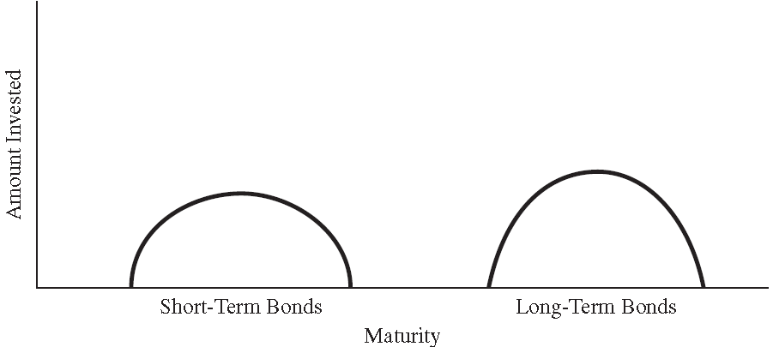
23.1.2 Maturity-Structure strategies
The dumbbell portfolio divides its funds between two components. The shortest maturity is usually less than three years, and the longest maturities are more than 10 years.
In Figure 23.1, it is apparent why this is called the dumbbell strategy — the resulting graph looks like a weight lifter’s dumbbell.
Figure 23.1 Dumbbell Maturity Strategy

Slide 7
23.1.3 Swapping
Swapping strategies generally concentrate on highly specialized trading relationships.
A commonly accepted method for classifying such swaps is Homer and Leibowitz’s four types: (1) pure yield-pickup swap, (2) interest-rate anticipations, (3) intermarket swap, and (4) substitution swap.

Slide 8
23.1.3.1 Substitution Swap
Substitution swap attempts to profit from a change in yield spread between two nearly identical bonds.
The trade is based upon a forecasted change in the yield spread between the two nearly bonds.
Both the H-bond (the bond now held) and the P-bond (the proposed purchase) are equality, coupon, and maturity.
The swap is executed at a time when the bonds are mispriced relative to each other.

Slide 9
Sample Problem 23.1 (Substitution Swap)
Table 23.1 Evaluation Worksheet for a Sample Substitution Swap
Source: Homer, S., and M. L. Leibowitz, Inside the Yield Book. Prentice-Hall and New York Institute of Finance, 1972, p. 84.
 | H-Bond | P-Bond
 | 30-year 7s @ 7.00% | 30-year 7s @ 7.10%
 | Workout time: 1 year Reinvestment rate: 7%
Original investment per bond | $1,000.00 | $ 987.70
Two coupons during year | 70.00 | 70.00
Interest on one coupon @ 7% for one-half year | 1.23 | 1.23
Principal value at end of year @ 7.00 yield to maturity | 1,000.00 | 1,000.00
Total accrued | 1,071.23 | 1,071.23
Total gain | 71.23 | 83.53
Gain per invested dollar | 0.07123 | 0.08458
Realized compound yield (percent) | 7.00 | 8.29
Value of swap | 129 basis points in one year

Slide 10
Sample Problem 23.1 (Substitution Swap)
In Table 23.2, as the workout time is reduced, the relative gain in realized compound yield over the workout period rises dramatically.
The substitution swap may not work out exactly as anticipated due to: (1) a slower workout time than anticipated, (2) adverse interim spreads, (3) adverse changes in overall rates and (4) the P-bond’s not being a true substitute.
Table 23.2 Effect of Workout Time on Substitution Swap: 30-Year 7s Swapped from 7% YTM to 7.10% YTM
Source: Homer and Leibowitz, 1972, p. 85
Workout Time | Realized Compound Yield Gain
30 years 20 10 5 2 1 6 months 3 months | 4.3 basis points/year 6.4 12.9 25.7 64.4 129.0 258.8 527.2

Slide 11
Sample Problem 23.1 (Substitution Swap)
In the substitution swap, major changes in overall market yields affect the price and reinvestment components of both the H- and P-bond. However, as these effects tend to run parallel for both the H- and P-bond.
Table 23.3 shows that the relative gain from the swap is insensitive even to major rate changes.
Table 23.3 Effect of Major Rate Changes on the Substitution Swap: 30-Year 7s Swapped from 7% to 7.1%, Realized Compound Yields—Principal Plus Interest
Reinvestment Rate and Yield to Maturity (percent) | 1-Year Workout |  |  | 30-Year Workout
 | H-Bond | P-Bond | Gain (Basis Points) | H-Bond | P-Bond | Gain (Basis Points)
5 6 7 8 9 | 34.551 19.791 7.00 (4.117) (13.811) | 36.013 21.161 8.29 (2.896) (12.651) | 146.2 137.0 129.0 122.1 116.0 | 5.922 6.445 7.000 7.584 8.196 | 5.965 6.448 7.043 7.627 8.239 | 4.3 4.3 4.3 4.3 4.3
Source: Homer and Leibowitz, 1972, p. 87.

Slide 12
23.1.3.2 Intermarket-Spread Swap
The intermarket spread swap works on trading between sector-quality-coupon categories, based upon a forecasted change in yield spread between two different categories.
Table 23.4 Evaluation Worksheet for a Sample Intermarket-Spread Swap in a Yield-Pickup Direction
 | H-Bond 30-year 4s @ 6.50% | P-Bond 30-year 7s @ 7.00%
Initial yield to maturity (percent) Yield to maturity at workout | 6.50 6.50 | 7.00 6.90
Spread narrows 10 basis points from 50 basis points to 40 basis points.
 | Workout time: 1 year, Reinvestment rate: 7%
Original investment per bond Two coupons during year Interest on one coupon @ 7% for 6 Months Principal value at end of year Total accrued Total gained Gain per invested dollar Realized compound yield (percent) | $671.82 40.00 0.70 675.55 716.25 44.43 0.0661 6.508 | $1,000.00 70.00 1.23 1,012.46 1,083.69 83.69 0.0837 8.200
Value of swap | 169.2 basis points in one year
Source: Homer and Leibowitz, 1972, p. 90

Slide 13
Sample Problem 23.2 (Intermarket-Spread Swap)
Table 23.5 shows that 24.5-basis-point gain over 30 years is less than the initial 50-basis-point gain because the same reinvestment rates (RR) benefits the bond with lower starting yield relative to the bond with the higher starting yield.
Table 23.5 Effect of Various Spread Realignments and Workout Times on the Sample Yield-Pickup Intermarket Swap: Basis-Point Gain (Loss) in Realized Compound Yields (Annual Rate)
 | Workout Time
Spread Shrinkage | 6 Months | 1 Year | 2 Years | 5Years | 30 Years
40 30 20 10 0 (10) (20) (30) (40) | 1083.4 817.0 556.2 300.4 49.8 (196.0) (437.0) (673.0) (904.6) | 539.9 414.6 291.1 169.2 49.3 (69.3) (186.0) (301.2) (414.8) | 273.0 215.8 159.1 103.1 47.8 (6.9) (61.0) (114.5) (167.4) | 114.3 96.4 78.8 61.3 44.0 26.8 9.9 (6.9) (23.4) | 24.5 24.5 24.5 24.5 24.5 24.5 24.5 24.5 24.5
Source: Homer and Leibowitz, 1972, p. 91

Slide 14
Sample Problem 23.2 (Intermarket-Spread Swap)
Table 23.6 shows another example that the H-bond is the 30-year 7s priced at par, and the P-bond is the 30-year 4s period at 67.18 to yield 6.50%. The investor believes that the present 50-basis-point spread is too narrow and will widen.
Table 23.6 Evaluation Worksheet for a Sample Intermarket-Spread Swap with Yield Giveup
 | H-Bond 30-year 7s @ 7% | P-Bond 30-year 4s @ 6.50%
Initial yield to maturity (percent) Yield to maturity at workout | 7 7 | 6.5 6.4
Reinvestment rate: 7% | Spread growth: 10 bp. Workout time: 1 year
Original investment per bond Two coupons during year Interest on one coupon @ 7% for 6 Months Principal value at end of year Total accrued Total gained Gain per invested dollar Realized compound yield (percent) | $1,000.00 70.00 1.23 1,000.00 1,071.23 71.23 0.0712 7 | $671.82 40.00 0.70 685.34 726.04 54.22 0.0807 7.914
Value of swap | 91.4 basis points in one year
Source: Homer and Leibowitz, 1972, p. 88

Slide 15
Sample Problem 23.2 (Intermarket-Spread Swap)
In Table 23.7, there is a high premium to be placed on achieving a favorable spread change within a relatively short workout period.
Table 23.7 Effect on Various Spread Realignments and Workout Times on the Sample Yield-Giveup Intermarket Swap: Basis-Point Gain (Loss) in Realized Compound Yields (Annual Rate)
 | Workout Time
Spread Shrinkage | 6 Months | 1 Year | 2 Years | 5Years | 30 Years
40 30 20 10 0 (10) (20) (30) (40) | 1,157.6 845.7 540.5 241.9 (49.8) (335.3) (614.9) (888.2) (1,155.5) | 525.9 378.9 234.0 91.4 (49.3) (187.7) (324.1) (458.4) (590.8) | 218.8 150.9 83.9 17.6 (47.8) (112.6) (176.4) (239.1) (302.1) | 41.9 20.1 (1.5) (22.9) (44.0) (64.9) (85.6) (106.0) (126.3) | (24.5) (24.5) (24.5) (24.5) (24.5) (24.5) (24.5) (24.5) (24.5)
Source: Homer and Leibowitz, 1972, p. 89

Slide 16
Sample Problem 23.3 (Interest-Rate Anticipation Swap)
Suppose an investor holds a 7% 30-year bond selling at par. He expects rate to rise from 7% to 9% within the year. Therefore, a trade is made into a 5% T-note maturing in one year and selling at par, as in Table 23.8 .
Table 23.8 Evaluation Worksheet for a Sample Interest-Rate-Anticipation Swap
 | H-Bond 30-year 7s @ 100 | P-Bond 30-year 5s @ 100
 | Anticipated rate change: 9% Workout time: 1 year
Original investment per bond Two coupons during year Interest on one coupon @ 7% for 6 Months Principal value at end of year Total accrued Total gained Gain per invested dollar Realized compound yield (percent) | $1,000.00 70.00 1.23 748.37 819.60 (180.4) (0.1804) (13.82) | $1,000 50 － 1,000 1,050 50 0.05 5.00
Value of swap | 1,885 basis points in one year
Source: Homer and Leibowitz, 1972, p. 94

Slide 17
Sample Problem 23.4 (Pure Yield-Pickup Swap)
Suppose an investor swaps from the 30-year 4s at 671.82 to yield 6.50% into 30-year 7s at 100 to yield 7% for the sole purpose of picking up the additional 105 basis points in current income or the 50 basis points in the YTM. The investor intends to hold the 7s to maturity.
Table 23.9 Evaluation Worksheet for a Sample Pure Yield-Pickup Swap
 | H-Bond 30-year 4s @ 6.50% | P-Bond 30-year 7s @ 7.00%
Coupon income over thirty years Interest on interest at 7% Amortization Total return Realized compound yield (percent) | (one bond) $1,200.00 2,730.34 328.18 $4,258.52 6.76 | (0.67182 of one bond) $1,410.82 3,210.02 0 $4,620.84 7.00
Value of swap | 24 basis points per annum at 7% reinvestment rate
Source: Homer and Leibowitz, 1972, p. 99

Slide 18
23.2 Duration
23.2.1 Weighted-Average Term to Maturity (WATM)
23.2.2 Weighted-Average Term to Maturity (WATM) versus Duration Measure
23.2.3 Yield to Maturity
23.2.4 The Macaulay Model

Slide 19
23.2 Duration
Duration (D) has emerged as an important tool for the measurement and management of interest-rate risk:
(23.1)
where:
= the coupon-interest payment in periods 1 through n – 1;
= the sum of the coupon-interest payment and the face value of the bond in period n;
= the YTM or required rate of return of the bondholders in the market;
t = the time period in years.

Slide 20
23.2.1 Weighted-Average Term to Maturity
The weighted-average term to maturity (WATM) computes the proportion of each individual payment as a percentage of all payments and makes this proportion the weight for the year the payment is made:
(23.2)
where:
= the cash flow in year t;
t = the year when cash flow is received;
n = maturity; and
TCF = the total cash flow from the bond.

Slide 21
Sample Problem 23.5 (WATM)
Suppose a ten-year, 4-percent bond will have total cash-flow payments of $1400. Thus, the $40 payment in will have a weight of 0.0287 ($40/$1400), each subsequent interest payment will have the same weight, and the principal in year 10 will have a weight of 0.74286 ($1040/1400).
Therefore:
The WATM is definitely less than the term to maturity, because it takes account of all interim cash flows in addition to the final payment.

Slide 22
23.2.2 Weighted-Average Term to Maturity (WATM) versus Duration Measure
The duration measure is simply a weighted-average maturity, where the weights are stated in present value terms. In the same format as the WATM, duration is
(23.3)
where:
= the present value of the cash flow in year t discounted at current yield to maturity;
t = the year when cash flow is received;
n = maturity; and
PVTCF = the present value of total cash flow from the bond discounted at current yield to maturity.

Slide 23
23.2.2 Weighted-Average Term to Maturity (WATM) versus Duration Measure
Table 23.10 Weighted-average Term to Maturity (Assuming Annual Interest Payments)
Source: Reilly and Sidhu, “The Many Uses of Bond Duration.” Financial Analysts Journal (July/August 1980), p. 60.
Bond A $1,000, 10 years, 4% |  |  |  | Bond B $1,000, 10 years, 8%
(1) Year | (2) Cash Flow | (3) Cash Flow/TCF | (4) (1)× (3) | (5) Year | (6) Cash Flow | (7) Cash Flow/TCF | (8) (5)× (7)
1 2 3 4 5 6 7 8 9 10 Sum | $ 40 40 40 40 40 40 40 40 40 1,040 $1,400 | 0.02857 0.02857 0.02857 0.02857 0.02857 0.02857 0.02857 0.02857 0.02857 0.74286 1.00000 | 0.02857 0.05714 0.08571 0.11428 0.14285 0.17142 0.19999 0.22856 0.28713 7.42860 8.71425 | 1 2 3 4 5 6 7 8 9 10 Sum | $ 80 80 80 80 80 80 80 80 80 1,080 $1,800 | 0.04444 0.04444 0.04444 0.04444 0.04444 0.04444 0.04444 0.04444 0.04444 0.60000 1.00000 | 0.04444 0.08888 0.13332 0.17776 0.22220 0.26664 0.31108 0.35552 0.39996 6.00000 7.99980
Weighted-average term to maturity = 8.71 years |  |  |  | Weighted-average term to maturity = 8.00 years

Slide 24
23.2.2 Weighted-Average Term to Maturity (WATM) versus Duration Measure
Table 23.11 Duration (Assuming 8-percent Market Yield)
(1) Year | (2) Cash Flow | (3) PV at 8% | (4) PV of Flow | (5) PV as % of Price | (6) (1) ×(5)
Bond A
1 2 3 4 5 6 7 8 9 10 Sum | $ 40 40 40 40 40 40 40 40 40 1,040 | 0.9259 0.8573 0.7938 0.7350 0.6806 0.6302 0.5835 0.5403 0.5002 0.4632 | $ 37.04 34.29 31.75 29.40 27.22 25.21 23.34 21.61 20.01 481.73 $ 731.58 | 0.0506 0.0469 0.0434 0.0402 0.0372 0.0345 0.0319 0.0295 0.0274 0.6585 1.0000 | 0.0506 0.0938 0.1302 0.1608 0.1860 0.2070 0.2233 0.2360 0.2466 6.5850 8.1193
Duration = 8.12 years

Slide 25
23.2.2 WATM versus Duration Measure
Table 23.11 Duration (Assuming 8-percent Market Yield) (Cont’d)
(1) Year | (2) Cash Flow | (3) PV at 8% | (4) PV of Flow | (5) PV as % of Price | (6) (1) ×(5)
Bond B
1 2 3 4 5 6 7 8 9 10 Sum | $ 80 80 80 80 80 80 80 80 80 1,080 | 0.9259 0.8573 0.7938 0.7350 0.6806 0.6302 0.5835 0.5403 0.5002 0.4632 | $ 74.07 68.59 63.50 58.80 54.44 50.42 46.68 43.22 40.02 500.26 $1000.00 | 0.0741 0.0686 0.0635 0.0588 0.0544 0.0504 0.0467 0.0432 0.0400 0.5003 1.0000 | 0.0741 0.1372 0.1906 0.1906 0.2720 0.3024 0.3269 0.3456 0.3600 5.0030 7.2470
Duration = 7.25 years
By comparing Table 23.10 with Table 23.11, due to the consideration of the time value of money in the duration measurement, duration is the superior measuring technique.

Slide 26
23.2.3 Yield to Maturity
Based upon Chapter 5, Yield to maturity is an average maturity measurement in its own way because it is calculated using the same rate to discount all payments to the bondholder — thus, it is an average of spot rates over time.
It has been shown that realized yield (RY) can be computed as a weighted average of the YTM and the average reinvestment rate (RR) available for coupon payments:
(23.4)

Slide 27
23.2 Duration
Duration appears a better measure of a bond’s life than maturity because it provides a more meaningful relationship with interest-rate changes.
This relationship has been expressed by Hopewell and Kaufman (1973) as:
(23.5)
where = “change in”; P = bond price;
D = duration; and I = market interest rate.

Slide 28
23.2 Duration- Characteristics (1)
The higher the coupon, the shorter the duration, because the face-value payment at maturity will represent a smaller proportional present-value contribution to the makeup of the current bond value.
Table 23.12 shows the relationship between duration, maturity, and coupon rates for a bond with a YTM of 6%.
Table 23.12 Duration, Maturity, and Coupon Rate
Maturity (years) | Coupon Rate
 | 0.02 | 0.04 | 0.06 | 0.08
1 5 10 20 50 100 ∞ | 0.995 4.756 8.891 14.981 19.452 17.567 17.667 | 0.990 4.558 8.169 12.98 17.129 17.232 17.667 | 0.985 4.393 7.662 11.904 16.273 17.120 17.667 | 0.981 4.254 7.286 11.232 15.829 17.064 17.667

Slide 29
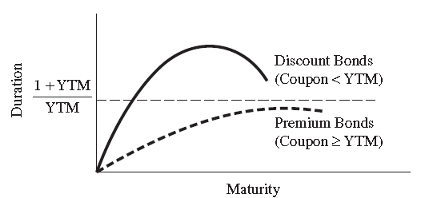
23.2 Duration- Characteristics (1)
When the coupon rate is the same as or greater than the yield rate (the bond is selling at a premium), duration approaches the limit directly.
Conversely, for discount-priced bonds (coupon rate is less than YTM), duration can increase beyond the limit and then recede to the limit.
Figure 23.2 Duration and Maturity for Premium and Discount Bonds

Slide 30
23.2 Duration- Characteristics (2)
The higher the YTM, the shorter the duration, because YTM is used as the discount rate for the bond’s cash flows and higher discount rates diminish the proportional present-value contribution of more distant payments (as shown in Table 23.13).
Table 23.13 Duration and Yield to Maturity
YTM | Duration at Limit (maturity → ∞)
0.02 0.04 0.08 0.10 0.20 0.30 0.50 | 51 26 13.5 11 6 4.33 3

Slide 31
23.2 Duration- Characteristics (3)
A typical sinking fund (one is which the bond principal is gradually retired over time) will reduce duration (as shown in Table 23.14).
Table 23.14 Duration With and Without Sinking Funds (Assuming 8% Market Yield)
 | Cash flow | Present-Value Factor | Present Value of Cash Flow | Weight | Duration
Bond A—No Sinking Fund
1 2 3 4 5 6 7 8 9 10 Sum | $ 40 40 40 40 40 40 40 40 40 1,040 | 0.9259 0.8573 0.7938 0.7350 0.6806 0.6302 0.5835 0.5403 0.5002 0.4632 | $ 37.04 34.29 31.75 29.40 27.22 25.21 23.34 21.61 20.01 481.73 $ 731.58 | 0.0506 0.0469 0.0434 0.0402 0.0372 0.0345 0.0319 0.0295 0.0274 0.6585 1.0000 | 0.0506 0.0938 0.1302 0.1608 0.1860 0.2070 0.2233 0.2360 0.2466 6.5850 8.1193
Duration = 8.12 years

Slide 32
23.2 Duration- Characteristics (3)
Table 23.14 Duration With and Without Sinking Funds (Assuming 8% Market Yield) (Cont’d)
Source: Reilly and Sidhu, 1980, pp. 61-62.
 | Cash flow | Present-Value Factor | Present Value of Cash Flow | Weight | Duration
Bond A—Sinking Fund (10% per year from fifth year)
1 2 3 4 5 6 7 8 9 10 Sum | $ 40 40 40 40 140 140 140 140 140 540 | 0.9259 0.8573 0.7938 0.7350 0.6806 0.6302 0.5835 0.5403 0.5002 0.4632 | $ 37.04 34.29 31.75 29.40 95.28 88.23 81.69 75.64 70.03 250.13 $ 793.48 | 0.04668 0.04321 0.04001 0.03705 0.12010 0.11119 0.10295 0.09533 0.08826 0.31523 1.00000 | 0.04668 0.08642 0.12003 0.14820 0.60050 0.66714 0.72065 0.76264 0.79434 3.15230 7.09890
Duration = 7.10 years

Slide 33
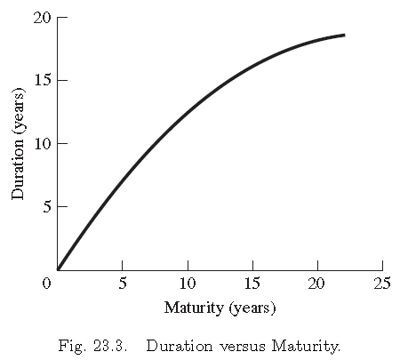
23.2 Duration- Characteristics (4)
For bonds of less than five years to maturity, the magnitudes of duration changes are about the same as those for maturity changes (as shown in Figure 23.3).

Slide 34
23.2 Duration- Characteristics (5)
In contrast to a sinking fund, all bondholders will be affected if a bond is called. The duration of a callable bond will be shorter than a noncallable bond.
To provide some measure of the return in the event that the issuer exercises the call option at some future point, the yield to call is calculated instead of the YTM.
The crossover yield is defined as that yield where the YTM is equal to the yield to call.
When the price of the bond rises to some value above the call price, and the market yield declines to value below the crossover yield, the yield to call becomes the minimum yield.

Slide 35
Sample Problem 23.6
To calculate the crossover yield for a 8%, 30-year bond selling at par with 10-year call protection, the annual return flow divided by the average investment can be used as an approximation for the yield. The implied crossover yield is 8.46%:
In one year’s time the bond’s maturity will be 29 years with nine years to call. If the market rate has decline to the point where the YTM of the bond is 7%, which is below the crossover yield of 8.46%, the bond’s yield to call will be 6%:

Slide 36
23.3 Convexity
If this linear relationship between percentage change in bond price and change in yield to maturity is not hold, then Equation (23.5) can be generalized as:
(23.6)
Where the Convexity is the rate of change of the slope of the price-yield curve as:
(23.7)
Where is the cash flow at time t as definition in Equation (23.2); n is the maturity; represents either a coupon payment before maturity or final coupon plus par value at the maturity date. is the capital loss from a one-basis-point (0.0001) increase in interest rates and is the capital gain from a one-basis-point (0.0001) decrease in interest rates

Slide 37
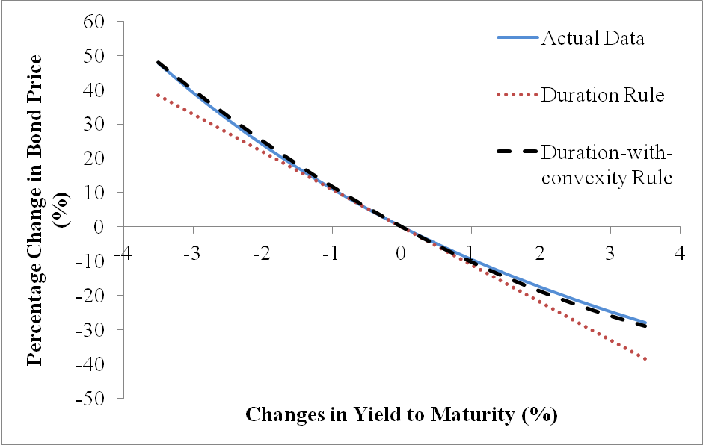
Sample Problem 23.7 (Convexity)
Figure 23.4 is drawn by the assumptions that the bond with 20-year maturity and 7.5% coupon sells at an initial yield to maturity of 7.5%.
Because the coupon rate equals yield to maturity, the bond sells at par value, or $1000.
The modified duration and convexity of the bond are 10.95908 and 155.059 calculated by Equation (23.1) and the approximation formula in Equation (23.7), respectively.
Figure 23.4
The Relationship between Percentage Changes in Bond Price and Changes in YTM

Slide 38
Sample Problem 23.7 (Convexity)
Figure 23.4 shows that convexity is more important as a practical matter when potential inertest rate changes are large.
When change in yield is 3%, the price of the bond on dash line actually falls from $1000 to $671.2277 with a decline of 32.8772% based on the duration rule in Equation (23.5):
According to the duration-with-convexity rule, Equation (23.6), the percentage change in bond price is calculated in following equation:
The bond price $741.0042 estimated by the duration-with-convexity rule is close to the actual bond price $753.0727 rather than the price $671.2277 estimated by the duration rule.

Slide 39
23.4 Contingent Immunization
Contingent immunization allows a bond-portfolio manager to pursue the highest yields available through active strategies while relying on the techniques of bond immunization to assure that the portfolio will achieve a given minimal return over the investment horizon.
The difference between the minimal, or floor, rate of return and the rate of return on the market is called the cushion spread.
Equation (23.8) shows the relationship between the market rate of return, Rm, and the cushion C to be the floor rate of return, RFL.
(23.8)

Slide 40
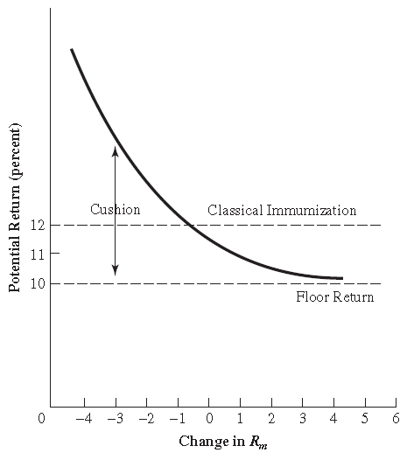
23.4 Contingent Immunization
Figure 23.5 is a graphical presentation of contingent immunization.
If interest rates were to go down, the portfolio would earn a return in excess of the because of the manager’s ability to have a portfolio with a duration larger than the investment horizon.
Fig. 23.5. Contingent Immunization

Slide 41
23.5 Bond Portfolios: A Case Study
Table 23.15 shows the calculation of duration of the bond with a five-year maturity and a 10% coupon at par under rate of interest at 10%.
TABLE 23.15 Weighted Present Value
(1) Year | (2) Coupons | (3) | (4) (2) ×(3) Unweighted PV | (5) (1) ×(4) Weighted P
1 2 3 4 5 | 100.00 100.00 100.00 100.00 1,100.00 1,500.00 | 0.9091 0.8264 0.7513 0.6830 0.6211 | 90.91 82.64 75.13 68.30 683.01 1,000.00 | 90.91 165.28 225.39 273.20 3,415.05 4,169.83
4,169.83 ÷ 1,000.00 = 4.17 years duration

Slide 42
23.5 Bond Portfolios: A Case Study
Table 23.16 shows an example of the effect of attempting to protect a portfolio by matching the investment horizon and the duration of a bond portfolio.
Table 23.16 Comparison of the Maturity Strategy and Duration Strategy for a 5 Year Bond
Year | Cash Flow | RR(%) | Value
Maturity Strategy
1 2 3 4 | 105.00 105.00 105.00 105.00 | 10.5 10.5 8.0 8.0 | 105.00 221.03 343.71 1,476.01 2,145.75
Duration Strategy
1 2 3 4 | 105.00 105.00 105.00 1,125.10* | 10.5 10.5 8.0 8.0 | 105.00 221.03 343.71 1,496.31 2,166.05
Expected wealth ratio is 1,491.00.
* The bond could be sold at its market value of $1,125.12, which is the value for a 10.5% bond with one year to maturity priced to yield 8 %.

Slide 43
23.5 Bond Portfolios: A Case Study
The fact that a premium would be paid for this five-year bond at the end of four years is an important factor in the effectiveness of the duration concept.
A direct relationship between the duration of a bond and the price volatility for the bond assuming given changes in the market rates of interest can be shown as:
Where BPC = the percent of change in price for the bond; D* = the adjusted duration of the bond in years, equal to D/(1+r); and r = the change in the market yield in basis points divided by 100.
Under the duration 4.13 years and interest-rate change from 8% to 10.5%, we can obtain D*=4.13/(1+0.105)=3.738. It implies that the price of the bond should decline by about 3.7% for every 100-basis-point increase in market rates.

Slide 44
23.6 SUMMARY
The management of a fixed-income portfolio involves techniques and strategies that are unique to the specific area of bonds.
This chapter has discussed riding the yield curve, swaps, and duration as three techniques that are familiar to all managers of fixed-income portfolios.
A comparison of these techniques was presented in the previous section in the context of a case situation.
Overall, this chapter has related bond-valuation theory to bond-portfolio theory and has developed bond-portfolio management strategies.

Slide 45
Appendix 23A PROCEDURES OF CALCULATING MODIFIED DURATION AND CONVEXITY
In this appendix, we show how convexity can be calculated. Tables 23A.1, 23A.2, and 23A.3 show the procedures of calculating convexity for bond maturity is 20, 15, and 25, respectively. From these tables we found the convexities are 155.059, 109.635, and 195.560 for maturity equal to 20, 15, and 25 years. This implies that convexity increases when the maturity increases. Finally, we calculate the percentage change in bond price related to the change of interest rate and duration.

Slide 46
Table 23A.1 Convexity for 20 years

Slide 47
Table 23A.2 Convexity for 15 years

Slide 48
Table 23A.3 Convexity for 25 years

