Slide 1
Chapter 24 Portfolio Insurance and Synthetic Options
By
Cheng Few Lee
Joseph Finnerty
John Lee
Alice C Lee
Donald Wort

Slide 2
Outline
24.1 BASIC CONCEPTS OF PORTFOLIO INSURANCE
24.2 STRATEGIES AND IMPLEMENTATION OF PORTFOLIO INSURANCE
24.2.1 Stop-Loss Orders
24.2.2 Portfolio Insurance with Listed Put Options
24.2.3 Portfolio Insurance with Synthetic Options
24.2.4 Portfolio Insurance with Dynamic Hedging

Slide 3
24.3 COMPARISON OF ALTERNATIVE PORTFOLIO-INSURANCE STRATEGIES
24.3.1 Synthetic Options
24.3.2 Listed Put Options
24.3.3 Dynamic Hedging and Listed Put Options
24.4 IMPACT OF PORTFOLIO INSURANCE ON THE STOCK MARKET AND PRICING OF EQUITIES
24.4.1 Regulation and the Brady Report
24.5 EMPIRICAL STUDIES OF PORTFOLIO INSURANCE
24.5.1 Leland (1985)
24.5.2 Asay and Edelsburg (1986)
24.5.3 Eizman (1986)

Slide 4
24.5.4 Rendleman and McEnally (1987)
24.5.5 Garcia and Gould (1987)
24.5.6 Zhu and Kavee (1988)
24.5.7 Perold and Sharpe (1988)
24.5.8 Rendleman and O’Brien (1990)
24.5.9 Loria, Pham, and Sim (1991)
24.5.10 Do and Faff (2004)
24.5.11 Cesari and Cremonini (2003)
24.5.12 Herald, Maurer, and Purschaker (2005)
24.5.13 Hamidi, Jurczenko, and Maillet (2007)
24.5.14 Ho, Cadle, and Theobald (2008)
24.6 SUMMARY

Slide 5
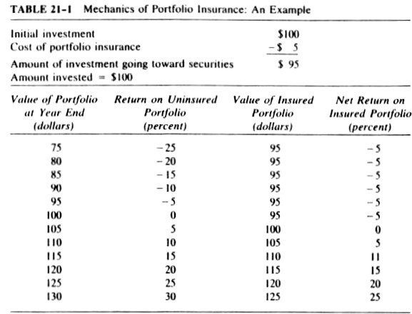
21.4 Basic Concepts of Portfolio Insurance
Portfolio insurance refers to any strategy that protects the value of a portfolio of assets like stocks, bonds, or real assets.
The table illustrates how portfolio insurance works and the profit and loss of the insured and uninsured portfolio.
Table 24.1 Mechanics of Portfolio Insurance: An Example

Slide 6
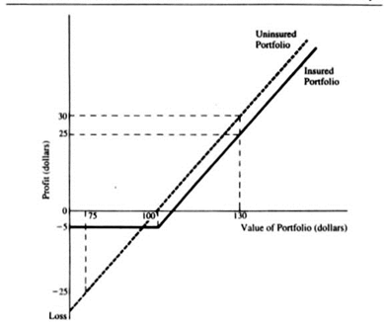
Rubinstein (1985) stated that the portfolio shown in Figure 24.1 has the three properties of an insured portfolio.
The loss is limited to a prescribed level.
The rate of return on the insured portfolio will be a predictable percentage of the rate of return on the uninsured portfolio.
The investments of the portfolio are restricted to a market index and cash. The expected return on the market index is above the expected return from holding cash, and the
insurance is fairly priced. This
guarantees that the insured portfolio
has a higher expected return than the
uninsured portfolio.
Figure 24.1
Gains and Losses of
Insured and Uninsured Portfolios:
An Example

Slide 7
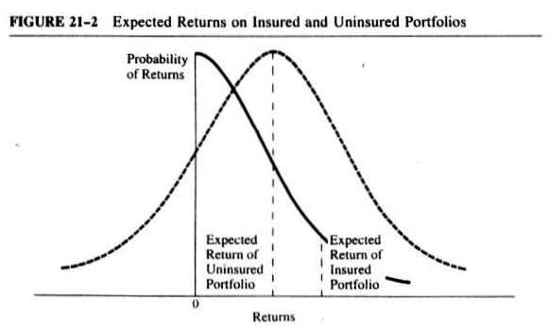
Figure 24.2 shows the effect of insurance on the expected returns of a portfolio
Notice that the expected return of the uninsured portfolio is greater than the expected return of the uninsured portfolio, according to the third property listed above.
Note that in an efficient market at a fair price the insurance will be used until the expected return on insured and uninsured portfolios are the same.
Figure 24.2 Expected Returns on Insured and Uninsured Portfolios:
An Example

Slide 8
Generally, portfolio insurance can be thought of as holding two portfolios.
The floor level, the lowest value the portfolio can have, is viewed as the safe or riskless portfolio with value equal to the level of protection desired.
The second portfolio is portfolio cushion which consists of the difference between the total value of the portfolio and the floor.
These assets consist of a leveraged position in risky assets.
To insure the portfolio, the cushion should be managed so as to never fall below zero in value because of the limited-liability property of common stock.

Slide 9
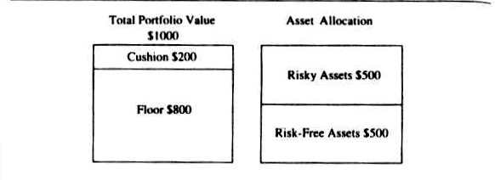
Figure 24.3 Components of an Uninsured Portfolio Valued at $1,000
Figure 24.3 shows the relationship between the total value of the portfolio, the cushion, and the floor.
It also shows an example of changing the mix between risky and risk-free assets in response to market changes offers the opportunity to demonstrate the dynamic nature of portfolio insurance.
The relationship between risky and risk-free assets is called multiple.
(24.1)
(24.2)

Slide 10
Example
The market value of the risky asset rises 20%, value of the cushion increases to $300 and the value of the risky assets rises to $600.
What is the total value of the portfolio?
Risky assets + risk-free assets
$500 + $600 = $1,100
What is the cushion?
Total value - floor value
$1,100 - $800 = $300
What is the multiple?
(24.3)

Slide 11
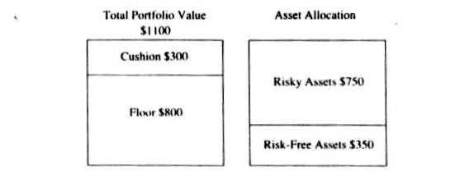
What if the target multiple is 2.5?
Figure 24-4 shows the portfolio after rebalancing.
(24.4)
Figure 24.4 Components of an Insured Portfolio Rebalanced after a Market Rise

Slide 12
If the market declined by 16$\frac{2}{3}$% back to its original level at the beginning of this example, what would be the value of risky assets?
$625 ($750 x 0.8333)
At this new level, the multiple would be
Since the target multiple of 2.5 < actual multiple of 3.56, the portfolio manager must sell some of the risky assets and put into risk-free assets.
What has the total value of the portfolio fallen to? $975 = $625 + $350
What has the value of the cushion fallen to? $175 = $975 - $800
In order to have a multiple of 2.5 the risky assets have to be reduced to
Hence $187.50 of the risky assets must be sold and invested into the risk-free assets.
(24.5)
(24.6)

Slide 13
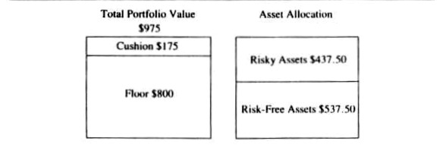
Figure 24.5 Components of an Insured Portfolio Rebalanced after a Market Fall
Above figure shows the position of the insured portfolio after the rebalancing.
This example shows “run with your winners and cut your losses”.
Underlying this discussion are the assumptions that the rise and fall of the market takes place over a time interval long enough for the portfolio manager to rebalance the position, and that the market has sufficient liquidity to absorb the value of the risky assets.
Constant-proportion portfolio insurance (CPPI) involves holding the risk-free asset in an amount equal to the level of protection desired (floor), plus holding the remainder of the portfolio in a risky asset.
The multiple of the risky asset to the cushion is then held in a constant proportion.

Slide 14
24.2 Strategies and Implementation of Portfolio Insurance
24.2.1 Stop-Loss Orders
A stop-loss order is a conditional market order to sell portfolio stock if the value of the stock drops to a given level.
Unfortunately, stop-loss order is path dependent.
Path independent is the ideal portfolio insurance where it works regardless of the subsequent movement of the market.

Slide 15
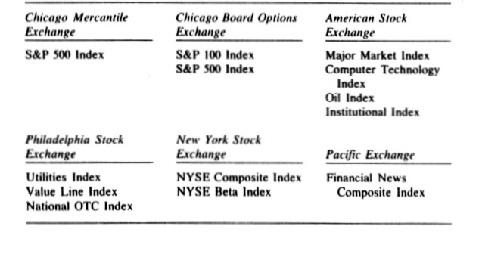
24.2.2 Portfolio Insurance with Listed Put Options
Table 24.2 lists the indexes and exchanges on which options are available.
Put options can be purchased and used for creating an insured portfolio.
Tracking problem is the issue that correlation between the market index and the portfolio may not be perfect.
The tracking problem is also the reason why a perfect hedge is usually not possible.
Table 24.2 Listed Options on Market Indexes

Slide 16
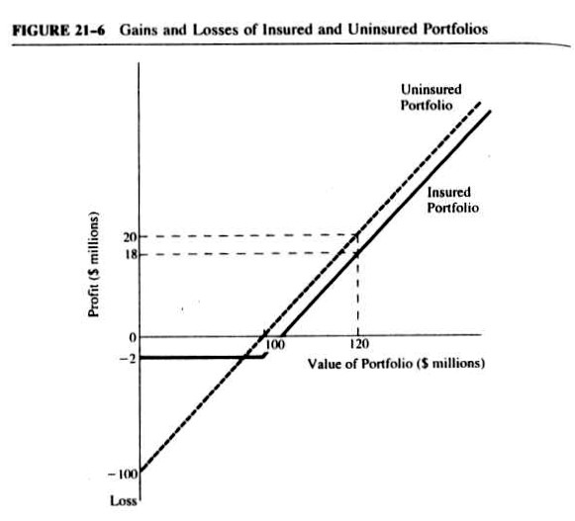
Example
A portfolio manager with a $100 million portfolio purchases 4000 Major Market Index (MMI) options with an exercise price of $250 with the cost of each option at $500.
Figure 24.6 depicts the portfolio returns for the example and the fluctuations of the market value.
Details of the example is in textbook.
If the market falls, the drop in
the value of the portfolio will be offset
by the gain in value of the put option.
On the other hand, if the market
increases in value, the portfolio will
increase in value but the premium
paid for the put option will be lost.
Figure 24.6 Gains and Losses of Insured and Uninsured Portfolios

Slide 17
The price change of the market index and the value of the portfolio, as well as the movement of the price of the option on the index, are all related.
The success of a portfolio-insurance strategy depends on correct determination of the hedge ratio.
The hedge ratio is the ratio of the value of the portfolio to the value of the options contracts used to hedge the portfolio:
In discussing the use of put options for portfolio insurance, two characteristics were assumed about the nature of the options used.
They are available with long maturities or with maturities that match the portfolio manager’s investment horizon.
They are exercisable only at maturity — that is, they are European-type options.

Slide 18
24.2.3 Portfolio Insurance with Synthetic Options
A synthetic call-option strategy; it involves increasing the investment in stock by borrowing when the value of stocks is increasing, and selling stock and paying off borrowing or investing in the risk-free asset when market values are falling.
The key variable in this strategy is the delta value, which measures the change in the price of a call option with respect to the change in the value of the portfolio of risky stocks.

Slide 19
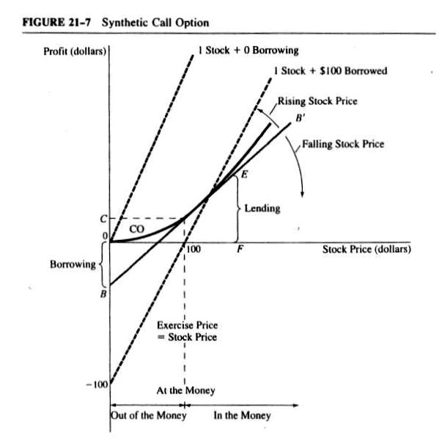
Figure 24.7 shows the logic behind a call-replicating strategy, , when the exercise price of the option and current share price are $100.
The amount of borrowing needed to replicate the portfolio is represented by the dotted line BB’.
The intercept of BB’ and the stock-price axis represents the amount of borrowing and the line segment EF represents the amount of paying off borrowing or holding a risk-free asset.
Figure 24.7 Synthetic Call Option

Slide 20
The accuracy of the replicating strategy depends on four considerations.
First, since the strategy may involve frequent trading, it is necessary that transaction costs be low.
Second, it must be possible to borrow whatever amount is required.
Third, trading in the stock may not provide continuous prices; there may be jumps or gaps. In this case, the strategy will not be able to exactly replicate the price movement of a traded call.
Fourth, there may be uncertainty surrounding future interest rates, stock volatility, or dividends.
This may affect the price of a traded call with an accompanying change in stock price.
Hence, the value of the replicated option would not change, while the traded option price would change.

Slide 21
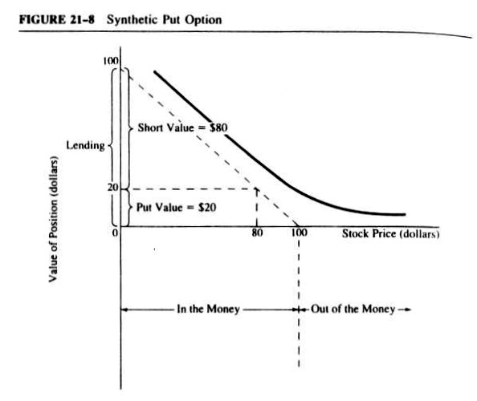
Figure 24-8 shows a synthetic put position in which the stock and exercise prices are $100.
As the stock value increases (decreases), the slope of a line tangent to the put-value curve becomes flatter (steeper) and the number of shares sold short in the synthetic put decreases (increases).
The intersection of the value axis gives the lending amount.
Figure 24.8 Synthetic Put Option

Slide 22
24.2.4 Portfolio Insurance with Dynamic Hedging
Dynamic hedging the procedure when portfolio manager purchases futures contracts to cover the short position by liquidating the investment in the risk-free asset.
The success is based on the correlation between the value of index-futures contracts and the value of the underlying index.
If the strategy for portfolio insurance incorporates the beta, the following relationship is necessary to determine the number of contracts required to insure the portfolio:
(24.7)

Slide 23
Example
Assume the S&P 500 index is selling at $110, and the portfolio is worth $1 million on day 1.
If the market falls by 10%, the value of the portfolio falls 11% to $890,000, the value of the S&P 500 futures contract falls to $99, and the scenario is as follows.
The portfolio has lost $110,000.
Each S&P 500 futures contract sold can be repurchased for $99 × 500 or $49,500, for a gain of $5500 ($55,000 − $49,500).
In order to have a perfect hedge, the portfolio manager would need $110,000/5500 = 20 contracts.
Using Equation (24.7), we see that adjusting the number of contracts for the volatility or beta of the portfolio yields:
.

Slide 24
24.3 Comparison of Alternative Portfolio-Insurance strategies
24.3.1 Synthetic Options
Synthetic options are not options but a strategy for allocating assets that replicates the return on a call option.
Due to the futures mispricing there might be a price advantage or disadvantage to a dynamic-hedging strategy.
When shorting futures for hedging purposes, the manager hopes that the futures sell at a premium and the basis (the cash price minus the futures price) widens.

Slide 25
By selling futures when they are expensive and buying them back at a lower price, a profit shows on the hedge.
Losses on the hedge will probably result if “cheap” futures are sold for hedging purposes.
Table 24.3 Profit or Loss of Expensive Futures
Future price
$260
Table 24.4 Profit or Loss of Cheap Futures
Future price
$245

Slide 26
24.3.2 Listed Put Options
Portfolio insurance with listed put options does not require continuous monitoring because the delta of the listed option is automatically changed when the price of the underlying asset changes.
Because of the automatic adjustment of the delta value, a listed-put strategy requires less monitoring and lower trading frequency than a synthetic-option or dynamic-hedging strategy.
. The dynamic-hedging approach uses the highly liquid futures market to rebalance the portfolio.
Futures mispricing will increase or decrease the cost of dynamic hedging; if the short hedger shorts expensive futures, profits will result from the hedges. If expensive futures are shorted, losses will be incurred.

Slide 27
24.3.3 Dynamic Hedging and Listed Put Options
The first difference between dynamic hedging and listed put options for portfolio insurance is that the delta value of a put option changes automatically while it must be adjusted continuously in a dynamic-hedging framework.
Second difference is the insurance cost, for listed-put strategy is paid up front but for dynamic-hedging strategy is the forgone profits that result from shorting futures.
Third difference is that listed-option strategy is confined to fixed interval exercise prices but dynamic-hedging strategy can be implemented around any exercise price.

Slide 28
Dynamic Hedging Example
Suppose that a portfolio consists of $10,000 of stock and that %50,000 of futures contracts are shorted to replicate a put option.
In the second period, the value of the portfolio increased to $120,000, whereas the value of the futures contract appreciated to $60,000.
If no futures were held, profit on the portfolio would be $20,000; however, the dynamic hedger lost $10,000 on the futures.
Thus the cost of the dynamic-hedging strategy is the gain on the insured portfolio minus the gain on the uninsured portfolio ($10,000 − $20,000 = −$10, 000 ).
Table 24.5 Dynamic Hedging

Slide 29
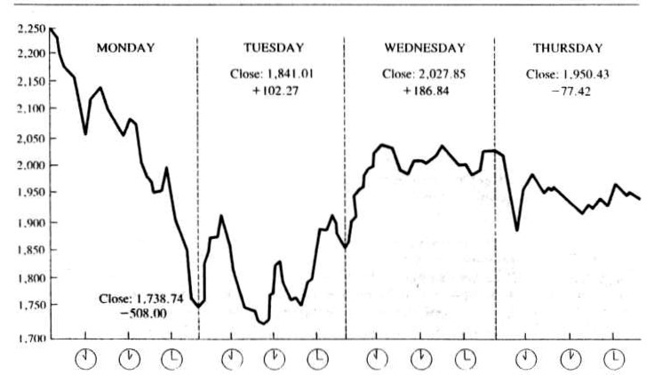
24.4 Impact of Portfolio Insurance on the Stock Market and Pricing of Equities
Portfolio insurance is a method of hedging a portfolio either by selling a certain portion of the risky assets themselves, or futures contracts on stock indexes, when the market falls.
The portfolio insurer sells futures contracts at index levels that, in a falling market, are higher than they will be later.
Figures 24.9 show the precipitous drop of 508 points on the Dow Jones index that took place on Black Monday.
Figure 24.9 Daily Movement of the Dow Jones Industrial Average, October 19-22

Slide 30
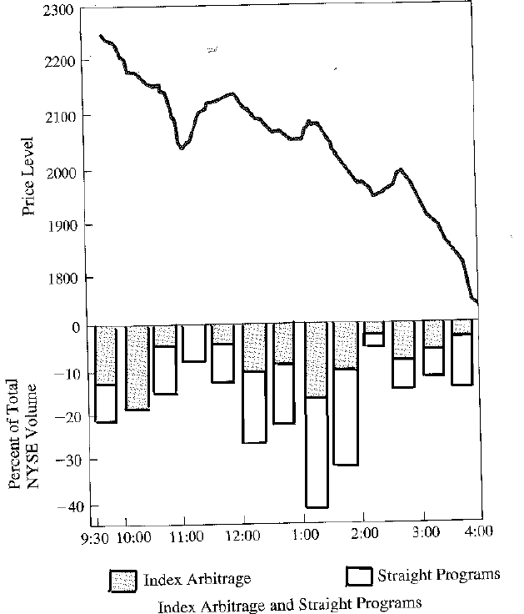
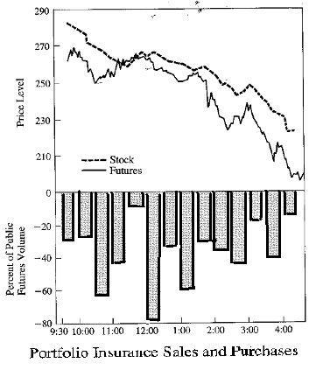
Figure 24-10 shows that for most of the day futures were selling at a discount to the index.
What is more revealing is that every time the discount got wider, the index started to fall faster.
The bottom panels in Figures 24-10 and 24-11 show the percentages of trading volume for futures and the NYSE.
Figure 24.11 Dow Jones Industrial One-Minute Chart,
Monday October 19-22
Figure 24.10 S&P Index and Futures Contracts, Monday, October 19-22

Slide 31
24.4.1 Regulation and the Brady Report
In the aftermath of the October 1987 crash, the role of regulation in both the futures and the stock markets was hotly debated.
Figure 24-12 shows the relationships of the Congress, Federal agencies, and the Federal Reserve with the two leading futures and stock exchanges.
The Brady Commission report is likely to provide the framework for the debate of how to regulate US security markets.
The Brady Commission report makes 5 primary recommendations.
However, it is clear that practices such as portfolio insurance that link different markets together have forced study of the problems of a segmented regulatory system.

Slide 32
Figure 24.12 Regulating the Markets
House/Senate Agriculture committees
Commodity Futures Trading Commission
Chicago Mercantile Exchange
Stock-Index Futures
Senate Banking/House Commerce Committees
New York Stock Exchange
Stocks
Securities and Exchange Commission
Federal Reserve Board
Index Arbitrage
Details of each title is in Figure 24.12 of the textbook

Slide 33
24.5 Empirical Studies of Portfolio Insurance
24.5.1 Leland (1985)
Leland (1985) developed a replication strategy in the presence of transaction costs and tested this approach by using a simulation.
Leland proposed a procedure that adjusts upward the volatility estimate to the replicating procedure.
This accentuation of up or down movements of the stock price can be modeled as if the volatility of the actual stock price was higher.

Slide 34
The adjustment to volatility is
Where
The delta value of this strategy takes into account transaction costs and will be higher than without transaction costs.
As can be seen from Equation (24.8), the volatility estimate increases as the revision period and transaction costs increase.
(24.8)

Slide 35
The effectiveness of the modified replication strategy is determined by the following simulation where
Risk-free rate :10%; Expected return for the stock: 16%; Standard deviations: 20%
Rebalancing periods of 1, 4, and 8 weeks to replicate options expiring in 3,6, and 12 months.
Here H is the difference between the listed call and the synthetic option after the revision period, $Δt$.
where $ΔC$ is the change in the listed call option over the revision period, $C_{s}$ is the delta value and is the number of shares in the replicated portfolio, and r is the interest rate over the revision period.
If the replicated option perfectly matches the changes in the listed option, $ΔH$ will equal zero.
For each of the revision periods, the mean and standard deviation of the errors is calculated.
(24.9)

Slide 36
24.5.2 Asay and Edelsburg (1986)
Asay and Edelsburg used Monte Carlo simulations to determine how closely a synthetic-option strategy can match the returns on options on Treasury-bill futures.
Whipsawing occurs when the underlying asset increases enough to trigger rebalancing.
A common remedy for this problem is to use a larger adjustment gap or filter rule; however, the wrong number of shares could be held if the filter rule was increased, particularly if the stock moved in a linear manner.
The authors concluded that problems such as transaction costs, whipsawing, and frequent rebalancing do not negate the effectiveness of the synthetic option on Treasury-bill futures.

Slide 37
24.5.3 Eizman (1986)
The purpose of Eizman’s paper is to determine which rebalancing strategy is the most effective in a dynamic-hedging portfolio-insurance framework.
For the discrete-time adjustment strategy, he rebalanced monthly, weekly, semiweekly, daily, and hourly.
The transaction costs increased and replication errors decreased as the rebalance periods shortened.
He used a utility function of Min (X + r), where X is average annual transaction costs and r is average annual replication error, to determine the most effective rebalance period.
Using this criterion, the best method is the weekly method, with the semiweekly strategy coming in second.
Notes:
Pg.979
utility function of Min (X + Y) has to be changed to Min (X + r)

Slide 38
24.5.4 Rendleman and McEnally (1987)
This study addresses the issue of portfolio-insurance cost.
They used a Monte Carlo simulation with a 16% expected return and a 10% interest rate.
The Black–Scholes model is used to derive delta values for the put option.
In addition, a logarithmic utility function is specified to measure the utility of a portfolio-insurance strategy.
They concluded that portfolio-insurance strategies are optimal only when investors are highly risk averse.

Slide 39
24.5.5 Gracias and Gould (1987)
The main goal of this article is to compute the costs of a synthetic-call portfolio-insurance strategy.
They use closing prices of the S&P 500 index from January 1, 1963 to December 31, 1983.
They generate returns for 240 overlapping years by taking 20 January to January returns, then 20 February to February returns, and so on.
This is the first published portfolio-insurance study to use real data as opposed to simulated data.
They concluded that the cost of portfolio insurance is 170 basis points for zero-floor insurance and 83 basis points for a strategy , and that a dynamically balanced portfolio will not outperform a buy-and-hold (BH) portfolio.

Slide 40
24.5.6 Zhu and Kavee (1988)
They evaluated and compared the performances of the two traditional portfolio strategies, the synthetic-put approach of Rubinstein and Leland (1981) and the constant-proportion approach of Black and Jones (1987).
They used Monte Carlo simulation methodology to determine whether these strategies can really guarantee the floor return and how much investors have to pay for the protection.
Both strategies are able to reshape the return distribution so as to reduce downside risk and retain a certain part of the upside gains.
There are two types of costs for portfolio insurance strategy, explicit cost, which is transaction costs and implicit cost, which is the average return forgone in exchange for protection against the downside risk.
When the market becomes volatile, the protection error of the synthetic-put approach increases, and the transaction costs may be unbearable.
On the contrary, while the constant proportion approach may have lower transactions costs, its implicit cost may still be substantial.

Slide 41
24.5.7 Perold and Sharpe (1988)
Using simulated stocks and bills prices, they examined and compared how the four dynamic asset allocation strategies, namely, the BH, constant mix (CM), CPPI, and option-based portfolio insurance (OBPI), perform in bull, bear, and flat markets and in volatile and not-so-volatile markets.
CPPI and OBPI strategies sell stocks as the market falls and buy stocks as the market rises.
CM strategy — holding a constant fraction of wealth in stocks — buys stocks as the market falls and sells them as it rises.
They suggested that no one particular type of dynamic strategy is best in all situations.

Slide 42
24.5.8 Rendleman and O’Brien (1990)
They addressed the issue that the misestimation of volatility input can have a significant impact on the final payoffs of a portfolio using a synthetic put strategy.
In an OBPI (option-based portfolio insurance)strategy, the daily portfolio adjustments depend on the delta of the put option on the risky asset.
More importantly, they addressed the biggest potential risk of implementing portfolio insurance strategies — the gap risk, by simulating the performance of the OBPI (option-based portfolio insurance) strategy over the period of the October 1987 market crash.
They indicated that most insured portfolios would have fallen short of their promised values because the managers would not be able to adjust the portfolio in time before a big drop in the market.

Slide 43
24.5.9 Loria, Pham, and Sim (1991)
They simulated the performance of a synthetic-put strategy using futures contracts based on the Australian All Ordinaries Index for the period from April 1984 to March 1989.
They reported that there is no perfect guarantee of loss prevention under any scenario.
In addition, the OBPI (option-based portfolio insurance) strategy is most effective under severe market conditions.
In other periods characterized by insignificant market declines, the value of the insured portfolio is below that of the market portfolio.
They suggested futures mispricing may be one potential culprit for this outcome.

Slide 44
24.5.10 Do and Faff (2004)
They examined two approaches (the OBPI [option-based portfolio insurance] and CPPI) and conducted simulations across two implementation strategies (via Australia stock index and bills, and via SPI futures and stock index).
In terms of floor protection, the futures-based portfolio insurance implementation generally dominates its index-and-bill rival in both floor specifications, which reflects the low transaction costs in the futures market.
Furthermore, the perfect floor protection is possible when implied volatility is used rather than using ex post volatilities.
. All portfolio insurance strategies achieve 100% floor protection during tranquil periods, whereas the futures-based OBPI approach records the highest portfolio return.
However, assuming the futures continued to trade during that crisis, from the algorithm’s perspective, the futures-based CPPI maintains a positive return, while the OBPI results in a negative return.

Slide 45
24.5.11 Cesari and Cremonini (2003)
This study is an extensive comparison of a wide variety of traditional portfolio insurance strategies.
There are basically five dynamic asset allocation strategies:
BH
CM
constant proportion (without and with the lock-in of profits, CP and CPL
the option-based approach (with three variations, BCDT, NL, and PS)
technical strategy (with two kinds of stop-loss mechanism, MA and MA2)
In bear and no-trend markets, CP and CPL strategies appear to be the best choice.
In a bull market or in no-trend but with high volatility market, the CM strategy is preferable.
If the market phase is unknown, CP, CPL, and BCDT strategies are recommended.

Slide 46
24.5.12 Herold, Maurer, and Purschaker (2005)
They compared the hedging performances between the traditional CPPI strategy and the risk-based (specifically, VaR-based) strategy.
They used a one-year investment hrizon that begins at each year from 1987 to 2003.
CPPI avoids losses in the bear years of 1994 and 1999.
The mean return is inferior to (about 40 bp below) that of the risk-based strategy.
CPPI also produces a higher turnover.

Slide 47
24.5.13 Hamidi, Jurczenko, and Maillet (2007)
They studied VaR-based measure in this empirical work.
According to the 1,608 back-testing results, the Asymmetric Slope CAViaR is the best model to fit the data.
After having calculated the VaR values, the conditional multipliers can be determined.
Using the time-varying CPPI multipliers estimated by different methods, and a “multi-start” analysis — the fixed one-year investment horizon beginning at every day of the out-of-sample period, they found that the final returns of these insured portfolios are not significantly different.

Slide 48
24.5.14 Ho, Cadle, and Theobald (2008)
This empirical study presents a complete structure of comparing traditional portfolio insurance strategies (OBPI, CPPI) with modern risk-based portfolio insurance strategies (VaR-, ES-based RBPI).
The performances are evaluated from six differing perspectives.
In terms of the Sharpe ratio and the volatility of portfolio returns, the CPPI is the best performer, while the VaR based upon the normal distribution is the worst.
From the perspective that the return distribution of the hedged portfolio is shifted to the right and in terms of both the average and the cumulative portfolio returns across years, the ES-based strategy using the historical distribution ranks first.
Moreover, the ES-based strategy results in a lower turnover within the investment horizon, thereby saving transaction costs.

Slide 49
24.6 Summary
This chapter has discussed basic concepts and methods of portfolio insurance for stocks.
Strategies and implementation of portfolio insurance have also been explored in detail.
Other issues related to portfolio insurance and dynamic hedging have also been studied.
Portfolio insurance was described not as an insurance technique but rather as an asset-allocation or hedging technique.
The general methods of portfolio insurance — (l) stop-loss orders, (2) market-traded index options, (3) synthetic options, and (4) futures trading — were discussed.
It can be regarded as a synthesis of the whole book although another chapter follows.

