Slide 1
Chapter 27
Itô’s Calculus: Derivation of the Black–Scholes Option Pricing Model
By
Cheng Few Lee
Joseph Finnerty
John Lee
Alice C Lee
Donald Wort

Slide 2
Outline
27.1 The Itô Process and Financial Modeling
27.2 Itô Lemma
27.3 Stochastic Differential-Equation Approach to Stock-Price Behavior
27.4 The Pricing of an Option
27.5 A Reexamination of Option Pricing
27.6 Remarks on Option Pricing
27.7 Summary

Slide 3
27.1 THE ITÔ PROCESS AND FINANCIAL MODELING
Stochastic calculus is the mathematical of random change in continuous time.
A key notion in stochastic calculus is the equation:
$dS\left(t,w\right)=μ\left[t,S\left(t,w\right)\right]dt+σ\left[t,S\left(t,w\right)\right]dZ\left(t,w\right)$ (27.1)
Because time takes values continuously in $\left[0,∞\right)$ , the Itô equation is a continuous-time random equation.

Slide 4
27.1 THE ITÔ PROCESS AND FINANCIAL MODELING
$μ\left[t,S\left(t,w\right)\right]dt$ =the expected change in $S\left(t,w\right)$ at time t.
This is called the drift component of the Itô equation, and in finance it is used to compute the instantaneous expected value of the change in the random variable $S\left(t,w\right)$.
$σ\left[t,S\left(t,w\right)\right]dZ\left(t,w\right)$ = reflects the uncertain term.

Slide 5
$σ\left[t,S\left(t,w\right)\right]dZ\left(t,w\right)$ = reflects the uncertain term.
The first factor, $σ\left[t,S\left(t,w\right)\right]$ , is used in the calculation of the instantaneous standard derivation of the change in the random variable $S\left(t,w\right)$; it is a function of both time t and the range of values taken by$S\left(t,w\right)$.
When $σ\left[t,S\left(t,w\right)\right]$ is squared to compute the instantaneous variance, it is usually called the diffusion coefficient; it measures the variability of $dS\left(t,w\right)$ at a given instance in time.

Slide 6
27.1 THE ITÔ PROCESS AND FINANCIAL MODELING
The second factor, $dZ\left(t,w\right)$, is called white noise.
The methodological foundation of the Itô model is that the uncertainty magnitude, $dZ\left(t,w\right)$ is multiplied by $σ\left[t,S\left(t,w\right)\right]$ to produce the total contribution of uncertainty.
Because $σ\left[t,S\left(t,w\right)\right]$ and $dZ\left(t,w\right)$ are independent random variables, from Equation (27.2):
Thus, Equation (27.1), which was developed by mathematicians, captures the spirit of financial modeling admirably because it is an equation that involves three important concepts in finance: mean, standard derivation, and randomness.

Slide 7
If at a given time t the possible future change in the price of an asset during the next trading interval is being evaluated, this change can be decomposed into two nonoverlapping components: the expected change and the unexpected change.
The expected change, $E\left[dS\left(t,w\right)\right]$ , is described by $E\left\{σ\left[t,S\left(t,w\right)\right]dt\right\}$ and the unexpected change is given by $E\left\{σ\left[t,S\left(t,w\right)\right]dZ\left(t,w\right)\right\}$.

Slide 8
Sample Problem 27.1
Consider the following example of an Itô process describing the price of given stock.
$dS\left(t,w\right)=0.001 S\left(t,w\right)dt+0.025 S\left(t,w\right)dZ\left(t,w\right)$
If both sides are divided by we get:
$\frac{dS\left(t,w\right)}{S\left(t,w\right)}=0.001 dt+0.025 dZ\left(t,w\right)$
Assume that dt equals one trading period, such as one day. Using appropriate coefficients in this equation dt could be denoted as one second. In Equation (27.4), the expected daily proportional change is given by:
$E\left[\frac{dS\left(t,w\right)}{S\left(t,w\right)}\right]=E\left[0.001 dt+0.025 dZ\left(t,w\right)\right]=0.001$

Slide 9
27.2 ITÔ LEMMA
This section presents briefly Itô’s lemma of stochastic differentiation. By formally integrating Equation (27.1):
$S\left(t,w\right)=S\left(0,w\right)+\int_{0}^{t}{μ\left(u,w\right) du}+\int_{0}^{t}{μ\left(u,w\right) dZ\left(u,w\right)}$
(27.6)
Itô’s Lemma. Consider the nonrandom continuous function $u\left(t,S\right):[0,∞)×R→R$ and suppose that it has continuous partial derivatives $u_{t}$ , $u_{S}$, and $u_{SS}$ .
Let:
$Y\left(t,w\right)=u\left[t,S\left(t,w\right)\right]$ (27.7)
with:
$dS\left(t,w\right)=μ\left[t,S\left(t,w\right)\right]dt+σ\left[t,S\left(t,w\right)\right]dZ\left(t,w\right)$ (27.8)
Then the process $Y\left(t,w\right)$ has a differential given by:
$\begin{matrix}\left.dY(t,w)=\{u_{t}[t,S(t,w)]+u_{S}[t,S(t,w)]μ[t,S(t,w)\right] \\ + \frac{1}{2}u_{SS}[t,S(t,w)]σ^{2}[t,S(t,w)]\} dt \\ \left. + u_{S}[t,S(t,w)]σ[t,S(t,w)] dZ(t,w\right)\end{matrix}$ (27.9)

Slide 10
27.3 Stochastic Differential-equation Approach To Stock-price Behavior
As a special case of Equation (27.1) consider:
$dS\left(t,w\right)=μS\left(t,w\right)dt+σS\left(t,w\right)dZ\left(t,w\right)$ (27.11)
The solution $\left.S(t, w\right)$ is given by:
$S(t, w)=S(0, w)exp\left[\left.\left(μ−\frac{1}{2}σ^{2}\right)t+σZ(t, w\right)\right]$(27.12)
Equation (27.12) is a function of t and$\left. Z(t, w\right)$ :
$\left.dZ(t, w)=0⋅dt+1⋅dZ(t, w\right)$

Slide 11
27.3 Stochastic Differential-equation Approach To Stock-price Behavior
Next, compute the first- and second-order partials denoted by $S_{t}$ , $S_{Z}$ , and $S_{ZZ}$ :
Collect these results and use Equation (27.9) to conclude that Equation (27.11) holds:

Slide 12
27.3 Stochastic Differential-equation Approach To Stock-price Behavior
To see if Equation (27.12) accurately describes stock prices in the real world, rewrite it as:
(27.13)
which is a random variable normally distributed with mean and variance . This means that if the stock price follows an Itô process, it has a log-normal probability distribution.

Slide 13
Sample Problem 27.4
Suppose that instead of Equation (27.11), Equation (27.14) is given:
(27.14)
Using Equation (27.14) for t = 1 to compute:
(27.15)
(27.16)
which means that for a given trading day, the price of the stock is expected to experience a continuous change of 0.068% with a standard derivation of 0.025%.

Slide 14
Sample Problem 27.5
In Table 27.1, we collect from Yahoo.com 40 recent daily closing Google Inc. prices.
For modeling purposes, the Black–Scholes equation requires a mathematical expression for prices, such as shown in Table 27.1 and Figure 27.1.
Figures 27.2 and 27.3 are frequency approximations to a normal distribution and illustrate the distributions of returns and distributions of dZs of Table 27.1.
This daily average is 0.000185, which annualized becomes 0.000185 × 250 = 0.04625. The volatility of these 40 returns is computed as the annualized standard deviation of daily returns and is computed as 0.011215 × √250 = 0.177324.

Slide 15
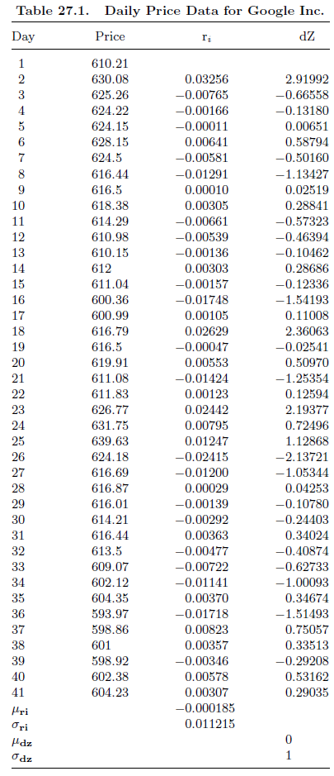
Sample Problem 27.5

Slide 16
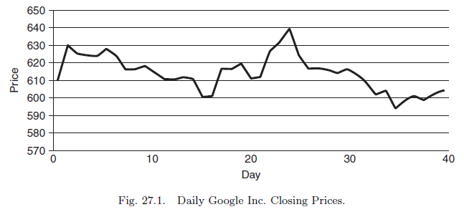
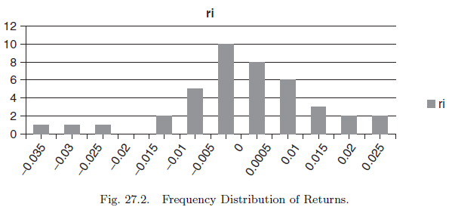
Sample Problem 27.5

Slide 17
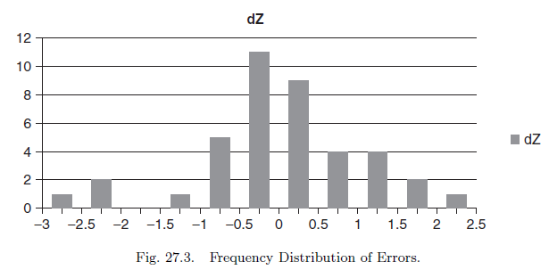
Sample Problem 27.5
Since these prices are daily, we use the daily constant average return and constant daily volatility to obtain daily dZs in column 4 of Table 27.1 using

Slide 18
27.4 The Pricing of an Option
An option is a contract giving the right to buy or sell an asset within a specified period of time subject to certain conditions.
The simplest kind of option is the European call option, which is a contract to buy a share of a certain stock at a given date for a specified price.
The date the option expires is called the expiration date (maturity date) and the price that is paid for the stock when the option is exercised is called the exercise price (striking price).

Slide 19
27.4 The Pricing of an Option
The first rigorous formulation and solution of the problem of option pricing was achieved by Black and Scholes (1973) and Merton (1973). Consider a stock option denoted by C whose price at time t can be written:
(27.17)
The price of this stock is assumed to follow Itô’s stochastic differential equation:
(27.18)
When μ and σ are constant, Equation (27.18) becomes:
(27.19)

Slide 20
27.4 The Pricing of an Option
Assume that the stock pays no dividends or other distributions. By Itô’s lemma, the differential of the call price using Equations (27.17) and (27.19) is:
(27.21)
Observe that in Equation (27.21):
(27.22)
(27.23)
In other words, is the expected change in the call-option price and is the variance of such a change per unit of time.
If the call-option price is a function of a spot stock price that follows an Itô process, then the call-option price also follows an Itô process with mean and standard derivation parameters that are more complex than those of the stock price (as shown in Eq. 27.22 and 27.23).

Slide 21
27.4 The Pricing of an Option
Consider an investor who builds up a portfolio of stocks, options on the stocks, and a riskless asset (for example, government bonds) yielding a riskless rate r. The nominal of the portfolio, P(t) is:
(27.20)
Where N1 the number of shares of the stock; N2 the number of call options; and Q the value of dollars invested in riskless bonds.
The change in the normal value of the portfolio results from the change in the prices of the assets because at a point in time the equations of option and stock are given —that is N1 =N2 = 0. Then,
(27.24)

Slide 22
27.4 The Pricing of an Option
Let w1 be the fraction of the invested in stock, w2 be the fraction invested in options, and w3 be the fraction of the invested in the riskless asset. Then Equation (27.24) becomes:
(27.25)
At this point, the notion of economic equilibrium (also called risk-neutral or preference-free pricing) is introduced in the analysis. This notion plays an important role in modeling financing behavior, and its appropriate formulation is considered to be a major breakthrough in financial analysis.

Slide 23
27.4 The Pricing of an Option
Let w1 and w2 be such that:
(27.26)
(27.27)
Then from Equation (27.25), because the portfolio is riskless it follows that the portfolio must be expected to earn the riskless rate of return, or:
(27.28)
Equations (27.27) and (27.28) yield the Black-Scholes-Merton equations:
(27.29)&(27.30)
(27.31)

Slide 24
27.4 The Pricing of an Option
Using Equation (27.31) and making the necessary substitutions from Equations (27.22) and (27.23), the partial differential equation of the pricing of an option is obtained:
(27.32)
The solution to the differential equation (27.32) given these boundary conditions is the Black–Scholes formula.

Slide 25
27.5 A Reexamination of Option Pricing
Consider the nominal value of a portfolio consisting of a stock and a call option on this stock and write:
(27.33)
Using Equations (27.33) and (27.21), the change in the value of the portfolio is given by
(27.34)

Slide 26
27.5 A Reexamination of Option Pricing
Note that $dN_{1}=dN_{2}=0$, since at any given point in time the equations of stock and option are given.
For arbitrary quantities of stock and option, Equation (27.34) shows that the change in the nominal value of the portfolio is stochastic because is a random variable. S
uppose the quantities of stock and call option are chosen as that
(27.35)
Note that in Equation (27.35) denotes a hedge ration and is called delta.

Slide 27
27.5 A Reexamination of Option Pricing
$N_{1}dS+N_{2}C_{S}dS=0$, and inserting Equation (27.35) into Equation (27.34) yields:
(27.36)
Let $N_{2}=1$ in Equation (27.36) and observe that in equilibrium the rate of return of the riskless portfolio must be the same as the riskless rate $r\left(t\right)$.
Therefore:
(27.37)

Slide 28
27.5 A Reexamination of Option Pricing
Equation (27.37) can be used to derive the partial differential equation for the value of the option.
Making the necessary substitutions in Equation (27.36):
which upon rearrangement gives Equation (27.32). Note that the option-pricing equation is a second-order linear partial differential equation of the parabolic type.
The boundary conditions of Equation (27.32) are determined by the specification of the asset.

Slide 29
27.5 A Reexamination of Option Pricing
For the case of an option that can be exercised only at the expiration date $t^{∗}$ with an exercise price X, the boundary conditions are
(27.38)
(27.39)
Observe that Equation (27.38) says that the call-option price is zero if the stock price is zero at any date t; Equation (27.39) says that the call-option price at the expiration date $t=t^{∗}$ must equal the maximum of either zero or the difference between the stock price and the exercise price.

Slide 30
27.5 A Reexamination of Option Pricing
The solution of the option-pricing equation for a call and a put option subject to the boundary conditions are given in Equations (27.40a) and (27.40b) for $T=t^{∗}−t$, as
(27.40a)
(27.40b)
where N denotes the cumulative normal distribution, namely:

Slide 31
27.5 A Reexamination of Option Pricing
In Equation (27.40a), T is time to expiration (measured in years) and $d_{1}$ and $d_{2}$ are given by
(27.41)
(27.42)
It can be shown that
(27.43)
These partial derivatives justify the intuitive behavior of the price of an option, as was indicated in the beginning of the previous section.

Slide 32
27.5 A Reexamination of Option Pricing
Before giving an example, it is appropriate to sketch the solution of Equation (27.32) subject to the boundary conditions of Equations (27.38) and (27.39).
Let $t$ denote the current trading period that is prior to the expiration date $t$*.
At time $t$, two outcomes can be expected to occur at $t$*.
(1) $S\left(t^{∗}\right)>X$— that is the price of the stock at the time of the expiration of the call option is greater than exercise price, or (2) $S\left(t^{∗}\right)≤X$.
Note that the first outcome occurs with probability $P_{0}≡P\left[S\left(t^{∗}\right)>X\right]$ and the second occurs with probability $1−p$.

Slide 33
27.5 A Reexamination of Option Pricing
If $S\left(t^{∗}\right)≤X$, then from Equation (27.39).
Again from Equation (27.39), if $S\left(t^{∗}\right)>X$, then the price of the call option at expiration can be computed from the expiration of Equation (27.39):
(27.44)
What is the price of a call option if the first outcome materializes at $t$ instead of $t$* ?
This can be answered immediately by appropriate continuous discounting. Using Equation (27.44):
(27.45)

Slide 34
27.5 A Reexamination of Option Pricing
Recall, however, that $C\left(t\right)$ in Equation (27.45) holds only with probability $p$.
Combine both possibilities to write:
(27.46)
Detailed calculation in Jarrow and Rudd (1983, pp. 92–94) shows that because the price of the underlying stock is distributed log normally, it follows that

Slide 35
27.5 A Reexamination of Option Pricing
Detailed calculation in Jarrow and Rudd (1983, pp. 92–94) shows that because the price of the underlying stock is distributed log normally, it follows that
(27.47)
(27.48)
Combining Equations (27.47) and (27.48) with $T=t^{∗}−t$ into Equation (27.46) yields Equation (27.40a).

Slide 36
27.5 A Reexamination of Option Pricing
It is worth observing that two terms of Equations (27.40a) and (27.40b) have economic meaning.
The first term, $SN\left(d_{1}\right)$ , denotes the present value of receiving the stock provided that $S\left(t^{∗}\right)>X$.
The second term gives the present value of paying the striking price provided that $S\left(t^{∗}\right)>X$.
In the special case when there is no uncertainty and $σ=0,$ observe that
(27.49)
that is, a call is worth the difference between the current value of the stock and the discounted value of the striking price provided $S\left(t^{∗}\right)>X$; otherwise the call price would be zero.

Slide 37
Sample Problem 27.6
Equations (27.40a) and (27.40b) indicate that the Black–Scholes option-pricing model is a function of only five variables: T, the time to expiration, S, the stock price, $σ^{2}$, the instantaneous variance rate on the stock price, X, the exercise price, and r, the riskless interest rate.
Of these five variables, only the variance rate must be estimated; the other four variables are directly observable.
A simple example is presented to illustrate the use of Equation (27.40).
The values of the observable variables are taken from Yahoo! Finance.
On Wednesday, March 16, 2011, at 3:58 pm EDT, IBM Corp. had a stock price of $152.93.
The July 11 call-option with a strike price of 150.00 was priced at $10.50.
We estimate the riskless rate at 0.25% from the US Treasury bill rate.
The only missing piece of information is the instantaneous variance of the stock price.

Slide 38
Sample Problem 27.6
Several different techniques have been suggested for estimating the instantaneous variance.
In the example the implicit variance is calculated by using a numerical search to approximate the standard derivation implied by the Black–Scholes formula with these parameters:
stock price S = 152.93,
exercise price X = 150,
time to expiration T = 121/365 ＝ 0.3315,
riskless rate r = 0.0025, and
call-option price C = 10.50.
The approximated implied volatility is found to be $σ^{}$ = 0.264.

Slide 39
Sample Problem 27.7
Using the information about the implied volatility presented above and a stock price of S = 155, we present the following example.
Given S = 155, X = 150, T = 0.3315, r = 0.0025, and s = 0.264, use Equation (27.40) to compute C.
Using Equation (27.41) and (27.42) calculate:
From a standard normal distribution table, giving the area of a standard normal distribution, N(0.29717) = 0.616836 and N(0.14517) = 0.557923.

Slide 40
Sample Problem 27.7
Finally,
These calculations show that as the price of the underlying stock increases from 152.93 to 155, the call price increases as indicated in (27.43) from $10.50 to $10.71, while all other variables are the same.

Slide 41
Sample Problem 27.8
Using the information from the above example, we will calculate a call with a strike price of $160 using Equation (27.40a)
From a standard normal distribution table, giving the area of a standard normal distribution, N(−0.127419) = 0.449314 and N(−0.268425) = 0.394208.
Finally,

Slide 42
Sample Problem 27.8
As expected, the price of this call option, C = $9.63, with X = 160 has a lower calculated price than the call option with X =150, as indicated in (27.43).
This simple example shows how to use the Black–Scholes model to price a call option under the assumptions of the model.
The closeness of a calculated call option price to the actual call price is not necessary evidence of the validity of the Black–Scholes model.

Slide 43
27.6 Remarks on Option Pricing
It is appropriate here to make a few remarks on the Black–Scholes option-pricing model to clarify its significance and its limitation.
First, the Black–Scholes model is based on several simplifying assumptions.
Second, it is worth repeating that the use of Itô’s calculus and the important insight concerning the appropriate concept of an equilibrium by creating a riskless hedge portfolio have let Black and Scholes obtain a closed-form solution for option pricing.
Third, the Black–Scholes pricing model has found numerous applications.
Fourth, Black (1976) showed that the original call-option formula for stocks can be easily modified to be used in pricing call options on futures.

Slide 44
27.6 Remarks on Option Pricing
The formula is
(27.50)
(27.51)
(27.52)
In Equation (27.50), F now denotes the current futures price.
The other four variables are as before — time to maturity, volatility of the underlying futures price, exercise price, and risk-free rate.
Note that Equation (27.50) differs from Equation (27.40) only in one respect: by substituting for S in the original Equation (27.40), Equation (27.50) is obtained.
This holds because the investment in a futures contract is zero, which causes the interest rate in Equations (27.51) and (27.52) to drop out.

Slide 45
27.7 Summary
This chapter has discussed the basic concepts and equations of stochastic calculus (Itô’s calculus), which has become a very useful tool in understanding finance theory and practice.
By using these concepts and equations, the manner by which Black and Scholes derived their famous option-pricing model was also illustrated.
Although this chapter is not required to understand the basic ingredients of security analysis and portfolio management discussed in Chapters 1–26, it is useful for those with trading in advanced mathematics to realize how advanced mathematics can be used in finance.

