Slide 1
Chapter 3
Common Stock: Return, Growth, and Risk
By
Cheng Few Lee
Joseph Finnerty
John Lee
Alice C Lee
Donald Wort

Slide 2
Chapter Outline
3.1 Holding-Period Return
3.2 Holding-Period Yield
  3.2.1 Arithmetic Mean
  3.2.2 Geometric Mean
  3.2.2 Weighted Unbiased Mean
3.3 Common-Stock Valuation Approaches
3.4 Growth-Rate Estimation and its Application
  3.4.1 Compound-Sum Method
  3.4.2 Regression Method
  3.4.3 One-Period Growth Model
  3.4.4 Two-Period Growth Model
  3.4.5 Three-Period Growth Model
3.5 Risk
  3.5.1 Definitions of Risk
  3.5.2 Sources of Risk
    3.5.2.1 Firm-specific Factors
    3.5.2.2 Market and Economic Factors
3.6 Covariance and Correlation
3.7 Systematic Risk, Unsystematic Risk, and the Market Model

Slide 3
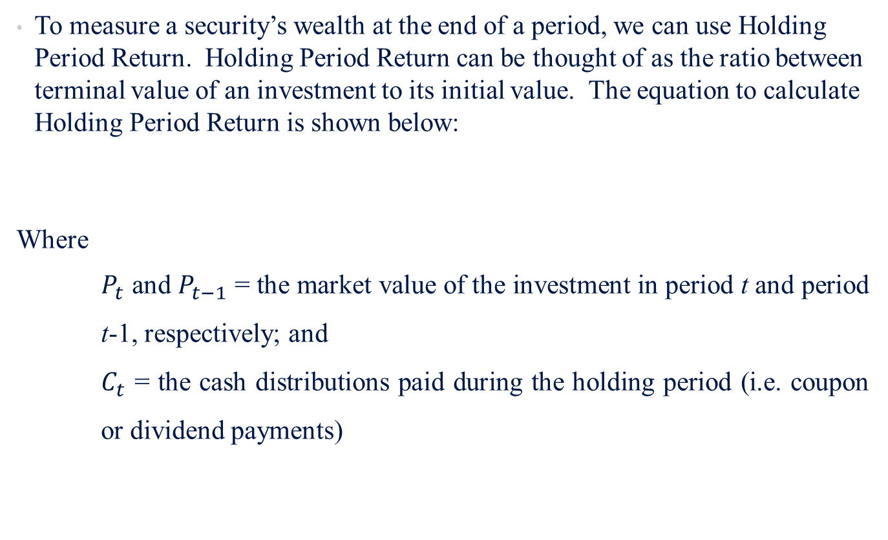
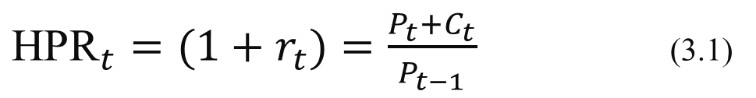
3.1 Holding-Period Return
To measure a security’s wealth at the end of a period, we can use Holding Period Return. Holding Period Return can be thought of as the ratio between terminal value of an investment to its initial value. The equation to calculate Holding Period Return is shown below:
Where
$P_{t}$ and $P_{t−1}$ = the market value of the investment in period t and period t-1, respectively; and
$C_{t}$ = the cash distributions paid during the holding period (i.e. coupon or dividend payments)
${\text{HPR}}_{t}=(1+r_{t})=\frac{P_{t}+C_{t}}{P_{t−1}}$ (3.1)

Slide 4
3.1 Holding-Period Return
Sample Problem 3.1 (pg. 82)
Table 3.1 lists J&J stock price and dividend data for 11 years. In order to calculate the HPR for 2009, the terminal value of the stock ($64.41) is added to the dividend received during 2009 ($1.91) and the sum is divided by the initial value of the stock for 2008 ($59.83)
Table 3.1 | Johnson & Johnson Company HPR and HPY
Year | Closing Price ($) | Annual Dividend ($) | Annual HPR | Annual HPY (%)
1999 | 93.25 | — | — | —
2000 | 105.10 | 1.22 | 1.14 | 14
2001 | 59.10 | 0.66 | 0.569 | −43.1
2002 | 53.71 | 0.78 | 0.922 | −7.8
2003 | 51.66 | 0.91 | 0.979 | −2.1
2004 | 63.42 | 1.08 | 1.249 | 24.9
2005 | 60.10 | 1.26 | 0.968 | −3.2
2006 | 66.02 | 1.44 | 1.222 | 22.2
2007 | 66.70 | 1.60 | 1.035 | 3.5
2008 | 59.83 | 1.77 | 0.924 | −7.6
2009 | 64.41 | 1.91 | 1.108 | 10.8
$\text{HPR}\text{(2009)}=\frac{\$64.41+\$1.91}{\$59.83}=\frac{\$66.32}{\$59.83}=1.108$

Slide 5
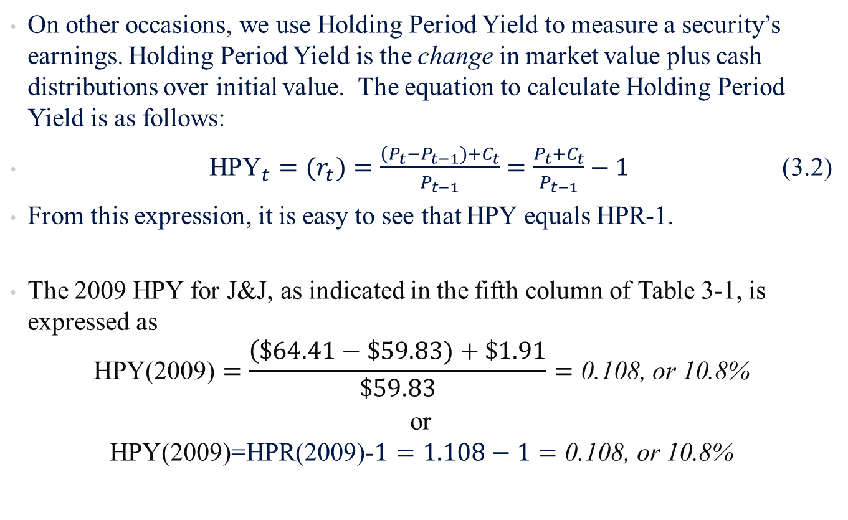
3.2 Holding-Period Yield
On other occasions, we use Holding Period Yield to measure a security’s earnings. Holding Period Yield is the change in market value plus cash distributions over initial value. The equation to calculate Holding Period Yield is as follows:
${\text{HPY}}_{t}=(r_{t})=\frac{\left(P_{t}−P_{t−1})+C_{t}\right.}{P_{t−1}}=\frac{P_{t}+C_{t}}{P_{t−1}}−1$ (3.2)
From this expression, it is easy to see that HPY equals HPR-1.
The 2009 HPY for J&J, as indicated in the fifth column of Table 3-1, is expressed as
$$\text{HPY}\text{(2009)}=\frac{\left(\$64.41−\$59.83)+\$1.91\right.}{\$59.83}=\text{0.108, }\text{or}\text{ 10.8\%}$$
or
$$\text{HPY}\text{(2009)=}\text{HPR}\text{(2009)−}1=1.108−1=\text{0.108, }\text{or}\text{ 10.8\%}$$

Slide 6
3.2 Holding-Period Yield
Continuous Compounding
Sometimes, these calculations are not convenient because they only take the beginning and ending price within a period. This is why we need to use logarithm to assume there are multiple prices within a period. We use natural logarithm in this case, since investors have limited liability (the most an investor can lose is 100%). A graph of a natural log distribution can be seen on page 84 of the book. By taking the natural log of the calculation, we can assume that all the prices within a period are zero or positive and that the return has been continuously invested.
Discrete vs. Continuous Compounding
  Discrete Modeling
    A security’s yield accounts for only the beginning and ending price.
  Continuous Compounding
    A security’s yield contains prices that are positive and returns that are continuously invested within that period.

Slide 7
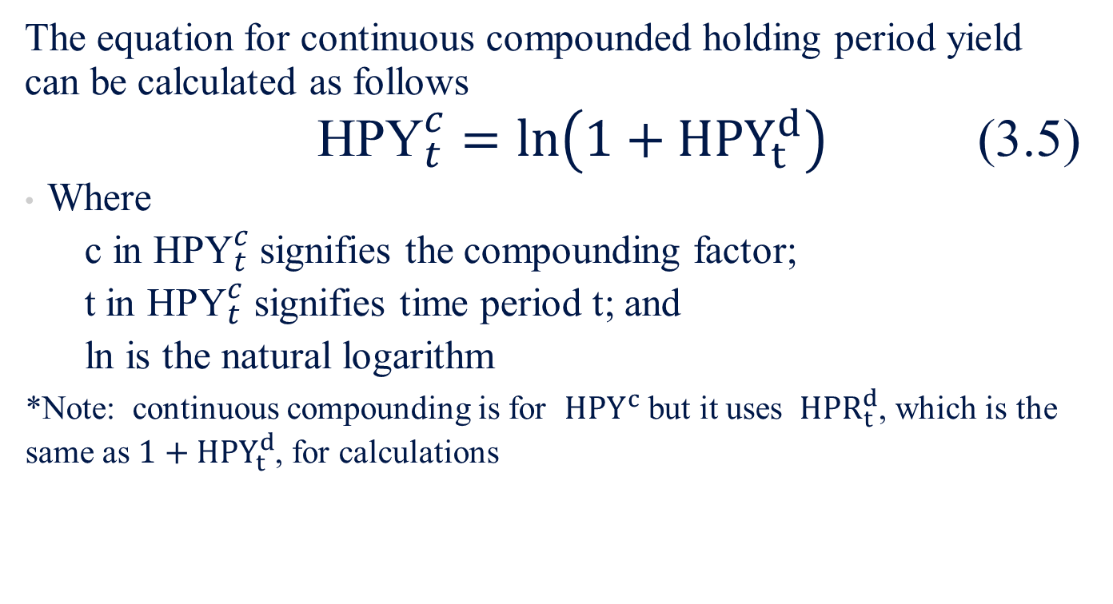
3.2 Holding-Period Yield
Continuous Compounding
The equation for continuous compounded holding period yield can be calculated as follows
${\text{HPY}}_{t}^{c}=ln\left(1+HPY_{t}^{d}\right)$ (3.5)
Where
  c in ${\text{HPY}}_{t}^{c}$signifies the compounding factor;
  t in ${\text{HPY}}_{t}^{c}$ signifies time period t; and
  ln is the natural logarithm
*Note: continuous compounding is for $HPY^{c}$ but it uses $HPR_{t}^{d}$, which is the same as $1+HPY_{t}^{d}$, for calculations

Slide 8
3.2 Holding-Period Yield
Example (pg. 85)
If $1,000 invested for one year produces an ending cash flow of $1,271, the HPR is 1.271 for a HPY of 27.1%. The continuously compounded rate implicit in this investment is calculated by using Equation (3.5):
1n(1+0.271)=0.24
for a HPY^{c} of 24%. In every case except HPY^{d} = 0, the continuously compounded return is always less than the discrete return.

Slide 9
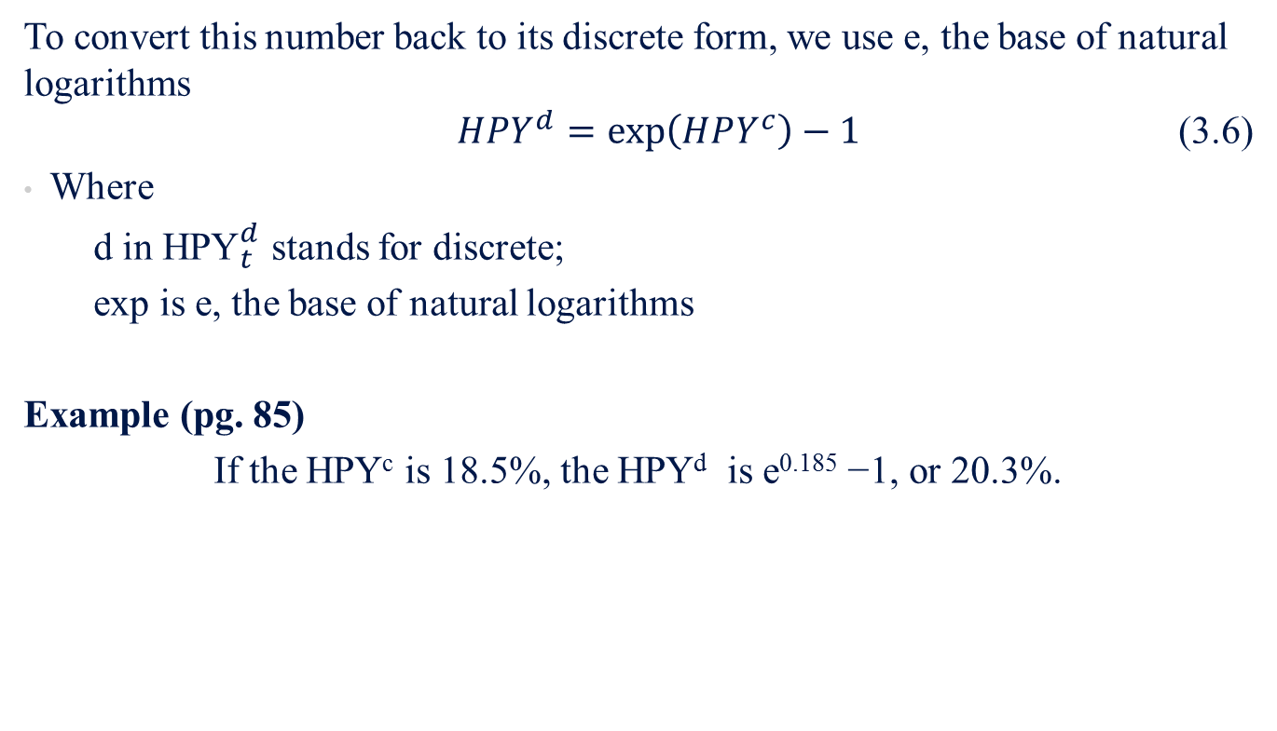
3.2 Holding-Period Yield
To convert this number back to its discrete form, we use e, the base of natural logarithms
$HPY^{d}=exp\left(HPY^{c}\right)−1$ (3.6)
Where
  d in ${\text{HPY}}_{t}^{d}$ stands for discrete;
  exp is e, the base of natural logarithms
Example (pg. 85)
If the HPY^{c} is 18.5%, the HPY^{d} is e^{0.185} −1, or 20.3%.

Slide 10
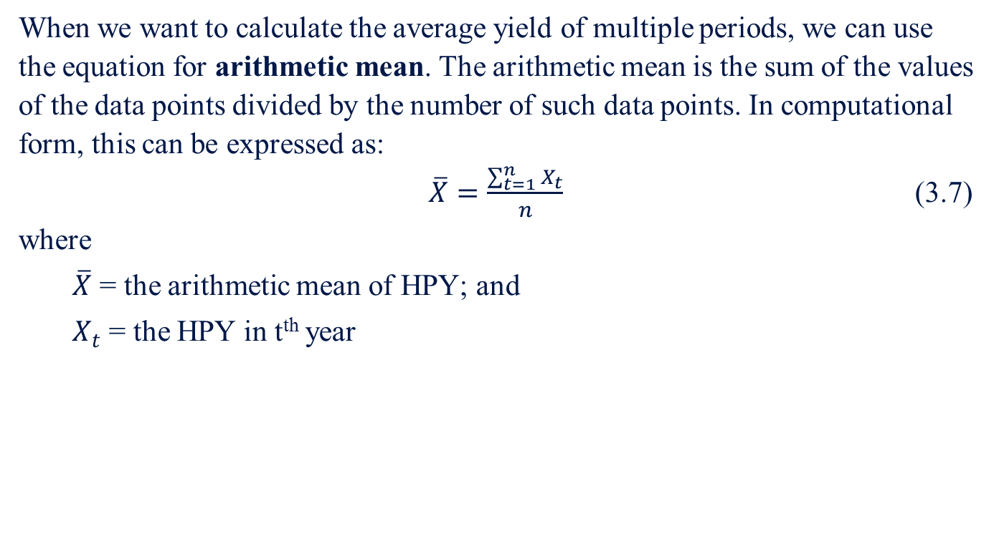
3.2 Holding-Period Yield
3.2.1 Arithmetic Mean
When we want to calculate the average yield of multiple periods, we can use the equation for arithmetic mean. The arithmetic mean is the sum of the values of the data points divided by the number of such data points. In computational form, this can be expressed as:
$\overline{X}=\frac{\sum_{t=1}^{n}{X_{t}}}{n}$ (3.7)
where
  $\overline{X}$ = the arithmetic mean of HPY; and
  $X_{t}$ = the HPY in t^{th} year

Slide 11
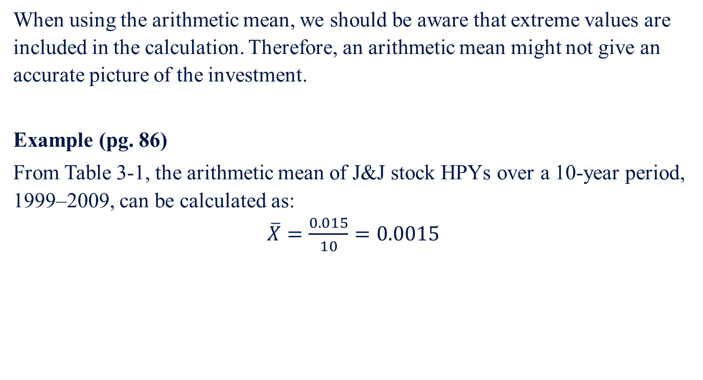
3.2 Holding-Period Yield
3.2.1 Arithmetic Mean
When using the arithmetic mean, we should be aware that extreme values are included in the calculation. Therefore, an arithmetic mean might not give an accurate picture of the investment.
Example (pg. 86)
From Table 3-1, the arithmetic mean of J&J stock HPYs over a 10-year period, 1999–2009, can be calculated as:
$\overline{X}=\frac{0.015}{10}=0.0015$

Slide 12
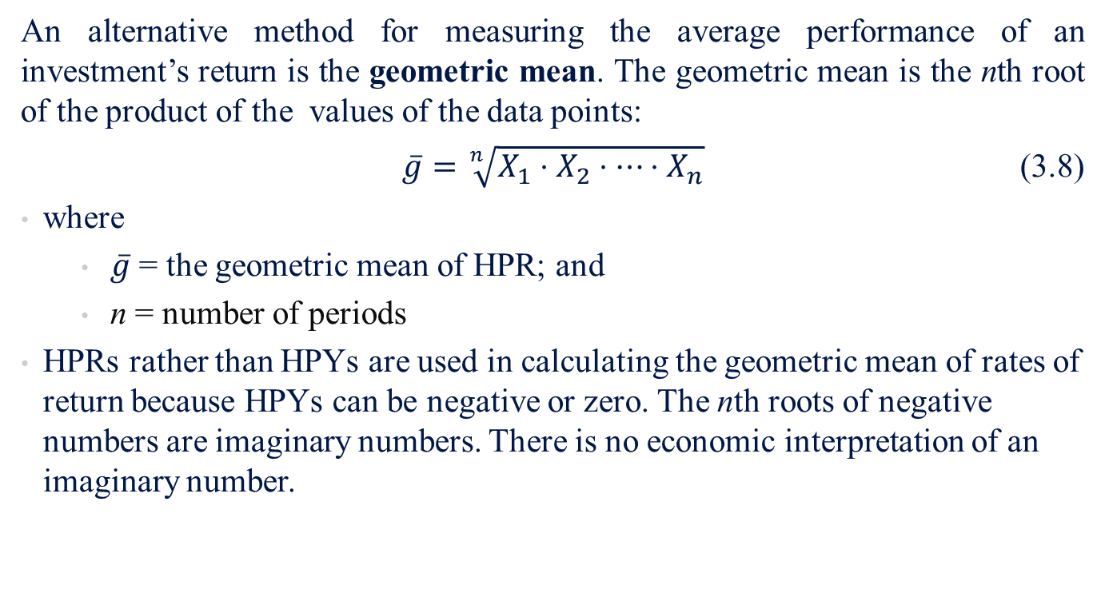
3.2 Holding-Period Yield
3.2.2 Geometric Mean
An alternative method for measuring the average performance of an investment’s return is the geometric mean. The geometric mean is the nth root of the product of the values of the data points:
$\overline{g}=\sqrt[n]{X_{1}⋅X_{2}⋅⋯⋅X_{n}}$ (3.8)
where
  $\overline{g}$ = the geometric mean of HPR; and
  n = number of periods
HPRs rather than HPYs are used in calculating the geometric mean of rates of return because HPYs can be negative or zero. The nth roots of negative numbers are imaginary numbers. There is no economic interpretation of an imaginary number.

Slide 13
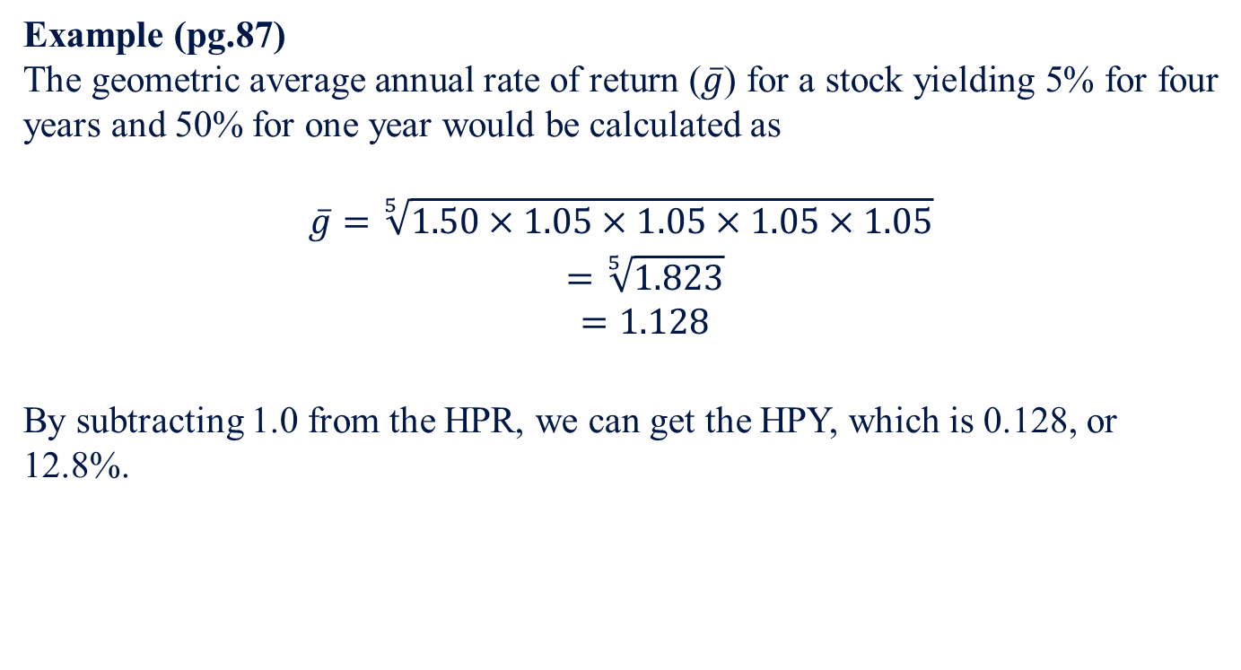
3.2 Holding-Period Yield
3.2.2 Geometric Mean
Example (pg.87)
The geometric average annual rate of return ($\overline{g}$) for a stock yielding 5% for four years and 50% for one year would be calculated as
$$\begin{matrix}\overline{g}=\sqrt[5]{1.50×1.05×1.05×1.05×1.05} \\ =\sqrt[5]{1.823} \\ =1.128\end{matrix}$$
By subtracting 1.0 from the HPR, we can get the HPY, which is 0.128, or 12.8%.

Slide 14
3.2 Holding-Period Yield
3.2.2 Geometric Mean
The best estimate of a future value for a given distribution is still the arithmetic average because it represents the expected value of the distribution. The arithmetic mean is most useful for determining the central tendency of a distribution at a point in time (i.e., for cross-sectional analysis). However, the geometric average mean is best suited for measuring a stock’s compound rate of return over time (i.e., time-series analysis). Hence, the geometric average or compound return should always be used when dealing with the returns of securities over time.
*Note: Arithmetic Mean ≥ Geometric Mean if all numbers are non-negative

Slide 15
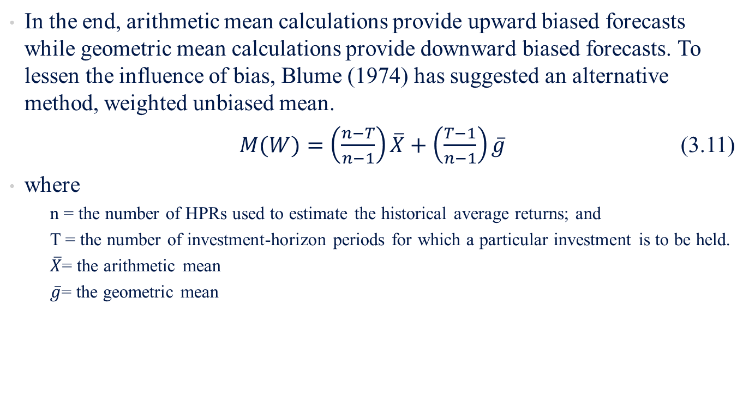
3.2 Holding-Period Yield
3.2.3 Weighted Unbiased Mean
In the end, arithmetic mean calculations provide upward biased forecasts while geometric mean calculations provide downward biased forecasts. To lessen the influence of bias, Blume (1974) has suggested an alternative method, weighted unbiased mean.
$M(W)=\left(\frac{n−T}{n−1}\right)\overline{X}+\left(\frac{T−1}{n−1}\right)\overline{g}$ (3.11)
where
  n = the number of HPRs used to estimate the historical average returns; and
  T = the number of investment-horizon periods for which a particular investment is to be held.
  $\overline{X}$= the arithmetic mean
  $\overline{g}$= the geometric mean

Slide 16
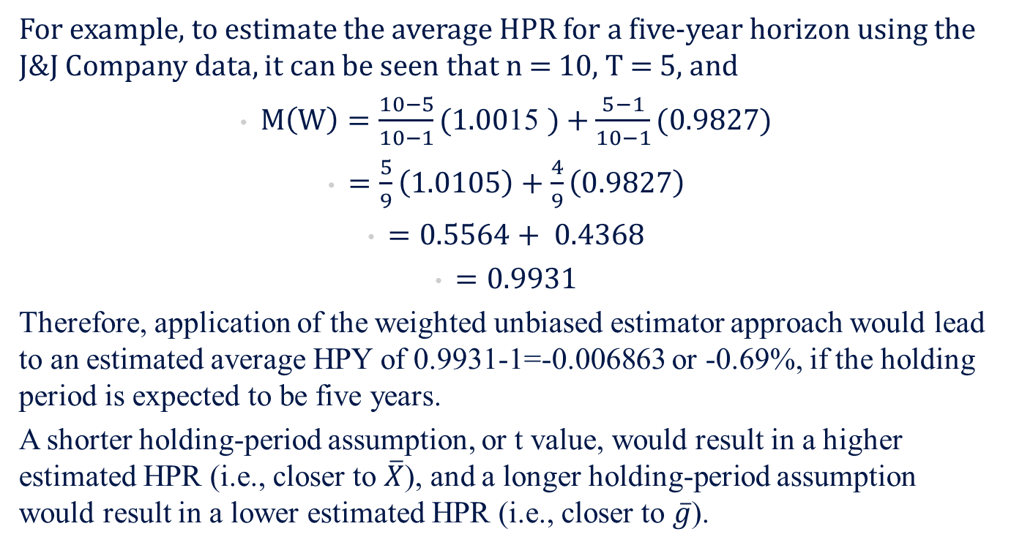
3.2 Holding-Period Yield
3.2.3 Weighted Unbiased Mean
For example, to estimate the average HPR for a five-year horizon using the J&J Company data, it can be seen that n = 10, T = 5, and
$M\left(W\right)=\frac{10−5}{10−1}(1.00\text{15 })+\frac{5−1}{10−1}(0.9827)$
$=\frac{5}{9}\left(1.0105\right)+\frac{4}{9}\left(0.9827\right)$
$=0.5564+ 0.4368$
$=0.9931$
Therefore, application of the weighted unbiased estimator approach would lead to an estimated average HPY of 0.9931-1=-0.006863 or -0.69%, if the holding period is expected to be five years.
A shorter holding-period assumption, or t value, would result in a higher estimated HPR (i.e., closer to $\overline{X}$), and a longer holding-period assumption would result in a lower estimated HPR (i.e., closer to $\overline{g}$).

Slide 17
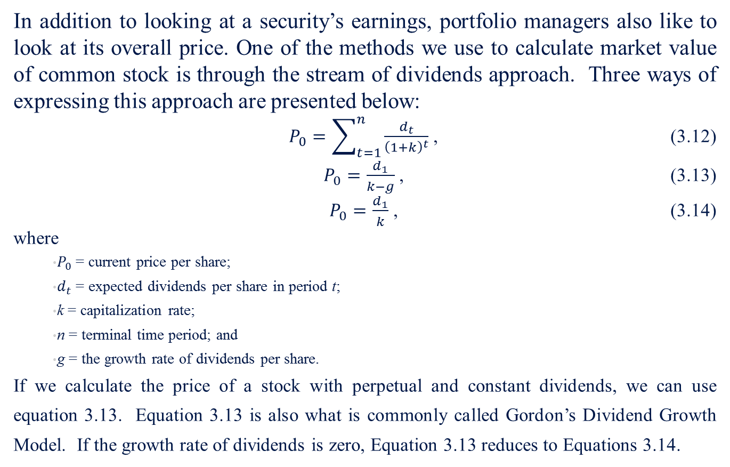
3.3 Common-Stock Valuation Approaches
In addition to looking at a security’s earnings, portfolio managers also like to look at its overall price. One of the methods we use to calculate market value of common stock is through the stream of dividends approach. Three ways of expressing this approach are presented below:
$P_{0}=\sum_{t=1}^{n}{\frac{d_{t}}{{\left(1+k\right)}^{t}}}$ , (3.12)
$P_{0}=\frac{d_{1}}{k−g}$ , (3.13)
$P_{0}=\frac{d_{1}}{k}$ , (3.14)
where
  $P_{0}$ = current price per share;
  $d_{t}$ = expected dividends per share in period t;
  k = capitalization rate;
  n = terminal time period; and
  g = the growth rate of dividends per share.
If we calculate the price of a stock with perpetual and constant dividends, we can use equation 3.13. Equation 3.13 is also what is commonly called Gordon’s Dividend Growth Model. If the growth rate of dividends is zero, Equation 3.13 reduces to Equations 3.14.

Slide 18
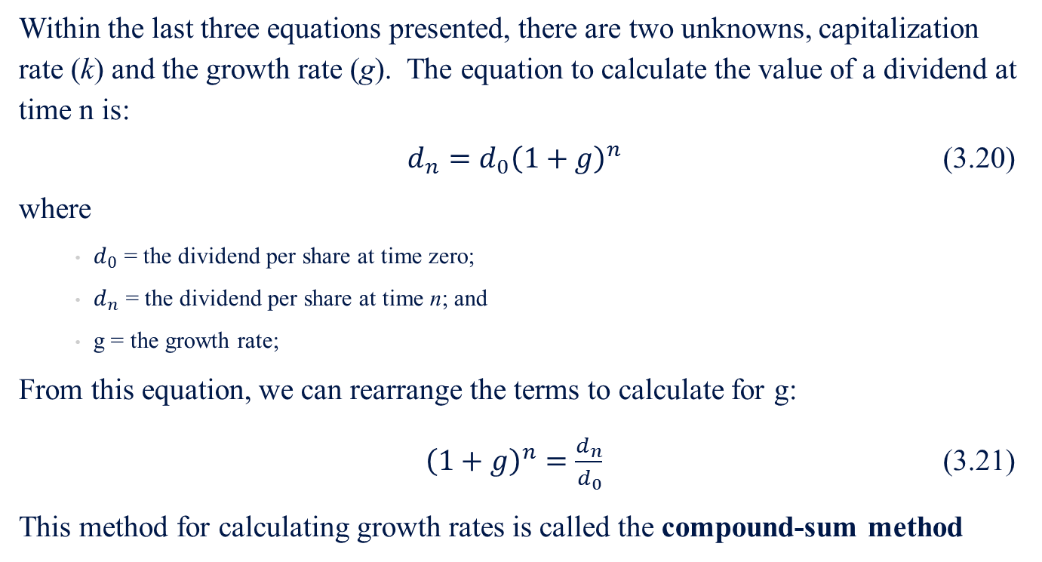
3.4 Growth-Rate Estimation and its Application
3.4.1 Compound-Sum Method
Within the last three equations presented, there are two unknowns, capitalization rate (k) and the growth rate (g). The equation to calculate the value of a dividend at time n is:
$d_{n}=d_{0}{\left(1+g\right)}^{n}$ (3.20)
where
  $d_{0}$ = the dividend per share at time zero;
  $d_{n}$ = the dividend per share at time n; and
  g = the growth rate;
From this equation, we can rearrange the terms to calculate for g:
${\left(1+g\right)}^{n}=\frac{d_{n}}{d_{0}}$ (3.21)
This method for calculating growth rates is called the compound-sum method

Slide 19
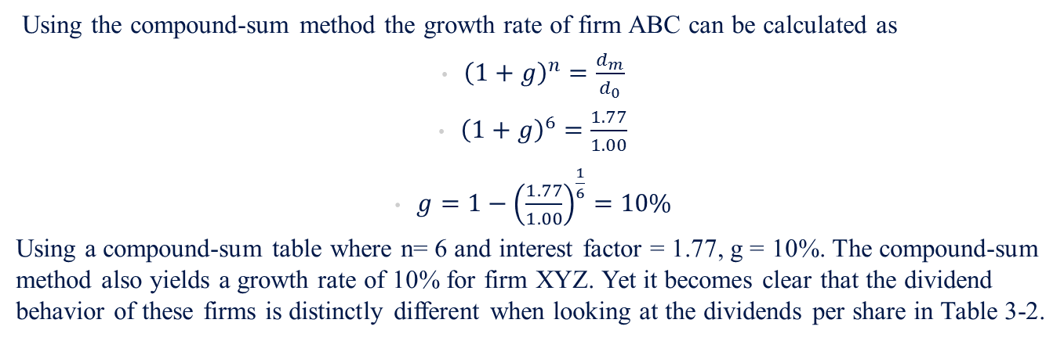
3.1 Holding-Period Return
Example (pg.93)
Suppose there are two firms whose dividend payments patterns are as shown in Table 3-2.
Table 3-2 Dividend Behavior of Firms ABC and XYZ in Dividends per Share (DPS, dollars)
Year | ABC | XYZ
2005 | 1.00 | 1.00
2006 | 1.00 | 1.10
2007 | 1.00 | 1.21
2008 | 1.00 | 1.33
2009 | 1.00 | 1.46
2010 | 1.00 | 1.61
2011 | 1.77 | 1.77
Using the compound-sum method the growth rate of firm ABC can be calculated as
${\left(1+g\right)}^{n}=\frac{d_{m}}{d_{0}}$
${\left(1+g\right)}^{6}=\frac{1.77}{1.00}$
$g={1−\left(\frac{1.77}{1.00}\right)}^{\frac{1}{6}}=10\%$
Using a compound-sum table where n= 6 and interest factor = 1.77, g = 10%. The compound-sum method also yields a growth rate of 10% for firm XYZ. Yet it becomes clear that the dividend behavior of these firms is distinctly different when looking at the dividends per share in Table 3-2.

Slide 20
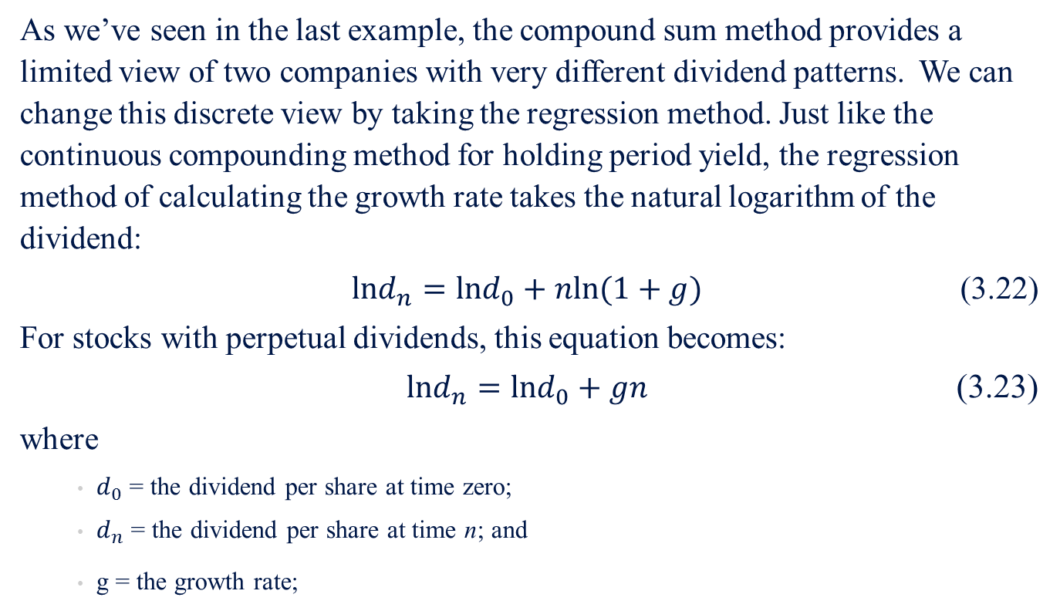
3.4 Growth-Rate Estimation and its Application
3.4.2 Regression Method
As we’ve seen in the last example, the compound sum method provides a limited view of two companies with very different dividend patterns. We can change this discrete view by taking the regression method. Just like the continuous compounding method for holding period yield, the regression method of calculating the growth rate takes the natural logarithm of the dividend:
$lnd_{n}=lnd_{0}+nln(1+g)$ (3.22)
For stocks with perpetual dividends, this equation becomes:
$lnd_{n}=lnd_{0}+gn$ (3.23)
where
  $d_{0}$ = the dividend per share at time zero;
  $d_{n}$ = the dividend per share at time n; and
  g = the growth rate;

Slide 21
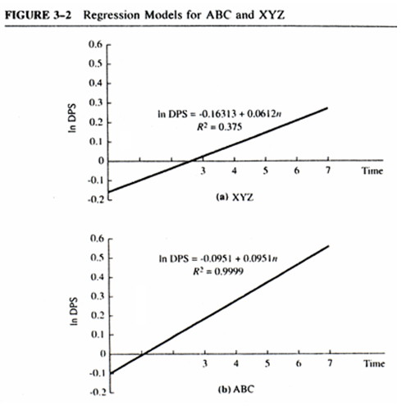
3.4 Growth-Rate Estimation and its Application
3.4.2 Regression Method
Example (pg. 94)
Both Equations (3.22) and (3.23) indicate that is linearly related to n. Using the data in Table 3-2 for companies ABC and XYZ, we can estimate the growth rates for their respective dividend streams. Graphs of the regression equations for ABC and XYZ are shown in Figure 3-2. The slope of the regression using Equation (3.23) for XYZ shows an estimated value for growth of about 0.0951 or 9.5%. The estimate for ABC is 0.0612=6.12%. If Equation (3.22) had been used to estimate the growth, then the antilog of the regression slope estimate would equal the growth rate.

Slide 22
3.4 Growth-Rate Estimation and its Application
3.4.3 One-Period Growth Model
Another method of estimating the growth rate involves the use of percentage change in some variable such as earnings per share, dividend per share, or price per share in a one-period growth model. The one-period growth model is the model in which the same growth will continue forever.
Two factors that contribute to this calculation are the retention rate and the average return of investment.

Slide 23
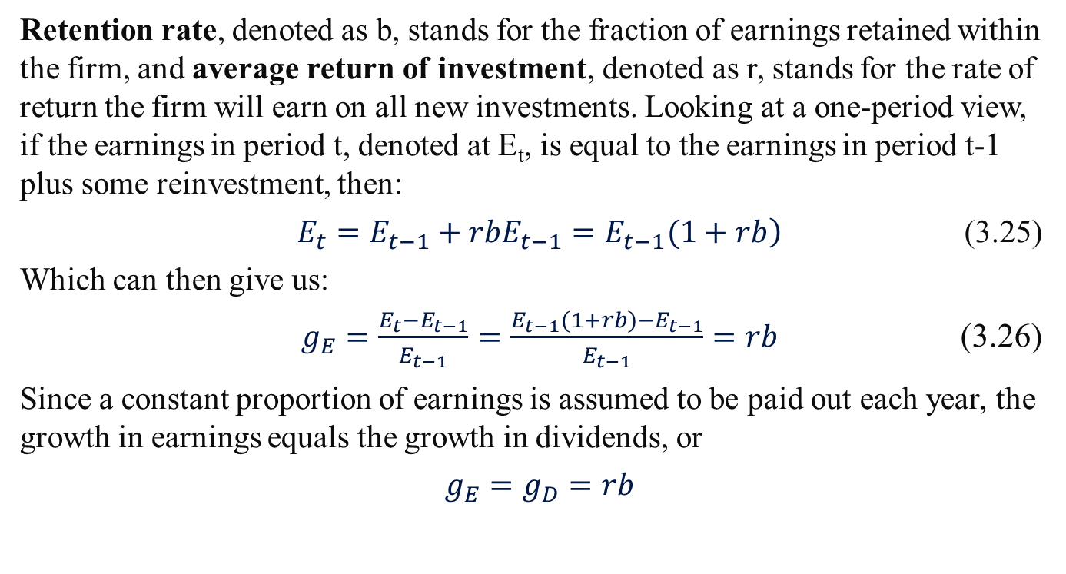
3.4 Growth-Rate Estimation and its Application
3.4.3 One-Period Growth Model
Retention rate, denoted as b, stands for the fraction of earnings retained within the firm, and average return of investment, denoted as r, stands for the rate of return the firm will earn on all new investments. Looking at a one-period view, if the earnings in period t, denoted at E_{t}, is equal to the earnings in period t-1 plus some reinvestment, then:
$\left.E_{t}=E_{t−1}+rbE_{t−1}=E_{t−1}(1+rb\right)$ (3.25)
Which can then give us:
$g_{E}=\frac{E_{t}−E_{t−1}}{E_{t−1}}=\frac{E_{t−1}(1+rb)−E_{t−1}}{E_{t−1}}=rb$ (3.26)
Since a constant proportion of earnings is assumed to be paid out each year, the growth in earnings equals the growth in dividends, or
$g_{E}=g_{D}=rb$

Slide 24

3.4 Growth-Rate Estimation and its Application
3.4.2 One-Period Growth Model
Going back to the Common Stock Valuation Approach, using the one period growth model, Equation (3.13) can be rewritten as
$P=\frac{D_{1}}{k−rb}$ (3.27)
Alternatively, this model can be stated in terms of the capitalization rate:
$k=\frac{D_{1}}{P_{0}}+rb$ (3.28)

Slide 25
3.4 Growth-Rate Estimation and its Application
3.4.2 One-Period Growth Model
Sample Problem 3.2
The use of the one-period model can be illustrated with a simple using the J&J data from the following table.
Table 3-3 Selected Financial Data for J&J
Year | Time | EPS | Dividend Price Per Share | Price Per Share
1997 | 1 | 2.41 | 0.93 | 65.88
1998 | 2 | 2.23 | 0.95 | 83.88
1999 | 3 | 2.94 | 1.04 | 93.25
2000 | 4 | 3.39 | 1.22 | 105.06
2001 | 5 | 1.83 | 0.66 | 59.1
2002 | 6 | 2.16 | 0.78 | 53.71
2003 | 7 | 2.39 | 0.91 | 51.66
2004 | 8 | 2.83 | 1.08 | 63.42
2005 | 9 | 3.46 | 1.26 | 60.1
2006 | 10 | 3.73 | 1.44 | 66.02
2007 | 11 | 3.63 | 1.6 | 66.7
2008 | 12 | 4.57 | 1.77 | 59.83
2009 | 13 | 4.4 | 1.91 | 64.41
Mean |  | 3.0746 | 1.1962 | 68.6938
Standard Deviation |  | 0.8692 | 0.3849 | 15.7598
Coefficient of Variation |  | 0.2827 | 0.3218 | 0.2294
Source: Moody's Industrial Manual, 1987

Slide 26
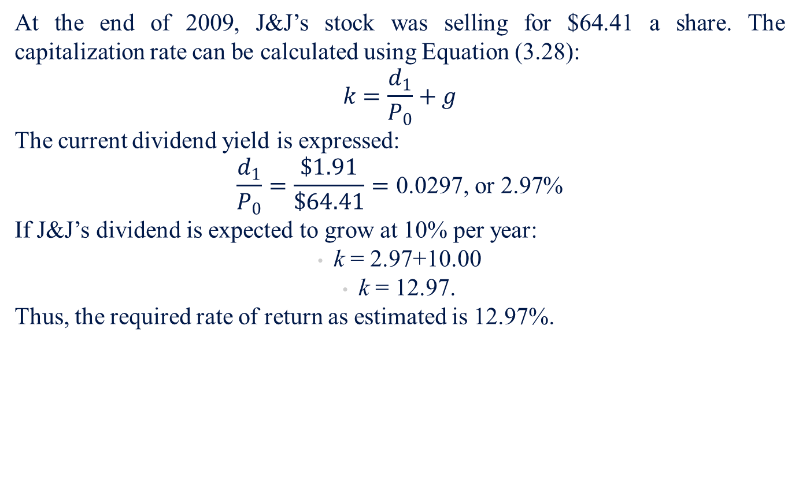
3.4 Growth-Rate Estimation and its Application
3.4.2 One-Period Growth Model
At the end of 2009, J&J’s stock was selling for $64.41 a share. The capitalization rate can be calculated using Equation (3.28):
$$k=\frac{d_{1}}{P_{0}}+g$$
The current dividend yield is expressed:
$$\frac{d_{1}}{P_{0}}=\frac{\$1.91}{\$64.41}=\text{0.0297, }\text{or}\text{ 2.97\%}$$
If J&J’s dividend is expected to grow at 10% per year:
k = 2.97+10.00
k = 12.97.
Thus, the required rate of return as estimated is 12.97%.

Slide 27
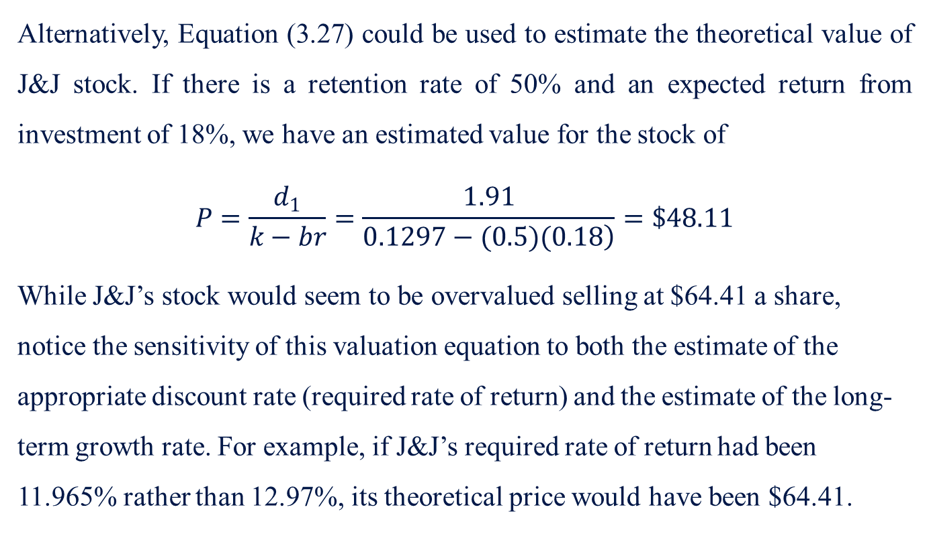
3.4 Growth-Rate Estimation and its Application
3.4.2 One-Period Growth Model
Alternatively, Equation (3.27) could be used to estimate the theoretical value of J&J stock. If there is a retention rate of 50% and an expected return from investment of 18%, we have an estimated value for the stock of
$$P=\frac{d_{1}}{k−br}=\frac{1.91}{\left.0.1297−(0.5)(0.18\right)}=\$48.11$$
While J&J’s stock would seem to be overvalued selling at $64.41 a share, notice the sensitivity of this valuation equation to both the estimate of the appropriate discount rate (required rate of return) and the estimate of the long-term growth rate. For example, if J&J’s required rate of return had been 11.965% rather than 12.97%, its theoretical price would have been $64.41.

Slide 28
3.4 Growth-Rate Estimation and its Application
3.4.4 Two-Period Growth Model
The simplest extension of the one-period model is to assume that a period of extraordinary growth will continue for a certain number of years, after which growth will change to a level at which it is expected to continue indefinitely. This kind of model is called the two-period growth model.

Slide 29
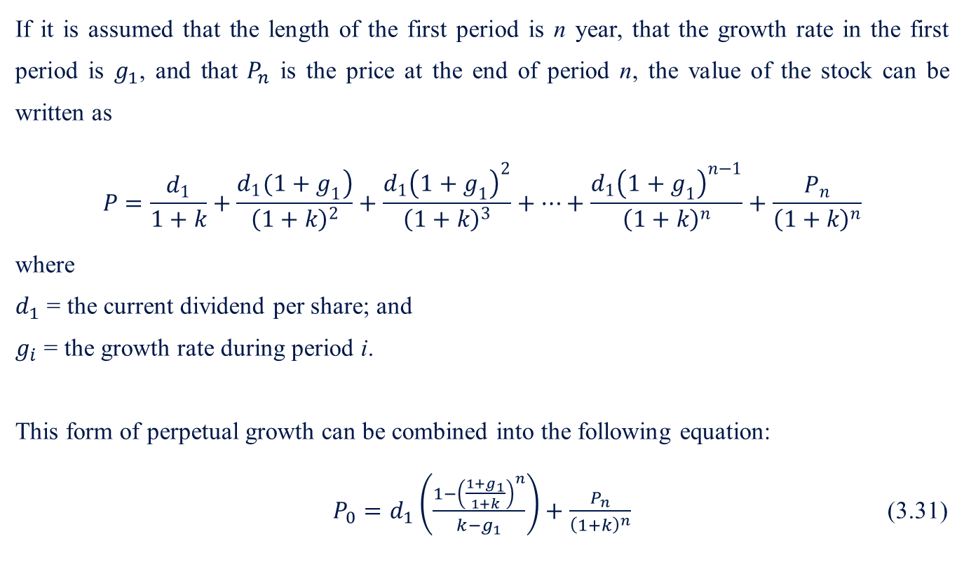
3.4 Growth-Rate Estimation and its Application
3.4.4 Two-Period Growth Model
If it is assumed that the length of the first period is n year, that the growth rate in the first period is $g_{1}$, and that $P_{n}$ is the price at the end of period n, the value of the stock can be written as
$$P=\frac{d_{1}}{1+k}+\frac{\left.d_{1}(1+g_{1}\right)}{{\left(1+k\right)}^{2}}+\frac{d_{1}{\left(1+g_{1}\right)}^{2}}{{\left(1+k\right)}^{3}}+⋯+\frac{d_{1}{\left(1+g_{1}\right)}^{n−1}}{{\left(1+k\right)}^{n}}+\frac{P_{n}}{{\left(1+k\right)}^{n}}$$
where
$d_{1}$ = the current dividend per share; and
$g_{i}$ = the growth rate during period i.
This form of perpetual growth can be combined into the following equation:
$P_{0}=d_{1}\left(\frac{1−{\left(\frac{1+g_{1}}{1+k}\right)}^{n}}{k−g_{1}}\right)+\frac{P_{n}}{{\left(1+k\right)}^{n}}$ (3.31)

Slide 30
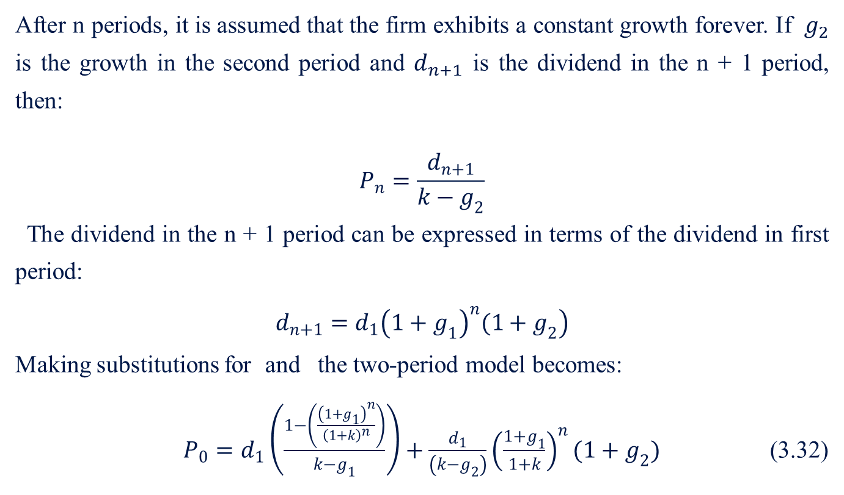
3.4 Growth-Rate Estimation and its Application
3.4.4 Two-Period Growth Model
After n periods, it is assumed that the firm exhibits a constant growth forever. If $g_{2}$ is the growth in the second period and $d_{n+1}$ is the dividend in the n + 1 period, then:
$$P_{n}=\frac{d_{n+1}}{k−g_{2}}$$
The dividend in the n + 1 period can be expressed in terms of the dividend in first period:
$$\left.d_{n+1}=d_{1}{\left(1+g_{1}\right)}^{n}(1+g_{2}\right)$$
Making substitutions for and the two-period model becomes:
$P_{0}=d_{1}\left(\frac{1−\left(\frac{{\left(1+g_{1}\right)}^{n}}{{\left(1+k\right)}^{n}}\right)}{k−g_{1}}\right)+\frac{d_{1}}{\left(k−g_{2}\right)}{\left(\frac{1+g_{1}}{1+k}\right)}^{n}(1+g_{2})$ (3.32)

Slide 31
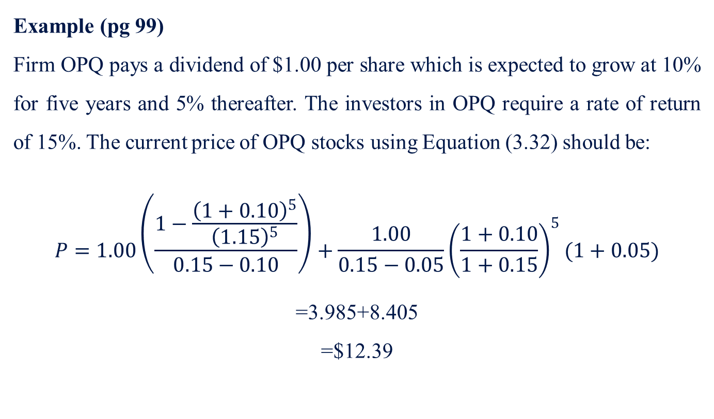
3.4 Growth-Rate Estimation and its Application
3.4.4 Two-Period Growth Model
Example (pg 99)
Firm OPQ pays a dividend of $1.00 per share which is expected to grow at 10% for five years and 5% thereafter. The investors in OPQ require a rate of return of 15%. The current price of OPQ stocks using Equation (3.32) should be:
$$P=1.00\left(\frac{1−\frac{{\left(1+0.10\right)}^{5}}{{\left(1.15\right)}^{5}}}{0.15−0.10}\right)+\frac{1.00}{0.15−0.05}{\left(\frac{1+0.10}{1+0.15}\right)}^{5}(1+0.05)$$
=3.985+8.405
=$12.39

Slide 32
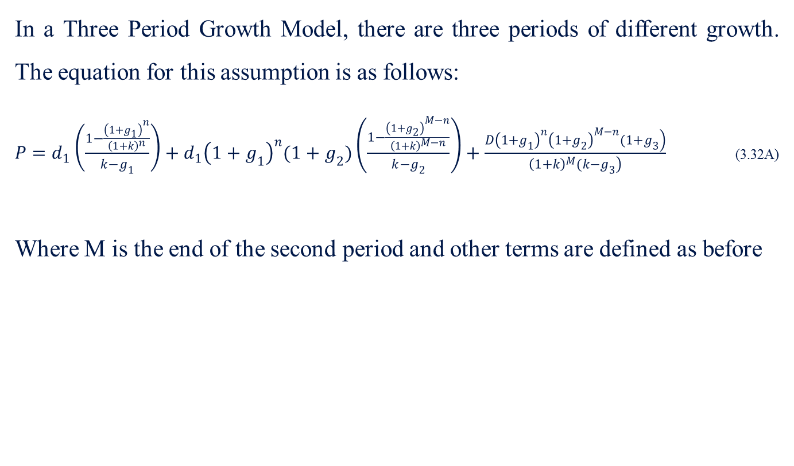
3.4 Growth-Rate Estimation and its Application
3.4.5 Three-Period Growth Model
In a Three Period Growth Model, there are three periods of different growth. The equation for this assumption is as follows:
$P=d_{1}\left(\frac{1−\frac{{\left(1+g_{1}\right)}^{n}}{{\left(1+k\right)}^{n}}}{k−g_{1}}\right)+d_{1}{\left(1+g_{1}\right)}^{n}(1+g_{2})\left(\frac{1−\frac{{\left(1+g_{2}\right)}^{M−n}}{{\left(1+k\right)}^{M−n}}}{k−g_{2}}\right)+\frac{\left.D{\left(1+g_{1}\right)}^{n}{\left(1+g_{2}\right)}^{M−n}(1+g_{3}\right)}{\left.{\left(1+k\right)}^{M}(k−g_{3}\right)}$ (3.32A)
Where M is the end of the second period and other terms are defined as before

Slide 33
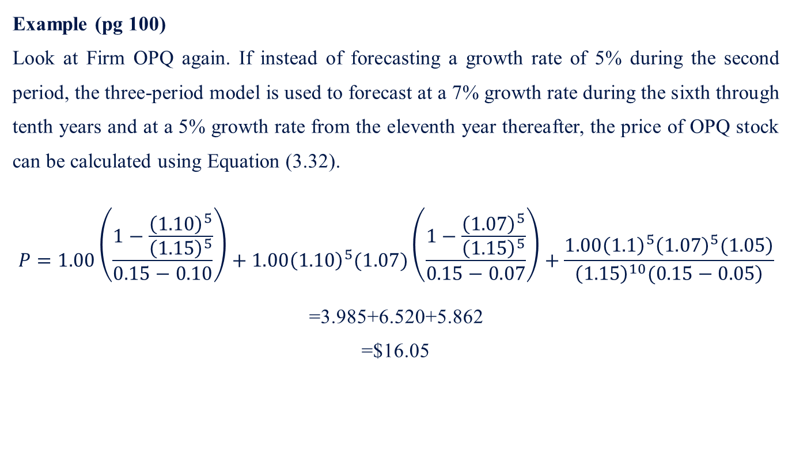
3.4 Growth-Rate Estimation and its Application
3.4.5 Three-Period Growth Model
Example (pg 100)
Look at Firm OPQ again. If instead of forecasting a growth rate of 5% during the second period, the three-period model is used to forecast at a 7% growth rate during the sixth through tenth years and at a 5% growth rate from the eleventh year thereafter, the price of OPQ stock can be calculated using Equation (3.32).
$$P=1.00\left(\frac{1−\frac{{\left(1.10\right)}^{5}}{{\left(1.15\right)}^{5}}}{0.15−0.10}\right)+1.00{\left(1.10\right)}^{5}(1.07)\left(\frac{1−\frac{{\left(1.07\right)}^{5}}{{\left(1.15\right)}^{5}}}{0.15−0.07}\right)+\frac{\left.1.00{\left(1.1\right)}^{5}{\left(1.07\right)}^{5}(1.05\right)}{\left.{\left(1.15\right)}^{10}(0.15−0.05\right)}$$
=3.985+6.520+5.862
=$16.05

Slide 34
3.5 Risk
3.5.1 Definitions of Risk
In order to discuss the relative as well as the absolute degree of the risk of various financial instruments, quantitative measures of risk are needed. Consistent with the definition of risk, such measures should provide a summary of the degree to which realized return is different from expected return. That is to say, such measures give an indication of the dispersion of the possible returns.
If the distribution of returns is symmetrical, two meaningful measures of dispersion are available: the variance and the standard deviation.

Slide 35
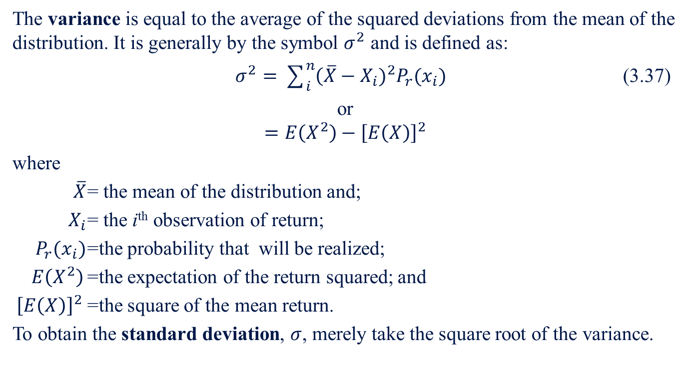
3.5 Risk
3.5.1 Definitions of Risk
The variance is equal to the average of the squared deviations from the mean of the distribution. It is generally by the symbol $σ^{2}$ and is defined as:
$σ^{2}=\sum_{i}^{n}{\left(\overline{X}\right.}−X_{i})^{2}P_{r}(x_{i})$ (3.37)
or
$$=E\left(X^{2}\right)−{\left[E\left(X\right)\right]}^{2}$$
where
$\overline{X}$ = the mean of the distribution and;
$X_{i}$ = the i^{th} observation of return;
$P_{r}(x_{i})$ =the probability that will be realized;
$E\left(X^{2}\right)$ =the expectation of the return squared; and
${\left[E\left(X\right)\right]}^{2}$ =the square of the mean return.
To obtain the standard deviation, $σ$, merely take the square root of the variance.

Slide 36
3.5 Risk
3.5.2 Sources of Risk
Sources of risk are important for understanding the degree of fluctuation for an investment over time. Sources of risk can be from firm-specific factors or market and economic factors.

Slide 37
3.5 Risk
3.5.2.1 Firm-specific Factors
Firm-specific factors include business risk and financial risk.
Business risk relates to the fluctuations in the growth of the operating cash flows of the issuers. This includes fluctuations of prices of a firm’s products, demand for its products, the costs of production, and technological change and managerial efficiency.
Financial risk is related to the mix of debt and equity in the capital structure of the issuer. The assets of a firm can be financed by either debt or equity. The use of debt promises the investor a fixed return, and equity holder’s return is leveraged or the fluctuation of return magnified. For investors in both debt and equity, the greater the amount of debt in the firm’s capital structure, the greater is the variance of returns.

Slide 38
3.5 Risk
3.5.2.2 Market and Economic Factors
As has been noted, the return on investment is made up of the cash flow from interest or dividends and the future price of the security. Price that is realized when the security matures or is sold. If the security is sold before it matures, future price is uncertain. Hence the variance of return (risk) is significantly related to the degree of price volatility over time.
There is an inverse relationship between interest rates and the price of securities. Government bonds are not subject to business or financial risk, but the rate of return realized by investors depends upon the movements in interests in interest rates.
For investors in equities, as the level of inflation increases, the amount of uncertainty with respect to how inflation will help or harm the economy, industries, companies, and financial markets increases; and this increase in uncertainty has an adverse effect on the rates of return realized by investors. High levels of inflation present an opportunity for greater variability and uncertainty, thereby adversely affecting security returns, while low levels of inflation reduce uncertainty about future price level changes, thus favorably affecting security prices.

Slide 39
3.6 Covariance and Correlation
The covariance is a measure of how returns on assets move together. If the time series of returns are moving in the same direction, the covariance is positive. If one series is increasing and the other is decreasing, the covariance is negative. If series move in an unrelated fashion relative to one another, the covariance is a small number or zero.
If we divide the covariance between the return series of two assets by the product of the standard deviations of the two series, we have the correlation coefficient between the two series. Basically it is similar to a covariance that has been standardized by the variability of each series. Its range of values falls between +1 (perfectly positively correlated) –1 (perfectly negatively correlated).

Slide 40
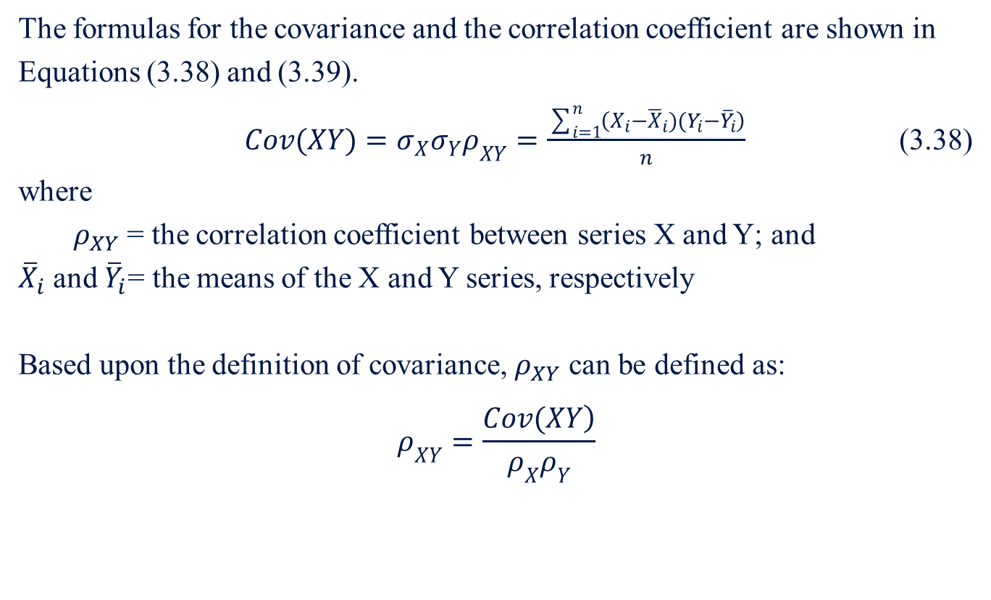
3.6 Covariance and Correlation
The formulas for the covariance and the correlation coefficient are shown in Equations (3.38) and (3.39).
$Cov(XY)=σ_{X}σ_{Y}ρ_{XY}=\frac{\sum_{i=1}^{n}{\left(X_{i}−{\overline{X}}_{i})(Y_{i}−{\overline{Y}}_{i}\right)}}{n}$ (3.38)
where
$ρ_{XY}$ = the correlation coefficient between series X and Y; and
${\overline{X}}_{i}$ and ${\overline{Y}}_{i}$= the means of the X and Y series, respectively
Based upon the definition of covariance, $ρ_{XY}$ can be defined as:
$$ρ_{XY}=\frac{\left.Cov(XY\right)}{ρ_{X}ρ_{Y}}$$

Slide 41
3.7 Systematic Risk, Unsystematic Risk, and the Market Model
In the discussion of the sources of risk, we identified sources of risk that originated from the issue of the security and sources of risk that affected securities in general. In these sections, this distinction is developed further in the context of the market model. The issuer-specific risk is called unsystematic risk, because it is unique to each issuer of securities and does not affect all financial securities. The market-related risk affecting all securities is called the systematic risk.

Slide 42
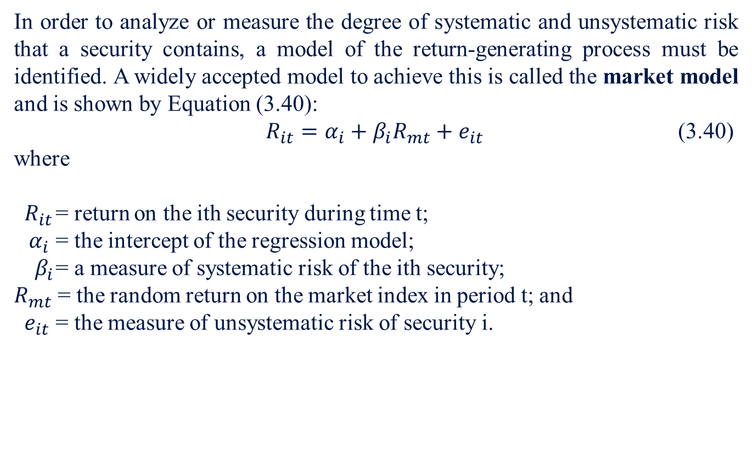
3.7 Systematic Risk, Unsystematic Risk, and the Market Model
In order to analyze or measure the degree of systematic and unsystematic risk that a security contains, a model of the return-generating process must be identified. A widely accepted model to achieve this is called the market model and is shown by Equation (3.40):
$R_{it}=α_{i}+β_{i}R_{mt}+e_{it}$ (3.40)
where
$R_{it}$ = return on the ith security during time t;
$α_{i}$ = the intercept of the regression model;
$β_{i}$ = a measure of systematic risk of the ith security;
$R_{mt}$ = the random return on the market index in period t; and
$e_{it}$ = the measure of unsystematic risk of security i.

Slide 43
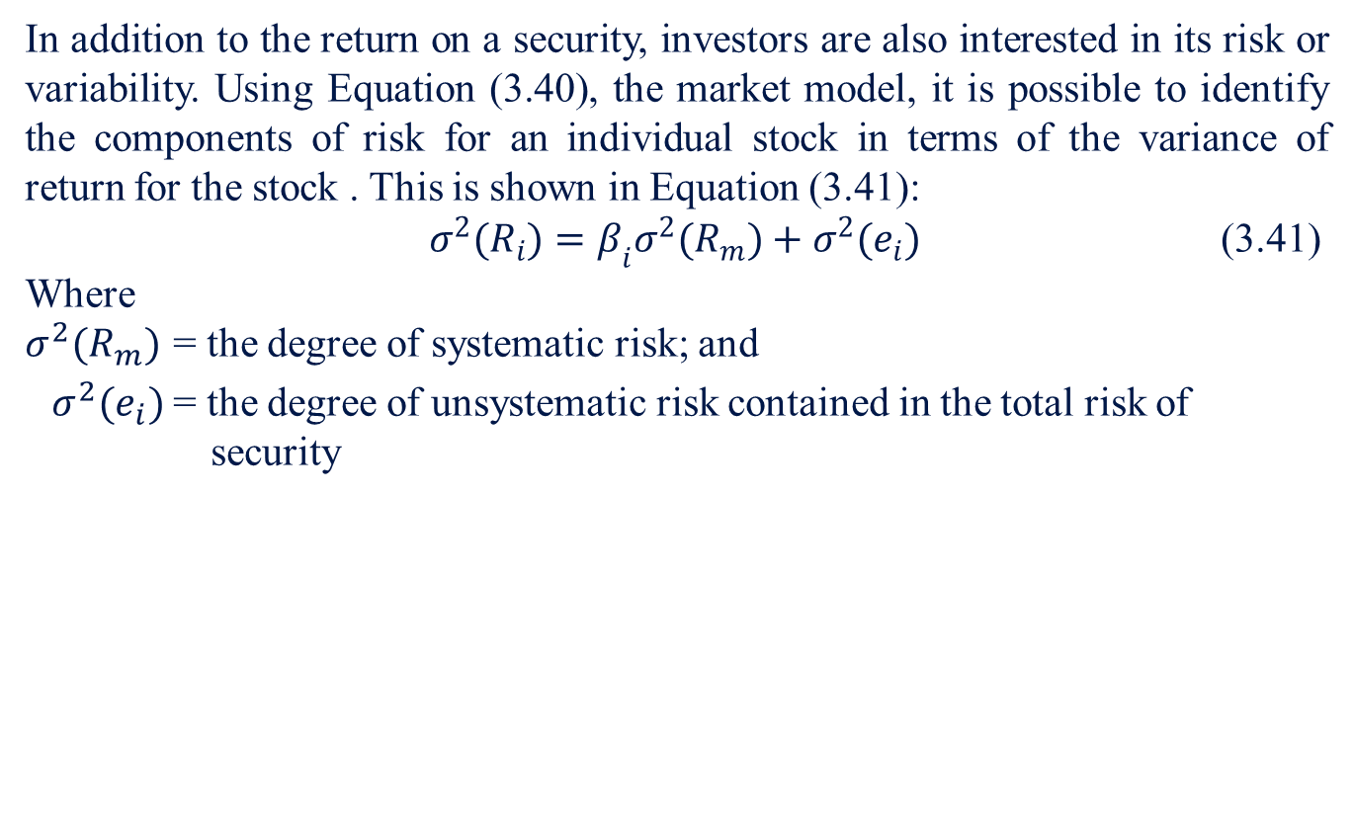
3.7 Systematic Risk, Unsystematic Risk, and the Market Model
In addition to the return on a security, investors are also interested in its risk or variability. Using Equation (3.40), the market model, it is possible to identify the components of risk for an individual stock in terms of the variance of return for the stock . This is shown in Equation (3.41):
$σ^{2}(R_{i})=β_{i}σ^{2}(R_{m})+σ^{2}(e_{i})$ (3.41)
Where
$σ^{2}(R_{m})$ = the degree of systematic risk; and
$σ^{2}(e_{i})$ = the degree of unsystematic risk contained in the total risk of security

Slide 44
Chapter Outline
3.1 Holding-Period Return
3.2 Holding-Period Yield
  3.2.1 Arithmetic Mean
  3.2.2 Geometric Mean
  3.2.2 Weighted Unbiased Mean
3.3 Common-stock Valuation Approaches
3.4 Growth-Rate Estimation and its Application
  3.4.1 Compound-Sum Method
  3.4.2 Regression Method
  3.4.3 One-Period Growth Model
  3.4.4 Two-Period Growth Model
  3.4.5 Three-Period Growth Model
3.5 Risk
  3.5.1 Definitions of Risk
  3.5.2 Sources of Risk
    3.5.2.1 Firm-specific Factors
    3.5.2.2 Market and Economic Factors
3.6 Covariance and Correlation
3.7 Systematic Risk, Unsystematic Risk, and the Market Model

