Slide 1
Chapter 4
Introduction to Valuation Theories
By
Cheng Few Lee
Joseph Finnerty
John Lee
Alice C Lee
Donald Wort

Slide 2
Chapter Outline
4.1 DISCOUNTED CASH-FLOW VALUATION THEORY
4.2 BOND VALUATION
4.2.1 Perpetuity
4.2.2 Term Bonds
4.3 COMMON-STOCK VALUATION
4.4 M&M VALUATION THEORY
4.4.1 Review and Extension of M&M Proposition I
4.4.2 Miller’s Proposition on Debt and Taxes
4.5 THE TAX REFORM ACT OF 1986 AND ITS IMPACT ON FIRM VALUE
4.6 CORPORATE RESPONSE TO THE TAX REFORM ACT OF 1986
4.7 CAPITAL ASSET PRICING MODEL
4.8 OPTION VALUATION
4.9 SUMMARY

Slide 3
Theories
Valuation theories are the basic tools for determining the intrinsic value of alternative financial instruments.
There are four alternative but interrelated valuation models of financial theory that might be useful for the analysis of securities and the management of portfolios:
  Discounted cash-flow valuation theory (classical financial theory)
  M&M valuation theory (neoclassical financial theory)
  Capital asset pricing model (CAPM)
  Option pricing theory (OPT)

Slide 4
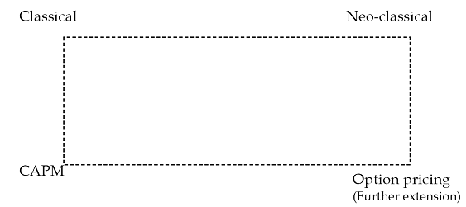
The relationship among these four different theories can be described by Figure 4-1
Figure 4-1 Relationship of the Four Different Theories

Slide 5
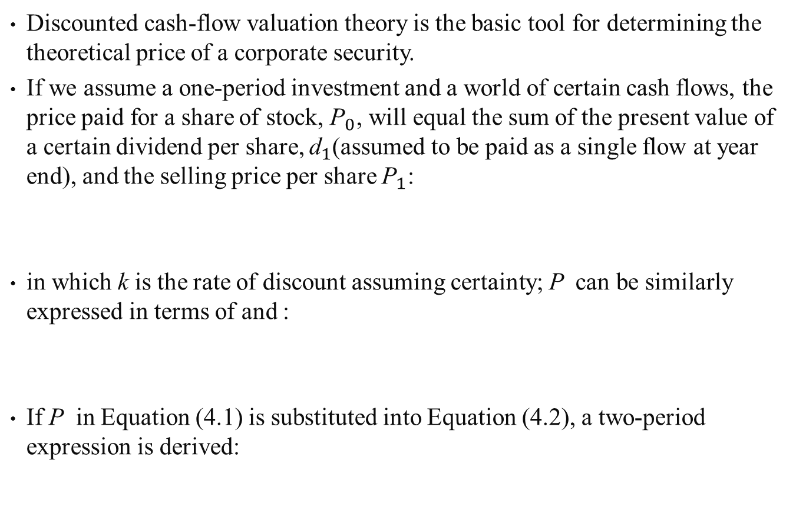
4.1 DISCOUNTED CASH-FLOW VALUATION THEORY
Discounted cash-flow valuation theory is the basic tool for determining the theoretical price of a corporate security.
If we assume a one-period investment and a world of certain cash flows, the price paid for a share of stock, ${\text{P}}_{0}$, will equal the sum of the present value of a certain dividend per share, ${\text{d}}_{1}$(assumed to be paid as a single flow at year end), and the selling price per share ${\text{P}}_{1}$:
in which k is the rate of discount assuming certainty; P can be similarly expressed in terms of and :
If P in Equation (4.1) is substituted into Equation (4.2), a two-period expression is derived:
(4.1)
(4.2)
(4.3)

Slide 6
It can be seen, then, that an infinite time-horizon model can be expressed as the
(4.4)
Equation (4.4) may be re-expressed in terms of total market value MV :
(4.5)
in which D = total dollars of dividends paid during year t.

Slide 7
Sample Problem 4.1
XYZ Company will pay dividends of $3 and $4 in years one and two, respectively. In addition, the market price per share is predicted to be $30 at the end of second year, and the discount rate is 12 percent. Substituting this information into Equation (4.3) the current theoretical price per share can be calculated.
Solution

Slide 8
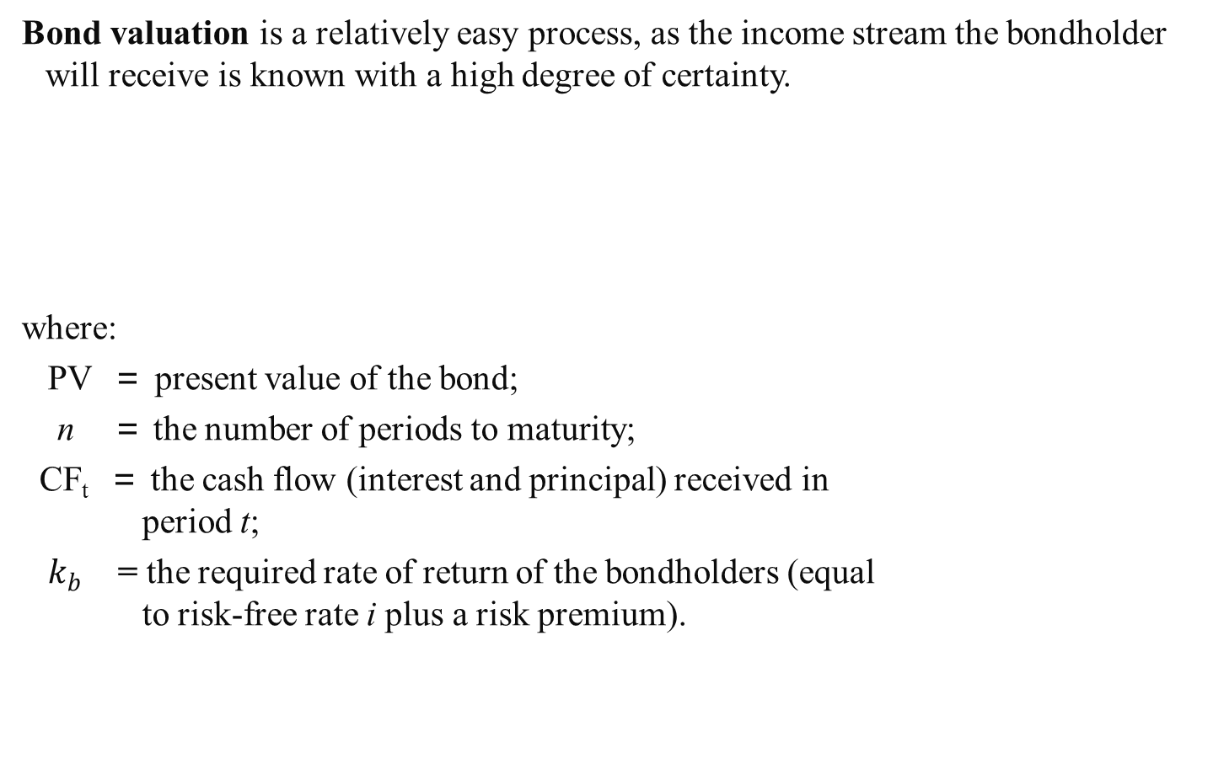
4.2 BOND VALUATION
Bond valuation is a relatively easy process, as the income stream the bondholder will receive is known with a high degree of certainty.
where:
PV ＝ present value of the bond;
n ＝ the number of periods to maturity;
CF_{t} ＝ the cash flow (interest and principal) received in
period t;
$k_{b}$ = the required rate of return of the bondholders (equal
to risk-free rate i plus a risk premium).
(4.6)

Slide 9
4.2.1 Perpetuity
The first (and most extreme) case of bond valuation involves a perpetuity, a bond with no maturity date and perpetual interest payments.
Such bonds are called consols, and the owners are entitled to a fixed amount of interest income annually in perpetuity.
In this case, Equation (4.6) collapses into:
For example, if the stated annual interest payment on the perpetuity bond is $50 and the required rate of return in the market is 10%, the price of the security is stated:
PV ＝ $50/0.10 ＝ $500
If its issuing price had been $1,000, it can be seen that the required rate of return would have been only 5% ( ＝ CF/PV ＝ $50/$1000 ＝ 0.05, or 5%).
(4.7)

Slide 10
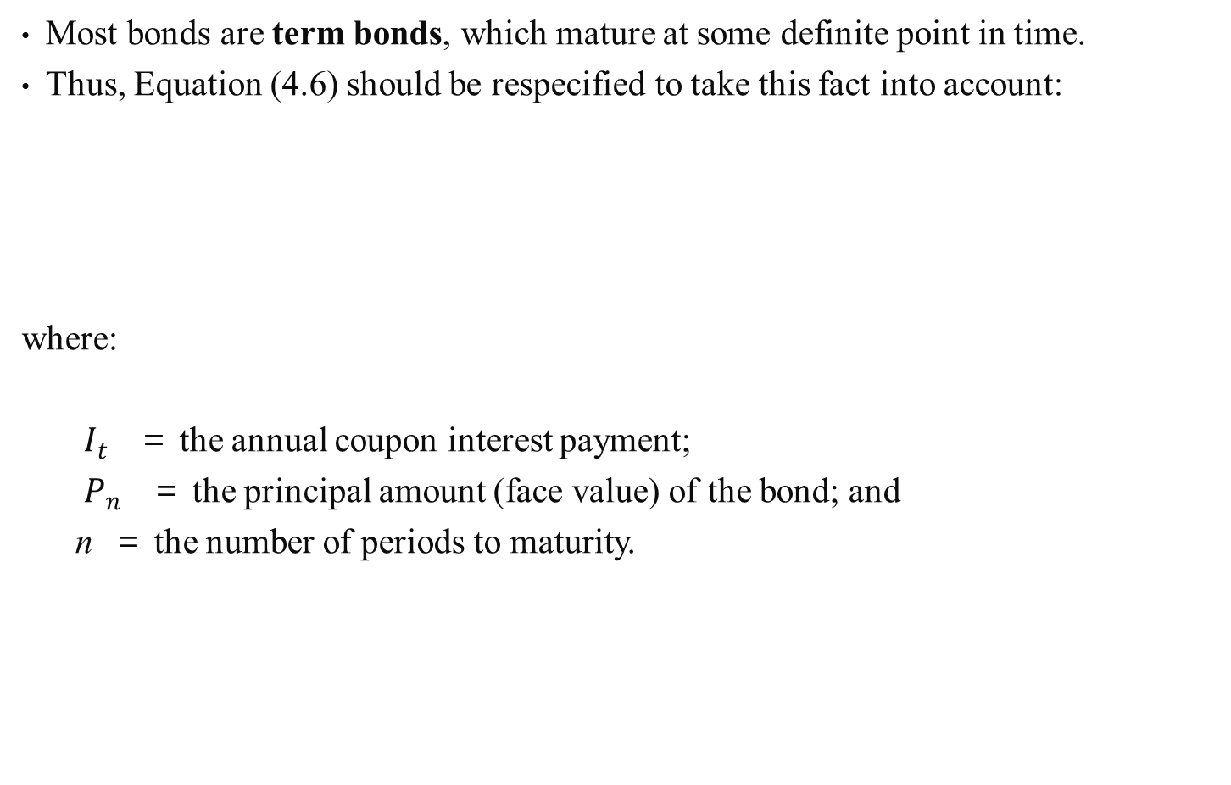
4.2.2 Term Bonds
Most bonds are term bonds, which mature at some definite point in time.
Thus, Equation (4.6) should be respecified to take this fact into account:
where:
$I_{t}$ ＝ the annual coupon interest payment;
$P_{n}$ ＝ the principal amount (face value) of the bond; and
n ＝ the number of periods to maturity.
(4.8)

Slide 11
Sample Problem 4.2
If a corporate bond issued by XYZ Company has the following characteristics:
Annual coupon payment = $90
Face value = $1,000
Number of years till bond matures = 5
Return required by bondholders = 12 percent
Then Equation (4.8) can be used to calculate the theoretical value of this Bond.

Slide 12
There are two types of risk premiums associated with interest-rate risk as it applies to corporate bonds.
The bond maturity premium refers to the net return from investing in long-term government bonds rather than the short-term bills.
Since corporate bonds generally possess default risk, another of the components of corporate bond rates of return is default premium.
The bond default premium is the net increase in return from investing in long-term corporate bonds rather than in long-term government bonds.
Convertible bonds, those with a provision for conversion into shares of common stock, are generally more valuable than firm’s straight bonds for several reasons.
A sinking-fund provision may also increase the value of a bond, at least at its time of issue.
A sinking-fund agreement specifies a schedule by which the sinking fund will retire the bond issue gradually over its life.
A call provision stipulates that the bond may be retired by the issuer at a certain price, usually above par or face value.

Slide 13
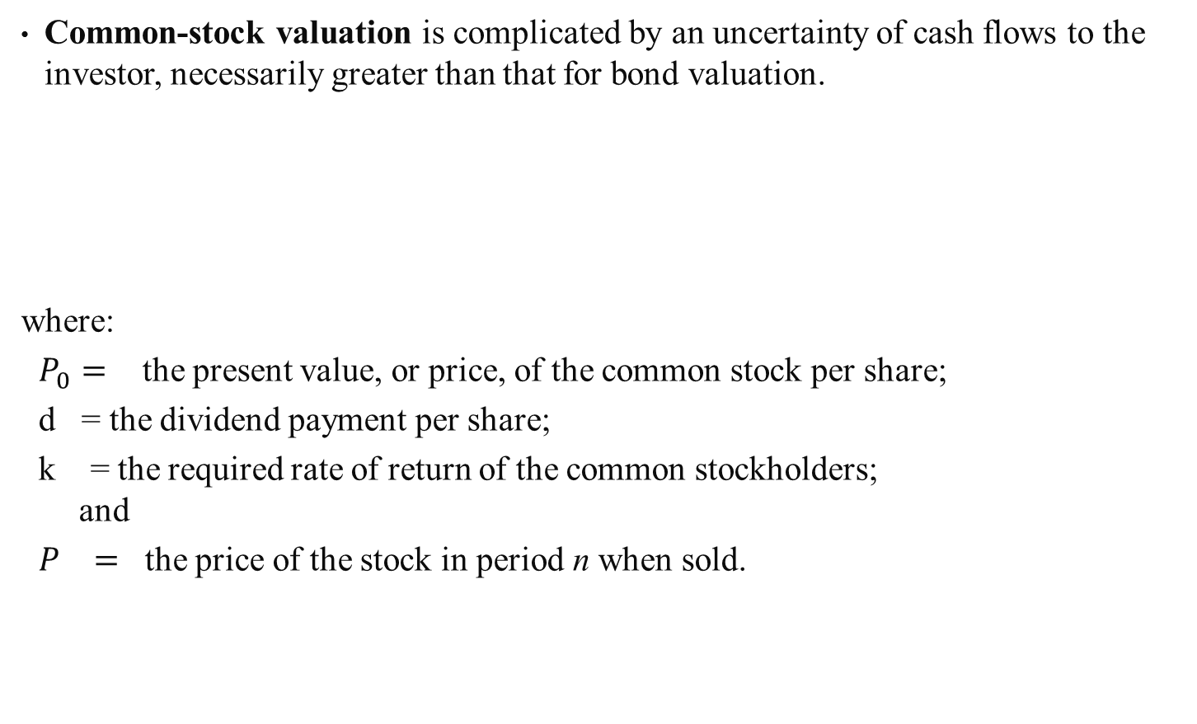
4.3 COMMON-STOCK VALUATION
Common-stock valuation is complicated by an uncertainty of cash flows to the investor, necessarily greater than that for bond valuation.
where:
$P_{0}=$ the present value, or price, of the common stock per share;
d = the dividend payment per share;
k = the required rate of return of the common stockholders;
and
$P_{}=$ the price of the stock in period n when sold.

Slide 14
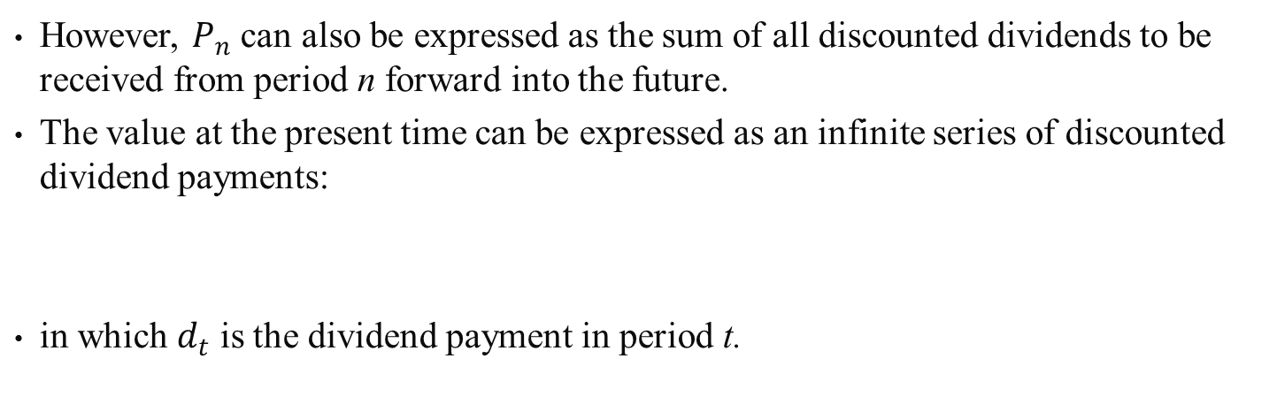
4.3 COMMON-STOCK VALUATION
However, $P_{n}$ can also be expressed as the sum of all discounted dividends to be received from period n forward into the future.
The value at the present time can be expressed as an infinite series of discounted dividend payments:
in which $d_{t}$ is the dividend payment in period t.
(4.4)

Slide 15
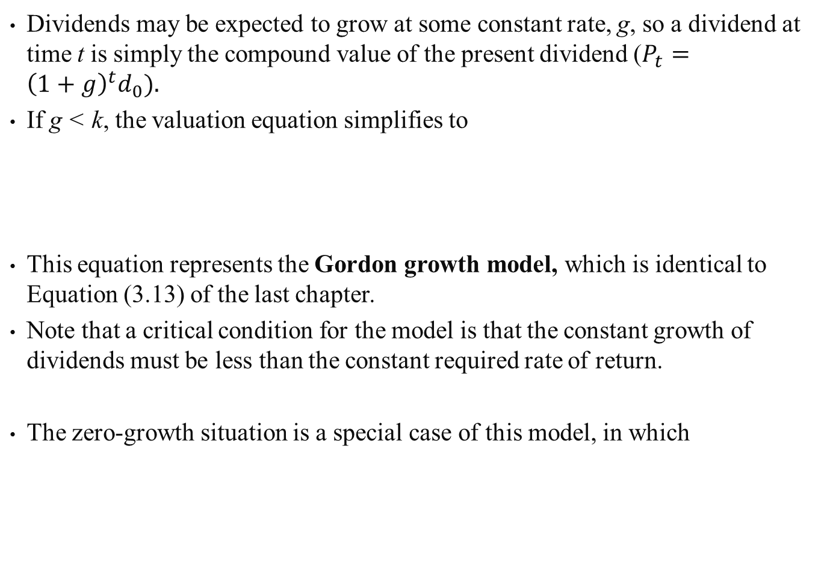
Dividends may be expected to grow at some constant rate, g, so a dividend at time t is simply the compound value of the present dividend ($P_{t}={\left(1+g\right)}^{t}d_{0}).$
If g < k, the valuation equation simplifies to
This equation represents the Gordon growth model, which is identical to Equation (3.13) of the last chapter.
Note that a critical condition for the model is that the constant growth of dividends must be less than the constant required rate of return.
The zero-growth situation is a special case of this model, in which
(4.10)
(4.11)

Slide 16
Sample Problem 4.3
LBO, Inc., has just paid a dividend of ＄6 per share.
In addition, dividends are expected to grow at a constant rate of 3% per year.
If shareholders require a 7% annual rate of return, what should be the current theoretical price of LOB’s stock?
Equation (4.10) can be used to calculate the current theoretical price.
However, Equation (4.10) uses the dividend expected to be received next year, while the current information relates to the dividend received this year.
Because dividends are expected to grow at a constant rate, next year’s dividend should just be the future value of this year’s dividend compounded at the growth rate of dividends.

Slide 17
(4.12)
where:
= supernormal growth rate;
n = the number of periods before the growth drops from
supernormal to normal;
k = the required rate of return of the stockholders; and
= the normal growth rate of dividends (assumed to be
constant there-after).

Slide 18
4.4 M&M VALUATION THEORY
Modigliani and Miller (M&M, 1961) have proposed four alternative valuation methods to determine the theoretical value of common stocks.
Working from a valuation expression referred to by M&M as the “fundamental principle of valuation”:
(4.13)

Slide 19
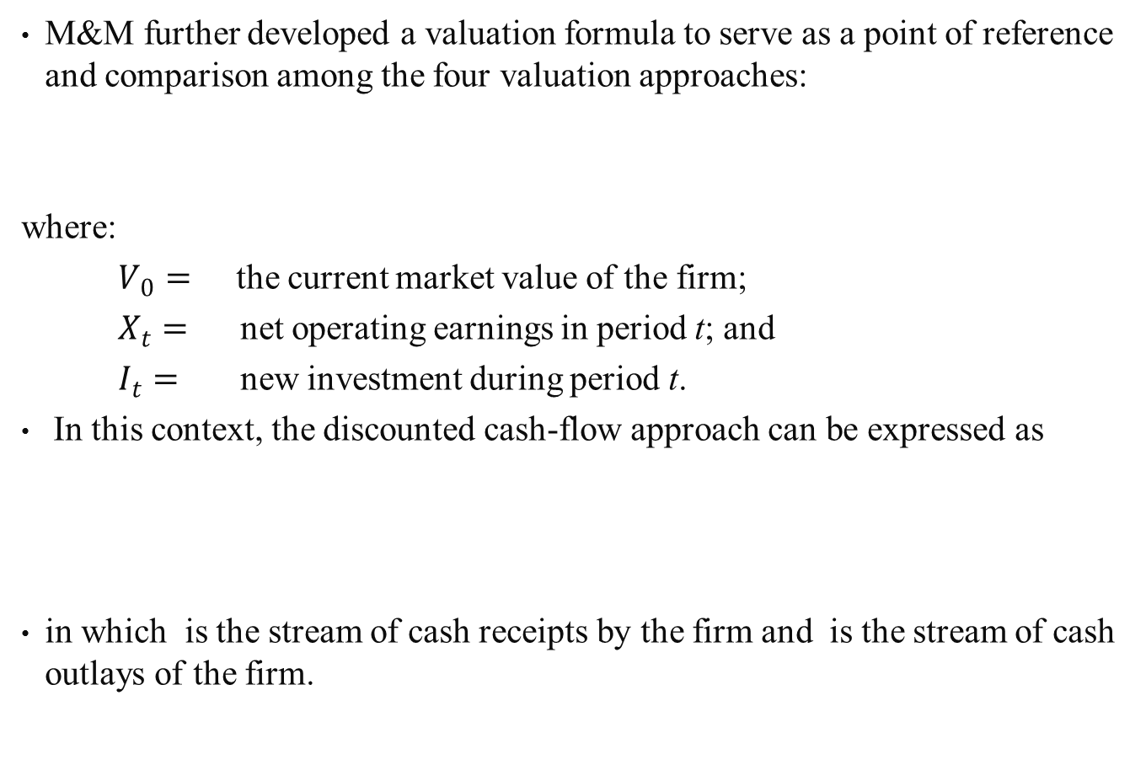
M&M further developed a valuation formula to serve as a point of reference and comparison among the four valuation approaches:
where:
$V_{0}=$ the current market value of the firm;
$X_{t}=$ net operating earnings in period t; and
$I_{t}=$ new investment during period t.
In this context, the discounted cash-flow approach can be expressed as
in which is the stream of cash receipts by the firm and is the stream of cash outlays of the firm.
(4.14)
(4.15)

Slide 20
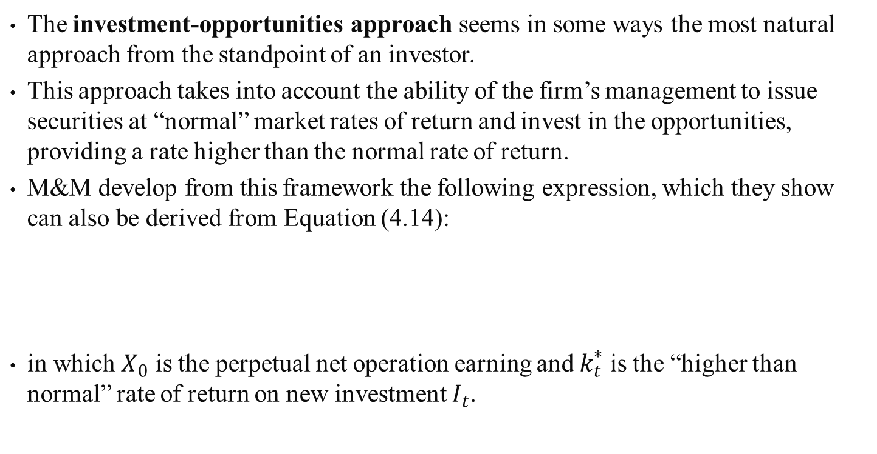
The investment-opportunities approach seems in some ways the most natural approach from the standpoint of an investor.
This approach takes into account the ability of the firm’s management to issue securities at “normal” market rates of return and invest in the opportunities, providing a rate higher than the normal rate of return.
M&M develop from this framework the following expression, which they show can also be derived from Equation (4.14):
in which $X_{0}$ is the perpetual net operation earning and $k_{t}^{∗}$ is the “higher than normal” rate of return on new investment $I_{t}$.
(4.16)

Slide 21
An important variable for security analysis is a firm’s price/earning (P/E) ratio (or earnings multiple), defined as
Conceptually the P/E ratio is determined by three factors:
(1) the investor’s required rate of return (K),
(2) the retention ratio of the firm’s earning, b, where b is equal to 1 minus the dividend payout ratio
(3) the firm’s expected return on investment (r).
Using the constant-growth model (Equation 4.10):
In the above relationship a direct relationship has been identified between P/E ratio and discount cash-flow valuation model.
(4.17)

Slide 22
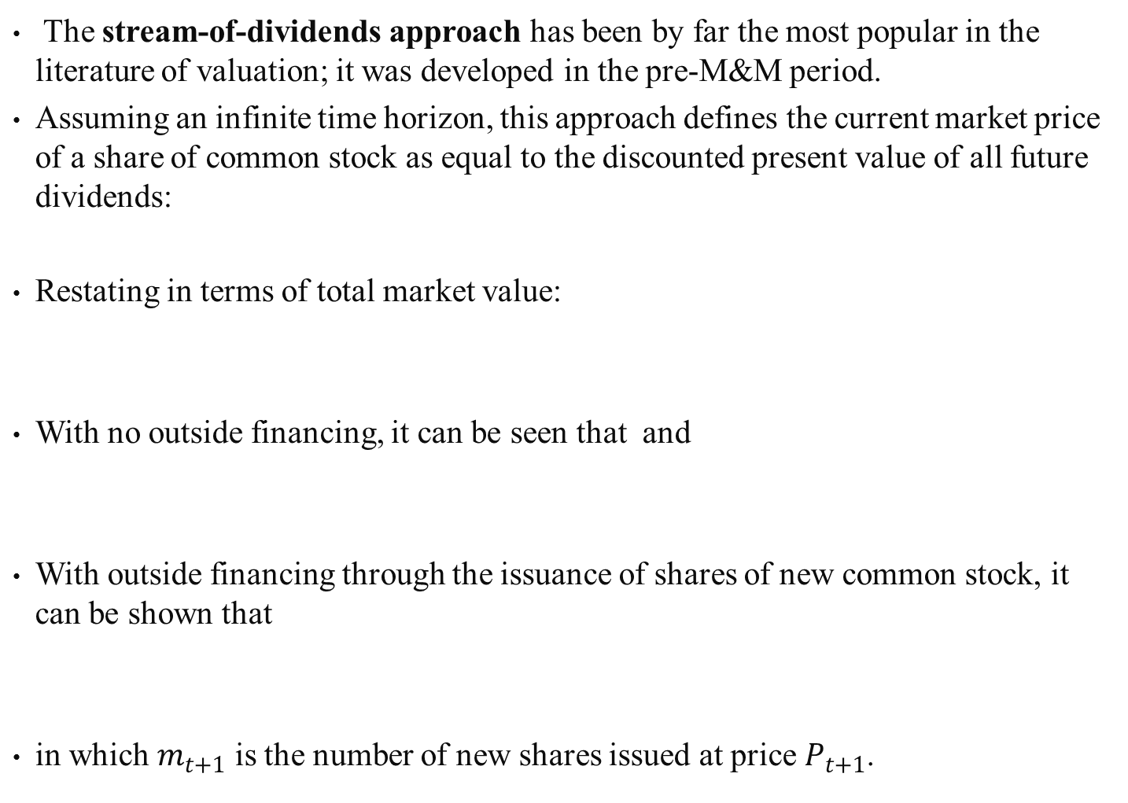
The stream-of-dividends approach has been by far the most popular in the literature of valuation; it was developed in the pre-M&M period.
Assuming an infinite time horizon, this approach defines the current market price of a share of common stock as equal to the discounted present value of all future dividends:
Restating in terms of total market value:
With no outside financing, it can be seen that and
With outside financing through the issuance of shares of new common stock, it can be shown that
in which $m_{t+1}$ is the number of new shares issued at price $P_{t+1}$.
(4.18)
(4.19)
(4.20)

Slide 23
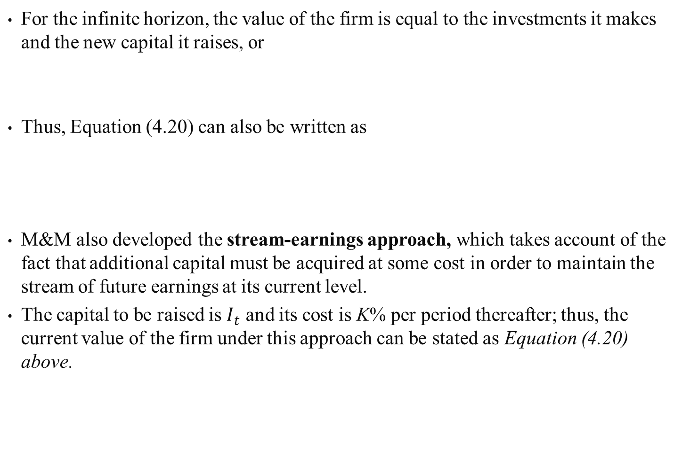
For the infinite horizon, the value of the firm is equal to the investments it makes and the new capital it raises, or
Thus, Equation (4.20) can also be written as
M&M also developed the stream-earnings approach, which takes account of the fact that additional capital must be acquired at some cost in order to maintain the stream of future earnings at its current level.
The capital to be raised is $I_{t}$ and its cost is K% per period thereafter; thus, the current value of the firm under this approach can be stated as Equation (4.20) above.

Slide 24
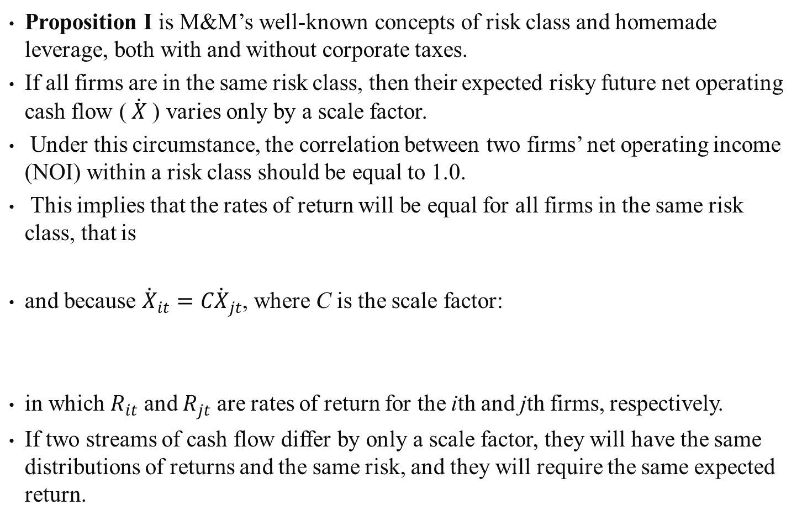
4.4.1 Review and Extension of M and M Proposition I
Proposition I is M&M’s well-known concepts of risk class and homemade leverage, both with and without corporate taxes.
If all firms are in the same risk class, then their expected risky future net operating cash flow ($\dot{X}$ ) varies only by a scale factor.
Under this circumstance, the correlation between two firms’ net operating income (NOI) within a risk class should be equal to 1.0.
This implies that the rates of return will be equal for all firms in the same risk class, that is
and because ${\dot{X}}_{it}=C{\dot{X}}_{jt}$, where C is the scale factor:
in which $R_{it}$ and $R_{jt}$ are rates of return for the ith and jth firms, respectively.
If two streams of cash flow differ by only a scale factor, they will have the same distributions of returns and the same risk, and they will require the same expected return.
(4.21)
(4.22)

Slide 25
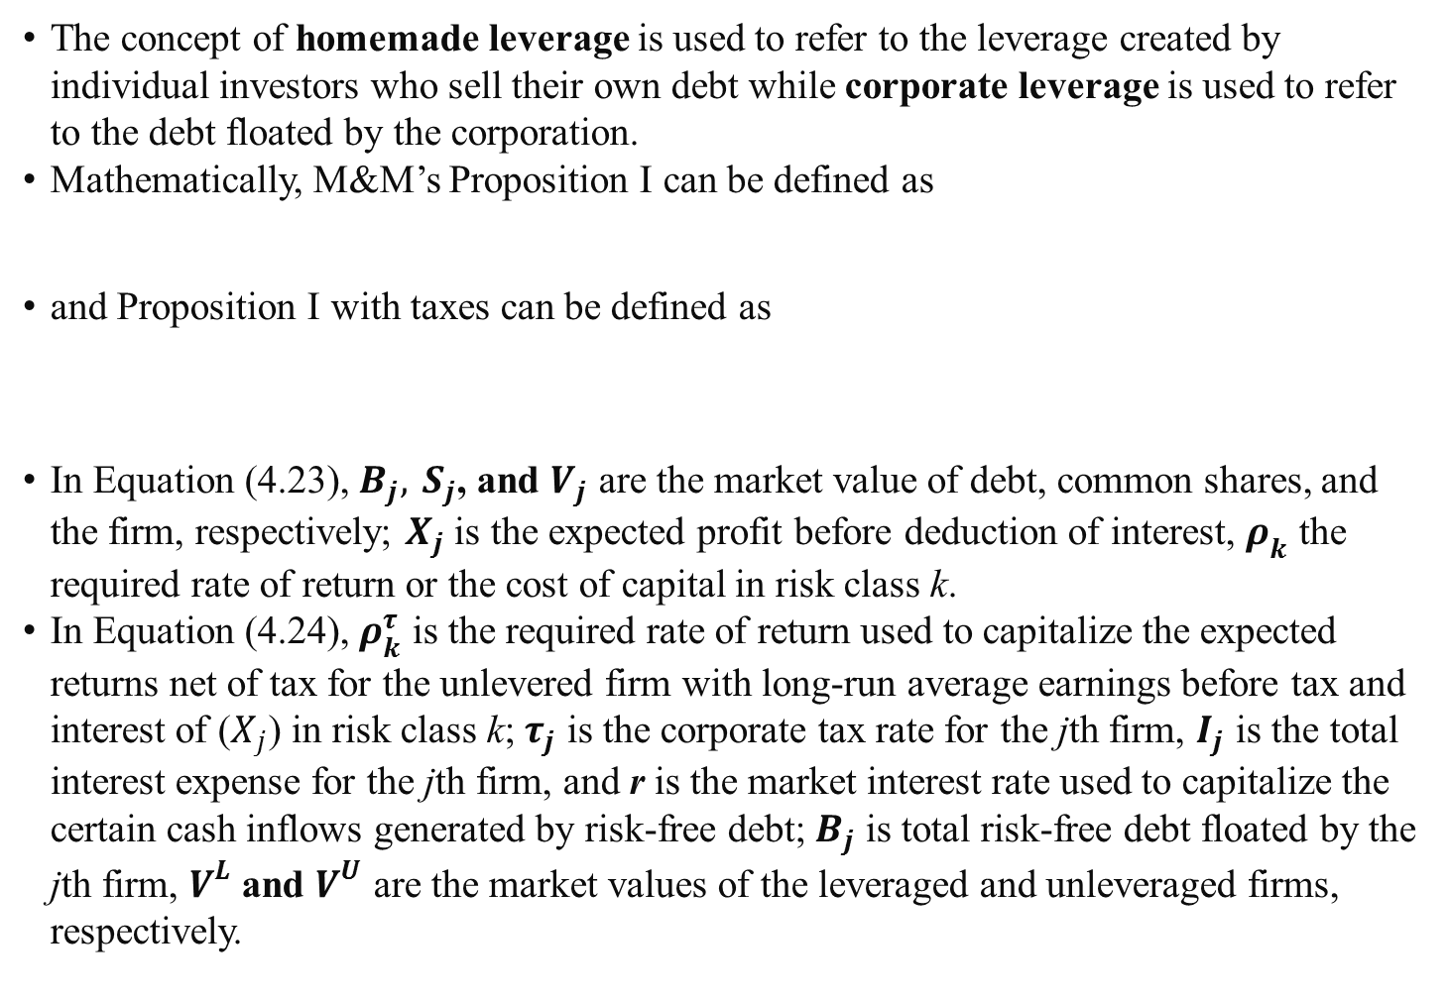
The concept of homemade leverage is used to refer to the leverage created by individual investors who sell their own debt while corporate leverage is used to refer to the debt floated by the corporation.
Mathematically, M&M’s Proposition I can be defined as
and Proposition I with taxes can be defined as
In Equation (4.23), $B_{j}, S_{j}$, and $V_{j}$ are the market value of debt, common shares, and the firm, respectively; $X_{j}$ is the expected profit before deduction of interest, $ρ_{k}$ the required rate of return or the cost of capital in risk class k.
In Equation (4.24), $ρ_{k}^{τ}$ is the required rate of return used to capitalize the expected returns net of tax for the unlevered firm with long-run average earnings before tax and interest of ($X_{j}$) in risk class k; $τ_{j}$ is the corporate tax rate for the jth firm, $I_{j}$ is the total interest expense for the jth firm, and r is the market interest rate used to capitalize the certain cash inflows generated by risk-free debt; $B_{j}$ is total risk-free debt floated by the jth firm, $V^{L}$ and $V^{U}$ are the market values of the leveraged and unleveraged firms, respectively.
(4.23)
(4.24)

Slide 26
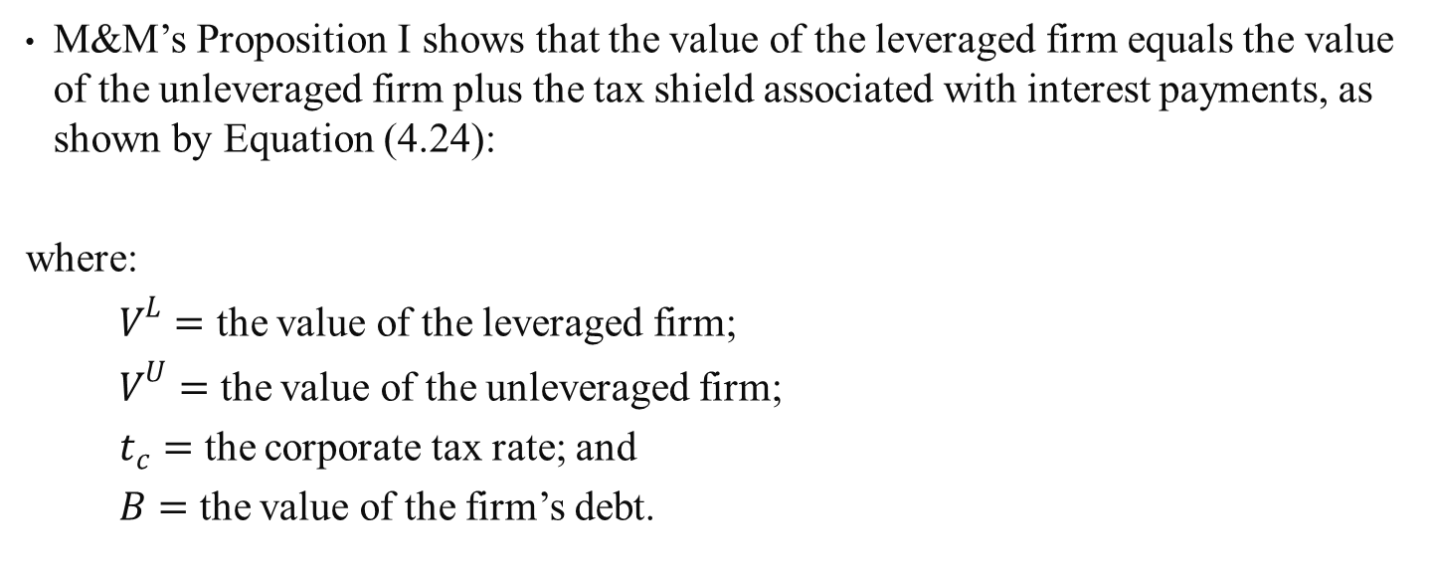
4.4.2 Miller’s Proposition on Debt and Taxes
M&M’s Proposition I shows that the value of the leveraged firm equals the value of the unleveraged firm plus the tax shield associated with interest payments, as shown by Equation (4.24):
where:
$V^{L}=$ the value of the leveraged firm;
$V^{U}=$ the value of the unleveraged firm;
$t_{c}=$ the corporate tax rate; and
$B=$ the value of the firm’s debt.

Slide 27
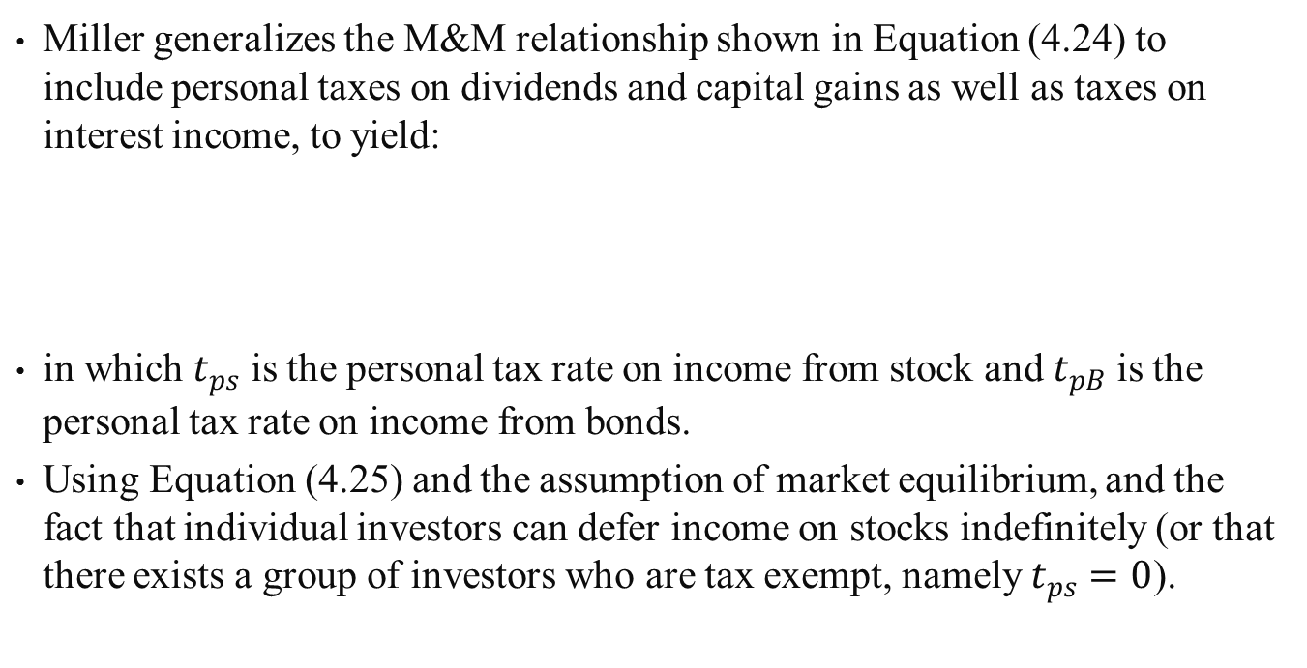
Miller generalizes the M&M relationship shown in Equation (4.24) to include personal taxes on dividends and capital gains as well as taxes on interest income, to yield:
in which $t_{ps}$ is the personal tax rate on income from stock and $t_{pB}$ is the personal tax rate on income from bonds.
Using Equation (4.25) and the assumption of market equilibrium, and the fact that individual investors can defer income on stocks indefinitely (or that there exists a group of investors who are tax exempt, namely $t_{ps}=0$).
(4.25)

Slide 28
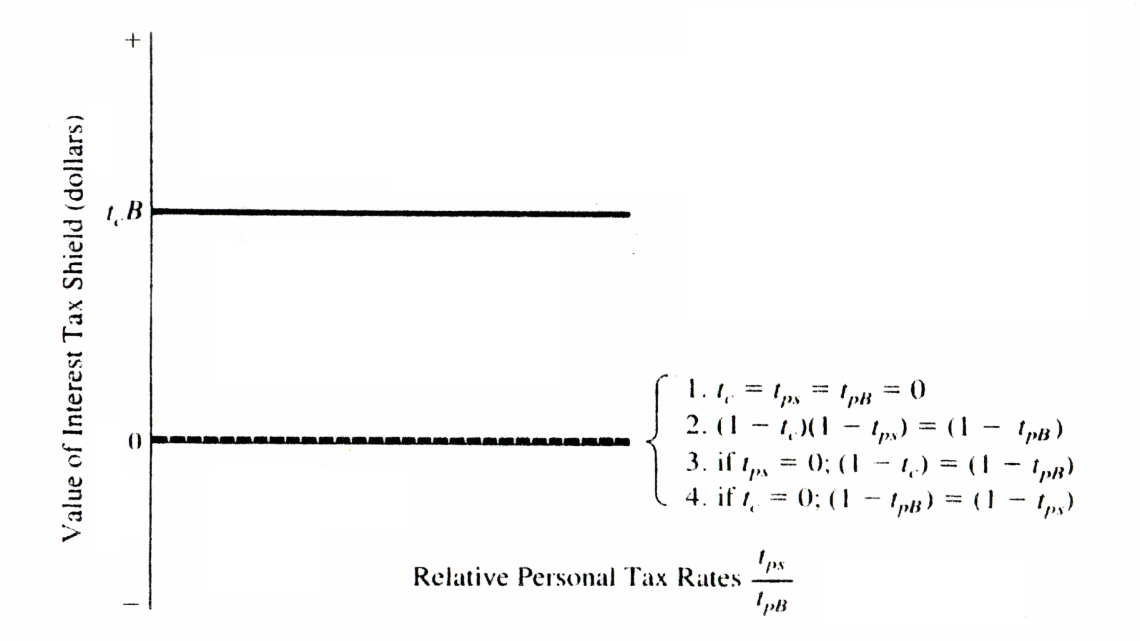
In general, by using the 1963 M&M relationship and the 1977 Miller relationship for tax shields, we can identify an upper and lower bound for the change in value associated with interest tax shields.
Figure 4.2 Upper and Lower Bounds on the Value of Interest Tax Shelter

Slide 29
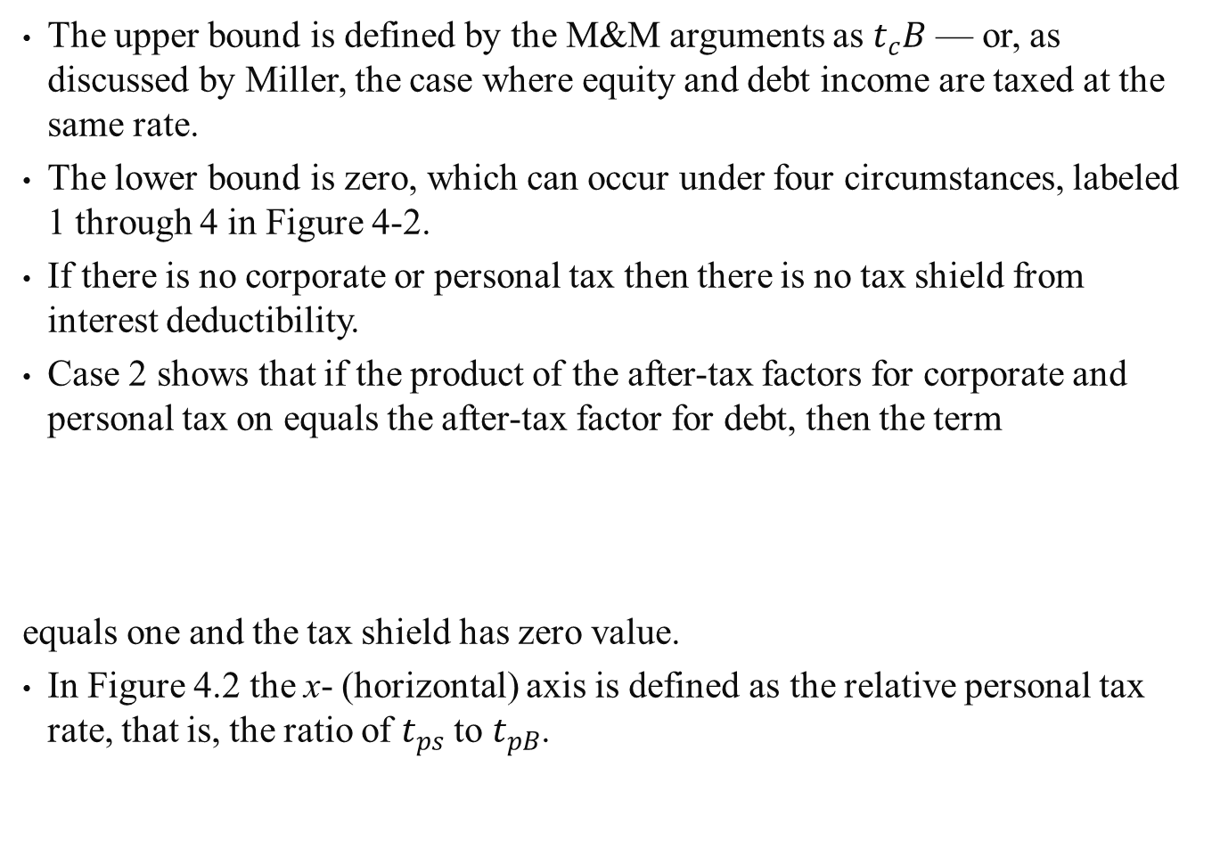
The upper bound is defined by the M&M arguments as $t_{c}B$ — or, as discussed by Miller, the case where equity and debt income are taxed at the same rate.
The lower bound is zero, which can occur under four circumstances, labeled 1 through 4 in Figure 4-2.
If there is no corporate or personal tax then there is no tax shield from interest deductibility.
Case 2 shows that if the product of the after-tax factors for corporate and personal tax on equals the after-tax factor for debt, then the term
equals one and the tax shield has zero value.
In Figure 4.2 the x- (horizontal) axis is defined as the relative personal tax rate, that is, the ratio of $t_{ps}$ to $t_{pB}$.

Slide 30
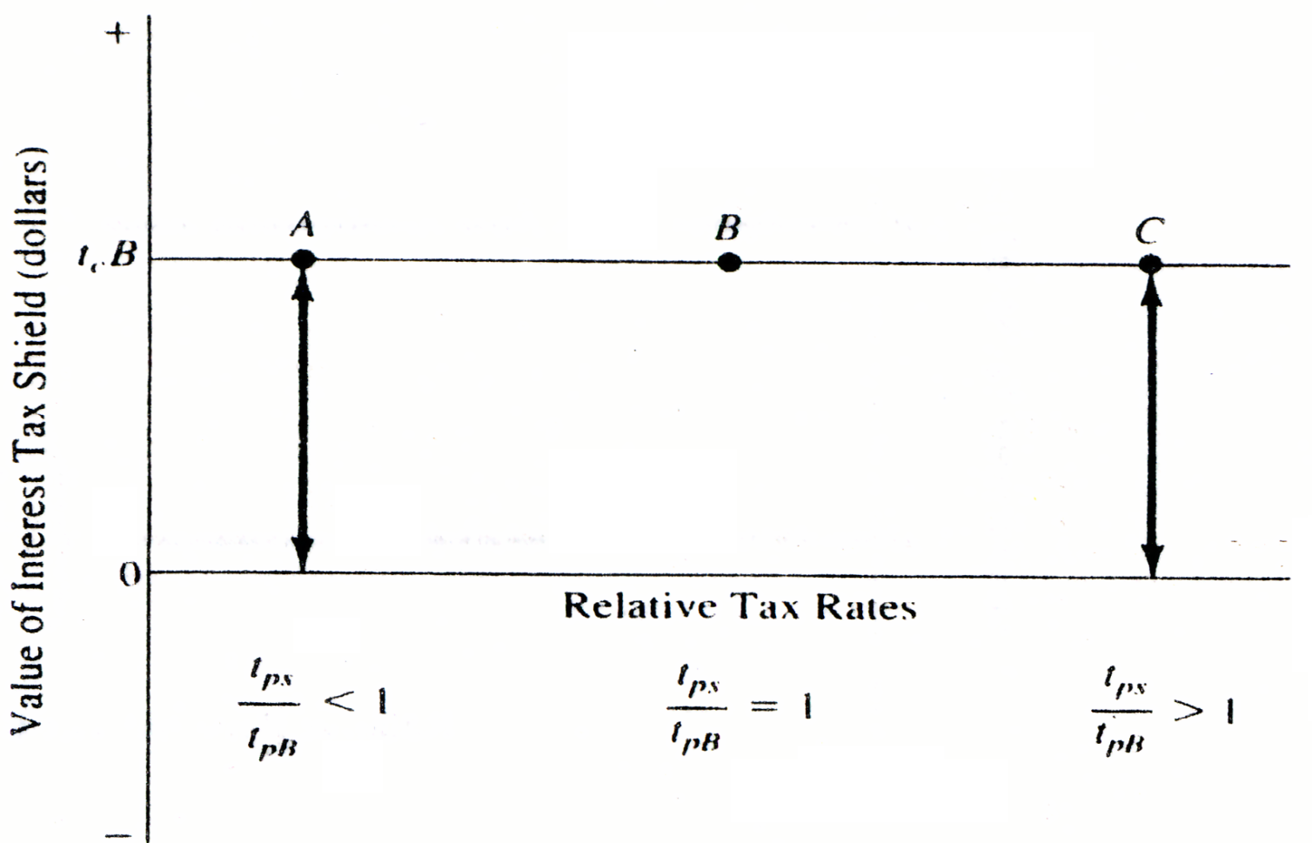
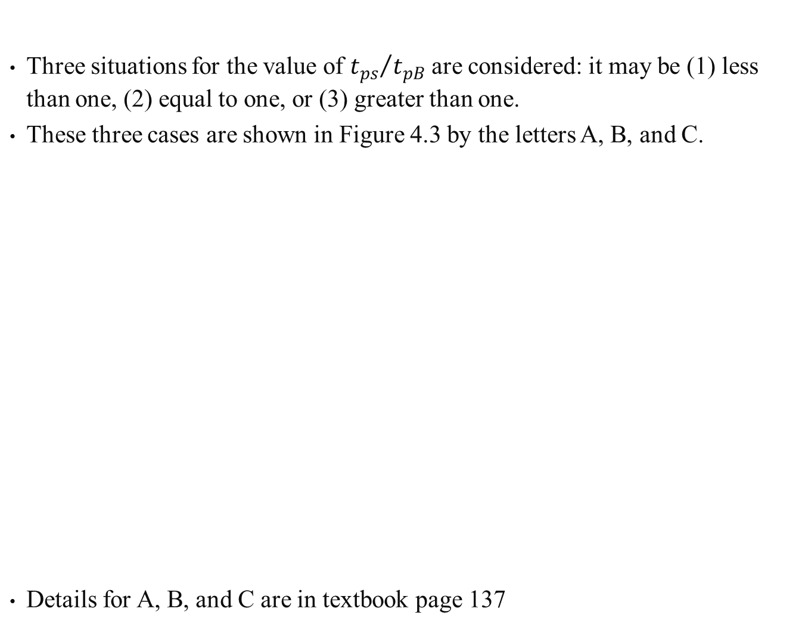
Three situations for the value of ${t_{ps}}/{t_{pB}}$ are considered: it may be (1) less than one, (2) equal to one, or (3) greater than one.
These three cases are shown in Figure 4.3 by the letters A, B, and C.
Details for A, B, and C are in textbook page 137
Figure 4.3 The Relationship between $t_{ps}$and $t_{pB}$and the Value of the Tax Shield on Interest

Slide 31
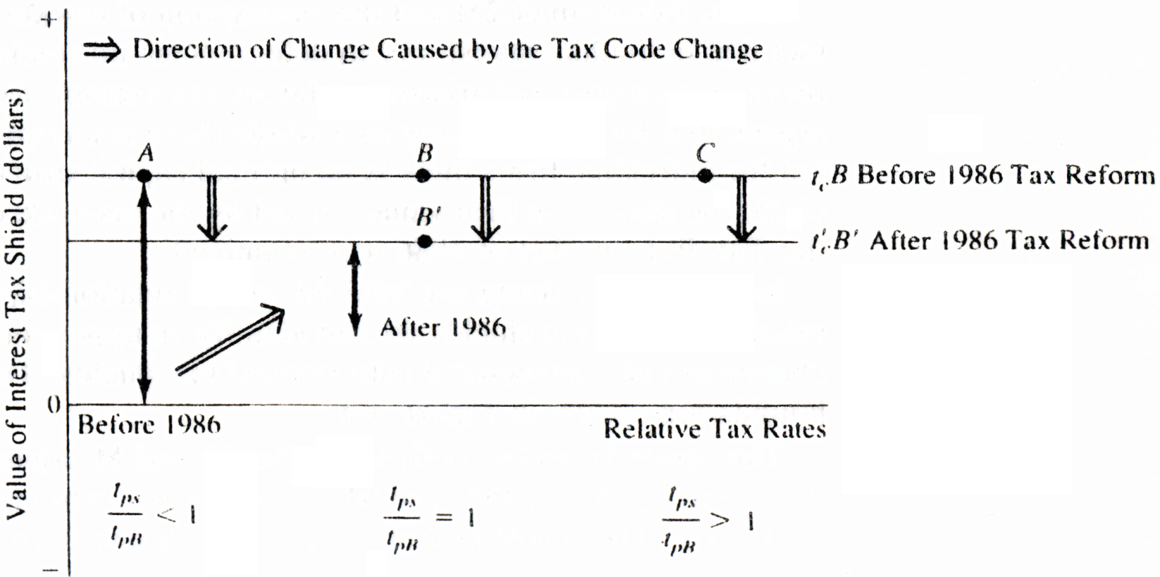
4.5 THE TAX REFORM ACT OF 1986 AND ITS IMPACT ON FIRM VALUE
Considering these changes in the tax code — reduction of personal rates, equaling of personal tax rate on bond and equity income, and the reduction in the corporate tax rate — we envision the following scenario.
Figure 4.4 illustrates the general position of the value of the interest tax shield up to the end of 1986.
Figure 4.4 The Impact of the Tax Reform Act of 1986 on the Value of the Interest Tax Shield

Slide 32
4.6 Corporate Response to the Tax Reform Act of 1986
The important implications of this section for security analysts are that dividend policy and leverage policy may not be as significant in the determination of the market value of the firm as originally assumed, and that primary emphasis should be put on the investment policy of the firm.
The impact of dividend policy seems to be closely involved with the information content included in the dividend decisions of management, as the same valuation can be determined using approaches that do not specifically include dividends.
The impact of debt leverage is heavily dependent upon the tax laws concerning the deductibility of interest payments.

Slide 33
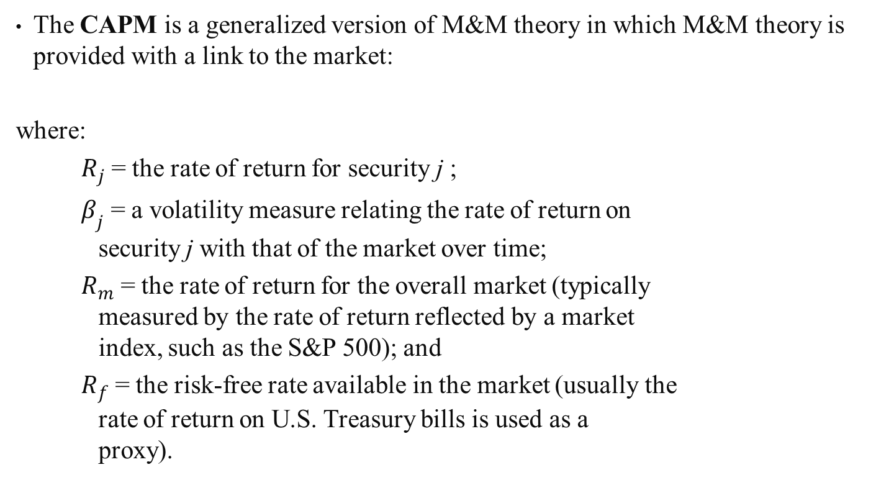
4.7 CAPITAL ASSET PRICING MODEL (CAPM)
The CAPM is a generalized version of M&M theory in which M&M theory is provided with a link to the market:
where:
$R_{j}$ = the rate of return for security j ;
$β_{j}$ = a volatility measure relating the rate of return on
security j with that of the market over time;
$R_{m}$ = the rate of return for the overall market (typically
measured by the rate of return reflected by a market
index, such as the S&P 500); and
$R_{f}$ = the risk-free rate available in the market (usually the
rate of return on U.S. Treasury bills is used as a
proxy).
(4.26)

Slide 34
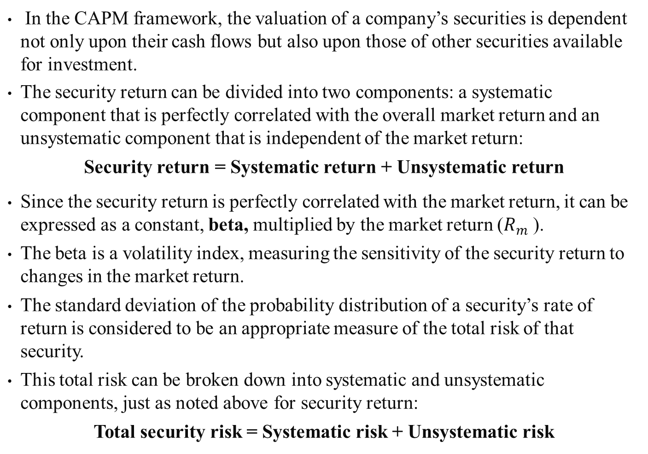
In the CAPM framework, the valuation of a company’s securities is dependent not only upon their cash flows but also upon those of other securities available for investment.
The security return can be divided into two components: a systematic component that is perfectly correlated with the overall market return and an unsystematic component that is independent of the market return:
Security return = Systematic return + Unsystematic return
Since the security return is perfectly correlated with the market return, it can be expressed as a constant, beta, multiplied by the market return ($R_{m}$ ).
The beta is a volatility index, measuring the sensitivity of the security return to changes in the market return.
The standard deviation of the probability distribution of a security’s rate of return is considered to be an appropriate measure of the total risk of that security.
This total risk can be broken down into systematic and unsystematic components, just as noted above for security return:
Total security risk = Systematic risk + Unsystematic risk
(4.27)
(4.28)

Slide 35
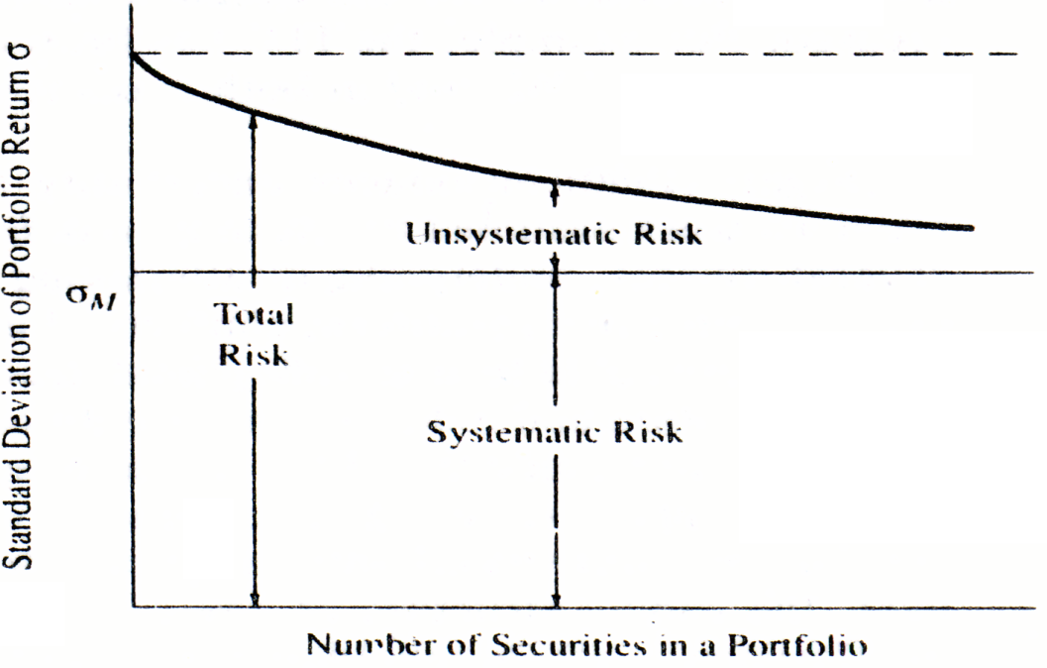
Diversification is achieved only when securities that are not perfectly correlated with one other are combined.
In the process; the portfolio risk measure declines without any corresponding lowering of portfolio return (see Figure 4.5).
It is assumed in this illustration that the selection of additional securities as the portfolio size is increased is performed in some random manner, although any selection process other than intentionally choosing perfectly correlated securities will suffice.
Figure 4.5 Diversification Process

Slide 36
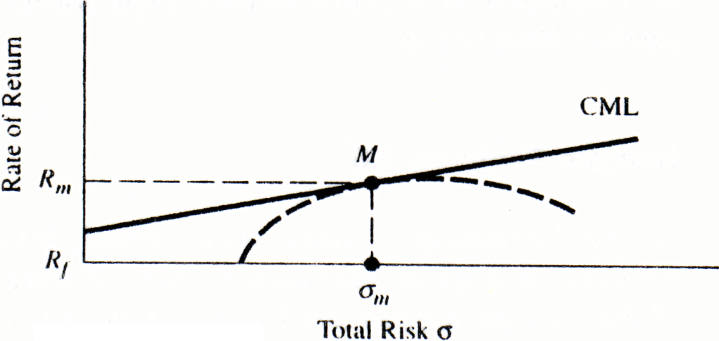
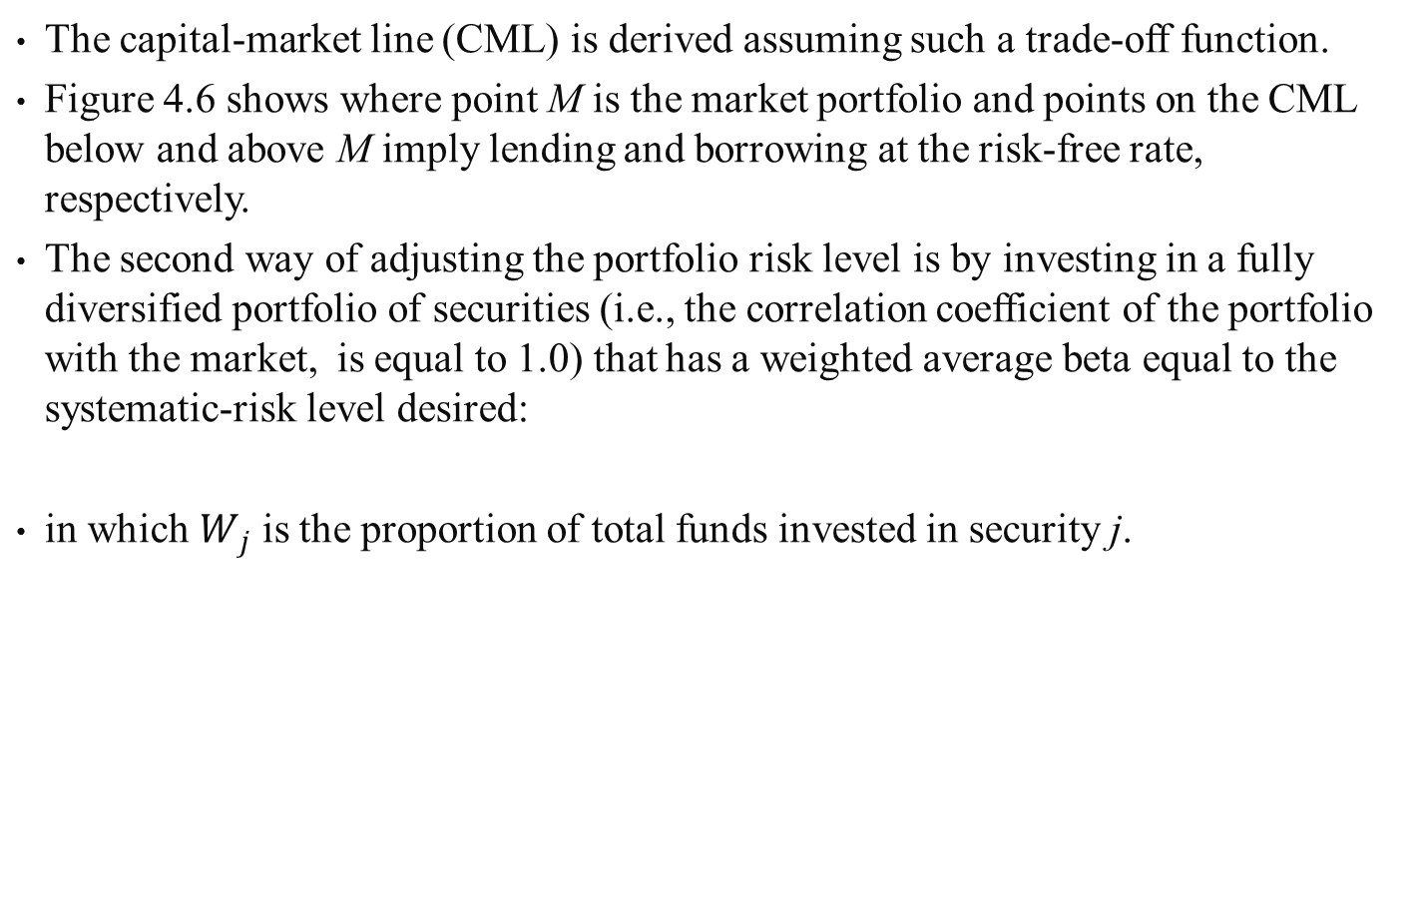
CAPITAL ASSET PRICING MODEL (CAPM)
The capital-market line (CML) is derived assuming such a trade-off function.
Figure 4.6 shows where point M is the market portfolio and points on the CML below and above M imply lending and borrowing at the risk-free rate, respectively.
The second way of adjusting the portfolio risk level is by investing in a fully diversified portfolio of securities (i.e., the correlation coefficient of the portfolio with the market, is equal to 1.0) that has a weighted average beta equal to the systematic-risk level desired:
in which $W_{j}$ is the proportion of total funds invested in security j.
(4.29)
Figure 4.6
Capital-Market Line

Slide 37
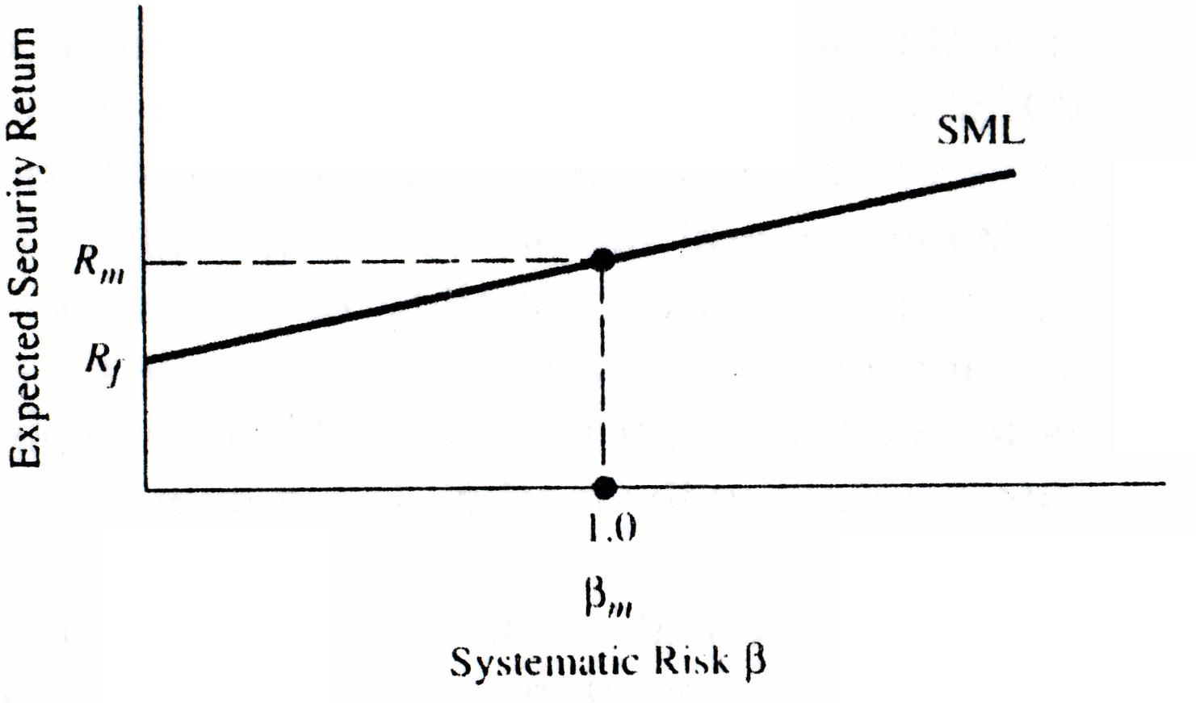

The relationship between expected return and risk can be better defined through the illustration of the security-market line (SML) in Figure 4.7 in which $R_{m}$ and $β_{m}$ are the expected return and risk level of the market portfolio, respectively.
Figure 4.7 Security-Market Line

Slide 38
Sample Problem 4.4
The following is known about the market and LBO, Inc.:
Three-month T-bill rate = 8 percent
Expected return on the S&P 500 =11 percent
Estimated beat for LOB’s stock = 1.5
Substituting into Equation (4.26) solves for the expected return on LOB’s stock.
Solution

Slide 39
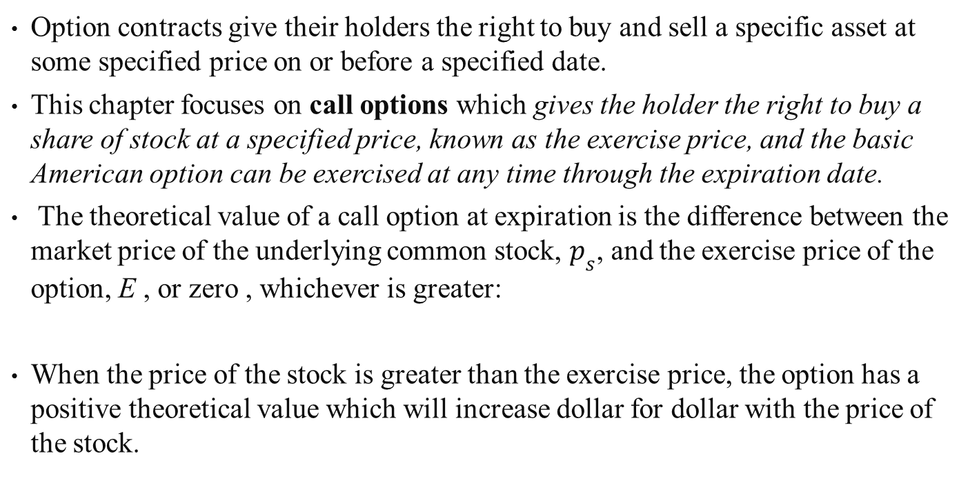
4.8 Option Valuation
Option contracts give their holders the right to buy and sell a specific asset at some specified price on or before a specified date.
This chapter focuses on call options which gives the holder the right to buy a share of stock at a specified price, known as the exercise price, and the basic American option can be exercised at any time through the expiration date.
The theoretical value of a call option at expiration is the difference between the market price of the underlying common stock, $p_{s}$, and the exercise price of the option, E , or zero , whichever is greater:
When the price of the stock is greater than the exercise price, the option has a positive theoretical value which will increase dollar for dollar with the price of the stock.
(4.30)

Slide 40
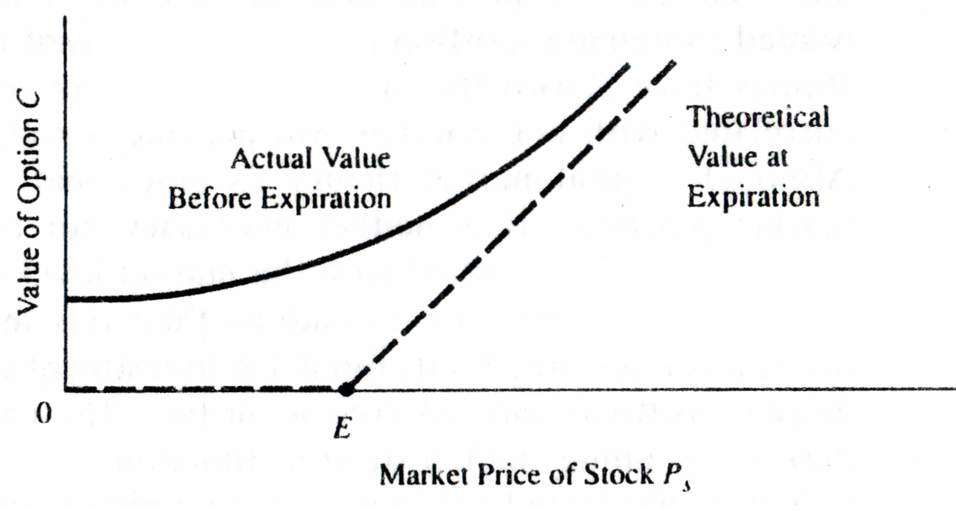
When the market price of the stock is equal to or less than the exercise price, the option has a theoretical value of zero, as shown in Figure 4.8.
The increment above the theoretical value is called the time value or speculative value of the option, and its size will depend primarily on the perceived likelihood of a profitable move on the price of the stock before expiration of the option.
Figure 4.8 Theoretical and Actual Values of a Call Option

Slide 41
Sample Problem 4.5
A call option written on LOB, Inc.’s stock has an exercise price of $95.
Calculate the value of the call option when the option expires if the price of the stock at expiration is (a) $106, (b) $92.
Solution
According to Equation (4.30), the call option can take on only two values, If the call option expires “in the money,” its value will be the difference between the stock price and the exercise price. If the call option expires “out of the money,” its value will be equal to zero because the option holder does not have to exercise this option.
Call expires “in the money” :
C = $106 － ＄95
= $11
Call expires “out of the money,” so option will not be exercised:
C = $0

Slide 42
Sample Problem 4.6
There is still another factor that is probably the single most important variable affecting the speculative value of the option not talked about.
That is the price volatility of the underlying stock.
The greater the probability of significant change in the price of the stock, the more likely it is that the option can be exercised at a profit before expiration.
Table 4.1 Stock Price and Option Price
Stock Price and Option Price
Probability 0.1 0.2 0.4 0.2 0.1
Price of stock A $40 $45 $50 $55 $60 Theoretical value of option A 0 0 $ 2 $ 7 $12 Price of stock B $30 $40 $50 $60 $70 Theoretical value of option B 0 0 $ 2 $12 $22
Exercise price of option A = Exercise price of option B = $48.
Option A = (0) (0.1) + (0) (0.2) + (2) (0.4) + (7) (0.2) + (12) (0.1) = $3.40
Option B = (0) (0.1) + (0) (0.2) + (2) (0.4) + (12) (0.2) + (22) (0.1) = $7.40

Slide 43

The factors that affect the value of an option can be written in a functional form:
where
C = value of the option;
S = stock price;
X = exercise price;
$σ^{2}$= variance of the stock;
T = time to expiration; and
$r_{f}$= risk-free rate
(4.31)

Slide 44
SUMMARY
This chapter has reviewed and summarized four alternative valuation theories－discounted cash flow, M and M, CAPM, and OPT－which are basic to introductory coursed in financial management or investments.
These theories can directly and indirectly become guidelines for further study of security analysis and portfolio management.
Derivations and applications of CAPM and OPT to security analysis and portfolio management are studied in detail in later chapters.

