Slide 1
Chapter 7
Sources of Risks and Their Determination
By
Cheng Few Lee
Joseph Finnerty
John Lee
Alice C Lee
Donald Wort

Slide 2
Chapter Outline
7.1 RISK CLASSIFICATION AND MEASUREMENT
  7.1.1 Call Risk
  7.1.2 Convertible Risk
  7.1.3 Default Risk
  7.1.4 Interest-Rate Risk
  7.1.5 Management Risk
  7.1.6 Marketability (Liquidity) Risk
  7.1.7 Political Risk
  7.1.8 Purchasing-Power Risk
  7.1.9 Systematic and Unsystematic Risk
7.2 PORTFOLIO ANALYSIS AND APPLICATION
  7.2.1Expected Return on a Portfolio
  7.2.2Variance and Standard Deviation of a Portfolio
  7.2.3The Two-Asset Case
  7.2.4 Asset Allocation among Risk-Free Asset, Corporate Bond, and Equity
7.3 THE EFFICIENT PORTFOLIO AND RISK DIVERSIFICATION
  7.3.1 The efficient Portfolio
  7.3.2 Corporate Application of Diversification
  7.3.3 The Dominance Principle
  7.3.4 Three Performance Measures
  7.3.5 Interrelationship among Three Performance Measure
7.4 DETERMINATION OF COMMERCIAL LENDING RATE
7.5 THE MARKET RATE OF RETURN AND MARKET RISK PREMIUM

Slide 3
7.1 RISK CLASSIFICATION AND MEASUREMENT
    Call Risk
    Convertible Risk
    Default Risk
    Interest-Rate Risk
    Management Risk
    Marketability (Liquidity) Risk
    Political Risk
    Purchasing-Power Risk
    Systematic and Unsystematic Risk

Slide 4
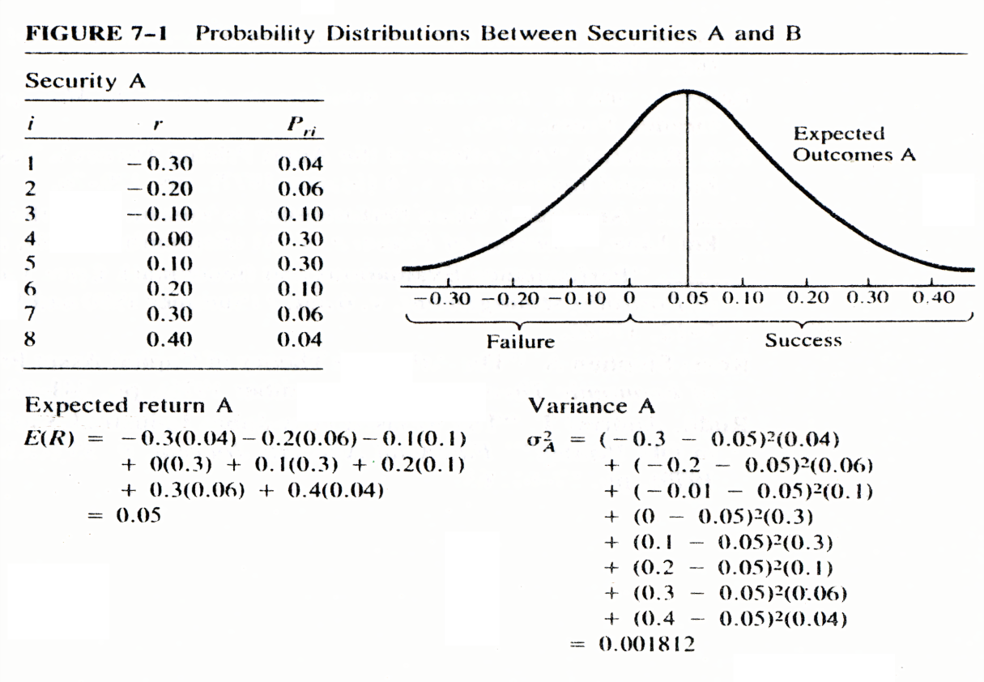

Figure 7-1
Probability Distributions Between Securities A and B

Slide 5
TABLE 7-1 Types of Risk
（ Convertible Risk ）
Risk Type | Description
Call risk | The variability of return caused by the repurchase of the security before its stated maturity.
Convertible risk | The variability of return caused when one type of security is converted into another type of security.
Default risk | The probability of a return of zero when the issuer of the security is unable to make interest and principal payments—or for equities, the probability that the market price of the stock will go to zero when the firm goes bankrupt.
Interest-rate risk | The variability of return caused by the movement of interest rates.
Management risk | The variability of return caused by bad management decisions; this is usually a part of the unsystematic risk of a stock, although it can affect the amount of systematic risk.
Marketability risk (Liquidity risk) | The variability of return caused by the commissions and price concessions associated with selling an illiquid asset.
Political risk | The variability of return caused by changes in laws, taxes, or other government actions.
Purchasing-power risk | The variability of return caused by inflation, which erodes the real value of the return.
Systematic risk | The variability of a single security’s return caused by the general rise or fall of the entire market.
Unsystematic risk | The variability of return caused by factors unique to the individual security.

Slide 6
Types of Risk (Continued)
Business risk refers to the degree of fluctuation of net income associated with different types of business operations. This kind of risk is related to different types of business and operating strategies.
Financial risk refers to the variability of returns associated with leverage decisions. The question then arises as to how much of the firm should be financed with equity and how much should be financed with debt.

Slide 7
7.2 PORTFOLIO ANALYSIS AND APPLICATION
Expected Return on a Portfolio
Variance and Standard Deviation of a Portfolio
The Two-Asset Case
Asset Allocation among Risk-Free Asset, Corporate Bond, and Equity

Slide 8
7.2.1 Expected Return on a Portfolio
Portfolio analysis is used to determine the return and risk for these combinations of assets.
The rate of return on a portfolio is simply the weighted average of the returns of individual securities in the portfolio.
in which are the percentages of the portfolio invested in securities A, B, and C, respectively.

Slide 9
7.2.1 Expected Return on a Portfolio
(7.1)
where:

Slide 10
7.2.2 Variance and Standard Deviation of a Portfolio
(7.2)
where:

Slide 11
7.2.2 Variance and Standard Deviation of a Portfolio
The covariance as indicated in Equation (7.2) can be used to measure the covariability between two securities (or assets) when they are used to formulate a portfolio. With this measure the variance for a portfolio with two securities can be derived:
(7.3)

Slide 12
7.2.2 Variance and Standard Deviation of a Portfolio
The general formula for determining the number of terms that must be computed (NTC) to determine the variance of a portfolio with N securities is

Slide 13
Sample Problem 7.1
Security 1 Security 2

Slide 14
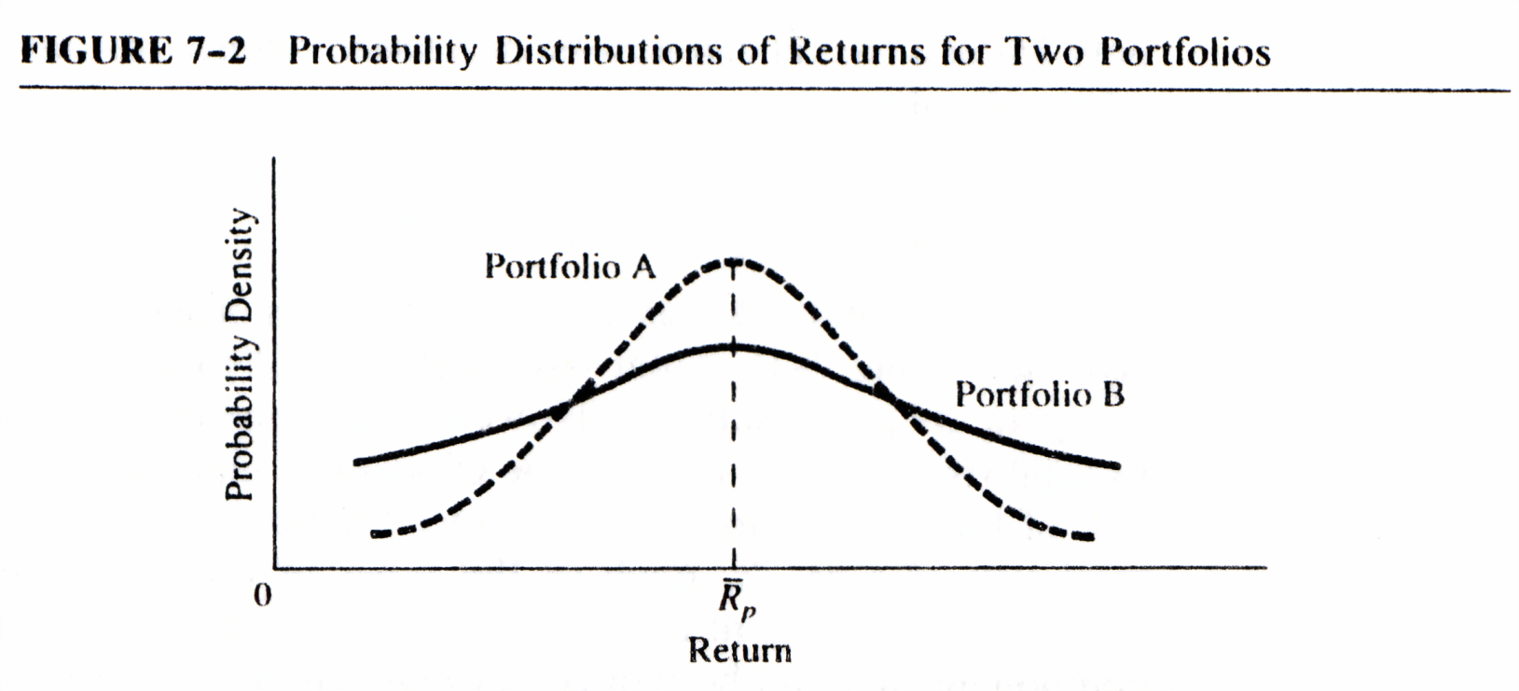
Sample Problem 7.1

Slide 15
Sample Problem 7.1
The riskiness of a portfolio can be measured by the standard deviation of returns as:
(7.6)
where is the standard deviation of the portfolio’s return and is the expected return of the n possible returns.

Slide 16
7.2.3 The Two-Asset Case
To explain the fundamental aspect of the risk-diversification process in a portfolio, consider the two-asset case:
(7.7)
where

Slide 17
7.2.3 The Two-Asset Case
By the definitions of correlation coefficients between and , the can be rewritten:
(7.8)
Where and are the standard deviations of the first and second security, respectively.
From Equations (7.7) and (7.8), the standard deviation of a two-security portfolio can be defined as
(7.9)

Slide 18
Sample Problem 7.2
For securities 1 and 2 used in the previous example, applying Equation (7.9), we get:
Security 1 Security 2
Var portfolio = 0.0025, the same answer as for Sample Problem 7.1.

Slide 19
Sample Problem 7.2
If = 1.0, Equation (7.6) can be simplified to the linear expression:
where . Since Equation (7.9) is a quadratic equation, some value of minimizes .
To obtain this value, differentiate Equation (7.9) with respect to and set this derivative equal to zero. Then we get:
(7.10a)

Slide 20
Sample Problem 7.2
If Equation (7.10a) reduces from:
To
(7.10b)

Slide 21
Sample Problem 7.2
If , Equation (7.10a) reduces to:
(7.10c)
However, if the correlation coefficient between 1 and 2 is –1, then the minimum-variance portfolio must be divided equally between security 1 and security 2—that is:

Slide 22
Sample Problem 7.2
As an expanded form of Equation (7.9), a portfolio can be written:
(7.11)
where:

Slide 23
Sample Problem 7.3
Consider two stocks, A and B:
(1) If a riskless portfolio could be formed from A and B, what would be the expected return of ? (2) What would the expected return be if ?
Solution
1.
If we let
So

Slide 24
Sample Problem 7.3
Solution
2. If we let
Then,

Slide 25
7.2.4 Asset Allocation among Risk-Free Asset, Corporate Bond, and Equity
The most straightforward way to control the risk of the portfolio is through the fraction of the portfolio invested in Treasury bills and other safe money market securities versus risky assets.
The capital allocation decision is an example of an asset allocation choice — a choice among broad investment classes, rather than among the specific securities within each asset class.
Most investment professionals consider asset allocation as the most important part of portfolio construction.

Slide 26
Sample Problem 7.4
Private fund $500,000 investing in a risk-free asset $100,000, risky equities (E) $240,000, and long-term bonds (B) $160,000.
Current risky portfolio consists 60% of E and 40% of B, and the weight of the risky portfolio in the mutual fund is 80%.

Slide 27
Sample Problem 7.4
Suppose the fund manager wishes to decrease risk portfolio from 80% to 70%, then should sell $400,000-0.7 ($500,000)=$50,000 of risky holdings, with the proceed used to purchase more shares in risk-free asset.
To keep the same weights of E and B (60% and 40%)in the risky portfolio, the fund manager should sell
0.6×50,000=$30,000 in E
0.4×50,000=$20,000 in B

Slide 28
7.3 THE EFFICIENT PORTFOLIO AND RISK DIVERSIFICATION
The efficient Portfolio
Corporate Application of Diversification
The Dominance Principle
Three Performance Measures
Interrelationship among Three Performance Measure

Slide 29
7.3.1 The Efficient Portfolio
Definition: A portfolio is efficient, if there exists no other portfolio having the same expected return at a lower variance of returns, or, if no other portfolio has a higher expected return as the same risk of returns.
This suggests that given two investments, A and B, investment A will be preferred to B if:
Where E(A) and E(B) = the expected returns of A and B, Var(A) and Var(B) = their respective variances or risk.

Slide 30
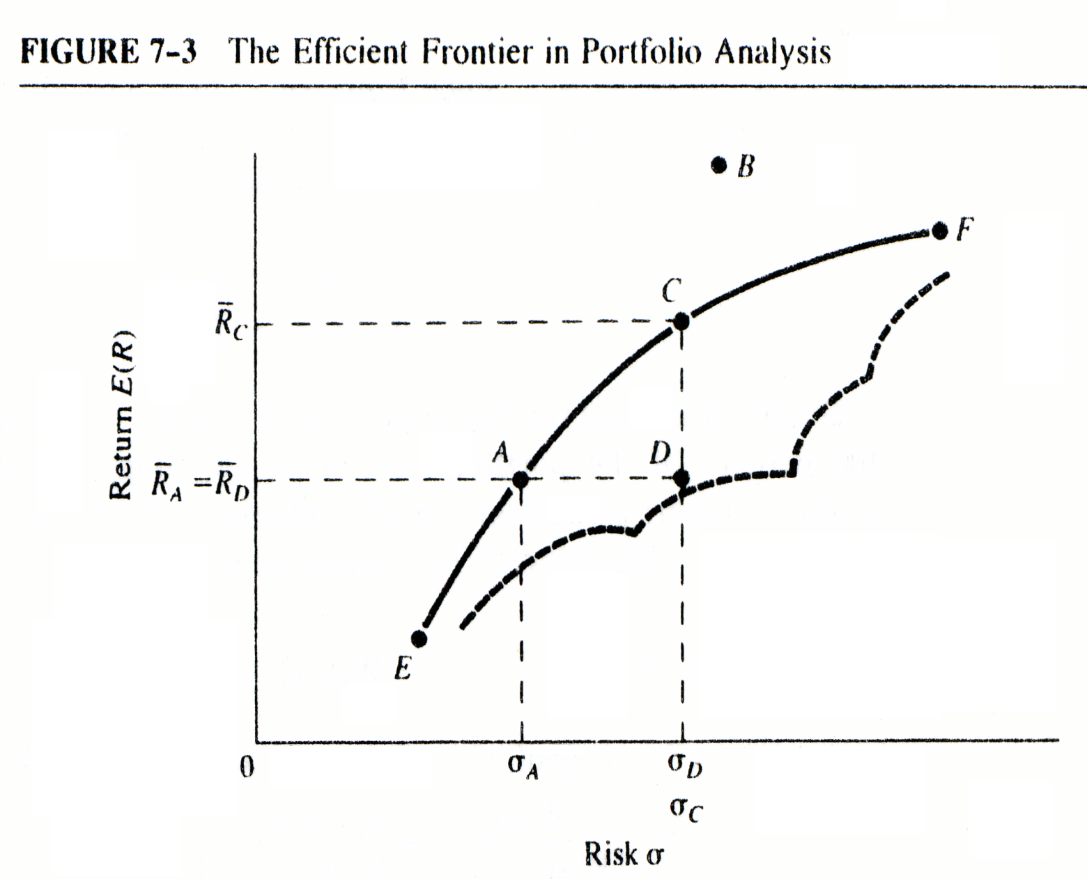
7.3.1 The efficient Portfolio

Slide 31
Sample Problem 7.5
Monthly rates of return for April, 2001 to April, 2010 for Johnson & Johnson (JNJ) and IBM are used as examples. The basic statistical estimates for these two firms are average monthly rates of return and the variance-covariance matrix.in Table 7.3:
Variance-Covariance Matrix
 | JNJ | IBM
JNJ | 0.0025 | 0.0007
IBM | 0.0007 | 0.0071

Slide 32
Sample Problem 7.5
From Equation (7.10), we have:
Using the weight estimates and Equations (7.2) and (7.3):
When is less than 1.00 it indicates that the combination of the two securities will result in a total risk less than their added respective risks.

Slide 33
7.3.2 Corporate Application of Diversification
The effect of diversification is not necessarily limited to securities but may have wider applications at the corporate level.
Instead of “putting all the eggs in one basket,” the investment risks are spread out among many lines of services or products in hope of reducing the overall risks involved and maximizing returns.
The overall goal is to reduce business risk fluctuations of net income.

Slide 34
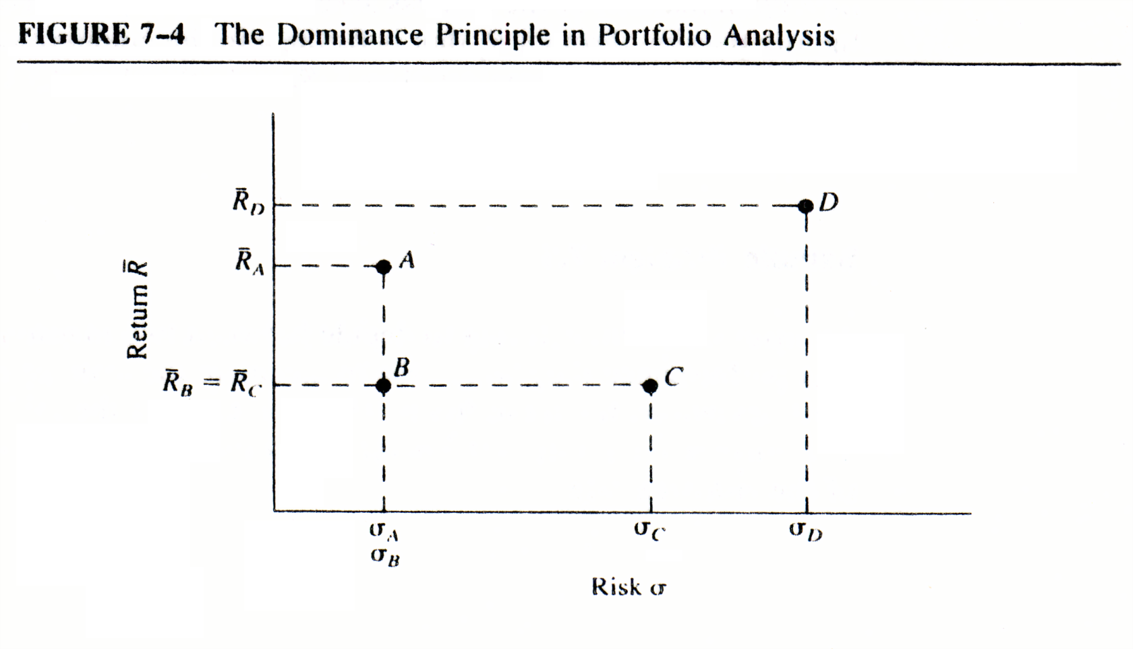
7.3.3 The Dominance Principle
The dominance principle has been developed as a means of conceptually understanding the risk/return tradeoff.
As with the efficient-frontier analysis, we must assume an investor prefers returns and dislikes risks.

Slide 35
7.3.4 Three Performance Measures
The Sharpe measure (SP) (Sharpe, 1966) is of immediate concern. Given two of the portfolios depicted in Figure 7.4, portfolios B and D, their relative risk-return performance can be compared using the equations:
and
where

Slide 36
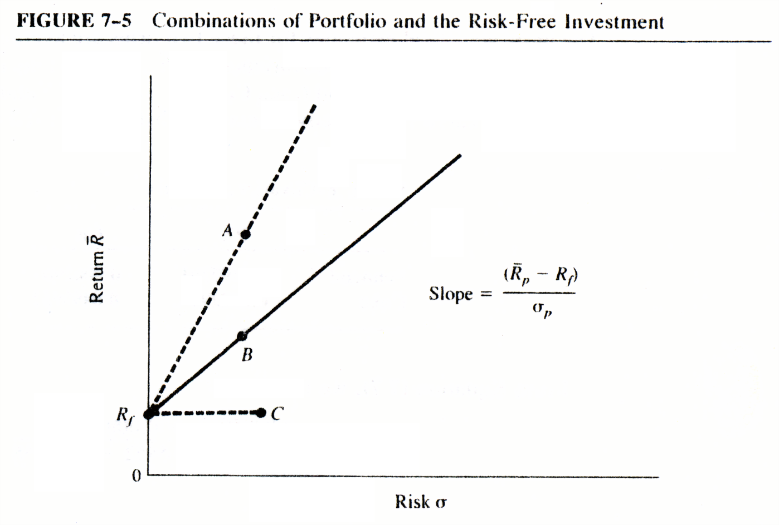
Sharpe measure (SP)
If a riskless rate exists, then all investors would prefer A to B because combinations of A and the riskless asset give higher returns for the same level of risk than combinations of the riskless asset and B.

Slide 37
Sample Problem 7.6
Table 7.4 | Smyth Fund | Jones Fund
Average return R (%) | 18 | 16
Standard deviation (%) | 20 | 15
Risk-free rate
Using the Sharpe performance measure, the risk-return measurements for these two firms are:
Jones fund has better performance based on Sharpe measure.

Slide 38
Sample Problem 7.7
The performances of portfolios A-E shown in Table 7.5.
By using Sharpe measure , assume risk-free rate is 8%, the rank of portfolios is A>B>E>C>D:
Protfolio A is the most desirable.
However, for risk-free rate 5%, the order changes to E>B>A>D>C:
Now E is the best portfolio.
Portfolio | Return (%) | Risk (%)
A | 50 | 50
B | 19 | 15
C | 12 | 9
D | 9 | 5
E | 8.5 | 1

Slide 39
Treynor measure (TP)
Treynor measure (TP), developed by Treynor in 1965, examines differential return when beta is the risk measure.
The Treynor measure can be expressed by the following:
(7.13)
where:
The Treynor performance measure uses the beta coefficient (systematic risk) instead of total risk for the portfolio as a risk measure.

Slide 40
Jensen’s measure (JM)
Jensen (1968, 1969) has proposed a measure referred to as the Jensen differential performance index (Jensen’s measure or JM).
JM is the differential return which can be viewed as the difference in return earned by the portfolio compared to the return that the capital asset pricing line implies should be earned.
CAPM:
(7.14)
(7.15)

Slide 41
Sample Problem 7.8
Portfolio | (%) | (%)
A | 50 | 50 | 2.5
B | 19 | 15 | 2.0
C | 12 | 9 | 1.5
D | 9 | 5 | 1.0
E | 8.5 | 1 | 0.25
Rank portfolios based on JM:
(1)When RM=10% and Rf=8%,
(2)When RM=12% and Rf=8%,

Slide 42
Sample Problem 7.8
Portfolio | (%) | (%)
A | 50 | 50 | 2.5
B | 19 | 15 | 2.0
C | 12 | 9 | 1.5
D | 9 | 5 | 1.0
E | 8.5 | 1 | 0.25
Rank portfolios based on JM:
(3)When RM=8% and Rf=8%,
(4)When RM=12% and Rf=4%,

Slide 43


7.3.5 Interrelationship among Three Performance Measure
Since
Since
(7.16)
The JM must be multiplied by in order to derive the equivalent SM:
If the JM divided by ,it is equivalent to the TM plus some constant common to all portfolios:
$${1/σ}_{P}$$
$$β_{P}$$

Slide 44
Sample Problem 7.9
Continuing with the example used for the Sharpe performance measure in Sample Problem 7.6, assume that in addition to the information already provided the market return is 10 percent, the beta of the Smyth Fund is 0.8, and the Jones Fund beta is 1.1. Then, according to the capital asset pricing line, the implied return earned should be:
Using the Jensen measure, the risk-return measurements for these two firms are:

Slide 45
7.4 Determination of Commercial Lending Rate
Based upon the mean and variance Equations (7.1) and (7.2) it is possible to calculate the expected lending rate and its variance. Using the information provided in Table 7.8, the weighted average and the standard deviation can be calculated:
 | (A) | (B) | (C) | (D) | ( ) | (A+C)
 |  |  |  |  | Joint | Lending
Economic |  |  |  |  | Probability | Rate
Conditions | (%) | Probability | (%) | Probability | of Occurrence | (%)
Boom | 12 | 0.25 | 3.0 | 0.40 | 0.100 | 15
 |  |  | 5.0 | 0.30 | 0.075 | 17
 |  |  | 8.0 | 0.30 | 0.075 | 20
Normal | 10 | 0.50 | 3.0 | 0.40 | 0.200 | 13
 |  |  | 5.0 | 0.30 | 0.150 | 15
 |  |  | 8.0 | 0.30 | 0.150 | 18
Poor | 8 | 0.25 | 3.0 | 0.40 | 0.100 | 11
 |  |  | 5.0 | 0.30 | 0.075 | 13
 |  |  | 8.0 | 0.30 | 0.075 | 16

Slide 46
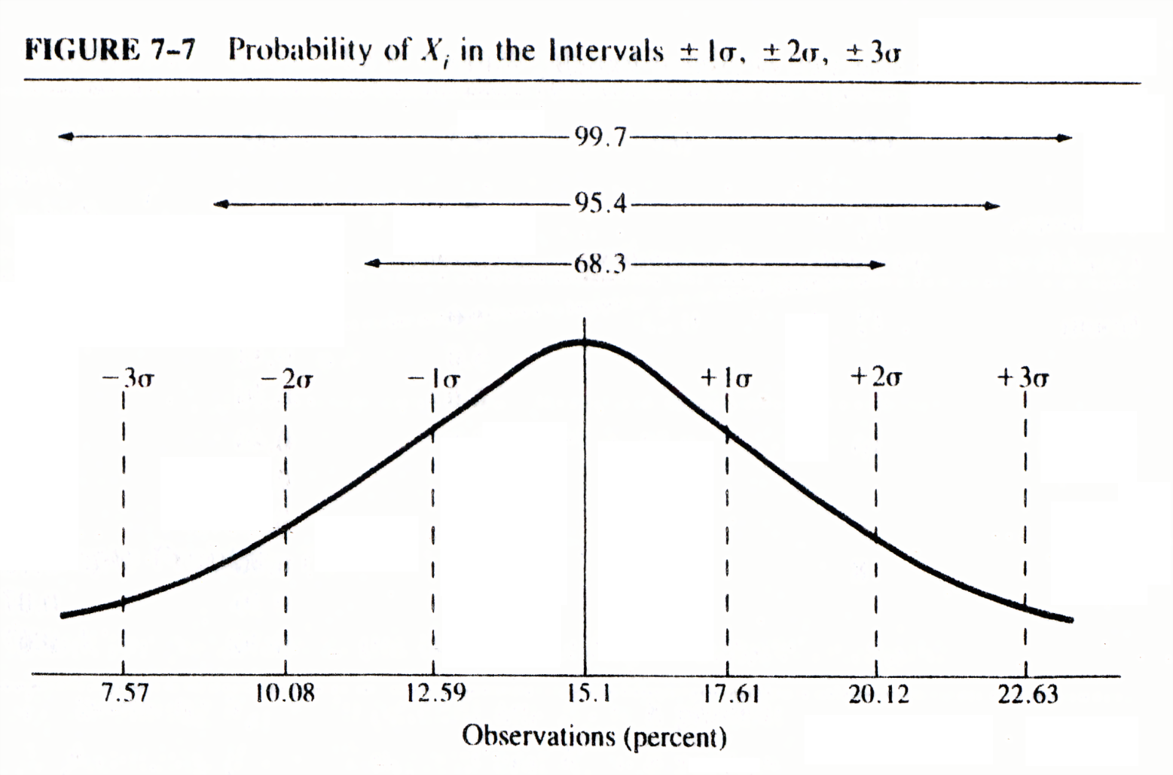
According to lending rates in Table 7.8
The weighted average and the standard deviation are:

Slide 47
7.5 The Market Rate Of Return And Market Risk Premium
The market rate of return is the return that can be expected from the market portfolio.
The market rate of return can be calculated using one of several types of market indicator series, such as the Dow-Jones Industrial Average or the Standard and Poor (S&P) 500 by using the following equation:
(7.19)
where:

Slide 48
7.5 The Market Rate Of Return And Market Risk Premium
A risk-free investment is one in which the investor is sure about the timing and amount of income streams arising from that investment.
The reasonable investor dislikes risks and uncertainty and would, therefore, require an additional return on his investment to compensate for this uncertainty. This return, called the risk premium, is added to the nominal risk-free rate.
Table 7.9 illustrates the concept of risk premium by using the market rate of return of S&P 500 index.

Slide 49
7.5 The Market Rate Of Return And Market Risk Premium
TABLE 7.9 Market Returns and T-bill by Quarters
Quarter | S&P 500 | (A) Market Return (percent) | (B) T-Bill Rate (percent) | (A)－(B) Risk Premium (percent)
1980
IV | 135.76
1981
I | 136.00 | + 0.18 | 13.36 | -13.18
II | 131.21 | - 3.52 | 14.73 | -18.25
III | 116.18 | -12.94 | 14.70 | -27.64
IV | 122.55 | + 5.48 | 10.85 | - 5.37

Slide 50
7.5 The Market Rate Of Return And Market Risk Premium
TABLE 7.9 Market Returns and T-bill by Quarters (Continued)
Quarter | S&P 500 | (A) Market Return (percent) | (B) T-Bill Rate (percent) | (A)－(B) Risk Premium (percent)
1983
I | 152.96 | + 8.76 | 8.35 | 0.41
II | 168.11 | + 9.90 | 8.79 | 1.11
III | 166.07 | - 1.22 | 9.00 | -10.22
IV | 164.93 | - 0.69 | 9.00 | - 9.69
1984
I | 159.18 | - 3.49 | 9.52 | -13.01
II | 153.18 | - 3.77 | 9.87 | -13.64
III | 166.10 | + 8.43 | 10.37 | - 1.94
IV | 167.24 | + 0.68 | 8.06 | - 7.37

Slide 51
7.5 The Market Rate Of Return And Market Risk Premium
TABLE 7.9 Market Returns and T-bill by Quarters (Continued)
Quarter | S&P 500 | (A) Market Return (percent) | (B) T-Bill Rate (percent) | (A)－(B) Risk Premium (percent)
1985
I | 180.66 | + 8.02 | 8.52 | - 0.50
II | 188.89 | + 4.55 | 6.95 | - 2.4
III | 184.06 | - 2.62 | 7.10 | - 9.72
IV | 207.26 | +12.60 | 7.07 | + 5.53
1986
I | 232.33 | +12.09 | 6.56 | + 5.53
II | 245.30 | + 5.58 | 6.21 | - 0.63
III | 238.27 | - 2.86 | 5.21 | - 8.07
IV | 248.61 | + 4.33 | 5.43 | - 1.10

Slide 52
7.5 The Market Rate Of Return And Market Risk Premium
TABLE 7.9 Market Returns and T-bill by Quarters (Continued)
Quarter | S&P 500 | (A) Market Return (percent) | (B) T-Bill Rate (percent) | (A)－(B) Risk Premium (percent)
1987
I | 292.47 | +17.64 | 5.59 | +12.05
II | 301.36 | + 3.03 | 5.69 | - 2.66
III | 318.66 | + 5.74 | 6.40 | + 0.05
IV | 240.96 | -24.38 | 5.77 | -30.10

Slide 53
7.6 SUMMARY
This chapter has defined the basic concepts of risk and risk measurement. The efficient-portfolio concept and its implementation was demonstrated using the relationships of risk and return. The dominance principle and performance measures were also discussed and illustrated. Finally, the interest rate and market rate of return were used as measurements to show how the commercial lending rate and the market risk premium can be calculated.
Overall, this chapter has introduced uncertainty analysis assuming previous exposure to certainty concepts. Further application of the concepts discussed in this chapter as related to security analysis and portfolio management are explored in later chapters.

