Slide 1
Chapter 8
Risk-Aversion, Capital Asset Allocation,
and Markowitz Portfolio-Selection Model
By
Cheng Few Lee
Joseph Finnerty
John Lee
Alice C Lee
Donald Wort

Slide 2
Outline
8.1 Utility Theory, Utility Functions, and Indifference Curves
  8.1.1 Utility Theory
  8.1.2 Utility Functions
  8.1.3 Risk Aversion and Asset Allocation
  8.1.4 Indifference Curves
8.2 Efficient Portfolios
  8.2.1 Portfolio Combinations
  8.2.2 Short Selling
8.3 Techniques for Calculating the Efficient Frontier with Short Selling
  8.3.1 The Normal Distribution
  8.3.2 The Log-Normal Distribution
  8.3.3 Mathematical Method to Calculate Efficient Frontier
  8.3.4 Portfolio Determination with Specific Adjustment for Short Selling
  8.3.5 Portfolio Determination without Short Selling
8.4 Summary

Slide 3
Markowitz Model
In this chapter basic portfolio analysis concepts and techniques discussed in the Markowitz portfolio-selection model and other related issues in portfolio analysis.
The Markowitz model is based on several assumptions concerning the behavior of investors:
A probability distribution of possible returns over some holding period can be estimated by investors.
Investors have single-period utility functions in which they maximize utility within the framework of diminishing marginal utility of wealth.
Variability about the possible values of return is used by investors to measure risk.
Investors use only expected return and risk to make investment decisions.
Expected return and risk as used by investors are measured by the first two moments of the probability distribution of returns-expected value and variance.
Return is desirable; risk is to be avoided.

Slide 4
8.1 Utility Theory, Utility Functions, and Indifference Curves
  8.1.1 Utility Theory
  8.1.2 Utility Functions
  8.1.3 Risk Aversion and Asset Allocation
  8.1.4 Indifference Curves

Slide 5
8.1.1 Utility Theory
Utility theory is the foundation for the theory of choice under uncertainty. Following Henderson and Quandt (1980), cardinal and ordinal theories are the two major alternatives used by economists to determine how people and societies choose to allocate scarce resources and to distribute wealth among one another over time.1
1 A cardinal utility implies that a consumer is capable of assigning to every commodity or combination of commodities a number representing the amount or degree of utility associated with it. An ordinary utility implies that a consumer needs not be able to assign numbers that represent (in arbitrary unit) the degree or amount of utility associated with commodity or combination of commodity. The consumer can only rank and order the amount or degree of utility associated with commodity.

Slide 6
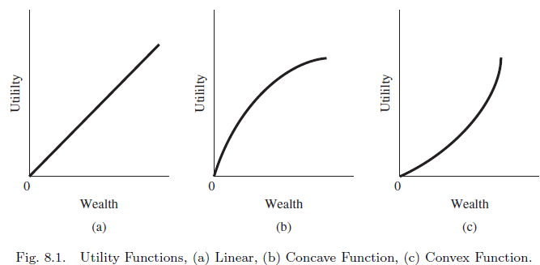
8.1.2 Utility Functions
An upward-sloping relationship between utility and wealth identifies the phenomena of increasing wealth and increasing satisfaction as being directly related.
These relationships can be classified into linear, concave, and convex utility functions in Figure 8.1.

Slide 7
8.1.2 Utility Functions
The utility function can be expressed in terms of wealth:
where indicates expected future wealth and represents the predicted standard deviation of the possible divergence of actual future wealth from .
Investors are expected to prefer a higher expected future wealth to a lower value. Moreover, they are generally risk averse as well.
These assumptions imply that the indifference curves relating to and will be upward sloping (Figure 8.2).

Slide 8
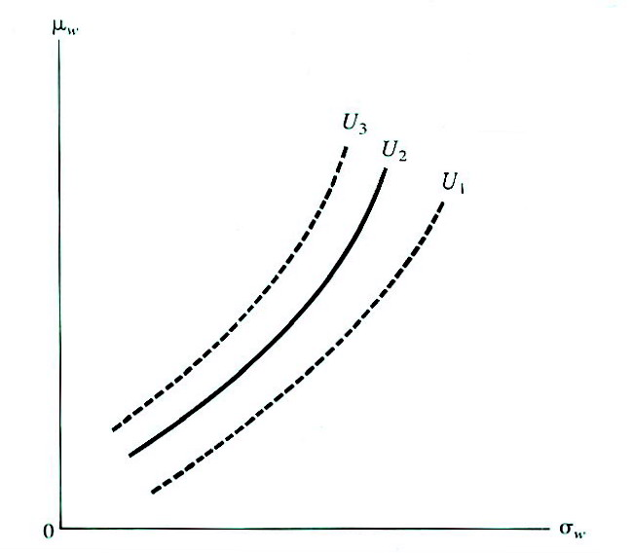
8.1.2 Utility Functions
FIGURE 8.2 Indifference Curves of Utility Functions
Von-Newmann and Morgenstern (VNM, 1947) define investor utility as a function of rates of return or wealth. Rational investors are expected to prefer a higher expected future wealth to a lower value, and are generally risk averse.
Each indifference curve is an expected utility isoquant showing all the various combinations of risk and return that provide an equal amount of expected utility for the investor.

Slide 9
8.1.2 Utility Functions
The expected utility can be calculated in terms of the probabilities of occurrence associated with each of the possible returns:
（8.1）
where:
= expected utility;
= the utility of the ith outcome ; and
= the Probability of the ith outcome.

Slide 10
Sample Problem 8.1
Table 8.1 Possible Outcomes of Investments A and B
A |  | B
Outcome | Probability | Outcome | Probability
10 5 1 | 2/5 2/5 1/5 | 9 3 | 2/3 1/3
Given investments A and B as shown in the table,
determine the utilities of A and B for the given
utility functions:
1.
2.
3.

Slide 11
Sample Problem 8.1
Solution
1. For
2. For

Slide 12
Sample Problem 8.1
3. (use results from 1 and 2)
In all three cases, B has the higher degree of utility.

Slide 13
8.1.2.1 Linear Utility Function and Risk
It is useful now to consider how the shape of an individual’s utility function affects his or her reaction to risk. Assume that an individual who has $5,000 and whose behavior is a linear utility function [Figure 8-1(a)] is offered a chance to gain $10,000 with a probability of 1/2 or to lose $10,000 with a probability of 1/2. What should he or she pay for such an opportunity? The answer is nothing, for as can be seen in Figure 8-3, this individual would be no better or worse off accepting or rejecting this opportunity. If he rejected the offer, his wealth would be $5,000 with utility U₁; if he paid nothing for the opportunity, his wealth would remain as $5,000 with Utility U₁. Any payment for this chance would reduce his wealth and therefore be undesirable. This is so because the expected value of the fair game is zero:

Slide 14
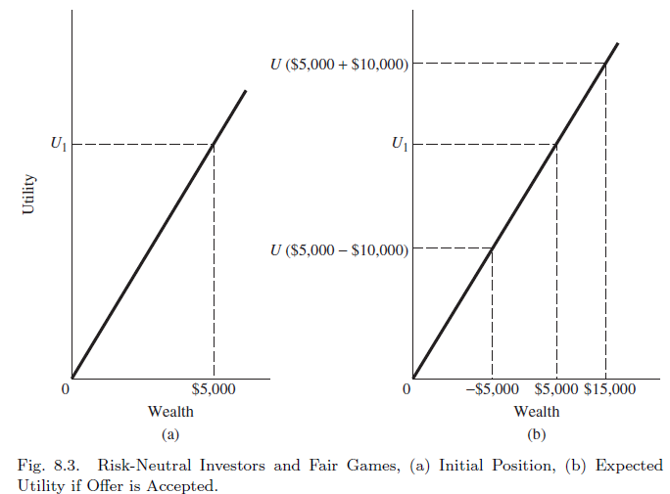
8.1.2.1 Linear Utility Function and Risk
Figure 8.3 illustrates this linear utility function concept in the previous example.

Slide 15
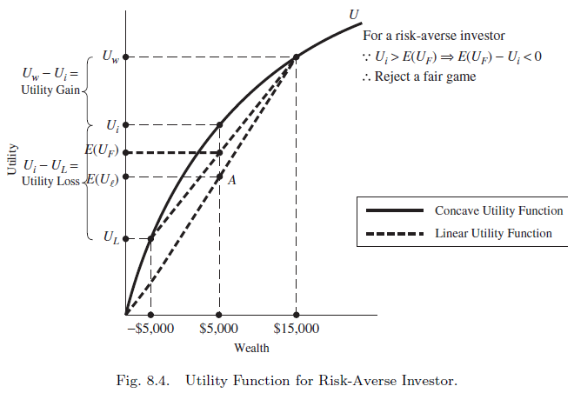


8.1.2.2 Concave Utility Function and Risk
Using the number in previous example, Figure 8.4 show that the utility of winning is less than the utility of losing .
Therefore, the utility of doing nothing is greater than the expected utility of accepting the fair game.
is the expected utility of the fair game under a concave utility function.
is the expected utility of the fair game under a linear utility function.
$$\left(U_{w}−U_{i}\right)$$
$$\left(U_{i}−U_{L}\right)$$
Figure 8.4 Utility Function for Risk-Averse Investor

Slide 16
Sample Problem 8.2
Given the following utility functions for four investors, what can you conclude about their reaction towards a fair game?
1.
2. (quadratic utility function)
3. (negative exponential utility function), and
4.

Slide 17
Sample Problem 8.2
Evaluate the second derivative of the utility according to the following rules:
Solution
1.
This implies risk neutrality; it is indifference for the investor to accept or reject a fair gamble.

Slide 18
Sample Problem 8.2
2.
This implies the investor is risk averse and would reject a fair gamble.
3.
This implies risk adversity; the investor would reject a fair gamble.

Slide 19
Sample Problem 8.2
4.
This implies risk preference; the investor would seek a fair gamble.

Slide 20
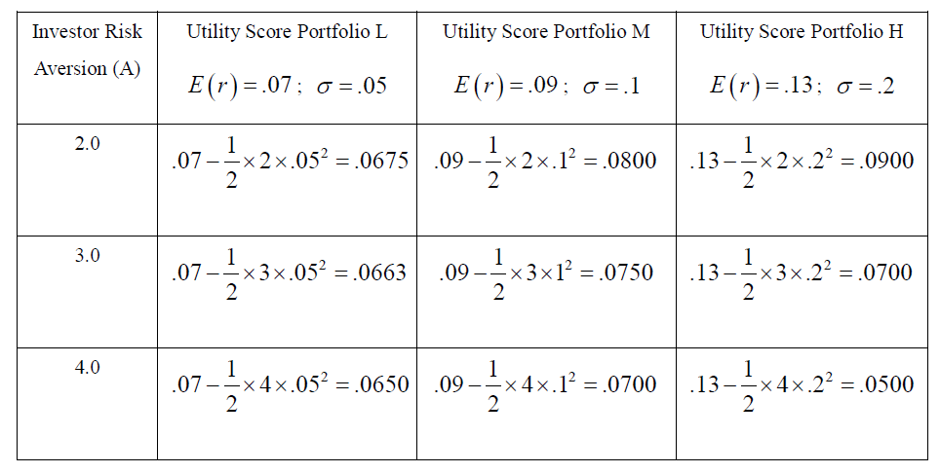
8.1.3 Risk Aversion and Asset Allocation
Assigning a portfolio with expected return and variance of returns, the following utility score:
(8.2)
Where U = utility, E(r) = expected return on the asset or portfolio, A = coefficient of risk aversion, and s² = variance of returns.
Table 8.2 presents the utility scores that would be assigned by each investor to each portfolio in Sample Problem 8.3.
Table 8.2 Utility Scores Assigned by Each Investor to Each Portfolio

Slide 21
Sample Problem 8.4
Assuming an investor who faces a risk-free rate and a risky portfolio with expected return and standard deviation will find that for any choice of W, the expected return of the complete portfolio is given by:
(8.3)
The variance of the complete portfolio is:
(8.4)
To solve the utility maximization problem, we write the problem as follows:
(8.5)
Taking derivative of U with respective to W and set the derivative of this expression to zero, W*, as follows:
(8.6)
If
Therefore, the investor will invest 83% of his investment budget in the risky asset and 17% of his investment budget in the risk-free asset.

Slide 22
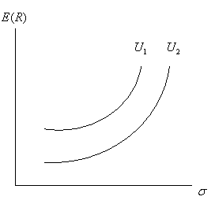
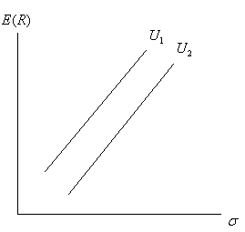
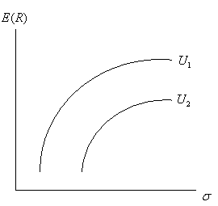
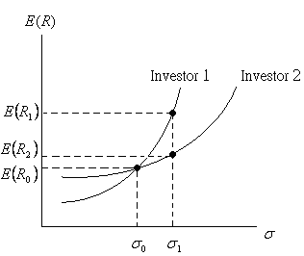
8.1.4 Indifference Curves
FIGURE 8.5 Indifference Curves for Various Types of Individuals
(a) Risk-Averse investor (b) Risk-Neutral Investor
(c) Risk-Seeking Investor (d) Level of Risk-Aversion
Note:
The slope of the indifference curve is a function of the investor’s particular preference for a lower but safer return versus a larger but riskier return.
Indifference curves can be used to indicate investors’ willingness to trade risk for return; now investors’ ability to trade risk for return needs to be represented in terms of indifference curves and efficient portfolios.

Slide 23
8.2 Efficient Portfolios
8.2.1 Portfolio Combinations
8.2.2 Short Selling

Slide 24
8.2.1 Portfolio Combinations
Optimal Portfolio
For each of the combinations of individual securities and inefficient portfolios in Figure 8.6 there is a corresponding portfolio along the efficient frontier that either has a higher return given the same risk or a lower risk given the same return. The optimal portfolio along the efficient frontier is not unique with this model and depends upon the risk/return tradeoff utility function of each investor. Portfolio selection, then, is determined by plotting investors’ utility functions together with the efficient-frontier set of available investment opportunities. No two investors will select the same portfolio except by chance or if their utility curves are identical.

Slide 25
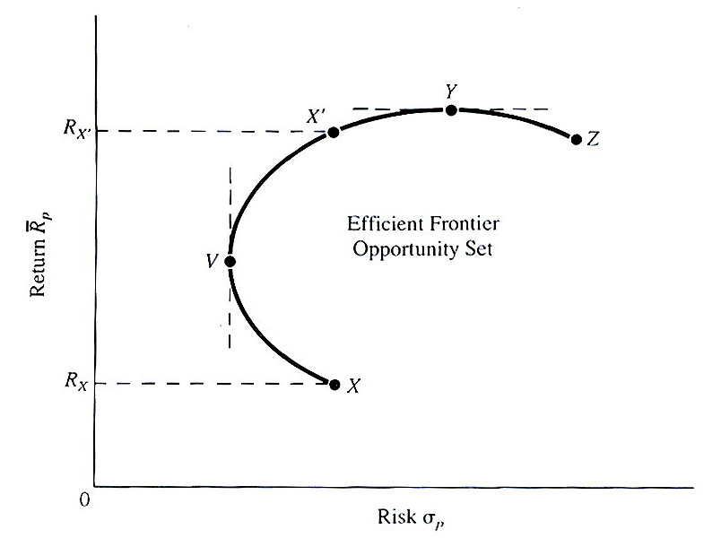
8.2.1 Portfolio Combinations
FIGURE The Minimum-Variance Set
The area within curve XVYZ is the feasible opportunity set representing all possible portfolio combinations. The curve YV represents all possible efficient portfolios and is the efficient frontier. The line segment VX is on the feasible opportunity set, but not on the efficient frontier; all points on VX represent inefficient portfolios.
→ Maximum-variance portfolio
Note: Points on the efficient do not dominate one another. While point Y has considerably higher return than point V, it also has considerably higher risk.
Minimum-variance portfolio

Slide 26
8.2.1 Portfolio Combinations
Optimal Portfolio
The optimal portfolio would be the one that provides the highest utility—a point in the northwest direction (higher return and lower risk). This point will be at the tangent of a utility curve and the efficient frontier. The tangency point investor in Figure 8.6 is point X’; for the risk-averse it is point Y. Each investor is logically selecting the optimal portfolio given his or her risk-return preference, and neither is more correct than the other.

Slide 27
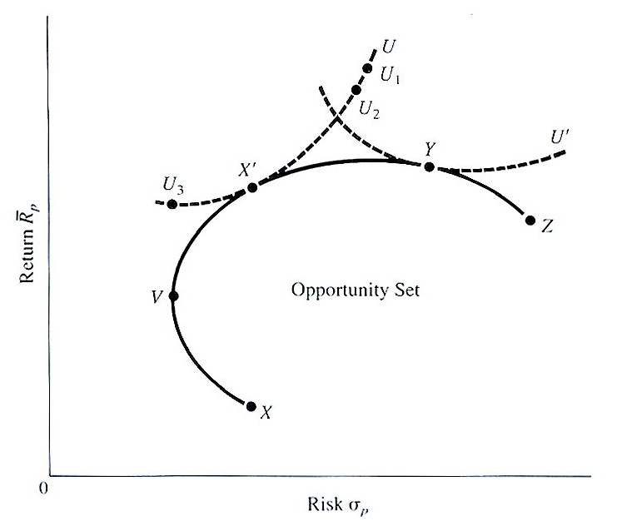
8.2.1Portfolio Combinations
FIGURE 8.6 Indifference Curves and The Minimum-Variance Set
→ More-risk averse investor (a higher slope indifference curve)
X’ is the optimal portfolio choice for more-risk averse investor
→ Less risk-averse investor (a lower slope indifference curve)
Y is the optimal portfolio choice for less-risk averse investor.
Note: Y is the optimal portfolio choice for less-risk averse investor. Point Y is also called the maximum-return portfolio, since there is no other portfolio with a higher return. It could also be a portfolio of securities, all having the same highest levels of risk and return. Point Z is normally a single security with the lowest level of return, although it could be a portfolio of securities, all having the same low level of return.

Slide 28
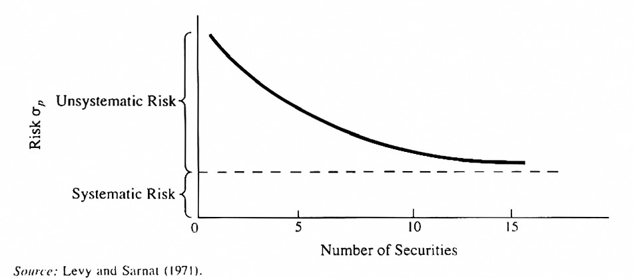
8.2.1Portfolio Combinations
Figure 8.7 shows that the additional reduction in portfolio variance rapidly levels off as the number of securities is increased beyond five.
FIGURE 8.7 Native Diversification Reduces Risk to the Systematic Level in a Randomly Selected Portfolio

Slide 29
8.2.2 Short Selling
Short selling (or “going short”) is a very regulated type of market transaction. It involves selling shares of a stock that are borrowed in expectation of a fall in the security’s price. When and if the price declines, the investor buys an equivalent number of shares of the same stock at the new lower price and returns to the lender the stock that was borrowed.
The Federal Reserve Board requires short selling customers to deposit 50 percent of the net proceeds of such short sales with the brokerage firm carrying out the transaction.
Another key requirement of a short sale, set by the Securities and Exchange Act of 1934, is that the short sale must occur at a price higher than the preceding sale—or at the same price as the preceding sale, if that took place at a higher price than a preceding price. This is the so-called uptick or zero-tick rule. It prevents the price of a security from successively falling because of continued short selling.

Slide 30
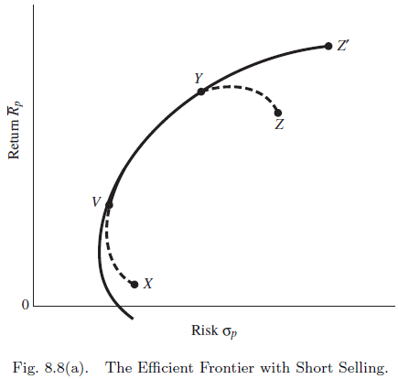
8.2.2 Short Selling
FIGURE 8.8A Short Selling Allowed
The Markowitz model (1952) does NOT allow short selling; while the Black (1972) model allows for short selling. That is, the non-negativity constraint on the amount that can be invested in each security is relaxed. A negative value for the weight invested in a security is allowed, tantamount to allowing a short sale of the security.

Slide 31
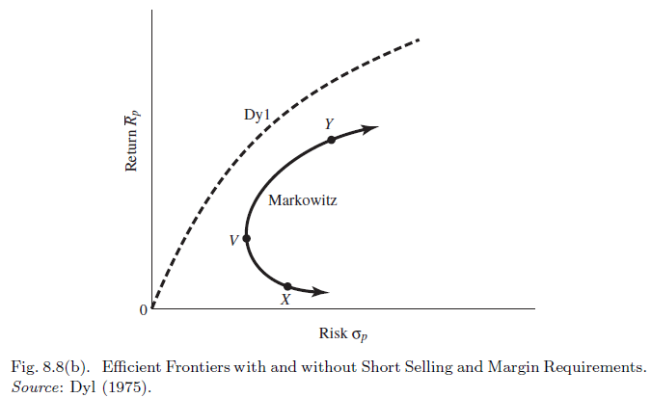
8.2.2 Short Selling
FIGURE 8.8B Efficient Frontiers With and Without Short Selling and Margin Requirements
Short Selling NOT Allowed
The major difference between the frontier in Figure 8-10A (short selling) and Figure 8-10B (no short selling) is the disappearance of the end points Y and Z.

Slide 32
Figure 8.8B (no short selling)
The major difference between Fig. 8.8(a) and 8.8(b) is that an investor could sell the lowest-return security (Y).
If the number of short sales is unrestricted, then by a continuous short selling of X and reinvesting in Y the investor could generate an infinite expected return.
Hence the upper bound of the highest-return portfolio would no longer be Y but infinity (shown by the arrow on the top of the efficient frontier).
Likewise the investor could short sell the highest-return security Y and reinvest the proceeds into the lowest-yield security X, thereby generating a return less than the return on the lowest-return security.
Given no restriction on the amount of short selling, an infinitely negative return can be achieved, thereby removing the lower bound of X on the efficient frontier. But rational investors will not short sell a high-return stock and buy a low-return stock and buy a low-return stock.

Slide 33
8.2.2 Short Selling (Dyl Model)
The Dyl introduced short selling with margin requirements by creating a new set of risky securities, the ones sold short, which are negatively correlated with the existing set of risky securities. These new securities greatly enhance the diversification effect when they are placed in portfolios.
The Dyl model affects the efficient frontier in two ways:
  (1) If the investor were to combine in equal weight any long position in a security or portfolio with a short position in a security or a portfolio, the resulting portfolio would yield zero return and zero variance
  (2) Any combination of unequal weighted long or short positions would yield portfolios with higher returns and lower risk levels.
Overall, these two effects will yield an efficient frontier that dominates the Markowitz efficient frontier. Figure 8.8B compares the Dyl and Markowitz efficient frontiers.

Slide 34
8.3 Techniques for Calculating the Efficient Frontier with Short Selling
8.3.1 The Normal Distribution
8.3.2 The Log-Normal Distribution
8.3.3 Mathematical Method to Calculate
Efficient Frontier
8.3.4 Portfolio Determination with Specific
Adjustment for Short Selling
8.3.5 Portfolio Determination without
Short Selling

Slide 35
8.3 Techniques for Calculating the Efficient Frontier with Short Selling
One way of determining the optimal investment proportions in a portfolio is to hold the return constant and solve for the weighting factors ( for n securities) that minimize the variance, given the constraint that all weights sum to one and that the constant return equals the expected return developed from the portfolio. The optimal weights can then be obtained by minimizing the Lagrange function C for portfolio variance.
(8.8)
in which and are the Lagrange multipliers, and are targeted rate of return and expected rate of return for security i and j

Slide 36
8.3.1 The Normal Distribution
The Normal (probability) distribution is a bell-shaped curve centered on the mean of a given population or sample distribution. The area under the curve is an accumulation of probabilities that sum to one.
Suppose the mean return on a particular investment is 10% for a given period, and that historically these returns have a variance of 0.16%, then the probabilities are of obtaining a 15% or greater return, or a return less than or equal to 8% can be calculated as:
（8.9）

Slide 37
8.3.2 The Log-Normal Distribution
If the return of portfolio p follows log-normal distribution, then its expected value and standard deviation can be expressed as
where and is the standard deviation of .
where and .
The applications of log-normal distribution are discussed in detail in Chapter 19.

Slide 38
8.3.3 Mathematical Method to Calculate Efficient Frontier**
One of the goals of portfolio analysis is minimizing the risk or variance of the portfolio, subject to the portfolio’s attaining some target expected rate of return, and also subject to the portfolio weights’ summing to one. The problem can be stated mathematically:
(8.10)
Subject to
(i)
where is the target expected return and
(ii)
**We also provide graphical method to calculate efficient frontier. Please see Appendix 8A for detailed graphical method to calculate efficient frontier.

Slide 39
8.3.3 Mathematical Method to Calculate Efficient Frontier
The Lagrangian objective function can be written:
(8.11)
For three securities case, the Lagrangian objective function is as follow:
Taking the partial derivatives of this equation with respect to each of the variables, W₁, W₂, W₃, λ₁, λ₂, and setting the resulting five equations equal to zero yields the minimization of risk subject to the Lagrangian constraints.

Slide 40
8.3.3 Mathematical Method to Calculate Efficient Frontier
(8.12)
This system of five equations and five unknowns can be solved by the use of matrix algebra. Briefly, the Jacobian matrix of these equations is:
(8.13)

Slide 41
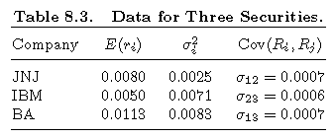
Sample Problem 8.4
This example focuses on the returns and risk of the first three industrial companies, Johnson & Johnson (JNJ), International Business Machines Corp. (IBM), and Boeing Co. (BA), for the period April 2001 to April 2010. The data used are tabulated in Table 8.3.

Slide 42
Sample Problem 8.4
Plugging the data listed in Table 8.3 and E*= 0.00106 into the matrix above yields:
(8.14)
When matrix A is properly inverted and postmultiplied by K, the solution vector is derived:
（8.15）

Slide 43
8.3.4 Portfolio Determination with Specific
Adjustment for Short Selling
The Markowitz model determines optimal asset allocation by minimizing portfolio variance using a constrained optimization procedure:
（8.16）
Subject to:(i) and (ii)

Slide 44
8.3.4 Portfolio Determination with Specific
Adjustment for Short Selling
The Lagrangian function is
（8.17）
Again, derivatives with respect to ’s and ’s are found. Setting these equations equal to zero leaves the following system of equations in matrix form:
（8.18）

Slide 45
8.3.4 Portfolio Determination with Specific
Adjustment for Short Selling
By solving using the identity-matrix technique the weights for the three securities can be obtained in previous problem 8.4:
By using the following relationship to rescale these weights so that the second constraint for the sum of the absolute values of the weights to equal one is satisfied:
(8.19)
Notes:
Results in Page 290 and 292 are incorrect. The results have been corrected in Slides.

Slide 46
8.3.4 Portfolio Determination with Specific
Adjustment for Short Selling
The resealed absolute weights are:
The return on this portfolio is:
The variance:
Notes:
The results in slides are correct. The results in page 292-293 are incorrect.

Slide 47
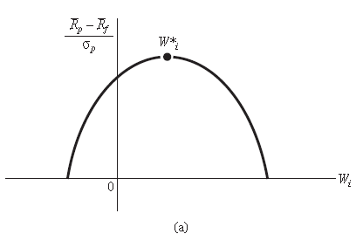
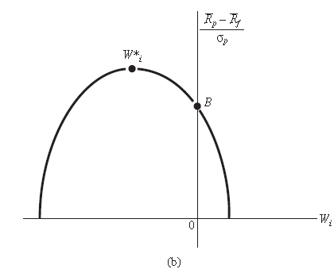
8.3.5 Portfolio Determination without Short Selling
The minimization problem under study can be modified to include the restriction of no short selling by adding a third constraint:
(8.20)
The addition of this non-negativity constraint precludes negative values for the weights (i.e., no short selling).
The problem now is a quadratic programming problem except that the optimal portfolio may fall in an unfeasible region (as shown in Figure 8.9).

Slide 48
8.5 Conclusion
This chapter has focused on the foundations of Markowitz’s model and on derivation of efficient frontier through the creation of efficient portfolios of varying risk and return. It has been shown that an investor can increase expected utility through portfolio diversification as long as there is no perfect positive correlation among the component securities. The extent of the benefit increases as the correlation is lower, and also increases with the number of securities included.
The Markowitz model can be applied to develop the efficient frontier that delineates the optimal portfolios that match the greatest return with a given amount of risk. Also, this frontier shows the dominant portfolios as having the lowest risk given a stated return. This chapter has included methods of solving for the efficient frontier both graphically and through a combination of calculus and matrix algebra, with and without explicitly incorporating short selling.
Next chapters will illustrate how the crushing computational load involved in implementing the Markowitz model can be alleviated through the use of the index portfolio, and how the tenets of the Markowitz efficient frontier are still met.

