Slide 1
Supplement for
Chapter 1
Introduction
By
Cheng Few Lee
Joseph Finnerty
John Lee
Alice C Lee
Donald Wort

Slide 2
Chapter Outline
Financial Markets
The Money Market
The Bond Market
Equity Securities
Derivative Markets
The Mutual Fund Markets
The Hedge Fund Markets
Summary

Slide 3
Introduction
Two important portions of financial markets
Money market: short-term, marketable, liquid, low-risk debt securities. Cash equivalents.
Capital markets: longer term and riskier securities. Subdivided into 1. longer term bond markets, 2. equity markets, and 3. the derivative markets for options and futures.

Slide 4
Introduction
Types of markets at work within the economic system:
1. Factor markets
allocate factors to production—land, labor, and capital—and distribute incomes in the form of wages, rental income, and so on to the owners of productive resources.
2. Product markets
Food, shelter, automobiles, books, theater tickets, gasoline, and swimming pools are among the many goods and services sold in product markets.
3. Financial markets
Money market: Treasury Bills, Certificates of Deposit, Commercial Paper, Bankers’ Acceptances, Eurodollars, Repo and Reverse Repo Market Instruments, Federal Funds, Brokers’ Calls, The Interbank Deposits and The LIBOR Market, and Yields on Money Market Instruments.
Capital market: The Bond Market, Equity Securities, Derivative Markets (Options and Futures), the Mutual Fund Markets, and the Hedge Fund Markets.

Slide 5
FINANCIAL MARKETS
Section A

Slide 6
FINANCIAL MARKETS
These instruments are traded in different financial markets such as
(i) the money markets
(ii) the bond markets
(iii) the equity security markets
(iv) mutual fund markets.

Slide 7
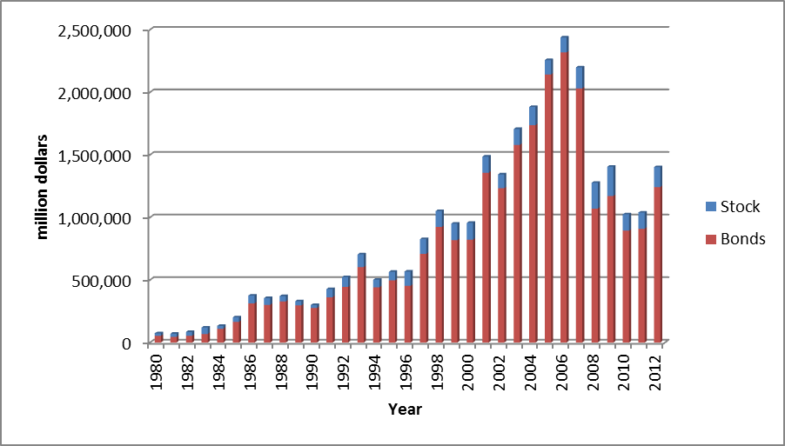
Figure 1.1 and Table 1.1 show that the volume in U.S. capital markets of new issues of traditional financial instruments (bonds and stocks) has more than tripled between 1980 and 1988. Most growth has occurred in debt securities, probably in response to the large decline in interest rates between 1980 and 1988; and common stock has likewise experienced an increase during this period. However, the new issues during 2006 to 2010 experienced a dramatic decrease due to the financial crisis in 2008. Recently, the new issues in 2012 increase up to ante-crisis level.
Figure 1-1 Volume of New Issues Sold in the United States, 1980–2012

Slide 8
Table 1.1 Volume of New Issues Sold in the United States (million dollars)
Year | Stock | Bonds
1980 | 20,489 | 53,206
1981 | 25,349 | 44,642
1982 | 30,562 | 53,226
1983 | 51,579 | 68,370
1984 | 22,628 | 109,903
1985 | 35,515 | 165,754
1986 | 61,830 | 313,502
1987 | 53,349 | 301,349
1988 | 42,455 | 327,864
1989 | 32,203 | 297,114
1990 | 23,441 | 275,760
1991 | 65,268 | 361,971
1992 | 78,457 | 443,911
1993 | 101,554 | 603,119
1994 | 60,398 | 441,287
1995 | 68,473 | 496,296
1996 | 112,546 | 453,963
1997 | 117,880 | 708,188
1998 | 126,755 | 923,771
1999 | 131,568 | 818,683
2000 | 134,917 | 822,012
2001 | 128,554 | 1,356,879
2002 | 110,435 | 1,232,618
2003 | 127,141 | 1,579,311
2004 | 144,603 | 1,737,342
2005 | 115,256 | 2,141,496
2006 | 119,165 | 2,318,379
2007 | 168,654 | 2,030,248
2008 | 206,598 | 1,069,815
2009 | 233,967 | 1,171,218
2010 | 131,135 | 893,717
2011 | 129,489 | 909,109
2012 | 158,933 | 1,242,453
Source: Board of Governors of the Federal Reserve System, Federal Reserve Bulletin (http://www.federalreserve.gov/econresdata/releases/corpsecure/current.htm)

Slide 9
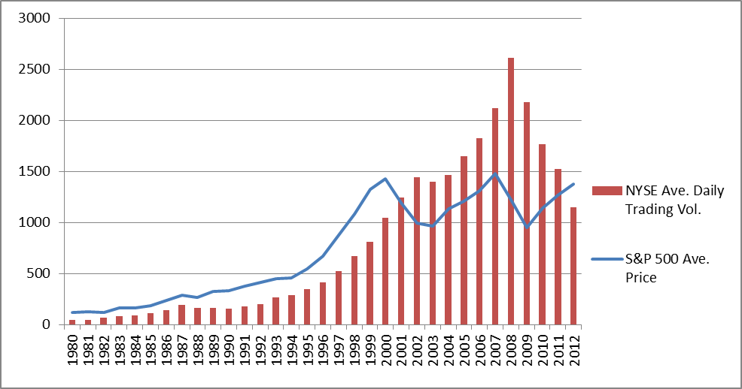
The amount of trading in the secondary market has experienced growth, as shown in Table 1.2 and Figure 1.2. After the highest average daily trading volume in 2008 financial crisis, the daily trading volume declined sharply during 2010 to 2012.
Figure 1.2 Average Daily Trading Volume of NYSE (Million shares) and S&P 500 Annual Price
Source: NYSE Euronext website and Federal Reserve Bank of St. Louis (http://www.nyxdata.com/nysedata/asp/factbook/viewer_edition.asp?mode=table&key=3141&category=3, http://research.stlouisfed.org/fred2/series/SP500/downloaddata)

Slide 10
Table 1.2 Average Daily Trading Volume in NYSE Listed Issues (millions of shares)
Year | Volume
1980 | 44.87
1981 | 46.85
1982 | 65.05
1983 | 85.33
1984 | 90.96
1985 | 109.17
1986 | 141.03
1987 | 188.54
1988 | 161.46
1989 | 165.47
1990 | 156.78
1991 | 178.92
1992 | 202.27
1993 | 264.52
1994 | 291.35
1995 | 346.10
1996 | 412.30
1997 | 525.68
1998 | 673.59
1999 | 809.18
2000 | 1041.58
2001 | 1239.96
2002 | 1441.02
2003 | 1398.40
2004 | 1466.79
2005 | 1647.13
2006 | 1826.67
2007 | 2119.63
2008 | 2609.83
2009 | 2179.78
2010 | 1764.49
2011 | 1523.28
2012 | 1147.18
Source: NYSE Euronext website (http://www.nyxdata.com/nysedata/asp/factbook/viewer_edition.asp?mode=table&key=3141&category=3)

Slide 11
The Money market
Section B
B.1 Treasury Bills
B.2 Certificates of Deposit
B.3 Commercial Paper
B.4 Bankers’ Acceptances
B.5 Eurodollars
B.6 Repo and Reverse Repo Market Instruments
B.7 Federal Funds
B.8 Brokers’ Calls
B.9 The Interbank Deposits and The LIBOR Market
B.10 Yields on Money Market Instruments

Slide 12
Introduction
Money-market instruments: short-term debt instruments with a maturity typically inferior or equal to 1 year.
Three categories of issuers: 1. Government (at both the federal and local levels), 2. Banks and 3. Corporations.
The Central Bank

Slide 13
B.1 Treasury Bills
Treasury Bills are Treasury securities with a maturity below or equal to 1 year
Entail no default risk because they are backed by the full faith and creditworthiness of the government
Bear no interest rate and are quoted using the yield on a discount basis or on a money-market basis depending on the country considered.
Highly liquid
Minimum denominations of $100
Income earned on T-bills is exempt from all state and local taxes

Slide 14
B.1 Treasury Bills
Figure 1.3 is a partial listing of T-bill rates. The asked price is the price you would have to pay to buy a T-bill from a securities dealer. The bid price is the slightly lower price you would receive if you wanted to sell a bill to a dealer. The bid–asked spread is the difference in these prices, which is the dealer’s source of profit. The “Ask Yield” is called the Treasury-bill’s bond-equivalent yield.
Maturity | Days to Maturity | Bid | Asked | Change | Ask Yield
12/20/2012 | 6 | 0.045 | 0.04 | -0.04 | 0.041
12/27/2012 | 13 | 0.05 | 0.035 | -0.035 | 0.035
12/31/2012 | 17 | 0.09 | 0.01 | 0 | 0.01
1/3/2013 | 19 | 0.01 | 0 | -0.01 | 0
1/10/2013 | 26 | 0.01 | 0 | -0.01 | 0
1/17/2013 | 33 | 0.02 | 0.01 | 0.005 | 0.01
1/24/2013 | 40 | 0.015 | 0.005 | 0.005 | 0.005
2/7/2013 | 53 | 0.01 | 0 | 0 | 0
2/14/2013 | 60 | 0.02 | 0.01 | 0.005 | 0.01
2/21/2013 | 67 | 0.015 | 0.005 | -0.005 | 0.005
Source: Compiled from data obtained from The Wall Street Journal Online, December 14, 2012

Slide 15
B.1 Treasury Bills
The first two yields in Figure 1.3 are reported using the bank-discount method.
On December 20 2012, days to maturity are 6 and the yield under the column labeled “Bid” is given as 0.045%.
This means that a dealer was willing to sell the bill at a discount from par value of 0.045% × (6/360) = .00075%.
So a bill with $10,000 par value could be purchased for $10,000 × (1 - .0000075) = $9,999.925.
Similarly, on the basis of the asked yield of 0.04%, a dealer would be willing to purchase the bill for $10,000 × [1 - .0004 × (6/360)] = $9,999.933

Slide 16
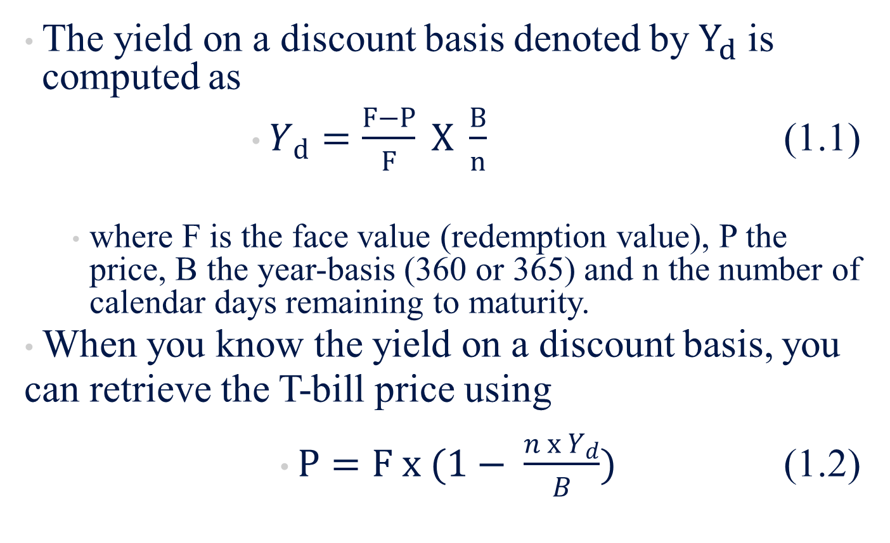
B.1 Treasury Bills
The yield on a discount basis denoted by $Y_{d}$ is computed as
$Y_{d}=\frac{F−P}{F} X \frac{B}{n}$ (1.1)
  where F is the face value (redemption value), P the price, B the year-basis (360 or 365) and n the number of calendar days remaining to maturity.
When you know the yield on a discount basis, you can retrieve the T-bill price using
$P=F x (1− \frac{n x Y_{d}}{B})$ (1.2)

Slide 17
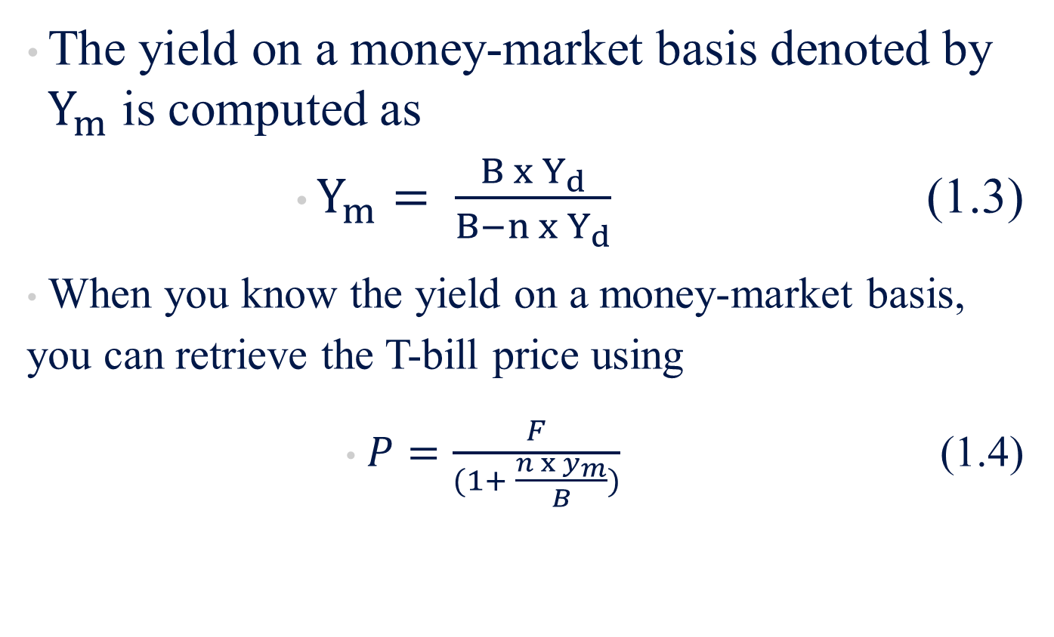
B.1 Treasury Bills
The yield on a money-market basis denoted by $Y_{m}$ is computed as
$Y_{m}= \frac{B x Y_{d}}{B−n x Y_{d}}$ (1.3)
When you know the yield on a money-market basis, you can retrieve the T-bill price using
$P=\frac{F}{(1+ \frac{n x y_{m}}{B})}$ (1.4)

Slide 18
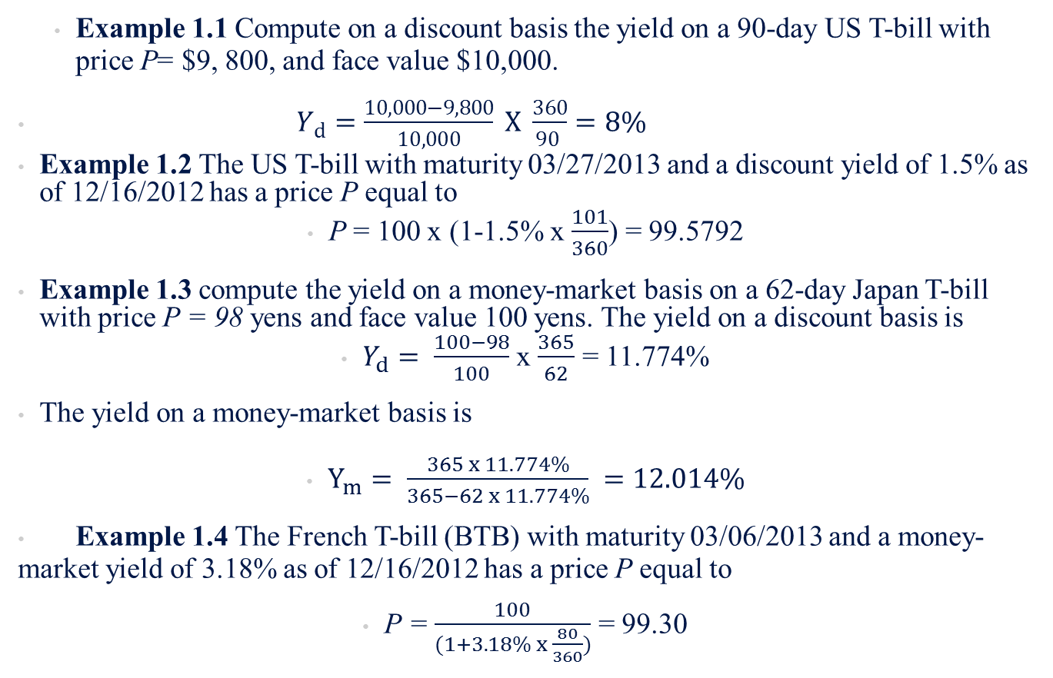
B.1 Treasury Bills
Example 1.1 Compute on a discount basis the yield on a 90-day US T-bill with price P= $9, 800, and face value $10,000.
$Y_{d}=\frac{10,000−9,800}{10,000} X \frac{360}{90 }=8\%$
Example 1.2 The US T-bill with maturity 03/27/2013 and a discount yield of 1.5% as of 12/16/2012 has a price P equal to
P = 100 x (1-1.5% x $\frac{101}{360}$) = 99.5792
Example 1.3 compute the yield on a money-market basis on a 62-day Japan T-bill with price P = 98 yens and face value 100 yens. The yield on a discount basis is
$Y_{d}= \frac{100−98}{100}$ x $\frac{365}{62}$ = 11.774%
The yield on a money-market basis is
$Y_{m}= \frac{365 x 11.774\%}{365−62 x 11.774\%} =12.014\%$
Example 1.4 The French T-bill (BTB) with maturity 03/06/2013 and a money-market yield of 3.18% as of 12/16/2012 has a price P equal to
P = $\frac{100}{(1+3.18\% x \frac{80}{360})}$ = 99.30

Slide 19
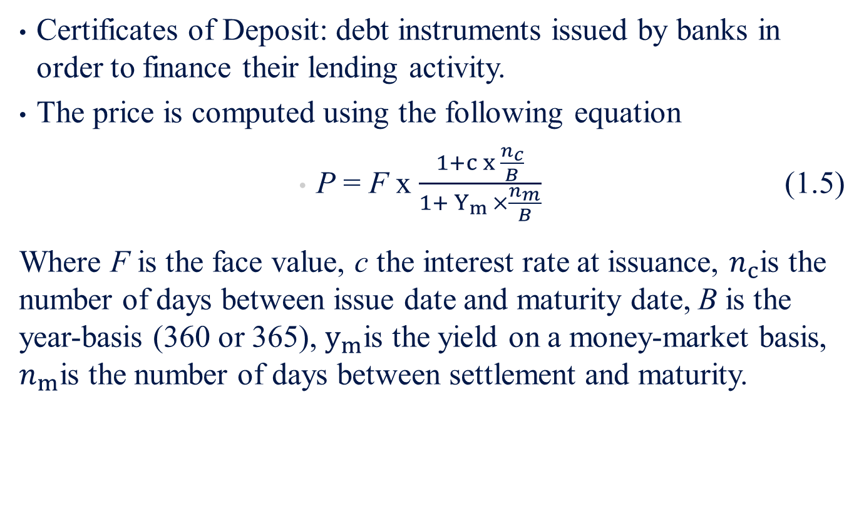
B.2 Certificates of Deposit
Certificates of Deposit: debt instruments issued by banks in order to finance their lending activity.
The price is computed using the following equation
P = F x $\frac{1+c x \frac{n_{c}}{B}}{1+ Y_{m }×\frac{n_{m}}{B}}$ (1.5)
Where F is the face value, c the interest rate at issuance, $n_{c}$is the number of days between issue date and maturity date, B is the year-basis (360 or 365), $y_{m}$is the yield on a money-market basis, $n_{m}$is the number of days between settlement and maturity.

Slide 20
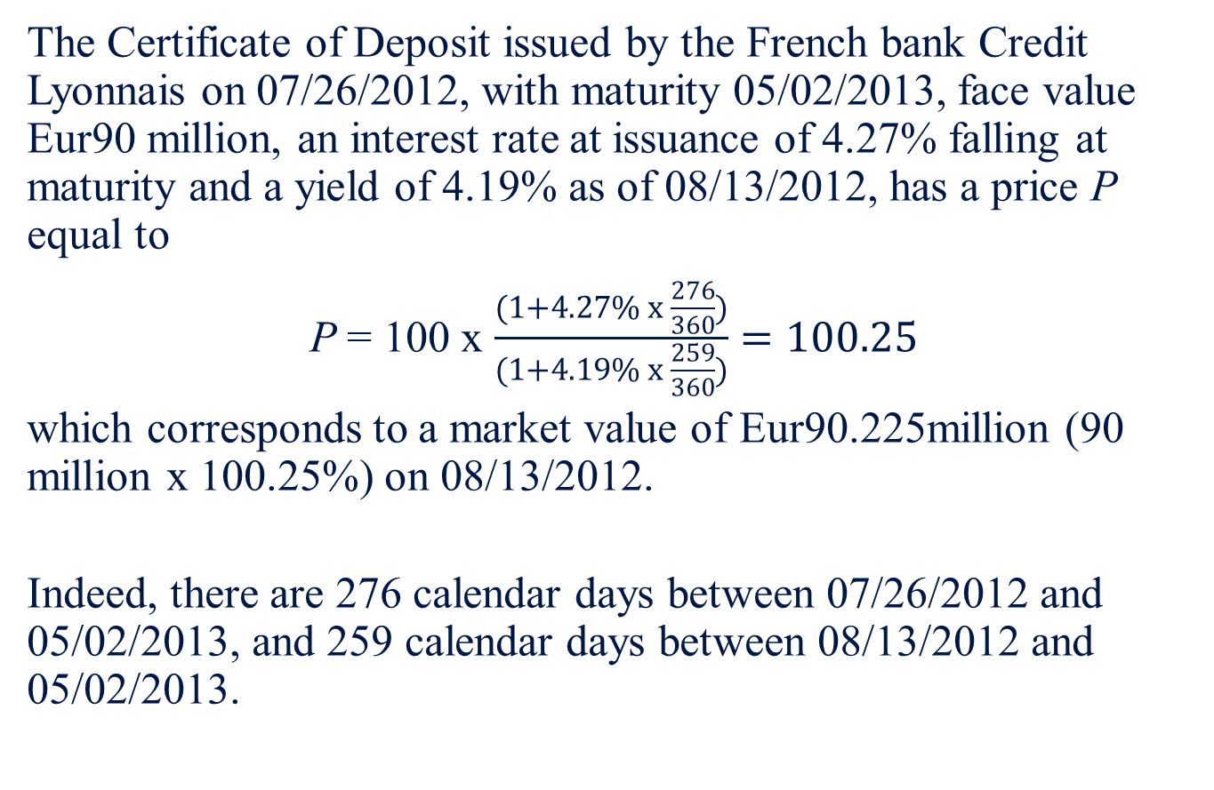
Example 1.5
The Certificate of Deposit issued by the French bank Credit Lyonnais on 07/26/2012, with maturity 05/02/2013, face value Eur90 million, an interest rate at issuance of 4.27% falling at maturity and a yield of 4.19% as of 08/13/2012, has a price P equal to
P = 100 x $\frac{(1+4.27\% x \frac{276}{360})}{(1+4.19\% x \frac{259}{360})}=100.25$
which corresponds to a market value of Eur90.225million (90 million x 100.25%) on 08/13/2012.
Indeed, there are 276 calendar days between 07/26/2012 and 05/02/2013, and 259 calendar days between 08/13/2012 and 05/02/2013.

Slide 21
B.3 Commercial Paper
Commercial papers: unsecured short-term debt securities issued by corporations including industrial and financial companies.
Maturities range from 2 to 270 days
Usually issued in multiples of $100,000
Bear no interest rate
Traded on a discount basis in the United States and on a money-market basis in the Euro area
Entail the credit risk of the issuing entity
Corporations typically use them either as a way of raising short-term funds or as interim loans to finance long-term projects while awaiting more attractive long-term capital market conditions, called bridge financing

Slide 22
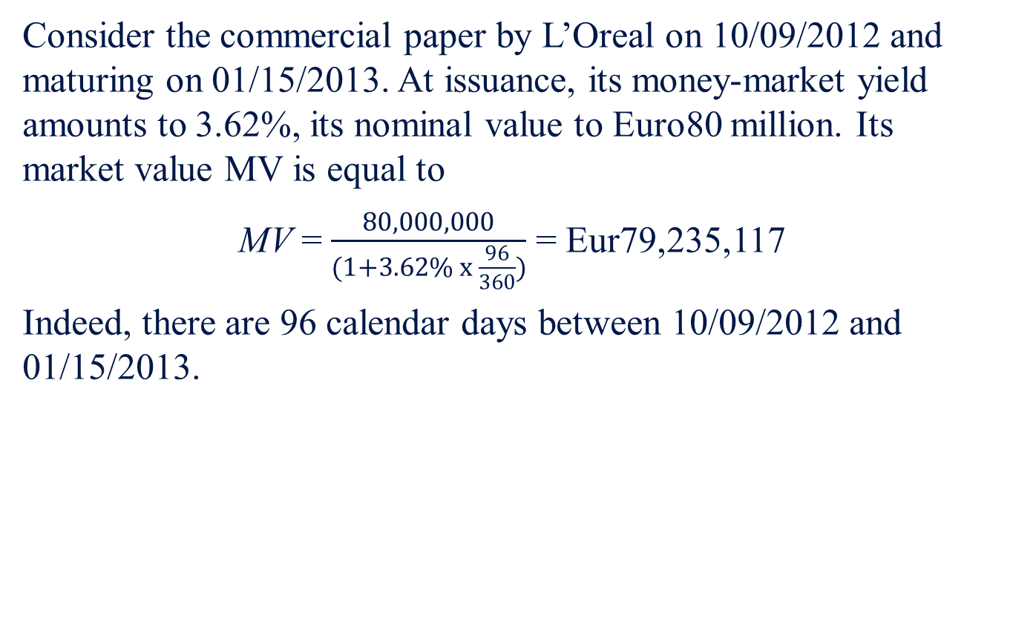
Example 1.6
Consider the commercial paper by L’Oreal on 10/09/2012 and maturing on 01/15/2013. At issuance, its money-market yield amounts to 3.62%, its nominal value to Euro80 million. Its market value MV is equal to
MV = $\frac{80,000,000}{(1+3.62\% x \frac{96}{360})}$ = Eur79,235,117
Indeed, there are 96 calendar days between 10/09/2012 and 01/15/2013.

Slide 23
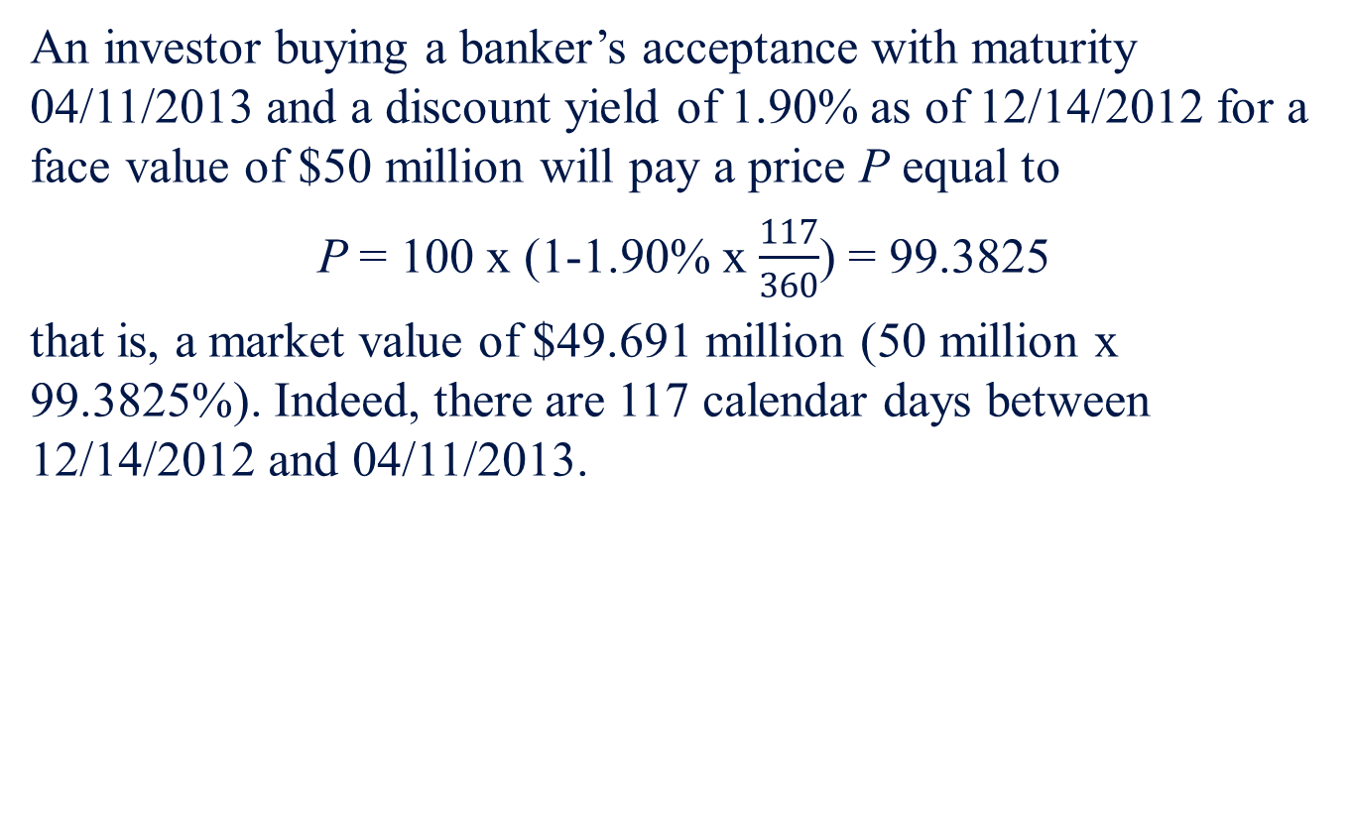
Example 1.7
An investor buying a banker’s acceptance with maturity 04/11/2013 and a discount yield of 1.90% as of 12/14/2012 for a face value of $50 million will pay a price P equal to
P = 100 x (1-1.90% x $\frac{117}{360}$) = 99.3825
that is, a market value of $49.691 million (50 million x 99.3825%). Indeed, there are 117 calendar days between 12/14/2012 and 04/11/2013.

Slide 24
B.5 Eurodollars
Eurodollars: dollar-denominated deposits at foreign banks or foreign branches of American banks.
Need not be in European banks, although that is where the practice of accepting dollar-denominated deposits outside the United States began.

Slide 25
B.6 Repo and Reverse Repo Market Instruments
Repurchase (repo) and reverse repurchase (reverse repo) agreement transactions are commonly used by traders and portfolio managers to finance either long or short positions (usually in government securities).
A repo is for an investor a means to lend bonds in exchange for a loan of money, while a reverse repo is a means for an investor to lend money in exchange for a loan of securities
Overnight repo: When the maturity of the loan is 1 day
Term repo: When the maturity exceeds 1 day
Repos are considered very safe in terms of credit risk because the loans are backed by the government securities

Slide 26
Example 1.8 – Example of a repo transaction
An investor lends Eur1 million of the 10-year Bund benchmark bond (i.e., the Bund 6% 07/05/2023 with a quoted price of 105.23, on 03/29/2013) over 1 month at a repo rate of 5%. There is 117 days accrued interest as of the starting date of the transaction.
At the beginning of the transaction, the investor will receive an amount of cash equal to the gross price of the bond times the nominal of the loan, that is,
(105.23% + 6% x 117/360) x 1,000,000 = Eur1,071,800
At the end of the transaction, in order to repurchase the securities he will pay the amount of cash borrowed plus the repo interest due over the period, that is,
1,071,800 x (1+ 5% x 30/360) = Eur1,076,265.8

Slide 27
Example 1.9 Financing a Long Position
An investor wants to finance a long position of Eur1 million Bund with coupon 6% and maturity date 07/05/2023.
He can purchase these securities and then lend them through a repo transaction, like the one that has just been described. He will use the resulting borrowed cash to pay for them. On the one hand, the investor will gain the coupon income times the nominal amount of the securities he owns, that is, he will gain 6% x 1,000,000/360 = Eur166.67 a day. On the other hand, he will lose the repo rate times the borrowed amount of cash, which is equal to the full price of the bond securities times the nominal amount, that is, he will lose 1,071,800 x 5%/360 = Eur 148.86 a day. His net gain per day equals 166.67 – 148.86 = Eur 17.81

Slide 28
Example 1.10 Financing a Short Position
An investor has to make delivery of Eur 1 million Bund on his short sale position. He can borrow the securities through a reverse repo transaction and then lend the money resulting from the short sale to the repo desk as collateral. Suppose the reverse repo is 5%. On the one hand, the investor will gain the reverse repo rate times the lent amount of cash, which is equal to the full price of the bond securities times the nominal amount. On the other hand, he will lose the coupon income times the nominal amount of the securities sold. His net loss per day amounts to Eur 17.81.

Slide 29
B.6 Repo and Reverse Repo Market Instruments
From an investment point of view, the repo market offers several opportunities:
The opportunity of contracting less expensive loans than traditional bank loans (because repo loans are secured loans).
The opportunity of investing in a very liquid short-term market.
The opportunity of investing cash over tailor-made horizons, by rolling over either several overnight transactions or different repo transactions with various maturity horizons. This is particularly attractive for an investor who has a short-term undefined horizon. It allows him to avoid the price risk he would incur if he had chosen to invest in a money-market security.
The opportunity for a buy-and-hold investor of putting idle money to work. Indeed, by lending the securities he owns in his portfolio, he receives some cash that he can invest in a money-market instrument. His gain will be the difference between the money-market income and the repo cost.
The opportunity to take short positions that enable portfolio managers to construct alternative strategies by combining long and short positions

Slide 30
B.7 Federal Funds
Banks maintain deposits of their own at a Federal Reserve bank. called federal funds, or fed funds
Banks with excess funds lend to those with a shortage, at a rate of interest called the federal funds rate

Slide 31
B.8 Brokers’ Calls
Individuals who buy stocks on margin borrow part of the funds to pay for the stocks from their broker. The broker in turn may borrow the funds from a bank, agreeing to repay the bank immediately (on call) if the bank requests it. The rate paid on such loans is usually about 1% higher than the rate on short-term T-bills.

Slide 32
B.9 The Interbank Deposits and The LIBOR Market
Interbank deposits: are short-term deposits made between banks, which use them to place surplus funds.
London Interbank Offered Rate (LIBOR): the rate at which large banks in London are willing to lend money among themselves, quoted on dollar- denominated loans.
European Interbank Offered Rate (EURIBOR): rate at which banks in the euro zone are willing to lend euros among themselves.

Slide 33
Example 1.11
Consider an investor who deposits $100 million on 12/15/2012 at an interest rate of 4.35% until 03/15/2013. At maturity, he receives the amount of its deposit plus, the interest earned over the period, that is,
$100 million x (1+ 3.35% x 90/360 )
= $101.0875 million

Slide 34
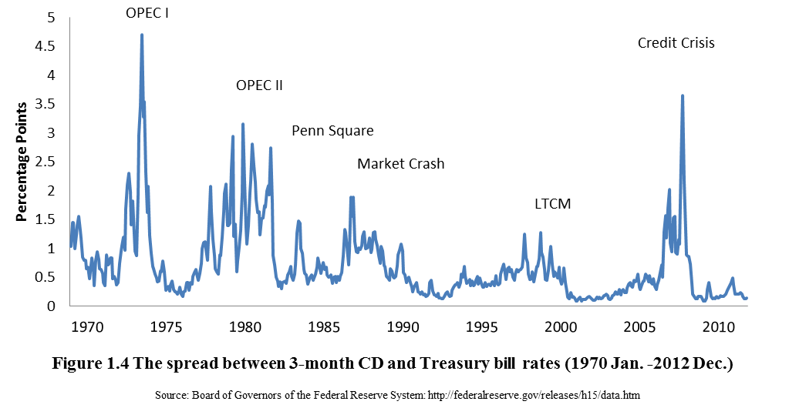
B.10 Yields on Money Market Instruments
Figure 1.4 shows that bank CDs, for example, consistently have paid a premium over T-bills, and that premium increased with economic crises.

Slide 35
The BOND market
Section C
C.1 Treasury Notes and Bonds
C.2 Inflation-Protected Treasury Bonds
C.3 Federal Agency Debt
C.4 International Bonds
C.5 Municipal Bonds
C.6 Corporate Bonds
C.7 Mortgages and Mortgage-Backed Securities

Slide 36
C. The BOND market
Bond: long-term fixed obligation of an issuer
Bond market includes: Treasury notes and bonds, corporate bonds, municipal bonds, mortgage securities, and federal agency debt
Types of bond issuers: U.S. Treasury, federal agencies, municipalities, and corporations

Slide 37
C.1 Treasury Notes and Bonds
The U.S. government borrows funds in large part by selling Treasury notes and Treasury bonds
Both notes and bonds make semiannual interest payments called coupon payments

Slide 38
C.1 Treasury Notes and Bonds
Figure 1.5 is a listing of Treasury issues. Notice the highlighted note that matures in May 31, 2013. The coupon income, or interest, paid by the note is 0.5% of par value, meaning that a $1,000 face-value note pays $5.0 in annual interest in two semiannual installments of $2.5 each. The bid price of the note is 100.1797 and the asked price is 100.1875. Although notes and bonds are sold in denominations of $1,000 par value, the prices are quoted as a percentage of par value. Thus the bid price of 100.1797 should be interpreted as 100.1797% of par, or $1,001.797, for the $1,000 par value security. Similarly, the note could be bought from a dealer for $1,001.875. The 0.0078 change means the closing price on this day increase 0.0078 (as a percentage of par value) from the previous day’s closing price. Finally, the yield to maturity on the note based on the asked price is 0.086%.
Figure 1.5 Listing of Treasury bonds and notes
U.S. Government Bonds and Notes
Maturity | Coupon | Bid | Asked | Chg | Asked yield
5/15/2013 | 3.625 | 101.4375 | 101.4609 | -0.0391 | 0.074
5/31/2013 | 0.500 | 100.1797 | 100.1875 | 0.0078 | 0.086
5/31/2013 | 3.500 | 101.5234 | 101.5469 | -0.0313 | 0.086
Source: Compiled from data obtained from the Wall Street Journal Online, December 14, 2012

Slide 39
C.2 Inflation-Protected Treasury Bonds
In the United States inflation-protected Treasury bonds are called TIPS (Treasury Inflation-Protected Securities).
The principal amount on these bonds is adjusted in proportion to increases in the Consumer Price Index.
Therefore, they provide a constant stream of income in real (inflation-adjusted) dollars. Yields on TIPS bonds should be interpreted as real or inflation-adjusted interest rates.

Slide 40
C.3 Federal Agency Debt
Some government agencies issue their own securities to finance their activities.
The major mortgage-related agencies are the Federal Home Loan Bank (FHLB), the Federal National Mortgage Association (FNMA, or Fannie Mae), the Government National Mortgage Association (GNMA, or Ginnie Mae), and the Federal Home Loan Mortgage Corporation (FHLMC, or Freddie Mac).

Slide 41
C.4 International Bonds
Eurobond: a bond denominated in a currency other than that of the country in which it is issued e.g. a dollar-denominated bond sold in Britain
Think of them simply as international bonds.
In contrast to bonds that are issued in foreign currencies, many firms issue bonds in foreign countries but in the currency of the investor.
For example, a Yankee bond is a dollar-denominated bond sold in the United States by a non-U.S. issuer.

Slide 42
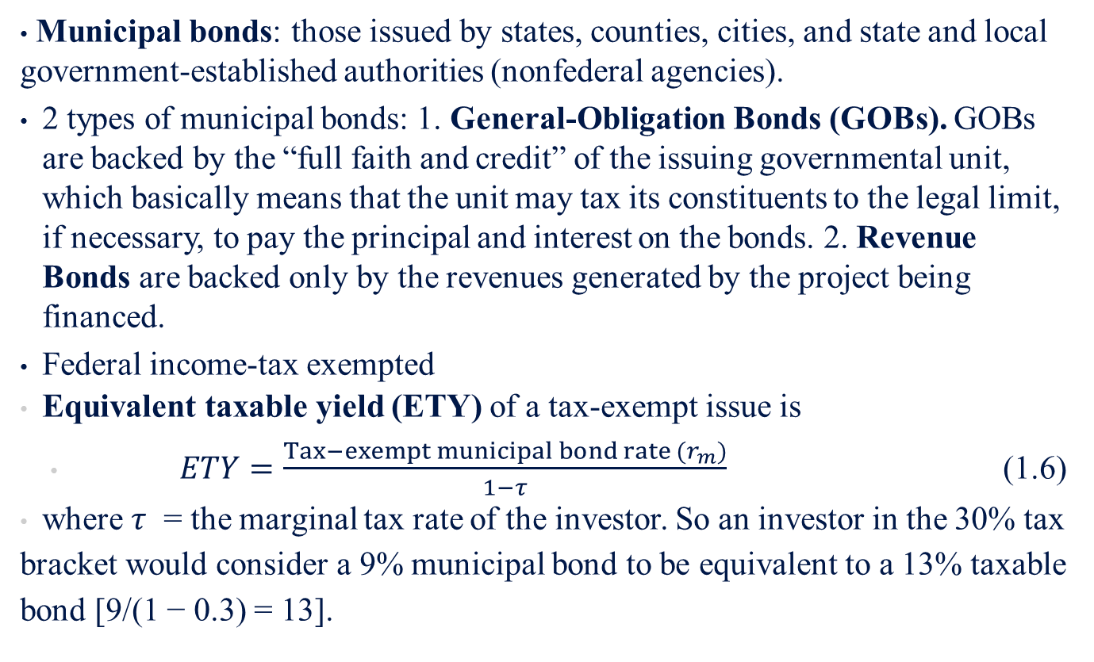
C.5 Municipal Bonds
Municipal bonds: those issued by states, counties, cities, and state and local government-established authorities (nonfederal agencies).
2 types of municipal bonds: 1. General-Obligation Bonds (GOBs). GOBs are backed by the “full faith and credit” of the issuing governmental unit, which basically means that the unit may tax its constituents to the legal limit, if necessary, to pay the principal and interest on the bonds. 2. Revenue Bonds are backed only by the revenues generated by the project being financed.
Federal income-tax exempted
Equivalent taxable yield (ETY) of a tax-exempt issue is
$ETY=\frac{Tax−exempt municipal bond rate (r_{m})}{1−τ}$ (1.6)
where $τ$ = the marginal tax rate of the investor. So an investor in the 30% tax bracket would consider a 9% municipal bond to be equivalent to a 13% taxable bond [9/(1 − 0.3) = 13].

Slide 43
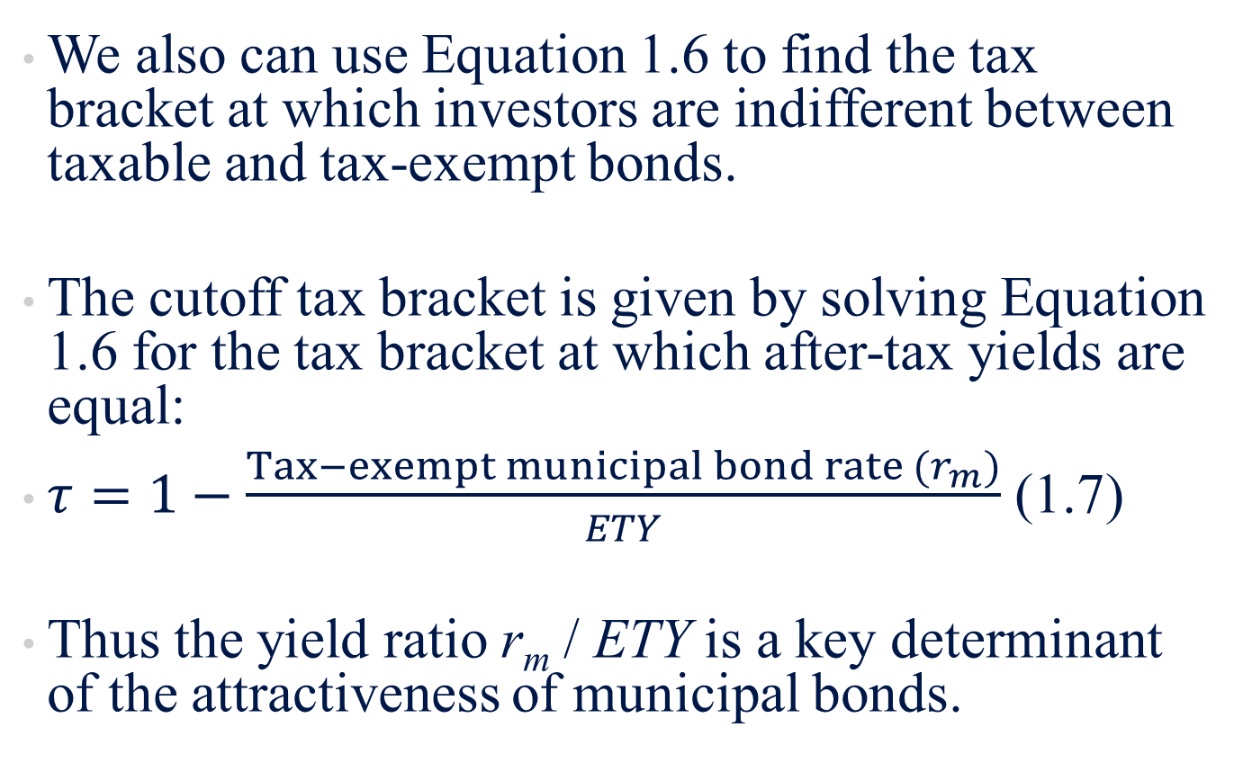
C.5 Municipal Bonds
We also can use Equation 1.6 to find the tax bracket at which investors are indifferent between taxable and tax-exempt bonds.
The cutoff tax bracket is given by solving Equation 1.6 for the tax bracket at which after-tax yields are equal:
$τ=1−\frac{Tax−exempt municipal bond rate (r_{m})}{ETY}$ (1.7)
Thus the yield ratio r_{m} / ETY is a key determinant of the attractiveness of municipal bonds.

Slide 44
Example 1.12 Taxable versus Tax-Exempt Yields
Figure 1.6 shows that in recent years, the ratio of tax-exempt to taxable yields has fluctuated around .85. Equation 1.7 shows that an investor whose tax bracket (federal plus local) exceeds 1 - .85 = .15, or 15%, will derive a greater after-tax yield from municipals. Note, however, that it is difficult to control precisely for differences in the risks of these bonds, so the cutoff tax bracket must be taken as approximate.

Slide 45
C.6 Corporate Bonds
Corporate bonds are the means by which private firms borrow money directly from the public
Secured bonds: have specific collateral backing them in the event of firm bankruptcy
Unsecured bonds (debentures): have no collateral; and subordinated debentures, which have a lower priority claim to the firm’s assets in the event of bankruptcy.
Callable bonds give the firm the option to repurchase the bond from the holder at a stipulated call price.
Convertible bonds give the bondholder the option to convert each bond into a stipulated number of shares of stock.

Slide 46
C.7 Mortgages and Mortgage-Backed Securities
A mortgage-backed security is either an ownership claim in a pool of mortgages or an obligation that is secured by such a pool.
These claims represent securitization of mortgage loans.

Slide 47
Equity Securities
Section D
D.1 Common Stock as Ownership Shares
D.2 Characteristics of Common Stock
D.3 Stock Market Listings
D.4 Preferred Stock
D.5 Depository Receipts
D.6 Stock Market Indexes
D.7 Bond Market Indicators

Slide 48
D.1 Common Stock as Ownership Shares
Common stocks, also known as equity securities or equities, represent ownership shares in a corporation.
Each share of common stock entitles its owner to one vote on any matters of corporate governance that are put to a vote at the corporation’s annual meeting and to a share in the financial benefits of ownership

Slide 49
D.2 Characteristics of Common Stock
The two most important characteristics of common stock as an investment are its residual claim and limited liability features.
Residual claim means that stockholders are the last in line of all those who have a claim on the assets and income of the corporation.
Limited liability means that the most shareholders can lose in the event of failure of the corporation is their original investment.

Slide 50
D.3 Stock Market Listings
Figure 1.7 List of stocks traded on the NYSE
Name | Symbol | Open | High | Low | Close | Net Change | % Change | Volume | 52 WK High | 52 WK Low | Div | Yield | P/E | YTD % Change
Johnson&Johnson | JNJ | 70.62 | 70.86 | 70.49 | 70.69 | -0.06 | -0.08 | 10,042,260 | 72.74 | 61.71 | 2.44 | 3.45 | 23.25 | 7.79
JPMorgan Chase | JPM | 42.77 | 43.11 | 42.71 | 42.81 | 0.03 | 0.07 | 15,931,537 | 46.49 | 30.42 | 1.20 | 2.80 | 8.94 | 28.75
JPMorgan Chase Wt | JPM% | 11.84 | 11.95 | 11.84 | 11.93 | 0.03 | 0.25 | 18,017 | 14.44 | 8.10 | ... | ... | ... | 40.35
Source: Compiled from data from TheWall Street Journal Online, December 14, 2012
The table provides the ticker symbol (JNJ), the closing price of the stock ($70.69), and its change (-$.06) from the previous trading day. About 10 million shares of JNJ traded on this day. The listing also provides the highest and lowest price at which JNJ has traded in the last 52 weeks.
The 2.44 value in the Dividend column means that the last quarterly dividend payment was $.61 per share, annual dividend payments is $.61× 4 = $2.44 and an annual dividend yield is 2.44/70.69 = .0345, or 3.45%.
The P/E ratio, or price–earnings ratio, is the ratio of the current stock price to last year’s earnings per share.

Slide 51
D.4 Preferred Stock
Preferred stock has features similar to both equity and debt.
Like a bond, it promises to pay to its holder a fixed amount of income each year. In this sense preferred stock is similar to an infinite-maturity bond, that is, a perpetuity.
Like a equity, the firm retains discretion to make the dividend payments to the preferred stockholders; it has no contractual obligation to pay those dividends. Instead, preferred dividends are usually cumulative.
Preferred stock is issued in variations similar to those of corporate bonds. It may be callable by the issuing firm, in which case it is said to be redeemable.

Slide 52
D.5 Depository Receipts
American Depository Receipts, or ADRs, are certificates traded in U.S. markets that represent ownership in shares of a foreign company.
Each ADR may correspond to ownership of a fraction of a foreign share, one share, or several shares of the foreign corporation.
ADRs were created to make it easier for foreign firms to satisfy U.S. security registration requirements.
They are the most common way for U.S. investors to invest in and trade the shares of foreign corporations.

Slide 53
D.6 Stock Market Indexes
Market-index values have also been commonly used to provide insights into such economic variables as the growth of economic output and corporate returns.
In this section, we will introduce
  Dow Jones Industrial Average (DJIA)
  Standard & Poor’s Composite 500 (S&P 500) stock index
  Quantity-Weighted Indexes
  Foreign and International Stock Market Indexes

Slide 54
D.6.1 Dow Jones Averages (DJIA)
DJIA is called a price-weighted average.
The computation involves summing the current prices of the 30 stocks and then dividing by a divisor that is adjusted to allow for any stock splits or large stock dividends:
DJIA = (1.8)

Slide 55
D.6.2 Standard & Poor’s Indexes
The Standard & Poor’s Composite 500 (S&P 500) is a value-weighted index of 400 industrial stocks, 40 utility stocks, 20 transportation stocks, and 40 financial stocks:
(1.9)
The base period is 1941–1943

Slide 56
D.6.4 Quantity-Weighted Indexes
Two classical forms of quantity-weighted indexes are the Paasche index and the Laspeyres index which can be defined as
Laspeyres price index (1.10)
Paasche price index (1.11)

Slide 57
Example 1.14
The data in Tables 1.4 and 1.5 indicate the price and volume of four pharmaceutical companies:
The total cost of purchasing the quantities in first week (base period) and second week are
Laspeyres price index (Eq 1.10) is 100(2,761.00/2,704.08)=102.10
Table 1.4 Prices of Stock in Four Pharmaceutical Corporations for the First 12 Weeks of 2013, with the Unweighted Aggregate Index of Prices
Week | Date | JNJ | MRK | PFE | BMY | Average | Index of Average
1 | 2013/1/2 | 70.45 | 41.19 | 25.32 | 32.81 | 42.44 | 100.00
2 | 2013/1/7 | 71.24 | 42.43 | 25.86 | 33.58 | 43.28 | 101.97
Table 1.5 Volume of Transactions in Shares of Four Pharmaceutical Corporations for the First 12 Weeks of 2013 (million shares)
Week | Date | JNJ | MRK | PFE | BMY
1 | 2013/1/2 | 11.37 | 18.31 | 31.96 | 10.36
2 | 2013/1/7 | 8.94 | 12.29 | 30.59 | 8.49

Slide 58
Example 1.14
The Paasche price index for the second week is calculated as follows:
The total cost of purchasing in the second week was:
The cost of purchasing had the demand stayed the same as the first week would be:
Substituting these numbers into Equation 1.11, the Paasche price index for the second week is:

Slide 59
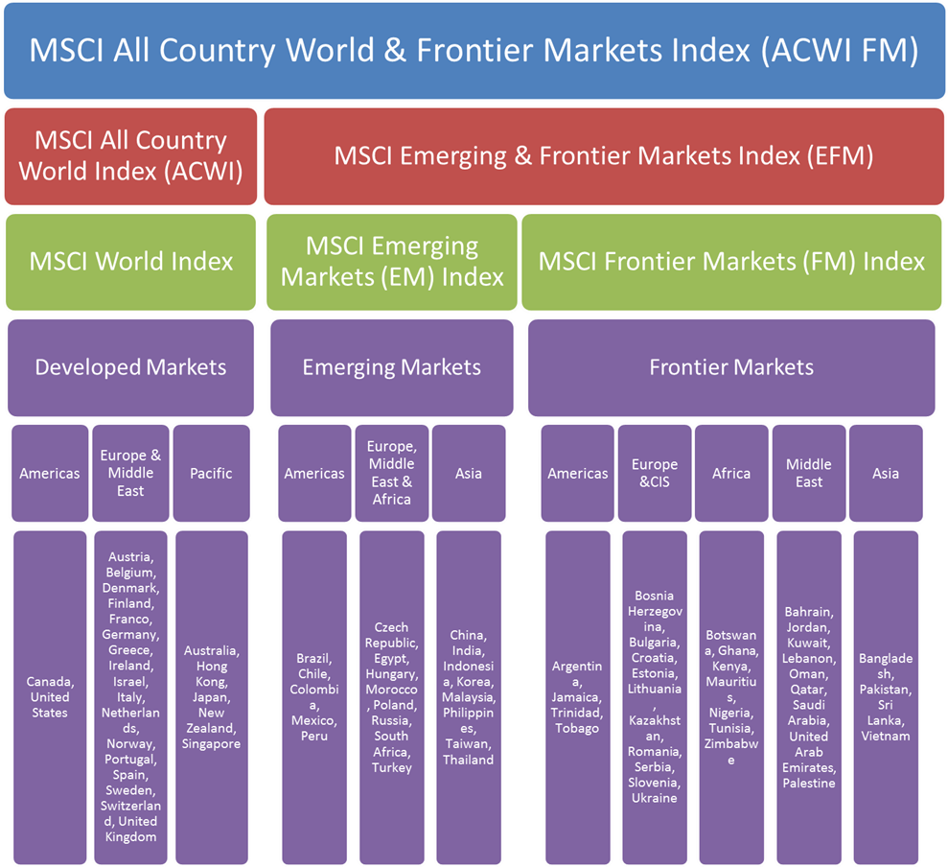
D.6.5 Foreign and International Stock Market Indexes
A leader in the construction of international indexes has been MSCI (Morgan Stanley Capital International), which computes over 50 country indexes and several regional indexes (Fig. 1.9).

Slide 60
D.7 Bond Market Indicators
Just as stock market indexes provide guidance concerning the performance of the overall stock market, several bond market indicators measure the performance of various categories of bonds.
The three most well-known groups of indexes are those of Merrill Lynch, Barclays (formerly, Barclays Capital Aggregate Bond Index which used to be called the Lehman Aggregate Bond Index), and Salomon Smith Barney (now part of Citigroup).
Most bonds are not listed on the major exchanges but trade in the over-the-counter market (OTC).

Slide 61
Derivative Markets
Section E
E.1 Futures Contracts
E.2 Options

Slide 62
E.1 Futures Contracts
A key element necessary for the existence of futures markets is the balance between the number of hedgers and speculators who are willing to transfer and accept risk.
A future contract is a standardized legal agreement between a buyer and a seller, who promise to exchange a specified amount of money for goods or services at a future time.
The long position is held by the trader who commits to purchasing the asset on the delivery date. The trader who takes the short position commits to delivering the asset at contract maturity.

Slide 63
E.1 Futures Contracts
Figure 1.10 Corn Futures prices in the Chicago Board of Trade
Month | Last | Chg | Open | High | Low | Volume | Open int.
Mar 2013 | 724’0 | -6’6 | 732’0 | 734’6 | 721’2 | 72845 | 587554
May 2013 | 727’4 | -6’2 | 734’6 | 737’4 | 724’4 | 17208 | 182691
Jul 2013 | 725’0 | -5’2 | 731’0 | 733’0 | 721’6 | 12074 | 146943
Sep 2013 | 643’2 | -6’2 | 650’4 | 653’0 | 642’2 | 2230 | 39441
Dec 2013 | 622’0 | -6’0 | 628’0 | 632’6 | 621’2 | 10032 | 189282
Mar 2014 | 630’4 | -6’0 | 637’2 | 640’0 | 630’4 | 260 | 4704
May 2014 | 636’4 | -6’2 | 645’0 | 645’6 | 636’4 | 56 | 1396
Jul 2014 | 637’6 | -6’4 | 647’0 | 647’0 | 637’6 | 68 | 1342
Sep 2014 | 597’0 | -3’0 | 600’0 | 600’0 | 597’0 | 16 | 106
Dec 2014 | 595’0 | -3’0 | 598’0 | 600’0 | 595’0 | 200 | 8243
Source: The Wall Street Journal Online, December 17, 2012
The first row is for the nearest term or “front” contract, with maturity in March 2013. The most recent price was $7.24 per bushel. That price is down $ .0675 from yesterday’s close.
Each contract calls for delivery of 5,000 bushels

Slide 64
E.2 Options
A call option gives its holder the right to purchase an asset for a specified price, called the exercise or strike price, on or before a specified expiration date.
In contrast, a put option gives its holder the right to sell an asset for a specified exercise price on or before a specified expiration date.
Figure 1.11 Trading data on Johnson & Johnson Options
December 17, 2012
Johnson & Johnson (JNJ) Underlying stock price: 70.96
Expiration | Call |  |  |  |  |  | Strike | Put
 | Last | Chg | Bid | Ask | Volume | Open Int. |  | Last | Chg | Bid | Ask | Volume | Open Int.
Dec 2012 | 3.50 | +0.35 | 3.45 | 3.55 | 3 | 626 | 67.50 | 0.03 | 0.00 | 0.02 | 0.04 | 1 | 9402
Dec 2012 | 1.03 | +0.28 | 1.04 | 1.10 | 10293 | 15316 | 70.00 | 0.09 | -0.08 | 0.09 | 0.10 | 735 | 7237
Dec 2012 | 0.03 | -0.03 | 0.03 | 0.01 | 99 | 10240 | 72.50 | 1.57 | -0.39 | 1.53 | 1.59 | 113 | 1399
Jan 2013 | 3.57 | +0.37 | 3.55 | 3.65 | 287 | 23980 | 67.50 | 0.11 | -0.02 | 0.10 | 0.12 | 240 | 72991
Jan 2013 | 1.42 | +0.21 | 1.41 | 1.43 | 313 | 70004 | 70.00 | 0.46 | -0.15 | 0.46 | 0.47 | 444 | 10940
Jan 2013 | 0.27 | +0.03 | 0.25 | 0.27 | 1188 | 33215 | 72.50 | 1.82 | -0.32 | 1.78 | 1.83 | 308 | 7645
Mar 2013 | 6.20 | +0.65 | 6.05 | 6.15 | 3 | 2418 | 65.00 | 0.26 | -0.07 | 0.25 | 0.26 | 235 | 25415
Mar 2013 | 3.85 | +0.30 | 3.80 | 3.85 | 53 | 47303 | 67.50 | 0.57 | -0.14 | 0.56 | 0.58 | 179 | 12726
Mar 2013 | 1.92 | +0.20 | 1.89 | 1.92 | 416 | 13686 | 70.00 | 1.34 | -0.18 | 1.31 | 1.33 | 120 | 5866

Slide 65
The Mutual Fund Markets
Section F

Slide 66
The Mutual Fund Markets
Mutual funds are one of the most important investments for individual investors.
The investment objectives of mutual funds can be classified into four categories as (1) Growth, (2) Income and growth, (3) Income and (4) Income, growth, and stability (balanced fund).
Based upon investment policy, mutual funds can also be classified into: 1. money market funds, 2. equity funds, 3. sector funds, 4. bond funds, 5. international funds, 6. balanced funds, 7. asset allocation and flexible funds and 8. index funds.

Slide 67
F. The Mutual Fund Markets
The balanced funds offer a complete investment program to their clients, so far as marketable securities are concerned. Their portfolios are presumably structured to include bonds and stocks in a ratio considered appropriate for an average individual investor given the return outlook for each sector and possibly a risk and volatility constraint.
Growth funds are structured to include a well-diversified combination of common stocks.
Income funds are composed of well-diversified selection of bonds. Empirical studies of long-term bond returns have indicated a widely diversified list of medium-quality bonds that have been superior to high-quality bonds.
Income-and-growth funds are composed of a combination of common stock and bonds. Whether the emphasis is on income or growth determines what percentage of bonds or common stock is in the portfolio.

Slide 68
The Hedge Fund Markets*
Section G
*This portion is contributed by John Longo, Finance & Economics Department, Rutgers Business School. Source: The material in this segment is adapted from the J. Longo, “Hedge Funds: Overview, Strategies, and Trends,” in Encyclopedia of Finance, 2nd Edition, Ed. C.F. Lee and A. Lee, Springer, 2013

Slide 69
G. The Hedge Fund Markets
Hedge funds are quite likely the most important investment vehicles in the financial markets today since they control roughly $2 trillion in assets and account for the bulk of trading volume across many asset classes.
In order to get some sense of how a hedge fund may work, it may be helpful to discuss the original hedge fund exposure model created by A.W. Jones. His fund commenced in 1949 and lost capital in only three of the thirty-four years of its operation. Jones’ Model may be expressed as follows:
Net Exposure (%) = ($ Long - $ Short) / $ Equity (1.12)
where:
$ Long = the dollar value of long positions held by the fund
$ Short = the dollar value of short positions held by the fund
$ Equity = the net equity in the fund

Slide 70
SUMMARY
Section H

Slide 71
H. SUMMARY
In this chapter, we first discuss financial markets, and then we discuss several markets as follows.
In money market section, we discuss Treasury bills, certificates of deposit, commercial papers and bankers’ acceptances.
In the bond market section, we include treasury notes and bonds, inflation-protected treasury bonds, federal agency debt, international bonds, municipal bonds, corporate bonds, and mortgages and mortgage-backed securities.
In equity securities section, we discuss common stock as ownership shares, characteristics of common stock, stock market listings, preferred stock, depository receipts, stock market indexes and bond market indicators.
Furthermore, option and future contracts and the examples are illustrated in derivative markets section.
The mutual fund markets section includes balanced funds, growth funds, income funds, and income-and-growth funds.
Finally, we discuss hedge fund exposure model in the hedge fund markets section to show how a hedge fund may work.

