Slide 1
Supplement Chapter 2
Raising Equity Capital and Trading Equity Securities
(Supplement material
for Chapter 3)

Slide 2
Chapter Outline
A. Trends in Long-Term Financing
B. Equity for a Private Firm
  I. Staying Private
  II. Going Public
  III. Some Recent Innovations
C. The Process of Going Public
  I. Working Group
  II. Structuring the Offer
  III. Role of the Investment Bank
D. The Cost of Going Public
E. Seasoned Equity Issues
  I. Selling to the Public
  II. Block Sales to Private Party
  III. Rights Offering
F. How Securities Are Traded
  I. Type of Trading Market
  II. Types of Orders
  III. Trading Systems
G. U.S. Securities Markets and Market Structure in Other Countries
  I. U.S. Securities Markets
  II. Market Structure in Other Countries
H. Trading Cost
I. Buying on Margin
  I. Short Sales
  II. Regulation of Securities Markets
J. Summary

Slide 3
A. Trends in Long-Term Financing
Each year, the manager must answer the questions:
  Should we finance this year’s long-term projects with debt or equity?
  Should we ration our capital and finance only the most attractive projects with this year’s addition to retained earnings?
After the decision is made, the manager must decide the external funds, if any, it will raise this year.
We will be discussing the process of raising capital in the equity market.
Table 2.1 shows aggregate sources and uses of income for U.S. corporations during 2004-2011.

Slide 4
Table 2.1 Sources and Uses of Private Enterprise Income: 2004-2011 (in billions)
 | 2004 | 2005 | 2006 | 2007 | 2008 | 2009 | 2010 | 2011
Uses of private enterprise income
Income payments on assets | 2169.5 | 2707.7 | 3439 | 3996.6 | 3703.4 | 2628 | 2413.9 | 2352.4
Business current transfer payments (net) | 81.7 | 95.9 | 83 | 103.3 | 123 | 133.4 | 140 | 132.6
Proprietors' income with inventory valuation and capital consumption adjustments | 1033.8 | 1069.8 | 1133 | 1090.4 | 1097.9 | 979.4 | 1103.4 | 1157.3
Rental income of persons with capital consumption adjustment | 198.4 | 178.2 | 146.5 | 143.7 | 231.6 | 289.7 | 349.2 | 409.7
Total uses | 4730.2 | 5507.6 | 6409.8 | 6844.7 | 6404.3 | 5372.8 | 5708.9 | 5879
Sources of private enterprise income
Net operating surplus | 2925 | 3239.4 | 3544 | 3449.3 | 3391.1 | 3233.9 | 3646.5 | 3794.1
Income receipts on assets | 1805.2 | 2268.2 | 2865.8 | 3395.4 | 3013.2 | 2138.9 | 2062.4 | 2084.9
Interest | 1477 | 1884.1 | 2431.4 | 2884.8 | 2431.3 | 1645.2 | 1478 | 1439.7
Dividend receipts from the rest of the world | 135.6 | 363.3 | 186 | 249 | 316.4 | 230.9 | 235 | 262
Reinvested earnings on U.S. direct investment abroad | 192.5 | 20.7 | 248.4 | 261.6 | 265.5 | 262.8 | 349.4 | 383.2
Total Sources | 4730.2 | 5507.6 | 6409.8 | 6844.7 | 6404.3 | 5372.8 | 5708.9 | 5879
Source: U.S. Bureau of Economic Analysis (BEA), National Income and Product Accounts Table 1.16, last revised on: August 02, 2012. http://www.bea.gov/iTable/

Slide 5
Most of the world’s corporations in developed countries find their largest source of financing in internally generated funds, then by short-term and long-term borrowing.
Today, the world’s financial markets have become more liquid and more integrated as large corporations begin looking outside their national boundaries to raise financing.
U. S. firms can raise money in the Euroequity and Eurobond markets by selling equity and debt claims to non-U.S. investors.
Changes in tax laws and regulations and lower financing costs have allowed U.S. firms to issue Euroequity offerings to non-U.S. investors.
Table 2.2 shows the dollar amount of debt and equity raised globally with the assistance of various investment banking firms.
The difference in the securities issued in the U.S. compared to amount issued outside the U.S. shoes that the U.S. is the world’s leading financial marketplace.

Slide 6
Table 2.2 Underwriter Rankings (1/1/2011-12/30/2011)
Manager | Amount (in millions) | Market Share | Number of Issues
JP Morgan & Co | 384,840.8 | 6.9 | 1,444
Deutsche Bank AG | 371,311.1 | 6.7 | 1,474
Barclays Capital | 365,898.2 | 6.6 | 1,151
Bank of America M | 325,608.0 | 5.9 | 1,291
Citi | 305,613.1 | 5.5 | 1,119
Morgan Stanley | 275,088.9 | 4.9 | 1,178
Goldman Sachs | 267,676.4 | 4.8 | 807
Credit Suisse | 227,030.0 | 4.1 | 965
UBS | 222,609.9 | 4.0 | 992
BNP Paribas SA | 212,691.9 | 3.8 | 795
Top 10 | 2,958,368.3 | 53.2 | 11,216
Industry Total | 5,569,722 | 100.0 | 17,851
Top Underwriters of Global Debt, Equity and Equity-Related
Manager | Amount (in millions) | Market Share | Number of Issues
Goldman Sachs | 11,858.7 | 7.2 | 54
Morgan Stanley | 10,337.5 | 6.3 | 68
Deutsche Bank AG | 9,583.5 | 5.9 | 54
Credit Suisse | 8,129.3 | 5.0 | 51
Bank of America M | 7,780.1 | 4.8 | 46
Citi | 7,508.6 | 4.6 | 50
JP Morgan & Co | 6,564.5 | 4.0 | 54
Barclays Capital | 5,007.9 | 3.1 | 32
UBS | 4,658.8 | 2.8 | 34
Pingan Securities | 4,467.1 | 2.7 | 33
Top 10 | 75,896 | 46.4 | 476
Industry Total | 163,816.2 | 100.0 | 982
Top Underwriters of Global IPOs

Slide 7
Top Underwriters of US IPOs
Manager | Amount (in millions) | Market Share | Number of Issues
Goldman Sachs | 4,847.8 | 14.4 | 32
Morgan Stanley | 4,259.4 | 12.7 | 37
Barclays Capital | 4,240.3 | 12.6 | 25
Bank of America M | 3,403.3 | 10.1 | 30
JP Morgan & Co | 3,208.9 | 9.6 | 31
Citi | 2,777.6 | 8.3 | 27
Deutsche Bank AG | 2,412.7 | 7.2 | 24
Credit Suisse | 2,335.2 | 7.0 | 19
Wells Fargo & Co | 1,989.3 | 5.9 | 19
Raymond James Fin | 757.0 | 2.3 | 9
Top 10 | 30,231.5 | 90.1 | 253
Industry Total | 33,573.2 | 100.0 | 115
Source: The Wall Street Journal, December 30, 2011.
http://online.wsj.com/article/BT-CO-20111230-708084.html
Source: Thomson Reuters

Slide 8
B. Equity for a Private Firm
As we begin explore ways of raising equity capital, let’s examine the situation of a private U.S. firm that more capital for attractive projects.
The firm’s managers can raise this equity using a number of methods depending on whether the firm stays private or goes public.
I. Staying Private
The owners may want to keep the firm private even if control is not a main concern because they may feel that the firm’s not ready to go public.
A strong desire to remain private and keep as much control as possible in the hands of the present owners can limit the firm’s equity financing options.

Slide 9
Rights Offering to Current Shareholders
Rights offering allows the firm’s current shareholders to purchase additional shares in proportion to their current ownership.
So that the original shareholders remain in control of the firm while raising the needed equity capital.
Example: 4 shareholders each own 25% of a firm whose equity is $4 million. If the firm needs an additional $1 million, this method will allow each shareholder to invest $250,000. This way, each shareholder still has 25%.
If a shareholder can’t or declines to invest the full amount, the remaining shareholders can invest the difference.
The advantage of this method is that the current set of shareholders can remain in control.
However, as a group, the shareholders may not be able to raise the needed funds, lending to a failure of the rights offering.
The firm then must arrange financing using other methods.

Slide 10
Private Placement of Equity
A private placement raises funds by allowing outside private investors to purchase shares in the firm.
This may be difficult because new investors may want to examine the original owner’s motives and question their ability.
To limit cost and ensure the compatibility of the new owners, current shareholders may seek possible investors among their friends, relatives, and other contacts.
Another possibility can be to seek financing from venture capitalists, who invest funds in private companies in return for ownership shares.
Venture capital comes from a pool of money raised from a variety of limited partners; the venture capitalist generally invests this capital in equity shares of private firms.
Venture capitalist invest with a future goal of “cashing out”, or selling their shares in the company for much more than they paid.

Slide 11
A venture capitalist cashes out if the firm goes public, is acquired by another firm, or if the firm’s success allows the original owners to repurchase the shares back at a fair price.
This method can provide the needed capital, but the original owners now must share control, voting rights, and company profits with new investors.
Equity investments in private firms can impose a great deal of liquidity risk, because no well-developed secondary market trades shares in firms that are not publicly owned.
Merger or Acquisition
Another way to raise money is by selling all or part of the firm to another corporation.
Acquisitions can be negotiated to allow the firm’s managers to retain their current position or to receive lucrative consulting contracts.
Another advantage to a merger or acquisition is when the investor is a large corporation with deep pockets and a willingness to help the firm grow.
The drawback to a merger or acquisition is a loss of control.
If the company does grow and succeed after the sale, someone else—the new investor— will reap the benefits.

Slide 12
II. Going Public
Acquiring capital privately may fail to raise the necessary funds or the cost of raising funds privately may be too high.
In this case, the firm may choose to go public in an initial public offering (IPO).
Which means that the firm may sell shares of stock to the general public and allow shares to trade freely between investors.
Public trading may make the shares even more valuable, by reducing their liquidity risk.
Advantages
1. Selling stock publicly allows the firm to tap another source of capital: the public equity markets.
2. A certain prestige and publicity surrounds a firm that goes public and lists its shares on a stock exchange for trading.
3. Shareholders may enjoy attractive capital gains if management achieves sales and profit goals.

Slide 13
III. Some Recent Innovations
Disadvantage
1. Offering stock to the public is expensive.
2. Loss of control over the firm.-
3. A public firm must lay out its finances for all to see.
4. Public firms also must submit to regulation by the Securities and Exchange Commission (SEC) and the exchange on which their share are traded.
5. Shares listed and traded on an exchange doesn’t guarantee a dramatic increase in liquidity and share price.
Most employment growth in the US comes from small businesses, so in 1992 the SEC adopted a series of rules to make it easier for small firms to raise public equity financing.
The new regulations allow a firm to evaluate the potential market for its shares before committing to the time and expenses of preparing a formal offering document.

Slide 14
C. The Process of Going Public
The process of going public can take six months or longer and the total cost can consume 30% ~ 40% of the funds raised.
No firm should decide to go public without receiving professional advice.
I. Working Group
The working group gathers the individuals and firms involved in taking the firm public, including investment banks, law firms, and accounting firms.
The initial planning for an IPO basically involves getting the firm’s legal, financial, and organizational details in proper form to minimize the probability difficulties arising.

Slide 15
II. Structuring the Offering
After the working group completes its preparations, the issuing firm and the managing investment bank structure the offering.
Decisions on the size of the offering, the approximate range for the initial offering price, and the number of shares that will be issued may cause conflicts.
III. Role of the Investment Bank
Investment bank advises the firm on the final decision to go public and remains active until sometime after the IPO occurs.
Generally, investment banks play four roles:
1. Originator
2. Advisor
3. Distributor
4. Market Stabilizer

Slide 16
Originator
As an originator, the investment bank tries to identify firms that may benefit from a public offering and market itself as the best bank for facilitating that process.
Advisor
Representatives of the investment bank complete due diligence research on the firm’s products, technology, suppliers, customers, competitive advantages, and competitors to identify the risks facing investors and to help determine an appropriate offering price, or selling price, for the IPO.
By advising and researching the firm, the investment bank accepts legal responsibility for any material misrepresentations or omissions of important information revealed after the IPO.
Before the stock issue can be officially offered to investors, it must be registered with the SEC.
There’s a 20-day waiting period after filing the registration for SEC to review the submitted materials.

Slide 17
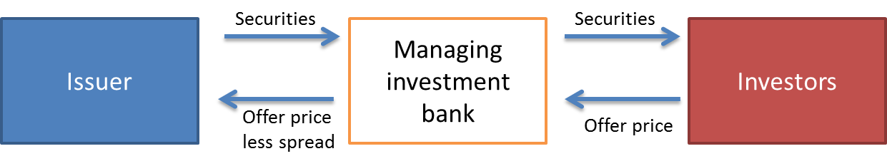
To offer the stock for sale, the firm distributes a prospectus, which contains much of the same information as the SEC filing.
While waiting, the firm can distribute a preliminary prospectus, called a red herring, to prospective investors.
Distributor
Investment banks make two types of arrangements with issuing firms when they market the shares of an IPO: firm commitment offerings and best effort offerings.
Investment banks distribute most IPOs in firm commitment offerings, which is when the investment bank commits its capital to purchase IPO shares.
Once the offering price is set, the bank purchases the shares at the offer price less a spread, or discount, which becomes the bank’s profit from reselling each share at the offer price.
The process is shown in Figure 2.1.
Figure 2.1 Diagram of a Firm Commitment Underwriting

Slide 18
The issuer has almost zero price risk in a firm commitment offering once the offer price is set.
However, the investment bank carries, or underwrites, the risk of fluctuating stock prices, that’s why investment bank is sometimes called underwriter.
For most firm commitment underwritings, the managing investment bank arranges investment banking syndicates to help distribute shares of the newly public firm.
Syndicates has several purposes:
1. To broaden the market base to include clients from other investment banking firms
2. Allows the managing investment bank to diversify or spread the risk of underwriting the new issue
A typical situation is shown in Figure 2.2.
Assume the offering price is $15 per share with a $1 spread, equals 6.67% of the offering price, giving issuer $14 per share.
Syndicate members pay $14.20 for their shares.
$14 goes to the issuer and managing investment bank receives $0.20.

Slide 19
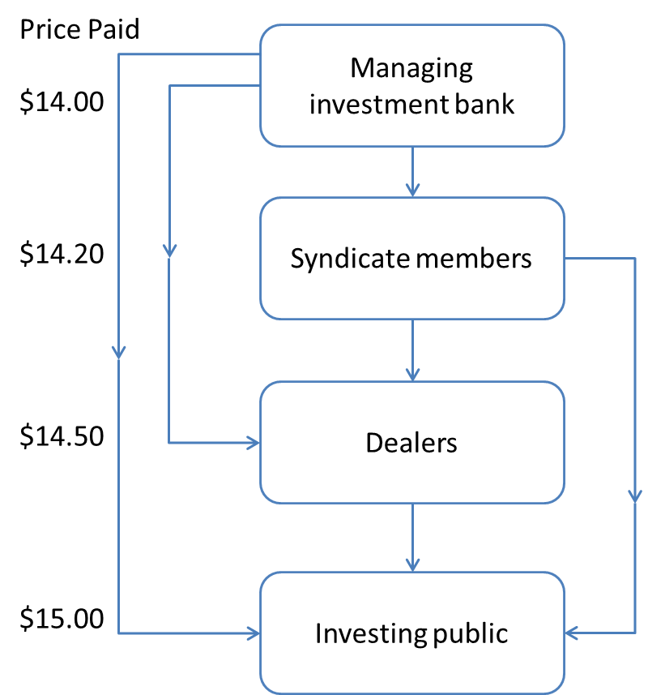
The managing investment bank and syndicate members sell the shares through their broker networks to retail and institutional clients at the offering price of $15.
Dealers, who maintain their own brokerage networks or make markets in certain stocks, also may purchase shares below the offering price.
Dealer and broker differs in that dealers place their own money at risk.
Best efforts offering is a less common type of IPO issued by a financially weaker, small, or otherwise risky firm.
In this situation, the issuer bears the risk of the price fluctuation s or low market demand.
If all the shares in a best efforts offering cannot be sold, the issuer may cancel the offering and return all the funds it receives to investors.
Figure 2.2
The Distribution Process

Slide 20
Market Stabilizer
The aftermarket is a period of time, ranging from several days to several months, following the initial sale of securities to the public.
Investment banks is sometimes called market stabilization because during aftermarket the managing investment bank tries to prevent any significant declines in the price of the issuer’s shares.
Investment banks do not want to be known for excessive offering prices or for handling IPOs of poor-quality issuers, so they risk their own money to show support for its IPOs.
IPOs usually contain lock-up provisions that forbid insiders (such as corporate officers and directors, or investors such as venture capitalists who own large amounts of the newly public firm’s shares) from selling their shares until a certain time after the IPO.
The main reason for the lock-up provision is to prevent insiders from selling what may turn out to be overpriced stock immediately after the offering.
Some IPOs contain Green Shoe Provisions, which gives the leading investment bank the right to increase the number of shares sold in the IPO.

Slide 21
D. The Cost of Going Public
The issuing firm faces direct, out-of-pocket costs for accountants’ and lawyers’ fees, printing expenses, and filing fees.
On top of that, the firm has the spread and underprice, which together represent the difference between market value of the firm’s shares in the aftermarket and the actual proceeds the firm receives from the underwriters.
The underpricing represents money left on the table, or money the firm could have received had the offer price better approximated the aftermarket value of the stock.
Together, these three costs—direct costs, the spread, and underpricing—are the floating costs of an IPO.
Table 2.3 summarizes the results of a study of IPO costs from 1977 to 1982.
Studies of the IPO proceeds shows that a firm can make an expensive mistake if it tries to go public too early.

Slide 22
Table 2.3 The Costs of Going Public
 | Firm Commitment Offerings |  | Best Effort Offerings
Gross Proceeds | Underpricing (percent) | Total Expenses (percent) | Underpricing (percent) | Total Expenses (percent)
$1,000,000-1,999,999 | 26.92% | 31.73% | 39.62% | 31.89%
$2,000,000-3,999,999 | 20.70 | 24.93 | 63.41 | 36.28
$4,000,000-5,999,999 | 12.57 | 20.90 | 26.82* | 14.49*
$6,000,000-9,999,999 | 8.99 | 17.85 | 40.79* | 25.97*
Over $10,000,000 | 10.32 | 16.27 | -5.42* | -0.17*
All offerings | 14.80 | 21.22 | 47.78 | 31.87
Underpricing is computed as: (closing price on the first trading day minus the offer price) divided by the offer price. Total expenses or flotation costs are computed as 100 percent minus the issuer’s net proceeds as a percent of the offering’s aftermarket market value. The negative signs indicate firms, on average, received more money from the sale than the market value of the securities in the aftermarkets. This category averaged less than one offspring per year.
*Based on fewer than 25 firms
Source: Modified from Journal of Financial Economics, Vol. 19 (1987). J.R. Ritter, “The Costs of Going Public,” p. 273. © 1987, with kind permission from Elsevier Science S.A., Lausanne, Switzerland.

Slide 23
E. Seasoned Equity Issues
Not every public sale of stock by a corporation is an IPO.
A new stock offering by an already public company is called seasoned offering.
Only the U.S. has a public financial market for preferred equity issues; other countries have not developed primary and secondary markets for preferred stock trading.
Once a firm decides upon the form to raise equity, it can sell the new shares to the public or to current shareholders or place them privately.
I. Selling to the Public
Selling shares of seasoned equity to the public is called a cash offer.
Usually an investment bank is involved in the sale in one of three ways:
1. Firm commitment underwriting
2. Shelf Registration
3. Competitive Bidding

Slide 24
Firm Commitment Underwriting
Selling seasoned equity through a firm commitment underwriting is similar to and easier than the IPO underwriting process.
The firm must pay the direct costs of preparing financial statements, registration documents, and the prospectus, as well as accountants’ and lawyers’ fees.
The investment bank’s spread equals the difference between the stock’s closing market price the day before the offering and the price the investment bank pays for the new shares.
Should the market price of the stock fall below the cutoff price, the offering is canceled or delayed until the market stabilizes.
As with any other firm commitment offer, the investment bank carries the risk of price fluctuations after the primary market transaction.
The certification effect conveys information to the marketplace that the issue is fairly prices.

Slide 25
Shelf Registration
SEC Rule 415 allows firms to register security issues (both debt and equity) and then “shelf them” for sale at any time over the next 2 years.
The shelf registration process saves issuers both time and money.
There is no cost or penalty for registering shelf securities and then not issuing them.
Firms must meet several size, credit quality, and ethic requirements.
Despite its attractiveness and lower cost, few firms have chosen to use this.
There are several disadvantages:
1. Securities are sold with no prior due diligence and analysis by an investment bank.
2. Even though shelf offering has no delay between submitting the short registration form and selling the share, the smart investors may suspect a shelf sale of equity as a sign that the shares are overpriced.
3. Shelf registration of common shares leads to uncertainty.

Slide 26
Competitive Bidding
Competitive bidding issue occurs when a firm announces the size and terms of a proposed security sale and then solicits bids from investment banks to underwrite the issue.
After a bid is accepted, the firm proceeds with the sale just as for a firm commitment underwriting.
Competitive bid underwriting involves no positive certification effect, as a bank must commit to a price before it can adequately perform its due diligence review and investigate the issuer.
II. Block Sales to Private Parties
To keep current shareholders from suspecting any “sweetheart deals,” privately placed equity typically is sold at a slight premium to the stock’s current market price.
Since the shares are not being sold in a public offering, the private placement avoids SEC registration and the mandatory 20-day waiting period, along with the subsequent publicity.

Slide 27
The private sale must still follow other SEC regulations.
The firm must disclose the sale after it occurs, and the private investors must meet SEC requirements as “accredited investors.”
Accredited investors are those who are considered knowledgeable and strong financially so that it can function without the protection of SEC’s registration process.
An investment bank usually markets a private placement.
For this work, the bank receives an advising fee and a commission or placement fee.
III. Rights Offerings
Some corporations seek to raise equity by obtaining funds from their current shareholders in a rights offering.
It was very popular among U.S. public corporations but have become infrequent during the 1980s and 1990s, but remains quite popular in Europe,

Slide 28
F. How Securities are Traded
Consider what would happen if organized markets didn’t exist.
We will discuss type of market, and then the different type of orders.
Financial market can be divided into money market and capital market.
I. Type of Trading Market
The market can be divided into four groups: 1) direct search markets, 2) brokered markets, 3) dealer markets and 4) auction markets.
Direct Search Markets
A direct search market is where the buyer and seller must seek each other out, which makes it the least organized market.
Example: Craigslist advertisements
This type of market is irregular and cheap.

Slide 29
Brokered Markets
Brokered markets are where the trading in a particular area is so active that a broker will offer a search service to potential buyers and sellers.
Example: real estate market
Another brokered market is the primary market, where investment bankers act as the broker when they market a firm’s securities directly to the public.
Another brokered market is for block transactions, where large blocks of stock are either bought or sold.
Dealer Markets
In dealer markets, dealers will purchase assets for their own account and then will sell them to make profit.
This option save traders the search cost because traders are able to look up prices at which the can buy and sell for themselves.
A dealer must participate for quite some time in this market before earning a significant income.

Slide 30
Auction Markets
An auction market is the most unified market and is where traders come together either physically or electronically to buy or sell assets.
Example: New York Stock Exchange (NYSE)
One advantage is that one doesn’t have to spend much time searching for the best deal.
Because continuous auction markets are so expensive to maintain, they have listing requirements.
Organized stock exchanges are also secondary markets and are set up for investors to trade existing securities among themselves.

Slide 31
II. Types of Orders
There are two types: 1) Market orders and 2) orders contingent on price.
When an investor places an order with a broker-dealer there are a few different trading arrangements that may happen.
Market Orders
This means that the investor is willing to pay the lowest price when buying and pay the highest market price when selling.
Market orders are typically used when an investor wishes to buy or sell immediately.
Price-Contingent Orders
Price-contingent orders allow investors to buy or sell at specific prices.
A limited buy order means that the broker will purchase “X” number of shares once the market price reaches or falls below the investor’s designated price.
But a limited sell order instructs the broker to sell if the stock rises above the price set by the investor.
A collection of limited orders waiting to be executed is called a limited order book.

Slide 32
Stop orders are like limit orders because the trade is not executed unless the stock hits a specific price determined by the investor.
A stop-loss order means the stock should be sold if it falls below a price that has been designated by the investor, to prevent greater loss from happening.
Stop-buy orders tell a broker to purchase shares when the price rises above the amount set by the investor.
Stop orders are often accompanied by short sales, which are the sales of securities that are borrowed from a broker.
Figure 2.4
Price-contingent orders

Slide 33
III. Trading Systems
In U.S., there are 3 trading systems: dealer markets, electronic communication network, and specialist markets.
OTC Market
The OTC market contains about 35,000 securities in which brokers who have registered with the SEC as security dealers, quote prices that they are willing to buy or sell at.
The OTC (over-the-counter) is not a formal market organization with membership requirements or a specific list of stocks deemed eligible for trading.
In theory, it’s possible to trade any security on the OTC market as long as someone is willing to “take a position” in the stock.

Slide 34
Electronic Communication Networks (ECNs)
An ECN is a financial term for a type of computer system that facilitates trading of financial products outside of stock exchanges.
The main products of exchange in ECN are stocks and currencies.
There are many advantages to ECNs; investors can trade quickly, purchase anonymously and since there is no broker or dealer involved the bid-ask spread is eliminated.
Specialist Markets
Formal exchanges like the New York Stock exchange have specialists who are assigned to specific securities.
A specialist has two roles:
1. They act as a broker by keeping a limit-order book to help the other brokers.
2. They act as a dealer by buying or selling for their own account when the public supply is insufficient.
When matching trades, the specialist must use the highest offered purchase price and the lowest offered selling price.
This results in an auction market, which means all of the buy and sell orders are in one place and the best “win” the trade.

Slide 35
G. U.S. Securities Markets and Market Structure in Other Countries
I. U.S. Securities Markets
The three major trading mechanisms used in the U.S. were OTC, dealer markets, specialists market, and ECNs.
These markets have evolved in response to new information technology and both have moved dramatically to automated electronic trading.
NASDAQ
Even though any security can be traded in the over-the-counter network of security brokers and dealers, not all securities were included in the original NASDAQ.
NASDAQ Stock Market, National Association of Security Dealers Automated Quotations System, lists about 3,200 firms and offers 3 listing options.
NASDAQ has 3 levels of subscribers.

Slide 36
The highest, level 3 subscribers, are for firms dealing, or “making markets,” in securities; they may enter the bid and ask prices at which they are willing to buy or sell stocks into the computer network and may update these quotes as desired.
These market makers maintain inventories of a security and constantly stand ready to buy or sell these shares from or to the public at the quoted bid and ask prices.
Level 2 subscribers receive all bid and ask quotes, but they cannot enter their own quotes.
Level 1 subscribers receive only the inside quotes (i.e. the highest bid and lowest ask prices on each stock).
The current version of NASDAQ’s electronic trading platforms is called the NASDAQ Market Center.
Market Center is NASDAQ’s competitive response to the growing popularity of ECNs, which have captured a large share of order flow.
But larger orders may still be negotiated so NASDAQ retains some features of a pure dealer market.

Slide 37
The New York Stock Exchange
The New York Stock Exchange is the largest stock exchange in the U.S.
Brokers must purchase the right to trade on the floor of the NYSE.
More recently, however, many exchanges have decided to switch from a mutual form of organization, in which seat holders are joint owners, to publicly traded corporations owned by shareholders.
As a publicly traded corporation, its share price rather than the price of a seat on the exchange is the best indicator of its financial health.
Each seat on the exchange has been replaced by an annual license permitting traders to conduct business on the exchange floor.
The NYSE’s market share measured by trades rather than share volume is considerably lower, as smaller retail orders are far more likely to be executed off the exchange.

Slide 38
Block Sales
Institutional investors frequently trade blocks of tens of thousands of shares of stock.
Larger block transactions are often too large for specialists to handle, as they don’t want to hold such large blocks in their inventory.
“Block houses” have evolved to aid in the placement of larger block trades.
Block houses are brokerage firms that specialize in matching block buyers and sellers.
Electronic Trading on the NYSE
SuperDot is an electronic order-routing system that enables brokerage firms to send market and limit orders directly to the specialist over computer lines.
A program trade is a coordinated purchase or sale of an entire portfolio of stocks.
While SuperDot simply transmits orders to the specialist’s post electronically, the NYSE also has instituted a fully automated trade-execution system called DirectPlus or Direct+.
It matches orders against the inside bid or ask price with execution times of less than one-half second.

Slide 39
Settlement
A requirement often called T+3 is when an order executed on the exchange must be settled with 3 working days.
The purchaser must deliver the cash, and the seller must deliver the stock to the broker, who in turn delivers it to the buyer’s broker.
Electronic Communication Networks
ECNs are private computer networks that directly link buyers with sellers.
As an order is received, the system determines whether there is a matching order, and if so, the trade is executed immediately.
Brokers that have an affiliation with an ECN have computer access and can enter orders in the limit-order book.
A new development in this market is superfast flash trading.
Computer programs designed to follow specified trading rules scour the markets looking for even the tiniest bits of mispricing, and execute trades in small fractions of a second.

Slide 40
The National Markets System
The Securities Act Amendments of 1975 directed the Securities and Exchange Commission to implement a national competitive securities market.
Such a market would entail centralized reporting of transactions as well as a centralized quotation system, with the aim of enhanced competition among market makers.
SEC’s Regulation NMS requires that investors’ orders be filled at the best price that can be executed immediately, even if that price is available in a different market.
Bond Trading
In 2006, the NYSE obtained regulatory approval to expand its bond-trading system to include the debt issues of any NYSE-listed firm.
In conjunction with these new listings, the NYSE has expanded its electronic bond-trading platform, which is now called NYSE Bonds and is the largest centralized bond market of any U.S. exchange.

Slide 41
II. Market Structure in Other Countries
London
The London Stock Exchange uses an electronic trading system dubbed SETS (Stock Exchange Electronic Trading Service) for trading in large, liquid securities.
This is an electronic clearing system similar to ECNs in which buy and sell orders are submitted via computer networks and any buy and sell orders that can be crossed are executed automatically
The major stock index for London is the FTSE (Financial Times Stock Exchange, pronounced footsie) 100 index.
Euronext
Euronext was formed in 2000 by a merger of the Paris, Amsterdam, and Brussels exchanges and itself merged with the NYSE Group in 2007.
Euronext, like most European exchanges, uses an electronic trading system. Its system, called NSC (for Nouveau Systeme de Cotation, or New Quotation System), has fully automated order routing and execution.
In fact, investors can enter their orders directly without contacting their brokers.

Slide 42
Tokyo
The Tokyo Stock Exchange (TSE) is among the largest in the world, measured by the market capitalization of its roughly 2,400 listed firms.
The TSE maintains three “sections.”
The First section is for large companies, the Second is for midsized firms, and the “Mothers” section is for emerging and high-growth stocks.
About three-quarters of all listed firms trade on the First section, and about 200 trade in the Mothers section.
The two major stock market indexes for the TSE are the Nikkei 225 index, which is a price-weighted average of 225 top-tier Japanese firms, and the TOPIX index, which is a value-weighted index of the First section companies.
Globalization and Consolidation of Stock Markets
All stock markets have come under increasing pressure in recent years to make international alliances or mergers, much of it is due to electronic trading.
This pressure have resulted in domestic and intercontinental consolidations.

Slide 43
H. Trading Cost
Besides carrying out the basic services of executing orders, holding securities for safe-keeping, extending margin loans, and facilitating short sales, brokers routinely provide information and advice relating to investment alternatives.
Full-service brokers usually depend on a research staff that prepares analyses and forecasts of general economic as well as industry and company conditions and often makes specific buy or sell recommendations.
Some customers take the ultimate leap of faith and allow a full-service broker to make buy and sell decisions for them by establishing a discretionary account.
In addition to the explicit part of trading costs—the broker’s commission—there is an implicit part—the dealer’s bid-ask spread.
Sometimes the broker is also a dealer in the security being traded and charges no commission but instead collects the fee entirely in the form of the bid-ask spread.
Another implicit cost of trading that some observers would distinguish is the price concession an investor may be forced to make for trading in quantities greater than those associated with the posted bid or asked price.

Slide 44
I. Buying on Margin
When purchasing securities, investors have easy access to a source of debt financing called broker’s call loans.
The act of taking advantage of broker’s call loans is called buying on margin.
Purchasing stocks on margin means the investor borrows part of the purchase price of the stock from a broker.
The Board of Governors of the Federal Reserve System limits the extent to which stock purchases can be financed using margin loans.
The current initial margin requirement is 50%, meaning that at least 50% of the purchase price must be paid for in cash, with the rest borrowed.

Slide 45
Example 2.1 Margin Calculation
The percentage margin is defined as the ration of the net worth, or the “equity value”, of the account to the market value of the securities.
Suppose an investor first pays $30,000 toward the purchase of $50,000 worth of stock (500 shares at $100 per share), borrowing the remaining $20,000 from a broker.
The initial balance sheet:
The initial percentage margin:
Assets |  | Liabilities and Owners' Equity
Value of stock | $50,000 | Loan from broker | $20,000
 |  | Equity | $30,000

Slide 46
If the price declines to $70 per share, the account balance becomes:
The percentage margin is now:
If the stock value in Example 2.1 were to fall below $20,000, owners’ equity would become negative, meaning the value of the stock is no longer sufficient collateral to cover the loan from the broker.
To guard against this possibility, the broker sets a maintenance margin.
If the percentage margin falls below the maintenance level, the broker will issue margin call, which requires the investor to add new cash or securities to the margin account.
Assets |  | Liabilities and Owners' Equity
Value of stock | $35,000 | Loan from broker | $20,000
 |  | Equity | $15,000

Slide 47
Example 2.2 Maintenance Margin Calculation
Suppose the maintenance margin is 40%.
How far could the stock price fall before the investor would get a margin call?
Let P be the price of the stock.
The value of the investor’s 500 shares is then 500P, and the equity in the account is 500P − $20,000.
The percentage margin is (500P − $20,000)/500P.
The price at which the percentage margin equals the maintenance margin of .3 is found by solving the equation
which implies that P = $60.67. If the price of the stock were to fall below $60.67 per share, the investor would get a margin call.

Slide 48
Investors buy securities on margin when they wish to invest an amount greater than their own money allows.
Suppose an investor wants Johnson and Johnson (JNJ) stock, which is selling for $70 per share.
The investor only has $7,000 and expects JNJ to go up by 20% next year.
Ignoring dividends, the expected rate of return would be 30% if investor invested $7,000 to buy 100 shares.
But now assume the investor borrows another $7,000 from the broker and bought more JNJ shares.
The total investment would be $14,000 (for 200 shares).
Assuming an interest rate on margin loan of 6% per year, what will the investor’s rate of return be now (ignore dividends) if JNJ stock goes up 20% by year’s end?

Slide 49
The 200 shares will be worth $16,800.
Paying off $7,420 of principal and interest on the margin loan leaves $9,380.
The rate of return in this case will be:
The investor has parlayed a 20% rise in the stock’s price into a 34% rate of return on the $7,000 investment.
Suppose that instead of going up, the JNJ stock goes down by 20% to $56 per share.
The 200 shares will be worth $11,200, and the investor is left with $3,780 after paying off the $7,420 of principal and interest on the loan.
Table 2.4 summarizes the possible results of these hypothetical transactions.
Table 2.4 Illustration of buying stock on margin
Changes in Stock Price | End of Year Value of Shares | Repayment of Principle* | Investors Rate of Return
20% increase | $16,800 | 7,420 | 34%
No change | 14,000 | 7,420 | -6%
20% decrease | 11,200 | 7,420 | -46%
*Assuming the investor buys $14,000 worth of stock, borrowing $7,000 of the purchase price at an interest rate of 6% per year.

Slide 50
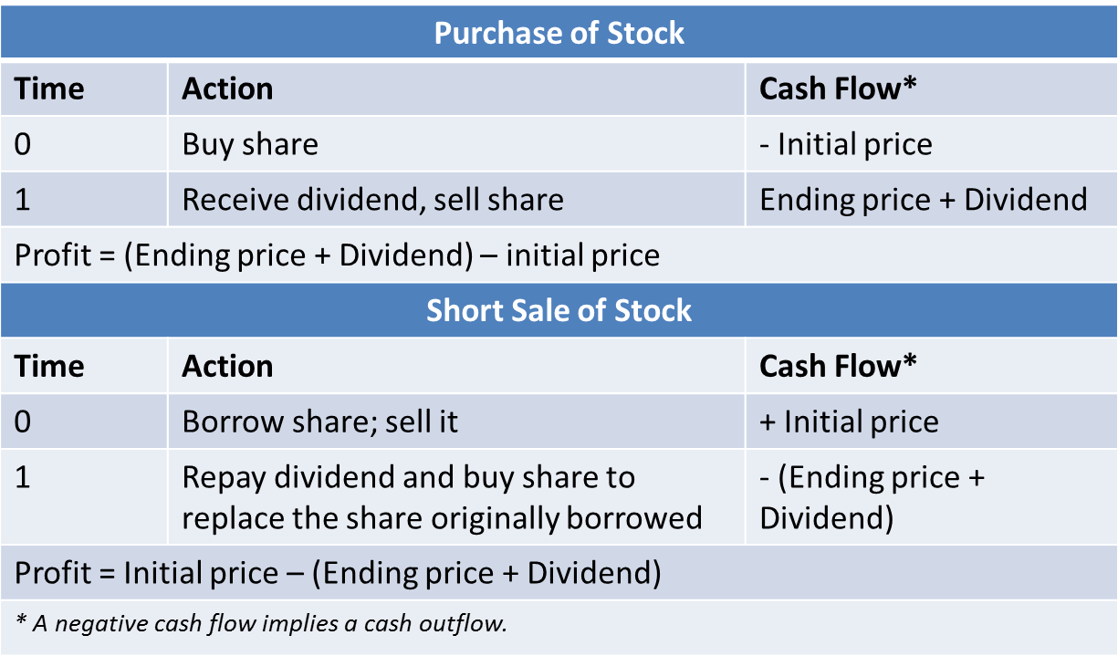
I. Short Sales
Short sale allows investors to profit from a decline in a security’s price.
First you sell, then you buy the shares.
Covering the short position is when an investor borrows a share of stock from a broker and sells it, then the short-seller must purchase a share of the same stock in order to replace the share that was borrowed.
Table 2.5 compares stock purchases to short sales.
Table. 2.5
Cash flows from purchasing versus short-selling shares of stock

Slide 51
The short-seller anticipates the stock price will fall so that the share can be purchased later at a lower price than it initially sold for.
Short-sellers must not only replace the shares but also pay the lender of the security any dividends paid during the short sale.
The shares loaned out for a short sale are typically provided by the short-seller’s brokerage firm.
Exchange rules require that proceeds from a short sale must be kept on account with the broker.
Short-sellers also are required to post margin with the broker to cover losses should the stock price rise during the short sale.

Slide 52
Example 2.3 Short Sales
Suppose you are pessimistic on JNJ stock and its market price is $70 per share.
You go and sell short 200 shares.
The $14,000 cash proceeds from the short sale are credited to your account.
Suppose the broker has a 50% margin requirement on short sales.
This mean you must have other cash or securities in your account worth at least $7,000 that can be served as a margin.
Let’s say that you have $7,000 in Treasury bills.
Your account with the broker after the short sale will then be:
Your initial percentage margin is the ratio of the equity in the account, $50,000, to the current value of the shares you have borrowed and eventually must return, $100,000:
Assets | Liabilities and Owners' Equity
Cash $14,000 | Short position in Dot Bomb | $14,000
 | stock (1,000 shares owed)
T-bills 7,000 | Equity | 7,000

Slide 53
Example 2.4 Margin Calls on Short Positions
Suppose you’re right and JNJ falls to $60 per share, you can now close out your position at a profit.
To cover the short sale, you buy 200 shares to replace the ones you borrowed.
Because the shares now sell for $60, the purchase costs only $12,000.
Since your account was credited for $14,000 when the shares were borrowed and sold, your profit is $2,000.
The profit = decline in the share price x the number of shares sold short.
If the stock price rises, the margin in the account will fall, and if it falls to the maintenance level, the short-seller will receive a margin call.
Suppose the broker has a maintenance margin of 25% on short sales.
This means the equity in your account must be at least 25% of the value of your short position at all times.
How much can the price of JNJ stock rise before you get a margin call?

Slide 54
P = price of JNJ stock
Then the value of the shares you must pay back is 200P and the equity in your account is $21,000 − 200P.
Your short position margin ratio is equity/value of stock = (21,000 − 200P)/200P.
The critical value of P is thus
which implies that P = $84 per share.
If JNJ stock should rise above $84 per share, you will get a margin call, and you will either have to put up additional cash or cover your short position by buying shares to replace the ones borrowed.

Slide 55
II. Regulation of Securities Markets
Trading securities markets in the U.S. is regulated by a myriad of laws.
In addition to federal regulations, security trading is subject to state laws.
In the wake of the 2008 financial crisis, the regulatory framework is under scrutiny.
Expanded powers for the Fed are likely, as is a new agency that would screen consumer financial products for excessive risk and fairness.
But at the moment, specific proposals for reform are still being hotly debated in Congress, and the final compromises between House and Senate versions of reform legislation are uncertain.
Criticizing Short-Selling
Short-selling have been banned in the past in England and viewed as a contributing fact to the market crash of 1929.
Short sales put downward pressure on share prices that may, in some cases, be unwarranted: rumors abound of investors who first put on a short sale and then spread negative rumors about the firm to drive down its price.

Slide 56
Hostility to short-selling may stem from confusion between bad news and the bearer of that news.
Short-selling allows investors whose analysis indicates a firm is overpriced to take action on that belief—and to profit if they are correct.
Self-Regulation
In addition to government regulation, the securities market exercises considerable self­-regulation.
The most important overseer in this regard is the Financial Industry Regulatory Authority (FINRA), which is the largest nongovernmental regulator of all securities firms in the United States.
It examines securities firms, writes and enforces rules concerning trading practices, and administers a dispute-resolution forum for investors and registered firms.

Slide 57
The Sarbanes-Oxley Act
This act was passed by Congress in 2002 in response to the scandals with allocations of shares in initial public offerings, tainted securities research and recommendations putout to the public, and misleading.
Key reforms are:
1. Creation of a Public Company Accounting Oversight Board to oversee the auditing of public companies
2. Rules requiring independent financial experts to serve on audit committees of a firm’s board of directors
3. CEOs and CFOs must personally certify of the firms’ financial reports
4. Auditors may no longer provide several other services to their clients
5. The Board of Directors must be composed of independent directors and hold regular meetings of directors whose company management isn’t present

Slide 58
Insider Trading
It is illegal for anyone to transact in securities to profit from inside information, or private information held by officers, directors, or major stockholders that has not yet been divulged to the public.
The SEC requires officers, directors, and major stockholders to report all transactions in their firm’s stock.
A compendium of insider trades is published monthly in the SEC’s Official Summary of Securities Transactions and Holdings.
The idea is to inform the public of any implicit vote of confidence or no confidence made by insiders.
3 forms of evidence shows that insiders do exploit their information:
1. There have been well-publicized convictions of principals in insider trading schemes
2. There is considerable evidence of “leakage” of useful information to some traders before any public announcement of that information
3.Abnormal returns earned on trades by insiders

Slide 59
J. Summary
The decision whether and when to issue debt equity depends on the relationship between the current and target capital structures of the firm.
A privately owned firm that needs an injection of equity can seek to raise funds for its current shareholders through a rights offering or look outside the firm to arrange a private placement of equity with an investor or venture capitalist.
Firms issue securities to raise the capital necessary to finance their investments.
Investment bankers market these securities to the public on the primary market.
Trading costs include explicit commissions as well as the bid-ask spread.
Buying on margin means borrowing money from a broker to buy more securities than can be purchased with one’s own money alone.
Securities trading is regulated by the Securities and Exchange Commission, by other government agencies, and through self-regulation of the exchanges.

Slide 60
Appendix 2A
Decimal Trading in the
U.S. Stock Markets
(Supplement material
for Chapter 3)

Slide 61
Abstract
All NYSE-listed stocks were switched from a fractional to a decimal trading system on January 29, 2001 and all NASDAQ stocks followed suit on April 9, 2001.
The conversion to decimal trading in the U.S. markets has significantly reduced bid–ask spreads.
This decline is primarily due to the drop in market makers’ costs for supplying liquidity.
In addition, rounding becomes less salient after the decimalization.
The decrease in bid–ask spreads can be ascribed to the decrease in price rounding, when controlling for the changes in trading variables.

